Slide 1
Inclusion Works Community Advisory Committee Meeting
We'll get started in a few minutes. Please mute your microphone
January 20, 2026

Slide 2

Housekeeping
Reminders about the webinar technology:
  Please make sure you are using a computer or smart phone connected to the internet, and the audio function is on, and the volume is turned up.
  Please make sure your microphone is muted for the duration of the call unless you are speaking or asking questions.
  Questions can be submitted any time during the presentation using the “Q&A” box located on your control panel, and we will answer as many questions as time allows after the presentation.

Slide 3
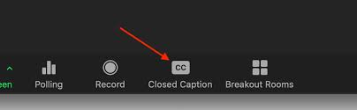
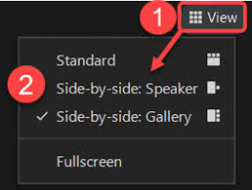
Housekeeping
American Sign Language (ASL) Interpreters and Closed-Captioning
  ASL Interpreters and Closed-Captioning options will be available for today’s event.
  For closed-captioning options select the "Closed Caption" feature located on your control panel.
Adjusting Video Layout and Screen View
  Select the "View" feature located in the top-right hand corner of your screen.
Intérpretes en lengua de signos americana (ASL) y subtítulos:
Habrá intérpretes de ASL y opciones de subtítulos disponibles para el evento de hoy. Para opciones de subtítulos, seleccione la función "Subtítulos" ubicada en su panel de control.

Slide 4

Agenda
Welcome
Advisory Committee Details
Inclusion Works Strategic Plan and Updates
Employment Assessments and CIE Liaisons
Provider Innovation Program
Inclusion Works Data Summary
Inclusion Works Training Opportunities and Resources
Q & A
Notes:
Yolanda

Slide 5
Welcome

Slide 6
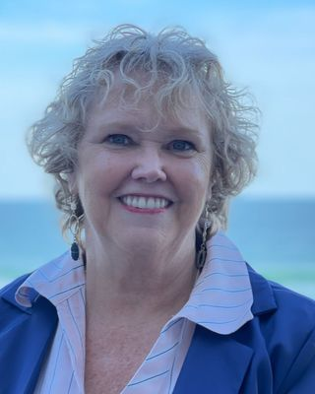

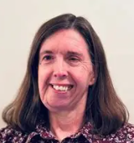


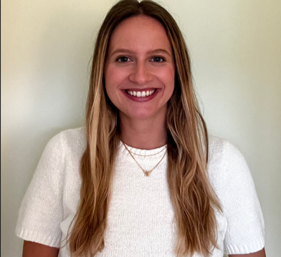

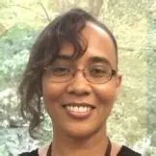
Introductions
Claire Colligan, MS, LCMHC, LCAS, CCS
I/DD Employment Lead, I/DD, TBI, & Olmstead
DMH/DD/SUS
Adrienne Kittle, MS
Program Specialist for Intellectual/Developmental Disabilities
Division of Employment and Independence for People with Disabilities (EIPD)
Katherine Titus, MSW
Senior Technical Assistance and Training Manager
WISE
Maya Glass, MPH
Data Quality Specialist
DMH/DD/SUS
Yolanda Perkins, EdS
Implementation Specialist
Frank Porter Graham Child Development Institute
The University of North Carolina at Chapel Hill

Slide 7
Community Meeting Details

Slide 8
Advisory Committee Purpose
Purpose Statement:
To provide a forum for individuals with lived experience, family members, providers, and advocates to share their thoughts, perspectives, and opinions about the Inclusion Works Program. NCDHHS will share key updates about Inclusion Works and gather feedback on the implementation of program activities.

Slide 9
Community Advisory Meeting Schedule
For future meetings, we are considering hosting meeting after typical “work” hours
3rd Tuesday every 3 months (quarterly) at 11:00am
The Community Meeting has been UPDATED! Future meetings will allow opportunity to update and track progress on the Inclusion Works Strategic Plan goals and objectives.
2026 Meetings:
Reminders:
RSVP to Calendar Invitations
Come prepared with questions and ideas about the Inclusion Works program
Reach out to Claire.Colligan@dhhs.nc.gov if you know other individuals who would like to participate in Advisory Committee
January 20, 2026
April 21, 2026
July 15, 2026
October 20, 2026
If there is a specific topic you would like NCDHHS to cover during the Advisory Committee, please reach out to Claire Colligan (Claire.Colligan@dhhs.nc.gov) and it will be added to the agenda for our next meeting.

Slide 10
Inclusion Works Program Updates

Slide 11

Inclusion Works Updates
What's New for 2026:
In January, applications will open for a new WISE Provider Transformation cohort. The Application Period will be open until the end of March.
Informed Choice video being developed.
Special Events planned for March 2026 Developmental Disability Awareness Month
Changes are coming to the Inclusion Works Webpage!
Notes:
Yolanda
Video Link: Mar7_Competitive Integrated Employment (Version 2)-1080p-250307.mp4

Slide 12
Inclusion Works Strategic Plan

Slide 13





Five Core Inclusion Works Goals
The Inclusion Works Strategic Plan is organized by outlining the Goals, Objectives, and Strategies that DHHS will employ to increase Competitive Integrated Employment for people with I/DD.
1
2
3
4
5
Informed Choice
Quality I/DD Services
Community Outreach
Workforce Development
Employer Connection
Notes:
1.Provide people with I/DD the opportunity to pursue competitive integrated employment if that is their choice
2. Expand and improve service options for people with I/DD to help reach employment goals.
3. Increase proactive communication and engagement with all community partners to provide accessible information about CIE options and resources
4. Develop the NC workforce for Employment Service Professional to increase staff capabilities and enhance service delivery
5. Promote an increase in employment opportunities through building employer capacity.

Slide 14
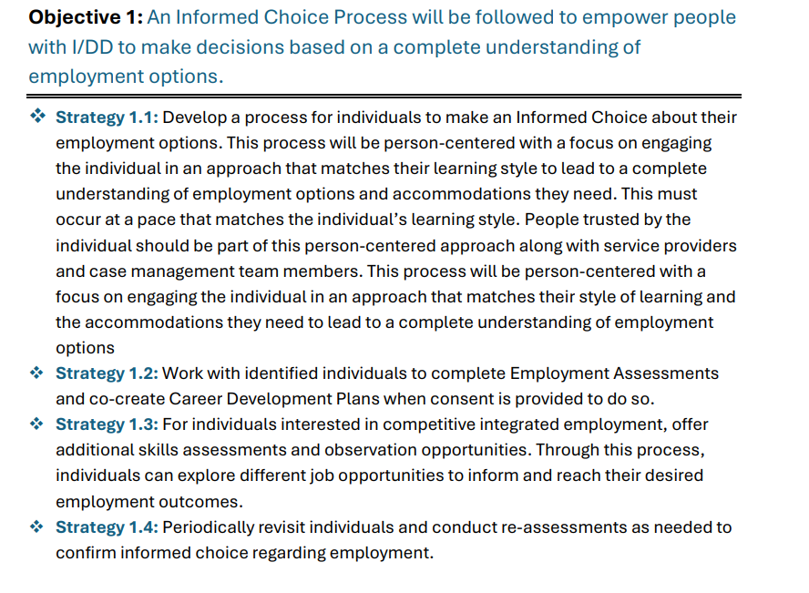
Strategic Plan – Goal One- Provide People with I/DD the opportunity to pursue competitive integrated employment if that is their choice

Slide 15
Employment Assessments, Career Development Plans and Referrals

Slide 16
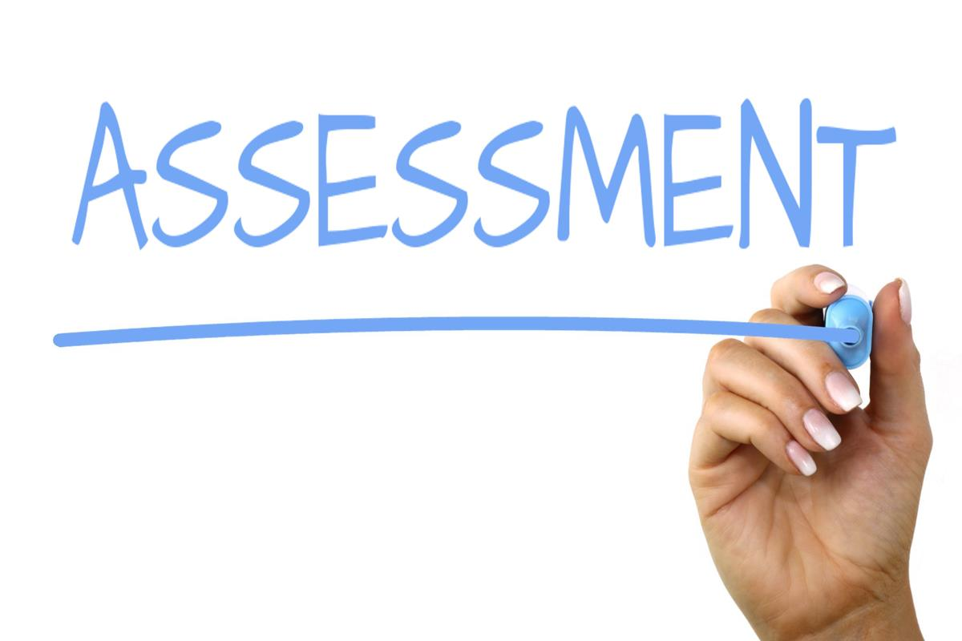
Work Together NC
Developed Standardized Employment Assessment which is being used across the state
Comes to each provider site
Conducts Evidence Based Assessment to ensure Informed Choice
Ensures smooth transfer to the CIE Liaisons

Slide 17

CIE Liaisons
EIPD Care Managers and Tailored Plans' CIE Coordinators form ONE TEAM to inform and support individuals who wish to move from non-CIE to CIE.

Slide 18
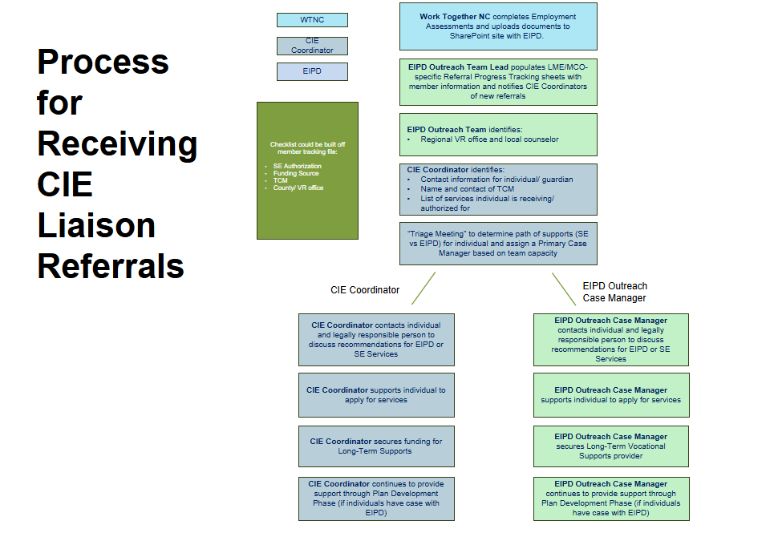
Employment Assessment – CIE Liaisons
Notes:
Next steps for these individuals:
guardian completes their component of the Employment Assessment (as needed)
WTNC completes a hand-off to regional EIPD Outreach Case Manager with EA and Preliminary CDP documents. WTNC also informs TCM of referral and shares contact info of EIPD OCM
EIPD Outreach Case Manager shares recommendations with member/ guardian and encourages EIPD VR Services
EIPD Outreach Case Manager assists individual with EIPD referral, application, and Individualized Plan for Employment
EIPD Services initiated, which may include career counseling, benefits counseling, internships, and job placement. TCM is involved to secure LTVS Provider
Referrals are made to Tailored Plan within 90 first 90 days of employment for long-term vocational supports

Slide 19
What is the purpose of the CIE Liaisons?
This team was formed specifically to meet to meet the needs of workers with I/DD in NC who work in non-CIE settings
Workers with I/DD often require additional information and support to assist them in accessing VR services to achieve competitive integrated employment, if desired.
CIE Liaisons form a uniquely collaborative team which includes the Tailored Plans and EIPD
56 people assigned an CIE Liaison
28 submitted application to EIPD
8 cases opened with EIPD

Slide 20
CIE Liaison Team Success
The CIE Liaison Team Goal is to inform/support the client and appropriate guardian/family/supports to facilitate participation in the EIPD VR Program & all needed resources to support the goal to achieve CIE
Team Goals & Responsibilities
  Be present to form connections with individuals who might currently be working in non-CIE jobs
  Work closely with WTNC to assist non-CIE workers and conduct direct outreach in the disability community
  As directed, contact others with I/DD who may be contemplating or seeking non-CIE to inform them of supports available for CIE
  Work closely with individuals with a disability and guardians/family/supports to help them with smooth transition to VR services and needed resources and supports
  Work with VR staff, WTNC, DMH/DD/SUS, Medicaid, Tailored Plans, and others to achieve these goals

Slide 21
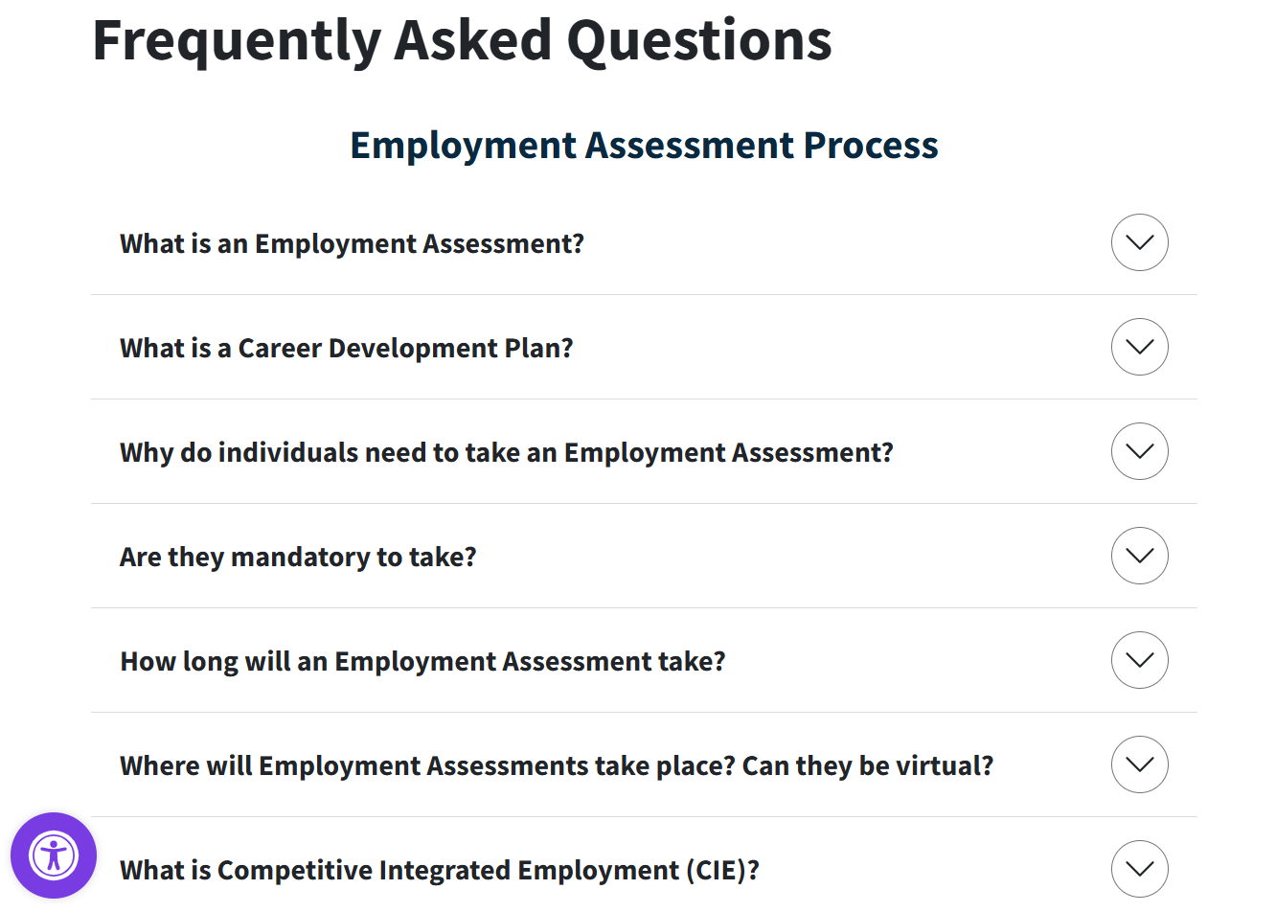
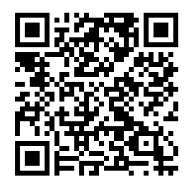
Check out website for additional FAQ’s
Visit the Inclusion Works Website
Directions:
1) Open the camera app on your phone to scan the QR code
2) Hold down the screen over the QR code you would like to access
3) Get transferred to web landing
If you have additional questions, feel free to reach out to us via email!
Claire.Colligan@dhhs.nc.gov
worktogethernc@med.unc.edu

Slide 22
Provider Innovation

Slide 23


Provider Innovation Program
Inclusion Works is partnering with Wise to develop the Provider Innovation Program.
Wise is leading a Provider Innovation Program to assist Provider agencies to enact Business Practice Transformation.
Providers now participating are receiving:
Selected Providers are receiving
financial incentive for participating
Payments are milestone-based for completing steps in the Program
There will be another opportunity In 2026 for more providers to apply
Organizational Assessment
Strategic Action Plan
Personalized Training Content
Ongoing Technical Assistance
Financial incentives
Notes:
Provider Innovation
Assess and QI Plan
Training –
ACRE course, additional online courses and TA
Self Employment
Develop a SE program
Recruit interested folks
SELN
SE job coaches pilot
Add coaches to provider locations
Train coaches
Learning Colaborative
collection of agencies
Peer mentors for other agencies
They will conduct Organizational Assessments and deliver Quality Improvement plans.
Wise will also deliver personalized training and TA for employment services

Slide 24
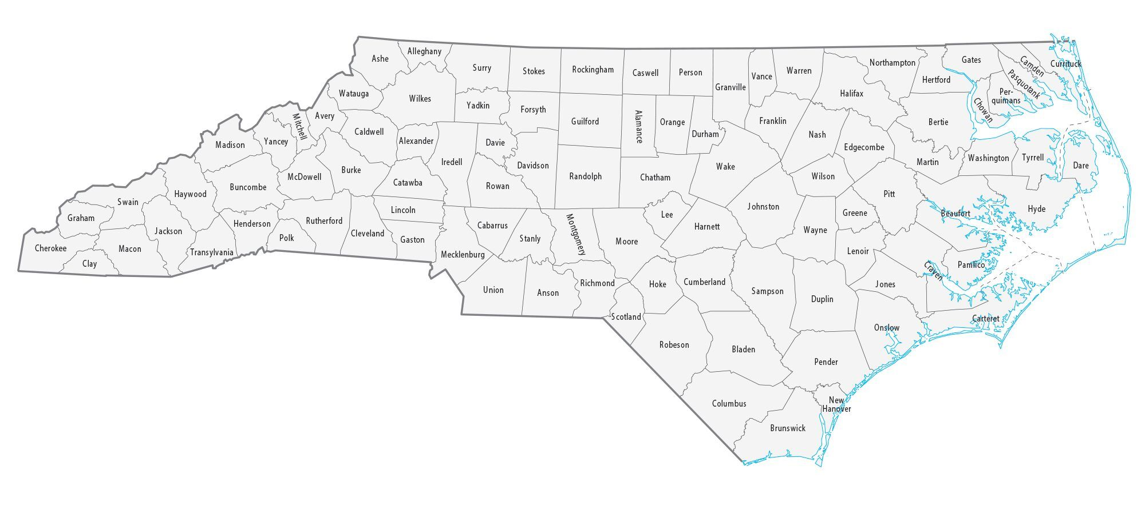





Provider Innovation Program
Four Provider Agencies selected for Provider Innovation Program
Vocational Opportunities of Cherokee Inc.
Alleghany County Group Homes Inc.
OE Enterprises Inc.
Neuse Enterprises Inc.
Provider Innovation Program Milestones
Identify Lead
Complete Working Agreement
Hold Initial Kickoff Meeting
Complete Organizational Self- Assessment
Develop Action Plan
Training and TA Plan
Begin CIE Data Tracking
Begin participating in Wise offerings
Submit Interim Report
Complete Action Plan
Actively Participate in Offerings
Final Report including job goals
Notes:
What was it like doing the self-assessment? What were your insights?

Slide 25



Provider Innovation
Monthly Provider Innovation Cohort Gatherings - Opportunity to learn together and enhance the network in the efforts to increase job outcomes for people with disabilities in North Carolina
Customized Training Opportunities through the Train the Trainer/Wise Pro Learning Sites
Opportunity to be a part of Additional Training Offerings including Plan to Placement and Recruit Cultivate Retain

Slide 26
Additional Wise Offerings through Partnership with Inclusion Works
Wise On-Line Academy 100 Series: This four part, self-paced training series is based on customized employment core competencies. Completion of the course results in an ACRE Certificate of completion with a Customized Employment Emphasis
Practicum: Wrapping up the first Practicum this month, open to students who have received their Wise On-Line Academy 100 Acre Certification.
Wise On-Line Academy 200 Series: A six-month advanced training program for seasoned professionals in the employment support field.
North Carolina Self-Employment Community of Practice: This six-month series is designed to prepare employment agencies and interested others to support individuals who are interested in self-employment or micro-enterprise. Kicks off in January 2026!

Slide 27
What the Numbers Say
109
8
7
32
People signed up for the WOA 100 series...so far!
Students have gone through the Practicum, just now completing Website Portfolios for a job-seeker, and learning from each other
North Carolina professionals signed up for and starting the advanced WOA 200 series this month
North Carolinians at the first Self-Employment Community of Practice in January!
Provider Innovation Providers are setting goals around job starts and working toward enhancing Competitive Integrated Employment opportunities!

Slide 28
Take a Moment for Data!

Slide 29
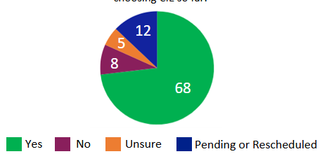
Data Metric: Informed Choice to Pursue CIE after Employment Assessment
As of November 2025,
81 employment assessments were completed
68 people (84%) were interested in CIE
Numbers are continuing to grow

Slide 30





Coming Soon: Inclusion Works Strategic Plan Dashboard
The Inclusion Works team is creating a public-facing dashboard to highlight progress made on key metrics tied to our 5 Strategic Plan Goals.
Example metrics include:
Number of individuals who have completed the Employment Assessment process and Career Development Plan.
Number of individuals receiving I/DD Supported Employment services in NC.
Number of quarterly stakeholder events open to the public hosted by Inclusion Works.
Number of NC Employment Provider staff completing Wise Online Academy Courses.
Number of paid internships provided for people with disabilities.
Goal 1: Informed Choice
Goal 2: Services
Goal 3: Communications
Goal 4: Workforce Development
Goal 5: Employer Connection

Slide 31


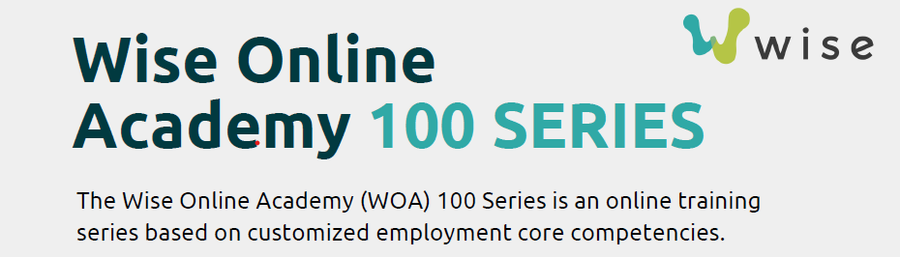
2025-2026
Inclusion Works TRAINING OPPORTUNITES

Slide 32
Q & A

Slide 33
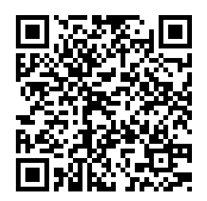
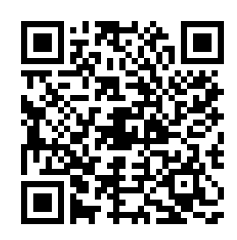
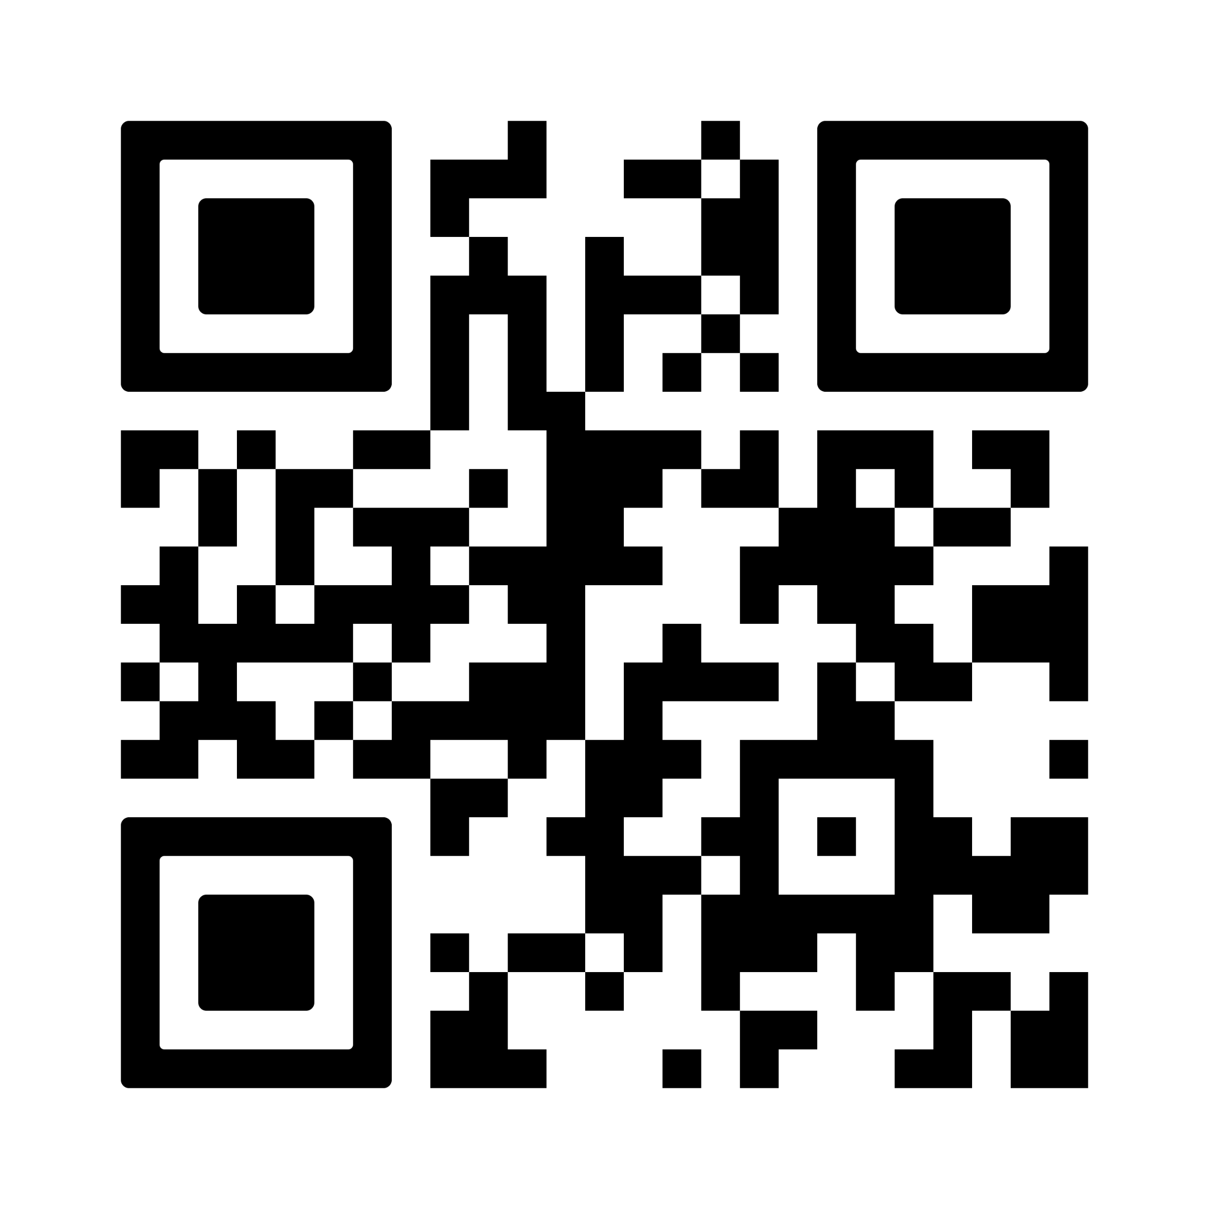
Stay involved with updates from Inclusion Works!
Register for our bi-monthly Lunch and Learns
Visit the Inclusion Works Website
Join our mailing list and receive community updates
Visit the Work Together NC Website

