Slide 1

Renewal Training for Currently Authorized WIC Program Vendors
2023
Notes:
Welcome to Annual Vendor Training For Currently Authorized WIC Program Vendors.

Slide 2
Training Overview and Goals
Review how to maintain vendor status
  Selection criteria
  Competitive pricing and limits
WIC Approved Foods List
Minimum Variety and Inventory
Transactions
eWIC procedures
Preventing Fraud and Program Compliance
  Monitoring, Inventory Audits, Violations & Sanctions, Claims, Handling Customer Service Issues
Completing required forms
Notes:
Today we will be covering a lot of material. We will review how to maintain your vendor status, including updates on selection criteria and competitive pricing and limits. We will also review the WIC Approved Foods and discuss requirements for minimum variety inventory. We will discuss eWIC procedures, program compliance and fraud prevention topics such as monitoring, compliance investigations, violations & sanctions, claims, and how to handle complaints. Lastly, I will review what required forms must be completed.

Slide 3
What is WIC?
The Special Supplemental Nutrition Program for Women, Infants and Children
Federally funded by the United States Department of Agriculture (USDA)
State-administered by the NC Department of Health and Human Services
WIC clinical services provided by contracted public health agencies
NC WIC-authorized vendors are contracted with the NC Department of Health and Human Services and Local WIC Agencies
Notes:
What is the WIC Program? WIC is an acronym for the Special Supplemental Nutrition Program for Women, Infants, and Children. It is a Federal program that is funded by the United States Department of Agriculture. In North Carolina, it is administered by the NC Department of Health and Human Services, Division of Child and Family Well-Being, Community Nutrition Services Section.
WIC clinical services are provided by contracted public health agencies. Services include nutrition education, food benefits for nutritious foods and health care referrals.
NC WIC authorized vendors are contracted with the NC Department of Health and Human Services and their Local WIC Agencies.
The Local WIC Agency operates the WIC Program in your county.

Slide 4
What is eWIC?
eWIC is the term used for EBT (Electronic Benefit Transfer) by the North Carolina WIC Program
EBT is a method that permits access to WIC food benefits using a plastic card
Notes:
What is eWIC?
eWIC is the term used for EBT (Electronic Benefit Transfer) by the North Carolina WIC Program.
EBT is a method that permits access to WIC food benefits using a plastic card.

Slide 5


WIC Works!
In NC, every WIC dollar spent on a pregnant woman saves multiple dollars in newborn health care costs
Children on WIC have better diets; particularly for vitamin C, thiamin, protein, niacin and vitamin B₆
Notes:
WIC’s goal is to prevent health problems and improve overall health during this critical time of growth and development. This includes pregnancy, infancy and early childhood.
In fact, research shows that WIC saves public health dollars. Every dollar spent on a pregnant woman saves multiple dollars in newborn health care costs. Research also shows that children on WIC have better diets, especially for key vitamins.
Photo Credit : PeoplePreg & babies vol.113: 113012.jpg
Photo Credit: AA Boy Apple_Fotolia_14820340.jpg

Slide 6
Maintaining Vendor Status
Meet all current selection criteria
Follow all Program policies
Meet competitive pricing and price limits
Attend annual vendor training
Train all staff to properly transact eWIC benefits
Complete vendor-related forms
  NC WIC Vendor Information Update
  eWIC Update for Non-Corporate Vendors
  Verification of Attendance
Notes:
In order to maintain your NC WIC Program vendor authorization, you must meet all current selection criteria and understand as well as follow State and Federal regulations. You must meet competitive pricing and price limits and you must also complete the annual vendor training (which is being done today). In addition, managers must train all staff on how to properly transact eWIC. Lastly, in order to complete renewal, you must complete the required forms listed on the screen.

Slide 7
Selection Criteria
Established by U.S. Department of Agriculture and NC WIC Program
  20 items
Listed in the Vendor Manual
Notes:
Vendors must meet all the criteria established by the USDA and the NC WIC Program. You can find this criteria in your vendor manual.

Slide 8
NC Peer Group System
VENDOR PEER GROUPS
# | STORE TYPE | LOCATION | DESCRIPTION
5 | Pharmacy | Statewide | Free-standing pharmacy that sells a limited variety of foods
6 | Convenience Store | Statewide | Retailer with a limited assortment of grocery items
7 | Mass Merchandiser and Commissary | Statewide | Retailer that sells a wide variety of merchandise but also carries groceries and has store locations in most or all states Grocery store operated by US Defense Commissary on a military base
8 | Independent Grocery | Urban | Retailer that primarily sells groceries with fewer than 11 store locations
9 | Independent Grocery | Non-urban | Retailer that primarily sells groceries with fewer than 11 store locations
10 | Regional Grocery Chain | Urban | Retailer that primarily sells groceries with at least 11 store locations and operates in 2 or more states
11 | Regional Grocery Chain | Non-urban | Retailer that primarily sells groceries with at least 11 store locations and operates in 2 or more states
Notes:
North Carolina’s peer group system is displayed on the slide. It is based on store type and geography. You may also find this chart in your vendor manual.

Slide 9

Competitive Pricing and Price Limitations
Peer group structure
  Peer groups have NTEs for WIC supplemental foods and contract formula
  No longer published by the State WIC Agency
Notes:
9
Federal regulations require State WIC Programs to establish competitive pricing and price limitations during the process of vendor authorization. Competitive pricing considers the prices a vendor charges for supplemental foods as compared to the prices charged by other authorized and applicant vendors. Price limitations ensure that a vendor applicant has competitive prices and maintains competitive prices as an authorized vendor. These price limitations are referred to as Not-to-Exceed (NTE) prices. I will be using the acronym NTE throughout the presentation today.
Each vendor is assigned to a peer group.
Peer groups have NTEs for each universal product code (UPC) for WIC supplemental foods and contract formula.
As I will explain, NTEs will be used for vendor selection
Also, the State WIC Agency will not pay or reimburse above the NTE for the individual approved foods.
Together, the use of peer groups and NTEs creates the required competitive pricing and price limitations

Slide 10
Minimum Redemption
Except for Free-standing pharmacies, a vendor must redeem at least $2,000 annually in WIC supplemental food sales
  If not, the Vendor Agreement will be terminated
  The store must wait 180 days to reapply
Notes:
Minimum redemption is a selection criteria. Authorized vendors, excluding Free-standing pharmacies, must redeem at least $2,000 annually in WIC supplemental food sales. Failure to do so will result in termination of the WIC Vendor Agreement and the store must wait 180 days (about 6 months) to reapply.

Slide 11
Purchasing and Providing Infant Formula from a State-approved Source
Vendors must purchase all infant formula, exempt infant formula and WIC-eligible nutritionals only from the sources on the State WIC Agency’s list of approved sources
Vendors must provide only such infant formula, exempt infant formula and WIC-eligible nutritionals to WIC customers
Authorized vendors will have their WIC Vendor Agreement terminated for failure to comply with this requirement
A list of State-approved sources can be obtained from your Local WIC Agency or found at https://www.ncdhhs.gov/wicvendorsconnection
Notes:
Vendors must ensure that WIC customers are provided infant formula, exempt infant formula and WIC-eligible nutritionals purchased only from the sources on the State WIC Agency’s list of approved sources which can be found on the website on the screen.
Authorized vendors will have their WIC Vendor Agreement terminated for failure to comply with this requirement. Additionally, the store must wait one year to become eligible to reapply for WIC vendor authorization.

Slide 12
Not-to-Exceed (NTE) Prices
NTEs are set at 2 standard deviations above the average price for supplemental foods within a vendor peer group.
    Calculated for each UPC for each WIC supplemental food
    Based on redemption of all vendors in the peer group
    Obtained from the eWIC system
    Different NTEs for different sizes of the same food even if it is the same brand
Foods and Contract Formula
Notes:
NTE prices are established for each supplemental food for each peer group, except exempt infant formula, WIC eligible nutritionals and fruits and vegetables purchased with CVBs. The NTEs are set at 2 standard deviations above the average price for supplemental foods within a vendor peer group.

Slide 13
NTEs vs. Current Shelf Price
Vendors must charge current shelf price
Vendors DO NOT have to charge the NTE
Charges for WIC transactions must be less than or equal to charges to regular customers
Vendors cannot set their prices at the NTE and charge other customers less
  This is a federal violation for which a vendor can be disqualified
Notes:
Charges for WIC transactions must be less than or equal to charges to regular customers. Vendors cannot set their prices at the NTE and charge other customers less, that is called overcharging, which is a federal violation that we will explore later during the presentation.

Slide 14
WIC Approved Foods With No NTE
NTEs do not apply to exempt infant formula or WIC-eligible nutritionals
Open market system (shelf price)
Exempt infant formula and WIC-eligible nutritionals can be found at https://www.ncdhhs.gov/wicvendorsconnection
NTEs do not apply to fruits and vegetables purchasable with cash-value benefits (CVBs)
Notes:
NTEs do not apply to exempt infant formula or WIC-eligible nutritionals.
These prices are driven by an open market system (shelf price)
The list of Exempt infant formula and WIC-eligible nutritionals can be found at the website listed on the screen
NTEs do not apply to fruits and vegetables purchasable with cash-value benefits (CVBs).

Slide 15

What about
exchanges?
Identical items only when:
  Defective
  spoiled or
  has exceeded its “best if used by” or “sell by” date on the date of purchase
Notes:
Another important topic vendors ask about concerning redemption of benefits is exchanges. Exchanges of identical items are allowed when it is determined that they are defective or spoiled.
Exchanges are also allowed when items have exceeded their “best if used by” or “sell by” date on the date of purchase.
Photo Credit: blond man thinking_Fotolia_82668318_Subscription_L.jpg

Slide 16
Annual Vendor Training
Vendors, their store manager or other authorized store representative are required to attend vendor training
Failure to attend annual training by September 30th of each year will result in termination of the WIC Vendor Agreement
Notes:
Vendors, their store managers or other authorized store representative must attend annual vendor training (what is happening today). Failure to attend annual training by September 30th of each year will result in termination of the WIC Vendor Agreement.

Slide 17
Predominantly WIC Vendor (PWV)
In North Carolina, the WIC Program classifies vendors that derive more than 50% of their annual food sales revenue from WIC food benefits (excluding CVBs) as Predominately WIC Vendors or PWVs
PWVs cannot be authorized NC WIC vendors
  If a vendor applicant is expected to be a PWV, the application will be denied
  If a vendor becomes a PWV anytime during authorization, the Vendor Agreement will be terminated
  Must wait 90 days to reapply
State Rule 10A NCAC 43D.0706-Vendor Peer Groups
Terms of Vendor Agreement): Section I Number 3(n)
Notes:
In North Carolina, the WIC Program classifies vendors that derive more than 50% of their annual food sales revenue from WIC food benefits as Predominately WIC Vendors or PWVs.
PWVs cannot be authorized as NC WIC vendors. If the State WIC Agency determines that a vendor applicant is expected to be a PWV, the vendor application will be denied. If at any time during a vendor’s authorization the State WIC Agency determines the vendor has become a PWV, the vendor’s WIC Vendor Agreement will be terminated. The store must wait 90 days to reapply for vendor authorization.

Slide 18
Predominantly WIC Vendor (PWV) continued
State WIC Agencies are required to identify vendors that derive more than 50% of their annual food sales revenue from WIC food benefits
The USDA classifies these vendors as Above 50% Vendors
In North Carolina, these stores are called Predominantly WIC vendors (PWVs)
State WIC Agency collects data to determine total SNAP – eligible food sales as part of the PWV identification process
Notes:
Even though PWVs are not authorized by the WIC program in NC, the State is still required to identify vendors that derive more than 50% of their annual food sales revenue from WIC food benefits.
Each year, the USDA supplies the state with a list of vendors with WIC Program sales that exceed Supplemental Nutrition Assistance Program (SNAP) sales. This list is an initial screening for vendors who may derive more than 50 percent of food sales from the WIC Program.
Newly authorized vendors will have their sales figures reviewed after the first six months to determine if the vendor is deriving more than 50 percent of food sales from the WIC Program. At this point, cash sales data will be requested to determine if a vendor needs to be classified as a “predominantly WIC vendor”.
Cash sales data requested is any SNAP eligible food sales. This information is compared with your SNAP and WIC sales to determine if your store will be classified as a “predominantly WIC vendor”.

Slide 19
PWV Identification
PWV Identification is reviewed after six months of authorization as well as annually
Notes:
PWV Identification is reviewed after six months of authorization as well as annually

Slide 20
PWV Identification continued
Request sales records, financial statements, reports, tax documents or other verifiable documentation
State Agency may require vendor to sign a release of information form from the Department of Revenue to verify SNAP eligible food sales-known as the “GEN-93”
Very important for vendors to be aware that this information may be requested each year for the previous federal fiscal year
Notes:
Though documentation of SNAP-eligible food sales is required, there is no standard form of documentation. You may be asked to submit sales records, financial statements, reports, tax documents or other verifiable documentation.
You could also be required to sign a release of information form from the Department of Revenue, known as the “GEN-93” which will give the State Agency access to the vendor’s sales & use tax returns.
It is very important for vendors to be aware that this information may be requested each year for the previous federal fiscal year

Slide 21
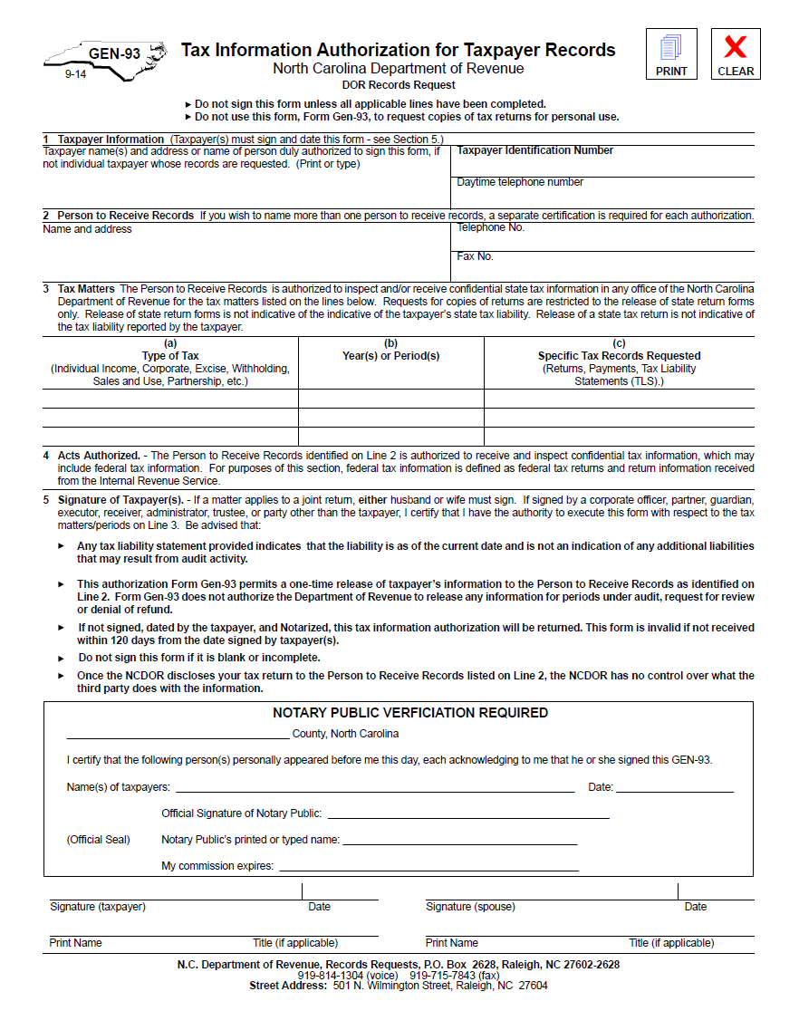
GEN-93 FORM
Release of Tax Information Form
Authorizes the Nutrition Services Vendor Unit to acquire the vendor’s E-500 forms directly from Department of Revenue (DOR)
Must be completed accurately matching what DOR has on file for store
Must be notarized
Notes:
This is a copy of a GEN-93 form.
As I mentioned, you may be requested to submit this form to the Community Nutrition Services Section Vendor Unit. It will enable the Vendor Unit to request copies of a vendor’s E-500 forms directly from the Department of Revenue, if necessary.
If you are requested to submit this form, it must be completed accurately. The name of the store, the owner and Tax Payer Identification Number must match exactly with how you file your returns.
This form must be notarized, and the original mailed to the State Agency.
If the information provided does not match exactly how you the store’s Sales and Use Tax returns, the Gen-93 must be resubmitted with correct information and notarized again.

Slide 22
SNAP-eligible Food Sales Records
Vendors must maintain a record of all SNAP-eligible food sales
SNAP-eligible food sales are sales of those foods that can be purchased with SNAP (Food Stamp) benefits
Vendors are required to provide the State WIC Agency, upon request, a statement of the total amount of revenue derived from SNAP-eligible food sales and written documentation to support the dollar amount of sales claimed
Food Sales
  The sale of all foods that could be purchased with SNAP benefits
  Food Sales Fact Sheet
Notes:
Vendors must maintain a record of all SNAP-eligible food sales. What is SNAP-eligible? SNAP-eligible is defined as any item that may be purchased with Supplemental Nutrition Assistance Program (SNAP) benefits. Vendors are required to provide to the State WIC Agency, upon request, a statement of the total amount of revenue derived such as sales records, financial statements, reports, tax documents or other verifiable documentation.
For the purpose of PWV determination, food sales is defined as the sale of all foods that could be purchased with SNAP benefits. This is also known as SNAP-eligible food sales. The emphasis is placed on the word “could’ because the food does not have to be purchased with SNAP, just purchasable with SNAP. As long as the food can be purchased with SNAP, it can be counted as a part of your food sales. The Food Sales Fact Sheet can be found at the back of your Vendor Manual and on the https://www.ncdhhs.gov/wicvendorsconnection website on the Vendor Connection webpage.

Slide 23
Appropriate Documentation
Each year select vendors are asked to submit SNAP eligible food sales as part of PWV determination
Request sales records, financial statements, reports, tax documents or other verifiable documentation
Keep a monthly copy in files
Notes:
As part of the PWV determination, SNAP eligible food sales data are requested from select vendors. This includes free-standing pharmacies and stores under corporate agreement.
The State WIC Agency will request and accept sales records, financial statements, reports, tax documents or other verifiable documentation that shows what your SNAP eligible food sales are for the time period requested. It is strongly advised that you keep copies readily available in the event this information is requested from you. Some of you may have already had this information requested in the past few years.
It is very important for you to supply the State WIC Agency with this information when requested. Failure to submit this information when requested could result in termination of your WIC vendor agreement.
Note to Local WIC Agency staff: Emphasize this point to vendors

Slide 24
Verifiable Documentation of SNAP-eligible Food Sales
Ledger Totals
  Daily, Weekly or Monthly Cash Register Receipts totaled in a ledger (DO NOT send actual cash register receipts)
  Some registers have the ability to separate out different types of items
  It is highly recommended that Vendors maintain this type of system. Makes this annual process easier
Sales and Use Tax returns are not always sufficient for documenting complete SNAP eligible food sales
  These returns may be used along with ledger totals to verify a vendor’s documentation of SNAP eligible food sales
Notes:
There are several ways to document SNAP eligible food sales including:
Ledger Totals
Daily, weekly or monthly cash register receipts totaled in ledger form (Do not send actual cash register receipts. They will be returned to the vendor)
Some registers are equipped to separate different types of items. This would be easiest to identify food items, if requested.
OR
Sales and Use Tax returns. While they are not always sufficient for documenting complete SNAP-eligible food sales, these returns may be used along with ledger totals to confirm a vendor’s documentation of SNAP-eligible food sales.

Slide 25
SAMPLE LEDGER
Date | Grocery (food only 2% rate) | Non-food items | Food items | Total of Food & Non-Food | WIC | SNAP
1/1/13 | $250 | $500 | $125 | $625 | $500 | $200
1/2/13 | $120 | $650 | $25 | $675 | $100 | $100
1/3/13 | $195 | $500 | $125 | $625 | $100 | $300
1/4/13 | $135 | $1000 | $50 | $1050 | $500 | $250
“ | $195 | $1000 | $25 | $1025 | $300 | $300
“ | $210 | $1000 | $25 | $1025 | $550 | $250
“ | $190 | $1000 | $55 | $1005 | $750 | $100
1/31/13 | $105 | $1000 | $20 | $1020 | $500 | $100
Totals | $1,400 | $6,650 | $400 | $7,050 | $3,300 | $1,600
SAMPLE ONLY
Notes:
This is a sample of a ledger we have accepted before…
As you can see, there is a column for:
Food only groceries taxed at 2%
Non-food items taxed at 4.75%
A column for food items that are taxed at the full tax rate of 4.75% (additional food items)
The food items in this column (if SNAP-eligible) are allowed to be counted as food sales for this review process and added with the 2% food only tax column. However, vendors must provide documentation like this that clearly shows where the totals come from
There is an additional slide that will show this information as it is reported on the sales and use tax returns

Slide 26
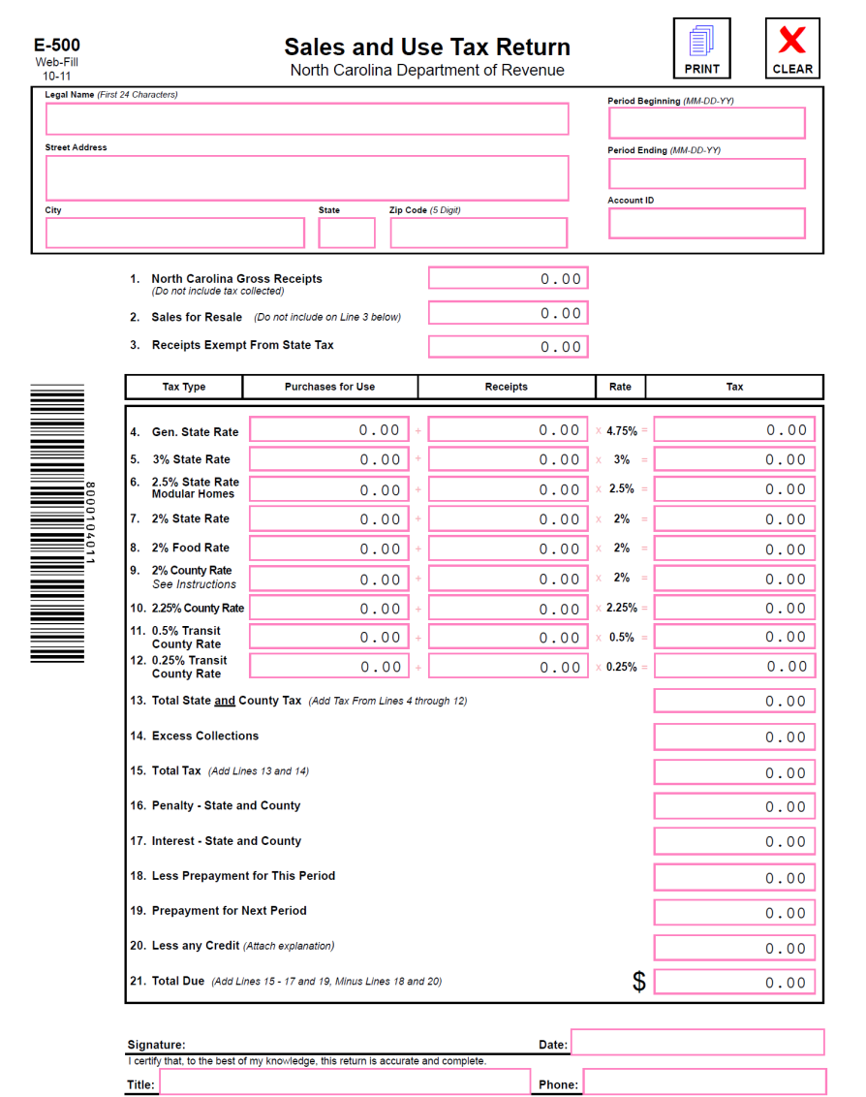
Different Types of Documentation
Sales and Use Tax Return
  If your store files electronically, it is recommended that you keep a copy for your records as this documentation may be requested as additional documentation
  Additional information may still be requested from the State WIC Agency if these forms are submitted as documentation
Notes:
This is a copy of the Sales and Use Tax Return form the store owner or accountant completes when you filing monthly/quarterly sales revenue to the NC Department of Revenue
If the vendor files electronically, it is recommended that they keep a copy for their records as this documentation may be requested as additional documentation
If the vendor decides to submit these forms as the required documentation, please be aware that this documentation may not be sufficient. We may need additional information.
If the vendor does not have copies of their monthly sales and use tax returns filed, you may be asked to complete a GEN-93 form where the State WIC Agency can request these returns directly from the Department of Revenue

Slide 27
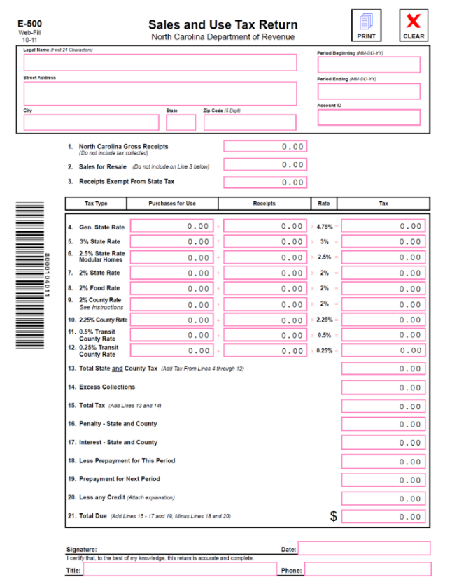
Type of Tax Rates
Tax Type Column
  Line 8
    2% Food Rate
    Any food sold that only requires a tax of 2%
Receipts Column
  Line 8
    Dollar ($) total of food sold at the 2% food rate
Notes:
If the Vendor submits this form to the State WIC Agency, we will first look at the Tax Type Column and find the line defined as “2% Food Rate” – this is usually on Line 8
Next, we’ll look at the dollar amount in the Receipts Column. They take this amount from each month’s return for the 12 months in review and total it.
If this total amount added with the vendors SNAP sales for the same time period is greater than the Vendors WIC sales, then your store is eliminated from being classified as a PWV for the year.
If this total amount added with the Vendors SNAP sales for the same time period is less than the Vendors WIC sales, then the store could be classified as a PWV
If you feel your store should not fall in this category, it is your responsibility to provide further documentation to verify this.

Slide 28

Types of Tax Rates - continued
Tax Type Column
  Line 4
  General State Rate
Receipts Column
  Current % 4.75
  Food items may also be reported in this column
SNAP eligible food sales possibly included
Notes:
This slide shows what we discussed a few slides back. Sometimes it is necessary for vendors to separate food items from non-food items from what is reported in line 4 for of this form
So to help with additional documentation you should examine items you report on line 4 of the return. It is very important for vendors to keep a record of SNAP-eligible foods sold and reported on line 4 of the Sales & Use Tax Return. It will be needed to verify additional cash food sales if requested by the State WIC Agency.
This is where the ledger I spoke of comes into play. The ledger is actually the verifiable documentation, and the Sales and Use Tax return is the back-up to the ledger information.
For purposes of reporting to WIC you must identify the SNAP-eligible food items and separate them from the non-eligible food items and the non-food items in order to determine what revenue is allowed for review

Slide 29
Submitting False Information
Vendors must not submit false, erroneous, or misleading information to the State or Local WIC Agency
Failure to comply will lead to denial of a vendor applicant’s authorization or termination of an authorized vendor’s WIC Vendor Agreement
The store must wait 1 year to become eligible to reapply for WIC vendor authorization
Notes:
Vendor applicants and authorized vendors must not submit false, erroneous, or misleading information to the State or Local WIC agency.
Failure to comply with this requirement will result in the denial of a vendor applicant’s authorization and termination of an authorized vendor’s WIC Vendor Agreement.
Additionally, the store must wait one year to be eligible to reapply for WIC vendor authorization.

Slide 30
eWIC Payments
Through the Banking System
Notes:
We will now review the eWIC payment process

Slide 31
Automated Clearing House (ACH)
Vendors will receive payment for all eWIC transactions processed in their store through an Automated Clearinghouse (ACH) system in which payments are directly deposited into their bank account
Each approved food has an NTE
If a vendor submits an item price that is above the NTE, their payment will be decreased to the NTE amount for the item
Notes:
Vendors will receive payment for all eWIC transactions processed in their store through an Automated Clearinghouse (ACH) system in which payments are directly deposited into their bank account. Each approved food has an NTE. If you submit an item price that is above the NTE, the payment will be decreased to the NTE amount for the item.

Slide 32

Vendor Bank Accounts
Vendors (with stand-beside devices because FIS pays them directly) must submit their most current banking information to the eWIC contractor, FIS, (or third-party processor) to ensure payment for eWIC transactions.
Current vendors (with stand-beside devices because FIS pays them directly) must contact the eWIC contractor with any changes in a vendor’s bank account.
Vendors can contact FIS at 1-800-894-0050 Monday- Friday from 8:00 AM to 5:00 PM CT for account changes or updates
Notes:
Vendor applicants must submit their most current banking information to the State Approved EBT Processor to ensure payment for eWIC transactions. Current vendors must contact the State Approved EBT Processor with any changes in a vendor’s bank account. Contact information for FIS is on the slide. Remember, FIS information is effective October 2023.
PiggyBank_Fotolia_113540_Subscription_L

Slide 33
FIS Retailer Helpdesk
FIS Retailer Helpdesk for stand-beside device assistance:
    Retailer Helpdesk: 1-844-230-0836 (available 24/7)
    Email: merchant.services.support@fisglobal.com
Notes:
Should a stand-beside device vendor need assistance troubleshooting stand-beside POS equipment, you will use the contact information listed on this slide. Again, FIS information is effective October 2023.

Slide 34
Vendor Reimbursement Policy
Vendors may not ask the WIC customer:
  To make up the difference in price for eWIC transactions
Vendors are responsible for keeping their prices at or below the NTE for their peer group
Notes:
Vendors may not ask the WIC customer:
To make up the difference in price for eWIC transactions
Vendors are responsible for keeping their prices at or below the NTE for their peer group.

Slide 35
Paying Above the Maximum
Customer can pay for an amount that exceeds the CVB maximum
  Example: $10.00 CVB
  Total cost of WIC fruits and vegetables is $10.25 Customer can pay 25¢ plus tax on the 25¢ or use other acceptable methods to pay for the outstanding balance, e.g SNAP which is not taxable
  Vendor submits an eWIC transaction for $10.00 in CVBs
Notes:
WIC customers can pay for an amount that exceeds the CVB maximum
Example: $10.00 CVB
Total cost of WIC fruits and vegetables is $10.25. Customer can pay 25¢ plus tax on the 25¢ or use other acceptable methods to pay for the outstanding balance, e.g SNAP which is not taxable
Vendor submits an eWIC transaction for $10.00 in CVBs

Slide 36

Questions
Notes:
We’ll pause here for any questions

Slide 37
WIC Approved Foods
https://www.ncdhhs.gov/ncwicfoods
Notes:
7
As you know, the implementation of eWIC has supported the development of a robust Authorized Product List or APL for the North Carolina WIC Program. The APL consists of all the WIC approved foods that meet Federal and State criteria and can be purchased by WIC participants. To ensure that only WIC approved foods may be purchased using WIC food benefits, the most current APL must be uploaded to the Vendor’s cash register system. The most updated APL can be found on the website: www.ncdhhs.gov/ncwicfoods.
Photo Credit: Adobe Stock #98855592

Slide 38
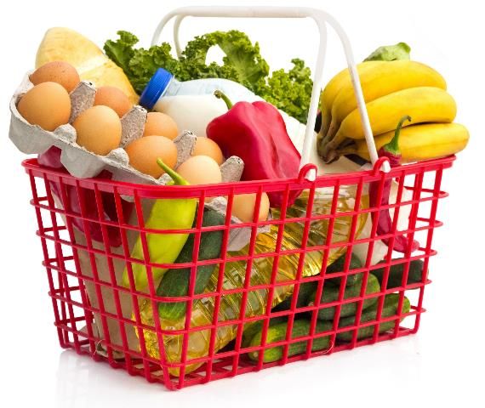
WIC Approved Foods
Criteria for Approval
Minimum Inventory Requirements
Unit of Measure
Notes:
7
This portion of the presentation discusses the processes for UPC submission and updates to the Authorized Product List.
Additionally, we will review each component of a WIC approved food category, including:
the criteria for approval
the unit of measure; and
The minimum inventory requirements. The minimum inventory requirements will be reviewed for all foods toward the end of this section.

Slide 39
Authorized Product List (APL)
NC WIC Approved Products Nutrition Criteria
Universal Product Code (UPC) Submission
NC WIC APL
https://www.ncdhhs.gov/ncwicfoods
Notes:
7
NC WIC Program Authorized Product List, or APL, is a compilation of all the WIC approved Universal Product Codes (UPCs) for each category of supplemental food available from the WIC program.
In order for food to be purchased using eWIC, the UPC for that specific food must be on the APL. Vendors are required to download the APL every 24 hours to ensure all approved foods are available to WIC participants.
To add a UPC to North Carolina WIC Program APL, vendors (or anyone) must submit a request using the web-based NC WIC Approved Product Registration form. Prior to submitting any UPC for review, vendors must verify that the UPC is not already listed in the most recent APL and refer to the NC WIC Approved Foods Nutrition Criteria to determine if the food meets the approved criteria.
Additional information regarding the current North Carolina APL, the NC WIC Approved Foods Nutrition Criteria and UPC submission process are available on our website: https://www.dhhs.nc.gov/ncwicfoods under “UPC Submissions”.

Slide 40
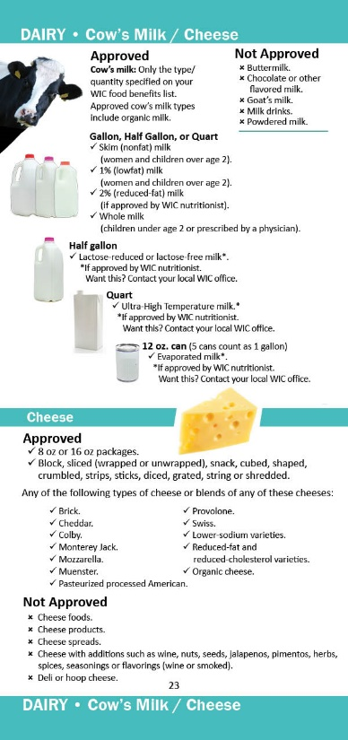
Milk
Criteria for Approval
Pasteurized cow’s milk
Skim/1%/2%/Whole
Lactose-reduced/free
Ultra High Temperature (UHT)
Evaporated
Gallons, half gallons, quarts and cans*
Regular or organic
*Evaporated milk only
Notes:
7
Let’s first discuss the Milk food category.
A variety of cow’s milk options are available including skim, 1%, 2%, or whole fat milk, and lactose-reduced or lactose free cow’s milk. Shelf- stable cow milk options include ultra high temperature and evaporated milk.
The approved container sizes are gallon, half gallon and quart. Only for evaporated milk, the approved container size is a can.
WIC participants are only able to purchase the type of milk issued on their food benefit account. This means, if a participant is issued skim/1% milk and they try to purchase 2% milk, the 2% milk will not be an allowable WIC food for purchase and will not be available using their eWIC benefits. Please note: because participant food benefits are aggregated as a family, it is possible to see a family purchase a variety of milk options at the grocery store.
WIC participants are allowed to purchase any brand of milk they prefer if it is included on the APL and matches the type of milk and amount available in their remaining food benefits. In other words, participants are not required to choose the least expensive brand of milk.

Slide 41
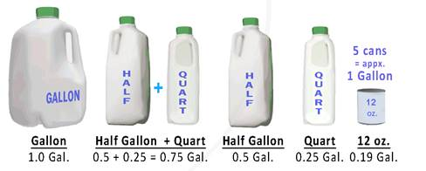
Milk
Unit of Measure
= GAL (Gallon)
Notes:
7
The unit of measure for milk is “GAL” indicating one gallon. This can include a combination of sizes that add up to one gallon.
For example, if a family has “1 Gal” of whole milk available to be purchased in their food benefit account, they could purchase a quart of whole milk today and leave a remaining 0.75 “Gal” of whole milk left in their food benefit account. At their next trip to the store, they could get up to 3 quarts (which is the equivalent of the remaining 0.75 “GAL”) OR a half gallon plus a quart of whole milk to utilize their remaining food benefits before they expire.
Notice the evaporated milk comes in a 12 oz. can which is equal to 0.1875 (rounding up to 0.19) gallons. The conversion utilized by the NC WIC Programs equates approximately 5 cans of evaporated milk to one gallon of milk.
Photo Credit: Designed by DCFW Graphic artist

Slide 42
Cheese
Criteria for Approval
Equivalent to one pound (16 oz.)
  Package sizes of 8 oz or 16 oz.
Low-sodium varieties
Reduced-fat/cholesterol varieties
Regular or organic
Types:
  Cheddar (Mild, Medium, Sharp, Extra Sharp)
  Colby
  Pasteurized Processed American
  Monterey Jack
  Mozzarella
  Muenster
  Provolone
  Swiss
Notes:
7
Approved forms of cheese include both the eight (8)-ounce and sixteen (16)-ounce package size. The cheese can be block or brick, sliced, snack, cubed, shaped, crumbled, strips, sticks, diced, grated, string or shredded cheese.
Participants have a variety of types of cheese to choose from including:
Cheddar (Mild, Medium, Sharp, Extra Sharp), Colby, Monterey Jack, Pasteurized Processed American, Mozzarella, Muenster, Provolone, Swiss.
Participants are not required to purchase the least expensive brand of cheese.

Slide 43

Cheese
Unit of Measure
= LB (Pound)
One container = 16 oz. package
or
two 8 oz. packages
*The minimum inventory requirement for cheese requires vendors to have at least two (2), one-pound packages available. Only one (1) type of approved cheese is required.
Notes:
7
Unit of Measure: LB-Pound = 16-ounce (1 pound) package or 2 – 8 ounce packages
The unit of measure for cheese is 1 container which equals one 16 oz package (1 pound) or 2-8 Ounce packages.
*The minimum inventory requirement for cheese requires vendors to have at least two (2), one-pound packages available. Only one (1) type of approved cheese is required.
Photo Credit: Slices of Cheddar Cheese_Fotolia_96367612_Subscription_XXL.jpg

Slide 44
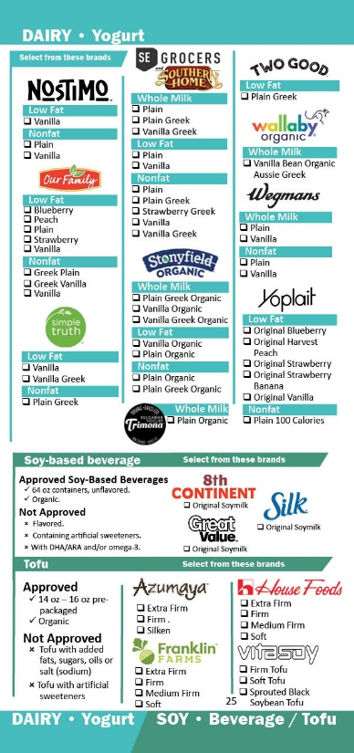
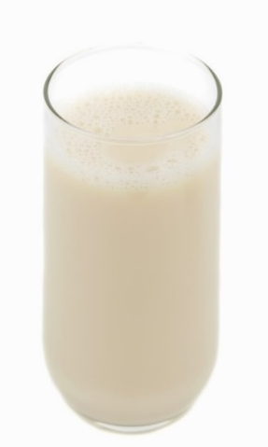
Soy-Based Beverage
Criteria for Approval
Half gallon containers
Unflavored
Meets nutrient requirements
Regular or organic
Unit of Measure
= GAL (Gallon)
Notes:
7
Soy-based beverages are allowed as a substitution for some or all of a participant’s milk. Unflavored soymilk in 64 oz. containers that meet FDA’s fortification requirements are approved. Organic Soy milk can be approved based on if it meets nutrient requirements.
Currently, There are three brands available:
8th Continent – Soymilk Original
Great Value-Original Soymilk
Silk Original Soymilk
These options are fortified to meet the following nutrient levels, in accordance with fortification guidelines issued by FDA per 8 oz. cup soy-based beverage:
276 milligrams calcium
8 grams protein
500 IU Vitamin A
100 IU Vitamin D
24 milligrams magnesium
222 milligrams phosphorus
349 milligrams potassium
0.4 milligramsriboflavin
1.1 micrograms Vitamin B12
The unit of measure for milk is “Gal” indicating gallon and is equivalent to 1 Gallon.
Photo Credit: Soy Milk Glass1_Fotolia_10268492.jpg

Slide 45
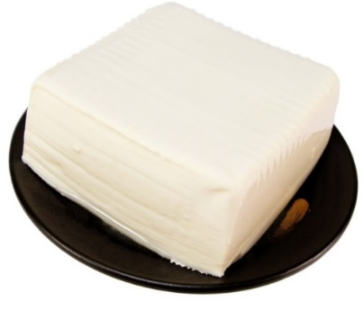
Tofu
Criteria for Approval
14 to 16 ounce prepackaged
Calcium-set tofu
Can contain coagulants
Regular or organic
Unit of Measure
= LB (Pound)
One container = 14 - 16 oz. package
Notes:
7
Tofu can also be prescribed as a substitution for milk. The approved tofu for WIC must be calcium-set. The unit of measure is container (CTR) It is approved in a range of package sizes from 14 to 16 ounces. Currently various brands of tofu are approved that include a variety of types from silken to extra firm tofu. Organic tofu is approved.
1 LB-Pound of tofu is equivalent to one 14 to 16 oz package.
Photo Credit: Tofu_Fotolia_151100_Subscription_L.jpg

Slide 46
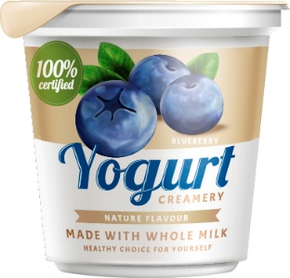
Yogurt
Criteria for Approval
Equivalent to one 32 oz. container
  Package sizes of 16 oz. or 32 oz.
Pasteurized
Flavored or unflavored
< 40 grams sugar per cup
Fortified with Vitamin A and D
Non-fat, Low-fat, Whole-fat yogurt
Regular or organic
Notes:
7
Yogurt is an additional milk substitution that is available to participants.
One quart of yogurt may be included on a food prescription in place of one quart of milk. The maximum issuance is one quart which is equivalent to 32 oz. container in total package sizes of 16 oz. or 32 oz.
To be approved, the yogurt must:
- be Pasteurized
- Conform to FDA standard of identity for whole-fat, low-far, or non-fat yogurt
- Contain no more than 40 gm sugar per cup (8 oz.), and
- be packaged in one-quart or 32-oz equivalent, so a package size of 16 oz. or 32 oz.
Similar to fluid milk, a specific fat content of the yogurt is specified for participant food benefits. Participants prescribed skim, 1% or 2% milk who choose a yogurt substitution receive Low-fat or non-fat yogurt. Participants prescribed whole milk will receive whole-fat yogurt.

Slide 47
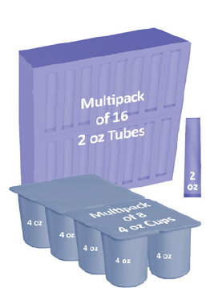
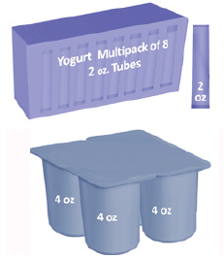
Yogurt
Unit of Measure
= CTR (Container)/Quart
One container = 32 oz. package or
two 16 oz. packages
Notes:
7
One container is equivalent to one quart (which is 32 oz) of yogurt. The North Carolina WIC Program Approved Foods expanded to include many different sizes of yogurts:
o A 16 oz package size would redeem for 0.5 of the 1 container yogurt benefit
This could be: One 16oz container, a package of 4 - 4 oz cups, or package of 8 - 2 oz yogurt tubes.
o A 32 oz package size would redeem for the 1.0 container yogurt benefits.
This could be: one 32 oz container, a package of 8 - 4 oz cups, or package of 16 - 2 oz yogurt tubes.

Slide 48
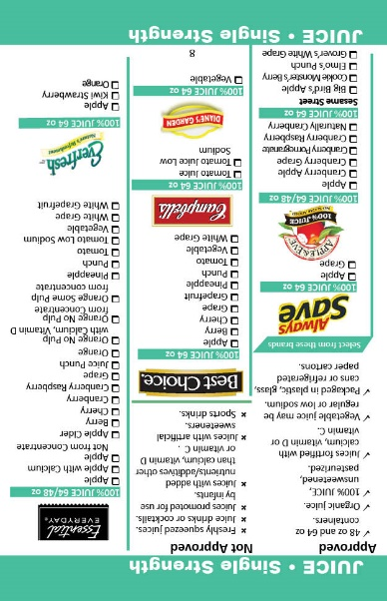
Juice
Criteria for Approval
Frozen or Shelf-stable Concentrate
  11.5 to 12 oz. containers
Single Strength
  48 oz. and 64 oz. containers
100% fruit or vegetable juice or blends
  unsweetened and pasteurized
Fortified with Calcium, Vitamin D or Vitamin C
Contains >30mg of Vitamin C per 100 mL
Plastic, glass, cans or refrigerated paper cartons
Regular or organic
Notes:
7
A variety of juices are available. Both national brands and store brands are approved.
Concentrate juice or single strength juice in 48 and 64-ounce containers continue to be approved.
Approved juices must be 100% fruit or vegetable juice blends that are unsweetened and pasteurized. The juices must contain at least 30mg of Vitamin C per 100 milliliters of juice and may be fortified with Calcium, Vitamin D or Vitamin C.
Plastic, glass, cans and refrigerated cartons are approved in addition to organic options.

Slide 49

Juice
Unit of Measure
= CTR (Container)
Food Packages: V, VI, VII, VII+ (III)
Pregnant, Postpartum, and Breastfeeding Woman
Food Package: IV (III)
Child
One container = 48 fluid oz.
48 oz single strength
11.5-12 oz. concentrate
One container = 64 fluid oz.
64 oz single strength
Notes:
7
Food packages may include 48 oz single strength juice or 11.5 – 12 oz concentrate options as well as 64 oz single strength juice. Understand that a family may have all of forms and sizes of juice available for purchase with their food benefits.

Slide 50
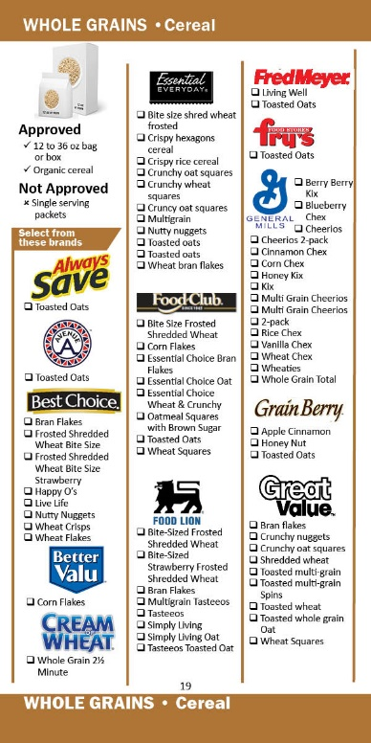
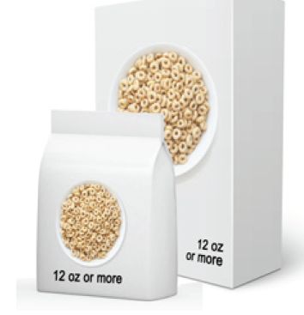
Cereal
Criteria for Approval
11.8 / 12 ounce or larger box or bag
Ready to eat
Instant and regular hot cereal
< 6 grams sugar per dry ounce
Regular or organic
Notes:
7
There is a variety of national and store brands to choose from. Approved cereals are 11.8 / 12 ounces or larger in a box or bag including ready to eat, instant or regular hot cereal.
The “approved” criteria for cereal include:
-At least 28 mg iron per 100 g dry cereal
-Less than or equal to 6 gm of Sugar per dry ounce of cereal
-Includes whole grain as the primary ingredient by weight AND meets labeling requirements for making a health claim as a “whole-grain food with moderate fat content”
14oz. -16oz. Oatmeal or oats can only be redeem using the Bread/Whole Grains benefits.
Photo Credit: Cereal3_Fotolia_22865129.tif/DCFW Graphic artist

Slide 51
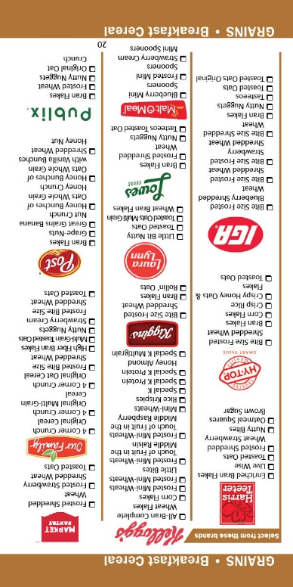
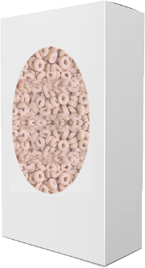

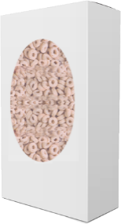
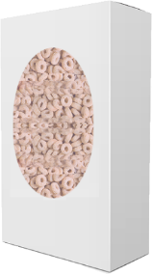
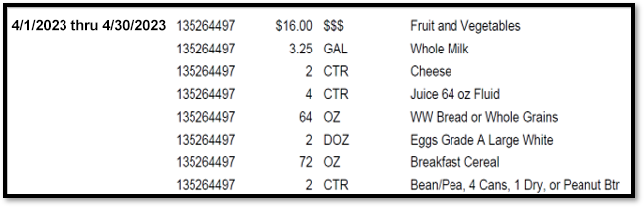
Cereal
Unit of Measure
= OZ (Ounce)
72 oz.
12oz
12oz
12 oz
18 oz
18 oz
Notes:
7
The unit of measure for cereal is OZ and is equivalent to 1 ounce of cereal. A family can purchase a combination of approved brands and sizes up to the amount of total ounces of cereal in their food benefit account.
For example, if a family has 72 oz of breakfast cereal available on their food benefit account, they can purchase three-12 oz boxes at their first shopping visit and then two 18-oz boxes at their next shopping visit. Similarly, a family may purchase one box of cereal at a time until they reach 72 ounces within that month of issuance.
Photo Credit: DCFW Graphic artist

Slide 52
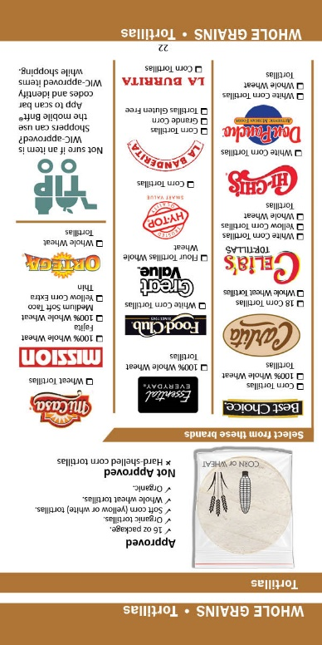
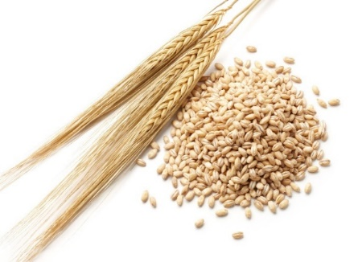
Bread/Whole Grains
Whole wheat tortillas
Soft corn tortillas
Whole grain/whole wheat bread/Buns/Rolls
Brown rice
Whole wheat pasta
Whole grain Barley
Bulgur
Oats
Notes:
7
Several whole grain options are available.
Allowed whole-grain products include:
Whole grain/whole wheat bread/Buns/Rolls
brown rice
whole wheat pasta and
whole wheat and soft corn tortillas.
Whole grain Barley
Bulgur
Oats

Slide 53
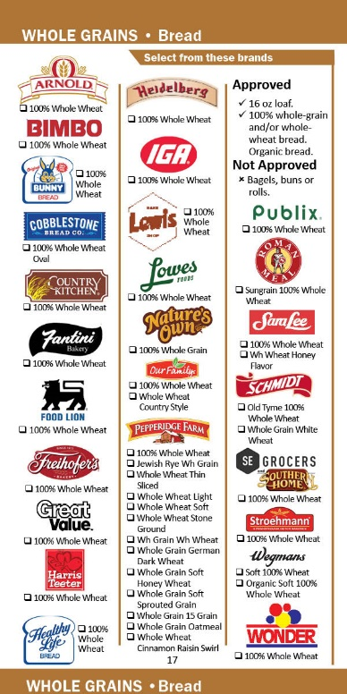
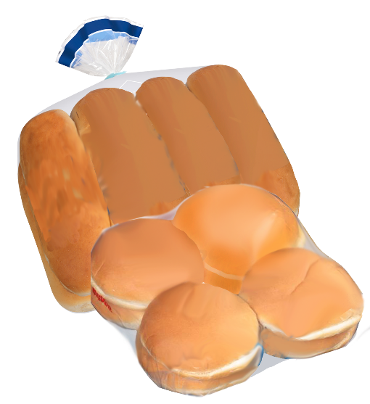

Bread/Buns/Rolls
Criteria for Approval
16 ounce loaf
100% whole-grain and/or whole-wheat bread/Buns/Rolls
Regular or organic
Notes:
7
Participants are allowed to select an approved loaf of bread/buns/rolls that is 16 ounces and made with only whole wheat flour and/or bromated whole wheat flour for a whole wheat bread/buns/rolls.
Breads/Buns/Rolls that contain other flours are not approved.
Photo Credit: Bread Sliced_Fotolia_7513047.jpg/DCFW Graphic Artist

Slide 54
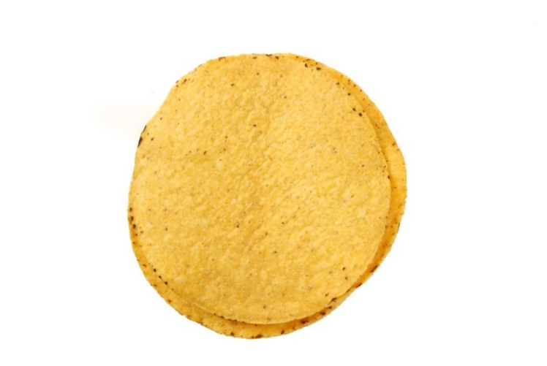
Tortillas
Criteria for Approval
16 ounce package
Soft corn tortillas (yellow or white)
Whole wheat tortillas
Regular or organic
Notes:
7
Participants are allowed to select package of tortillas.
To be approved, soft corn tortillas must be made from ground masa flour. Whole wheat tortillas must be made from whole wheat flour.
Photo Credit: Corn Tortillas_Fotolia_27035299.jpg

Slide 55
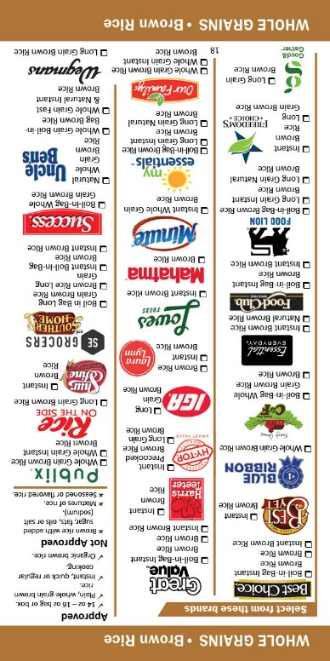

Brown Rice
Criteria for Approval
14 to 16 ounce bag or box
Plain, whole grain brown rice
Instant, quick or regular cooking
Regular or organic
Notes:
7
Plain, whole grain brown rice that comes in a 14 to 16 oz bag or box continues to be approved. Instant, quick or regular cooking are approved options.
(Photo Credit: Brown Rice_Fotolia_16759871.jpg)

Slide 56
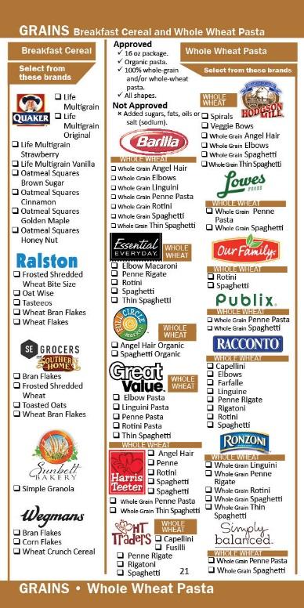

Whole Wheat Pasta
Criteria for Approval
16 ounce packages
100% whole grain and/or whole wheat
All shapes
Regular or organic
Notes:
7
Like all other items in the whole grains category, participants are allowed to select an approved whole wheat pasta.
To be approved the pasta must:
_ conform to the standard of identity
_ have no added sugars, fats, oils or salt
_ whole wheat flour or whole durum wheat flour must be the only flours listed on the ingredient list
Any shape pasta that meets the approved criteria is included. There is no minimum inventory requirement for whole wheat pasta.
Photo Credit: Whole wheat Pasta Spaghetti and Penne_Fotolia_92794316_Subscription_XXL.jpg

Slide 57
Whole Grain Barley/Bulgur/Oats
Criteria for Approval
14 to 16 ounce bag or box
Plain, whole grain barley/bulgur/oats
Instant, quick or regular cooking
No added sugars, fats, oils, or salt
Regular or organic
Notes:
7
Participants are allowed to select an approved brand of whole grain barley/Bulgur or Oats. Plain, whole grain barley/Bulgur or Oats that comes in a 14 to 16 oz bag or box continues to be approved. Instant, quick or regular cooking are approved options.
Photo Credit: DCFW Graphic Artist

Slide 58

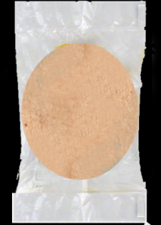

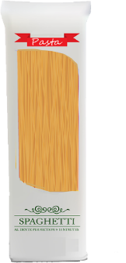
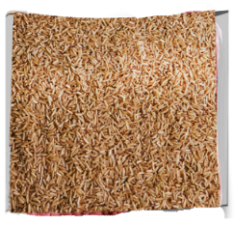
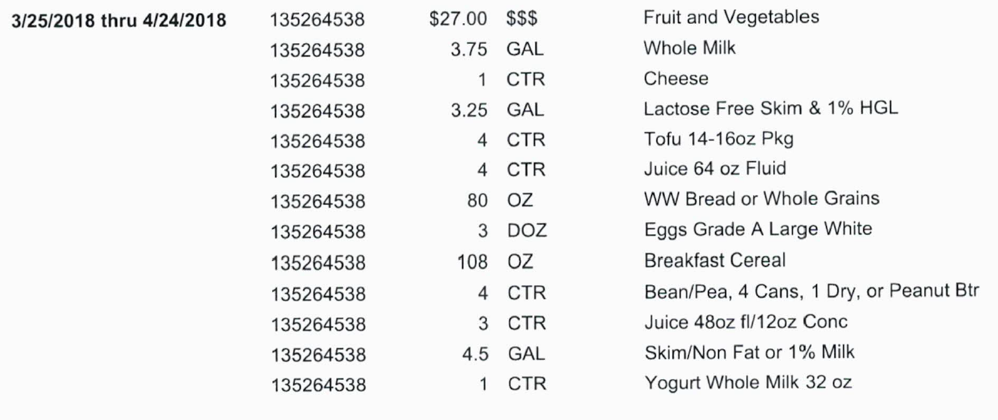
Whole Grains
Unit of Measure
= OZ (Ounce)
16 oz Rice
16 oz Loaf
16 oz Tortilla
16 oz Pasta
16 oz Oatmeal
80 oz
Notes:
7
The unit of measure for whole grains is OZ which is equivalent to one ounce of whole grain of choice. Women and children participants are prescribed up to 32 ounces of whole grains and can purchase a combination of items from the whole grain category.
For example, a family can purchase up to 80 oz of whole grains during their month to spend. Mom makes 5 trips to the grocery store and chooses one of each whole grain to equal 80 total ounces of whole grain.
Photo credit: DCFW Graphic Artist

Slide 59
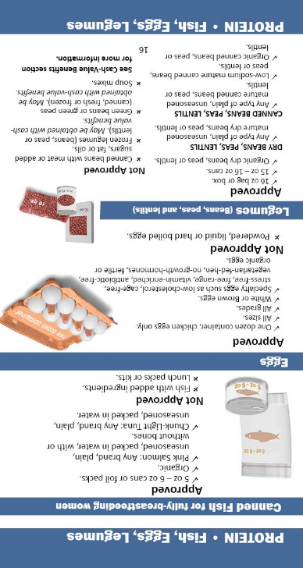

Eggs
Criteria for Approval
One dozen chicken eggs of different sizes and grades
Brown eggs
Specialty eggs such as low-cholesterol, cage free, stress-free, free-range, vitamin enriched, antibiotic-free, vegetarian-fed-hen, no-growth-hormones, fertile
Regular or organic
Unit of Measure
= DOZ (Dozen)
Notes:
7
Participants are allowed to select an approved brand of chicken eggs in one-dozen size container when included in their food benefits. Participants are no longer required to purchase the least expensive brand of eggs.
Photo Credit: Eggs2_Fotolia_22337316.jpg

Slide 60

Beans, Peas, and Lentils
Criteria for Approval
Dry
  (Any type) plain, unseasoned mature
  16-ounce bag or box
  Regular or organic
Canned
  (Any type) plain, unseasoned mature
  Regular or low sodium
  15 to 16-ounce can
  Regular or organic
Notes:
7
Dry and canned beans, peas and lentils continue to be approved.
Both types must be plain, unseasoned mature beans, peas, and lentils. Organic is an allowable option.
Please note: frozen mature beans, peas, and lentils are not approved as a legume. Frozen varieties fall within the cash-value benefit option as food items approved for redemption.
Photo Credit: Vegetables on Wooden Spoon on white background_ Fotolia_77226525_Subscription_XXL.jpg

Slide 61
Beans, Peas, and Lentils
Food Benefits
Cash-value Benefits
Mature
Black Beans
Butter Beans
Lima Beans
Garbanzo Beans
Soybeans
Lentils
Split Peas
Vegetable
Green Beans
Green Peas
Snap Peas
Snow Peas
Snap Beans
Garden Peas
Wax Beans
VS
Notes:
7
Again, only mature beans, peas and lentils, canned and dry are approved. Listed on the slide are examples of mature beans, peas and lentils.
Please note that green beans and peas are not mature beans and peas; therefore, they are not allowed as a legume.
However, varieties of fresh, frozen, and canned green beans and peas are allowed to be purchased using the cash value benefit. We will talk more about what is approved cash value benefits later in the presentation.

Slide 62
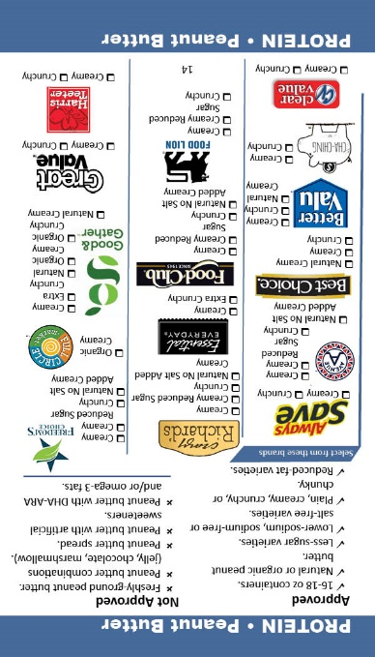

Peanut Butter
Criteria for Approval
16 to 18 ounce container
Regular or less sugar, salted or unsalted
Regular or reduced-fat varieties
Plain, creamy, crunchy or chunky
Regular, “natural”, or organic
Notes:
7
Peanut butter continues to be approved in the 16 to 18-ounce container. A variety of peanut butter types are available including reduced sugar, with salt or unsalted, reduced fat, all textures, and organic or ‘natural’ options included.
Photo Credit: An open Jar of Peanut Butter with Spoon_Fotolia_40556509_Subscription_XL.jpg

Slide 63
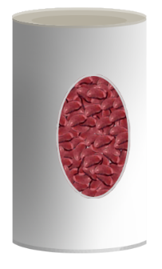

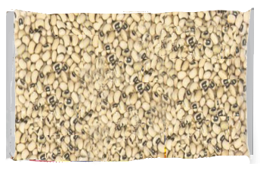
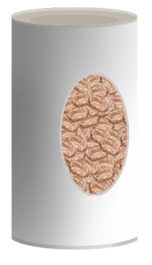
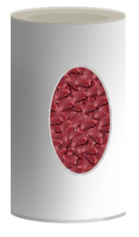
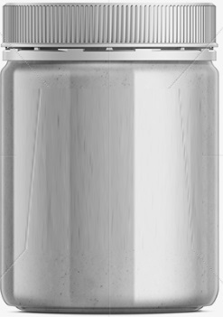
Beans, Peas, Lentils and Peanut Butter
Unit of Measure
= CTR (Container)
One container Beans/Peas or Peanut Butter =
OR
16 oz dry
4 cans (15-16 oz each)
*Note: 1 can = 0.25 Container
OR
16-18 oz jar
Peanut Butter
Notes:
7
If a family’s food benefits include 1 container of beans/peas or Peanut butter, they have a choice of purchasing one 16 oz bag dried bag or four (15 to 16) oz cans of mature beans, peas, and lentils OR a 16 to18 oz jar of approved peanut butter.
The subcategory default for legumes allows participants a choice of canned or dry beans, peas, or lentils OR peanut butter when shopping.
Photo Credit: Created by DCFW Graphic artist

Slide 64
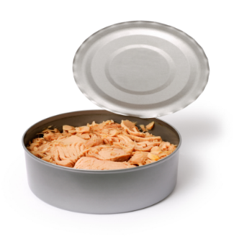
Fish
Criteria for Approval
5 to 6-ounce cans or foil packs
Plain, unseasoned pink salmon
  with or without bones
Chunk-light tuna packed in water
Regular or organic
Unit of Measure
= OZ (Ounce)
Notes:
7
Canned fish continues to be an approved item.
Plain, unseasoned pink salmon or chunk-light tuna packed in water in 5 to 6 oz cans or foil pouches are approved.
The unit of measurement is OZ which is equivalent to one ounce.
Photo Credit: TunaCanned7_Fotolia_4309159.jpg

Slide 65
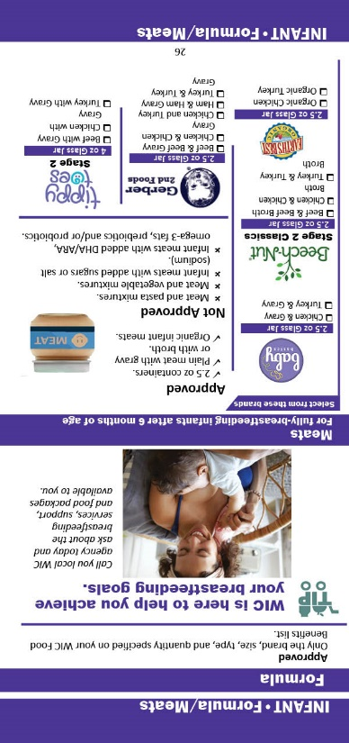
Infant Formula
WIC participants must purchase what is specified on their food benefit
account:
    Brand
    Size
    Type
    Quantity
Notes:
7
There are no changes in criteria for infant formula. WIC participants must purchase the brand, container size, type and quantity specified in their food benefit account.

Slide 66
NC WIC Program Contract Formula
Criteria for Approval
Milk-based powder:
Soy-based powder:
(Brands must be NC contract formula)
Notes:
7
The Gerber contract expires September 30th, 2023. If new contract information is available updated formula name can be announced here.. The new contact formulas are…
Note to Speaker: If the formula contract has been announced, State staff will ensure you all are aware to announce it here or provide the information as soon as it is available.

Slide 67

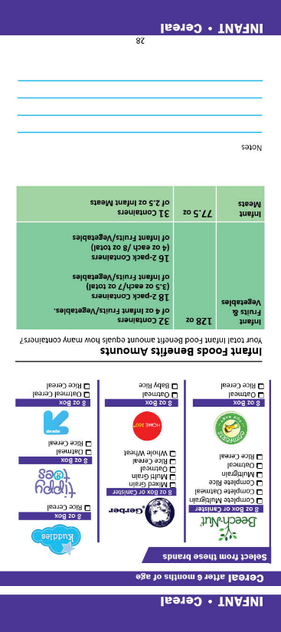
Infant Cereal
Criteria for Approval
8-ounce box of plain, dry infant cereal
Must contain minimum of 45 mgs of iron per 100 grams of dry cereal
Regular or organic
Unit of Measure
= OZ (Ounce)
Notes:
7
Eight (8) ounce boxes of plain, dry infant cereal continue to be approved, organic options included.
If submitting an infant cereal for APL approval, infant cereal must contain minimum of 45 milligrams of iron per 100 grams of dry cereal.
The unit of measure is OZ which is equivalent to one ounce.
Photo Credit: Infant Cereal and Spoon4_Fotolia_9217384.jpg

Slide 68

Infant Meats
Criteria for Approval
Plain meat with gravy or with broth
2.5-ounce containers, single or multi pack
Regular or organic
Unit of Measure
= OZ (Ounce)
Notes:
7
For infant meats the “approved” criteria include: 2.5oz containers of organic or non-organic plain meat with gravy or broth.
The unit of measure is OZ which is equivalent to one ounce.
Photo Credit: DCFW Graphic artist

Slide 69
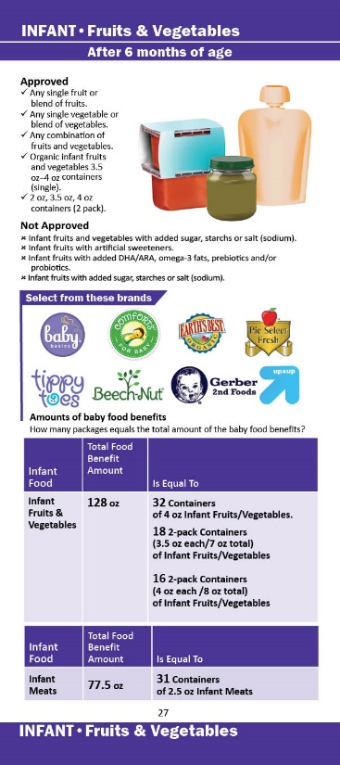

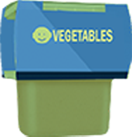
Infant Fruits & Vegetables
Criteria for Approval
Single ingredient fruit or blends of fruits
Single ingredient vegetable or blends of vegetables
Without added sugars, starches, or salt
Combination of Infant fruits and vegetables
  2-ounce (2 pack),
  3.5-ounce or 4-ounce containers single or multi pack
Regular or organic
Unit of Measure
= OZ (Ounce)
Notes:
7
The unit of measure for infant fruit and vegetables is OZ which is equivalent to one ounce.
Single fruit or blends of fruits, Single vegetable or blends of vegetables, and combination infant fruits and vegetables in 3.5 oz to 4 oz single or multi pack containers or 2 oz - 2 pack containers are approved.
Photo credit: DCFW Graphic artist

Slide 70
Shopping for Infant Foods
Food | Amount Listed | Is Equal To
Infant Fruits & Vegetables | 128 OZ | 32 2oz 2-packs or 4-oz containers of infant fruits and vegetables. 18 3.5oz 2-pack containers of infant fruits and vegetables. 16 4oz 2-pack containers of Infant fruits and vegetables.
Infant Meats | 77.5 OZ | 31 2.5-oz containers of infant meats.
Notes:
7
The family shopping list will detail the total number of ounces of baby food participants are allowed for the month. This slide provides examples of the number of jars that may be purchased based on the number of ounces listed on the shopping list.

Slide 71
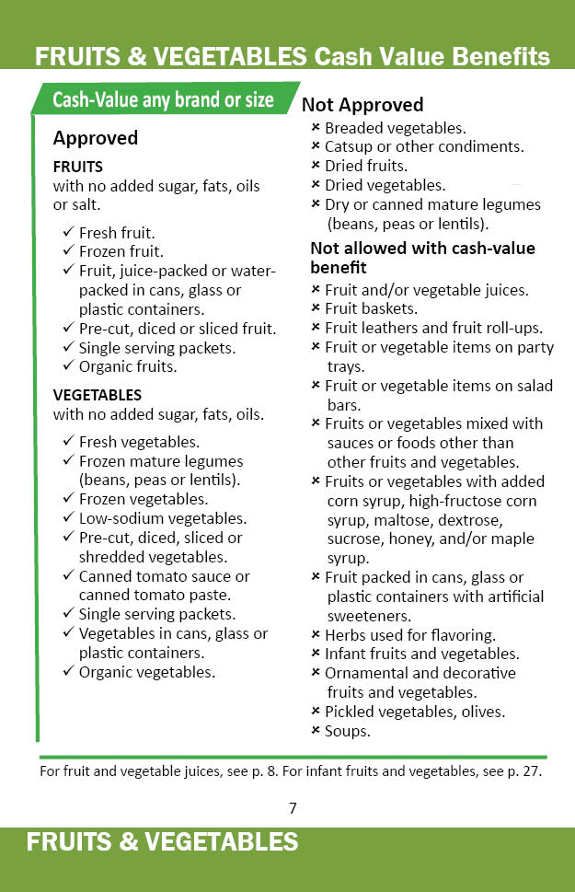
Cash-Value Benefits
Fruits and Vegetables
Criteria for Approval
Fresh, frozen or canned fruits and vegetables
Regular or organic
Unit of Measure
= $ Cash Value Benefit Dollar Amount
Notes:
7
Participants can buy a combination of fresh, frozen or canned fruits and vegetables up to cash-value benefit dollar amount in their food benefit account.
Participants receive:
$9 for children
$11 for all women
or $16.50 for Fully breastfeeding women with multiples
Note: ** The CVV/B amount was increased for federal FY 2023 to $25 for child participants, $44 for pregnant and postpartum participants, and $49 for fully and partially breastfeeding participants. Additional legislation will determine future values.**
Remember with eWIC, participants do not have to buy all of their food benefits at once, they can choose to buy any amount up to their available food benefit. This is also true for the cash-value benefit. For example, if a family has 20 dollars in cash value benefits they can choose to spend as much or as little as they want up to 20 dollars over several transactions.
If a participant purchases more than the amount of their cash-value benefit, the participant can pay the extra or choose not to buy certain items.
The North Carolina WIC APL includes applesauce and other pureed fruits and vegetable available for the participant to purchase under the Cash Value Benefits.
These items are for intended by the manufacturers for children over 12 months of age and is not available for purchase for infants.

Slide 72

Fruits
Criteria for Approval
Fresh, frozen, canned
Whole or cut fruit without added sugar, fats, oils or salt
Notes:
7
Nutrition criteria for fruits purchasable with the cash-value benefits include: Fresh, frozen, and canned fruits that contain no added sugar fats, oils or salt.
Remember, Infant fruits are not allowed to be obtained with the cash-value benefits.
Photo Credit: FruitSmileyFace_Fotolia_33280198_Subscription_L.jpg

Slide 73


Vegetables
Criteria for Approval
Fresh, frozen and canned
Whole or cut without added sugar, fats or oils
Vegetables can contain added salt
Notes:
7
Fresh, frozen and canned vegetables with no added sugar, fats, or oils continue to be approved. Vegetables can contain added salt.
Be reminded:
Salsa is not approved (as it contains not-approved herbs and spices)
White potatoes in addition to sweet potatoes are approved
Tomato products that contain herbs are not approved
Canned or dry mature legumes (dry beans, peas or lentils) do not count as a vegetables for the purpose of the cash-value benefit. They are obtained with the food benefits for legumes.
Sauerkraut is not approved, as it counts as a condiment.
Infant vegetables are not allowed to be obtained with cash-value benefits. They are obtained with the food benefit for infant fruits and vegetables.
Photo Credit: CannedCorn_Fotolia_38431540_Subscription_L.jpg
Graphic: Powerpoint Template

Slide 74
Fruits and Vegetables
NOT Approved
Herbs used for flavoring
Infant fruits and vegetables*
Mature legumes (dry or canned beans, peas, lentils)*
Ornamental or decorative fruits or vegetables
Catsup or other condiments
Dried fruits or vegetables
Salsa
Sauerkraut
Pickled vegetables, olives
Fruit and/or vegetable juices*
Fruit baskets
Fruit leathers and fruit roll-ups
Fruit or vegetable items on party trays
Fruit or vegetable items on salad bars
* See other approved criteria:
‘Infant fruits and vegetables’; ‘Beans, Peas, Lentils’ and “Juice”.
Notes:
7
Shown above are some clarifications for fruits and vegetables not approved for purchase with cash-value benefits.
Take a moment to review these items.

Slide 75

Minimum Inventory Requirements
Food Category | Required Package Size | Required Quantity
Milk | Skim/1% Milk AND Whole Milk *2 types required* | Skim/1% milk = six (6) gallons Whole Milk =two (2) gallons
Cheese | One (1) pound = 16 ounces | Two (2) pounds of one approved type
Juice (Single Strength) *concentrated juice does not have inventory requirement* | 48-ounce container AND 64-ounce container *2 sizes required* | 48-ounce container = four (4) containers 64-ounce container = four (4) containers
Cereal | 12-ounce package | Six (6) packages *required to have 2 types whole grain cereal*
Notes:
7
The next few slides review the minimum inventory requirements required for each food category:
Both skim/low fat 1% milk and whole milk are required types of milk with the minimum inventory requirement of six (6) gallons for skim/1% milk and two (2) gallons for whole milk. Although 2% milk cannot be used to satisfy the minimum inventory/variety requirement for Low fat milk, vendors are still encouraged to carry 2% milk in their store.
The minimum inventory requirement for cheese requires vendors to have at least two (2) one-pound packages available. Only one (1) type of approved cheese is required.
For juice, the minimum inventory requirement is for single-strength juice only. There is no minimum inventory for concentrated juice. The minimum inventory requirement for single-strength juice is four (4) 48 oz containers and (4) 64 oz containers.
There is a minimum inventory requirement for cereal. Vendors are required to carry a minimum of two types of whole grain cereal. The minimum package size is 12 oz.. and the minimum number of packages you can carry is six. As a reminder, only whole grain cereal can count towards minimum inventory. Some non whole grain cereal which are currently approved in our Authorized Product List cannot count towards minimum inventory (such as various brands of Corn Flakes, Rice Krispies, Special K, Corn Chex, Rice Chex, Cinnamon Chex, and Blueberry Chex.

Slide 76
Minimum Inventory Requirements
Food Category | Required Package Size | Required Quantity
Bread | 16-ounce loaf of bread AND 16-ounce package of tortillas | Two (2) loaves or packages OR One (1) loaf or One (1) package
Brown Rice | 14 to 16-ounce package | Two (2) packages
Eggs | One (1) dozen | Two (2) packages
Beans, Peas, Lentils | One (1) pound dry beans, peas, lentils | Two (2) packages of dry beans, peas, lentils *Only one 1 (one) approved type required*
Peanut Butter | 16 to 18-ounce containers | Two (2) containers
Fish | Five (5) to Six (6) – ounce containers | Six (6) cans
Notes:
7
Stores must carry at least two -16 oz loaves of bread or two - 16 oz packages of tortillas or 1 loaf bread and 1 package of tortillas to equal 2 in their minimum inventory.
The Minimum inventory requirement for brown rice is at least 2 – 14 to 16 oz packages.
Stores must carry at least two (2) dozen size containers of large, white, grade A chicken eggs.
There is a minimum inventory requirement for dry beans, peas and lentils, BUT not for canned. Only one (1) approved type of beans, peas or lentils is required, and there must be at least two (2) one-pound packages. As a reminder, canned green beans and peas are NOT dry beans or peas and CANNOT be counted for minimum inventory in this category. Also, frozen mature legumes cannot be counted for minimum inventory.
There is minimum inventory requirements for fish. Vendors are required to carry at least six (5 to 6) ounce cans.

Slide 77
Minimum Inventory Requirements
Food Category | Required Package Size | Required Quantity
Infant Formula (powder) | 11.0 – 14.0 - ounce cans of Milk base Infant Formula AND Soy based Infant Formula | Milk based Infant Formula = Eight (8) cans Soy based Infant Formula = Four (4) cans
Infant Cereal | Eight (8) – ounce container | Six (6) boxes *only one (1) approved type required*
Infant Fruits and Vegetables | One (1) type of fruit AND One (1) type of vegetable, 3.5 - ounce to 4 - ounce containers | 64 ounces total (or ~16-18 containers)
Notes:
7
The minimum inventory required for infant formula is: 8 cans of powdered Milk based Infant Formula and 4 cans of powdered Soy based Infant Formula. There is No Minimum Inventory requirements for Concentrate or Ready to Feed formula types. They must be 11.0 – 14.0 ounce cans.
The minimum inventory requirement for infant cereal is six (6) 8-ounce boxes. It is okay to have just one type or several types as long as there are at least 6 boxes.
Vendors are required to stock at least 64 ounces total of infant fruits and infant vegetables in 3.5-4oz containers. The 64 ounces must include at least 1 type of fruit and 1 type of vegetable.

Slide 78
Minimum Inventory Requirements
Food Category | Required Package Size | Required Quantity
Fruit (Canned Fruit) | 14 to 16-ounce cans | 10 cans * Two (2) varieties required*
Vegetables (Canned Vegetables) | 14 to 16-ounce cans | 10 cans * Two (2) varieties required*
Notes:
7
The minimum inventory requirements for fruits and vegetables are for the canned forms, but not fresh or frozen.
The minimum inventory for canned fruit is 10 cans.
At least 2 types of 14 to 16 –ounce cans of fruit are required.
The same fruit processed in different ways is NOT two different types of fruit. For instance, pear slices and pear halves is the same type of fruit processed differently. Peaches and pears are two different types of fruit.
Even though this is the minimum inventory requirement, WIC participants are able to select any size can that meets the criteria outlined in the approved foods list.
The minimum inventory requirement is the same for vegetables as for fruit with additional notes of caution.
Minimum inventory of canned vegetables requires 10 cans of 2 types of vegetables in a 14 to 16 oz cans.
Canned mature legumes (beans, peas, or lentils such as canned lima beans) do not count as a vegetables towards minimum inventory. They can only be counted in the dried peas/beans/lentils category.
The only canned beans that count towards minimum inventory in the canned vegetable category include sweet peas, green beans, wax beans, and yellow beans.
North Carolina WIC approves pureed fruits and vegetable pouches into the APL. These products are recommended for children over 12 months of the age and are available with the CVB as opposed to infant fruits or infant vegetables which as available for infants 6-11months of age.

Slide 79
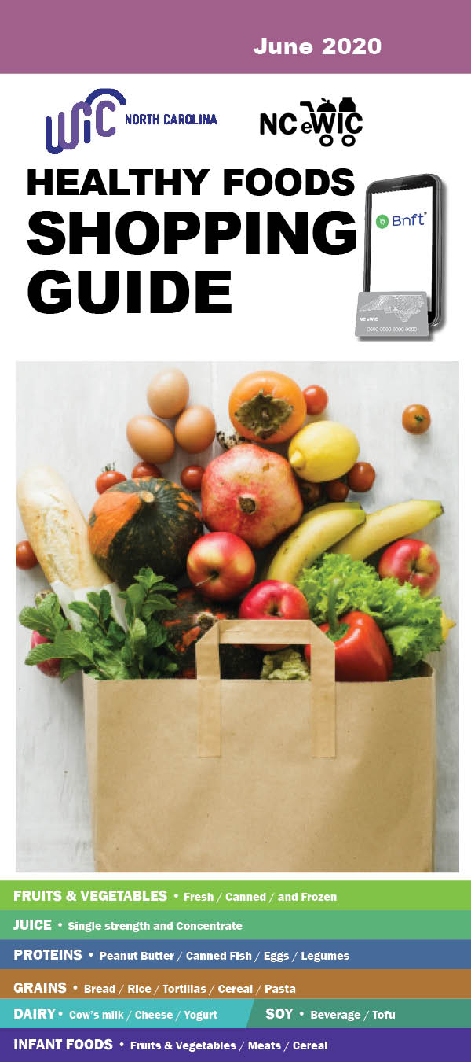
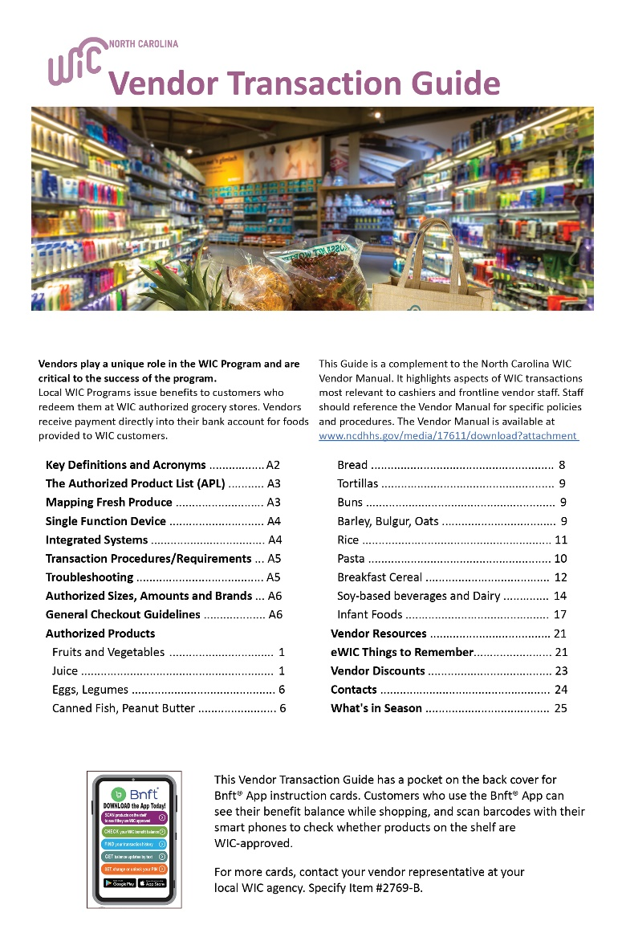
Resources
Notes:
7
Examples of the The WIC Program Shopping Guide and WIC Vendor Transaction Guide are listed on the slide.
Please note the APL is a constantly changing resource that is frequently updated, so while the Transaction Guide and Shopping Guide are wonderful tools for vendors and participants, they may not have ALL the individually approved items listed. One should always refer to the APL on the website for the most up to date APL to determine if an item is approved or not.

Slide 80
Summary
The NC WIC Program offers a variety of nutritious foods as part of the Authorized Product List (APL).
The APL is a list of all the approved products which meet the nutrition criteria for WIC foods.
Consider a food category ‘unit of measure’
Required minimum inventory must be available to WIC customers.
Notes:
7
The NC WIC Program offers a variety of nutritious foods which each meet federal and state regulations.
The Authorized Product List is a compilation of all the foods that are currently approved for the NC WIC Program based nutrient specifications, size, availability and cost. Recent modifications in North Carolina mean that participants can purchase any brand on the APL instead the least expensive brand of milk, cheese and eggs.
Required minimum variety and inventory of WIC Approved Foods must be available to WIC customers for all peer groups, except free-standing pharmacies. Minimum inventory requirements have not changed for Federal Fiscal year 2023. Please refer to the WIC Vendor Manual for detailed information regarding required minimum variety and inventory.

Slide 81

Questions
Notes:
7
Photo Credit: QuestionsConcernsComments Fotolia_38199224_Subscription_XXL.jpg

Slide 82
eWIC Requirements
Obtain card readers to support eWIC transactions within their store(s). The vendor must ensure that the card readers they obtain meet all eWIC requirements (Integrated systems)
Cessation of operations, withdrawal from the WIC Program or disqualification from the WIC Program shall result in termination of the WIC Vendor Agreement by the State WIC Agency
Notes:
Read Slide..
Please refer to the Terms of Vendor Agreement and 10A N.C.A.C. Subchapter 43D for a comprehensive list of requirements relevant to maintaining WIC vendor authorization

Slide 83
eWIC Requirements - continued
Process eWIC transactions accurately, in a timely manner, and in accordance with the terms of the North Carolina WIC Vendor Agreement. Maintain compliance with the eWIC Processor Vendor Agreement, the FNS EBT operating rules, standards and technical requirements, WIC Program Rules, and state and federal regulations, and statutes
Maintain a certified eWIC system that is available for WIC redemption processing during all hours the store is open;
Request eWIC Processor re-certify the vendor’s eWIC system if it is altered or revised in any manner that impacts eWIC redemption
Notes:
Vendors are required to process eWIC transactions accurately, in a timely manner, and in accordance with the terms of the North Carolina WIC Vendor Agreement.
Maintain compliance with the eWIC Processor Vendor Agreement, the FNS EBT operating rules, standards and technical requirements, WIC Program Rules, and state and federal regulations, and statutes. You must also maintain point of sale terminals used to support the WIC Program, in accordance to federal policy, as well as maintain a North Carolina eWIC processor certified in-store eWIC system that is available for WIC redemption processing during all hours of operation.

Slide 84
eWIC Requirements - continued
Integrated Vendors:
There is no need for WIC customers to separate their items when transacting WIC benefits
Do not make them separate their WIC items from non-WIC items
  All items can be rung up together; however, the WIC customer must swipe their eWIC card first before any other tender type is applied to ensure that the proper items are deducted from the WIC customer’s benefit balance before another tender type is used for purchase
Notes:
Integrated Vendors: There is no need for WIC customers to separate their items when transacting WIC benefits. Do not make them separate their WIC items from non-WIC items. All items can be rung up together; however, the WIC customer must swipe their eWIC card first before any other tender type is applied to ensure that the proper items are deducted from the WIC customer’s benefit balance before another tender type is used for purchase.

Slide 85
eWIC Requirements - continued
Should a vendor that uses stand-beside device(s) to transact eWIC decide to upgrade to an integrated system, the vendor must:
  Inform the eWIC processor before making any change, so that it can be determined if the system needs to be certified and testing can be performed to establish connectivity
  Inform the State WIC Agency so that Level III certification testing can be performed prior to use of the system in the store
Testing performed with the eWIC processor for a new system that a vendor chooses to use does not supersede the Level III certification testing that must be performed by the State WIC Agency
These procedures also apply to vendors who alter the integrated system that they currently use or decide to use a different integrated system altogether
Notes:
Vendors that use stand-beside device(s) to transact eWIC may decide to upgrade to an integrated system. In order to do that you must:
Inform the eWIC processor (Solutran) before making any change, so that it can be determined if the system needs to be certified and testing can be performed to establish connectivity. This is an important step that should not be skipped.
Inform the State WIC Agency so that Level III certification testing can be performed prior to use of the system in the store.
Testing performed with the eWIC processor for a new system that a vendor chooses to use does not supersede the Level III certification testing that must be performed by the State WIC Agency. The state will still need to perform Level III certification testing.
These procedures also apply to vendors who alter the integrated system that they currently use or decide to use a different integrated system altogether.

Slide 86
eWIC Requirements - continued
The State WIC Agency, not the eWIC processor, must grant final approval before a new system or system that has been altered is used by a vendor
Vendors must inform the State WIC Agency if their integrated cash register system will be altered or revised in any manner that impacts eWIC redemption. This is a requirement detailed in the Terms of Vendor Agreement. Failure to do so may result in the termination of their WIC Vendor Agreement
Notes:
The State WIC agency must grant final approval of the system, before the new system is altered and/or used by vendors.
Vendors must inform the State WIC Agency if their integrated cash register system will be altered or revised in any manner that impacts eWIC redemption. This is a requirement detailed in the Terms of Vendor Agreement. Failure to do so may result in the termination of their WIC Vendor Agreement.

Slide 87
eWIC Requirements - continued
It is important to continue to follow policies and procedures to maintain authorization
Federal regulations provide processes to support program integrity
Review your Vendor Manual for more detailed information regarding federally and state mandated WIC Vendor policies and procedures
Notes:
It is important to continue to follow policies and procedures to maintain authorization. Federal regulations provide processes to prevent fraud and ensure compliance. Review your Vendor Manual for more information.

Slide 88
Business Integrity Standards
May not have any owners, officers or managers who have been convicted of or had a civil judgment entered against them in the last six years for any activity indicating a lack of business integrity
Includes, but is not limited to fraud, antitrust violations, embezzlement, theft, forgery, bribery, falsification or destruction of records, receiving stolen property, making false claims, and obstruction of justice
Notes:
The Federal regulation requires business integrity standards be a vendor selection criteria. A vendor may not have any current owners, officers or managers who have been convicted of or had a civil judgment entered against them in the last six years for any activity indicating a lack of business integrity. This includes, but is not limited to:
fraud
antitrust violations
embezzlement
theft
forgery
bribery
falsification or destruction of records
receiving stolen property
making false claims, and
obstruction of justice

Slide 89

Violations and Sanctions
A violation is an infraction of WIC Program regulations or other requirements
A sanction is an administrative action taken as a result of a pattern of violations and may include:
  Disqualification or civil money penalty in lieu of disqualification
Notes:
We will now begin to talk about some important compliance aspects of the WIC Program. To make sure we are all on the same page, I will start with some definitions.
A violation is an infraction of WIC Program regulations or other requirements.
A sanction is an administrative action taken as a result of a pattern of violations and may include disqualification or civil money penalties in lieu of disqualification.
Photo Credit: Fotolia_37171221_Subscription_L.jpg

Slide 90
Violations
Any intentional or unintentional action of a vendor’s owners, officers, managers, agents or employees, with or without knowledge of management, that violates the WIC Vendor Agreement or federal or state statutes, regulations, policies or procedures governing the Program
Notes:
Violations are any intentional or unintentional action of a vendor’s owners, officers, managers, agents or employees that violate the Vendor Agreement or federal or state statutes, regulations, policies or procedures governing the Program. It is very important to emphasize that these violations can occur with or without knowledge of management.
Also, violations can be committed even if the person that commits the violation did not mean to do so. That is why all staff that work in your store should be properly trained regarding WIC Program policies and procedures.

Slide 91
Types of Violations
Federal violations for which vendors are subject to disqualification
  Federal violations; carry longest disqualification periods
  Found through compliance buys and inventory audits
State violations for which vendors are subject to disqualification
  Usually found during compliance buys and Local WIC Agency monitoring
Notes:
There are two categories of violations. Federal violations which result in 1 year to permanent disqualification. These violations are found through compliance buys and inventory audits. State violations are usually found during compliance buys and Local WIC Agency monitoring.

Slide 92
Vendor Violations and Sanctions
10A NCAC 43D.0710 includes language for eWIC transactions. The rule states a vendor shall be disqualified from the WIC Program for:
  One year for three occurrences within a 12-month period of failure to properly transact WIC food benefits by manually entering the EBT card number or entering the PIN into the POS instead of the WIC customer, scanning the UPC or PLU codes from UPC codebooks or reference sheets when completing a WIC customer’s EBT transaction, not entering the correct quantity and item price, or not providing the WIC customer with a receipt that shows the items purchased and the customer’s remaining food benefit balance.
Notes:
10A NCAC 43D.0710 includes language for eWIC transactions. The rule states a vendor shall be disqualified from the WIC Program for:
One year for three occurrences within a 12-month period of failure to properly transact WIC food benefits by manually entering the EBT card number or entering the PIN into the POS instead of the WIC customer, scanning the UPC or PLU codes from UPC codebooks or reference sheets when completing a WIC customer’s EBT transaction, not entering the correct quantity and item price, or not providing the WIC customer with a receipt that shows the items purchased and the customer’s remaining food benefit balance.

Slide 93
Vendor Violations and Sanctions continued
As a Reminder:
10A NCAC 43D.0708 (20)(j) states that the vendor must:
  Scan or manually enter Universal Product Codes (UPC) only from approved supplemental foods being purchased by the WIC customer in the types, sizes, and quantities available on the WIC customer's EBT account. The vendor shall not scan codes from UPC codebooks or reference sheets;
This requirement is also listed in the current Terms of Vendor Agreement
10A NCAC 43D.0710 has two state violations relating to the eWIC system
Vendors may be disqualified from the WIC Program if they commit either of these state-established violations
Notes:
As a Reminder:
10A NCAC 43D.0708 (20)(j) states that the vendor must:
Scan or manually enter Universal Product Codes (UPC) only from approved supplemental foods being purchased by the WIC customer in the types, sizes, and quantities available on the WIC customer's EBT account. The vendor shall not scan codes from UPC codebooks or reference sheets;
This requirement is also listed in the current Terms of Vendor Agreement
10A NCAC 43D.0710 has two state violations relating to the eWIC system
Vendors may be disqualified from the WIC Program if they commit either of these state-established violations

Slide 94
Vendor Violations and Sanctions continued
The two violations for which a vendor can be disqualified are failure to make EBT point of sale equipment accessible to WIC customers and failure to comply with minimum lane coverage criteria. The pattern of occurrences and respective disqualification periods are:
180 days for three occurrences within a 12-month period of failure to make EBT point of sale equipment accessible to WIC customers to ensure that EBT transactions are completed in accordance with 10A NCAC 43D .0708(20)
90 days for three occurrences within a 12-month period of failure to comply with minimum lane coverage criteria required by 7 CFR 246.12(z)(2) and 10A NCAC 43D .0708(20)(c)
Notes:
The two violations for which a vendor can be disqualified are failure to make EBT point of sale equipment accessible to WIC customers and failure to comply with minimum lane coverage criteria. The pattern of occurrences and respective disqualification periods are:
180 days for three occurrences within a 12-month period of failure to make EBT point of sale equipment accessible to WIC customers to ensure that EBT transactions are completed in accordance with 10A NCAC 43D .0708(20)
90 days for three occurrences within a 12-month period of failure to comply with minimum lane coverage criteria required by 7 CFR 246.12(z)(2) and 10A NCAC 43D .0708(20)(c)

Slide 95
Pattern of Occurrences
The nature of the violation and the number of violations determine the sanction imposed
Sanctions remain on a vendor’s record for 12 months or until a vendor is disqualified
A pattern of occurrences for the same violation may result in disqualification
The number of occurrences needed to establish a pattern depends on the violation
Notes:
The nature of the violation and the number of violations determine the sanction imposed. Sanctions may remain on a vendor’s record for 12 months or until a vendor is disqualified. A pattern of occurrences for the same violation may result in disqualification. The number of occurrences needed to establish a pattern depends on the violation.

Slide 96
Examples of Patterns of Violations
Three occurrences within a 12-month period of failure to stock minimum inventory
Three occurrences within a 12-month period of stocking WIC supplemental foods outside of the manufacturer’s expiration date
Three occurrences within a 12-month period of failure to mark the current shelf prices of all WIC supplemental foods
Three occurrences within a 12-month period of failure to make EBT point of sale equipment accessible to WIC customers
Notes:
These are examples of how patterns can lead to disqualification:
Three occurrences within a 12-month period of failure to stock minimum inventory
Three occurrences within a 12-month period of stocking WIC supplemental foods outside of the manufacturer’s expiration date
Three occurrences within a 12-month period of failure to mark the current shelf prices of all WIC supplemental foods
Three occurrences within a 12-month period of failure to stock minimum inventory equals a pattern. Once a pattern has been established, the State WIC Agency will proceed to disqualify the vendor from the WIC program.

Slide 97

Preventing Fraud and Ensuring Compliance
State WIC Agency must investigate at least 5% of vendors annually using:
  compliance (undercover) buys
  inventory audits
Must also ensure that vendors are monitored by Local WIC Agency staff
Notes:
Just as there are business integrity standards, there are also systems in place for program integrity to prevent fraud and ensure compliance with Program rules. Federal regulations require that the State WIC Agency investigate 5% of vendors annually using compliance (undercover) buys and/or inventory audits. In addition, the State WIC Agency must also ensure that vendors are monitored by their Local WIC Agency.
Photo Credit: Magnifyingglass_Fotolia_6189802_Subscription_L.jpg

Slide 98
Compliance Buys and Audits
State WIC Programs are required to identify and investigate high-risk vendors
NC sometimes works with the U.S. Office of Inspector General for investigations
Notes:
In addition, the State WIC Agency is required by federal regulations to identify and investigate high-risk vendors. NC does this through compliance buys and inventory audits; however, it sometimes works with the U.S. Office of the Inspector General for investigations. Refer to the Vendor Manual for more information.

Slide 99

Compliance Buys
Undercover purchases by a compliance investigator
May make multiple visits over one year
Vendors may receive a letter from the State WIC Agency if problems are noted
Notes:
Compliance buys are undercover (anonymous) purchases by a compliance investigator. There can be multiple visits over one year. The vendor may receive a letter from the State WIC Agency if problems are identified. These problems may have sanctions associated with them.
Photo Credit: Comicbookcharacter_Fotolia_29389804_Subscription_L.jpg

Slide 100
Vendor Overcharging
Intentionally or unintentionally charging more for supplemental food provided to a WIC customer than a non-WIC customer or charging more than the current shelf price for supplemental food provided to a WIC customer
Overcharging is a serious federal violation that can lead to vendor disqualification
This violation is uncovered during compliance buys
Vendor overcharging is NOT the same as charging over the NTE
Notes:
One of the most frequent federal violations committed by vendors is overcharging. Overcharging is defined as intentionally or unintentionally charging more for supplemental food provided to a WIC customer than a non-WIC customer or charging more than the current shelf price for supplemental food provided to a WIC customer. Overcharging is a serious federal violation that can lead to vendor disqualification. It is a violation that is uncovered during compliance buys.
It is important to remember that vendor overcharging is NOT the same as charging over the NTE. A vendor can charge over the NTE and not be overcharging if what they have charged is their current shelf price and is not more than what they would charge a non-WIC customer. If they charge over the NTE, they will be paid at the NTE
A vendor can charge under the NTE and be overcharging because they charged more than their current shelf price or charged the WIC customer more than they charged a non-WIC customer. As stated previously, this is a federal violation and the penalty, if a pattern is established, is disqualification from the WIC Program.

Slide 101
Overcharging?
A vendor looks at the NTE to determine what they could charge the WIC customer for a gallon of whole milk. The current shelf price is $2.79. They charge the WIC customer $3.69 for the gallon of whole milk because that is the current NTE for the month. Is this vendor overcharging?
A vendor charges a WIC customer $6.50 for WIC approved cheese. The current shelf price is $6.50.The NTE is $6.29. Is this vendor overcharging?
Notes:
As I previously stated, vendor overcharging is NOT the same as charging over the NTE. On this slide you see there are two scenarios to determine if you understand the difference between vendor overcharging and charging over the NTE. Let’s look at them both individually:
SPEAKER: Go over each example with the training participants
Example #1:
A vendor looks at the NTE to determine what they could charge the WIC customer for a gallon of whole milk. The current shelf price is $2.79. They charge the WIC customer $3.69 for the gallon of whole milk because that is the current NTE for the month. Is this vendor overcharging?
The answer is yes because the vendor charged more than the current shelf price for supplemental food provided to the WIC customer.
Example #2
A vendor charges a WIC customer $6.50 for WIC approved cheese. The current shelf price is $6.50. The NTE is $6.29. Is this vendor overcharging?
The answer is no because their current shelf price is $6.50. They charged the WIC customer a price that was over the NTE for cheese. This vendor will be paid via ACH.

Slide 102
Food Substitution
Per the Vendor Agreement:
  Vendors must provide to the WIC customer only the approved supplemental foods, fruit, and vegetables contained in the authorized product list (APL) after it has been determined that the WIC customer has an available balance for the item on the date of the transaction
Vendors must properly transact the WIC supplemental foods that are listed on the participant’s food benefit balance
Vendors cannot substitute one food subcategory for another
  Federal violation that carries 1-year disqualification
    Example: Substituting 1% Milk/Skim Milk for 2% Milk or Whole Milk
Notes:
Per your signed Vendor Agreement, vendors must properly transact the WIC supplemental foods that are listed on the participant’s food benefit balance.
Vendors cannot substitute one food subcategory for another. This would be a Federal violation that carries 1 year disqualification
Example: Substituting 1% Milk/Skim Milk for 2% Milk or Whole Milk

Slide 103
Questions
Notes:
We’ll pause here for any questions

Slide 104
Use of Scanning Sheets Prohibited
Vendors cannot use a collection of UPC barcodes on Scanning Sheets, cash registers, computers, tablets, cell phones or any other similar electronic devices to transact eWIC
Failure to comply with this policy could result in termination of their WIC Vendor Agreement
Notes:
Vendors cannot use a collection of UPC barcodes on Scanning Sheets, cash registers, computers, tablets, cell phones or any other similar electronic devices, like in the example on the slide, to transact eWIC.
Failure to comply with this policy could result in termination of your WIC Vendor Agreement.

Slide 105

Inventory Audits
A vendor must make available at any reasonable time and place ALL:
  Program-related records: invoices, purchase orders, various tax and business records
MUST be retained 3 years or until audit pertaining to these records is resolved, whichever is later
Notes:
Inventory audits involve reviewing a vendor’s inventory records of WIC supplemental foods over a sixty-day period.
For inventory audits, the vendor must make available at any reasonable time and place, all:
Program related records, including invoices, copies of purchase orders various tax records and records of financial and business transactions
Please note that all Program-related records, such as invoices and receipts must be kept for three years or until any audits pertaining to these records is resolved. This is mentioned in your Vendor Terms of Agreement.
Photo Credit:Calculator_Fotolia_33099869_Subscription_L.jpg

Slide 106
Purchase Documentation Requirement
Specific requirements for purchase documentation of WIC supplemental foods
Invoices, receipts, purchase orders, and any other proofs of purchase for WIC supplemental foods must include the following:
  The name of the seller and be prepared entirely by the seller or on the seller’s business letterhead;
  The date of purchase and the date the authorized vendor received the WIC supplemental food at the store if this date is different;
  A description of each WIC supplemental food item purchased, including brand name, unit size, type or form, and quantity
Notes:
The State rules specify requirements for purchase documentation of WIC supplemental foods. Invoices, receipts, purchase orders, and any other proofs of purchase for WIC supplemental foods must include the following:
The name of the seller and be prepared entirely by the seller or on the seller’s business letterhead;
The date of purchase and the date the authorized vendor received the WIC supplemental food at the store if this date is different; and
A description of each WIC supplemental food item purchased, including brand name, unit size, type or form, and quantity.

Slide 107
Violations Detected During Inventory Audit
Claiming reimbursement for the sale of an amount of a specific supplemental food item which exceeds the store’s documented inventory of that supplemental food item for six or more days within the 60-day period
  The six or more days do not have to be consecutive
Inability to provide records or providing false records is also a violation
Notes:
The Vendor Agreement specifically addresses violations which may have occurred as a result of an inventory audit. These violations are as follows:
Claiming reimbursement for the sale of an amount of a specific supplemental food item which exceeds the store’s documented inventory of that supplemental food item for six or more days within the 60-day period. The six or more days do not have to be consecutive.
Inability to provide records or providing false records is also a violation.
For more information regarding inventory audits, please refer to your Vendor Manual.

Slide 108
Vendor Claims
Overpayment to a vendor as determined by an inventory audit or compliance buy investigation requires repayment to the WIC Program
The State WIC Agency assesses a claim against the vendor in the amount of the overpayment
Vendors can request a conference to review the claim, but this action cannot be appealed
Notes:
Overpayment to a vendor as determined by an inventory audit or a compliance buy investigation requires repayment to the WIC Program. The State WIC Agency assesses a claim against the vendor in the amount of the overpayment. Vendors can request a conference to review the claim, but this action cannot be appealed.

Slide 109
Claims Assessed for Vendor Violations
If a vendor is assessed a claim, the vendor must reimburse the State WIC Agency in full or agree to a repayment plan within 30 days of written notification of the claim
  Failure to do so will lead to termination of the Vendor Agreement
A vendor applicant cannot be authorized if any of the vendor applicant’s owners, officers or managers currently have or previously had a financial interest in a WIC Vendor that was assessed a claim by the WIC Program and the claim has not been paid in full
Notes:
When the State WIC Agency determines the vendor has committed a vendor violation that affects payment to the vendor, the State WIC Agency will deny payment. A claim may be assessed based on violations detected through inventory audits, compliance buy investigations or any other means the State WIC Agency deems necessary to determine Program compliance.
Vendors must reimburse the State WIC Agency in full or agree to a repayment plan with the State WIC Agency within 30 days of written notification of a claim. If the vendor fails to reimburse the State WIC Agency in full or agree to a repayment plan within 30 days of written notification of a claim, the WIC Vendor Agreement will be terminated. Please refer to the Vendor Claims section of the Vendor Manual for more information.
A vendor applicant cannot be authorized if any of the vendor applicant’s owners, officers or managers currently have or previously had a financial interest in a WIC Vendor that was assessed a claim by the WIC Program and the claim has not been paid in full.

Slide 110

Disqualification
Ranges from 60 days to permanent
WIC status may impact status with SNAP (formerly the Food Stamp Program)
Vendor has right to appeal
Notes:
Disqualification from the WIC Program could range from 60 days to permanent, dependent upon the situation/violation. Vendors should take note that their status with the WIC Program may impact their status with SNAP (formerly the Food Stamp Program) and vice versa. Remember, SNAP is also referred to as Food and Nutrition Services in North Carolina.
Vendors have the right to appeal a disqualification.
Photo Credit: Justice_Fotolia_6901118_Subscription_L.jpg

Slide 111
Disqualification continued
Upon disqualification or termination, vendors are required to return their stand-beside equipment to Solutran within 10 business days
  Including all cords, cables, scanners and pin pads (if applicable)
  Solutran will send a shipping label
Failure to return all stand-beside equipment to Solutran will result in the initiation of an ACH debit from the vendor’s account
If a vendor’s bank account has been closed, Local Agency staff will be asked to retrieve all equipment from the vendor location
Notes:
Upon disqualification or termination, vendors are required to return their stand-beside equipment to Solutran within 10 business days
Including all cords, cables, scanners and pin pads (if applicable)
Solutran will send a shipping label
Failure to return all stand-beside equipment to Solutran will result in the initiation of an ACH debit from the vendor’s account
If a vendor’s bank account has been closed, Local Agency staff will be asked to retrieve all equipment from the vendor location

Slide 112
Office of Inspector General
MISSION:
  Perform audits and investigations of the Department's programs and operations;
  Work with the Department's management team in activities that promote economy, efficiency, and effectiveness or that prevent and detect fraud and abuse in programs and operations, both within USDA and in non-Federal entities that receive USDA assistance;
OIG web site: https://usdaoig.oversight.gov/
Notes:
In some instances of vendor fraud, the State WIC Agency works in conjunction with the USDA, Office of the Inspector General. A large part of their mission is to:
Perform audits and investigations of the Department's programs and operations, and Work with the Department's management team in activities that promote economy, efficiency, and effectiveness or that prevent and detect fraud and abuse in programs and operations, both within USDA and in non-Federal entities that receive USDA assistance; For more information about the USDA, Office of the Inspector General, visit the web site on the slide.

Slide 113
Conflict of Interest
A vendor shall not have any owner(s), officer(s) or manager(s) who are employed, or who have a spouse, child, or parent employed by the State WIC Agency or the Local WIC Agency serving the county in which the vendor conducts business
A vendor shall not have an employee who handles or transacts food benefits or cash-value benefits who is employed or has a spouse, child or parent who is employed by the State WIC Agency or the Local WIC Agency serving the county in which the vendor conducts business
Ask your staff if they have a spouse, child or parent who works for the WIC program
  If they do, report it to your vendor contact at your Local WIC Agency
Notes:
Another important topic related to preventing fraud is the conflict-of-interest policy regarding employment. This is a very important provision of the Vendor Agreement. Please make sure that you ask your staff if they have a spouse, child or parent who works for the WIC program. If they do, inform your vendor contact at the Local Agency right away.
A vendor shall not have any owner(s), officer(s) or manager(s) who are employed, or who have a spouse, child, or parent employed by the State WIC Agency or the Local WIC Agency serving the county in which the vendor conducts business
Also, a vendor shall not have an employee who handles or transacts food benefits or cash-value benefits who is employed or has a spouse, child or parent who is employed by the State WIC Agency or the Local WIC Agency serving the county in which the vendor conducts business.

Slide 114
Routine Monitoring
Includes, but is not limited to:
  Review of formula invoices and receipts
  Price checks
  Treatment of WIC Program participants and customers
  Inventory of WIC-approved foods subject to minimum inventory requirement
  Ensure equipment for use in transacting eWIC is accessible
Visits are documented and if violations found:
  An occurrence assessed
  The vendor must take steps to correct them
  Will be monitored again within 21 days
Notes:
Local WIC Agency staff complete on-site monitoring of authorized vendors. These visits provide a chance for vendors to receive training, discuss problems and ask questions.
WIC Monitoring includes, but is not limited to:
Review of infant formula invoices and receipts
Price checks of WIC approved foods
Treatment of WIC customers.
Inventory of WIC approved foods subject to minimum inventory requirement
Ensure equipment for use in transacting eWIC is accessible
The form used by Local WIC Agency staff during monitoring is in the Vendor Manual. Local WIC Agency staff document these visits. If violations are found, the vendor must take steps to correct them. Some violations may result in an occurrence. Other violations can result in more serious penalties if the vendor fails to correct circumstances causing the violation.

Slide 115
Equitable Treatment
Section 246.12(h)(3)iii of the Federal WIC Regulations requires WIC-authorized vendors to offer WIC customers the same courtesies that are offered to other (non-WIC) customers
  WIC customers cannot be excluded from in-store promotions
Failure to provide the same courtesies to WIC customers is a violation of Federal WIC Regulations, thereby constituting a vendor violation
  Discrimination on the basis of WIC participation
  May result in disqualification
Notes:
As you know, WIC authorized vendors may not treat WIC customers differently from non-WIC customers by excluding them from in-store promotions. This includes disallowing the use of coupons or other vendor discounts in WIC transactions that are allowed in non-WIC transactions. This information is found in Section 246.12 (h)(3)iii of the Federal WIC Regulations.
Similarly, WIC authorized vendors may not treat WIC customers differently by offering them incentive items, vendor discounts, coupons or other promotions that are not offered to non-WIC customers. Failure to provide the same courtesies to WIC customers is a violation of Federal WIC Regulations, thereby constituting a vendor violation.
Failure to provide the same courtesies to WIC customers is a vendor violation and may result in disqualification of one year for two occurrences within a 12-month period of discrimination on the basis of WIC participation as referenced in Item (31) of Rule .0708. Each date this violation is detected is a separate occurrence;
Item (31) states that a WIC Authorized vendor should not discriminate on the basis of WIC participation, such as failing to offer WIC customers the same courtesies offered to other customers or requiring separate WIC lines.

Slide 116
Definitions
Incentive item-an item or service provided by a vendor to attract customers or encourage customer loyalty
Vendor discount-an in-store promotion that reduces the price or increase the quantity of a given product; a vendor discount could also result from the use of a coupon
In-store promotion-a sales promotion in which a vendor may offer incentive items, vendor discounts or coupons in order to increase sales of certain items or to encourage customer loyalty to the vendor
Notes:
Let’s go over the definitions for incentive items, vendor discount, and in-store promotions.
An Incentive Item is an item or service provided by a vendor to attract customers or encourage customer loyalty.
A Vendor Discount is an in-store promotion that reduces the price or increases the quantity of a given product; a vendor discount could also result from the use of a coupon.
In-store promotion is a sales promotion in which a vendor may offer incentive items, vendor discounts or coupons in order to increase sales of certain items or to encourage customer loyalty to the vendor.

Slide 117
Incentive Items
Incentive items must be approved by the North Carolina WIC Program prior to providing them to WIC customers
The North Carolina WIC Program may approve incentive items-including food, merchandise or services-that a vendor obtained at no cost or that cost a vendor less than $2.00. Vendors may also provide food sales or specials (vendor discounts) that involve no cost or cost the vendor less than $2.00
Notes:
Incentive items must be approved by the North Carolina WIC Program prior to providing them to WIC customers.
The North Carolina WIC Program may approve incentive items-including food, merchandise or services-that a vendor obtained at no cost or that cost a vendor less than $2.00. Vendors may also provide food sales or specials (vendor discounts) that involve no cost or cost the vendor less than $2.00. This includes bonus size food items that were obtained from the manufacturer at no cost to the vendor as well as any other types of vendor discounts as long as the cost to the vendor of providing these vendor discounts is less than $2.

Slide 118
Approval for Incentive Items
To obtain approval to provide incentive items to WIC customers, a vendor must submit a written request directly to the North Carolina State WIC Agency
WIC vendors cannot offer incentive items to WIC customers without approval from the State WIC Agency
Notes:
To obtain approval to provide incentive items to WIC customers, a vendor must submit a written request directly to the North Carolina State Agency.
WIC vendors cannot offer incentive items to WIC customers without approval from the State WIC Agency.

Slide 119
Approval for Incentive Items continued
Following is a list of prohibited incentive items:
  Assistance applying for WIC benefits
  Transportation for WIC customer to and/or from vendor premises
  Delivery of WIC supplemental foods
  Lottery tickets
  Cash gifts
  Any other service that results in a conflict of interest, any item that incurs a liability to the WIC Program or violates any Federal, State or Local law or regulation
Notes:
Following is a list of prohibited incentive items:
Assistance applying for WIC benefits
Transportation for WIC customer to and/or from vendor premises
Delivery of WIC supplemental foods
Lottery tickets
Cash gifts
Any other service that results in a conflict of interest, any item that incurs a liability to the WIC Program or violates any Federal, State or Local law or regulation.

Slide 120
In-Store Promotions and Coupons
Allowing WIC customers to use vendor discounts in WIC purchases reinforces wise food purchasing practices
Vendor staff/cashiers should be well-informed about the use of different types of in-store promotions and coupons
  Understand the temporary nature of some offers in order to reduce confusion at the point of sale
  Know how to properly transact eWIC using in-store promotions and coupons
Notes:
Allowing WIC customers to use vendor discounts in WIC purchases reinforces wise food purchasing practices, which is a goal of WIC nutrition education.
You should ensure that your staff/cashiers are well informed about the use of different types of in-store promotions and coupons so that both participants and the WIC Program are able to achieve the maximum benefit from such offers.

Slide 121
Types of In-Store Promotions and Coupons
Buy One, Get One Free (BOGO)
Buy One, Get One at a Reduced Price
Free Ounces Added to Food Item by Manufacturer (Bonus Size Items)
Transaction Discounts
Store Loyalty/Rewards Cards
Manufacturers’ Cents Off Coupons
Notes:
There are several types of in-store promotions and coupons that your store may offer, some of which are listed on the screen. Please refer to your Vendor Manual for detailed definitions of each type of promotion.

Slide 122
In-Store Promotions:
BOGOs and eWIC
Per the USDA WIC EBT Operating Rules:
In a true BOGO, the free item cannot be deducted from the WIC customer’s benefit balance or reported to the State Agency.
If a food item is advertised as “Buy one, get one free” with the disclosure that each item is sold for half the advertised price, both food items shall be redeemed using WIC benefits and shall reflect an item price of half the advertised price in the transaction.
  Quantity discount
  If using this methodology for BOGOs, vendors must put this disclosure in store advertising
Notes:
Per the USDA WIC EBT Operating Rules:
In a true BOGO, the free item cannot be deducted from the WIC customer’s benefit balance or reported to the State Agency.
If a food item is advertised as “Buy one, get one free” with the disclosure that each item is sold for half the advertised price, both food items shall be redeemed using WIC benefits and shall reflect an item price of half the advertised price in the transaction.
This is a Quantity discount
If using this methodology for BOGOs, vendors must put this disclosure in store advertising

Slide 123
Sales Tax & Cash Back
Sales Tax on Manufacturers’ Coupons
  Not permitted to tax WIC items, so cannot charge WIC customers tax on manufacturer’s coupons
Cash Back
  Not permitted as a result of vendor discount in any WIC transaction
Notes:
Now let’s discuss sales tax and cash back:
Sales Tax on Manufacturers’ Coupons is not permitted on WIC items. Vendors cannot charge WIC customers tax on manufacturer’s coupons. Cash Back is not permitted as a result of a vendor discount in any WIC transaction. In a transaction that only includes WIC items, all vendor discounts must be applied to the WIC transaction, thus benefiting the Program.

Slide 124
Reporting Customer Service Issues (Complaints)
Vendors should report customer service issues (complaints) to the Local WIC Agency concerning:
  WIC customer inappropriate behavior
    Vendors are not required to tolerate behavior from a WIC customer that they would not tolerate from other customers
    May also report complaints about other vendors
May use form in the Vendor Manual or on website at: https://www.ncdhhs.gov/wicvendorsconnection
Notes:
Monitoring is a good time to check in about any customer service issues related to vendor management.
We are interested in hearing any concerns and complaints you may have. In the back of the Vendor Manual is a form that you can use to report inappropriate behaviors by WIC customers. The form can also be downloaded from the website listed on the screen. If you become aware of issues with other vendors, you can report them on the same form.

Slide 125
Training Employees
Vendor owners/managers are responsible for training all cashiers on WIC as it pertains to the following:
  WIC-approved foods
  WIC Vendor Transaction Guides
  Allowing same courtesies to WIC customers that are provided to non-WIC customers
  Completing eWIC transactions
  All other NC WIC-vendor related policies and procedures
Notes:
It is the vendor owner’s responsibility to ensure all cashiers are trained on WIC as it pertains to the following:
WIC-approved foods – WIC Vendor Transaction Guides should be reviewed and placed at each cash register for easy access.
Allowing the same courtesies to WIC customers as non-WIC customers
Completing eWIC transactions

Slide 126
Questions
Notes:
We’ll pause here for any questions

Slide 127
Completing Required Forms
Notes:
We will now review the required forms necessary for this renewal year.

Slide 128
Completing Required Forms
To comply with renewal requirements, these documents must be completed
Corporate Contract Vendors
  The corporate office will:
    Update the vendor record using the Vendor Portal
  Individual corporate contract store managers must complete annual training and submit the Verification of Attendance
Non-corporate contract vendors
  Pre-populated NC WIC Information Update
  eWIC Update for Non-Corporate Vendors
  Verification of Attendance
Notes:
To comply with renewal requirements, these documents must be completed
Corporate Contract Vendors
The corporate office will:
Update the vendor record using the Vendor Portal
Individual corporate contract store managers must complete annual training and submit the Verification of Attendance
Non-corporate contract vendors
Pre-populated NC WIC Information Update
eWIC Update for Non-Corporate Vendors
Verification of Attendance

Slide 129
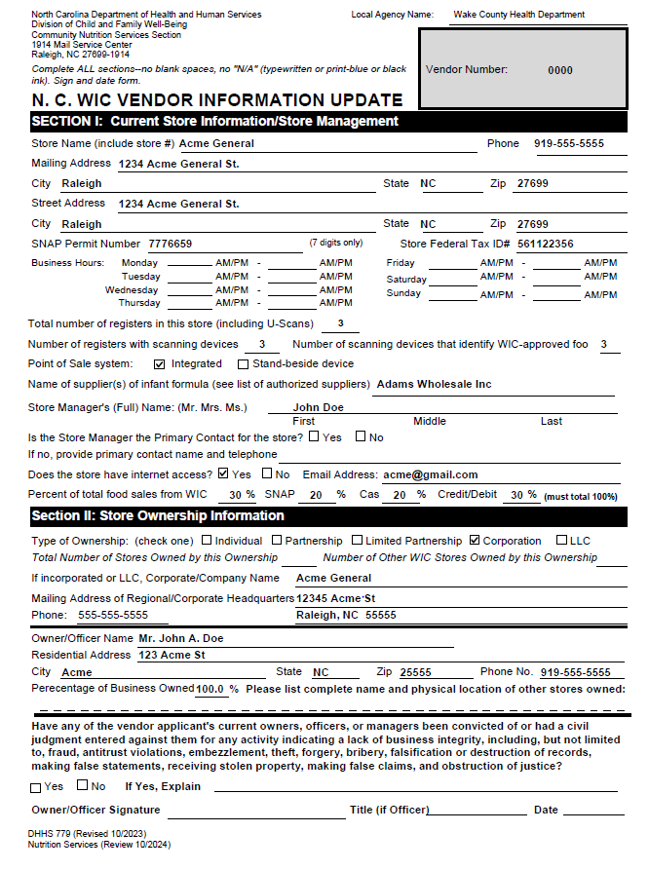
NC WIC Information Update
Pre-populated
Non-Corporate Contract vendors only
Review data and make corrections or update information where necessary
Notes:
The first form to be completed is the NC WIC Information Update.
If your store is a non-corporate contract vendor, then you have received a pre-populated NC WIC Information Update form.
Please review for accuracy and completeness, make corrections or update information where necessary.

Slide 130
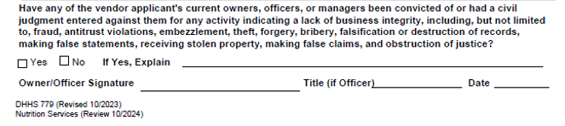
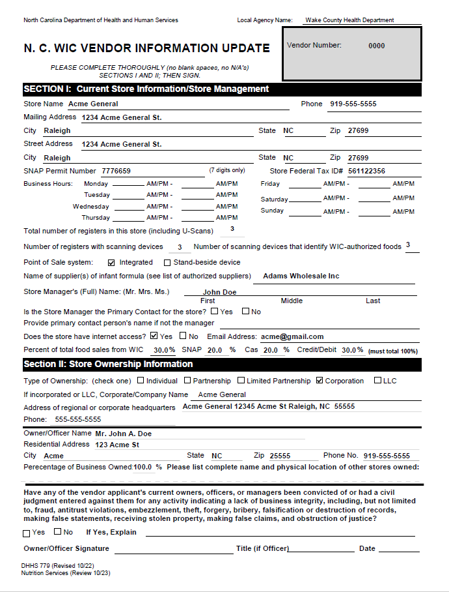
NC WIC Information Update - Reminder
Business Integrity and Signature
Question must be read and answered
Must only be signed and dated by an owner or officer (no managers)
Notes:
As a reminder, please note that at the bottom of the form, the Business Integrity question must be read and answered.
The form must only be signed and dated by the owner or officer (No Managers)
Also note that the owner/officer signing should be listed as an owner/officer in section II.
If your store has multiple owners and or officers, remember a list must be included if they are not listed already on the form. The list should contain at a minimum, the President, Vice President, Secretary and Treasurer.

Slide 131

New Question - Stores Owned
Required to answer
Total Number of Stores Owned by this Ownership
  Minimum of 1
Number of other WIC Stores owned by this Ownership
  Must answer even if “0” other WIC stores owned
Notes:
Two new questions have been added to the Information Update form.
Federal Regulations now require State WIC programs to collect and report information on the number of other stores owned by a vendor's current ownership.
Vendors must also list the number of other stores owned that are also WIC authorized.
These questions cannot be left blank
Example:
Total number of Stores owned by this ownership would be at least 1 but could be numerous others owned. Document the number owned by ANY of the owners
If ANY of the owners own another store that is a WIC authorized store provide that number – not including this one store.
If no other WIC authorized stores owned populate with “0”

Slide 132
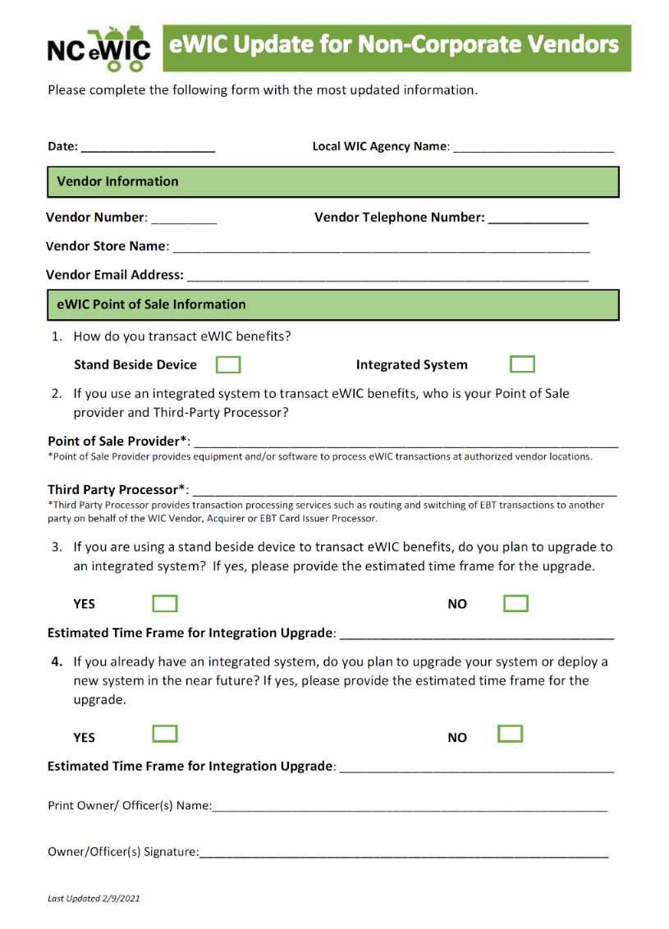
eWIC Update
Updated information needed on vendor’s cash register system
Stand-beside device or integrated system
If integrated system:
  Point-of-sale provider
  Third-party processor
  Possible plans for upgrade; time frame
If stand-beside device:
  Possible plans for upgrading to an integrated system
Notes:
An eWIC Update form regarding eWIC point of sale information, must be completed by all non-corporate contract vendors each year.
This form will help keep our files current on the type of POS system vendors have. It will also inform us of any changes such as intention to upgrade to an integrated system, if they are currently using a stand beside device.
The information needed regarding the vendor’s cash register systems is:
Do they have a stand beside device or integrated system
If their system is integrated, they should provide:
Point of Sale Provider, and
Third-Party Processor
Any plans for upgrading the current system and the time frame for the upgrade
If they have a stand beside device, are there any plans for upgrading to an integrated system and the time-frame for the upgrade, if applicable.

Slide 133
eWIC Update continued
Why Is This Form Needed?
Comply with the Electronic Benefit Transfer (EBT) provisions in the Terms of Vendor Agreement
    Section I, Number 18(e)
Notes:
The reason for this form is:
Per the Terms of Vendor Agreement Section I, a vendor must:
18. Comply with the following Electronic Benefit Transfer (EBT) provisions:
e. Request the North Carolina EBT Processor re-certify its in-store system if the vendor alters or revises the system in any manner that impacts the EBT redemption or claims processing system after initial certification is completed.
The following applies:
(1) If the EBT system is reconfigured or modified by the vendor and/or other parties in such a way that the WIC in-store system no longer exhibits the required system accuracy, integrity, or performance required and under which requirements the WIC in-store system was certified, the State will not accept a redemption;
The vendor is liable for the costs of all recertification events needed to return the EBT system for all outlets covered by this agreement to full compliance with the State Agency’s system requirements. Failure to seek recertification when the vendor’s system is altered/revised shall subject the vendor to the financial liabilities for all transactions processed.

Slide 134

Verification of Attendance Form
Vendors must check off ALL items they receive in their training packets
Vendor number must be documented on the form
Signature of the vendor owner/ representative reviewing training ensures the receipt of forms, manual and training materials
Notes:
Vendors must check off ALL items they receive in their training packets
Vendor number must be documented on the form
Signature of the vendor owner/ representative reviewing training ensures the receipt of forms, manual and training materials

Slide 135
Required Forms Reminders!
All required forms must be completed, dated and returned to the Vendor Coordinator at your Local WIC Agency, by the date the Vendor Coordinator has provided
Be complete and accurate
Vendor number, store name must be the same on each form
Only an owner or officer can sign the Information Update form
  Completed by Non-corporate contract vendors only
  If store is Incorporated or an LLC, the store must forward the form to corporate office for signature
Call your Local WIC Agency, if you have questions
Notes:
Here are a few reminders:
All required forms must be completed, dated and returned to the Vendor Coordinator at your Local WIC Agency, by the date the Vendor Coordinator has provided
Be complete and accurate
Vendor number, store name must be the same on each form
Only an owner or officer can sign the Information Update form
Completed by Non-corporate contract vendors only
If store is Incorporated or an LLC, the store must forward the form to corporate office for signature
Call your Local WIC Agency, if you have questions
Remember to complete in blue or black ink and if you see an error, draw one line through it, initial and write in the correct information. Also, please remember that instructions for completing all vendor forms can be found in the Vendor Manual

Slide 136
WIC Shelf Tags
Identify WIC-approved foods in your store
  Decreases confusion for WIC customers when selecting food items
For vendors that do not have shelf tags that include WIC information already
Sent to vendors by mail last year
  Can request additional shelf tags, if needed, from your Local WIC Agency
Highly recommended, but not required
Notes:
WIC shelf tags are available
Identify WIC-approved foods in your store
Decreases confusion for WIC customers when selecting food items
For vendors that do not have shelf tags that include WIC information already
Will be sent to vendors by mail,
Can request additional shelf tags, if needed, from your Local WIC Agency
Highly recommended, but not required

Slide 137

Questions

Slide 138
Assurance of Civil Rights Compliance
The vendor hereby agrees that it will comply with Title VI of the Civil Rights Act of 1964 (42 U.S.C. 2000d et seq.); Title IX of the Education Amendments of 1972 (20 U.S.C. 1681 et seq.); Section 504 of the Rehabilitation Act of 1973 (29 U.S.C. 794); the Age Discrimination Act of 1975 (42 U.S.C. 6101 et seq.); Title II and Title III of the Americans with Disabilities Act (ADA) of 1990, as amended by the ADA Amendment Act of 2008 (42 U.S.C. 12131-12189) and as implemented by Department of Justice regulations at 28 CFR Parts 35 and 36; Executive Order 13166, "Improving Access to Services for Persons with Limited English Proficiency" (August 11, 2000); all provisions required by the implementing regulations of the U.S. Department of Agriculture (7 CFR Part 15 et seq.); and FNS directives and guidelines to the effect that no person shall, on the ground of race, color, national origin, age, sex (including gender identity and sexual orientation), or disability, be excluded from participation in, be denied the benefits of, or otherwise be subjected to discrimination under any program or activity for which the agency receives Federal financial assistance from FNS; and hereby gives assurance that it will immediately take measures necessary to effectuate this agreement.
This assurance is given in consideration of and for the purpose of obtaining any and all Federal financial assistance, grants, and loans of Federal funds, reimbursable expenditures, grant, or donation of Federal property and interest in property, the detail of Federal personnel, the sale and lease of, and the permission to use Federal property or interest in such property or the furnishing of services without consideration or at a nominal consideration, or at a consideration that is reduced for the purpose of assisting the recipient, or in recognition of the public interest to be served by such sale, lease, or furnishing of services to the recipient, or any improvements made with Federal financial assistance extended to the Program applicant by USDA. This includes any Federal agreement, arrangement, or other contract that has as one of its purposes the provision of cash assistance for the purchase of food, and cash assistance for purchase or rental of food service equipment or any other financial assistance extended in reliance on the representations and agreements made in this assurance.
This assurance is binding on the vendor, its successors, transferees, and assignees as long as it receives assistance or retains possession of any assistance from the Department. The person or persons whose signatures appear below are authorized to sign this assurance on the behalf of the vendor.
Notes:
On this slide you will find the Assurance of Civil Rights Compliance, please take a moment to read it.

Slide 139
USDA Nondiscrimination Statement
In accordance with federal civil rights law and U.S. Department of Agriculture (USDA) civil rights regulations and policies, this institution is prohibited from discriminating on the basis of race, color, national origin, sex (including gender identity and sexual orientation), disability, age, or reprisal or retaliation for prior civil rights activity.
Program information may be made available in languages other than English. Persons with disabilities who require alternative means of communication to obtain program information (e.g., Braille, large print, audiotape, American Sign Language), should contact the responsible state or local agency that administers the program or USDA’s TARGET Center at (202) 720-2600 (voice and TTY) or contact USDA through the Federal Relay Service at (800) 877-8339.
To file a program discrimination complaint, a Complainant should complete a Form AD-3027, USDA Program Discrimination Complaint Form which can be obtained online at: https://www.usda.gov/sites/default/files/documents/USDA-OASCR%20P-Complaint-Form-0508-0002-508-11-28-17Fax2Mail.pdf, from any USDA office, by calling (866) 632-9992, or by writing a letter addressed to USDA. The letter must contain the complainant’s name, address, telephone number, and a written description of the alleged discriminatory action in sufficient detail to inform the Assistant Secretary for Civil Rights (ASCR) about the nature and date of an alleged civil rights violation. The completed AD-3027 form or letter must be submitted to USDA by:
mail: U.S. Department of Agriculture
Office of the Assistant Secretary for Civil Rights
1400 Independence Avenue, SW
Washington, D.C. 20250-9410;
fax: (833) 256-1665 or (202) 690-7442; or
email: program.intake@usda.gov
This institution is an equal opportunity provider.
Notes:
On this slide you will find the USDA Nondiscrimination Statement, please take a moment to review.
Thank you for your attention to this training.

