Slide 1
Annual Training for Currently Authorized WIC Free-standing Pharmacies 2024
Notes:
Welcome to annual training for currently authorized WIC free-standing pharmacies.

Slide 2
Training Overview and Goals
After completing this training, pharmacy vendors will have a clear understanding of the following topics:
Maintaining vendor status
Vendor selection criteria
Classification of free-standing pharmacies
WIC-eligible nutritionals and exempt infant formula
eWIC procedures
Program compliance and preventing fraud
Monitoring, compliance investigations, violations & patterns of occurrences, claims & handling customer service issues (complaints)
Completing required forms
Notes:
Today we will be covering a lot of material. We will review how to maintain your vendor status, including review of selection criteria, classification of free-standing pharmacies and transaction of WIC-eligible nutritionals and exempt infant formula. We will discuss eWIC procedures as well as program compliance and fraud prevention measures. These include monitoring, compliance investigations, violations and patterns of occurrences, vendor claims, and how to handle customer service issues (complaints). Lastly, we will discuss the required forms you must complete.

Slide 3
What is WIC?
The Special Supplemental Nutrition Program for Women, Infants and Children
Federally funded by the United States Department of Agriculture (USDA)
State-administered by the NC Department of Health and Human Services
Community Nutrition Services Section
WIC clinical services provided by contracted public health agencies
NC WIC authorized vendors are contracted with the NC Department of Health and Human Services and Local WIC Agencies
Notes:
What is the WIC Program? WIC is an acronym for the Special Supplemental Nutrition Program for Women, Infants, and Children. It is a Federal program that is funded by the United States Department of Agriculture. In North Carolina, it is administered by the NC Department of Health and Human Services, Division of Child and Family Well-Being, Community Nutrition Services Section.
WIC clinical services are provided by contracted public health agencies. Services include nutrition education, food benefits for nutritious foods and health care referrals.
NC WIC authorized vendors are contracted with the NC Department of Health and Human Services and their Local WIC Agencies.
The Local WIC Agency, for which I work, operates the WIC Program in your county.

Slide 4
What is eWIC?
eWIC is the term used for EBT (Electronic Benefit Transfer) by the North Carolina WIC Program
EBT is a method that permits access to WIC food benefits using a plastic card
Notes:
eWIC is the term used by the NC WIC Program for EBT or Electronic Benefit Transfer. EBT is a method that permits access to WIC food benefits using a plastic card.

Slide 5
WIC Works!
In NC, every WIC dollar spent on a pregnant woman saves multiple dollars in newborn health care costs
Children on WIC have better diets; particularly for Vitamin C, Thiamin, Protein, Niacin and Vitamin B₆
Notes:
WIC’s goal is to prevent health problems and improve overall health during this critical time of growth and development. This includes pregnancy, infancy and early childhood.
In fact, research shows that WIC saves public health dollars. Every dollar spent on a pregnant woman saves multiple dollars in newborn health care costs. Research also shows that children on WIC have better diets, especially for key vitamins.
Photo Credit : PeoplePreg & babies vol.113: 113012.jpg
Photo Credit: AA Boy Apple_Fotolia_14820340.jpg

Slide 6
WIC Works!
WIC serves over 6 million participants nationwide
WIC also improves other health outcomes
Reduced likelihood of adverse birth outcomes
Increased breastfeeding initiation and duration
Notes:
WIC serves over 6 million participants nationwide
WIC also improves other health outcomes
Reduced likelihood of adverse birth outcomes
Increased breastfeeding initiation and duration

Slide 7
Review: Free-standing Pharmacy Vendors
Does not operate within a retail store
May have a Free-standing Pharmacy:
Pharmacy that has an individual or corporate agreement
Definition can be found in the WIC Vendor Manual
Notes:
Let’s discuss the definition of a Free-standing pharmacy.
A free-standing pharmacy is a pharmacy that does not operate within another retail store. This includes free-standing pharmacies that are chain stores and free-standing pharmacies participating under a WIC corporate agreement. Pharmacies that operate within a retail store, such as Food Lion or Wal-Mart, are not included in this category. Such pharmacies will be authorized as part of the retail store and will not be authorized independently.
This definition can be found in your Vendor Manual.

Slide 8
Free-standing Pharmacy Transactions
May only accept eWIC benefits for exempt infant formula and WIC-eligible nutritionals
May NOT accept eWIC benefits for other food categories including Cash-Value Benefits for fruits and vegetables
Notes:
As a free-standing pharmacy, you may only accept eWIC benefits for exempt infant formula and WIC-eligible nutritionals. Other food benefits like Cash-Value Benefits (CVBs) may not be accepted by authorized pharmacies.

Slide 9
Maintaining Vendor Status
Notes:
Let’s discuss what is required to maintain your WIC vendor status as a free-standing pharmacy.
Red Clipboard_ Fotolia_52074987_Subscription_XL photo credit

Slide 10
Annual Vendor Renewal Process
All pharmacies must:
Comply with program policies:
Meet all current selection criteria related to pharmacies
Follow the remainder of the vendor policies and procedures for pharmacies that are listed in the WIC Vendor Manual
eWIC Requirements
Notes:
In order to maintain your NC WIC Program vendor authorization, you must meet all current selection criteria applicable to free-standing pharmacies and understand as well as follow State and Federal regulations.

Slide 11
Annual Vendor Renewal Process continued
Attend annual vendor training:
Train all staff to properly transact eWIC only for exempt infant formula and WIC-eligible nutritionals
Complete vendor-related forms:
NC WIC Vendor Agreement
NC WIC Vendor Application
Cost Containment Exemption form
eWIC Update for Non-Corporate Contract Vendors
Verification of Attendance
Email Verification Form
Notes:
You must also complete the annual vendor training; this is what is being done today. In addition, all staff must be trained on how to properly transact eWIC, for exempt infant formula and WIC-eligible nutritionals. Lastly, in order to complete reauthorization, non-corporate pharmacies must complete the required forms which are:
NC WIC Vendor Agreement
NC WIC Vendor Application
Cost Containment Exemption form
eWIC Update for Non-Corporate Contract Vendors
Verification of Attendance
Email Verification Form

Slide 12
Selection Criteria
Established by U.S. Department of Agriculture and NC WIC Program
20 items:
Must continue to meet 18 of the 20 criteria (do not need to be SNAP authorized and do not have to maintain current shelf prices)
Selection criteria is listed in the vendor manual
SNAP is the Supplemental Nutrition Assistance Program in NC formerly known as Food Stamps
Notes:
Continuing to meet all applicable selection criteria is vital in maintaining authorization. Free-standing pharmacy vendors must meet all the criteria established by the USDA and the NC WIC Program, with the exception of being SNAP authorized and maintaining current shelf prices.
SNAP is the Supplemental Nutrition Assistance Program, formerly known as food stamps; remember, free-standing pharmacies are not required to be SNAP authorized in order to participate in the WIC Program.
Since you are experienced vendors, you are familiar with selection criteria. If there are any questions about selection criteria, refer to the items in your Vendor Manual or contact your Local WIC Agency vendor representative. Keep in mind, free-standing pharmacies must meet 18 of the 20 criteria.

Slide 13
Annual Vendor Training
Vendors, their store manager or another authorized pharmacy representative are required to complete annual vendor training each year
Failure to complete training by September 30th of each year will result in termination of the WIC Vendor Agreement
Notes:
Vendors, their store managers or another authorized pharmacy representative must attend annual vendor training, which is being held today. Failure to attend annual training by September 30th of each year will result in termination of the WIC Vendor Agreement.

Slide 14
Competitive Pricing and Price Limitations
Competitive Pricing:
The price a vendor charges for supplemental foods compared to other vendors
Price Limitations:
Ensures an applicant has and maintains competitive prices as an authorized vendor
Peer groups:
Not-to-exceed (NTE) prices for each universal product code (UPC) for each WIC supplemental food and contract formula
Free-standing pharmacies are not subject to NTE guidelines
Notes:
14
Federal regulations require State WIC Programs to establish competitive pricing and price limitations during the process of vendor authorization. Competitive pricing considers the prices a vendor charges for supplemental foods as compared to the prices charged by other authorized vendors and vendor applicants. Price limitations ensure that a vendor applicant has competitive prices and maintains competitive prices as an authorized vendor.
Each vendor is assigned to a peer group.
Most peer groups will have a Not-to-exceed (NTE) for each universal product code (UPC) for WIC supplemental foods and contract formula.
Free-standing pharmacies are not subject to NTE guidelines

Slide 15
NC Peer Group System
VENDOR PEER GROUPS
# | STORE TYPE | LOCATION | DESCRIPTION
5 | Pharmacy | Statewide | Free-standing pharmacy that sells a limited variety of foods
6 | Convenience Store | Statewide | Retailer with a limited assortment of grocery items
7 | Mass Merchandiser and Commissary | Statewide | Retailer that sells a wide variety of merchandise but also carries groceries and has store locations in most or all states Grocery store operated by US Defense Commissary on a military base
8 | Independent Grocery | Urban | Retailer that primarily sells groceries with fewer than 11 store locations
9 | Independent Grocery | Non-urban | Retailer that primarily sells groceries with fewer than 11 store locations
10 | Regional Grocery Chain | Urban | Retailer that primarily sells groceries with at least 11 store locations and operates in 2 or more states
11 | Regional Grocery Chain | Non-urban | Retailer that primarily sells groceries with at least 11 store locations and operates in 2 or more states
Notes:
North Carolina’s peer group system is displayed on the slide. It is based on store type and geography. Free-standing pharmacies are in peer group five, regardless of geography.

Slide 16
Exempt Infant Formulas & WIC-eligible Nutritionals
Modified to meet special nutritional needs
Nutramigen and Pregestimil are examples of exempt formula
Ensure and Boost are examples of WIC-eligible nutritionals
Shelf price can be charged for these items
NTEs do not apply – termed “exempt” for this reason
Exempt infant formulas and WIC-eligible nutritionals are listed on the Vendor webpage
Does not include contract milk-based or soy-based formulas
Notes:
As discussed earlier, NTEs apply only to WIC approved foods and contract infant formulas.
Exempt infant formula and WIC-eligible nutritionals are termed “exempt” for the purposes of NTEs. For these infant formulas, an open market or shelf price system is used for pricing. Exempt infant formulas and WIC-Eligible Nutritionals are modified to meet special nutritional needs. Examples include Nutramigen, Pregestimil and Ensure. Some grocery stores carry these exempt infant formulas and WIC-eligible nutritionals, but they are not required to. As previously stated, you may obtain the list from the Community Nutrition Services web site listed on the slide.
Remember, free-standing pharmacies are not subject to NTE guidelines.

Slide 17
Purchasing and Providing Infant Formula From a State-Approved Source
Vendors must purchase and provide exempt infant formula and WIC-eligible nutritionals directly from a State-approved source
Authorized pharmacies will have their WIC Vendor Agreement terminated for failure to comply with these requirements
A list of State-approved sources can be obtained from your Local WIC Agency or found at https://www.ncdhhs.gov/wicvendorsconnection
Notes:
A special note about all formulas, contract and exempt:
You are required to purchase infant formula directly from a State-approved source. Vendors must provide WIC customers exempt infant formula and WIC-eligible nutritionals purchased only from the State-approved source. Failure to comply with these requirements shall result in termination of the WIC Vendor Agreement.
A list of state-approved sources can be obtained from your local WIC agency or found at the webpage on the slide under the Approved List of Suppliers of Infant Formula, WIC-eligible nutritionals and Exempt Infant Formula tab.

Slide 18
Purchasing and Providing Infant Formula From a State-Approved Source continued
Vendors MUST keep invoices and receipts showing dates purchased and sources of exempt infant formula and WIC-eligible nutritionals
Must detail the name of the seller and be prepared entirely by the seller or on the seller’s business letterhead; the date of purchase and the date the authorized vendor received the WIC supplemental food at the store if different from the date of purchase; and a description of each WIC supplemental food item purchased, including brand name, unit size, type or form, and quantity.
Authorized pharmacies may only accept eWIC benefits for exempt infant formula and WIC-eligible nutritionals.
Notes:
Vendors must retain invoices, receipts, copies of purchase orders, and any other proofs of purchase for all WIC supplemental foods, including exempt infant formula and WIC-eligible nutritionals, which details at minimum: the name of the seller and be prepared entirely by the seller or on the seller’s business letterhead; the date of purchase and the date the authorized vendor received the WIC supplemental food at the store if different from the date of purchase; and a description of each WIC supplemental food item purchased, including brand name, unit size, type or form, and quantity. Failure to retain and provide this purchase documentation upon request can lead to disqualification from the WIC Program.
Again, please remember that authorized pharmacies may only accept eWIC benefits for exempt infant formula and WIC-eligible nutritionals.

Slide 19
Contract Formulas
Milk-based and soy-based contract formula CANNOT be provided to WIC customers by Free-standing Pharmacies
Notes:
Free-standing Pharmacies are NOT allowed to provide Milk-based and Soy-based contract formula to WIC customers. The WIC Program will not reimburse a pharmacy for an eWIC transaction for these formulas.
REMINDER TO SPEAKER: Similac is NC’s contract formula.

Slide 20
Only Provide Item(s) Issued to Customer
Free-standing pharmacy vendors must provide only the brand, size, quantity and type of exempt infant formula or WIC-eligible nutritional issued to the WIC customer
Can run a balance inquiry using participant’s eWIC card to verify the type of exempt infant formula or WIC-eligible nutritional issued to the customer
Notes:
There are a wide variety of exempt infant formulas and WIC-eligible nutritionals allowed by the WIC Program. It is important that free-standing pharmacy vendors, remember to provide only the brand, size, quantity and type of exempt infant formula or WIC-eligible nutritional issued to the WIC customer. You can run a balance inquiry for the WIC customer to verify the type of exempt infant formula or WIC-eligible nutritional issued.

Slide 21
What about
exchanges?
Identical items only when:
Defective
Spoiled or
Has exceeded its “best if used by” or “sell by” date on the date of purchase
Notes:
Exchanges of identical items are allowed when it is determined that they are defective or spoiled.
Exchanges are also allowed when items have exceeded their “best if used by” or “sell by” date on the date of purchase.
Photo Credit: blond man thinking_Fotolia_82668318_Subscription_L.jpg

Slide 22
eWIC Requirements
Process eWIC transactions accurately, in a timely manner, and in accordance with the terms of the North Carolina WIC Vendor Agreement. Maintain compliance with the eWIC Processor Vendor Agreement, the FNS EBT operating rules, standards and technical requirements, WIC Program Rules, State and Federal regulations and statutes
Maintain a certified eWIC system that is available for WIC redemption processing during all hours the store is open
Notes:
Pharmacies are required to process eWIC transactions accurately, in a timely manner, and in accordance with the terms of the North Carolina WIC Vendor Agreement. Maintain compliance with the eWIC Processor Vendor Agreement, the FNS EBT operating rules, standards and technical requirements, WIC Program Rules, State and Federal regulations and statutes.
You must also maintain a North Carolina eWIC processor certified in-store eWIC point-of-sale system, that is available for WIC redemption processing during all hours of operation.

Slide 23
eWIC Requirements continued
Should a vendor that uses stand-beside device(s) to transact eWIC decide to upgrade to an integrated system, the vendor must:
Inform the eWIC processor before making any change, so that it can be determined if the system needs to be certified and testing can be performed to establish connectivity
Inform the State WIC Agency so that Level III certification testing can be performed prior to use of the system in the store
Testing performed with the eWIC processor for a new system that a vendor chooses to use does not supersede the Level III certification testing that must be performed by the State WIC Agency
These procedures also apply to vendors who alter the integrated system that they currently use or decide to use a different integrated system altogether
Notes:
Vendors that use stand-beside device(s) to transact eWIC may decide to upgrade to an integrated system. In order to do that you must:
Inform the eWIC processor (State Approved EBT Processor) before making any change, so that it can be determined if the system needs to be certified and testing can be performed to establish connectivity.
Inform the State WIC Agency so that Level III certification testing can be performed prior to use of the system in the store.
Testing performed with the eWIC processor for a new system that a vendor chooses to use does not supersede the Level III certification testing that must be performed by the State WIC Agency. The state will still need to perform Level III testing.
These procedures also apply to vendors who alter the integrated system that they currently use or decide to use a different integrated system altogether.

Slide 24
eWIC Requirements continued
The State WIC Agency, not the eWIC processor, must grant final approval before a new system or system that has been altered is used by a vendor
Vendors must inform the State WIC Agency if their integrated cash register system will be altered or revised in any manner that impacts eWIC redemption. This is a requirement detailed in the Terms of Vendor Agreement. Failure to do so may result in the termination of their WIC Vendor Agreement
Notes:
The State WIC Agency must grant final approval of the system, before the new system is altered and/or used by vendors.
Vendors must inform the State WIC Agency if their integrated cash register system will be altered or revised in any manner that impacts eWIC redemption. This is a requirement detailed in the Terms of Vendor Agreement. Failure to do so may result in the termination of their WIC Vendor Agreement.

Slide 25
eWIC Requirements continued
Integrated Vendors:
WIC customers do NOT need to separate their items when transacting WIC benefits. Do not make them separate their WIC items from non-WIC items. All items can be rung up together; however, the WIC customer must swipe their eWIC card first before any other tender type is applied to ensure that the proper items are deducted from the WIC customer’s benefit balance before another tender type is used for purchase.
Notes:
Integrated Vendors: There is no need for WIC customers to separate their items when transacting WIC benefits. Do not make them separate their WIC items from non-WIC items. All items can be rung up together; however, the WIC customer must swipe their eWIC card first before any other tender type is applied to ensure that the proper items are deducted from the WIC customer’s benefit balance before another tender type is used for purchase.

Slide 26
eWIC Payments Through the Banking System
Notes:
Now let’s discuss eWIC payments through the banking system

Slide 27
Automated Clearing House (ACH)
Vendors will receive payment for all eWIC transactions processed in their store through an Automated Clearinghouse (ACH) system in which payments are directly deposited into their bank account
Notes:
27
As you know, you will receive payment for all eWIC transactions processed in your store through an Automated Clearinghouse (ACH) system in which payments are directly deposited into your bank account.

Slide 28
Changes in Vendor Bank Accounts
Vendors (with stand-beside devices because FIS pays them directly) must submit their most current banking information to the eWIC contractor, FIS, (or third-party processor) to ensure payment for eWIC transactions.
Current vendors (with stand-beside devices because FIS pays them directly) must contact the eWIC contractor with any changes in a vendor’s bank account.
Vendors can contact FIS at 1-800-894-0050 Monday- Friday from 8:00 AM to 5:00 PM CT for account changes or updates
Notes:
28
You must submit your most current banking information if there have been any changes, to FIS, the State Approved EBT Processor, to ensure you receive payment for eWIC transactions. Contact information for FIS is on the slide.

Slide 29
FIS Retailer Helpdesk
FIS Retailer Helpdesk for stand-beside device assistance:
Retailer Helpdesk: 1-844-230-0836 (available 24/7)
Email: merchant.services.support@fisglobal.com
Notes:
Should a stand-beside device vendor need assistance troubleshooting stand-beside POS equipment, you will use the contact information listed on this slide.

Slide 30
Questions?
Notes:
We’ll pause here for any questions.
Photo credit:
PowerPoint Design Graphic

Slide 31
Program Compliance and Fraud Prevention
Notes:
We will now talk about important compliance aspects of the WIC Program.
Photo Credit: Justice_Fotolia_6901118_Subscription_L.jpg

Slide 32
Vendor Compliance
It is important to continue to follow policies and procedures to maintain authorization
Federal regulations provide process to support program integrity
Review your Vendor Manual for more detailed information regarding federally and state mandated WIC Vendor policies and procedures
Notes:
It is important to continue to follow policies and procedures to maintain authorization. Federal regulations provide the process to prevent fraud and ensure compliance. Review your Vendor Manual for more information.

Slide 33
Business Integrity Standards
May not have any owners, officers or managers who have been convicted of or had a civil judgment entered against them in the last six years for any activity indicating a lack of business integrity
Includes, but is not limited to fraud, antitrust violations, embezzlement, theft, forgery, bribery, falsification or destruction of records, receiving stolen property, making false claims, and obstruction of justice
Notes:
Federal regulations require business integrity standards be a vendor selection criteria. A vendor may not have any current owners, officers or managers who have been convicted of or had a civil judgment entered against them in the last six years for any activity indicating a lack of business integrity. This includes, but is not limited to:
fraud
antitrust violations
embezzlement
theft
forgery
bribery
falsification or destruction of records
receiving stolen property
making false claims, and
obstruction of justice

Slide 34
Violations and Sanctions
A violation is an infraction of WIC Program regulations or other requirements
A sanction is an administrative action taken as a result of a pattern of violations and may include:
Disqualification or civil money penalty in lieu of disqualification
Notes:
Let’s review some definitions.
A violation is an infraction of WIC Program regulations or other requirements.
A sanction is an administrative action taken as a result of a pattern of violations and may include disqualification or civil money penalties in lieu of disqualification.
Photo Credit: Fotolia_37171221_Subscription_L.jpg

Slide 35
Violations
Any intentional or unintentional action of a vendor’s owners, officers, managers, agents or employees, with or without knowledge of management, that violates the WIC Vendor Agreement or federal or state statutes, regulations, policies or procedures governing the program
Notes:
Violations are any intentional or unintentional action of a vendor’s owners, officers, managers, agents or employees that violate the Vendor Agreement or federal or state statutes, regulations, policies or procedures governing the Program. Please understand, violations can occur with or without knowledge of management.
Also, violations can be committed even if the person that commits the violation did not mean to do so. That is why all staff that work in your store should be properly trained regarding WIC Program policies and procedures.

Slide 36
Types of Violations
Federal violations for which vendors are subject to disqualification:
Federal violations; carry longest disqualification periods
Found through compliance buys and inventory audits
State violations for which vendors are subject to disqualification:
Usually found during compliance buys and Local WIC Agency monitoring
Notes:
There are two categories of violations.
Federal violations which result in 1 year to permanent disqualification. These violations are found through compliance buys and inventory audits
State violations are usually found during compliance buys and Local WIC Agency monitoring.

Slide 37
Pattern of Occurrences
The nature of the violation and the number of violations determine the sanction imposed
Sanctions remain on a vendor’s record for 12 months or until a vendor is disqualified
A pattern of occurrences for the same violation may result in disqualification
The number of occurrences needed to establish a pattern depends on the violation
Notes:
The nature of the violation and the number of violations determine the sanction imposed. Sanctions may remain on a vendor’s record for 12 months or until a vendor is disqualified. A pattern of occurrences for the same violation may result in disqualification. The number of occurrences needed to establish a pattern depends on the violation.

Slide 38
Patterns of Violations that Lead to Disqualification
Three occurrences within a 12-month period of stocking exempt infant formula or WIC-eligible nutritionals outside of the manufacturer’s expiration date
Three occurrences within a 12-month period of failure to make EBT point of sale equipment accessible to WIC customers
Notes:
Some examples of how patterns of violations can lead to disqualification:
3 occurrences within a 12-month period of stocking exempt infant formula or WIC-eligible nutritionals outside of the manufacturer’s expiration date equals a pattern.
3 occurrences within a 12-month period of failure to make EBT point of sale equipment accessible to WIC customers. please remember, you are not to take the card from the customer or enter their pin. Equipment should be accessible.
Once a pattern has been established, the State WIC Agency will proceed to disqualify the vendor from the WIC program. The Vendor Manual provides more information on patterns for specific violations.

Slide 39
Preventing Fraud and Ensuring Compliance
State WIC Agency must investigate at least 5% of vendors annually using:
Compliance (undercover) buys
Inventory audits
Must also ensure that vendors are monitored by Local WIC Agency staff
Notes:
Just as there are business integrity standards, there are also systems in place for program integrity, to prevent fraud and ensure compliance with program rules. Federal regulations require that the State WIC Agency investigate 5% of vendors annually, using compliance (undercover) buys and inventory audits. In addition, the State WIC Agency must also ensure that vendors are monitored by us, Local WIC Agency staff.
Photo credit:
Seek. Dude with Magnifying Glass_Fotolia_65696182_Subscription_XXL.jpg

Slide 40
Compliance Investigations
State WIC Agency is required to identify and investigate high-risk vendors
NC sometimes works with the U.S. Office of Inspector General to conduct investigations
Notes:
The State WIC Agency is also required by federal regulations to identify and investigate high-risk vendors. North Carolina does this through compliance buys and inventory audits; however, NC sometimes work with the U.S. Office of the Inspector General to conduct investigations.

Slide 41
Compliance Buys
Undercover purchases by a compliance investigator
May make multiple visits over one year
Vendors receive a letter from the State WIC Agency if problems are noted
Notes:
Compliance buys are undercover (anonymous) purchases made by a compliance investigator. There may be multiple visits to a single store over a one-year period. The vendor will receive a letter from the State WIC Agency if problems are identified. These problems may have sanctions associated with them.
Investigator_Fotolia_67363434_Subscription_XXL.jpg

Slide 42
Vendor Overcharging
Intentionally or unintentionally charging more for exempt infant formula or WIC-eligible nutritionals to a WIC customer than a non-WIC customer;
Charging more than the current shelf price for exempt infant formula or WIC-eligible nutritionals provided to a WIC customer
Overcharging is a serious federal violation that can lead to vendor disqualification
This violation is uncovered during compliance buys
Notes:
One of the most frequent federal violations committed by vendors is overcharging. Overcharging is defined as intentionally or unintentionally charging more for exempt infant formula or WIC-eligible nutritionals provided to a WIC customer, than a non-WIC customer or; charging more than the current shelf price for exempt infant formula or WIC-eligible nutritionals provided to a WIC customer. Overcharging is a serious federal violation that can lead to vendor disqualification. It is a violation that is uncovered during compliance buys.

Slide 43
Overcharging?
A vendor charges the WIC customer $10.69 for Nutramigen ready-to-feed. The current shelf price is $9.50. Is this vendor overcharging?
Answer: Yes, because the vendor charged more than the current shelf price for exempt infant formula provided to the WIC customer.
Notes:
Let’s go over a couple of overcharging examples…
Example #1:
A vendor charges the WIC customer $10.69 for Nutramigen ready-to-feed. The current shelf price is $9.50. Is this vendor overcharging?
The answer is yes because the vendor charged more than the current shelf price for exempt infant formula provided to the WIC customer.
43

Slide 44
Overcharging?
A vendor charges a WIC customer $6.50 for WIC approved exempt infant formula. $7.50 is the current shelf price. Is this vendor overcharging?
Answer: No, because their current shelf price is $7.50, and the vendor did not charge the WIC customer more than the current shelf price.
Notes:
Example #2:
A vendor charges a WIC customer $6.50 for WIC approved exempt infant formula. $7.50 is the current shelf price. Is this vendor overcharging?
The answer is no, their current shelf price is $7.50 and the vendor did not charge the WIC customer more than the current shelf price.
44

Slide 45
Food Substitution
Per the Vendor Agreement:
Vendors must provide to the WIC customer only the approved supplemental foods, fruit, and vegetables contained in the authorized product list (APL) after it has been determined that the WIC customer has an available balance for the item on the date of the transaction
Vendors cannot substitute one food subcategory in place of another or a food item that is not WIC approved in place of a WIC-approved supplemental food.
Federal violation that carries 1-year disqualification
Example: Substituting Pediasure for Ensure or Cereal for Ensure
Notes:
Per your signed Vendor Agreement, you agree to properly transact the WIC supplemental foods that are listed on the WIC customers food benefit balance.
You cannot substitute one food subcategory for another
This is a Federal violation that carries a 1-year disqualification
Example: Substituting Pediasure for Ensure or Cereal for Ensure

Slide 46
Use of Scanning Sheets Prohibited
Vendors cannot use a collection of UPC barcodes on scanning sheets, cash registers, computers, tablets, cell phones or any other similar electronic devices to transact eWIC
Failure to comply with this policy could result in termination of your WIC Vendor Agreement
Notes:
Vendors cannot use a collection of UPC barcodes on scanning sheets, cash registers, computers, tablets, cell phones or any other similar electronic devices to transact eWIC.
Failure to comply with this policy could result in termination of your WIC Vendor Agreement.

Slide 47
Inventory Audits
A vendor must make available at any reasonable time and place ALL:
Program-related records: invoices, purchase orders, various tax and business records
MUST be retained 3 years or until audit pertaining to these records is resolved, whichever is later
Notes:
Inventory audits involve reviewing a vendor’s inventory records of WIC supplemental foods for up to a ninety-day period.
For inventory audits, the vendor must make available at any reasonable time and place, all:
Program related records, including invoices, copies of purchase orders various tax records and records of financial and business transactions.
Please note that all Program-related records, such as invoices and receipts, must be kept for three years or until any audits pertaining to these records has been resolved, whichever is later.
Photo Credit:
FigureCheckingOffBoxesClipart_Fotolia_31790874_Subscription_L

Slide 48
Purchase Documentation Requirement
Specific requirements for purchase documentation of WIC supplemental foods
Invoices, receipts, purchase orders, and any other proofs of purchase for WIC supplemental foods must include the following:
The name of the seller and be prepared entirely by the seller or on the seller’s business letterhead;
The date of purchase and the date the authorized vendor received the WIC supplemental food at the store if this date is different;
A description of each WIC supplemental food item purchased, including brand name, unit size, type or form, and quantity
Notes:
State rules specify requirements for purchase documentation of WIC supplemental foods. Invoices, receipts, purchase orders, and any other proofs of purchase for WIC supplemental foods must include the following:
The name of the seller and be prepared entirely by the seller or on the seller’s business letterhead;
The date of purchase and the date the authorized vendor received the WIC supplemental food at the store if this date is different; and
A description of each WIC supplemental food item purchased, including brand name, unit size, type or form, and quantity.

Slide 49
Violations Detected During An Inventory Audit
Claiming reimbursement for the sale of an amount of a specific supplemental food item which exceeds the store’s documented inventory of that supplemental food item for six or more days within the 60-day period. The six or more days do not have to be consecutive
Inability to provide records or providing false records is also a violation
Notes:
The Vendor Agreement specifically addresses violations which may have occurred as a result of an inventory audit. These violations are as follows:
Claiming reimbursement for the sale of an amount of a specific supplemental food item which exceeds the store’s documented inventory of that supplemental food item for six or more days within the 60-day period. The six or more days do not have to be consecutive.
Inability to provide records or providing false records is also a violation.

Slide 50
Questions?
Notes:
Let’s pause here for any questions.

Slide 51
Vendor Claims
Overpayment to a vendor as determined by an inventory audit or compliance buy investigation requires repayment to the WIC Program
The State WIC Agency assesses a claim against the vendor in the amount of the overpayment
Vendors can request a conference to review the claim, but this action cannot be appealed
Notes:
51
Overpayment to a vendor as determined by an inventory audit or a compliance buy investigation requires repayment to the WIC Program. The State WIC Agency assesses a claim against the vendor in the amount of the overpayment. Vendors can request a conference to review the claim, but this action cannot be appealed.

Slide 52
Claims Assessed for Vendor Violations
If a vendor is assessed a claim, the vendor must reimburse the State WIC Agency in full or agree to a repayment plan within 30 days of written notification of the claim
Failure to do so will lead to termination of the WIC Vendor Agreement
A vendor applicant cannot be authorized if any of the vendor applicant’s owners, officers or managers currently have or previously had a financial interest in a WIC Vendor that was assessed a claim by the WIC Program and the claim has not been paid in full
Notes:
When the State WIC Agency determines the vendor has committed a vendor violation that affects payment to the vendor, the State WIC Agency will deny payment or assess a claim. A claim may be assessed based on violations detected through inventory audits, compliance buy investigations or any other means the State WIC Agency deems necessary to determine program compliance.
Vendors must reimburse the State WIC Agency in full or agree to a repayment plan with the State WIC Agency within 30 days of written notification of a claim. If the vendor fails to reimburse the State WIC Agency in full or agree to a repayment plan within 30 days of written notification of a claim, the WIC Vendor Agreement will be terminated.

Slide 53
Disqualification
Ranges from 60 days to permanent
WIC status may impact status with SNAP (formerly the Food Stamp Program)
Also referred to as Food & Nutrition Services in North Carolina
Vendor has right to appeal
Notes:
Disqualification from the WIC Program could range from 60 days to permanent, depending on the violation. Pharmacies that are authorized with SNAP should take note that their status with the WIC Program may impact their status with SNAP (formerly the Food Stamp Program) and vice versa. Remember, SNAP is also referred to as Food and Nutrition Services in North Carolina.
You have the right to appeal a disqualification.

Slide 54
Vendor Disqualifications
Upon disqualification or termination, vendors are required to return their stand-beside equipment to FIS within 10 business days
Including all cords, cables, scanners and pin pads (if applicable)
FIS will provide a shipping label
Failure to return all stand-beside equipment to FIS will result in the initiation of an ACH debit from the vendor’s account
If a vendor’s bank account has been closed, Local Agency Staff will be asked to retrieve all equipment from the vendor location
Notes:
Upon disqualification or termination, vendors are required to return all stand-beside equipment, including all cords, cables, scanners and pin pads (if applicable) to FIS within 10 business days. FIS will send a shipping label to return the equipment.
Failure to return all stand-beside equipment to FIS will result in the initiation of an ACH debit from the vendor’s account.
If a vendor’s bank account has been closed, Local Agency Staff will be asked to retrieve all equipment from the vendor location.

Slide 55
Conflict of Interest
A vendor shall not have any owner(s), officer(s) or manager(s) who are employed, or who have a spouse, child, or parent employed by the State WIC Agency or the Local WIC Agency serving the county in which the vendor conducts business
A vendor shall not have an employee who handles or transacts food benefits who is employed or has a spouse, child or parent who is employed by the State WIC Agency or the Local WIC Agency serving the county in which the vendor conducts business.
Ask your staff if they have a spouse, child or parent who works for the WIC program
If they do, report it to your vendor contact at your Local WIC Agency
Notes:
Another important policy related to preventing fraud is conflict of interest regarding employment. This is a very important provision of the Vendor Agreement which states:
A vendor shall not have any owner(s), officer(s) or manager(s) who are employed, or who have a spouse, child, or parent employed by the State WIC Agency or the Local WIC Agency serving the county in which the vendor conducts business.
Also, a vendor shall not have an employee who handles or transacts food benefits who is employed or has a spouse, child or parent who is employed by the State WIC Agency or the Local WIC Agency serving the county in which the vendor conducts business.
Please make sure that you ask your staff if they have a spouse, child or parent who works for the WIC program. If they do, inform me, your vendor contact at the Local Agency right away.

Slide 56
Routine Monitoring
Includes, but is not limited to:
Review of exempt infant formula and WIC-eligible nutritionals invoices and receipts
Infant formula purchased and provided to WIC customers must be from a State-approved source
Authorized vendors will have their WIC Vendor Agreement terminated for failure to comply with this requirement
Treatment of WIC customers
Ensure stand-beside equipment used to transact eWIC is accessible
Notes:
Local WIC Agency staff complete on-site monitoring of authorized vendors. These visits provide a chance for vendors to receive training, discuss problems and ask questions.
WIC vendor monitoring includes, but is not limited to:
Review of exempt infant formula and WIC-eligible nutritionals invoices and receipts.
Treatment of WIC customers.
Ensure stand-beside equipment used to transact eWIC is accessible.

Slide 57
Routine Monitoring continued
Visits are documented and if violations found:
An occurrence of the violation is assessed
The vendor must take steps to correct them
Will be monitored again within 21 days
Notes:
The form used by Us, Local WIC Agency staff during monitoring is in the Vendor Manual. We document these visits. If violations are found, you must take the appropriate steps to correct them. Some violations may result in sanctions. Other violations can result in more serious penalties, if you fail to correct circumstances causing the violation. The store will be monitored again within 21 days, this monitoring will not be announced.

Slide 58
Equitable Treatment
Section 246.12(h)(3)iii of the Federal WIC Regulations requires WIC-authorized vendors to offer WIC Program participants the same courtesies that are offered to other (non-WIC) customers
WIC customers cannot be excluded from in-store promotions
Failure to provide the same courtesies to WIC customers is a violation of Federal WIC regulations, thereby constituting a vendor violation
Discrimination on the basis of WIC participation
May result in disqualification
Notes:
Let’s discuss incentives.
As you know, WIC authorized vendors may not treat WIC customers differently from non-WIC customers by excluding them from in-store promotions. This includes disallowing the use of coupons or other vendor discounts in WIC transactions that are allowed in non-WIC transactions. This information is found in Section 246.12 (h)(3)iii of the Federal WIC regulations.
Similarly, WIC authorized vendors may not treat WIC customers differently by offering them incentive items, vendor discounts, coupons or other promotions that are not offered to non-WIC customers. Failure to provide the same courtesies to WIC customers is a violation of Federal WIC regulations, thereby constituting a vendor violation.
Failure to provide the same courtesies to WIC customers is a vendor violation and may result in disqualification of one year for two occurrences within a 12-month period of discrimination on the basis of WIC participation as referenced in Item (31) of Rule .0708. Each date this violation is detected is a separate occurrence;
Item (31) states that a WIC-authorized vendor should not discriminate on the basis of WIC participation, such as failing to offer WIC customers the same courtesies offered to non-WIC customers or requiring separate WIC lines.

Slide 59
Definitions
Incentive item- an item or service provided by a vendor to attract customers or encourage customer loyalty
Vendor discount- an in-store promotion that reduces the price or increases the quantity of a given product; a vendor discount could also result from the use of a coupon
In-store promotion- a sales promotion in which a vendor may offer incentive items, vendor discounts or coupons in order to increase sales of certain items or to encourage customer loyalty to the vendor
Notes:
Let’s go over the definitions for incentive items, vendor discount, and in-store promotions.
An Incentive Item is an item or service provided by a vendor to attract customers or encourage customer loyalty.
A Vendor Discount is an in-store promotion that reduces the price or increases the quantity of a given product; a vendor discount could also result from the use of a coupon.
In-store promotion is a sales promotion in which a vendor may offer incentive items, vendor discounts or coupons in order to increase sales of certain items or to encourage customer loyalty to the vendor.

Slide 60
Incentive Items
Incentive items must be approved by the North Carolina WIC Program prior to providing them to WIC customers
The North Carolina WIC Program may approve incentive items-including food, merchandise or services-that a vendor obtained at no cost or that cost a vendor less than $2.00. Vendors may also provide food sales or specials (vendor discounts) that involve no cost or cost the vendor less than $2.00.
Notes:
Incentive items must be approved by the North Carolina WIC Program prior to providing them to WIC customers.
The North Carolina WIC Program may approve incentive items-including food, merchandise or services-that a vendor obtained at no cost or that cost a vendor less than $2.00. Vendors may also provide food sales or specials (vendor discounts) that involve no cost or cost the vendor less than $2.00. This includes bonus size food items that were obtained from the manufacturer at no cost to the vendor as well as any other types of vendor discounts as long as the cost to the vendor of providing these vendor discounts is less than $2.

Slide 61
Approval for Incentive Items
To obtain approval to provide incentive items to WIC customers, a vendor must submit a written request directly to the State WIC Agency.
WIC vendors cannot offer incentive items to WIC customers without approval from the State WIC Agency
Notes:
To obtain approval to provide incentive items to WIC customers, a vendor must submit a written request directly to the North Carolina State WIC Agency. WIC vendors cannot offer incentive items to WIC customers without approval from the State WIC Agency.

Slide 62
Approval for Incentive Items continued
Following is a list of prohibited incentive items:
Assistance applying for WIC benefits
Transportation for WIC customer to and/or from vendor premises
Delivery of WIC supplemental foods
Lottery tickets
Cash gifts
Any other service that results in a conflict of interest, any item that incurs a liability to the WIC program or violates any Federal, State or Local law or regulation
Notes:
Following is a list of prohibited incentive items:
Assistance applying for WIC benefits
Transportation for WIC customer to and/or from vendor premises
Delivery of WIC supplemental foods
Lottery tickets
Cash gifts
Any other service that results in a conflict of interest, any item that incurs a liability to the WIC program or violates any Federal, State or Local law or regulation.

Slide 63
In-Store Promotions and Coupons
Allowing WIC customers to use vendor discounts in WIC purchases reinforces wise food purchasing practices
Vendor staff/cashiers should be well informed about the use of different types of in-store promotions and coupons
Understand the temporary nature of some offers in order to reduce confusion at the point of sale
Know how to properly transact eWIC using in-store promotions and coupons
Notes:
Allowing WIC customers to use vendor discounts in WIC purchases reinforces wise food purchasing practices, which is a goal of WIC nutrition education.
You should ensure that your staff/cashiers are well informed about the use of different types of in-store promotions and coupons so that both participants and the WIC Program are able to achieve the maximum benefit from such offers.

Slide 64
Types of In-Store Promotions and Coupons
Buy One, Get One Free (BOGO)
Buy One, Get One at a Reduced Price
Free ounces added to food item by manufacturer (bonus size items)
Transaction discounts
Store loyalty/Rewards cards
Manufacturers’ cents off coupons
Notes:
There are several types of in-store promotions and coupons that your store may offer, some of which are listed on the screen. Please refer to your Vendor Manual for detailed definitions of each type of promotion.

Slide 65
In-Store Promotions: BOGOs and eWIC
Per the USDA WIC EBT Operating Rules:
In a true BOGO, the free item cannot be deducted from the WIC customer’s benefit balance or reported to the State WIC Agency
If a food item is advertised as “Buy one, get one free” with the disclosure that each item is sold for half the advertised price, both food items shall be redeemed using WIC benefits and shall reflect an item price of half the advertised price in the transaction
Quantity discount
If using this methodology for BOGOs, vendors must put this disclosure in store advertising
Notes:
Per the USDA WIC EBT Operating Rules: In a true BOGO, the free item cannot be deducted from the WIC customer’s benefit balance or reported to the State WIC Agency. If a food item is advertised as “Buy one, get one free” with the disclosure that each item is sold for half the advertised price, both food items shall be redeemed using WIC benefits and shall reflect an item price of half the advertised price in the transaction. This is a Quantity discount If using this methodology for BOGOs, vendors must put this disclosure in store advertising

Slide 66
Sales Tax & Cash Back
Sales Tax on Manufacturers’ Coupons
Not permitted to tax WIC items, so cannot charge WIC customers tax on manufacturer’s coupons
Cash Back
Not permitted as a result of vendor discount in any WIC transaction
Notes:
Now let’s discuss sales tax and cash back: WIC vendors cannot tax WIC items or charge WIC customers tax on manufacturer’s coupons Also, cash back is not permitted as a result of a vendor discount in any WIC transaction. In a transaction that only includes WIC items, all vendor discounts must be applied to the WIC transaction, thus benefiting the program.
Photo credit:
bill and money from supermarket_Fotolia_85165590_Subscription_XL

Slide 67
Reporting Customer Service Issues (Complaints)
Vendors should report customer service issues (complaints) to the Local WIC Agency concerning:
WIC customer inappropriate behavior
Vendors are not required to tolerate behavior from a WIC customer that they would not tolerate from other customers
Complaints about other vendors
May use form in the Vendor Manual or on the website at https://www.ncdhhs.gov/wicvendorsconnection
Notes:
Vendors are encouraged to check in about any customer service issues related to vendor management. Routine monitoring visits are a good time to do so. We are interested in hearing any concerns and complaints you may have. In the back of the Vendor Manual is a form that you can use to report inappropriate behaviors by WIC customers. The form can also be downloaded from the website listed on the screen under the Forms tab and is available in your vendor manual. If you become aware of issues with other vendors, you can report them on the same form.

Slide 68
Training Employees
Vendor owners/managers are responsible for training all cashiers on WIC as it pertains to the following:
Exempt infant formulas and WIC-eligible nutritionals https://www.ncdhhs.gov/wicvendorsconnection
Allowing same courtesies to WIC customers that are provided to non-WIC customers
Completing eWIC transactions
All other NC WIC-vendor related policies and procedures
Notes:
It is the vendor owner’s responsibility to ensure all cashiers are trained on WIC as it pertains to the following:
Exempt infant formulas and WIC-eligible nutritionals (medical foods) – the list of exempt infant formulas and WIC eligible nutritionals can be found on the NC WIC Vendor’s Connection website listed on the slide, under the Resources tab.
Allowing same courtesies to WIC customers as non-WIC customers
Completing eWIC transactions.

Slide 69
Questions?
Notes:
Before we move on to the reauthorization process, let’s pause for questions.

Slide 70
2024 Reauthorization process
Notes:
We will now review the required forms necessary for this reauthorization year.

Slide 71
Completing Required Forms
To comply with reauthorization requirements, new documents must be completed
Corporate Contract Vendors
The corporate office will:
Update the vendor record using the Vendor Portal
Will complete one of the following for all store locations
NC WIC Vendor Agreement
Above 50% Self-declaration form
eWIC Update for Corporate Vendors
Individual corporate contract store managers must complete annual training and submit the Verification of Attendance
Notes:
Completing Required Forms
To comply with reauthorization requirements, new documents must be completed:
Corporate Contract Pharmacy Vendors:
The corporate office will:
Update the vendor record using the Vendor Portal
The corporate office will also complete one of the following for all store locations
NC WIC Vendor Agreement,
Above 50% Self-declaration form,
eWIC Update for Corporate Vendors
Individual corporate contract pharmacy store managers attending training today, must complete annual training (happening now) and submit the Verification of Attendance

Slide 72
Completing Required Forms continued
All non-corporate contract pharmacy vendors must complete:
NC WIC Vendor Agreement
NC WIC Vendor Application
Cost Containment Exemption form
eWIC Update for Non-Corporate Contract Vendors
Verification of Attendance
Email Verification Form
All documents, excluding the Verification of Attendance and Email Verification Form, will be completed using DocuSign. DocuSign enables you to complete and sign the required documents electronically. The documents will be sent to you via email.
Notes:
Completing Required Forms continued
All non-corporate contract pharmacy vendors must complete:
NC WIC Vendor Agreement
NC WIC Vendor Application
Cost Containment Exemption form
eWIC Update for Non-Corporate Contract Vendors
Verification of Attendance
Email Verification Form
All documents, excluding the Verification of Attendance and Email Verification form, will be completed using DocuSign. DocuSign enables you (store owner) to complete and sign the required documents electronically. The documents will be sent to you via email.

Slide 73
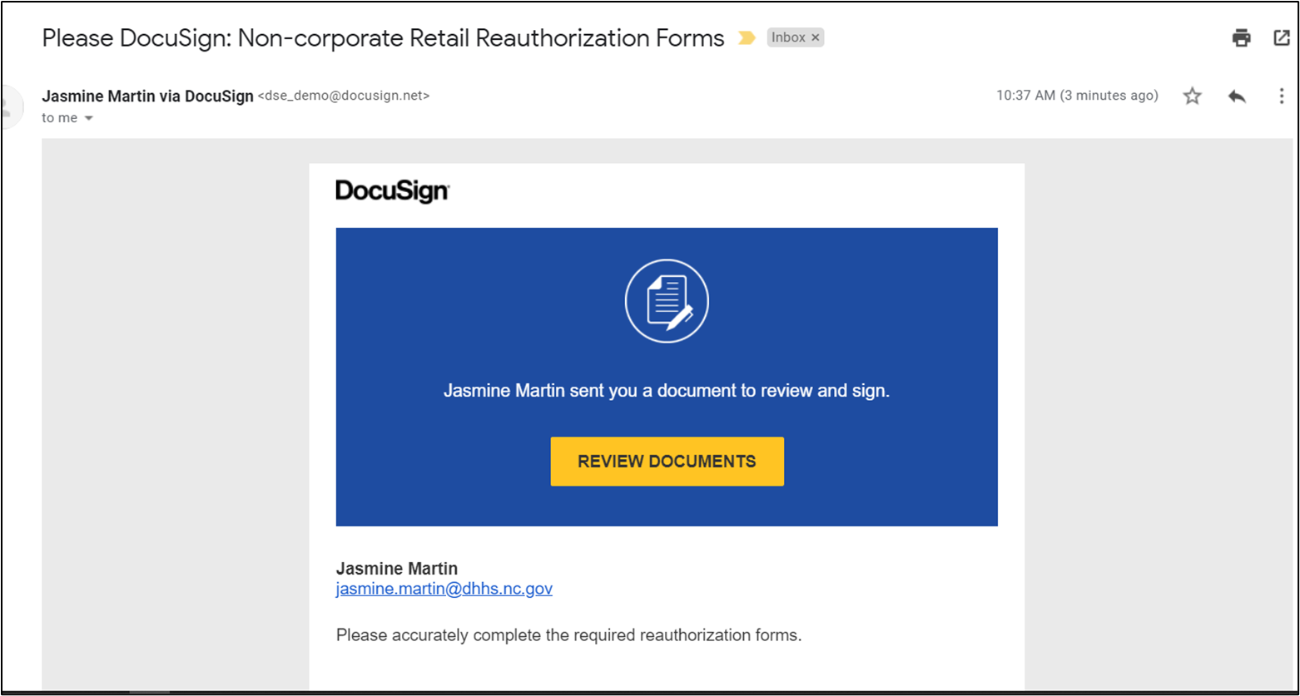
Vendor Process Using DocuSign
You will receive an email from the State Agency via DocuSign.
This is the email you will receive
You will click on the “Review Documents” button.
Notes:
Non-corporate vendors will receive an email from the State Agency via DocuSign. This is a general idea of what the email will look like once received by the vendor. The vendor will click on the Review Documents button.

Slide 74
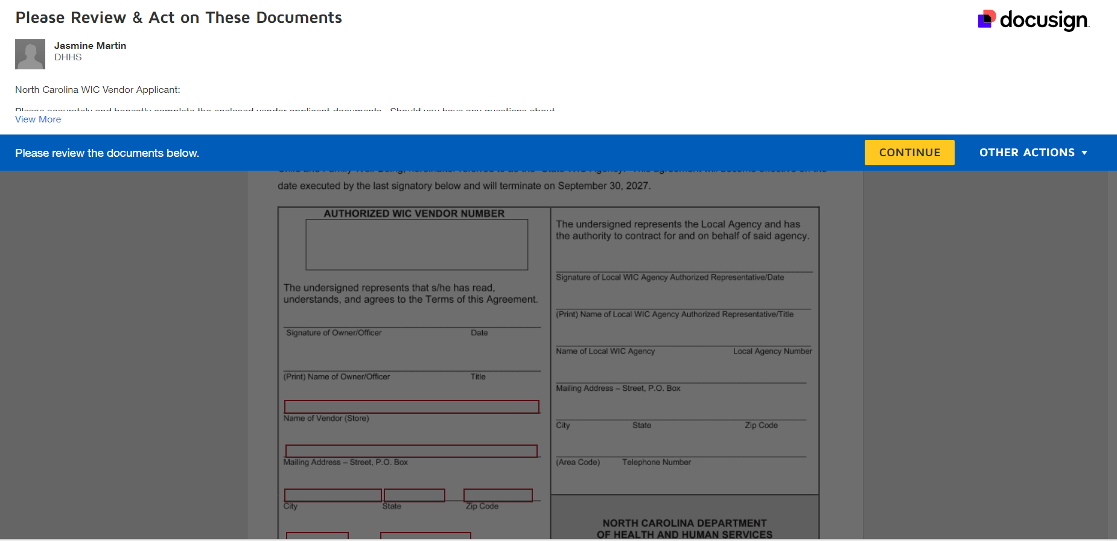
Vendor Process continued
Once you have clicked “Review Documents,” this screen will open.
You will click the “Continue” button to review and complete the reauthorization documents.
Notes:
Once you have clicked on Review Documents, this screen will open. The vendor will click the continue button to review and complete the reauthorization documents.

Slide 75
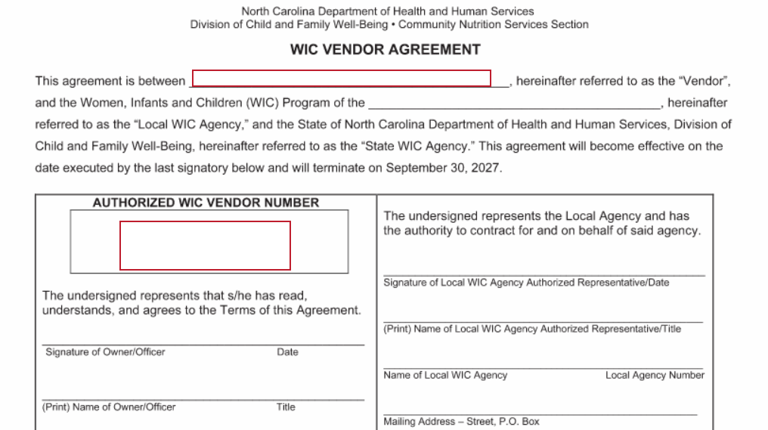
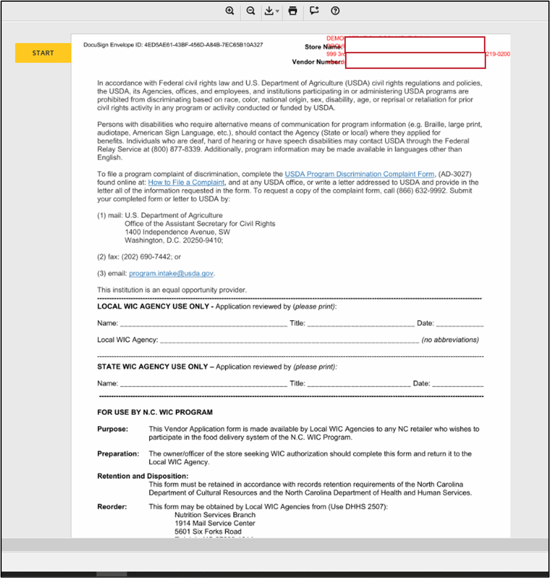
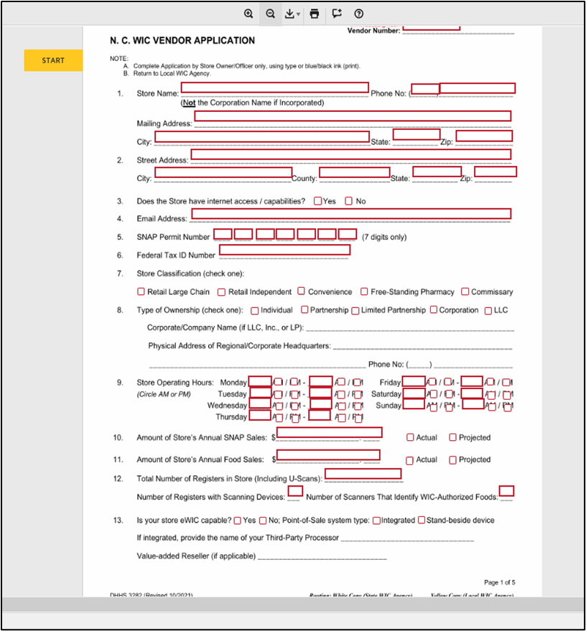
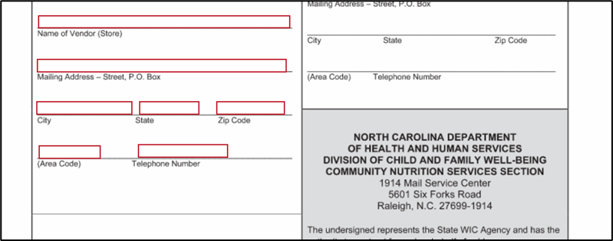
Fields to Complete
You will move through the documents, typing in the correct information as it pertains to your store. You will only be able to complete fields that are indicated for vendors. You will not be able to click the Finish button unless all fields have been completed. Answer all questions accurately. If fields are not answered accurately, ALL documents will be returned for completion.
Please note, the signature fields on the agreement will not be marked for completion. A second email will be sent upon completion of the application
Notes:
Using DocuSign continued
You will move through the documents, typing in the correct information as it pertains to your store. You will only be able to complete fields that are indicated for vendors. You will not be able to click the Finish button upon completion, unless all fields have been completed. Be sure you have answered all questions accurately. If fields are not answered accurately ALL documents will be returned for completion.

Slide 76
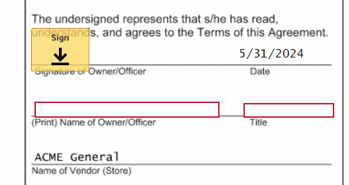
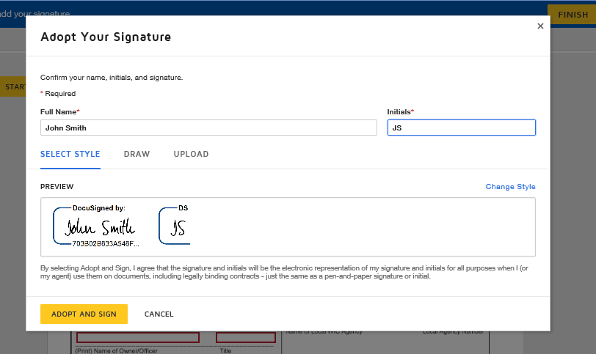
Adopting a Signature
When you first click on the Sign tab, an Adopt Your Signature screen will appear as shown in the example. There are three options for completing signatures: Type your signature and initials in and select the style, Draw your signature using your mouse, or Upload a clear picture of your signature and initials.
Once your signature is to your liking, click on the Adopt and Sign button. Throughout the documents, wherever sign or initial appears, click the button and the adopted signature appears.
Notes:
Using DocuSign continued
A second Docusign email will be sent to the owner of the store after all other information fields have been completed and the Finish button has been clicked. This portion of the process will enable the owner signature fields. When you first click on the Sign tab, an Adopt Your Signature screen will appear as shown in the example. There are three options for completing signatures: Type your signature and initials in and select the style, draw your signature using your mouse or upload a clear picture of your signature and initials.
Once your signature is to your liking, click on the Adopt and Sign button. Throughout the documents, wherever sign or initial appears, click the button and the adopted signature appears.

Slide 77
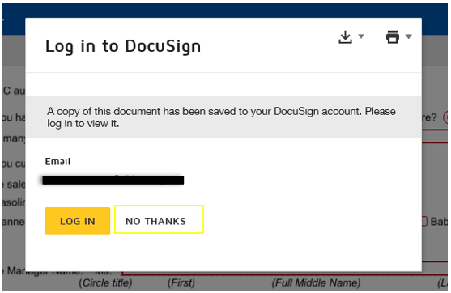
Final Screen
You may see this screen upon completion
Can select “No Thanks”
All parties will receive a copy of the fully completed forms
Notes:
Using DocuSign continued
Once all documents have been signed, you may be asked about signing up to receive copies. This is not necessary. Click no thanks. When all parties involved have signed the documents, all parties will receive PDF copies via email.

Slide 78
Important Note
It is extremely important that the email address associated with the store is checked regularly. If the documents are not opened in a timely manner, a new link will be sent to you for security purposes. The documents are also set to expire on 9/30/2024 so you will need to complete them once you receive the email.
Notes:
Using DocuSign continued
It is extremely important the email address associated with the store is checked regularly. If the documents are not opened in a timely manner, for security purposes, a new link will be sent. The documents are also set to expire 9/30/2024 so you will need to complete them as soon as you receive the email.

Slide 79
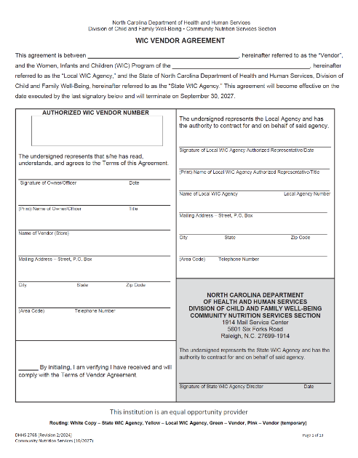
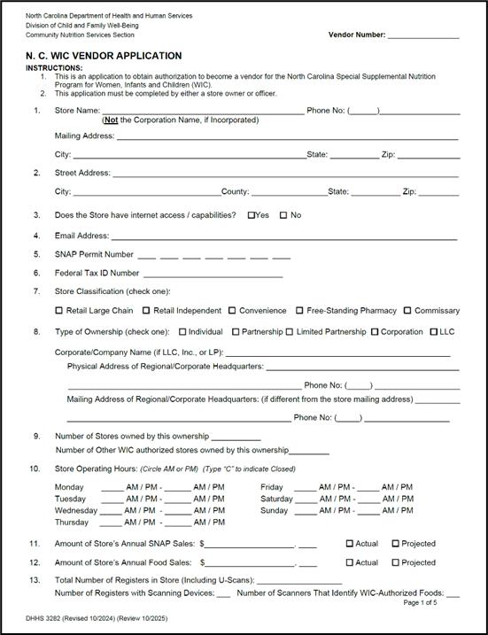
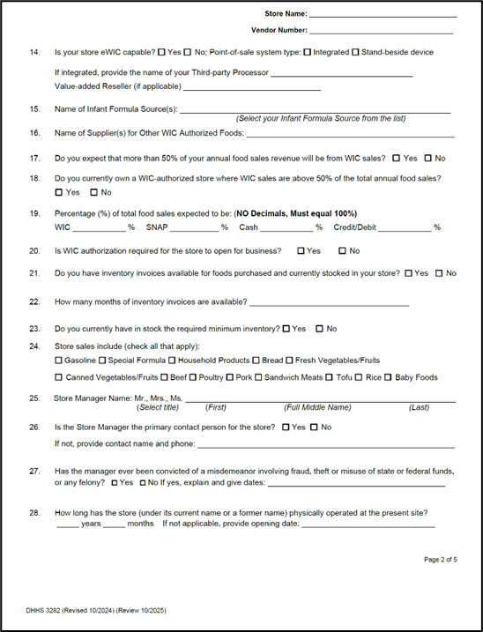
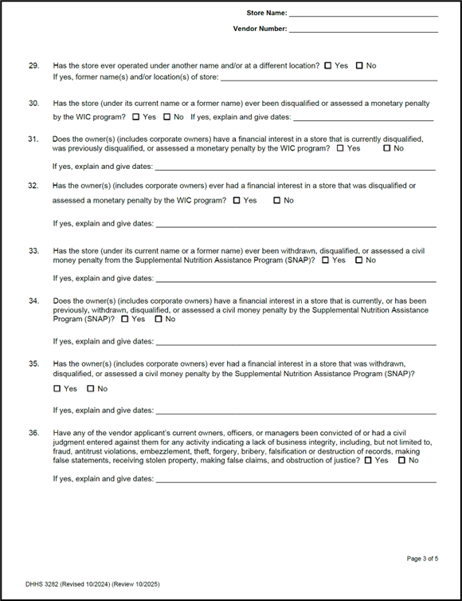
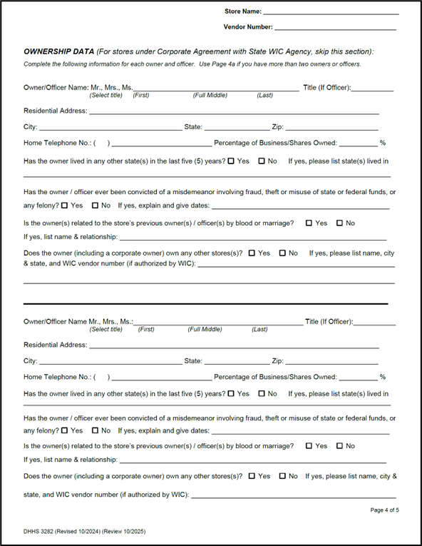
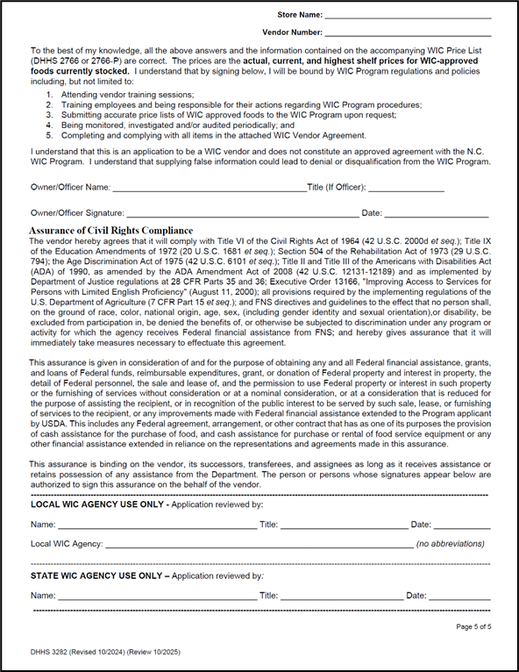
Required Forms
NC WIC Vendor Agreement
NC WIC Vendor Application
To be completed using DocuSign by Owner/Officer.
Notes:
Required Forms
NC WIC Vendor Agreement
NC WIC Vendor Application
To be completed using DocuSign by Owner/Officer

Slide 80
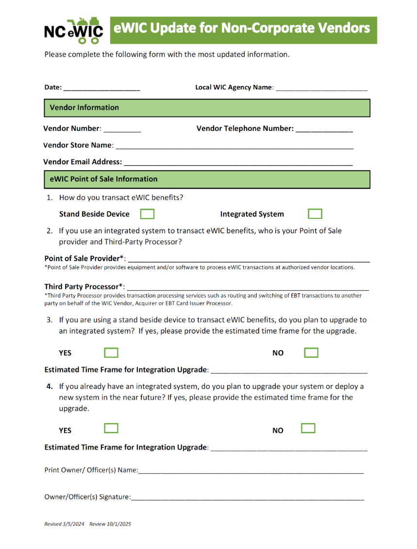
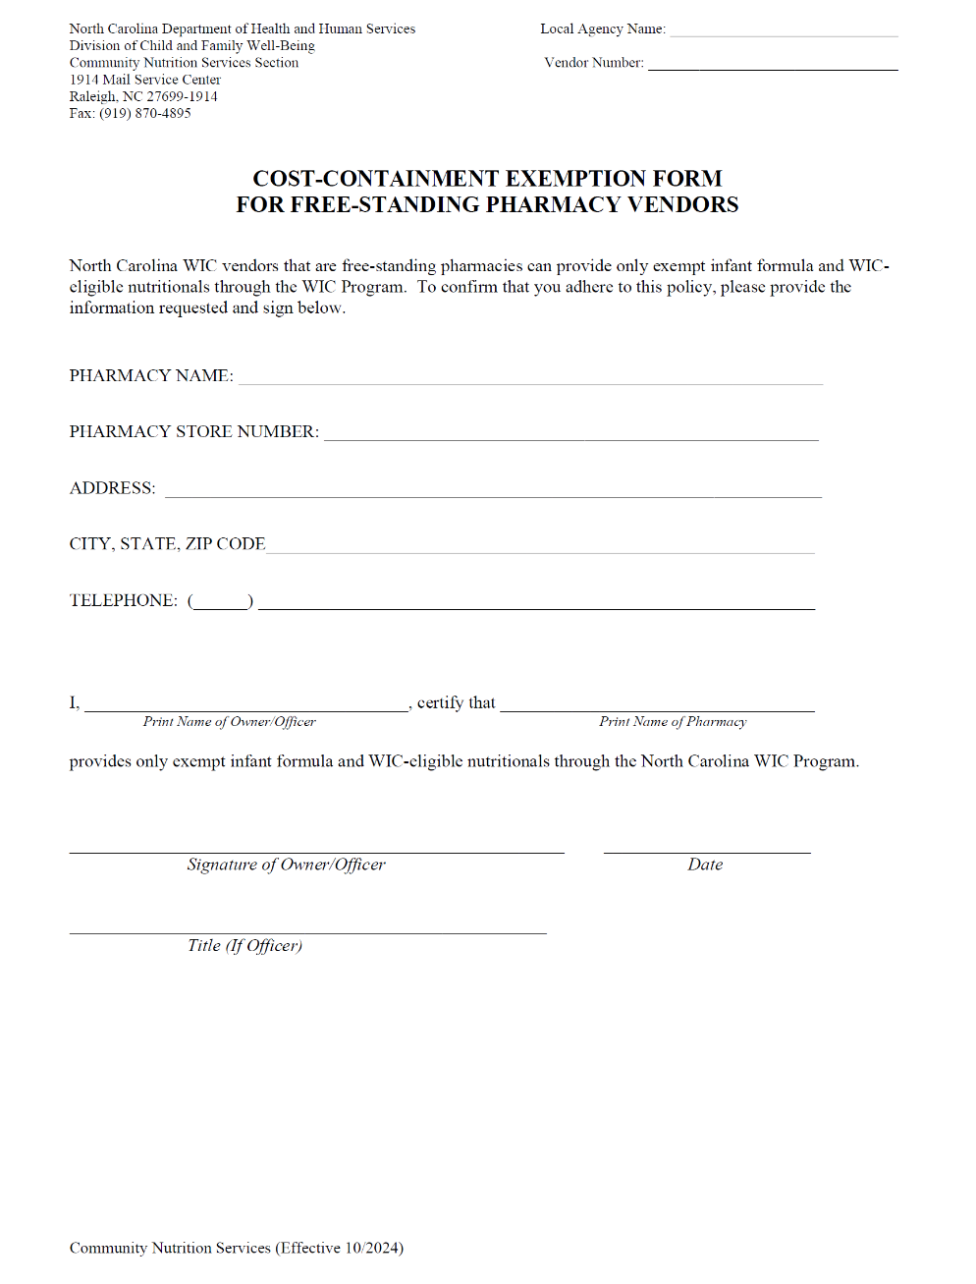
Required Forms continued
Cost Containment Exemption form
eWIC Update for Non-Corporate Contract Vendors
To be completed using DocuSign by Owner/Officer.
Notes:
Required Forms continued
Cost Containment Exemption form
eWIC Update for Non-Corporate Contract Vendors
To be completed using DocuSign by Owner/Officer.

Slide 81
Required Forms continued
Accurately complete these required forms using DocuSign when you receive them via email.
Your Verification of Attendance and Email Verification form needs to be completed, dated and returned to the Vendor Coordinator at your Local WIC Agency, by the date the Vendor Coordinator has provided.
Notes:
Required Forms continued
Accurately complete these required forms using DocuSign when you receive them via email.
Your Verification of Attendance and Email Verification form needs to be completed, dated and returned to me, your vendor coordinator here at the Local WIC Agency, by the date I have provided

Slide 82
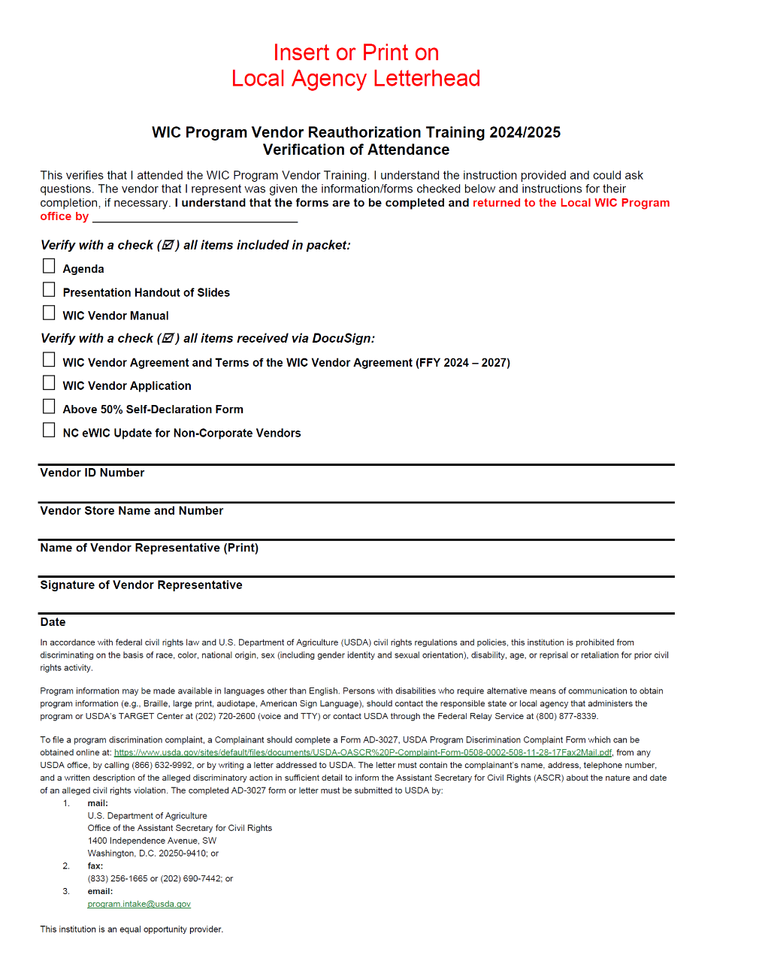
Verification of Attendance Form
Vendors must check off ALL items they receive in their training packets on the “Verification of Attendance” form
Vendor number must be documented on the form
Signature of the vendor owner/ representative reviewing training ensures the receipt of forms, manual and training materials
State Staff will check off the DocuSign items for the vendor, only after the items are received and reviewed through DocuSign.
Notes:
Verification of Attendance Form
Vendors must check off ALL items they receive in their training packets on the “Verification of Attendance” form
Vendor number must be documented on the form
Signature of the vendor owner/ representative attending training ensures the receipt of forms, manual and training materials
State Staff will check off the DocuSign items for the vendor, only after the items are received and reviewed through DocuSign.
If multiple employees are attending training, only one verification of attendance form needs to be submitted.

Slide 83
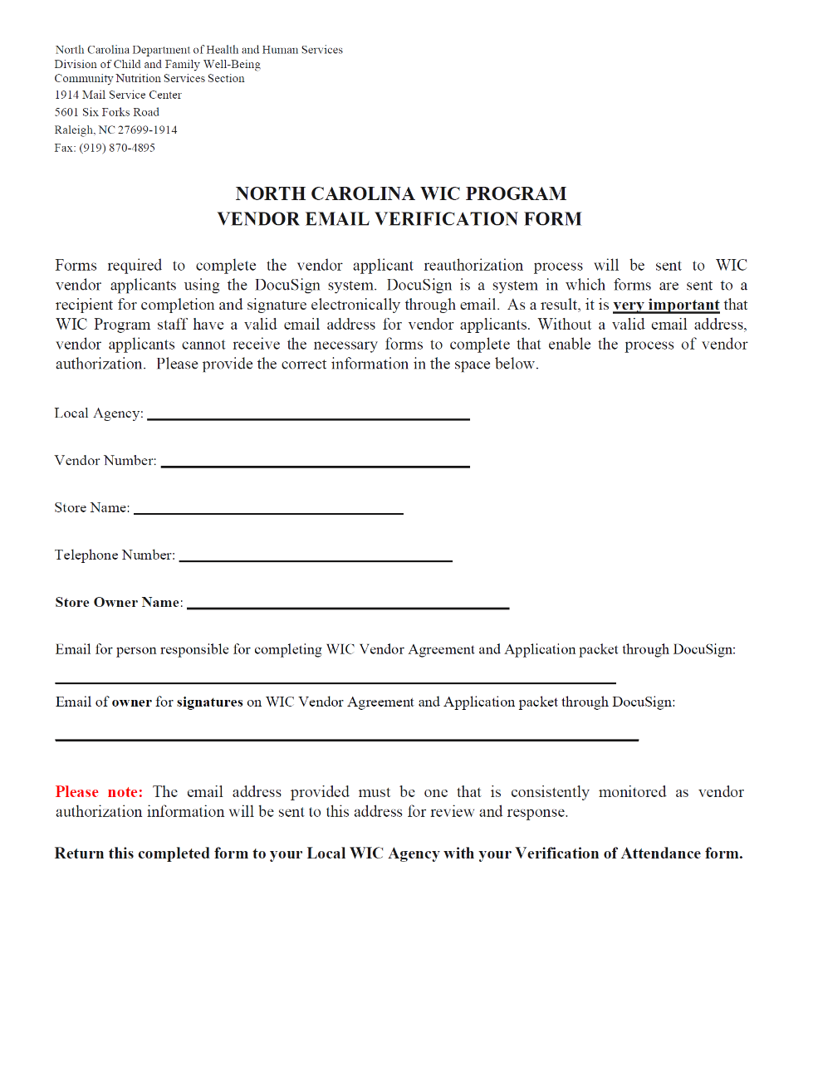
Email Verification Form
Non-Corporate Contract Vendors will receive the Email Verification Form
This form is to verify which email addresses reauthorization documents need to be sent to
DocuSign will not be sent until State WIC Agency receives Verification of Attendance Form and Email Verification Form
Complete the forms in DocuSign in a timely manner and as accurately as possible as to not delay your reauthorization
Notes:
Non-Corporate Contract Vendors will receive the Email Verification Form. This form is to verify which email addresses reauthorization documents need to be sent to
You will receive a DocuSign email once we at the local agency send your verification of attendance form and this email verification form to the State WIC Agency.
Vendors will receive two emails. The first email you will notice the spaces for owner signatures will not be open to sign. Those spaces will open in the second email, meant for the owner so please ensure you complete both email lines, even if the email addresses are the same. Complete the forms in DocuSign in a timely manner and as accurately as possible as to not delay your reauthorization.

Slide 84
Technical Assistance
Local WIC Agency is the primary contact for technical assistance regarding:
Exempt infant formulas and WIC-eligible nutritionals
Completing required forms
Customer service issues (complaints)
Notes:
As always, we here at the Local WIC Agency will continue to be your primary contact for technical assistance regarding:
exempt infant formulas and WIC-eligible nutritionals, completing the required forms and customer service issues (complaints).

Slide 85
Questions?
Notes:
Thank you for your attention during this training session. Do you have any questions?
Photo credit:
QuesitonMarkClipart_Fotolia_13909944_Subscription_L.jpg

Slide 86
Assurance of Civil Rights Compliance
The vendor hereby agrees that it will comply with Title VI of the Civil Rights Act of 1964 (42 U.S.C. 2000d et seq.); Title IX of the Education Amendments of 1972 (20 U.S.C. 1681 et seq.); Section 504 of the Rehabilitation Act of 1973 (29 U.S.C. 794); the Age Discrimination Act of 1975 (42 U.S.C. 6101 et seq.); Title II and Title III of the Americans with Disabilities Act (ADA) of 1990, as amended by the ADA Amendment Act of 2008 (42 U.S.C. 12131-12189) and as implemented by Department of Justice regulations at 28 CFR Parts 35 and 36; Executive Order 13166, "Improving Access to Services for Persons with Limited English Proficiency" (August 11, 2000); all provisions required by the implementing regulations of the U.S. Department of Agriculture (7 CFR Part 15 et seq.); and FNS directives and guidelines to the effect that no person shall, on the ground of race, color, national origin, age, sex (including gender identity and sexual orientation), or disability, be excluded from participation in, be denied the benefits of, or otherwise be subjected to discrimination under any program or activity for which the agency receives Federal financial assistance from FNS; and hereby gives assurance that it will immediately take measures necessary to effectuate this agreement.
This assurance is given in consideration of and for the purpose of obtaining any and all Federal financial assistance, grants, and loans of Federal funds, reimbursable expenditures, grant, or donation of Federal property and interest in property, the detail of Federal personnel, the sale and lease of, and the permission to use Federal property or interest in such property or the furnishing of services without consideration or at a nominal consideration, or at a consideration that is reduced for the purpose of assisting the recipient, or in recognition of the public interest to be served by such sale, lease, or furnishing of services to the recipient, or any improvements made with Federal financial assistance extended to the Program applicant by USDA. This includes any Federal agreement, arrangement, or other contract that has as one of its purposes the provision of cash assistance for the purchase of food, and cash assistance for purchase or rental of food service equipment or any other financial assistance extended in reliance on the representations and agreements made in this assurance.
This assurance is binding on the vendor, its successors, transferees, and assignees as long as it receives assistance or retains possession of any assistance from the Department. The person or persons whose signatures appear below are authorized to sign this assurance on the behalf of the vendor.
Notes:
On this slide is the Assurance of Civil Rights Compliance

Slide 87
USDA Nondiscrimination Statement
In accordance with federal civil rights law and U.S. Department of Agriculture (USDA) civil rights regulations and policies, this institution is prohibited from discriminating on the basis of race, color, national origin, sex (including gender identity and sexual orientation), disability, age, or reprisal or retaliation for prior civil rights activity.
Program information may be made available in languages other than English. Persons with disabilities who require alternative means of communication to obtain program information (e.g., Braille, large print, audiotape, American Sign Language), should contact the responsible state or local agency that administers the program or USDA’s TARGET Center at (202) 720-2600 (voice and TTY) or contact USDA through the Federal Relay Service at (800) 877-8339.
To file a program discrimination complaint, a Complainant should complete a Form AD-3027, USDA Program Discrimination Complaint Form which can be obtained online at: https://www.usda.gov/sites/default/files/documents/USDA-OASCR%20P-Complaint-Form-0508-0002-508-11-28-17Fax2Mail.pdf, from any USDA office, by calling (866) 632-9992, or by writing a letter addressed to USDA. The letter must contain the complainant’s name, address, telephone number, and a written description of the alleged discriminatory action in sufficient detail to inform the Assistant Secretary for Civil Rights (ASCR) about the nature and date of an alleged civil rights violation. The completed AD-3027 form or letter must be submitted to USDA by:
mail: U.S. Department of Agriculture Office of the Assistant Secretary for Civil Rights 1400 Independence Avenue, SW Washington, D.C. 20250-9410;
fax: (833) 256-1665 or (202) 690-7442; or
email: program.intake@usda.gov
This institution is an equal opportunity provider.
Notes:
On this slide you will find the USDA Nondiscrimination Statement. Please take a moment to review.
Thank you for your attention to this training.

