Slide 1
NC Department of Health and Human Services
Office of Rural Health
Health Information Technology & Telehealth (HITT) Program

Slide 2
Programs at ORH
NC Community Health Grants
NC Farmworker Health Program
Rural Health Information Technology Program
Placement and HPSA Services
NC Rural Health Centers
Supports state designated rural health centers that serve the entire community
Supports the primary care safety net system with increasing access to health care for vulnerable populations
Supports medical, dental and educational services for members of the North Carolina agricultural labor force and their families
Provides technical assistance to improve the use of Electronic Health Record (EHR) Systems and the health information exchange
Recruit providers and designates health professional shortage areas
NC Rural Hospital Program
NC Medication Assistance Program
NC Statewide Telepsychiatry
Program
Analytics and Innovations Program
Funds operational improvement projects for the benefit of all critical access hospitals and eligible small rural hospitals
Provides free and low-cost medications donated by pharmaceutical manufacturers to patients who cannot afford them
Supports psychiatric evaluation of patients through videoconferencing technology in emergency departments
Supports data analytics, community health initiatives and demonstration projects that benefit vulnerable populations

Slide 3
About the ORH HIT Team – What do we do?
Provide Technical Assistance to get connected to NC HealthConnex (HIE)
Assess Electronic Health Record (EHR) needs and recommend viable validated solutions
Assist with Meaningful Use of Health Information Technology

Slide 4
ORH Health Information Technology (HIT) Program
SFY 2022- 23 Projects
BH
EHR
Tele-
Health
PCMH/HIE
HIE
Health Information Exchange
Behavioral Health Electronic Health Record (EHR) Incentive Program
NC Association of Free and Charitable Clinics PCMH/HIE Project
ORH Telehealth Initiatives
Health Information Exchange – Assisting ORH Grantees and Safety Net Providers with Connecting to and utilizing the Statewide HIE (NC HealthConnex).
Behavioral Health EHR Incentive Program – Assisting Behavioral Health Providers with procuring/implementing an EHR and connecting to the State HIE (NC HealthConnex).
Telehealth Initiatives – Providing safety net providers with Telehealth technical assistance and Working with DIT Broadband Team on an ARC Telehealth Planning Grant.
PCMH/HIE Project – through Duke Endowment funds, NC AFCC is working with CC-WNC to assist free clinics with PCMH and HIEA Value Added Services.
*Salesforce Implementation – Assisting with an ORH wide deployment of Salesforce to work more efficiently and share data across programs and regional teams.

Slide 5
What are the Goals for the HIT Team?
Percentage of ORH-Funded Practices that have Implemented an Electronic Health Record (EHR) System in their Practice
Percentage of ORH-Funded Practices that have a signed Participation Agreement to connect to the NC Health Connex
Percentage of ORH-Funded Practices that have Achieved Connectivity to the Health Information Exchange
Percentage of ORH-Funded Practices that Utilize the NC HIE Value-Add Services – Clinical Notifications, and Disease Registry.

Slide 6
What Does the Law Mandate?
Hospitals as defined by G.S. 131E-176(3), doctors (licensed to practice under Article 1 of Chapter 90 of the General Statutes), and mid-level practitioners who provide Medicaid services and who have an electronic health record were required to connect by June 1, 2018.
All other providers of Medicaid and state-funded services shall connect by June 1, 2019 except:
Dentists and ambulatory surgical centers are required to submit clinical and demographic data by June 1, 2021
Pharmacies are required to submit claims data pertaining to State services once per day by June 1, 2021, using pharmacy industry standardized formats
Notes:
Notwithstanding the voluntary nature of NC HealthConnex, healthcare providers are required to connect if receiving any type of state funds.
The law was passed 2 years ago that stated healthcare providers that received any type of state funds would have to connect by certain dates.
Explain mandate.

Slide 7
What Does Connected Mean?
To meet the state’s mandate, a Medicaid provider is “connected” when:
Its clinical and demographic information pertaining to services paid for by Medicaid and other State-funded health care funds are being sent to NC HealthConnex, at least daily.
Either through a direct connection or via a hub (i.e., a larger system with which it participates, another regional HIE with which it participates or an EHR vendor).
Participation agreements signed with the designated entity would need to list all affiliate connections.

Slide 8
What is Health Information Exchange (HIE)?
A Health Information Exchange (HIE) is a secure, electronic network that gives authorized health care providers the ability to access and share health-related information across a statewide information highway.
pharmacy
ambulatory care
HIE
behavioral health
labs
public health
long term care
specialists
hospitals

Slide 9
What is NC HealthConnex?
North Carolina’s state-designated Health Information Exchange.
A tool to facilitate conversations between all health care provider types across the state to break down the silos between existing networks.

Slide 10
How do we track progress?
We are currently tracking progress towards HITT Team Goals using a free Customer Relationship Management (CRM) Database called – Hubspot.
Customer relationship management (CRM) is a technology for managing all of your company’s relationships and interactions with customers and potential customers.

Slide 11
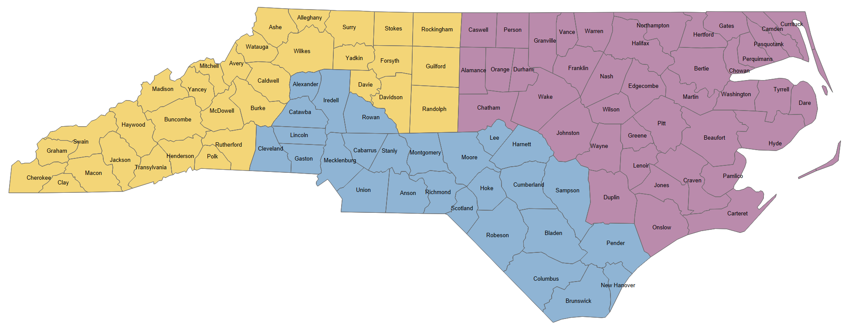
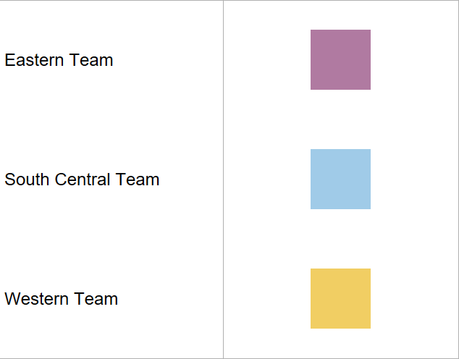
NC Office of Rural Health Service Area Map

