Slide 1

An Orientation for Retail
Vendor Applicants
2022-2023
Notes:
Welcome! This training is for food retailers that are interested in becoming authorized WIC Program vendors. Throughout this presentation I will refer to the Vendor Manual, a copy of which you have.
It can also be accessed online on the Vendor Connection webpage at https://www.nutritionnc.com/wic/vendor.htm under the resource tab.

Slide 2
Orientation to NC WIC Program
What is WIC?
What is the role of vendors?
How to become a WIC vendor
Guidance for completing required forms
Notes:
We will be covering a lot of material. We will discuss some general information about the WIC Program and the role of WIC vendors. We will also discuss how to become an authorized WIC vendor and guidance for completing required forms, to become a WIC vendor in North Carolina.

Slide 3
What is WIC?
The Special Supplemental Nutrition Program for Women, Infants and Children
Federally funded by the United States Department of Agriculture (USDA)
State-administered by the NC Department of Health and Human Services
WIC clinical services provided by contracted public health agencies
NC WIC-authorized vendors are contracted with The NC Department of Health and Human Services and Local WIC Agencies
Notes:
What is the WIC Program? WIC is an acronym for the Special Supplemental Nutrition Program for Women, Infants, and Children. It is a Federal program that is funded by the United States Department of Agriculture. In North Carolina, it is administered by the NC Department of Health and Human Services, Division of Child and Family Well-Being, Community Nutrition Services Section.
WIC clinical services are provided by contracted public health agencies. Services include nutrition education, food benefits for nutritious foods and health care referrals.
NC WIC-authorized vendors are contracted with the NC Department of Health and Human Services and their Local WIC Agencies.
The Local WIC Agency (that’s us) operates the WIC Program in your county.

Slide 4


WIC Works!
In NC, every WIC dollar spent on a pregnant woman saves multiple dollars in newborn health care costs
Children on WIC have better diets, particularly for vitamin C, thiamin, protein, niacin and vitamin B₆
Notes:
WIC’s goal is to prevent health problems and improve overall health during this critical time of growth and development. This includes pregnancy, infancy and early childhood.
In fact, research shows that WIC saves public health dollars. Every dollar spent on a pregnant woman saves multiple dollars in newborn health care costs. Research also shows that children on WIC have better diets, especially for key vitamins.
Photo Credit : PeoplePreg & babies vol.113: 113012.jpg
Photo Credit: AA Boy Apple_Fotolia_14820340.jpg

Slide 5
How Stores Become Authorized WIC Vendors
Vendors work primarily with the Local WIC Agency
  Orientation and training
  Completing required forms in DocuSign
  Technical assistance
  Monitoring
Local WIC Agency submits required vendor forms to the State WIC Agency
Vendor is authorized by State WIC Agency
Notes:
In order to become an authorized WIC vendor, applicants work with us, the Local WIC Agency. We provide orientation (what is being done today) and training as well as technical assistance during the process. We also assist vendor applicants in completing the appropriate forms for submission to the State WIC Agency for approval. Lastly, local agency staff monitor applicants prior to authorization to determine if applicants are in compliance with WIC Program policies.
To be eligible to accept eWIC benefits, food retailers must be authorized by the State WIC Agency. Vendors accept eWIC from WIC customers in exchange for WIC approved foods.

Slide 6
Types of Vendors
Vendors under Corporate Agreement
  20 or more WIC-authorized stores
  - Food Lion* - Harris Teeter*
  - Ingles* - Lowe’s*
  - CVS - Wal-Mart*
  - Target - Publix*
  - Walgreens
  * Pharmacies within the corporate store that is also WIC approved
Vendors not under Corporate Agreement
Notes:
There are two different types of vendors: those under corporate agreement and those that are not. The first type are those under corporate agreement. Vendors under corporate agreement have 20 or more WIC-authorized stores in North Carolina. These stores have a slightly different authorization process than stores that are not under corporate agreement.
As noted on the slide, any corporate agreement store location that has a pharmacy within the store, is authorized under the umbrella of that corporate agreement. This means that the pharmacy within the store must provide exempt infant formula and WIC-eligible nutritionals in the 24–48-hour time frame, when requested. The only exception would be if the pharmacy is owned by a separate entity. For example, the CVS pharmacies that operate within Target stores, are not a WIC approved pharmacy.
The other type of vendors are those that are not under corporate agreement.
It is important to remember that stores can be a corporation, but not under corporate agreement with the WIC Program.

Slide 7
Vendor Applicant’s Responsibility
Attend training by Local WIC Agency
Meet all selection criteria
Contact Solutran for preparation in accepting eWIC
  Retailer Helpdesk: 1-866-730-7746 (available 24/7)
  Email: ebtservices@Solutran.com
Complete required forms accurately and completely using DocuSign
Understand and follow all Federal and State regulations and rules
Train all staff handling eWIC transactions
Notes:
As with any contracting process, each party involved has responsibilities.
As a vendor applicant your responsibility is to:
Attend training conducted by Local WIC Agency, this is done annually.
Meet all selection criteria
Contact the states banking contractor (Solutran) for preparation in accepting eWIC
Complete required forms accurately and completely using DocuSign
Understand and follow all Federal and State regulations and rules
Train all staff handling eWIC transactions.
Managers need to share information with store owners

Slide 8
Local WIC Agency’s Responsibility
Inform Vendor Applicant there is a deposit and monthly lease fee required for a stand-beside device
Provide orientation and training to store owner, manager or designee
Respond to questions about required forms and application process
Review required forms for completeness
In a timely manner:
  Perform Pre-authorization Monitoring
  Send required forms to State WIC Agency
  Ensure Vendor is set up to accept eWIC prior to final authorization
    State Agency staff will complete L3 certification testing once equipment has been received by vendor or Solutran has determined the vendor’s cash register system meets the eWIC requirements
Notes:
The responsibility of the Local WIC Agency is to:
Inform Vendor Applicant there is a deposit ($300) and monthly lease fee ($150) required for a stand-beside device.
Provide orientation and training to the store owner, manager or designee.
Respond to questions about required forms and the application process.
Review required forms for completeness.
Also, in a timely manner:
Perform a Pre-authorization Monitoring
Send required forms to State WIC Agency
Ensure Vendor is set up to accept eWIC prior to final authorization
State Agency staff will complete L3 certification testing once equipment has been received by vendor or Solutran has determined the vendor’s cash register system meets the requirements

Slide 9
Local WIC Agency’s Responsibility continued
  Inform vendor of vendor ID number (to be used on vendor forms only)
  Provide NC WIC Vendor Transaction Guides
  Address any questions from the vendor
Notes:
Local Agency staff will also:
Inform Vendor of Vendor ID number
Provide a supply of NC WIC Transaction Guides and
Address any questions from vendor

Slide 10
Selection Criteria
Established by U.S. Department of Agriculture and NC WIC Program
  20 items
Vendor Manual pages 7-8
Notes:
Vendors must meet all the criteria established by the USDA and the NC WIC Program. You can find this criteria in your vendor manual on pages 7 and 8.

Slide 11
Supplemental Nutrition Assistance Program (SNAP)
Must be authorized as SNAP vendor
Cannot become WIC authorized vendor if currently disqualified from SNAP or paying a civil money penalty for which the disqualification period would still be running
SNAP is also known as Food and Nutrition Services in NC
Notes:
It is required that vendors be authorized SNAP vendors. Applicants cannot become authorized WIC vendors if they are currently disqualified from SNAP (the Food Stamp Program) or paying a civil money penalty, for which the disqualification period would still be running. SNAP is also known as Food and Nutrition Services in North Carolina.

Slide 12
Competitive Pricing and Price Limitations
Peer group structure
  Peer groups have not-to-exceed (NTEs) prices for each WIC supplemental food and contract formula
Notes:
7
Federal regulations require State WIC Programs to establish competitive pricing and price limitations during the process of vendor authorization. Competitive pricing considers the prices a vendor charges for supplemental foods as compared to the prices charged by other authorized and applicant vendors. Price limitations ensure that a vendor applicant has competitive prices and maintains competitive prices as an authorized vendor. These price limitations are referred to as not-to-exceed (NTE) prices.
Each vendor is assigned to a peer group.
Peer groups have NTEs for WIC supplemental food and contract formula.
Please note, the acronym NTE will be used throughout the presentation. As I will explain, NTEs will be used for vendor selection. Also, the State WIC Agency will not pay or reimburse above the NTE for the individual approved foods. Together, the use of peer groups and NTEs creates the required competitive pricing and price limitations.

Slide 13
Annual Vendor Training
Vendors, their store manager or other authorized store representative are required to attend annual vendor training
Failure to attend annual training by September 30th of each year will result in termination of the WIC Vendor Agreement
Notes:
Vendors, their store managers or other authorized store representative must attend annual vendor training. This is conducted during the summer on dates set by us, local agency staff. Failure to attend annual training by September 30th of each year will result in termination of the WIC Vendor Agreement.

Slide 14
NC Peer Group System
VENDOR PEER GROUPS
# | STORE TYPE | LOCATION | DESCRIPTION
5 | Pharmacy | Statewide | Free-standing pharmacy that sells a limited variety of foods
6 | Convenience Store | Statewide | Retailer with a limited assortment of grocery items
7 | Mass Merchandiser and Commissary | Statewide | Retailer that sells a wide variety of merchandise but also carries groceries and has store locations in most or all states Grocery store operated by US Defense Commissary on a military base
8 | Independent Grocery | Urban | Retailer that primarily sells groceries with fewer than 11 store locations
9 | Independent Grocery | Non-urban | Retailer that primarily sells groceries with fewer than 11 store locations
10 | Regional Grocery Chain | Urban | Retailer that primarily sells groceries with at least 11 store locations and operates in 2 or more states
11 | Regional Grocery Chain | Non-urban | Retailer that primarily sells groceries with at least 11 store locations and operates in 2 or more states
Notes:
North Carolina’s peer group system is displayed on the slide. It is based on store type and geography.

Slide 15
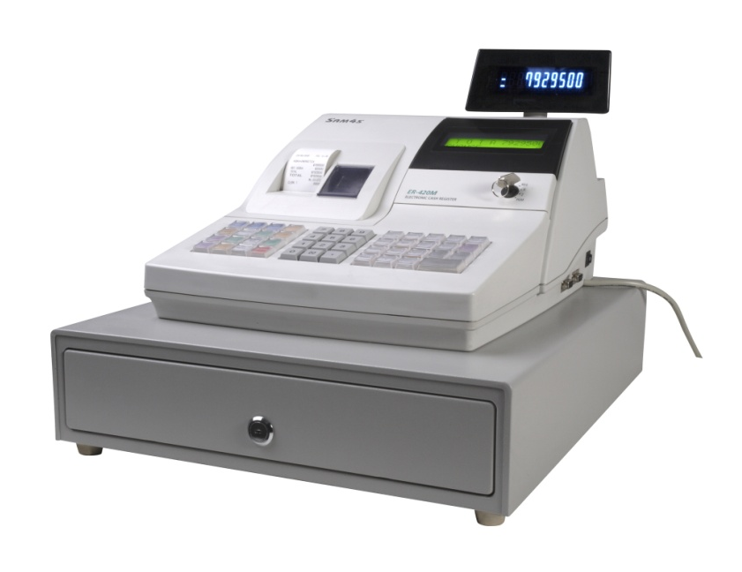
Determining Peer Groups
Store type
Geography
Notes:
Again, there are two methods to assign peer groups, store type and geography, which is initially done at time of authorization.
Store type: this is the first method and is applied before all others. It affects chain stores, stores under corporate agreement, military commissaries and free-standing pharmacies.
Geography: defined as either an urban or non-urban location
Photo Credit: CashRegister_Fotolia_8598503_Subscription_L.jpg

Slide 16
Store Types
Pharmacy – pharmacy retailer that sells limited variety of food
Mass Merchandiser – retailer that sells a wide variety of merchandise, but also carries groceries and has outlets in most or all states
Commissary – grocery store operated by US Defense Commissary within the confines of a military installation
Convenience Store – retailer with limited assortment of grocery items
Notes:
The store types present in North Carolina are:
Pharmacies – a pharmacy retailer that sells a limited variety of food items;
Mass Merchandisers – a retailer that sells a wide variety of merchandise, but also carries groceries and has outlets in most or all states;
Commissary – a grocery store operated by the US Defense Commissary within the confines of a military installation; and
Convenience Store – a retailer with a limited assortment of grocery items.

Slide 17
Store Types continued
Independent Grocery – a vendor that primarily sells groceries in fewer than eleven store locations
Regional Grocery Chain – a vendor that primarily sells groceries in eleven or more store locations whose parent company operates in more than two states
Notes:
Two additional store types are:
An independent grocery, which is defined as a vendor that primarily sells groceries in fewer than eleven store locations and;
a regional grocery chain, a vendor that primarily sells groceries in eleven or more store locations whose parent company operates in more than two states.

Slide 18
Geography
Geography determined by using Rural Urban Commuting Area (RUCA) file and documentation from USDA Economic Research Service (ERS)
  Classifies census tracts using measures of population density, urbanization, and daily commuting; and
  Identifies urban, large rural, small rural, and isolated areas.
Notes:
Geography is determined by using the Rural Urban Commuting Area (RUCA) file and documentation from the USDA Economic Research Service (ERS). The system used classifies census tracts using measures of population density, urbanization, and daily commuting; and identifies urban, large rural, small rural, and isolated areas.

Slide 19
Not-to-Exceed (NTE) Prices
NTEs are set at 2 standard deviations above the average price for supplemental foods within a vendor peer group. NTEs are not set for exempt infant formula, WIC-eligible nutritionals or fruits and vegetables purchased with cash-value Benefits (CVBs)
    Calculated for each WIC supplemental food
    Based on redemption of all vendors in the peer group
    Obtained from the eWIC system
    Different NTEs for different sizes of the same food even if it is the same brand
Foods and Contract Formula
Notes:
NTE prices are established for supplemental foods for each peer group except, exempt infant formula, WIC-eligible nutritionals and fruits and vegetables purchased with CVBs.
NTEs are set at 2 standard deviations above the average price for supplemental foods within a vendor peer group.
NTEs are calculated based on redemption of all vendors in the peer group and are obtained from the eWIC system. There are different NTEs for different sizes of the same food even if it is the same brand.
WIC supplemental foods and contract formula have NTEs.

Slide 20
NTEs vs. Current Shelf Price
Vendors must charge current shelf price
Vendors DO NOT have to charge the NTE
Charges for WIC transactions must be less than or equal to charges to regular customers
Vendors cannot set their prices at the NTE and charge other customers less. This is a federal violation for which a vendor can be disqualified
Notes:
Vendors must charge current shelf price; you DO NOT have to charge the NTE. Charges for WIC transactions must be less than or equal to charges to regular customers. Vendors cannot set their prices at the NTE and charge other customers less, that is called overcharging, which is a federal violation for which a vendor can be disqualified.

Slide 21
Minimum Redemption
Vendor must redeem at least $2,000 annually in WIC supplemental food sales
  If not, the Vendor Agreement will be terminated
  The store must wait 180 days to reapply
Notes:
Minimum redemption is a selection criteria. Authorized vendors must redeem at least $2,000 annually in WIC supplemental food sales. Failure to do so will result in termination of the WIC Vendor Agreement and the store must wait 180 days (about 6 months) to reapply.

Slide 22
Contract Infant Formulas
Gerber Good Start Soy®
  12.9 oz cans Powder **
  8.1 oz Concentrate Containers
  33.8 oz Ready to Feed (4 pack of 8.45 oz Containers)
Gerber Good Start SoothePro®
  12.4 oz cans Powder
NTEs are set for milk-based and soy-based formulas
Brands must be contract infant formulas:
Gerber Good Start Gentle®
  12.7 oz cans Powder **
  8.1 oz Concentrate Containers (GentlePro)
  33.8 oz Ready to Feed (4 pack of 8.45 oz Containers)
  (GentlePro)
  ** Minimum Inventory item
Notes:
Most eWIC benefits issued for infant formula will be for one of the NC WIC Program’s contract infant formula products. These are milk-based and soy-based formulas. Brands must be the primary contract infant formula.
Minimum Inventory requirement is for powder in:
Gerber Good Start GentlePro 12.7 oz. powder and Gerber Good Start Soy 12.9 oz. powder as indicated by the asterisk ** on the slide
NTEs are set for all contract formulas

Slide 23
WIC Approved Foods with No NTE
NTEs do not apply to exempt infant formula or WIC-eligible nutritionals
Open market system (shelf price)
Exempt infant formula and WIC-eligible nutritionals can be found at www.nutritionnc.com/wic/vendor.htm
NTEs do not apply to fruits and vegetables purchasable with cash-value benefits (CVBs)
Notes:
NTEs do not apply to exempt infant formula or WIC-eligible nutritionals. These prices are driven by an open market system (shelf price)
The list of Exempt infant formula and WIC-eligible nutritionals can be found at www.nutritonnc.com on the vendor connection page.
NTEs do not apply to fruits and vegetables purchasable with cash-value benefits (CVBs).

Slide 24
Purchasing and Providing Infant Formula From State-Approved Sources
WIC Reauthorization Act of 2004 requires vendors to purchase infant formula from a State-approved source
Infant formula, exempt infant formula, and WIC-eligible nutritionals provided to WIC customers must be purchased directly from the State-approved sources
Must keep invoices and receipts showing sources of formula
Failure to do so will result in termination of the WIC Vendor Agreement
Notes:
A special note about all formulas, contract and exempt:
As required by Public Law 108-265 of the Child Nutrition and WIC Reauthorization Act of 2004, vendors are required to purchase infant formula from a State-approved source. Vendors must provide WIC customers infant formula, exempt infant formula, and WIC-eligible nutritionals purchased only from the State-approved list of sources. In addition, vendors must keep invoices or receipts showing source of formula. These will be reviewed at the time of monitoring and inventory audits (which will be discussed a little later).
The current list, complete with addresses, can be found on the Vendor Connection webpage.
Failure to purchase and provide WIC customers infant formula, exempt infant formula, and WIC-eligible nutritionals purchased directly from the State-approved list of sources will result in termination of the WIC Vendor Agreement.

Slide 25
WIC Price Lists
Price List Submission
  Vendor applicants must submit price lists at initial authorization which have prices at or below the NTE for their assigned peer group
  Authorized vendors must submit a price list if requested by the State WIC Agency
Notes:
Price List Submission. Vendor applicants, excluding corporate applicants, must submit price lists at initial authorization which have prices at or below the NTE for their assigned peer group. Authorized vendors must submit a price list if requested by the State WIC Agency.

Slide 26
Applicant Prices Must Be At Or Below NTE
>
=
PRICE OF WIC FOODS
NTE
WILL NOT BE AUTHORIZED
Opportunity to resubmit within 30 days to become authorized
Notes:
NTEs are a critical part of vendor selection.
All vendor prices must be at or below the NTE for the vendor applicant to be authorized. If even one price is above the NTE for that vendor applicant’s peer group, the vendor applicant receives a written letter. The letter will include a list of food items priced over the NTE and they are given the chance to resubmit new prices within 30 days.

Slide 27
Resubmitted Price List
Written denial
Must wait 90 days to reapply
Notes:
The vendor applicant has the choice to reduce the price to below or at the NTE. If, however, the resubmitted price is still above the NTE, the vendor will receive a written denial of authorization and must wait 90 days to reapply for authorization.

Slide 28
Questions
Notes:
Let’s take a moment for questions

Slide 29
Predominantly WIC Vendor (PWV)
A predominantly WIC vendor, also known as a PWV, is a vendor that derives more then 50% of their food sales from WIC food benefits.
PWVs cannot be authorized NC WIC vendors
  If a vendor applicant is expected to be a PWV, the application will be denied
  If a vendor becomes a PWV anytime during authorization, the Vendor Agreement will be terminated
  Must wait 90 days to reapply
Selection Criteria Listed in Vendor Agreement
Notes:
We will now discuss Predominantly WIC Vendors.
A predominantly WIC vendor, also known as a PWV, is a vendor that derives more than 50% of their food sales from WIC food benefits.
PWVs cannot be authorized as NC WIC vendors. If we determine that a vendor applicant is expected to be a PWV, the vendor application will be denied-(not authorized).
If at any time during a vendor’s authorization the State Agency determines the vendor has become a PWV, the vendor’s WIC Vendor Agreement will be terminated. The store must then wait 90 days to reapply for vendor authorization.

Slide 30
Predominantly WIC Vendor (PWV) continued
State WIC Agencies are required to identify vendors that derive more than 50% of their annual food sales revenue from WIC food redemption
The USDA classifies these vendors as Above 50% Vendors
In North Carolina, these stores are called Predominantly WIC vendors (PWVs)
State WIC Agency collects data to determine total SNAP-eligible food sales as part of the PWV identification process
Notes:
Even though PWVs are not authorized by the WIC program in NC, the State is still required to identify vendors that derive more than 50% of their annual food sales revenue from WIC food redemption.
The USDA classifies these vendors as Above 50% vendors. In North Carolina, these stores are called Predominantly WIC Vendors (PWVs).
Each year, the USDA supplies the state with a list of vendors with WIC Program sales that exceed Supplemental Nutrition Assistance Program (SNAP) sales. This list is an initial screening for vendors who may derive more than 50 percent of food sales from the WIC Program. Newly authorized vendors will have their sales figures reviewed after the first six months to determine if the vendor is deriving more than 50 percent of food sales from the WIC Program. At this point, cash sales data will be requested to determine if a vendor needs to be classified as a “predominantly WIC vendor”. Cash sales data requested is any SNAP-eligible food sales. This information is compared with your SNAP and WIC sales to determine if your store will be classified as a “predominantly WIC vendor”.

Slide 31
SNAP-eligible Food Sales Records
Vendors must maintain a record of all SNAP-eligible food sales
SNAP-eligible food sales are sales of those foods that can be purchased with SNAP (Food Stamp) benefits
Vendors are required to provide the State WIC Agency, upon request, a statement of the total amount of revenue derived from SNAP-eligible food sales and written documentation to support the amount of sales claimed
Notes:
Vendors must maintain a record of all SNAP-eligible food sales. Vendors are required to provide to the State WIC Agency, upon request, a statement of the total amount of revenue derived such as sales records, financial statements, reports, tax documents or other verifiable documentation. Vendors are encouraged to have a system of being able to show food sales and non-food sales separately for reporting to WIC if requested.
It is very important to keep documentation of food and non-food items sold separately for submission to the Sate WIC Agency, if requested.

Slide 32
PWV Identification
What is SNAP-eligible?
  Any item that may be purchased with Supplemental Nutrition Assistance Program (SNAP) benefits
Food Sales
  The sale of all foods that could be purchased with SNAP benefits.
  Food Sales Fact Sheet
Notes:
So, what is SNAP-eligible? SNAP-eligible is defined as any item that may be purchased with Supplemental Nutrition Assistance Program (SNAP) benefits.
For the sale of all foods that could be purchased with SNAP benefits. This is also known as SNAP-eligible food sales. The emphasis is placed on the word “could’ because the food does not have to be purchased with SNAP, but if a SNAP customer wanted to purpose of PWV determination, food sales is defined as purchase it, they could. If the food can be purchased with SNAP, it can be counted as a part of your food sales.
If the request for sales data is sent to you, the food sales fact sheet from SNAP will be sent to you also.

Slide 33
Appropriate Documentation
Each year select vendors are asked to submit SNAP-eligible food sales as part of PWV determination
Request sales records, financial statements, reports, tax documents or other verifiable documentation
Keep a monthly copy in files
Notes:
As part of the PWV determination, SNAP-eligible food sales data are requested from select vendors. This includes free-standing pharmacies and stores under corporate agreement.
The State WIC Agency will request and accept sales records, financial statements, reports, tax documents or other verifiable documentation that shows what your SNAP-eligible food sales are for the time period requested. It is strongly advised that you keep copies readily available in the event this information is requested from you. Some of you may have already had this information requested in the past few years.
It is very important for you to supply the State WIC Agency with this information when requested. Failure to submit this information when requested could result in termination of your WIC vendor agreement.
Note to Local WIC Agency staff: Emphasize this point to vendors

Slide 34
Verifiable Documentation of SNAP-eligible Food Sales
Ledger Totals
  Daily, Weekly or Monthly cash register receipts totaled in a ledger (DO NOT send actual cash register receipts)
  Some registers have the ability to separate out different types of items
  It is highly recommended that Vendors maintain this type of system. Makes this annual process easier.
Sales and Use Tax returns are not always sufficient for documenting complete SNAP-eligible food sales
  These returns may be used along with ledger totals to verify a vendor’s documentation of SNAP-eligible food sales
Notes:
There are several ways to document your SNAP-eligible food sales including
Ledger Totals: Daily, Weekly or Monthly cash register receipts totaled in a ledger (DO NOT send actual cash register receipts). Some registers are able to separate out different types of items. It is highly recommended that Vendors maintain this type of system; makes this annual process easier. Sales and Use Tax returns are not always sufficient for documenting complete SNAP-eligible food sales. These returns may be used along with ledger totals to verify a vendor’s documentation of SNAP-eligible food sales.

Slide 35
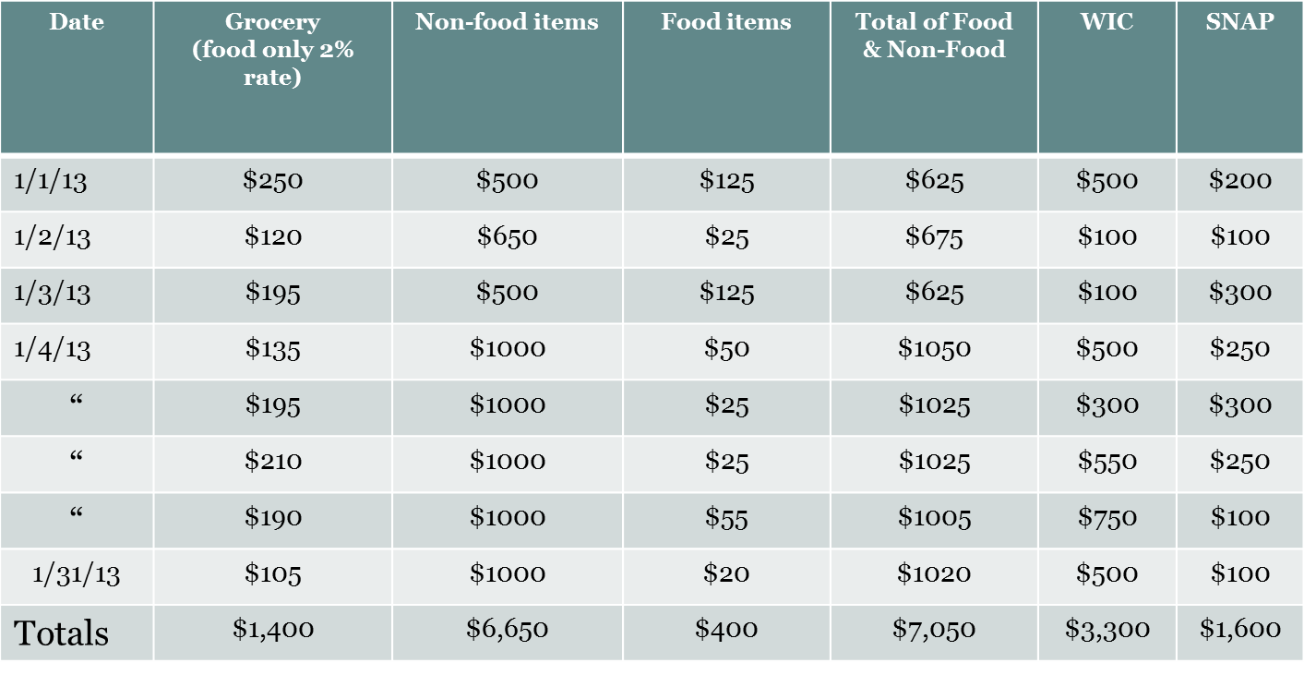
Sample Ledger
SAMPLE ONLY
Notes:
This is a sample of a ledger we have accepted before…
As you can see there is a column for:
Food only groceries taxed at 2%
Non-food items taxed at 4.75%
A column for food items that are taxed at the full tax rate of 4.75% (additional food items)
The food items in this column (if SNAP-eligible) are allowed to be counted as food sales for this review process and added with the 2% food only tax column. However, you must provide documentation such as this that clearly shows where the totals come from
There is an additional slide that will show this information as it is reported on the sales and use tax returns
(NOTE to presenter: Emphasize this point about the additional food items column – it is imperative vendors know the difference and are able to supply us with this information if requested)

Slide 36
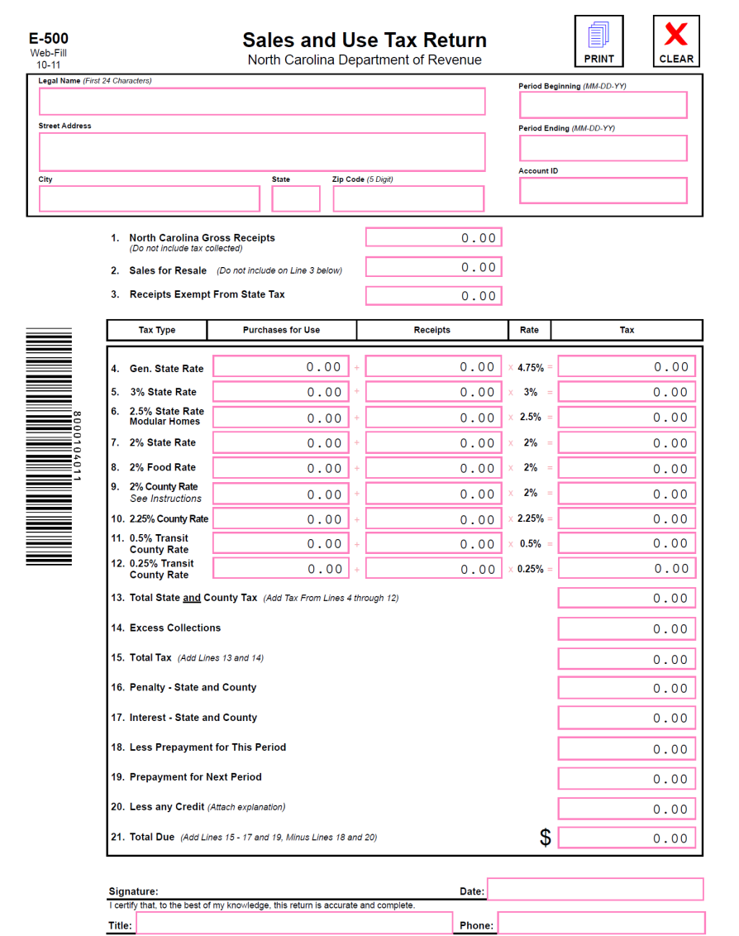
Different Types of Documentation
Sales and Use Tax Return
  If your store files electronically, it is recommended that you keep a copy for your records as this documentation may be requested as additional documentation
  Additional information may still be requested from the State WIC Agency if these forms are submitted as documentation
Notes:
This is a copy of the Sales and Use Tax Return form you or your accountant completes when you file your monthly/quarterly sales revenue to the NC Department of Revenue
If your store files electronically, it is recommended that you keep a copy for your records as this documentation may be requested as additional documentation
If you decide to submit these forms as the required documentation, please be aware that this documentation may not be sufficient. We may need additional information from you.

Slide 37
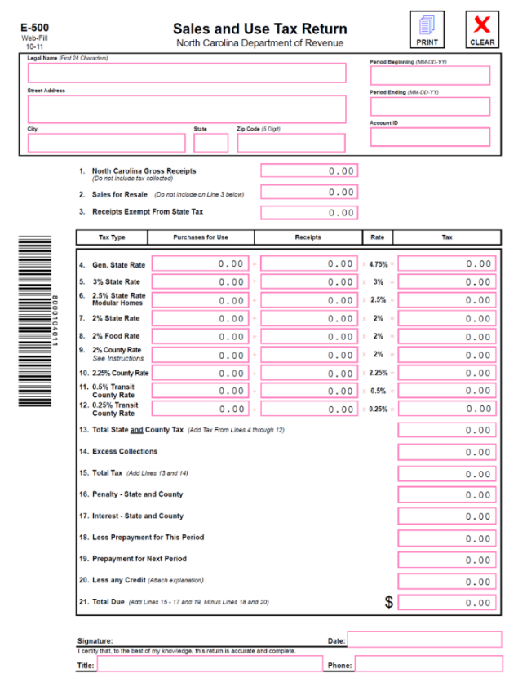
Type of Tax Rates
Tax Type Column
  Line 8
    2% Food Rate
    Any food sold that only requires a tax of 2%
Receipts Column
  Line 8
    Dollar ($) total of food sold at the 2% food rate
Notes:
If you submit this form to the State WIC Agency, they will first look at the Tax Type Column and find the line defined as “2% Food Rate” – this is usually on Line 8. Then, they look at the dollar amount in the Receipts Column.
They take this amount from each month’s return for the 12 months in review and total it. If this total amount added with your SNAP sales for the same time period is greater than your WIC sales, then your store is eliminated from being classified as a PWV for the year.
If this total amount added with your SNAP sales for the same time period is less than your WIC sales, then your store could be classified as a PWV. If you feel your store should not fall in this category, it is your responsibility to provide further documentation to verify this.

Slide 38

Types of Tax Rates
Tax Type Column
  Line 4
  General State Rate
Receipts Column
  Current % 4.75
  Food items may also be reported in this column
SNAP-eligible food sales possibly included
Notes:
This slide shows what we discussed a few slides back. Sometimes it is necessary for vendors to separate food items from non-food items from what is reported in line 4 for of this form.
So, to help with additional documentation you should examine items you report on line 4 of the return. It is very important for vendors to keep a record of SNAP-eligible foods sold and reported on line 4 of the Sales & Use Tax Return. It will be needed to verify additional cash food sales if requested by the State WIC Agency.
This is where the ledger I spoke of comes into play. The ledger is actually the verifiable documentation and the Sales and Use Tax return is the back-up to the ledger information. For purposes of reporting to WIC you must identify the SNAP-eligible food items and separate them from the non-eligible food items and the non-food items in order to determine what revenue is allowed for review

Slide 39
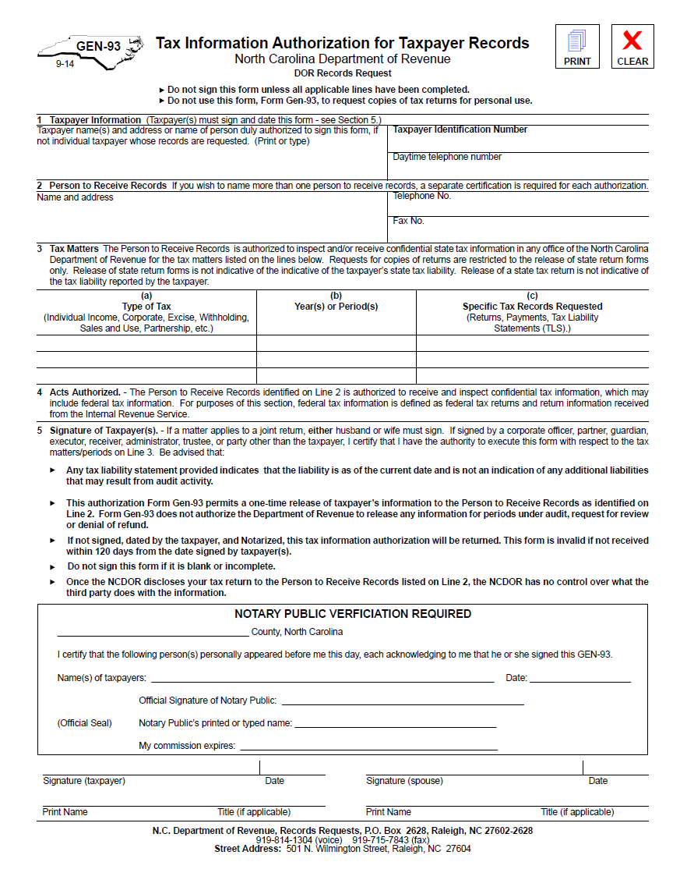
GEN-93 FORM
Release of Tax Information Form
Authorizes WIC to acquire the vendor’s E-500 forms directly from Department of Revenue (DOR)
Must be completed accurately matching what DOR has on file for store
Must be notarized
Notes:
This is a copy of a GEN-93 form.
As mentioned, you may be requested to submit this form. It will enable the Vendor Unit to request copies of a vendor’s E-500 forms directly from the Department of Revenue, if necessary.
If a vendor is requested to submit this form, it must be completed accurately by the vendor. The name of the store, the owner and Tax Payer Identification Number must match exactly with how a vendor files his/her returns. If the information provided does not match exactly how a vendor files the store’s Sales and Use Tax returns, the Gen-93 must be resubmitted with correct information and notarized again.

Slide 40
Submitting False Information
Vendors must not submit false, erroneous, or misleading information to the State or Local WIC Agency
Failure to comply will lead to denial of a vendor applicant’s authorization or termination of an authorized vendor’s WIC Vendor Agreement
The store must wait 1 year to become eligible to reapply for WIC vendor authorization
Notes:
Vendor applicants and authorized vendors must not submit false, erroneous, or misleading information to the State or Local WIC agency. Failure to comply with this requirement will result in the denial of a vendor applicant’s authorization and termination of an authorized vendor’s WIC Vendor Agreement. Additionally, the store must wait one year to be eligible to reapply for WIC vendor authorization.

Slide 41
Equitable Treatment
Section 246.12(h)(3)iii of the Federal WIC Regulations requires WIC-authorized vendors to offer WIC customers the same courtesies that are offered to other (non-WIC) customers
  WIC customers cannot be excluded from in-store promotions
Failure to provide the same courtesies to WIC customers is a violation of Federal WIC Regulations, thereby constituting a vendor violation
  Discrimination on the basis of WIC participation
  May result in disqualification
Notes:
WIC authorized vendors may not treat WIC customers differently from non WIC customers by excluding them from in-store promotions. This includes disallowing the use of coupons or other vendor discounts in WIC transactions that are allowed in non WIC transactions. This information is found in Section 246.12 (h)(3)iii of the Federal WIC Regulations.
Similarly, WIC authorized vendors may not treat WIC customers differently by offering them incentive items, vendor discounts, coupons or other promotions that are not offered to non WIC customers. Failure to provide the same courtesies to WIC customers is a violation of Federal WIC Regulations, thereby constituting a vendor violation.
Failure to provide the same courtesies to WIC customers is a vendor violation and may result in disqualification of one year, for two occurrences within a 12-month period of discrimination on the basis of WIC participation as referenced in Item (31) of Rule .0708. Each date this violation is detected is a separate occurrence;
Item (31) states that a WIC authorized vendor should not discriminate on the basis of WIC participation, such as failing to offer WIC customers the same courtesies offered to other customers or requiring separate WIC lines.

Slide 42
Definitions
Incentive item - an item or service provided by a vendor to attract customers or encourage customer loyalty
Vendor discount - an in-store promotion that reduces the price or increase the quantity of a given product; a vendor discount could also result from the use of a coupon
In-store promotion - a sales promotion in which a vendor may offer incentive items, vendor discounts or coupons in order to increase sales of certain items or to encourage customer loyalty to the vendor
Notes:
Let’s go over the definitions for incentive items, vendor discount, and in-store promotions.
An Incentive Item is an item or service provided by a vendor to attract customers or encourage customer loyalty.
A Vendor Discount is an in-store promotion that reduces the price or increases the quantity of a given product; a vendor discount could also result from the use of a coupon.
In-store promotion is a sales promotion in which a vendor may offer incentive items, vendor discounts or coupons in order to increase sales of certain items or to encourage customer loyalty to the vendor.

Slide 43
Incentive Items
Incentive items must be approved by the North Carolina WIC Program prior to providing them to WIC customers
The North Carolina WIC Program may approve incentive items-including food, merchandise or services-that a vendor obtained at no cost or that cost a vendor less than $2.00. Vendors may also provide food sales or specials (vendor discounts) that involve no cost or cost the vendor less than $2.00
Notes:
Incentive items must be approved by the North Carolina WIC Program prior to providing them to WIC customers.
The North Carolina WIC Program may approve incentive items-including food, merchandise or services-that a vendor obtained at no cost or that cost a vendor less than $2.00. Vendors may also provide food sales or specials (vendor discounts) that involve no cost or cost the vendor less than $2.00. This includes bonus size food items that were obtained from the manufacturer at no cost to the vendor as well as any other types of vendor discounts as long as the cost to the vendor of providing these vendor discounts is less than $2.

Slide 44
Approval for Incentive Items
To obtain approval to provide incentive items to WIC customers, a vendor must submit a written request directly to the North Carolina State WIC Agency.
WIC vendors cannot offer incentive items to WIC customers without approval from the State WIC Agency
Notes:
To obtain approval to provide incentive items to WIC customers, a vendor must submit a written request directly to the North Carolina State WIC Agency.
WIC vendors cannot offer incentive items to WIC customers without approval from the State WIC Agency.

Slide 45
Approval for Incentive Items continued
Following is a list of prohibited incentive items:
  Assistance applying for WIC benefits
  Transportation for WIC customer to and/or from vendor premises
  Delivery of WIC supplemental foods
  Lottery tickets
  Cash gifts
  Any other service that results in a conflict of interest, any item that incurs a liability to the WIC Program or violates any Federal, State or Local law or regulation
Notes:
Following is a list of prohibited incentive items:
Assistance applying for WIC benefits
Transportation for WIC customer to and/or from vendor premises
Delivery of WIC supplemental foods
Lottery tickets
Cash gifts
Any other service that results in a conflict of interest, any item that incurs a liability to the WIC Program or violates any Federal, State or Local law or regulation.

Slide 46
In-Store Promotions and Coupons
Allowing WIC customers to use vendor discounts in WIC purchases reinforces wise food purchasing practices
Vendor staff/cashiers should be well-informed about the use of different types of in-store promotions and coupons
  Understand the temporary nature of some offers in order to reduce confusion at the point of sale
  Know how to properly transact eWIC using in-store promotions and coupons
Notes:
Allowing WIC customers to use vendor discounts in WIC purchases reinforces wise food purchasing practices, which is a goal of WIC nutrition education.
You should ensure that your staff/cashiers are well informed about the use of different types of in-store promotions and coupons so that both participants and the WIC Program are able to achieve the maximum benefit from such offers.

Slide 47
Types of In-Store Promotions and Coupons
Buy One, Get One Free (BOGO)
Buy One, Get One at a Reduced Price
Free Ounces Added to Food Item by Manufacturer (Bonus Size Items)
Transaction Discounts
Store Loyalty/Rewards Cards
Manufacturers’ Cents Off Coupons
Notes:
There are several types of in-store promotions and coupons that your store may offer, some of which are listed on the screen. Please refer to your Vendor Manual for detailed definitions of each type of promotion.

Slide 48
In-Store Promotions: BOGOs and eWIC
Per the USDA WIC EBT Operating Rules:
In a true BOGO, the free item cannot be deducted from the WIC customer’s benefit balance or reported to the State Agency
If a food item is advertised as “Buy one, get one free” with the disclosure that each item is sold for half the advertised price, both food items shall be redeemed using WIC benefits and shall reflect an item price of half the advertised price in the transaction
  Quantity discount
  If using this methodology for BOGOs, vendors must put this disclosure in store advertising
Notes:
Per the USDA WIC EBT Operating Rules:
In a true BOGO, the free item cannot be deducted from the WIC customer’s benefit balance or reported to the State Agency.
If a food item is advertised as “Buy one, get one free” with the disclosure that each item is sold for half the advertised price, both food items shall be redeemed using WIC benefits and shall reflect an item price of half the advertised price in the transaction.
This is a Quantity discount
If using this methodology for BOGOs, vendors must put this disclosure in store advertising

Slide 49
Sales Tax & Cash Back
Sales Tax on Manufacturers’ Coupons
  Not permitted to tax WIC items, so cannot charge WIC customers tax on manufacturer’s coupons
Cash Back
  Not permitted as a result of vendor discount in any WIC transaction
Notes:
Now let’s discuss sales tax and cash back:
Sales Tax on Manufacturers’ Coupons is not permitted on WIC items. Vendors cannot charge WIC customers tax on manufacturer’s coupons. Cash Back is not permitted as a result of a vendor discount in any WIC transaction. In a transaction that only includes WIC items, all vendor discounts must be applied to the WIC transaction, thus benefiting the Program.

Slide 50

What about
exchanges?
Identical items only when:
  Defective
  spoiled or
  has exceeded its “best if used by” or “sell by” date on the date of purchase
Notes:
Another important topic vendors always ask about concerning redemption of benefits is exchanges. Exchanges of identical items are allowed when it is determined that they are defective or spoiled.
Exchanges are also allowed when items have exceeded their “best if used by” or “sell by” date on the date of purchase.
Photo Credit: blond man thinking_Fotolia_82668318_Subscription_L.jpg

Slide 51
eWIC Payments
Through the Banking System

Slide 52
Automated Clearing House (ACH)
Vendors will receive payment for all eWIC transactions processed in their store through an Automated Clearinghouse (ACH) system in which payments are directly deposited into their bank account
With eWIC, most items will have an NTE
If a vendor submits an item price that is above the NTE (for the items with NTEs), their payment will be decreased to the NTE amount for the item
Notes:
Vendors will receive payment for all eWIC transactions processed in their store through an Automated Clearinghouse (ACH) system in which payments are directly deposited into their bank account. With eWIC, most items will have an NTE. If a vendor submits an item price that is above the NTE (for the items with NTEs), the payment will be decreased to the NTE amount for the item.

Slide 53

Changes in Vendor Bank Accounts
Vendor applicants that need a stand-beside device, must submit their most current banking information to the eWIC contractor, Solutran
Vendor applicants with integrated cash register systems will provide banking information to their third-party processor to ensure payment for eWIC transactions
Notes:
Vendor applicants submit their most current banking information to the eWIC contractor or their third-party processor to ensure payment for eWIC transactions. Vendors with integrated cash register systems provide banking information to their third-party processor.
PiggyBank_Fotolia_113540_Subscription_L

Slide 54
Vendor Reimbursement Policy
Vendors may not ask the WIC customer to make up the difference in price for eWIC transactions
Vendors are responsible for keeping their prices at or below the NTE for their peer group
Notes:
Vendors may not ask the WIC customer to make up the difference in price for eWIC transactions
Vendors are responsible for keeping their prices at or below the NTE for their peer group

Slide 55
Split Tender Transactions
Customer can pay for an amount that exceeds the CVB maximum
  Example: $10.00 CVB
  Total cost of WIC fruits and vegetables is $10.25. Customer can pay 25¢ plus tax on the 25¢ or use other acceptable methods to pay for the outstanding balance, e.g SNAP which is not taxable
  Vendor submits an eWIC transaction for $10.00 in CVBs
Notes:
Customer can pay for an amount that exceeds the CVB maximum
Example: $10.00 CVB
Total cost of WIC fruits and vegetables is $10.25. Customer can pay 25¢ plus tax on the 25¢ or use other acceptable methods to pay for the outstanding balance, e.g SNAP which is not taxable
Vendor submits an eWIC transaction for $10.00 in CVBs

Slide 56
Food Substitution
Vendors must properly transact the WIC supplemental foods that are listed on the customer’s food benefit balance
Vendors cannot substitute one food subcategory for another unless granted a waiver by the State WIC Agency
  Federal violation that carries 1-year disqualification
    Example: Substituting 1% Milk/Skim Milk for 2% Milk or Whole Milk
Notes:
Vendors must properly transact the WIC supplemental foods that are listed on the customer ’s food benefit balance.
Vendors cannot substitute one food subcategory for another
Federal violation that carries 1 year disqualification
Example: Substituting 1% Milk/Skim Milk for 2% Milk or Whole Milk

Slide 57
Use of Scanning Sheets Prohibited
Vendors cannot use a collection of UPC barcodes on Scanning Sheets, cash registers, computers, tablets, cell phones or any other similar electronic devices to transact eWIC
Failure to comply with this policy could result in termination of their WIC Vendor Agreement
Notes:
Shown on the slide are examples of UPC Codes on electronic devices.
Vendors cannot use a collection of UPC barcodes on Scanning Sheets, cash registers, computers, tablets, cell phones or any other similar electronic devices to transact eWIC.
Failure to comply with this policy could result in termination of their WIC Vendor Agreement.

Slide 58
Ideas
Keep a copy of the North Carolina WIC Vendor Transaction Guide at each register
Prevent mistakes with good training
Review common errors with staff on a regular basis
Notes:
Here are a few helpful ideas for easier transactions:
Keep a copy of the North Carolina WIC Vendor Transaction Guide at each register.
Prevent mistakes with good training. You are responsible for training your front-line staff and cashiers.
Review common errors with staff on a regular basis.

Slide 59
Questions
Notes:
Let’s take a moment for questions

Slide 60


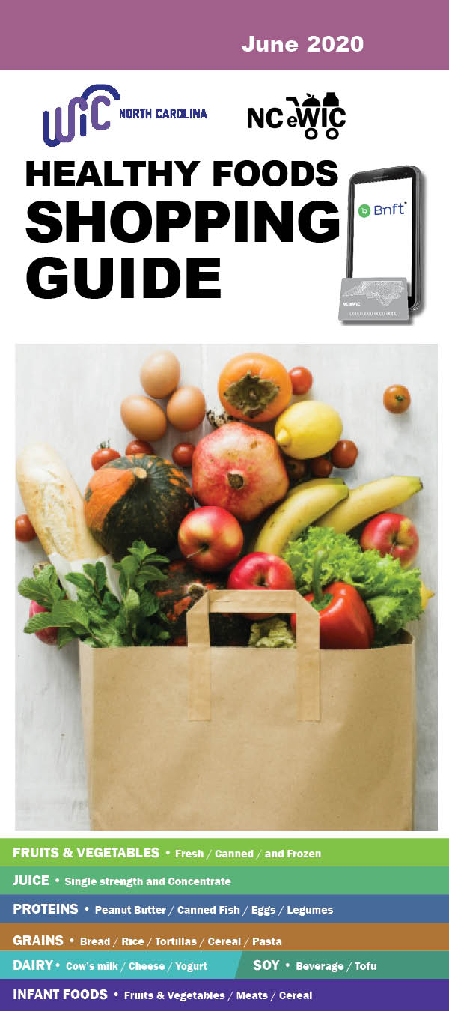


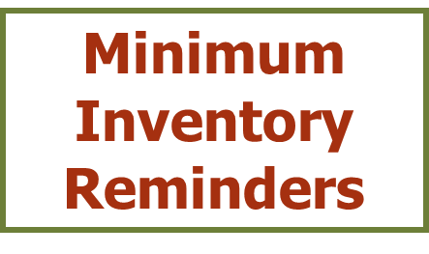
WIC Approved Foods
Authorized Product List
Approved Criteria
Unit of Measure
Notes:
The implementation of eWIC has allowed North Carolina to develop a robust Authorized Product List or APL. The APL consists of all the WIC approved foods that meet Federal and State criteria and can be purchased by WIC participants. To ensure that only WIC approved foods may be purchased using WIC food benefits, the most current APL must be uploaded to the your cash register system. The most updated APL can be found on the website: www.nutritionnc.com under “eWIC for Vendors”.
Shoppers can find WIC approved foods information in their Bnft app or in the print edition of the Healthy Foods Shopping Guide available at County WIC offices statewide.
This portion of the presentation:
Reviews for each category of WIC approved food:
the approved criteria;
the unit of measure;
and the Minimum Inventory requirements, if applicable; and
Discusses the process for product UPC submission and update to the Approved Product List.

Slide 61
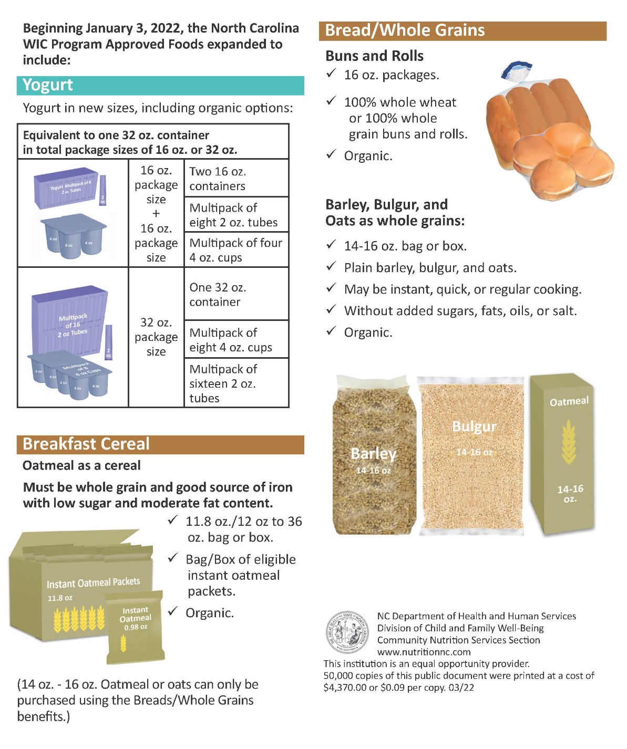
WIC Approved Foods
Notes:
The NC WIC Program approves a variety of nutritious foods that are in compliance with federal and state regulations.
WIC foods are approved based on criteria such as nutrient specifications; availability and cost. Food products which meet the specification can be submitted for North Carolina WIC APL consideration and each item is being reviewed individually by a Registered Dietitian/Nutrition Consultant.
In January 2022, the North Carolina WIC Program Approved Foods expanded to include:
Bread/Whole Grain
o 100% whole wheat or 100% whole grain buns and rolls in 16 oz package size
o Whole grain Barley/Bulgar/Oats without added sugars, fats, oils, or salt. May be instant, quick, or regular-cooking, in 14 oz to 16 oz size package.
• Yogurt in the following sizes:
o 4 - 4 oz containers = 16 oz package size
o 8 - 4 oz containers = 32 oz package size
o 8 - 2 oz yogurt containers = 16 oz package size
o 16 - 2 oz yogurt containers = 32 oz package size
• Oatmeal/oats or other whole grain hot cereals
o individual serving packets in total container size of minimum 11.8 oz or 12 oz to 36 oz package which meets nutrition criteria for breakfast cereals.

Slide 62
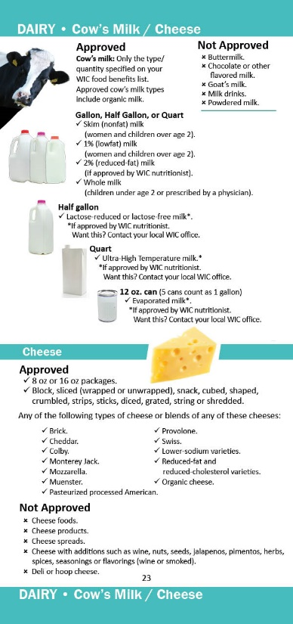
Milk
Approved Criteria
  Pasteurized cow’s milk
    Skim/1%/2%/Whole
    Lactose-reduced/free
    Ultra High Temperature (UHT)
    Evaporated
    Organic
  Gallons, half gallons, quarts and cans*
*Evaporated milk only
Notes:
Let’s first discuss the Milk food category. A variety of cow’s milk options are available including skim, 1%, 2%, whole, lactose-reduced or lactose free cow’s milk. Shelf stable cow milk options include ultra high temperature and evaporated milk.
The container sizes are gallon, half gallon and quart. Evaporated milk comes in a 12 oz can.
Most participants receive skim or 1% milk in their food benefits. Children under 2 years of age are issued whole milk. Some participants may also be issued 2% milk. Because family benefits are aggregated, it is possible to see families purchase a variety of types of milks at the grocery store.
WIC participants are only able to purchase the type of milk issued on their food benefit account. So, if a participant is issued skim/1% milk, and they try to purchase 2% milk, it will not be an allowable WIC food for purchase and will not be available using their eWIC benefits.
WIC participants are allowed to purchase the brand of milk they wish as long as that brand of milk is on the APL and they have that type and amount available in their food benefits. In other words, participants are not required to choose the least expensive brand of milk.

Slide 63
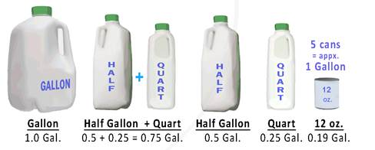
Milk
Unit of Measure
GAL = 1 Gallon
Notes:
The unit of measure for milk is “Gal” indicating one gallon or a combination of sizes that add up to one gallon.
For example, if a family has “1 Gal” of whole milk available to be purchased in their food benefit account, they could purchase a quart of whole milk today and leave a remaining 0.75 Gal of whole milk left in their food benefit account. At their next trip to the store, they could get up to 3 quarts OR a half gallon plus a quart of whole milk to utilize their food benefits before they expire.
As you will notice when reviewing the evaporated milk, one 12 oz can is equal to 0.1875 gallons (rounding to .19). The conversion utilized by the NC WIC Programs equates approximately 5 cans to one gallon of milk.
Photo Credit: Designed by DCFW Graphic artist

Slide 64

Milk
Two (2) types required…
  Skim/Low fat
  Whole
Quantity required…
  Skim/1% = six (6) gallons
  Whole = two (2) gallons
Notes:
Both skim/low fat milk and whole milk are required types of milk with the minimum inventory requirement of six (6) gallons for skim/1% milk and two (2) gallons for whole milk.
Although 2% milk cannot be used to satisfy the minimum inventory/variety requirement for Low fat milk, vendors are still encouraged to carry 2% milk in their store.
Photo credit: Milk half gal_71995983_Subscription_XXL.jpg

Slide 65

Cheese
Approved Criteria
8-ounce and 16-ounce (1 Pound) sizes of all types of approved packaged cheese
Low-sodium varieties
Reduced-fat/cholesterol varieties
Organic or Regular
Types:
  Cheddar (Mild, Medium, Sharp, Extra Sharp)
  Colby
  Monterey Jack
  Pasteurized Processed American
  Mozzarella
  Muenster
  Provolone
  Swiss
Notes:
Approved forms of cheese include both the eight (8)-ounce and sixteen (16)-ounce sizes of block, sliced, snack, cubed shaped, crumbled, strips, sticks, diced, grated, string or shredded cheese.
Participants have a variety of types of cheese to choose from including:
Cheddar (Mild, Medium, Sharp, Extra Sharp), Colby, Monterey Jack, Pasteurized Processed American, Mozzarella, Muenster, Provolone, Swiss.
Participants are not required to purchase the least expensive brand of cheese.
Photo Credit: Slices of Cheddar Cheese_Fotolia_96367612_Subscription_XXL.jpg

Slide 66
Cheese
Unit of Measure
CTR = 1 (16-ounce) package or
      2 (8-ounce) packages
Required Package size…
    one (1) pound (16 ounces)
Quantity required…
    two (2) pounds
Only one (1) approved type required
Notes:
Unit of Measure: CTR = 16-ounce (1 pound) package or 2 8-ounce packages
The unit of measure for cheese is 1 container which equals one 16 oz package (1 pound) or 2-8 Ounce packages.
The minimum inventory requirement for cheese requires vendors to have at least two (2) one-pound packages available. Only one (1) type of approved cheese is required.

Slide 67
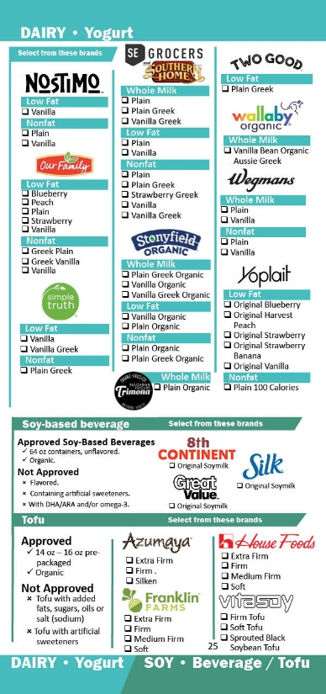
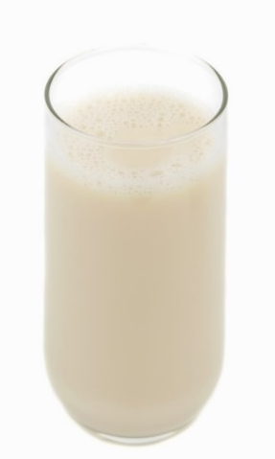
Soy-Based Beverage
Approved Criteria
Half gallon containers
Unflavored
Meets nutrient requirements
Organic
Unit of Measure
GAL = Equivalent to 1 Gallon
Notes:
Soy-based beverages are allowed as a substitution for some or all of a participant’s milk. Unflavored soymilk in 64 oz. containers that meet FDA’s fortification requirements are approved. Organic Soy milk can be approved based on if it meets nutrient requirements.
Currently, There are three brands available:
8th Continent – Soymilk Original
Great Value-Original Soymilk
Silk Original Soymilk
The unit of measure for milk is “Gal” indicating gallon and is equivalent to 1 Gallon.
Photo Credit: Soy Milk Glass1_Fotolia_10268492.jpg

Slide 68

Tofu
Approved Criteria
14- to 16-ounce prepackaged
Calcium-set tofu
Can contain coagulants
Organic
Unit of Measure
CTR = 14- to 16-Ounce Package
Notes:
Tofu can also be prescribed as a substitution for milk. The approved tofu for WIC must be calcium-set. The unit of measure is container (CTR) It is approved in a range of package sizes from 14 to 16 ounces. Currently various brands of tofu are approved that include a variety of types from silken to extra firm tofu. Organic tofu is approved.
1 Container of tofu is equivalent to one 14 to 16 oz package.
Photo Credit: Tofu_Fotolia_151100_Subscription_L.jpg

Slide 69
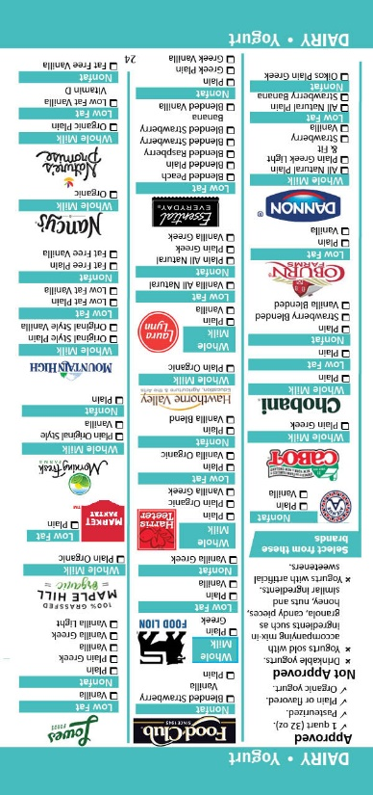
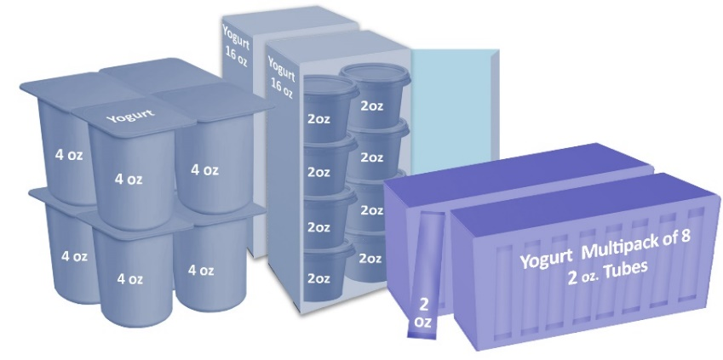
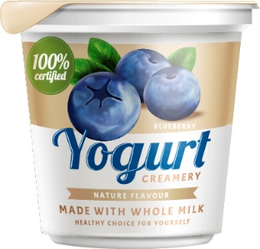
Yogurt
Approved Criteria
Equivalent to one 32 oz. container in total package sizes of 16 oz. or 32 oz.
Regular or organic
Pasteurized
Flavored and unflavored
< 40 grams sugar per cup
Fortified with Vitamin A and D
Non-fat, Low-fat, Whole-fat yogurt
Unit of Measure
CTR = One Quart/Total 32 Ounces
Notes:
Yogurt is an additional milk substitution that is available to participants.
One quart of yogurt may be included on a food prescription in place of one quart of milk. The maximum issuance is one quart which is equivalent to 32 oz. container in total package sizes of 16 oz. or 32 oz.
To be approved, the yogurt must:
- be Pasteurized, and
- Conform to FDA standard of identity for whole-fat yogurt, low-fat yogurt, or non-fat yogurt
- Contain no more than 40 gm sugar per cup (8 oz.)
- and be packaged in an equivalent to one-quart, total 32oz in package sizes of 16 oz. or 32 oz.
Similar to milk, a specific fat content of the yogurt is issued to participants. Participants prescribed skim, 1% or 2% milk who choose a yogurt substitution receive Low-fat or Non-fat yogurt. Participants prescribed whole milk will receive whole-fat yogurt.
One container is equivalent to one quart of yogurt.

Slide 70

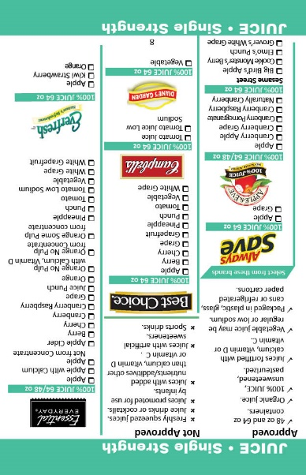
Juice
Approved Criteria
Frozen or Shelf-stable Concentrate:
  11.5 to 12 ounce containers
Single Strength
  48 and 64 ounce containers
100% fruit or vegetable juice or blends
  Unsweetened and Pasteurized
Fortified with Calcium, Vitamin D or Vitamin C
Contains >30mg of Vitamin C per 100 ml
Plastic, glass, cans or refrigerated paper cartons
Organic varieties
Notes:
A variety of juices are available. Both national brands and store brands are approved.
Concentrate juice or single strength juice in 48- and 64-ounce containers are approved.
Approved juices must be 100% fruit or vegetable juice blends that are unsweetened and pasteurized.
The juices must contain at least 30mg of Vitamin C per 100 milliliters of juice and may be fortified with Calcium, Vitamin D or Vitamin C.
Plastic, glass, cans and refrigerated cartons are approved in addition to organic options.

Slide 71
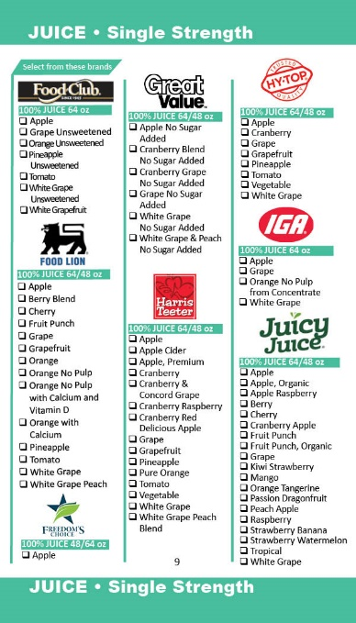
Juice
Food Packages
Pregnant, Postpartum, and
Breastfeeding Woman
Unit of Measure
  1 CTR Juice (48 oz Fluid) =
  1 - 48 oz Single Strength or
  1 - 11.5-12 oz Concentrate
Child
Unit of Measure
  1 CTR Juice 64oz Fluid =
  1 -64 oz Single Strength
Notes:
Please note that women’s food packages include 48 oz single strength juice or 11.5 – 12 oz concentrate and children’s food packages include 64 oz single strength juice.
So a family may have all of the various types of juice available in their food benefit balance to purchase.

Slide 72
Juice
(Single-Strength)
Two (2) sizes required…
  48-ounce container
  64-ounce container
Quantity required…
  48-ounce container = four (4) containers
  64-ounce container = four (4) containers
Concentrated Juice = NOT REQUIRED
Notes:
For juice, the minimum inventory requirement is for single-strength juice only. There is no minimum inventory for concentrated juice.
The minimum inventory requirement for single-strength juice is four (4) 48 oz containers and (4) 64 oz containers

Slide 73
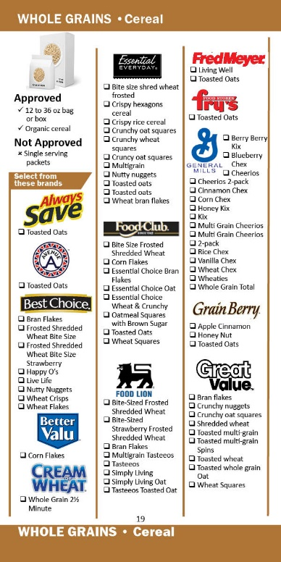
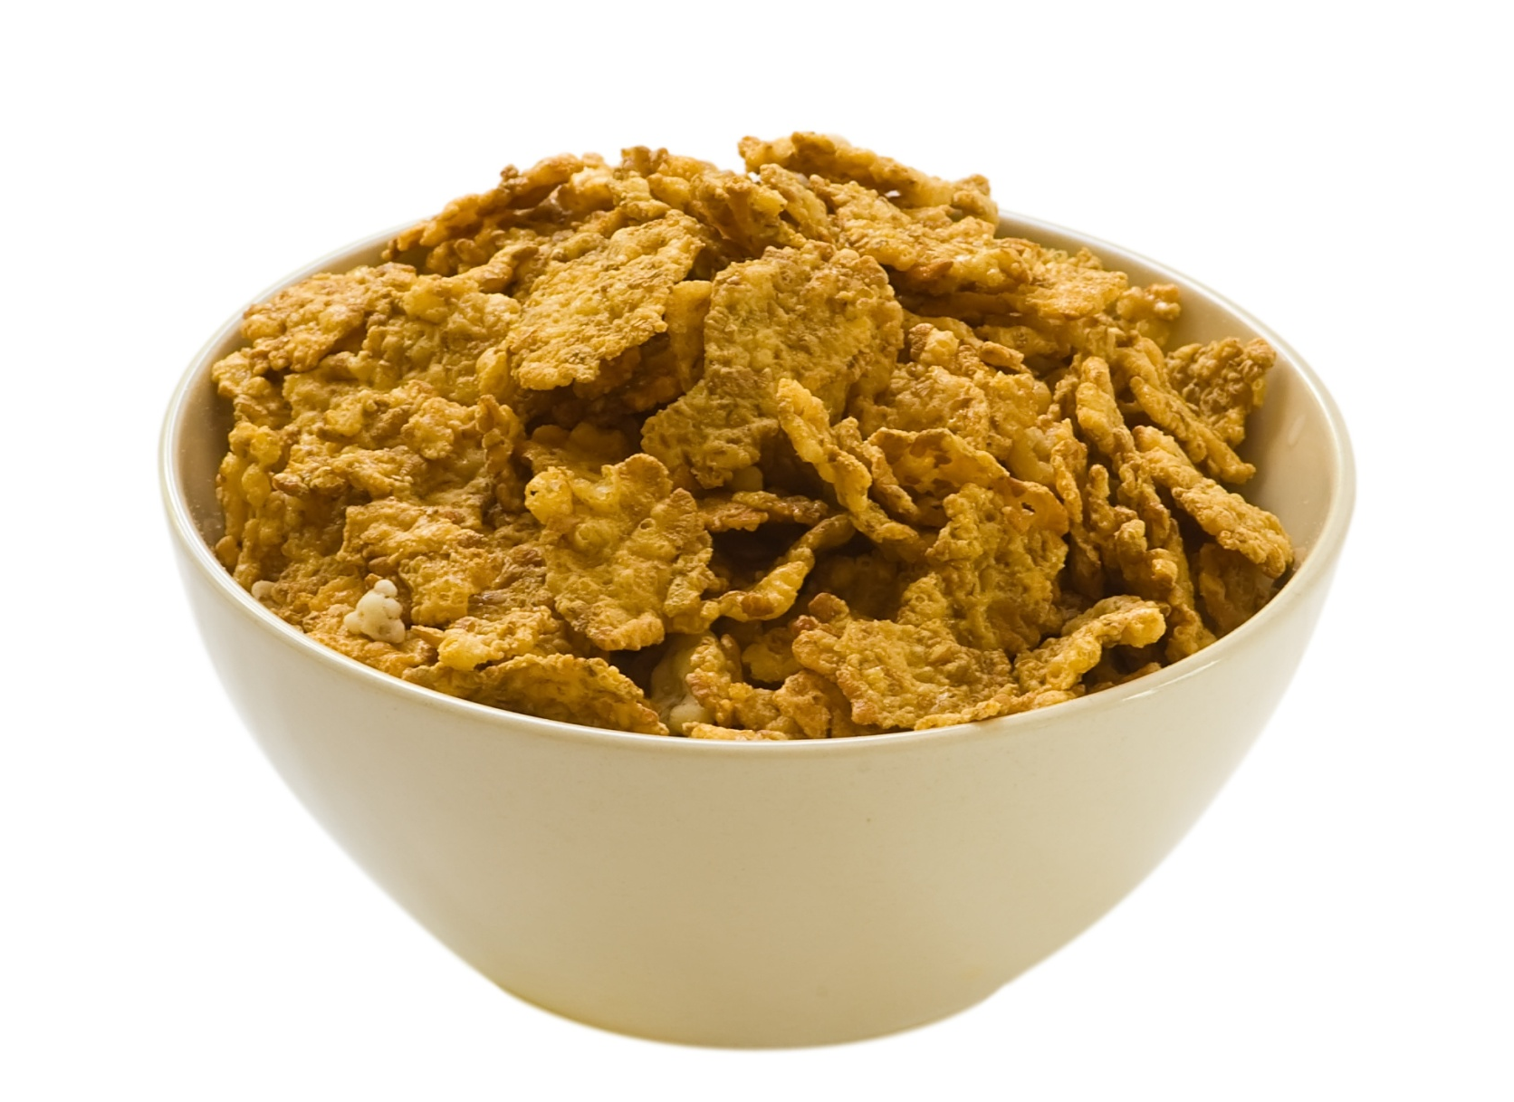
Cereal
Approved Criteria
11.8 ounce-12 ounce or larger box or bag, regular or organic
Ready to eat
Instant and regular hot cereal
Organic
Notes:
Participants have a variety of national and store brands to choose from. Approved cereals are 11.8 ounces-12 ounces or larger in a box or bag including ready to eat, instant or regular hot cereal.
The “approved” criteria for cereal include:
-At least 28 mg iron per 100 g dry cereal
-Less than or equal to 6 gm of Sugar per dry ounce of cereal
-Includes whole grain as the primary ingredient by weight AND meets labeling requirements for making a health claim as a “whole-grain food with moderate fat content”
14oz. -16oz. Oatmeal or oats can only be redeem using the Bread/Whole Grains benefits.
Photo Credit: Cereal3_Fotolia_22865129.tif/DCFW Graphic artist

Slide 74
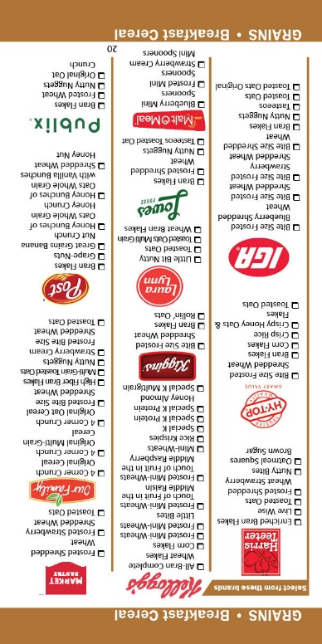
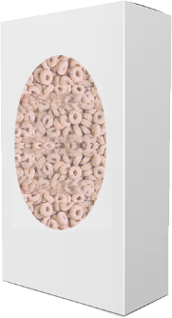


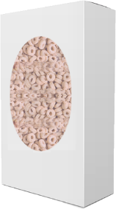
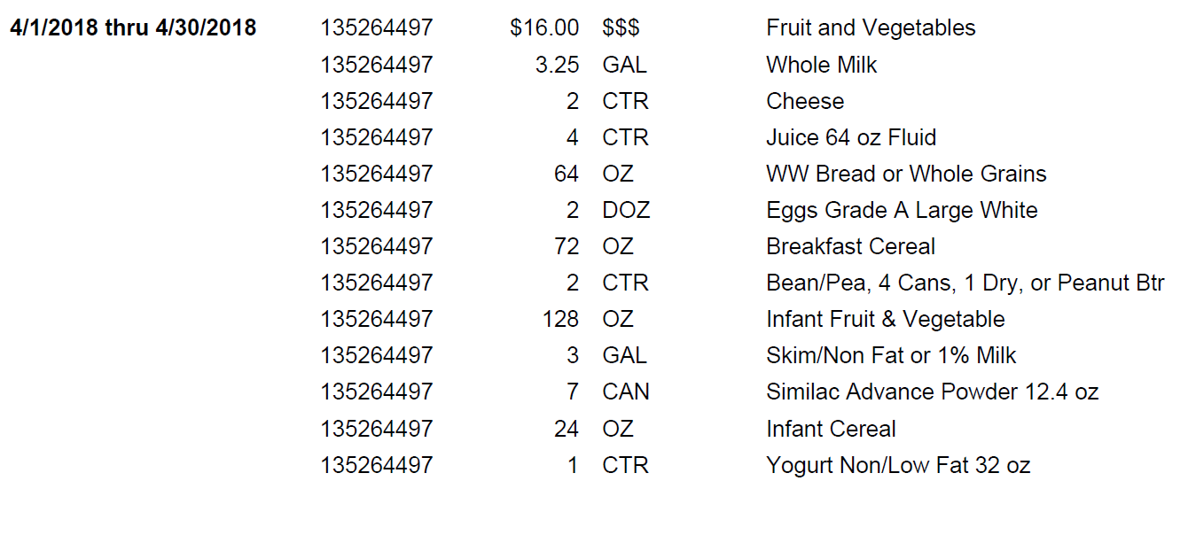
Cereal
Unit of Measure
OZ = OUNCE
72 OZ
12 oz
12 oz
12 oz
18 oz
18 oz
Notes:
The unit of measure for cereal is OZ and is equivalent to 1 ounce of cereal. Women and children participants are prescribed up to 36 ounces of cereal.
A family can purchase a combination of approved brands and sizes up to the amount of ounces of cereal in their food benefit account.
For example, if a family has 72 oz of breakfast cereal available on their food benefit account, they can purchase three, 12-oz boxes at their first shopping visit and then two 18 oz boxes at their 2nd shopping visit. Similarly, a family may purchase one box of cereal at a time until they reach 72 ounces within that month of issuance.
Photo Credit: DCFW Graphic artist

Slide 75
Cereal
Required package size…
  12-ounce package (minimum size)
Quantity required…
  six (6) packages
Two (2) approved types whole grain cereals required
Notes:
There is a minimum inventory requirement for cereal.
Vendors are required to carry a minimum of two types of whole grain cereal. The minimum package size is 12 oz.. and the minimum number of packages you can carry is six.

Slide 76
Whole Grain Cereal vs.
Non-Whole Grain Cereal
Only whole grain cereal can count toward minimum inventory
Some non-whole grain cereal is currently listed in our authorized product list (APL) and allowed for purchase; however, they cannot be counted toward minimum inventory. Examples include:
    Rice Krispies (various brands)
    Corn Flakes (various brands)
    Special K
    Corn Chex
    Rice Chex
    Cinnamon Chex
    Blueberry Chex
Notes:
Whole grain cereal can count towards minimum inventory. Some non-whole grain cereal which are currently approved in the Authorized Product List, cannot count toward minimum inventory. Example includes, various brands of Corn Flakes, Rice Krispies or other rice cereals, Special K, Corn Chex, and Rice Chex, Cinnamon Chex, and Blueberry Chex, .

Slide 77
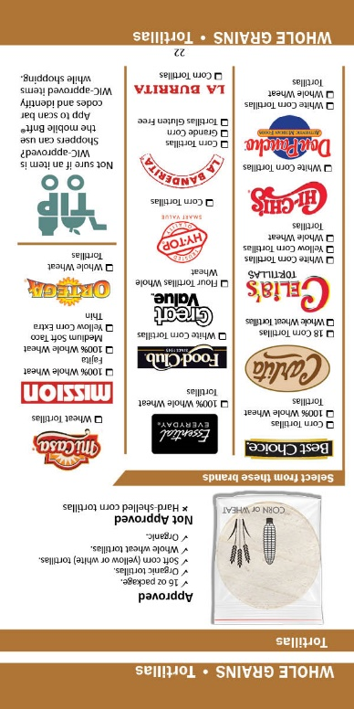
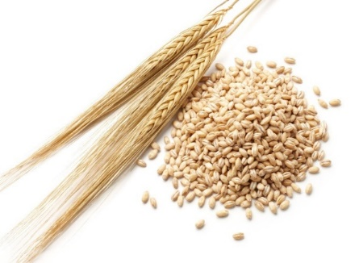
Bread/Whole Grains
Approved Criteria
Whole wheat tortillas
Soft corn tortillas
Whole grain/whole wheat bread/Buns/Rolls
Brown rice
Whole wheat pasta
Whole grain Barley
Bulgur
Oats
Notes:
Five whole grain options are available for participants. Allowed whole-grain products include:
Whole grain/whole wheat bread/Buns/Rolls
brown rice
whole wheat pasta and
whole wheat and soft corn tortillas.
Whole grain Barley
Bulgur
Oats

Slide 78
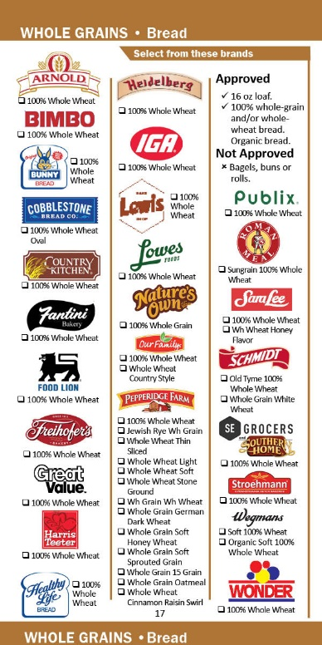
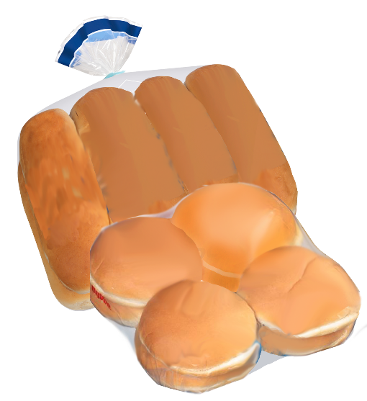

Breads/Buns/Rolls
16-ounce loaf, regular or organic
100% whole-grain and/or whole-wheat bread/Buns/Rolls
Notes:
Participants are allowed to select an approved loaf of bread/buns/rolls that is 16 ounces and made with only whole wheat flour and/or bromated whole wheat flour for a whole wheat bread/buns/rolls.
Breads/Buns/Rolls that contain other flours are not approved.
Photo Credit: Bread Sliced_Fotolia_7513047.jpg/DCFW Graphic Artist

Slide 79
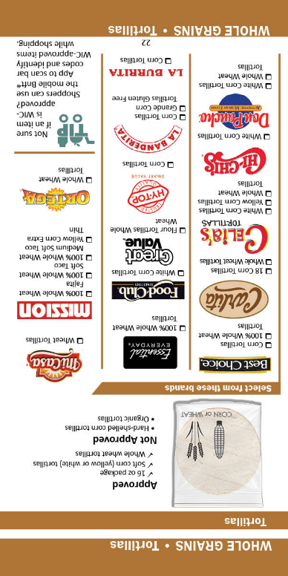

Tortillas
16-ounce package regular or organic
Soft corn tortillas (yellow or white)
Whole wheat tortillas
Notes:
Participants are allowed to select a package of tortillas.
To be approved, soft corn tortillas must be made from ground masa flour. Whole wheat tortillas must be made from whole wheat flour.
Photo Credit: Corn Tortillas_Fotolia_27035299.jpg

Slide 80
Breads and Tortillas
Required package size…
  16-ounce loaf of bread
  16-ounce package of tortillas
Quantity required….
  Two (2) loaves or packages OR
  One (1) loaf and One (1) package
Notes:
Stores must carry at least two, 16-oz loaves of bread or two,16-oz packages of tortillas or 1 loaf bread and 1 package of tortillas to equal 2 in their minimum inventory

Slide 81
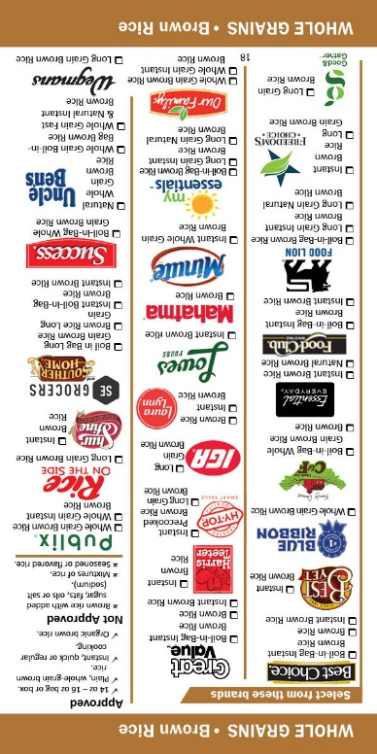

Brown Rice
14 to 16-ounce bag or box, regular or organic
Plain, whole grain brown rice
Instant, quick or regular cooking
Notes:
Participants are allowed to select an approved brand of brown rice. Plain, whole grain brown rice that comes in a 14 to 16 oz bag or box is approved. Instant, quick or regular cooking are approved options.
(Photo Credit: Brown Rice_Fotolia_16759871.jpg)

Slide 82
Brown Rice
Required Package Size…
  14 to 16- ounce package
Quantity Required….
  Two (2) packages
Notes:
The Minimum inventory requirement for brown rice is at least 2, 14 to 16 oz packages.

Slide 83
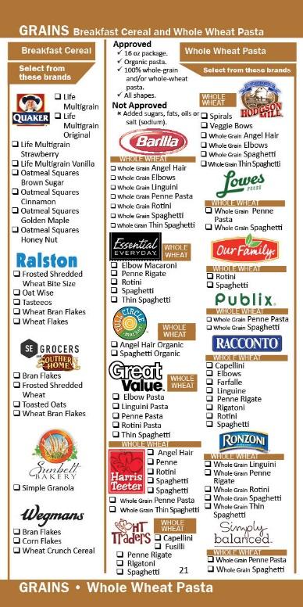

Whole-Wheat Pasta
16-ounce packages regular or organic
100% whole grain and/or whole wheat
All shapes
Notes:
Like all other items in the whole grains category, participants are allowed to select an approved whole wheat pasta.
To be approved the pasta must:
_ conform to the standard of identity
_ have no added sugars, fats, oils or salt
_ whole wheat flour or whole durum wheat flour must be the only flours listed on the ingredient list
Any shape pasta that meets the approved criteria is included. There is no minimum inventory requirement for whole wheat pasta.
Photo Credit: Whole wheat Pasta Spaghetti and Penne_Fotolia_92794316_Subscription_XXL.jpg

Slide 84
Whole Grain Barley/Bulgur/Oats
14 to 16-ounce bag or box, regular or organic
Plain, whole grain barley/Bulgur/Oats
Instant, quick or regular cooking
Notes:
Participants are allowed to select an approved brand of whole grain barley/Bulgur or Oats. Plain, whole grain barley/Bulgur or Oats that comes in a 14 to 16 oz bag or box is be approved. Instant, quick or regular cooking are approved options.
Photo Credit: DCFW Graphic Artist

Slide 85

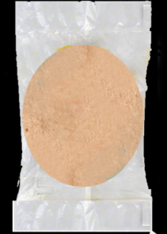

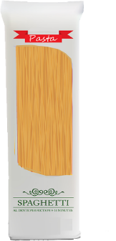
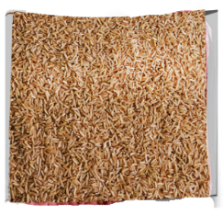
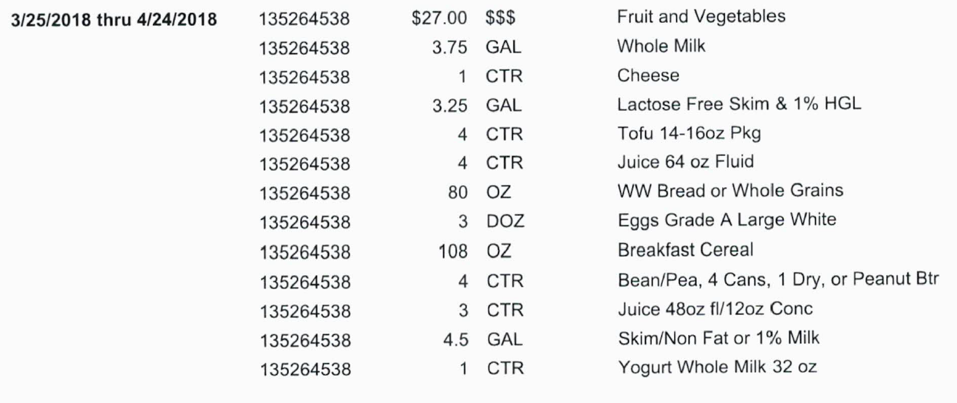
Whole Grains
Unit of Measure
OZ = Ounce
16 oz Rice
80 oz
16 oz Loaf
16 oz Tortilla
16 oz Pasta
16 oz Oatmeal
Notes:
The unit of measure for whole grains is OZ which is equivalent to one ounce of whole grain of choice. Women and children participants are prescribed up to 32 oz ounces of whole grains and can purchase a combination of items from the whole grain category. The subcategory for whole grains default in the food prescription in Crossroads allows participants a choice of brown rice, corn or whole wheat tortillas, bread and pasta when shopping.
Participants will make this choice at the store not in the agency.
In this example, a family can purchase up to 80 oz of whole grains during their month to spend. Mom makes 5 trips to the grocery store and chooses one of each whole grain to equal 80 total ounces of whole grain.
Photo credit: DCFW Graphic Artist

Slide 86
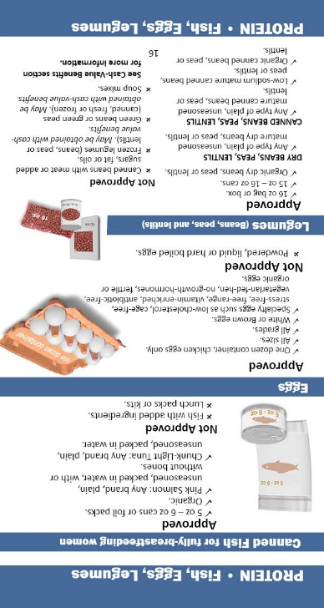

Eggs
Approved Criteria
One dozen chicken eggs of different sizes and grades
  Brown eggs
  Specialty eggs such as low-cholesterol, cage free, stress-free, free-range, vitamin enriched, antibiotic-free, vegetarian-fed-hen, no-growth-hormones, fertile or organic eggs
Unit of Measure
DOZ = 1 Dozen
Notes:
Participants are allowed to select an approved brand of chicken eggs in one-dozen size container when included in their food benefits. Participants are no longer required to purchase the least expensive brand of eggs.
Photo Credit: Eggs2_Fotolia_22337316.jpg

Slide 87
Eggs
Required package size…
  One (1) dozen
Quantity required…
  Two (2) packages
Must be Grade A and large size
White eggs only
Notes:
There is a minimum inventory requirement for eggs
There must be at least two, one-dozen size containers of grade A, large white chicken eggs.

Slide 88

Beans, Peas, and Lentils
Dry
  (Any type) plain, unseasoned mature, regular or organic
  16-ounce bag or box
Canned
  (Any type) plain, unseasoned mature, regular or organic
  Low sodium
  15 to 16-ounce can
Notes:
Dry and canned beans, peas and lentils continue to be approved.
Both types must be plain, unseasoned mature beans, peas, and lentils. Organic is an allowable option.
Please note that frozen mature beans, peas, and lentils are not approved as a legume; however, frozen varieties are approved when using the cash-value benefit for redemption.
Photo Credit: Vegetables on Wooden Spoon on white background_ Fotolia_77226525_Subscription_XXL.jpg

Slide 89
Beans, Peas, and Lentils
Food Benefits
Cash-value Benefits
VS
Mature
Black Beans
Butter Beans
Lima Beans
Garbanzo Beans
Soybeans
Lentils
Split Peas
Vegetable
Green Beans
Green Peas
Snap Peas
Snow Peas
Snap Beans
Garden Peas
Wax Beans
Notes:
Again, only mature beans, peas and lentils, canned and dry are approved. Example of mature beans, peas and lentils are listed on the slide.
Please note that green beans and peas are not mature beans and peas; therefore, they are not allowed as a legume.
There are, however, varieties of green beans and peas which are allowed to be purchased using the cash value benefit. We will talk more about what is approved cash value benefits later in the presentation, but for now this list may provide some clarity.

Slide 90
Beans, Peas, and Lentils
Required package size…
  one (1) pound
Quantity required…
  two (2) packages of dry
Only one (1) approved type required
Canned beans, peas, lentils = NOT REQUIRED
Notes:
There is a minimum inventory requirement for dry beans, peas and lentils, BUT not for canned.
Only one (1) approved type of beans, peas or lentils is required, and there must be at least two (2) one-pound packages.
Canned green beans and peas are NOT dry beans or peas and CANNOT be counted for minimum inventory in this category.
Also, frozen mature legumes cannot be counted for minimum inventory.

Slide 91
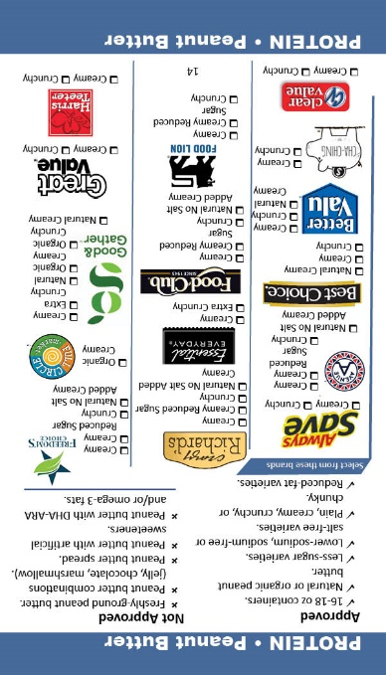

Peanut Butter
16 to 18-ounce container
Less sugar, lower-sodium, salt-free, reduced-fat varieties
Plain, creamy, crunchy, chunky or whipped
‘Natural’, organic varieties
Notes:
Peanut butter is approved in the 16 to 18 ounce container. A variety of types of peanut butter are available.
Photo Credit: An open Jar of Peanut Butter with Spoon_Fotolia_40556509_Subscription_XL.jpg

Slide 92
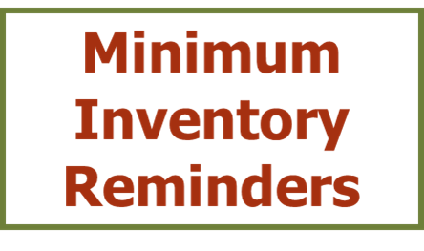
Peanut Butter
Required package size…
  16- to 18-ounce containers
Quantity required…
  two (2) containers
Notes:
The minimum inventory requirement for peanut butter continues to be at least two, 16 to 18-ounce containers.

Slide 93
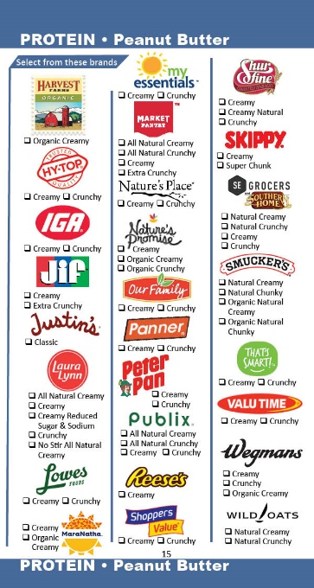

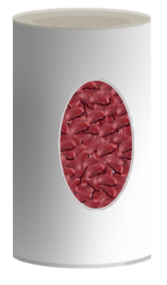
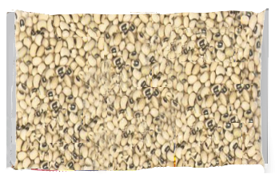
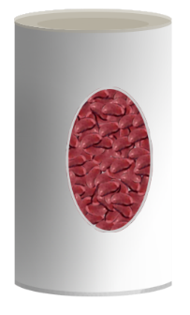

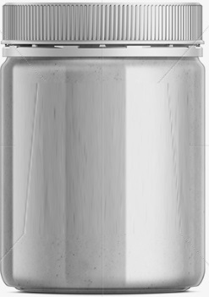
Beans, Peas, Lentils and Peanut Butter
Unit of Measure
OR
1 CTR Beans/Peas or Peanut Butter =
16 oz dry
4 cans (15-16 oz each)
*Note: 1 can = 0.25 Container
OR
Peanut Butter
16-18 oz jar
Notes:
If a family’s food benefits include 1 container of beans/peas or Peanut butter, they have a choice of purchasing one 16 oz bag dried or four (15 to 16) oz cans of mature beans, peas, and lentils OR a 16 to18 oz jar of approved peanut butter.
Participants make a choice of canned or dry beans, peas, or lentils OR peanut butter when shopping.
Photo Credit: Created by DCFW Graphic artist

Slide 94
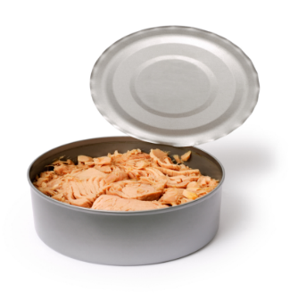
Fish
Unit of Measure
OZ = Ounce
5 to 6-ounce cans or foil packs
Organic
Plain, unseasoned pink salmon
  With or without bones
Chunk-light tuna packed in water
Notes:
Canned fish continues to be an approved item.
Plain unseasoned pink salmon or chunk-light tuna packed in water in 5 to 6 oz cans or foil pouches are approved.
The unit of measurement is OZ which is equivalent to one ounce.
Photo Credit: TunaCanned7_Fotolia_4309159.jpg

Slide 95
Tuna
Required Package Size…
  5 to 6-ounce can
Required Quantity…
  six (6) cans
Notes:
There is minimum inventory requirements for tuna. Vendors are required to carry at least six, 5 to 6-ounce cans.

Slide 96
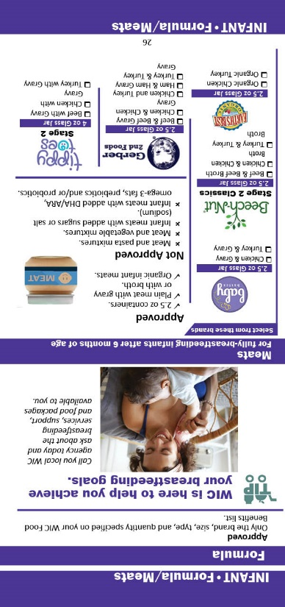
Infant Formula
WIC participants must purchase what is specified on their food benefit account:
      Brand
      Size
      Type
      Quantity
Notes:
WIC participants must purchase the brand, size, type and quantity specified in their food benefit account.

Slide 97
NC WIC Program Contract Formula
Gerber Good Start Gentle®
  12.7 oz cans Powder
  8.1 oz Concentrate Containers (GentlePro)
  33.8 oz Ready to Feed (4 pack of 8.45 oz Containers)
  (GentlePro)
Gerber Good Start SoothePro®
  12.4 oz cans Powder
Gerber Good Start Soy®
  12.9 oz cans Powder
  8.1 oz Concentrate Containers
  33.8 oz Ready to Feed (4 pack of 8.45 oz Containers)
Notes:
The contract formulas are Gerber Good Start Gentle, Gerber Good Start SoothePro, and Gerber Good Start Soy.
The default food package for non-breastfeeding infants in Crossroads is to assign the Gerber Good Start Gentle powder in the 12.7 oz can.
Families may instead receive on their WIC food benefits as discussed with the WIC nutritionist the: Gerber Good Start GentlePro Concentrate, Gerber Good Start SoothePro powder, or Gerber Good Start Soy powder or concentrate formula.
The Gerber Good Start Formulas come in 8.1 oz concentrate containers and 33.8 oz Ready to Feed containers. In addition, there was a name change from “Gerber Good Start Soothe” to “Gerber Good Start SoothePro” Powder.
The ready to feed formula will continue to be packaged as a 4 pack of 8.45 oz containers..

Slide 98
Infant Formula (Powder)
Two types required…
  Gerber Good Start Gentle®
  Gerber Good Start Soy®
Required package size…
  11.0-14.0-ounce cans
Quantities required…
Gerber Good Start Gentle®
    eight (8) cans
Gerber Good Start Soy®
    four (4) cans
  No Minimum Inventory for Concentrate or Ready to Feed
Notes:
The minimum inventory required is: 8 cans of powdered Gerber Good Start Gentle and 4 cans of powdered Gerber Good Start Soy. There is No Minimum Inventory requirements for Concentrate or Ready to Feed formula types.
They must be 11.0 – 14.0 ounce cans.

Slide 99

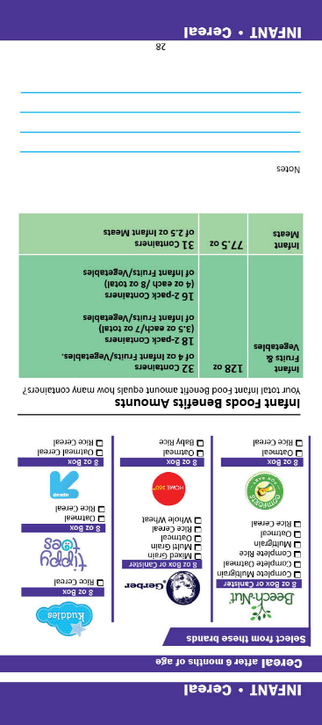
Infant Cereal
8-ounce box of plain, dry infant cereal, regular or organic
Must contain minimum of 45 mgs of iron per 100 grams of dry cereal
Unit of Measure
OZ = Ounce
Notes:
Eight-ounce boxes of plain, dry infant cereal continue to be approved, now allowing organic options.
Infant cereal must contain minimum of 45 milligrams of iron per 100 grams of dry cereal.
Infants after six months of age are allowed up to 24 ounces of infant cereal.
The unit of measure is OZ which is equivalent to one ounce.
Photo Credit: Infant Cereal and Spoon4_Fotolia_9217384.jpg

Slide 100
Infant Cereal
Required package size…
  eight (8)-ounce package
Quantity required…
  six (6) boxes
Only one (1) approved type required
Notes:
The minimum inventory requirement for infant cereal is six, 8-ounce boxes.
It is okay to have just one type or several types as long as there are at least 6 boxes.

Slide 101

Infant Meats
Plain meat with gravy or with broth regular or organic
2.5-ounce containers, single or multi pack
Unit of Measure
OZ = Ounce
Notes:
Infant meats in 2.5 oz. containers are approved.
This food benefit is available to fully breastfeeding Infants between six to eleven months of age and is allowed up to 77.5 ounce of infant meats.
The unit of measure is OZ which is equivalent to one ounce.
Photo Credit: DCFW Graphic artist

Slide 102
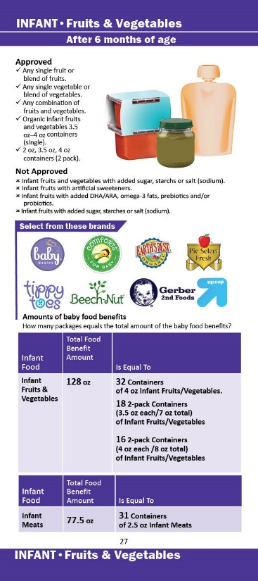
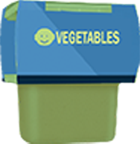

Infant Fruits & Vegetables
Unit of Measure
OZ = Ounce
Regular or organic varieties
Single fruit or blends of fruits
Single vegetable or blends of vegetables
Combination of Infant fruits and vegetables
  2-ounce (2 pack),
  3.5-ounce or 4-ounce containers single or multi pack
Notes:
Participants are allowed to select Infant Fruits and Vegetables, when included in their food benefits.
The unit of measure is OZ which is equivalent to one ounce.
Single fruit or blends of fruits, Single vegetable or blends of vegetables, and combination infant fruits and vegetables in 3.5 oz to 4 oz single or multi pack containers or 2 oz - 2 pack containers are approved.
Photo credit: DCFW Graphic artist

Slide 103
Infant Fruits & Vegetables
Required package size….
  3.5 to 4-ounce containers
  one (1) type of fruit and one (1) type of vegetable
Quantity Required….
  64 ounces total (or ~16-18 Containers)
Notes:
Infant fruits and Infant vegetables have minimum inventory requirements.
Vendors are required to stock at least 64 oz total of infant fruits and infant vegetables in 3.5-4oz containers. The 64 ounces must include at least 1 type of fruit and 1 type of vegetable.

Slide 104
Shopping for Infant Foods
Food | Amount Listed | Is Equal To
Infant Fruits & Vegetables | 128 OZ | 32 2 oz-2 pack or 4-oz containers of infant fruits and vegetables. 18 3.5 oz-2 pack containers of infant fruits and vegetables. 16 4 oz-2 pack containers of Infant fruits and vegetables.
Infant Meats | 77.5 OZ | 31 2.5-oz containers of infant meats.
Notes:
104
The family shopping list will list the total number of ounces of baby food participants are allowed for the month. This slide provides examples of the number of jars that may be purchased based on the number of ounces listed on the shopping list.

Slide 105
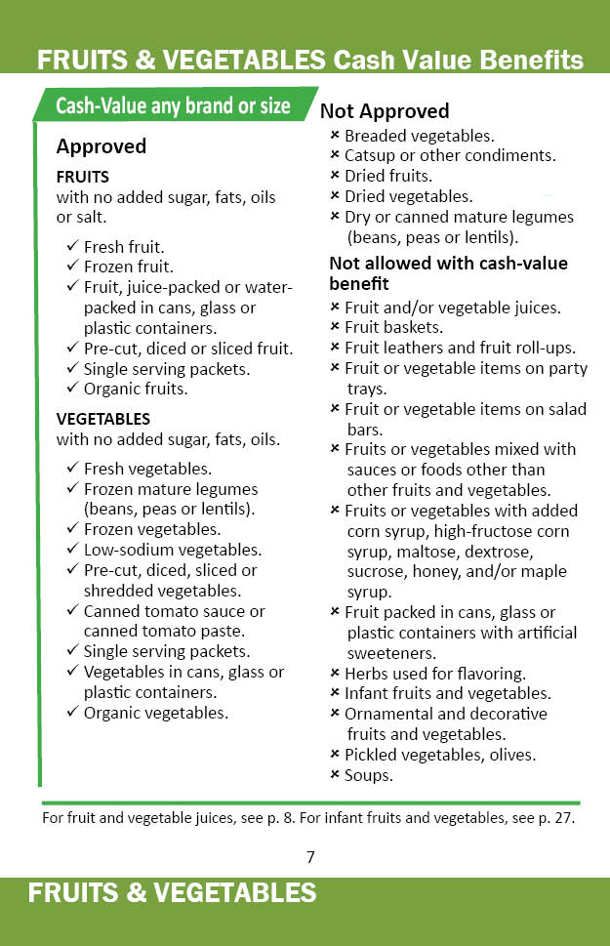
Cash-value Benefits
Fresh, frozen or canned fruits and vegetables
Non-organic or organic
Unit of Measure
$$$ = Cash-value Benefit Dollar Amount
Notes:
Participants can buy a combination of fresh, frozen or canned fruits and vegetables up to cash-value benefit dollar amount in their food benefit account.
Remember with eWIC, participants do not have to buy all of their food benefits at once, they can choose to buy any amount up to their available food benefit. This is also true for the cash-value benefit. For example, if a family has 20 dollars in cash value benefits they can choose to spend as much or as little as they want up to 20 dollars over several transactions.
If a participant purchases more than the amount of their cash-value benefit, the participant can pay the extra or choose not to buy certain items.
The North Carolina WIC APL includes applesauce and other pureed fruits and vegetable available for the participant to purchase under the Cash Value Benefits.
These items are for intended by the manufacturers for children over 12 months of age and is not available for purchase for infants.

Slide 106


Fruit
Fresh, frozen, canned
Fruit with no added sugar, fats, oils or salt
Notes:
Fruit can be obtained with the cash-value benefits.
Fresh, frozen, and canned fruits that contain no added sugar fats, oils or salt are approved.
Remember, Infant fruits are not allowed to be obtained with the cash-value benefits.
Photo Credit: FruitSmileyFace_Fotolia_33280198_Subscription_L.jpg

Slide 107
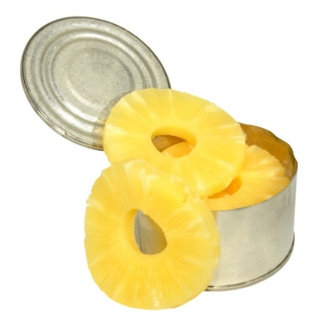
Canned Fruit
Required package size…
  14 to 16-ounce cans
Quantity required…
  10 cans
At least two (2) varieties required
Combinations allowed
Notes:
The minimum inventory requirements for fruits and vegetables are for the canned forms, but not fresh or frozen.
The minimum inventory for canned fruit is 10 cans.
At least 2 types of 14 to 16 –ounce cans of fruit are required.
The same fruit processed in different ways is NOT two different types of fruit. For instance, pear slices and pear halves is the same type of fruit processed differently. Peaches and pears are two different types of fruit.
Even though this is the minimum inventory requirement, WIC participants are able to select any size can that meets the criteria outlined in the approved foods list.
Photo Credit: Canned Pineapple_Fotolia_68238391_Subscription_L.jpg

Slide 108

Vegetables
Fresh, frozen and canned
No added sugar, fats or oils
Vegetables can contain added salt
Notes:
Fresh, frozen and canned vegetables with no added sugar, fats, or oils continue to be approved. Vegetables can contain added salt.
I do want to remind you that :
Salsa is not approved (as it contains not-approved herbs and spices)
White potatoes in addition to sweet potatoes are approved
Tomato products that contain herbs are not approved
Canned or dry mature legumes (dry beans, peas or lentils) do not count as a vegetables for the purpose of the cash-value benefit. They are obtained with the food benefits for legumes.
Sauerkraut is not approved, as it counts as a condiment.
Infant vegetables are not allowed to be obtained with cash-value benefits. They are obtained with the food benefit for infant fruits and vegetables.
Photo Credit: CannedCorn_Fotolia_38431540_Subscription_L.jpg

Slide 109
Canned Vegetables
Required Package size…
  14- to 16-ounce cans
Quantity required…
  10 cans
At least two (2) varieties required
Combinations allowed
Canned vegetables vs. beans, peas and lentils
  NO canned mature legumes
    Lima beans do NOT count
Notes:
The minimum inventory requirement is the same for vegetables as for fruit with additional notes of caution.
Minimum inventory of canned vegetables requires 10 cans of 2 types of vegetables in a 14 to 16 oz cans.
Canned mature legumes (beans, peas, or lentils such as canned lima beans) do not count as a vegetables towards minimum inventory. They can only be counted in the dried peas/beans/lentils category.
The only canned beans that count towards minimum inventory in the canned vegetable category include sweet peas, green beans, wax beans, and yellow beans.

Slide 110
Fruits and Vegetables - Not Approved
Breaded vegetables
Fruit packed in cans, glass or plastic containers with artificial sweeteners
Catsup or other condiments
Dried fruit
Dried vegetables
Salsa
Sauerkraut
Fruit and/or vegetable juices*
Fruit baskets
Fruit leathers and fruit roll ups
Fruit or vegetable items on party trays
Fruit or vegetable items on salad bars
* May obtain when included in food benefits
Notes:
110
Shown above are fruits and vegetables not approved for purchase with cash-value benefits. Please take a moment to review these items.

Slide 111
Fruits and Vegetables - Not Approved
Fruits or vegetables mixed with sauces or foods other than other fruits or vegetables
Herbs used for flavoring
Infant fruits and vegetables*
Mature legumes (dry or canned beans, peas, lentils)*
Ornamental or decorative fruits or vegetables
No added sugars, fats or oils
Fruits and vegetables with added corn syrup, high-fructose corn syrup, maltose, dextrose, sucrose, honey, and/or maple syrup
Pickled vegetables, olives
Soups
* May obtain when included in food benefits
Notes:
111
Shown above are additional fruits and vegetables not approved for purchase with cash-value benefits.
Take a moment to review these items.

Slide 112
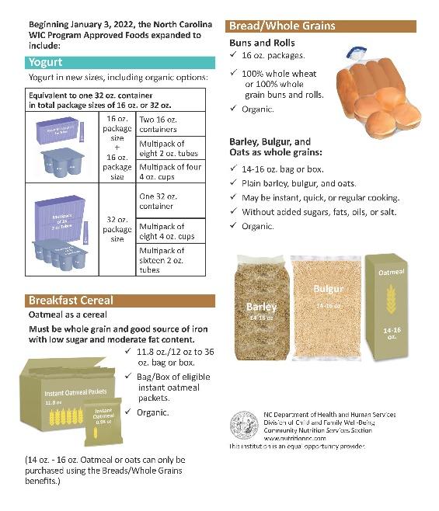


Resources
Notes:
The WIC Program Shopping Guide is available on the nutritionnc.com/eWIC website.
Please note the APL is a constantly changing resource that is frequently updated, so while the Transaction Guide and Shopping Guide are wonderful tools for vendors and participants, they may not have ALL the individually approved items listed. One should always refer to the APL on the website for the most up to date APL to determine if an item is approved or not.

Slide 113
Authorized Product List (APL)
NC WIC Approved Products Nutrition Criteria
UPC Submission
NC WIC APL
https://www.nutritionnc.com/ewic
Notes:
113
NC WIC Program Authorized Product List, or APL, is a compilation of all the WIC approved Universal Product Codes (UPCs) for each category of supplemental food available from the WIC program.
In order for a food to be purchased using eWIC, the food must be on the APL. Vendors are required to download the APL every 24 hours to ensure all approved foods are available to WIC participants.
Vendors must submit a request to add a UPC to North Carolina WIC Program APL using the web-based NC WIC Approved Product Registration form. UPCs are no longer accepted via mail.
Prior to submitting any UPC, vendors must verify that the UPC is not already listed in the most recent APL and refer to the NC WIC Approved Foods Nutrition Criteria to determine if the food meets the approved criteria.
Additional information regarding current North Carolina APL, the NC WIC Approved Foods Nutrition Criteria and UPC submission process are available on our website: https://www.nutritionnc.com/ewic/index.htm under “eWIC for Vendors”.

Slide 114
Summary
NC WIC Program offers a variety of nutritious foods
Participants no longer need to purchase the least expensive brand for milk, cheese or eggs
APL = Authorized Product List: a list of all approved WIC products
Consider a food category ‘unit of measure’
Required minimum inventory must be available to WIC customers
Notes:
The NC WIC Program offers a variety of nutritious foods which meet federal and state regulations.
WIC foods are approved based on criteria such as nutrient specifications, size, availability and cost.
Participants are no longer required to purchase the least expensive brand of milk, cheese and eggs and may purchase any brand on the APL .
The Authorized Product List is a compilation of all the foods that are currently approved for the NC WIC Program.
Considerations regarding unit of measure should be made when shopping for WIC approved foods.
Required minimum variety and inventory of WIC Approved Foods must be available to WIC customers for all peer groups, except free-standing pharmacies. Minimum inventory requirements have not changed for Federal Fiscal year 2020. Please refer to the WIC Vendor Manual for detailed information regarding required minimum variety and inventory.

Slide 115
Questions
Notes:
Let’s take a moment for questions

Slide 116
After Authorization
Process EBT transactions accurately, in a timely manner, and in accordance with the terms of the North Carolina WIC Vendor Agreement. Maintain compliance with the EBT Processor Vendor Agreement, the FNS EBT operating rules, standards and technical requirements, WIC Program Rules, and state and federal regulations, and statutes
Maintain certified eWIC system that is available for WIC redemption processing during all hours the store is open
Request eWIC Processor re-certify the vendor’s eWIC system if it is altered or revised in any manner that impacts eWIC redemption
Notes:
Process EBT transactions accurately, in a timely manner, and in accordance with the terms of the North Carolina WIC Vendor Agreement. Maintain compliance with the EBT Processor Vendor Agreement, the FNS EBT operating rules, standards and technical requirements, WIC Program Rules, and state and federal regulations, and statutes,
Maintain certified eWIC system that is available for WIC redemption processing during all hours the store is open;
Request eWIC Processor re-certify the vendor’s eWIC system if it is altered or revised in any manner that impacts eWIC redemption

Slide 117
After Authorization continued
Should a vendor that uses stand-beside device(s) to transact eWIC decide to upgrade to an integrated system, the vendor must:
  Inform the eWIC processor before making any change, so that it can be determined if the system needs to be certified and testing can be performed to establish connectivity.
  Inform the State WIC Agency so that Level III certification testing can be performed prior to use of the system in the store.
Testing performed with the eWIC processor for a new system that a vendor chooses to use does not supersede the L3 certification testing that must be performed by the State WIC Agency.
These procedures also apply to vendors who alter the integrated system that they currently use or decide to use a different integrated system altogether.
Notes:
Should a vendor that uses stand-beside device(s) to transact eWIC decide to upgrade to an integrated system, the vendor must:
Inform the eWIC processor before making any change, so that it can be determined if the system needs to be certified and testing can be performed to establish connectivity.
Inform the State WIC Agency so that Level III certification testing can be performed prior to use of the system in the store.
Testing performed with the eWIC processor for a new system that a vendor chooses to use does not supersede the Level III certification testing that must be performed by the State WIC Agency.
These procedures also apply to vendors who alter the integrated system that they currently use or decide to use a different integrated system altogether.

Slide 118
After Authorization continued
The State WIC Agency, not the eWIC processor, must grant final approval before a new system or system that has been altered is used by a vendor
Vendors must inform the State WIC Agency if their integrated cash register system will be altered or revised in any manner that impacts eWIC redemption. This is a requirement detailed in the Terms of Vendor Agreement. Failure to do so may result in the termination of their WIC Vendor Agreement
Notes:
The State WIC Agency, not the eWIC processor, must grant final approval before a new system or system that has been altered is used by a vendor
Vendors must inform the State WIC Agency if their integrated cash register system will be altered or revised in any manner that impacts eWIC redemption. This is a requirement detailed in the Terms of Vendor Agreement. Failure to do so may result in the termination of their WIC Vendor Agreement.

Slide 119
After Authorization continued
Integrated Vendors:
There is no need for WIC customers to separate their items when transacting WIC benefits. Do not make them separate their WIC items from non-WIC items. All items can be rung up together; however, the WIC customer must swipe their eWIC card first before any other tender type is applied to ensure that the proper items are deducted from the WIC customer’s benefit balance before another tender type is used for purchase.
Notes:
Integrated Vendors:
There is no need for WIC customers to separate their items when transacting WIC benefits. Do not make them separate their WIC items from non-WIC items. All items can be rung up together; however, the WIC customer must swipe their eWIC card first before any other tender type is applied to ensure that the proper items are deducted from the WIC customer’s benefit balance before another tender type is used for purchase.

Slide 120
After Authorization continued
It is important to continue to follow policies and procedures to maintain authorization
Federal regulations provide process to support program integrity
Notes:
It is important to continue to follow policies and procedures to maintain authorization. Federal regulations provide process to prevent fraud and ensure compliance. Review your Vendor Manual for more information.

Slide 121
Termination of WIC Vendor Agreement
Change in ownership will result in termination of the WIC Vendor Agreement by the State WIC Agency
Change in store location of more than three miles from the store’s previous location will result in termination of the WIC Vendor Agreement by the State WIC Agency
Cessation of operations, withdrawal from the WIC Program or disqualification from the WIC Program will result in termination of the WIC Vendor Agreement by the State WIC Agency
Notes:
Now let’s discuss other reasons why your Vendor Agreement may be terminated. Change in ownership will result in termination of the WIC Vendor Agreement by the State WIC Agency. Change in store location of more than three miles from the store’s previous location will also result in termination of the WIC Vendor Agreement. Additionally, cessation of operations, withdrawal from the WIC Program or disqualification from the WIC Program will result in termination of the WIC Vendor Agreement by the State WIC Agency.

Slide 122
Business Integrity Standards
May not have any owners, officers or managers who have been convicted of or had a civil judgment entered against them in the last six years for any activity indicating a lack of business integrity
Convictions or civil judgments include, but is not limited to: fraud, antitrust violations, embezzlement, theft, forgery, bribery, falsification or destruction of records, receiving stolen property, making false claims, or obstruction of justice
Notes:
The federal regulation requires business integrity standards be a vendor selection
criteria. A vendor may not have any current owners, officers or managers who have been convicted of or had a civil judgment entered against them in the last six years for any activity indicating a lack of business integrity.
This includes, but is not limited to, these examples:
fraud
antitrust violations
embezzlement
theft
forgery
bribery
falsification or destruction of records
receiving stolen property
making false claims, or
obstruction of justice

Slide 123
Conflict of Interest
A vendor shall not have any owner(s), officer(s) or manager(s) who are employed, or who have a spouse, child, or parent employed by the State WIC Program or the Local WIC Program serving the county in which the vendor conducts business
A vendor shall not have an employee who handles transactions of WIC food or cash-value benefits who is employed by or has a spouse, child or parent who is employed by the State WIC Program or Local WIC
Ask your staff if they have a spouse, child or parent who works for the WIC program
  If they do, report it to your vendor contact at your Local WIC Agency
Notes:
Another important Vendor Agreement issue related to preventing fraud is the conflict-of-interest policy regarding employment. This is a very important provision of the Vendor Agreement. Please make sure that you ask your staff if they have a spouse, child or parent who works for the WIC program. If they do, inform your vendor contact (that’s me) right away.
A vendor shall not have an employee who handles transactions of WIC food or cash-value benefits who is employed or has a spouse, child or parent who is employed by the State WIC Agency or the Local WIC Agency serving the county in which the vendor conducts business.

Slide 124

Violations and Sanctions
A violation is an infraction of WIC Program regulations or other requirements
A sanction is an administrative action taken as a result of a pattern of violations and may include:
  Disqualification or civil money penalty in lieu of disqualification
Notes:
We will now begin to talk about some important compliance aspects of the WIC Program. To make sure we are all on the same page, I will start with some definitions.
A violation is an infraction of WIC Program regulations or other requirements.
A sanction is an administrative action taken as a result of a pattern of violations and may include disqualification or civil money penalties in lieu of disqualification.
Photo Credit: Fotolia_37171221_Subscription_L.jpg

Slide 125
Violations
Any intentional or unintentional action of a vendor’s owners, officers, managers, agents or employees, with or without knowledge of management, that violates the WIC Vendor Agreement or federal or state statutes, regulations, policies or procedures governing the Program
Notes:
Violations are any intentional or unintentional action of a vendor’s owners, officers, managers, agents or employees that violate the Vendor Agreement or federal or state statutes, regulations, policies or procedures governing the Program. It is very important to emphasize that these violations can occur with or without knowledge of management.
Also, violations can be committed even if the person that commits the violation, did not mean to do so. Therefore, all staff that work in your store should be properly trained regarding WIC Program policies and procedures.

Slide 126
Types of Violations
Federal violations for which vendors are subject to disqualification
  Federal violations carry longest disqualification periods
  Found through compliance buys and inventory audits
State violations for which vendors are subject to disqualification
  Usually found during compliance buys and Local WIC Agency monitoring
Notes:
There are two categories of violations. Federal violations which result in 1 year to permanent disqualification. These violations are found through compliance buys and inventory audits. State violations are usually found during compliance buys and Local WIC Agency monitoring.

Slide 127
Vendor Violations and Sanctions
10A NCAC 43D.0710 states a vendor shall be disqualified from the WIC Program for:
  One year for three occurrences within a 12-month period of failure to properly transact WIC food benefits by manually entering the EBT card number or entering the PIN into the POS instead of the WIC customer, scanning the UPC or PLU codes from UPC codebooks or reference sheets when completing a WIC customer’s EBT transaction, not entering the correct quantity and item price, or not providing the WIC customer with a receipt that shows the items purchased and the customer’s remaining food benefit balance.
Notes:
10A NCAC 43D.0710 states a vendor shall be disqualified from the WIC Program for one year for three occurrences within a 12-month period of failure to properly transact WIC food benefits by manually entering the EBT card number or entering the PIN into the POS instead of the WIC customer, scanning the UPC or PLU codes from UPC codebooks or reference sheets when completing a WIC customer’s EBT transaction, not entering the correct quantity and item price, or not providing the WIC customer with a receipt that shows the items purchased and the customer’s remaining food benefit balance.

Slide 128
Vendor Violations and Sanctions continued
As a Reminder:
10A NCAC 43D.0708 (20)(j) states that the vendor must:
  Scan or manually enter Universal Product Codes (UPC) only from approved supplemental foods being purchased by the WIC customer in the types, sizes, and quantities available on the WIC customer's EBT account. The vendor shall not scan codes from UPC codebooks or reference sheets;
This requirement is also listed in the current Terms of Vendor Agreement.
Notes:
As a Reminder, 10A NCAC 43D.0708 (20)(j) states that the vendor must scan or manually enter Universal Product Codes (UPC) only from approved supplemental foods being purchased by the WIC customer in the types, sizes, and quantities available on the WIC customer's EBT account. The vendor shall not scan codes from UPC codebooks or reference sheets. This requirement is also listed in the current Terms of Vendor Agreement.

Slide 129
Vendor Violations and Sanctions continued
180 days for three occurrences within a 12-month period of failure to make EBT point of sale equipment accessible to WIC customers to ensure that EBT transactions are completed in accordance with 10A NCAC 43D .0708(20).
90 days for three occurrences within a 12-month period of failure to comply with minimum lane coverage criteria required by 7 CFR 246.12(z)(2) and 10A NCAC 43D .0708(20)(c).
Notes:
Two other violations for which a vendor can be disqualified are failure to make EBT point of sale equipment accessible to WIC customers and failure to comply with minimum lane coverage criteria. The pattern of occurrences and respective disqualification periods are:
180 days for three occurrences within a 12-month period of failure to make EBT point of sale equipment accessible to WIC customers to ensure that EBT transactions are completed in accordance with 10A NCAC 43D .0708(20) and
90 days for three occurrences within a 12-month period of failure to comply with minimum lane coverage criteria required by 7 CFR 246.12(z)(2) and 10A NCAC 43D .0708(20)(c).

Slide 130
Pattern of Occurrences
The nature of the violation and the number of violations determine the sanction imposed
A pattern of occurrences for the same violation can result in disqualification
The number of occurrences needed to establish a pattern depends on the violation
Notes:
The nature of the violation and the number of violations determine the sanction imposed. A pattern of occurrences for repeated incidences of the same violation can result in disqualification. The number of occurrences needed to establish a pattern depends on the violation.

Slide 131
Examples of Patterns of Violations
Three occurrences within a 12-month period of failure to stock required minimum inventory
Two occurrences of vendor overcharging within a 12-month period
Three occurrences of not making eWIC equipment accessible to the WIC customer
Three occurrences within a 12-month period of failure to mark the current shelf prices of all WIC supplemental foods
Notes:
These are examples of how patterns can lead to disqualification:
3 occurrences within a 12-month period of failure to stock required minimum inventory
2 occurrences of vendor overcharging within a 12-month period
3 occurrences of not making eWIC equipment accessible to the WIC customer
3 occurrences within a 12-month period of failure to mark the current shelf prices of all WIC supplemental foods
These examples equal a pattern
Once a pattern has been established, the State WIC agency will proceed to disqualify the vendor from the WIC program. Pages 25-26 of the Vendor Manual provides more information on patterns of occurrence.

Slide 132
Compliance Buys and Audits
State WIC Programs are required to identify and investigate high-risk vendors
NC sometimes works with the U.S. Office of Inspector General for investigations
See Vendor Manual
Notes:
In addition, the State WIC Agency is required by the federal government to identify and investigate high-risk vendors. NC does this through compliance buys and inventory audits; however, it sometimes works with the U.S. Office of the Inspector General for investigations. Refer to the Vendor Manual for more information.

Slide 133

Compliance Buys
Undercover purchases by a compliance investigator
May make multiple visits over one year
Vendors may receive a letter from the State WIC Agency if problems are noted
Notes:
Compliance buys are undercover (anonymous) purchases by a compliance investigator. There can be multiple visits over one year. The vendor may receive a letter from the State WIC Agency if problems are identified. These problems may have sanctions associated with them.
Photo Credit: Comicbookcharacter_Fotolia_29389804_Subscription_L.jpg

Slide 134
Vendor Overcharging
Intentionally or unintentionally charging more for supplemental food provided to a WIC customer than a non-WIC customer or charging more than the current shelf price for supplemental food provided to a WIC customer
Overcharging is a serious federal violation that can lead to vendor disqualification
This violation is uncovered during compliance buys
Vendor overcharging is NOT the same as charging over the NTE
Notes:
One of the most frequent federal violations committed by vendors is overcharging. Overcharging is defined as intentionally or unintentionally charging more for supplemental food provided to a WIC customer than a non-WIC customer or charging more than the current shelf price for supplemental food provided to a WIC customer. Overcharging is a serious federal violation that can lead to vendor disqualification. It is a violation that is uncovered during compliance buys.
It is important to remember that vendor overcharging is NOT the same as charging over the NTE. A vendor can charge over the NTE and not be overcharging if what they have charged is their current shelf price and is not more than what they would charge a non-WIC customer. If they charge over the NTE, they will be paid at the NTE
A vendor can charge under the NTE and be overcharging because they charged more than their current shelf price or charged the WIC customer more than they charged a non-WIC customer. As stated previously, this is a federal violation and the penalty, if a pattern is established, is disqualification from the WIC Program.
134

Slide 135
Overcharging?
A vendor looks at the NTE to determine what they could charge the WIC customer for a gallon of whole milk. The current shelf price is $2.79. They charge the WIC customer $3.69 for the gallon of whole milk because that is the current NTE for the month. Is this vendor overcharging?
A vendor charges a WIC customer $6.50 for WIC approved cheese. The current shelf price is $6.50.The NTE is $6.29. Is this vendor overcharging?
Notes:
As I previously stated, vendor overcharging is NOT the same as charging over the NTE. On this slide you see there are two scenarios to determine if you understand the difference between vendor overcharging and charging over the NTE. Let’s look at them both individually:
Example #1:
A vendor looks at the NTE to determine what they could charge the WIC customer for a gallon of whole milk. The current shelf price is $2.79. They charge the WIC customer $3.69 for the gallon of whole milk because that is the current NTE for the month. Is this vendor overcharging?
The answer is yes because the vendor charged more than the current shelf price for supplemental food provided to the WIC customer.
Example #2
A vendor charges a WIC customer $6.50 for WIC approved cheese. The current shelf price is $6.50. The NTE is $6.29. Is this vendor overcharging?
The answer is no because their current shelf price is $6.50. They charged the WIC customer a price that was over the NTE for cheese. This vendor will be paid via ACH.
135

Slide 136
Inventory Audits
A vendor must make available at any reasonable time and place ALL:
  Program-related records of vendor
    Purchase records, Sales records, Bank statements, Credit card statements, or any other personal or business financial documents that pertains to their business
MUST be retained 3 years or until audit pertaining to these records is resolved, whichever is later
Notes:
Inventory audits involve reviewing a vendor’s inventory records of WIC supplemental foods over a sixty-five-to-ninety-day period.
For inventory audits, the vendor must make available at any reasonable time and place, all:
Program related records, including invoices, copies of purchase orders various tax records and records of financial and business transactions Purchase records, Sales records, Bank statements, Credit card statements, or any other personal or business financial documents that pertains to their business.
Please note that all Program related records, such as invoices and receipts must be kept three years or until any audits pertaining to these records is resolved.

Slide 137
Purchase Documentation Requirement
Specific requirements for purchase documentation of WIC supplemental foods
Invoices, receipts, purchase orders, and any other proofs of purchase for WIC supplemental foods must include the following:
  The name of the seller and be prepared entirely by the seller or on the seller’s business letterhead;
  The date of purchase and the date the authorized vendor received the WIC supplemental food at the store if this date is different;
  A description of each WIC supplemental food item purchased, including brand name, unit size, type or form, and quantity.
Notes:
The State rules specify requirements for purchase documentation of WIC supplemental foods. Invoices, receipts, purchase orders, and any other proofs of purchase for WIC supplemental foods must include the following:
The name of the seller and be prepared entirely by the seller or on the seller’s business letterhead;
The date of purchase and the date the authorized vendor received the WIC supplemental food at the store if this date is different; and
A description of each WIC supplemental food item purchased, including brand name, unit size, type or form, and quantity.

Slide 138
Violations Detected During Inventory Audit
Claiming reimbursement for the sale of an amount of a specific supplemental food item which exceeds the store’s documented inventory of that supplemental food item for six or more days within the 60-day period. The six or more days do not have to be consecutive
Inability to provide records or providing false records is also a violation
Notes:
The Vendor Agreement specifically addresses violations which may have occurred as a result of an inventory audit. These violations are as follows:
Claiming reimbursement for the sale of an amount of a specific supplemental food item which exceeds the store’s documented inventory of that supplemental food item for six or more days within the 60-day period. The six or more days do not have to be consecutive.
Inability to provide records or providing false records is also a violation.
For more information regarding inventory audits, please refer to your Vendor Manual.

Slide 139
Vendor Claims
Overpayment to a vendor as determined by an inventory audit or compliance buy investigation requires repayment to the WIC Program
The State WIC Agency assesses a claim against the vendor in the amount of the overpayment
Vendors can request a conference to review the claim, but this action cannot be appealed
Notes:
139
Overpayment to a vendor as determined by an inventory audit or a compliance buy investigation requires repayment to the WIC Program. The State WIC Agency assesses a claim against the vendor in the amount of the overpayment. Vendors can request a conference to review the claim, but this action cannot be appealed.

Slide 140
Claims Assessed for Vendor Violations
If a vendor is assessed a claim, the vendor must reimburse the State WIC Agency in full or agree to a repayment plan within 30 days of written notification of the claim
  Failure to do so will lead to termination of the Vendor Agreement
A vendor applicant cannot be authorized if any of the vendor applicant’s owners, officers or managers currently have or previously had a financial interest in a WIC Vendor that was assessed a claim by the WIC Program and the claim has not been paid in full
Notes:
When the State WIC Agency determines the vendor has committed a vendor violation that affects payment to the vendor, the State WIC Agency will deny payment. A claim may be assessed based on violations detected through inventory audits, compliance buy investigations or any other means the State WIC Agency deems necessary to determine Program compliance.
Vendors must reimburse the State WIC Agency in full or agree to a repayment plan with the State WIC Agency within 30 days of written notification of a claim. If the vendor fails to reimburse the State WIC Agency in full or agree to a repayment plan within 30 days of written notification of a claim, the WIC Vendor Agreement will be terminated. Please refer to the Vendor Claims section of the Vendor Manual for more information.
A vendor applicant cannot be authorized if any of the vendor applicant’s owners, officers or managers currently have or previously had a financial interest in a WIC Vendor that was assessed a claim by the WIC Program and the claim has not been paid in full.

Slide 141

Disqualification
Ranges from 60 days to permanent
WIC status may impact status with SNAP (formerly the Food Stamp Program)
Vendor has right to appeal
Notes:
Disqualification from the WIC Program could range from 60 days to permanent, dependent upon the violation committed. Vendors should take note that their status with the WIC Program may impact their status with SNAP (formerly the Food Stamp Program) and vice versa. Remember, SNAP is also referred to as Food and Nutrition Services in North Carolina.
Vendors have the right to appeal a disqualification.
Photo Credit: Justice_Fotolia_6901118_Subscription_L.jpg

Slide 142
Routine Monitoring
Includes, but is not limited to:
  Review of formula invoices and receipts
  Price checks
  Treatment of WIC customers
  Inventory of WIC approved foods subject to minimum inventory requirement
  Ensure stand-beside equipment for use in transacting eWIC is accessible, if necessary
Visits are documented and if violation(s) found:
  An occurrence is noted
  The vendor must take steps to correct the violations
  Will be monitored again within 21 days
Notes:
Local WIC Agency staff complete on-site monitoring of authorized vendors. These visits provide a chance for vendors to receive training, discuss problems and ask questions.
WIC routing monitoring includes, but is not limited to:
Review of infant formula invoices and receipts.
Price checks of WIC approved foods
Treatment of WIC customers
Inventory of WIC approved foods subject to minimum inventory requirement
Ensure stand-beside equipment for use in transacting eWIC is accessible, if necessary
The form used by Local WIC Agency staff during monitoring is in the Vendor Manual. Local WIC Agency staff document these visits. If violations are found, you as the vendor, must take steps to correct them. Some violations may result in sanctions or termination of the WIC Vendor Agreement, if you fail to correct circumstances causing the violation.

Slide 143

Reporting Customer Service Issues (Complaints)
Vendors should report customer service issues (complaints) to the Local WIC Agency concerning:
  WIC customer inappropriate behavior
    Vendors are not required to tolerate behavior from a WIC customer that they would not tolerate from other customers
  Complaints about other vendors
May use form in the Vendor Manual
Notes:
We are interested in hearing any concerns and complaints you may have. In the back of the Vendor Manual is a form that you can use to report inappropriate behaviors by WIC customers. You may also become aware of issues WIC customers have had with other vendors; these issues can be reported on the same form.

Slide 144
Questions
Notes:
Let’s take a moment for questions

Slide 145
Required Applicant Forms
Notes:
Now we’ll review applicant forms.

Slide 146
Completing Required Forms
Vendors to be authorized through corporate agreements must complete:
  Application (DHHS 3282) – completed through the vendor portal
  Verification of Attendance
All other retail stores must receive and complete:
  Agreement (DHHS 2768) ending date 9/30/2024
  Terms of the WIC Vendor Agreement
  Application (DHHS 3282)
  Price List (DHHS 2766)
  Above Fifty-Percent Vendor Self Declaration form
  Verification of Attendance
Notes:
Vendors to be authorized through corporate contracts must complete:
Application (DHHS 3282) this will be done by the corporate office through the vendor portal and;
Verification of Attendance
All other retail stores must receive and complete:
Agreement (DHHS 2768) ending date 9/30/2024
Terms of the WIC Vendor Agreement
Application (DHHS 3282)
Price List (DHHS 2766)
Above Fifty-Percent Vendor Self Declaration form
Verification of Attendance form
We will discuss all these different forms in the following slides.

Slide 147
Completion of Forms using DocuSign
Notes:
Lets review the completion of vendor forms using DocuSign. These forms will be sent via email so make sure to provide an email address that is monitored daily.

Slide 148
Completing Required Forms in DocuSign
  Received through DocuSign
  Vendor Agreement (DHHS 2768) ending date 9/30/2024
  Terms of the WIC Vendor Agreement
  Application (DHHS 3282)
  Price List (DHHS 2766)
  Above Fifty-Percent Vendor Self Declaration form
  Received from Local Agency
  Verification of Attendance
  Email form
Notes:
Received through DocuSign
Agreement (DHHS 2768) ending date 9/30/2024
Terms of the WIC Vendor Agreement
Application (DHHS 3282)
Price List (DHHS 2766)
Above Fifty-Percent Vendor Self Declaration form
Received from Local Agency
Verification of Attendance to be completed in blue or black ink
Email form
Samples of forms and instructions for completing each can be found in your Vendor Manual.
Remember, all forms should be complete and accurate. If you have questions, please ask.

Slide 149

Using DocuSign
You will receive an email from the State Agency via DocuSign
Click on the “Review Documents” button
Notes:
You will receive an email from the State Agency via DocuSign. This is a general idea of what the email will look like once received. You will click on the Review Documents button.

Slide 150


Vendor Process
Once you have clicked “Review Documents,” this screen will open
You will click the “Continue” button to review and complete the application documents (forms)
Notes:
Once you have clicked on Review Documents, this screen will open. Click the continue button to review and complete the reauthorization documents.

Slide 151

Fields to Complete
Red boxes will appear on the fields required for completion
Notes:
Red boxes will appear on the fields required for vendor applicant completion.
NOTE: Vendors cannot enter information in fields designated for any other role except those meant for vendors.

Slide 152


Adopting a Signature
When you click on the first Sign button, the “Adopt Your Signature” screen will appear.
Signature options
  Type your name and initials and change the style to look more like your handwritten signature
  Draw or “write” signature by selecting the draw tab and using the mouse
  Upload a clear picture of signature for use
Notes:
When you first click on the Sign button, the adopt your signature screen will appear. You have the option to type your name and initials and change the style to look more like your handwritten signature. There is also an option to draw or “write” your signature by selecting the draw tab and using the mouse. Lastly, you have the option to upload a clear picture of their signature for use although, the first option may be best.
Once you have completed their signature and initials, click the adopt and sign button. Your signature will then appear in the space designated Sign.

Slide 153



SIGNATURE
Once signature and initials have been adopted, when you click any space labeled sign or initial, the adopted signature will appear.
Notes:
Once the signature and initials have been adopted, when you click any space labeled sign or initial, the adopted signature will appear.

Slide 154

Form Fields
Certain fields triggered once specific fields selected.
  Blue arrow at question 13 shows that the check box for Integrated has been selected
    Sub questions and corresponding fields have now been highlighted
    The value-added reseller is not highlighted in red because this is an optional field
Green arrow at question 14 shows a drop-down option.
  Ensures vendors only choose State approved sources
  Also available for question 15
Notes:
There are certain fields that will only trigger once specific fields have been clicked. The blue arrow at question 13 shows that the check box for Integrated has been checked. Due to this, the sub questions and corresponding fields have now been highlighted. The value-added reseller is not highlighted in red because this is an optional field, as you see, the value added reseller only needs to be answered if applicable.
The green arrow at question 14 shows a drop down option. This is to ensure you only choose state approved sources. The same is available for question 15.

Slide 155

Vendor Process Completed
Once you have gone through all documents and completed all required fields, you will be able to click the “Finish” button.
Notes:
Once you have gone through all documents and completed all required fields, they will be able to click the “Finish” button.

Slide 156


Final Screen
You may see this screen upon completion
  Can select “No Thanks”
All parties will receive a copy of the fully completed forms
Notes:
Once you have completed your required fields and click finish, this screen may appear. You can select No Thanks. All parties will receive a copy once all parties involved have signed.

Slide 157
Application (DHHS 3282)
All vendor applicants must complete an application
The store owner or officer must complete and sign
Do not leave blanks, do not use “N/A”
Do not type “same as above”
  Complete every line!
Notes:
All vendor applicants must complete this form.
The store owner or officer must complete and sign this form.
Do not leave blanks, do not use “N/A” or “same as above”.
At the top of each page is a place to write in the store name. Make sure that the name is listed the same way on all pages and is consistent between forms.
Note to speaker: All questions on application should be reviewed!

Slide 158
Application (DHHS 3282)
Questions #1-2
  Store address information
Questions #3-4
  Needed for future notifications
Question #5
  MUST be a SNAP (formerly the Food Stamp Program) Provider
Question #6
  Provide Store’s Federal Tax ID number
Question #7 - check only one!
See instructions for definitions:
  Retail Large Chain
  Retail Convenience
  Free-standing Pharmacy
  Commissary Independent
  (Military Based Stores)
Notes:
A few notes about specific questions….
Question #’s 1-2: this is for the store mailing address, physical address and directions to the store.
Question 3 – Check whether the store has internet access. Answer yes or no
Question 4 – Provide email address
Question 5 - Provide your seven-digit SNAP permit number.
Question 6 - Provide your store’s Federal Tax ID number
Question 7 - Only one (1) block must be checked. Classification must be consistent with the Vendor Agreement. Check appropriate block that applies to store's setup. Refer to Application instructions for brief definitions.

Slide 159
Application (DHHS 3282)
Question #8 - check only one!
  Individual
  Partnership
  Limited Partnership
  Corporation
  LLC
Question #9
  Since business hours are a selection criteria, please be accurate and indicate AM/PM
Question #10-11
  Annual SNAP & Food Sales – Projected for new stores
Question #12
  Total Number of registers in store - not number in use (including U-Scans)
  Number of registers with scanning devices
  Number of scanners that identify WIC approved foods
Notes:
Question 8 - Check only one (1) type of ownership. Use the one most appropriate. Example: If two people own a business and the store is incorporated or an LLC, the type of store is corporation or LLC even though there is a partnership formed. Provide the name, physical address and phone number of the corporation or LLC the store is registered under.
Question 9 - Provide all the hours that the store is open for business. Indicate AM or PM for opening and closing times. Remember that 12PM is noon and 12AM is midnight. As part of selection criteria, the store needs to be open 6 days a week for at least 40 hours per week.
Question 10 – Amount of Store’s Annual Food Sales: Provide the yearly dollar amount of SNAP sales. If this is a new store, projected sales must be given based on the business conducted prior to purchase.
Question 11 - Annual Food Sales: Provide the yearly dollar amount of food sales only. If this is a new store, projected sales must be given based on the business conducted prior to purchase.
Question 12 – Provide the total number of cash registers in the store

Slide 160
Application (DHHS 3282)
Question #13
  eWIC capable (integrated cash register system)
Question #14-15
  Infant formula source
  Food suppliers
Question #16-17
  More than fifty percent of stores annual revenue from WIC?
Question #18
  Percentage of business expected to be WIC, SNAP, cash, and credit/debit card (no decimals)
Question #19
  WIC authorization required?
Notes:
Question 13 – Check Yes or No to indicate whether store is eWIC capable or not. Check your Point of Sale system type as either Integrated or Stand-beside. If integrated, provide the name of your Third-Party Processor and if applicable, Value-added Reseller.
Question 14 – Provide the name of source(s) for all infant formulas (Refer to list of approved sources)
Question 15 - Provide the name of supplier(s) for all WIC approved foods
Question 16 – Check whether the store expects to derive more than fifty-percent of the store’s annual revenue from the sale of food items through WIC transactions. Answer yes or no
Question 17 – Check whether you own a WIC authorized store where the WIC sales are above 50% of the total annual food sales. Answer yes or no
Question 18 - Record what percent of food sales is expected to be from WIC sales, SNAP sales, cash sales, and credit/debit. These should all total up to 100%. (no decimals)
Question 19 – Check whether WIC authorization is required in order for the store to open for business. Answer yes or no

Slide 161
Application (DHHS 3282)
Question #20-21
  Inventory invoices
Question #22
  Required minimum inventory
Question #23
  Check all boxes that apply
Question #24-25
  Manager’s full name
  Indicate if manager is primary contact for the store
Notes:
Question 20 – Check whether there are inventory invoices available for food items purchased and currently stocked in your store. Answer yes or no.
Question 21 – If the answer is yes, document how many months of inventory invoices that are available.
Question 22 – Check whether or not the store currently has in stock the required minimum inventory. Answer yes or no
Question 23 – Check all blocks that apply to what contents are sold in the store.
Question 24 - Circle title of courtesy (Mr., Mrs., Ms.) for store manager. The full name (first, middle, and last) of store manager is required. Do not use initials. Document if there is no middle name by writing “NMN”.
Question 25 – Check whether the store manager is the primary contact person for the store. If no is checked, the owner will be listed as primary contact. Answer yes or no.

Slide 162
Application (DHHS 3282)
Questions #26-35
  Business integrity questions
  Do not leave any blanks
  Provide explanations and dates for “yes” responses
Notes:
Questions 26 thru 35 pertain to business integrity. Do not leave any unanswered and always provide explanations and dates for any “Yes” responses.
Question 26 - Check only one (1) block. If "yes" is checked, a detailed explanation is required from store manager with dates of occurrence.
Question 27 - Provide how many years and months the store has been in business at the present site. If the store has been in business less than a month, provide the date the store opened for business.
Question 28 - Check only one (1) block. If "yes" is checked, provide the old name and address of the store.
Question 29 - Check only one (1) block. If "yes" is checked, a detailed explanation, including what WIC incident occurred with dates of occurrence, is required.
Question 30- Check only one (1) block. If "yes" is checked, a detailed explanation, with dates of occurrence, is required.
Question 31- Check only one (1) block. If "yes" is checked, a detailed explanation, with dates of occurrence, is required.
PAGE 3 of 4:
Provide store name in the space provided in the upper right corner of page. The store name must be consistent throughout the application.
Questions 32 – 34 - Check only one (1) block. If "yes" is checked, a detailed explanation, with dates of occurrence, is required.
Question 35 – Check only one (1) block. If “yes” is checked, a detailed explanation is required of all owners, officers or managers “yes” applies to. If additional space to document the explanation is necessary, attach a separate sheet of paper, with the additional documentation referring back to this question.

Slide 163

Ownership Data Section
Stores under corporate agreement do not complete this section
Stores not under corporate agreement should list all owners/officers
For more than TWO owners, complete page 3a
Incorporated or Limited Liability Companies (LLC) list officers
Notes:
On page 3 of the application you will see there is an Ownership Data Section. Stores that will be authorized under a corporate agreement do not complete this section of the form, because it is completed by your corporate office. For all others, please list all owners, regardless of the percentage owned.
Do you have more than two owners? If yes, please complete page 3a in the docusign packet when emailed.
If your store is incorporated or an LLC with many owners/shareholders, please list the President, Vice President, Secretary and Treasurer – a page 3a will be required.

Slide 164

Page 3a
Additional ownership page
For vendors with more than 2 owners or officers
Notes:
This is page 3a where additional ownership information is listed. Please list all owners, regardless of the percentage owned.

Slide 165

Page 4
Read application statement
Store Owner/Officer signs
Check all answers before signing to avoid delay of application
Notes:
Page 4 is the signature page. Please make sure to read the application statement. It must be signed by the store owner or an officer.
To avoid delay of your application, it is a good idea to review all your responses before you click finish and have the documents sent to the local agency.

Slide 166

Page 5
Page 5 is signed by the Local Agency before being sent to the State WIC Agency
Notes:
Page 5 shows the detailed Assurance of Civil Rights Compliance statemen. This page is also signed by the Local Agency before being sent to the State WIC Agency

Slide 167
WIC Price List (DHHS 2766)
Must be completed individually by each:
  Independent stores
  Convenience stores
  Commissaries
Role of Price List
  A criteria for selecting authorized vendors
Notes:
The WIC Price List must be completed individually by each Independent chain store, independent/convenience store or commissary at the time of application.
It is not necessary for stores under a corporate agreement with the State to complete a price list for each store. This is handled through the corporate office and sent directly to the State WIC Agency for processing.
Pricing less than current NTEs is a criteria for selecting vendors

Slide 168


Store Name and Number
Street Address
Phone Number
Date
Notes:
As with the other forms, take care to ensure the store name and number is accurate and on each page. Please include the physical street address not the mailing address. Also include the phone number and the date completed.

Slide 169
Required Prices
Whole and skim/low fat milk (gallon)
Cheese (16oz.)
Two types of cereal – whole grain
Eggs (large white)
Juice, 48 oz. container
Juice, 64 oz. container
Dry beans, peas & lentils
Peanut butter
Tuna
Rice
Bread and/or Tortillas
Infant cereal
Infant formula
    Milk-based and Soy-based
    Powder
Infant Fruits
Infant Vegetables
Notes:
The items here are minimum inventory items that you must provide a price for, on the price list.

Slide 170

WIC Vendor Agreement
Read and understand
all terms!
Notes:
This is the WIC Vendor Agreement form that is effective through September 30, 2024. Only stores not under a corporate agreement will complete this form individually. You can look at a copy of the form in your vendor manual while I review a few key points. We will also review the Terms of the Agreement also in your vendor manual.
Note to Local WIC Agency: You need to go over the actual Terms of Vendor Agreement

Slide 171


Both names must match
Notes:
This is the WIC Vendor Agreement signature page; it is a legal document with strict guidelines for its completion. It is very important that the store name matches in each place. You must use the same store name on all your forms. Again, this is the store name, not the name of the partnership or small corporation. The “Authorized WIC Vendor Number” area will be left blank. This will be filled in by the State WIC Agency if the application is approved and you are assigned a vendor number.

Slide 172


WIC Vendor Agreement continued
Owner must initial for the receipt of the Terms of Vendor Agreement
Notes:
In the lower left-hand corner of the signature page of the agreement you will see a statement and a place for your initials. This statement is verification that you received the Terms of Vendor Agreement and that you have read, understand and will comply with the provisions in the WIC Vendor Agreement.
The owner/officer of the store must initial this space, not the manager.

Slide 173
ID Requirement
The State WIC Agency requires that vendor applicants submit a copy of their driver’s license or state issued ID with their application.
Notes:
The State WIC Agency requires that vendor applicants submit a copy of their driver’s license or state issued ID with their application.

Slide 174
Technical Assistance
Local WIC agency is the primary contact for technical assistance regarding:
  WIC-approved foods
  Completing required forms
  eWIC transaction issues
    Triage form to be completed (refer to Vendor Manual)
  Customer service issues (complaints)
Notes:
Local WIC Agency staff (that’s me) will be your primary contact for technical assistance regarding:
WIC-approved foods
Completing the required forms
eWIC transaction issues
Customer service issues (complaints)

Slide 175
Training Employees
Vendor owners/managers are responsible for training all cashiers on WIC as it pertains to the following:
  WIC-approved foods
    WIC Vendor Transaction Guides
  Allowing same courtesies to WIC customers as non-WIC customers
  Processing eWIC transactions
Notes:
It is the vendor owner’s responsibility to ensure all cashiers are trained on WIC as it pertains to the following:
WIC-approved foods
WIC Vendor Transaction Guides should be reviewed and placed at each cash register for easy access. Refer to the APL for definitive list of approved items
Allowing the same courtesies to WIC customers as non-WIC customers
Processing eWIC transactions

Slide 176
Questions
Notes:
Any last questions?

Slide 177
Assurance of Civil Rights Compliance
The vendor hereby agrees that it will comply with Title VI of the Civil Rights Act of 1964 (42 U.S.C. 2000d et seq.); Title IX of the Education Amendments of 1972 (20 U.S.C. 1681 et seq.); Section 504 of the Rehabilitation Act of 1973 (29 U.S.C. 794); the Age Discrimination Act of 1975 (42 U.S.C. 6101 et seq.); Title II and Title III of the Americans with Disabilities Act (ADA) of 1990, as amended by the ADA Amendment Act of 2008 (42 U.S.C. 12131-12189) and as implemented by Department of Justice regulations at 28 CFR Parts 35 and 36; Executive Order 13166, "Improving Access to Services for Persons with Limited English Proficiency" (August 11, 2000); all provisions required by the implementing regulations of the U.S. Department of Agriculture (7 CFR Part 15 et seq.); and FNS directives and guidelines to the effect that no person shall, on the ground of race, color, national origin, age, sex (including gender identity and sexual orientation), or disability, be excluded from participation in, be denied the benefits of, or otherwise be subjected to discrimination under any program or activity for which the agency receives Federal financial assistance from FNS; and hereby gives assurance that it will immediately take measures necessary to effectuate this agreement.
This assurance is given in consideration of and for the purpose of obtaining any and all Federal financial assistance, grants, and loans of Federal funds, reimbursable expenditures, grant, or donation of Federal property and interest in property, the detail of Federal personnel, the sale and lease of, and the permission to use Federal property or interest in such property or the furnishing of services without consideration or at a nominal consideration, or at a consideration that is reduced for the purpose of assisting the recipient, or in recognition of the public interest to be served by such sale, lease, or furnishing of services to the recipient, or any improvements made with Federal financial assistance extended to the Program applicant by USDA. This includes any Federal agreement, arrangement, or other contract that has as one of its purposes the provision of cash assistance for the purchase of food, and cash assistance for purchase or rental of food service equipment or any other financial assistance extended in reliance on the representations and agreements made in this assurance.
This assurance is binding on the vendor, its successors, transferees, and assignees as long as it receives assistance or retains possession of any assistance from the Department. The person or persons whose signatures appear below are authorized to sign this assurance on the behalf of the vendor.
Notes:
On this slide you see the Assurance of Civil Rights Compliance Statement. Please take a moment to read it.

Slide 178
USDA Nondiscrimination Statement
In accordance with federal civil rights law and U.S. Department of Agriculture (USDA) civil rights regulations and policies, this institution is prohibited from discriminating on the basis of race, color, national origin, sex (including gender identity and sexual orientation), disability, age, or reprisal or retaliation for prior civil rights activity.
Program information may be made available in languages other than English. Persons with disabilities who require alternative means of communication to obtain program information (e.g., Braille, large print, audiotape, American Sign Language), should contact the responsible state or local agency that administers the program or USDA’s TARGET Center at (202) 720-2600 (voice and TTY) or contact USDA through the Federal Relay Service at (800) 877-8339.
To file a program discrimination complaint, a Complainant should complete a Form AD-3027, USDA Program Discrimination Complaint Form which can be obtained online at: https://www.usda.gov/sites/default/files/documents/USDA-OASCR%20P-Complaint-Form-0508-0002-508-11-28-17Fax2Mail.pdf, from any USDA office, by calling (866) 632-9992, or by writing a letter addressed to USDA. The letter must contain the complainant’s name, address, telephone number, and a written description of the alleged discriminatory action in sufficient detail to inform the Assistant Secretary for Civil Rights (ASCR) about the nature and date of an alleged civil rights violation. The completed AD-3027 form or letter must be submitted to USDA by:
mail: U.S. Department of Agriculture
Office of the Assistant Secretary for Civil Rights
1400 Independence Avenue, SW
Washington, D.C. 20250-9410;
fax: (833) 256-1665 or (202) 690-7442; or
email: program.intake@usda.gov
This institution is an equal opportunity provider.
Notes:
On this slide you see the USDA Nondiscrimination Statement. Please take a moment to read it.

Slide 179
Thank you!
Notes:
Thank you for your attention to this orientation training. If you have any additional questions, please let me know.

