Slide 1

NC CACFP Monthly Institution Call
All information presented on this call is true and accurate as of the date of the call.
Notes:
First Friday of every month @ 1:00 pm
Questions should be submitted through chat function
State agency encourages topic suggestions

Slide 2

Agenda
P-EBT for Child Care
Emergency Cost Information Update
COVID Waiver Follow Up Survey
Application Update
Claim Validation
Upcoming SA Trainings
Q&A

Slide 3
P-EBT for Child Care

Slide 4

Child Nutrition (CN) Emergency Cost Program
Nutrition Services Branch submitted the application to participate in the Program on February 19, 2021
Submission acknowledged by USDA Food and Nutrition Service (FNS)
Supplemental application/full
implementation plan due to FNS
May 10, 2021
State agency is currently working
on the implementation plan
At this time, we believe funds will be
available to allow for distribution beginning in July

Slide 5

CN Emergency Cost Program
Sponsoring Organizations (SO) were emailed a REVISED SO Reporting Facility Emergency Operating Costs Excel spreadsheet along with instructions on April 5, 2021.
Sponsors are required to submit the spreadsheet on or before close of business April 20, 2021.
Spreadsheets must be submitted to the following email address: financialmanagementteam@dhhs.nc.gov
If you have questions, please contact:
  Peace Ndalama at 919-634-0190 or
  Joe Patton at 919-418-1052

Slide 6


What Questions Do You Have?
Notes:
What questions do you have?
Adobe Stock: 104477106

Slide 7
Waiver Follow Up Survey

Slide 8

Institutions that were approved for a waiver will be asked to complete a follow up survey.
The follow up survey will ask some of the following questions:
  How did the institution maintain accountability and maintain integrity regarding the specific waiver?
  Explain how the waiver was utilized.
  Describe how the waiver improved services.
  Was the waiver useful?
    If the waiver was not useful,
    provide an explanation.
  Is the institution still utilizing the waiver?
    If the waiver is not being utilized
    provide the date when the
    institution stopped using the
    waiver.

Slide 9
Application Update
2022

Slide 10

Application Update 2022
The State agency is working diligently to ensure Application Update 2022 is a success.
  The process will be similar to last year
  State agency training will begin the end of June into July
    Live Webinar training
    Post recorded webinars
  Anticipated Rollover will be mid July 2021
  Application update is due September 30, 2021
  SD Notices will be issued starting October 1, 2021

Slide 11
Application Update 2022
Sponsoring Organizations of Unaffiliated Centers will be required to submit a sponsored center budget for all their sponsored facilities.
State Forms added to application update 2022
  IRS Tax Exemption Verification (Non-Profits Only)
  Conflict of Interest Acknowledgement and Policy-all institutions
SAM Registration (Required for ALL Institutions)
  For information regarding SAM Registration go to:
  https://www.sam.gov/SAM/

Slide 12
What Questions Do You Have?
Notes:
What questions do you have?
Adobe Stock: 104477106

Slide 13
Claim Validation

Slide 14

Claims Validation
Financial Management Team has started reviewing claims every month.
The review will focus on:
  Claims with errors
  Claims that are not submitted
  Non-Profit Food Service
  Claim with Irregularities:
    Drastic change in reimbursement amounts
    All rounded numbers for expenses
    Actual vs Budgeted amount
    Spending rate
    Applying reimbursement to the expenses of approved budget line items in NC Cares for every claim

Slide 15
Claims Validation
Claims with Error and are not submitted: Finance and Risk Mitigation member will contact you and remind you to submit the claim. This will minimize the use of one-time exception.
Claims with irregularities will be validated:
  Hold the payment of the claim
  Ask for supporting documentation
  A member of the Finance and Risk Mitigation will review the documentation
  A valid claim will be processed within 45 business days of submission
To make the process go smoother:
  Institutions must submit claims based off the supporting documentation and approved budget
  Have the supporting documentation ready if requested by the State Agency

Slide 16
Upcoming Trainings – Mark Your Calendar
Date | Time | Training
April 13 | 1 PM – 4 PM | Get Started with NC CACFP for SOs*
April 15 | 1 PM – 4 PM | Get Started with NC CACFP for ICs*
May 11 | 9 AM – 12 PM | Duties & Documents for ICs
May 13 | 9 AM – 12 PM | Duties & Documents for SOs
May 20 | 9 AM – 11 AM | Compliance Review – Are You Ready?
*Note: This training is for those wishing to apply, not those already on the program. Please help us spread the word.

Slide 17
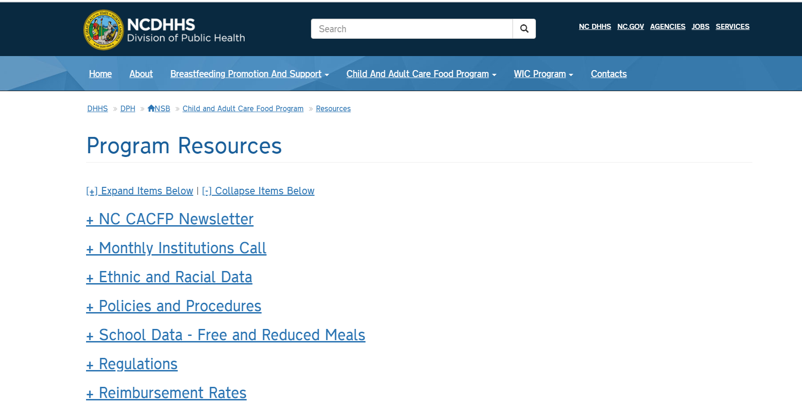
Monthly Institution Calls
The PowerPoints for the institution calls can now be found on our website www.nutritionnc.com
  Click on Child and Adult Care Food Program
  Click on Program Resources
  Click on Monthly Institution Calls

Slide 18

Q&A
Please use the chat function to submit your questions. We will review what we have time for that pertains to the good of the group. Questions that apply to one specific institution will be handled offline.

