Slide 1

NC CACFP Monthly Institution Call
All information presented on this call is true and accurate as of the date of the call.
Notes:
First Friday of every month @ 1:00 pm
Questions should be submitted through chat function
State agency encourages topic suggestions

Slide 2

Agenda
P-EBT for Child Care
Emergency Cost Information Update
COVID Waiver Follow Up Survey
COVID Nationwide Waivers for School Year 2021-2022
Application Update
Upcoming SA Trainings
Q&A

Slide 3
P-EBT for Child Care
Child and Adult Care Food Program

Slide 4

Topics for today’s discussion
TOPICS
About P-EBT
P-EBT eligibility for children under age 6
Timeline
Overview of toolkits
What to expect next and what we need from you
Questions

Slide 5
Purpose, overview, and impact of P-EBT
The Pandemic Electronic Benefit Transfer (P-EBT) program helps families with children whose access to meals or buying food has been impacted by COVID-19.
Overview
P-EBT for students (Kindergarten through 12th grade) – enables families to purchase food for children whose access to free or reduced-priced meals at school has been impacted by COVID-19 because students are learning virtually, outside of brick-and-mortar schools.
  P-EBT is intended to cover the cost of the student’s meals/snacks (approximately $6.82 per day)
P-EBT for children under 6 (NEW) – North Carolina is expanding its P-EBT program to provide P-EBT to children under the age of 6 that are in households receiving Food and Nutrition Services (FNS).
  FNS data will be used to identify potentially eligible children under age 6
  The learning mode (remote/hybrid/in-person) of public schools will be used to determine eligibility and benefit amount
Households can receive P-EBT and continue to receive any benefits they may have access to. Those benefits include free meals at local school and community meal sites.

Slide 6
P-EBT eligibility for children under 6
There is no application. Eligibility will be determined through circumstances of the child and the circumstances of the public school district(s) in the county where the child lives.
Child Circumstances
Circumstances of public schools
in the child’s county
Both of the following conditions must be met for a child to be eligible:
The child must be a member of a household that received Food and Nutrition Services (FNS) benefits at any time since October 1, 2020, AND
The child is under 6 and does not already receive P-EBT as a student enrolled in an eligible school
Other Considerations
Children born after October 1, 2020 and part of a household receiving FNS will be able to receive benefits starting with the month of birth or October 1, 2020, whichever comes later.
Households with children that are not currently enrolled in FNS are not eligible to receive P-EBT. Families who apply for FNS prior to the initial issuance may receive benefits back to October 2020.
Information from public schools near families with young children will be used to understand if these children were impacted by COVID-19 and are also in need of food assistance.
The following school condition must be met:
One or more public schools in the school district(s) where the child lives is either learning in a fully remote (100% virtual instruction) or in a hybrid (combination of virtual and in-person instruction) learning mode for the eligible month
If ALL public schools in a county are operating fully in-person (no remote or hybrid learning) in a month, children in the Under Age 6 FNS population in that county will not be eligible for P-EBT for that month.

Slide 7





P-EBT eligibility for children under 6
Is a child eligible for P-EBT?
START
1
2
3
Must be member of a household that received Food and Nutrition Services (FNS) benefits at any time since October 1, 2020.
The child is under 6 years old and does not already receive P-EBT as a student enrolled in an eligible school.
The monthly benefit amount will be determined based on the learning mode, either a remote or hybrid learning mode, of the public schools in the district(s) in the county where the child lives¹ .
ELIGIBLE
REMOTE AMOUNT - If at least one public school in the school district(s) where the child lives is operating in a fully remote learning mode (100% virtual instruction, or 17+ virtual days in a month) the child will receive the remote benefit amount for that month.
ELIGIBLE
HYBRID AMOUNT - If no public schools in the school district(s) where the child lives are operating in a remote learning mode, but at least one public school is operating in a hybrid learning mode for the month (less than 100% of instructional days, and at least 1+ day of virtual instruction in a month) the child will receive the hybrid benefit amount.
How much P-EBT?
INELIGIBLE
IN-PERSON - If all public schools in the county where the child lives are operating 100% in person (0 days of virtual instruction in a month) no benefit will be provided for that month.
ELIGIBLE
  HYBRID AMOUNT
Please visit www.ncdhhs.gov/PEBT to learn more about
P-EBT.
The learning mode in public school district(s) is assessed each month using information from schools. The learning mode determines the amount each eligible child may receive.
Average number of days NC schools using a hybrid schedule conducted virtual instruction for that month.
$6.82 X avg # of days = monthly P-EBT amount
  REMOTE AMOUNT
NC determined on average there are 17 instructional days per month for an 11-month school year.
$6.82 X 17 days = $115.94
¹ Only the learning mode of public schools that participate in the National School Lunch Program (NSLP) will be included. The county the child lives in is based on the address associated with the child’s FNS case.
Updated : May 2021

Slide 8

P-EBT for children under 6 benefits timeline
The state will issue P-EBT benefits for eligible children back to October 1, 2020 based on their FNS status and based on the varying status of public schools learning modes in the school’s district(s) for each month.
1
Benefits for Oct 2020 to Mar 2021
Benefits for Apr and May 2021
Benefits for June 2021
2
3
Eligible students will receive their P-EBT benefits for October 2020 to March 2021 in late May 2021. Benefits will be issued to the households existing FNS EBT card.
P-EBT benefits will be issued monthly for the remaining eligible months; however, April and May benefits will be issued in June.
Benefits (representative of one month) for June will be issued in July.
When will P-EBT benefits be issued?
Oct 2020 to Mar 2021 | Apr 2021 | May 2021 | June 2021 | July 2021
1
2
3
P-EBT for Children Under 6 is a temporary program that has been authorized to provide benefits until June 2021 with the last month of issuance being in July.
P-EBT guidance for the summer months has been provided by USDA as of April 2021. North Carolina must develop and submit a plan to USDA for approval.

Slide 9

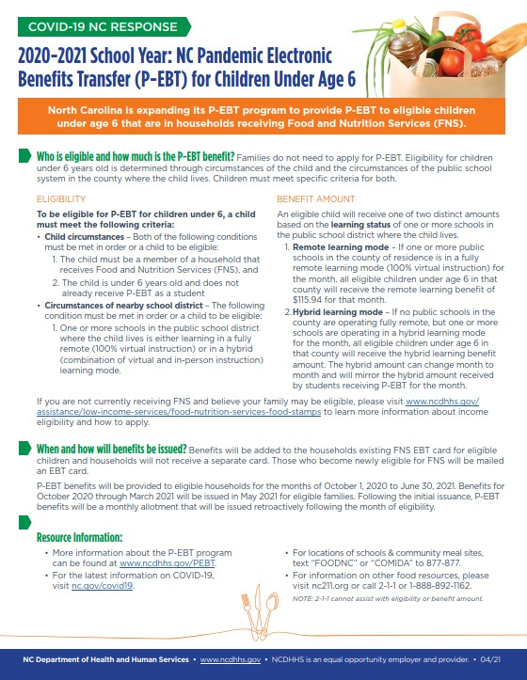
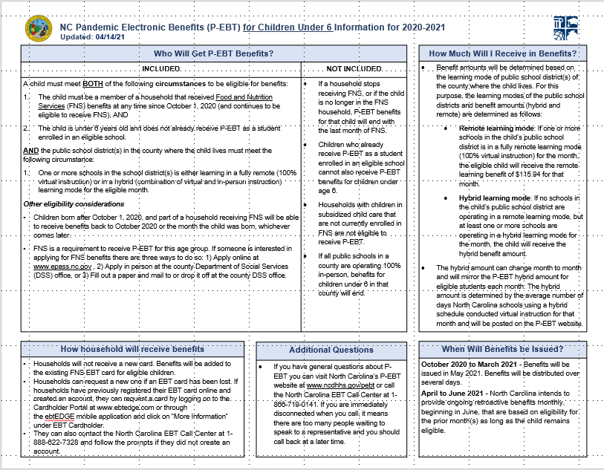
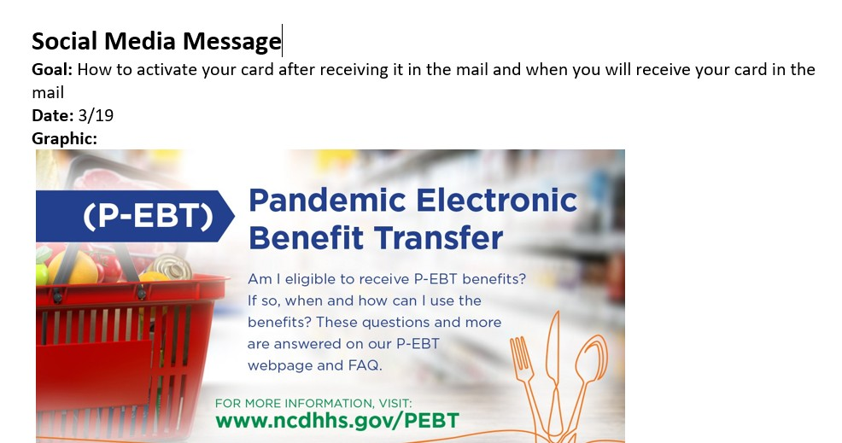
P-EBT toolkits to be provided
The state will distribute toolkits to assist internal partners 2 days prior to the P-EBT press release. Toolkits will also be made available to assist external partners (211, Grocers Association, etc.)
Component | Description of Component
Internal Materials
Info Sheet | One-pager highlighting key messages that can help partners / stakeholders answer basic questions about P-EBT.
Frequently Asked Questions (FAQ) | A culmination of questions that are anticipated to be asked by customers and stakeholders based on changes to P-EBT and frequently asked questions in 2020.
External Materials (OK to share with public)
Flyer / Infographic | One-page documents or graphics that are visual to help communicate the key elements of P-EBT in-person (physical) or through digital channels.
Website content | Content partners and stakeholders can publish on their websites that will ‘push’ customers / users to the main P-EBT website.
Social media messages | Messages and graphics that can be distributed over Facebook, Twitter, and Instagram in English and Spanish. The messages will be aligned with the DHHS campaign.
Example screenshots (Materials are still being finalized)
Example flyer
Info sheet
’Packaged social media messages’
DRAFT

Slide 10
What you can expect next and what we need from you
What you can expect next
A public awareness campaign will begin in mid-May
DHHS will provide a ‘toolkit’ of resources 2 days prior to press release to assist with the P-EBT for children under 6 rollout and communication (i.e. flyers, media releases, recommended website updates)
Partners will continue to receive updates on P-EBT and ongoing materials (social media messages, etc.) to share
What we need from you
Review and share P-EBT information provided by DHHS with WIC agency teams to make sure they are prepared to answer questions
Update websites and other online resources with updated information (once info is shared)

Slide 11


What Questions Do You Have?
Notes:
What questions do you have?
Adobe Stock: 104477106

Slide 12
Emergency Cost Reimbursement
Child and Adult Care Food Program

Slide 13
Purpose, overview, and impact of Emergency Cost Reimbursement
The Emergency Operational Costs Reimbursement program helps families program operators who have been impacted by COVID-19.
Overview
Emergency Operational Costs Reimbursement Program – provides local operators with additional reimbursements for emergency operating costs they incurred during the public health emergency.
  CACFP reimbursements for emergency operating costs incurred during the months of March – June 2020.
Allowable Uses of Funds – Funds provided to program operators under this authority represent reimbursement for excess costs incurred during defined reimbursement period. Funds may be used to:
  Reimburse any local source of funds used to supplement the Nonprofit Food Service account during the reimbursement period to offset the impact of pandemic operations on that account.
  Program operators must maintain documentation supporting reimbursements for future audit or oversight purposes.
  Any remaining funds must be deposited in the Nonprofit Food Service account and be used in accordance with normal program requirements.

Slide 14
Emergency Cost Reimbursement benefits timeline
The State agency will submit its implementation plan on or before May 10, 2021
1
May 30, 2021
2
June 30, 2021
3
July 31, 2021
Institutions will receive an official notice from the State agency
Anticipated reimbursement amount
Acceptable use of funds
Any institution not eligible will have to provide assurance by June 15, 2021
Requirement to report use of funds
The State agency will begin disbursing funds to institutions
The State agency will request additional funds from FNS (if applicable)
4
September 30, 2021
5
January 31, 2022
6
March 31, 2022
Funds obligation deadline
Funds liquidation deadline.
Recovery process begins.
Institutions must report to the State agency of the use of funds.
The State agency must submit a summary of the use of funds to FNS
All institutions receiving Emergency Cost Reimbursement must report back to the State agency how the funds were used.

Slide 15
What Questions Do You Have?
Notes:
What questions do you have?
Adobe Stock: 104477106

Slide 16
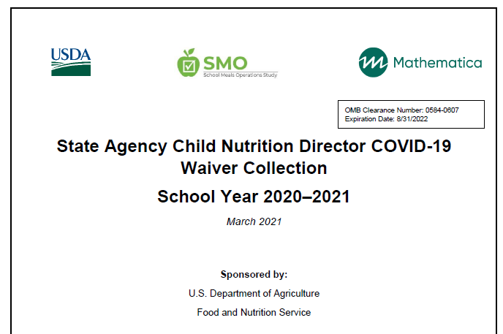
COVID-19 Wavier Follow Up Survey
All institutions that received a waiver were required to submit a Waiver Follow Up Survey on or before April 27, 2021
The State agency used institution’s responses to complete a School Meals Operations Study (SMO) entitled State Agency Child Nutrition Director COVID-19 Waiver Collection

Slide 17

Existing Nationwide Waivers
Institutions are eligible to apply for existing waivers. The link to the waivers can be found at:
  www.nutritionnc.com
  NC CARES Bulletin Board

Slide 18
COVID-19 Nationwide Waivers for School Year 2021-2022
PLEASE NOTE: Institutions must be approved to use the flexibilities allowed in the waivers

Slide 19
COVID-19: Child Nutrition Response #84
Announcement of new suite of Child Nutrition Program waivers and flexibility to support a successful reopening in school year 2021-2022.
FNS expect schools and child care providers to use the flexibilities for ONLY the duration and extent that they are needed.
Program operators should continue to refer to the Centers for Disease Control and Prevention for the latest information on mitigation and prevention measures, including those around food and drink consumption.

Slide 20
COVID-19: Child Nutrition Response #87
Nationwide Waiver to Allow Non-Congregate Meal Service for School Year 2021-2022
Waiver is effective July 1, 2021 and remains in effect through June 30, 2022
Non-congregate feeding flexibilities provide schools and child care operators the opportunity to provide meal pick-up options for students learning virtually, and also facilitate grab-and-go meals for students in school
Flexibilities under this waiver should be implemented by program operators until such a time when greater levels of congregation in in-school settings is safe and healthy to pursue
If approved for this waiver, program operators must provide a summary of the use of the non-congregate feeding flexibilities and a description of whether and how the flexibilities resulted in improved services

Slide 21
COVID-19: Child Nutrition Response #88
Nationwide Waiver of Meal Times Requirements for School Year 2021-2022
Waiver is effective July 1, 2021 and remains in effect through June 30, 2022
This waiver is for the purpose of implementing appropriate safety measures by supporting alternative meal service models and social distancing in Child Nutrition Programs
This waiver should support:
  A successful school reopening by facilitating a safe, efficient, and socially distant meal service
State agencies may also adjust the time of meal services, including suspension of meal times as needed
Institutions that have been approved for this waiver may continue to participate under that approval for the duration of Summer 2021

Slide 22
COVID-19: Child Nutrition Response #88
Nationwide Waiver of Meal Times Requirements for School Year 2021-2022
If approved for this waiver, program operators must provide a summary of the use of the meal time flexibilities and a description of whether and how the flexibilities resulted in improved services

Slide 23
COVID-19: Child Nutrition Response #89
Nationwide Waiver to Allow Parents and Guardians to Pick Up Meals for Children for School Year 2021-2022
Waiver is effective July 1, 2021 and remains in effect through June 30, 2022
This flexibility allows a parent or guardian the ability to pick up meals to take home to their children
Institutions should have plans in place to ensure:
  Meals are distributed only to parent or guardians of eligible children
  Duplicate meals are not distributed to any child
Flexibilities under this waiver should be implemented by program operators until such a time when greater levels of congregation in in-school settings is safe and healthy to pursue

Slide 24
COVID-19: Child Nutrition Response #89
Nationwide Waiver to Allow Parents and Guardians to Pick Up Meals for Children for School Year 2021-2022
If approved for this waiver, program operators must provide a summary of the use of the meal time flexibilities and a description of whether and how the flexibilities resulted in improved services

Slide 25
COVID-19: Child Nutrition Response #91
Nationwide Waiver to Allow Specific Meal Pattern Flexibility in the Child and Adult Care Food for School Year 2021-2022
Waiver is effective July 1, 2021 and remains in effect through June 30, 2022
Program Operators may request targeted meal pattern flexibility for select requirements:
  At least one service per day, across all eating occasions, must be whole grain-rich
  Crediting of grains by ounce equivalents must be fully implemented by October 1, 2021
  Low-fat milk (1 percent) must be unflavored
The State agency will consider approval on a case-by-case basis

Slide 26
COVID-19: Child Nutrition Response #91
Nationwide Waiver to Allow Specific Meal Pattern Flexibility in the Child and Adult Care Food for School Year 2021-2022
For technical assistance resources on serving whole grains and milk, meeting grains ounce equivalent requirement, and meal service during COVID-19, please see
https://www.fns.usda.gov/tn/child-care-organization

Slide 27
COVID-19: Child Nutrition Response #91
Nationwide Waiver to Allow Specific Meal Pattern Flexibility in the Child and Adult Care Food for School Year 2021-2022
If approved for this waiver, program operators must provide a summary of the use of the meal pattern flexibilities and a description of whether and how the flexibilities resulted in improved services to program participants

Slide 28
COVID-19: Child Nutrition Response #93
Nationwide Waiver of Area Eligibility in the Afterschool Programs and for Family Day Care Home Providers in School Year 2021-2022
Waiver is effective July 1, 2021 and remains in effect through June 30, 2022
The purpose of this waiver is to assist schools, community organizations, and day care homes with reopening and to ensure that children are able to receive benefits with appropriate safety measures

Slide 29
COVID-19: Child Nutrition Response #93
Nationwide Waiver of Area Eligibility in the Afterschool Programs and for Family Day Care Home Providers in School Year 2021-2022
What this waiver allows:
  Schools, regardless of their location, to claim all afterschool snacks at the FREE rate
  At-Risk Afterschool Care Centers, regardless of their location, to apply to participate in the CACFP and claim all meals and snacks at the FREE rate
  All Day Care Homes, regardless of their location, to receive the Tier I reimbursement rate for all meals and snacks

Slide 30
COVID-19: Child Nutrition Response #93
Nationwide Waiver of Area Eligibility in the Afterschool Programs and for Family Day Care Home Providers in School Year 2021-2022
If approved for this waiver, program operators must:
  Provide a summary of the use of the waiver
  Provide a summary of how new meal sites targeted benefits to children who were previously eligible or newly eligible for program benefits
  And provide a description of whether and how the flexibilities resulted in improved services to program participants

Slide 31
COVID-19: Child Nutrition Response #96
Nationwide Waiver of Onsite Monitoring Requirements for Sponsors in the Child and Adult Care Food Program - Extension
This waiver extends the Nationwide Waiver of Onsite Monitoring Requirements for Sponsors in the Child and Adult Care Food Program, granted on August 4, 2020, that expires on September 30, 2021 – until 30 days after the end of the public health emergency, which was declared on January 31, 2020 by the US Department of Health and Human Services
Sponsoring Organizations should continue monitoring activities of Program operations offsite (e.g., through desk audits)

Slide 32
COVID-19: Child Nutrition Response #96
Nationwide Waiver of Onsite Monitoring Requirements for Sponsors in the Child and Adult Care Food Program - Extension
If approved for this waiver, program operators must provide a summary of the use of this extension and a description of whether and how the extension resulted in improved services to program participants

Slide 33
What Questions Do You Have?
Notes:
What questions do you have?
Adobe Stock: 104477106

Slide 34
Application Update
2022

Slide 35

Application Update 2022
  Application Update State agency training will begin the end of June into July
    Live Webinar training
    Post recorded webinars
  Anticipated Rollover will be mid July 2021
  Application Update is due September 30, 2021
  SD Notices will be issued starting October 1, 2021

Slide 36
Application Update 2022
Sponsoring Organizations of Unaffiliated Centers will be required to submit a sponsored center budget for all their sponsored facilities
State Forms added to Application Update 2022
  IRS Tax Exemption Verification (Non-Profits Only)
  Conflict of Interest Acknowledgement and Policy-all institutions
SAM Registration (Required for ALL Institutions)
  For information regarding SAM Registration go to:
  https://www.sam.gov/SAM/

Slide 37
What Questions Do You Have?
Notes:
What questions do you have?
Adobe Stock: 104477106

Slide 38


Slide 39
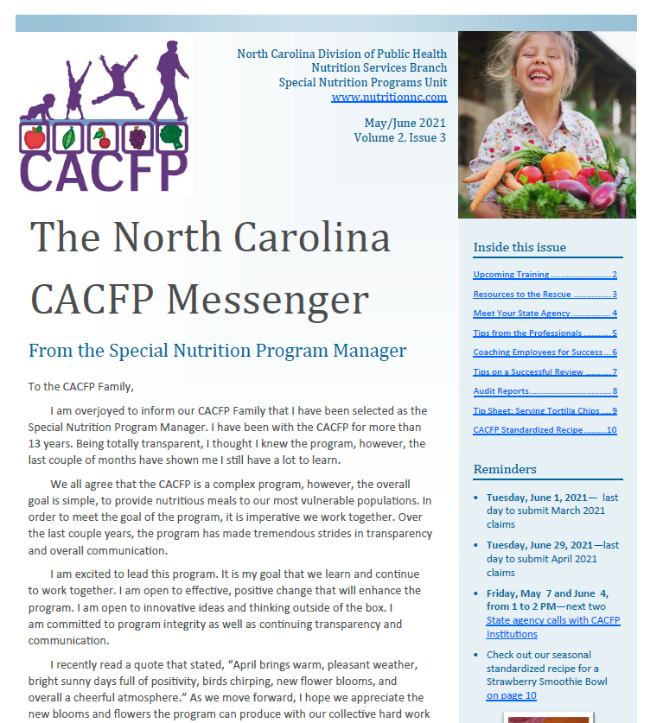
NC CACFP Messenger – May/June 2021
Gardening ideas
Crediting tortilla chips
Coaching staff at your center(s)
Audit report requirements
And more!

Slide 40
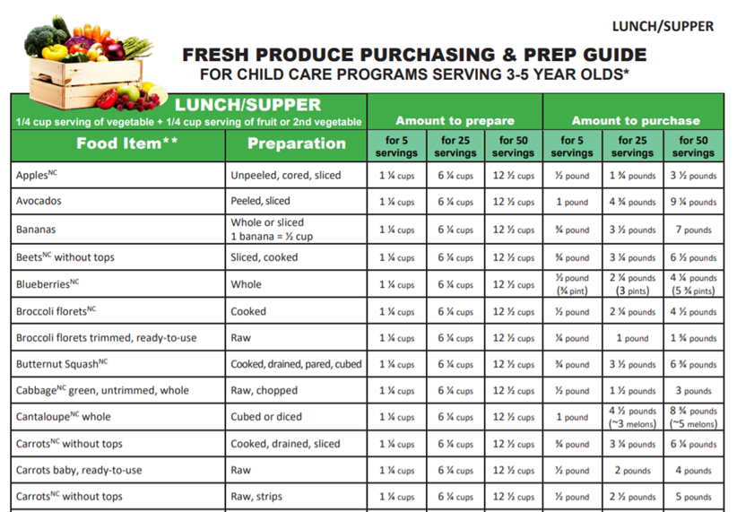
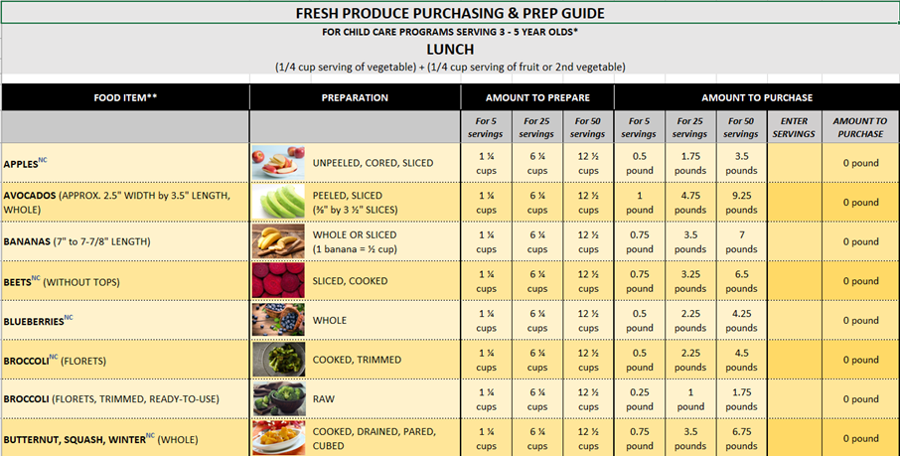
NC Fresh Produce Purchasing and Prep Guides
PDF versions
Microsoft Excel versions
01
02
  From the NC Farm to Preschool Network:
  https://growing-minds.org/nc-farm-to-preschool-network/

Slide 41
Upcoming Trainings – Mark Your Calendar
Date | Time | Training
May 11 | 9 AM – 12 PM | Duties & Documents for ICs
May 13 | 9 AM – 12 PM | Duties & Documents for SOs
May 20 | 9 AM – 11 AM | Compliance Review – Are You Ready?
June 2 | 9 AM – 12 PM | Get Started with NC CACFP for SOs*
June 3 | 1 PM – 4 PM | Get Started with NC CACFP for ICs*
July 20 | 9 AM – 1 PM | Build A Better Menu
*Note: This training is for those wishing to apply, not those already on the program. Please help us spread the word.

Slide 42
Trainings Coming Soon
CACFP Meal Pattern Success: Serving Grains Using Ounce Equivalents
  Sessions the week of June 7 and June 14
  More sessions will be offered later this summer as well
Application Update for 2021-2022
  Sessions will be offered the week of June 28 and the week of July 5
Registration will be posted on our training page soon: https://www.nutritionnc.com/snp/training.htm

Slide 43
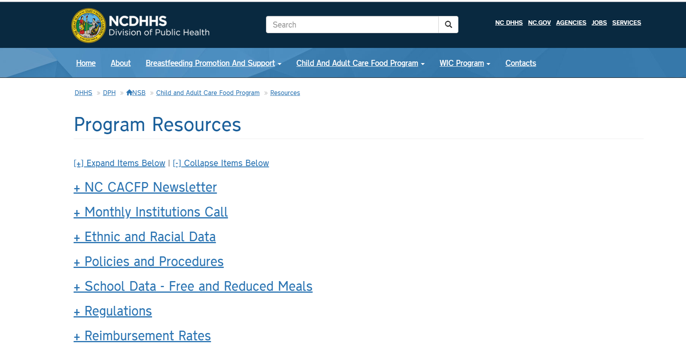
Monthly Institution Calls
The PowerPoints for the institution calls can now be found on our website www.nutritionnc.com
  Click on Child and Adult Care Food Program
  Click on Program Resources
  Click on Monthly Institution Calls

Slide 44

Q&A
Please use the Q & A function to submit your questions. We will review what we have time for that pertains to the good of the group. Questions that apply to one specific institution will be handled offline.

