Slide 1
NC Department of Health and Human Services
Division of Mental Health, Developmental Disabilities, and Substance Use Services
Opioid and Prescription Drug Abuse Advisory Committee Meeting
June 12, 2026

Slide 2
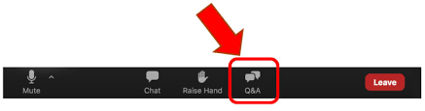
Housekeeping
Reminders about the webinar technology:
  Please make sure you are using a computer or smart phone connected to the internet, the audio function is on, and the volume is turned up.
  Please make sure your microphone is muted for the duration of the call.
  Questions can be submitted any time during the presentation using the “Q&A” box located on your control panel. We will answer as many questions as time allows after the presentation.

Slide 3
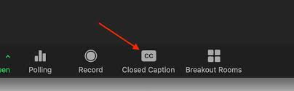
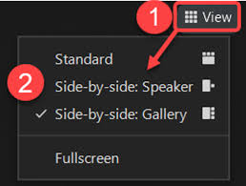
Housekeeping
American Sign Language (ASL) Interpreters and Closed-Captioning
  ASL Interpreters and Closed-Captioning options will be available for today’s event.
  For closed-captioning options select the "Closed Caption" feature located on your control panel.
Adjusting Video Layout and Screen View
  Select the "View" feature located in the top-right hand corner of your screen.
Intérpretes en lengua de signos americana (ASL) y subtítulos:
Habrá intérpretes de ASL y opciones de subtítulos disponibles para el evento de hoy. Para opciones de subtítulos, seleccione la función "Subtítulos" ubicada en su panel de control.

Slide 4
Agenda
Welcome and Housekeeping- Latoya de Lagarde, Tyler Yates
Public Health Surveillance of the Overdose Epidemic - Scott Proescholdbell; Mary Beth Cox
NC Controlled Substance Reporting System: Data Request Process - Stella Bailey
Naloxone Distribution Dashboard Preview - Anita Nsubuga
CORE-NC: Tracking Opioid Settlement Funds - Cecilia Gonzales
Q&A - Moderated by Amy O’Regan
Closing Remarks and Reminders - Latoya de Lagarde

Slide 5
Opioid and Prescription Drug Abuse Advisory Committee
Prescription Drug Abuse Advisory Committee created in 2015 to develop and implement a statewide strategic plan to combat the problem of prescription drug use in North Carolina.
Renamed to the Opioid and Prescription Drug Abuse Advisory Committee (OPDAAC) in 2017.
OPDAAC has evolved from its initial role of implementing DHHS’s opioid strategic plan to a community of practice
https://www.ncdhhs.gov/about/department-initiatives/overdose-epidemic/nc-opioid-and-prescription-drug-abuse-advisory-committee

Slide 6
Opioid and Prescription Drug Abuse Advisory Committee
Meetings are held quarterly
Designed to focus on priorities of the NC Opioid and Substance Use Action Plan
Today’s topic will focus on the overarching priorities of tracking progress, measuring our impact, and monitoring for emerging trends.
The next meeting is Sept. 25, 2026; 9:30AM-12:00PM
  Registration link: https://www.zoomgov.com/meeting/register/1awndEqNT5K7FTOlGvDBVA#/registration
Materials and recordings are available online: https://www.ncdhhs.gov/about/department-initiatives/overdose-epidemic/nc-opioid-and-prescription-drug-abuse-advisory-committee/opdaac-meetings-agendas-and-presentations

Slide 7
Public Health Surveillance of the Overdose Epidemic
Division of Public Health
Injury and Violence Prevention Branch
Mary Beth Cox, MPH
Substance Use Epidemiologist
Scott Proescholdbell, MPH
Injury Epi, Surveillance & Informatics Unit Manager
This slide deck was supported by the Centers for Disease Control and Prevention (CDC) of the U.S. Department of Health and Human Services (HHS) as part of the Overdose Data to Action in States (CDC-RFA-CE-23-0002) cooperative agreement award totaling $4,950,273 annually with 100% funded by CDC/HHS. The contents are those of the author(s) and do not necessarily represent the official views of, nor an endorsement by, CDC/HHS or the U.S. Government.
Notes:
This slide set was created to provide basic data trends and public health surveillance around the drug overdose epidemic. They are meant to offer a state-level background on drug overdose. If you’d like a copy of the slides, please visit the Overdose Data page on our branch website, https://www.dph.ncdhhs.gov/programs/chronic-disease-and-injury/injury-and-violence-prevention-branch. The direct link is also shared at the end of this presentation.
Feel free to incorporate these slides into your own presentations, grant proposals, reports, or any other way they may be useful.
Please read both the speaking and technical notes to ensure that data are presented in a consistent manner.

Slide 8


Mary Beth Cox, MPH
Substance Use Epidemiology Team Lead
NCDHHS, Division of Public Health, Injury and Violence Prevention Branch
Scott Proescholdbell, MPH
State Injury Epidemiologist and Unit Manager
NCDHHS, Division of Public Health, Injury and Violence Prevention Branch

Slide 9
We have no actual or potential conflicts of interest in relation to this presentation.
Agenda
Passive Surveillance
Active Surveillance
Injury Data Users Toolkit
Funding
This work and other work by the NC Injury & Violence Prevention Branch (IVPB) is made possible from funding from several cooperative agreements with the CDC’s Center for Injury and Prevention.

Slide 10
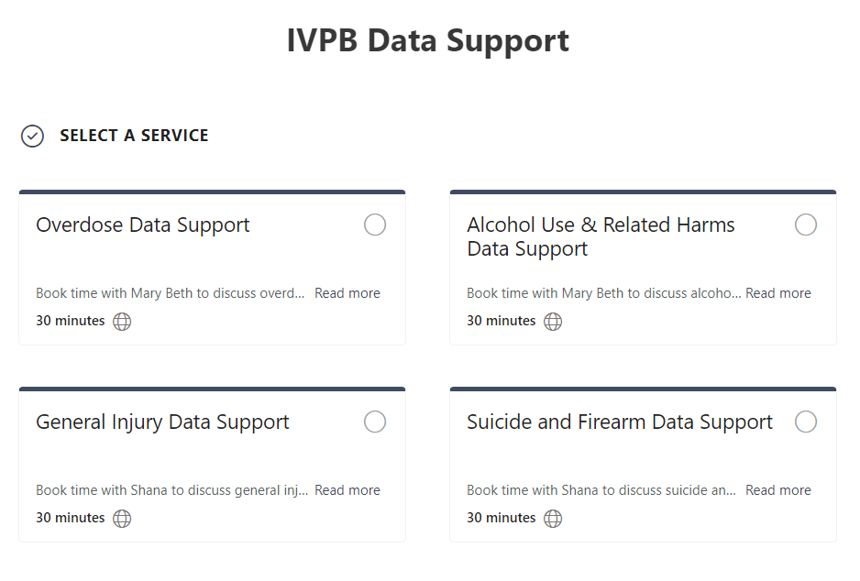

IVPB Data Support available!
Book time with an IVPB epidemiologist to discuss available data products, to talk through custom data requests, or for general data questions.
IVPB Data Request Policy
IVPB Data Support Bookings

Slide 11
Public Health Surveillance
Surveillance = the systematic, ongoing collection, management, analysis, and interpretation of data
Passive
Delayed
Detailed & Complete
Active
Fast
Incomplete
Long-term action
Quick response

Slide 12
Passive Surveillance

Slide 13
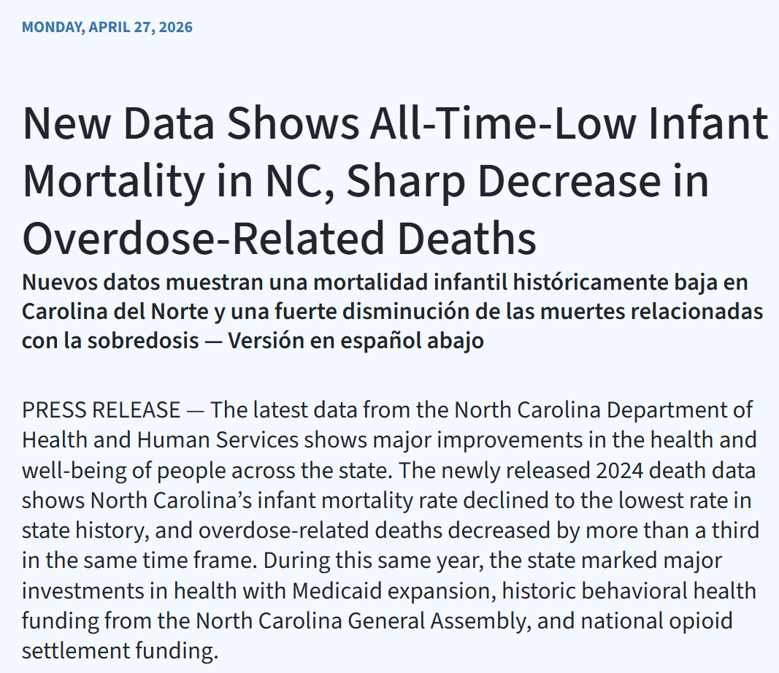

Slide 14
Overdose death data are final through 2024.
Data are finalized when the file is complete, meaning that the overdose counts should not change.
Technical Notes: All intent medication and drug overdose: X40-X44, X60-X64, Y10-Y14, X85; Limited to NC residents
Source: Deaths-NC State Center for Health Statistics, Vital Statistics, 2015-2024
Analysis by Injury Epidemiology and Surveillance Unit

Slide 15
Overdose deaths have a longer lag time than other causes of death.
The lag time is the time between when the death occurred and when the data are available for analysis.
When numbers are shared before data are final, or complete, numbers are labeled “provisional.”
Technical Notes: All intent medication and drug overdose: X40-X44, X60-X64, Y10-Y14, X85; Limited to NC residents;
*2025 and 2026 data are provisional and will increase as additional deaths are confirmed; as of 5/1/2026
Source: Deaths-NC State Center for Health Statistics, Vital Statistics, 2015-2026*
Analysis by Injury Epidemiology and Surveillance Unit
Notes:
34% decrease in 2024; 41% decrease in 2025

Slide 16
Who are the people most impacted by the overdose epidemic?
Who?

Slide 17
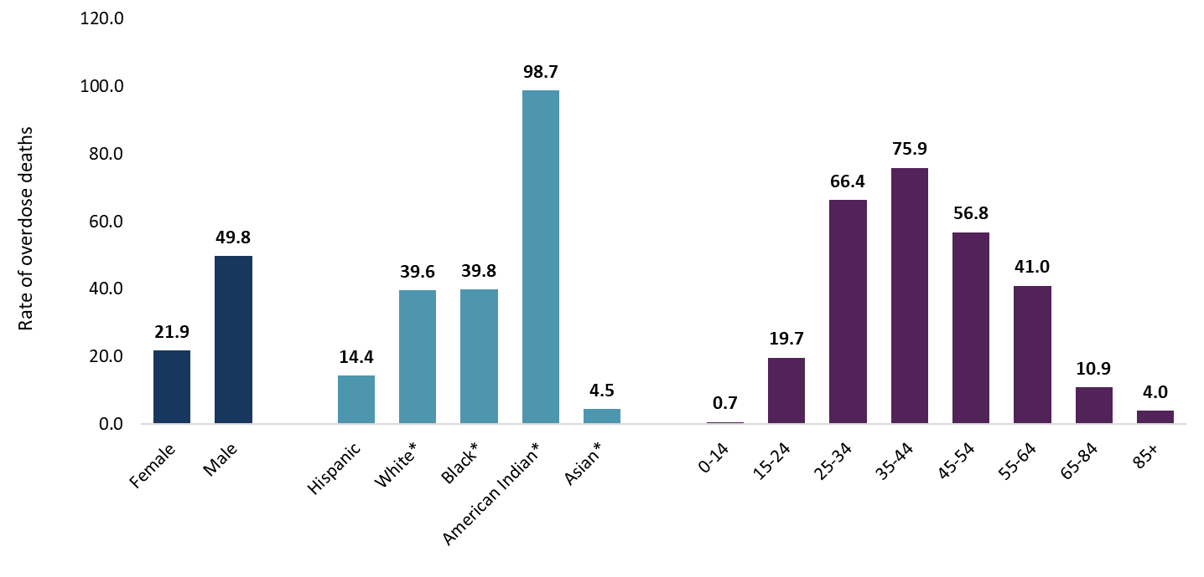
Overdose death rates are highest among males, American Indians, and those 25-54 years old (2020-2024)
*NH = Non-Hispanic
Technical Notes: Rates are per 100,000 NC residents; All intent medication and drug overdose: X40-X44, X60-X64, Y10-Y14, X85
Source: Deaths- NC State Center for Health Statistics, Vital Statistics, 2020-2024; Population-NCHS, 2020-2024
Analysis by Injury Epidemiology and Surveillance Unit
Notes:
The highest rates of med/drug overdose deaths occurred among NC residents ages 35-44 (75.9 per 100,000) and 25-34 (66.4 per 100,000), males (49.8 per 100,000), Non-Hispanic American Indians (98.7 per 100,000). These rates are calculated over a five-year time period (2020-2024).

Slide 18
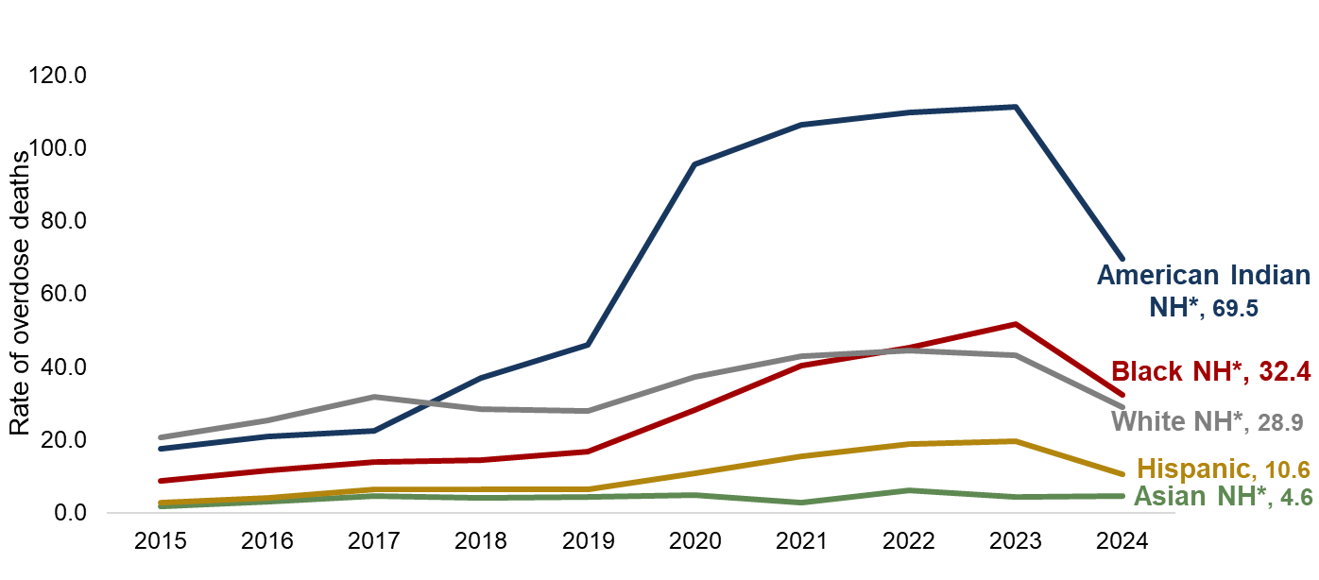
In 2024, nearly all populations experienced a decrease in overdose deaths
Rate change | 2019 to 2023 | 2023 to 2024
Black* | +210% | -37%
Hispanic | +200% | -46%
American Indian* | +141% | -38%
White* | +55% | -33%
Asian* | +2% | +7%
*NH = Non-Hispanic
Technical Notes: Rates are per 100,000 NC residents; All intent medication and drug overdose: X40-X44, X60-X64, Y10-Y14, X85
Source: Deaths-NC State Center for Health Statistics, Vital Statistics, 2015-2024; Population-NCHS, 2015-2024
Analysis by Injury Epidemiology and Surveillance Unit
Notes:
After reaching its peak overdose death rate in 2023, North Carolina experienced a decrease in 2024. However, the decrease seen statewide is not evenly dispersed amongst historically marginalized populations.
The percentage by which overdose death rates changed from 2023 to 2024 was highest among Hispanic people with a 45.6% decrease in their overdose death rate (19.5 to 10.6 per 100,000). American Indian/Indigenous communities had the highest overdose death rate in 2024, a 37.6% decrease from 2023 to 2024 (111.3 to 69.5 per 100,000). White NH people saw a 33.1% decrease in overdose death rates from 2023 to 2024 (43.2 to 28.9 per 100,000). Black NH people had the second highest rate in 2024, a 37.5% decrease from 2023 to 2024 (51.8 to 32.4 per 100,000). Asian NH people saw a 7.0% increase in overdose death rates from 2023 to 2024 (4.3 to 4.6 per 100,000).

Slide 19
What substances are involved in overdoses?
What?

Slide 20
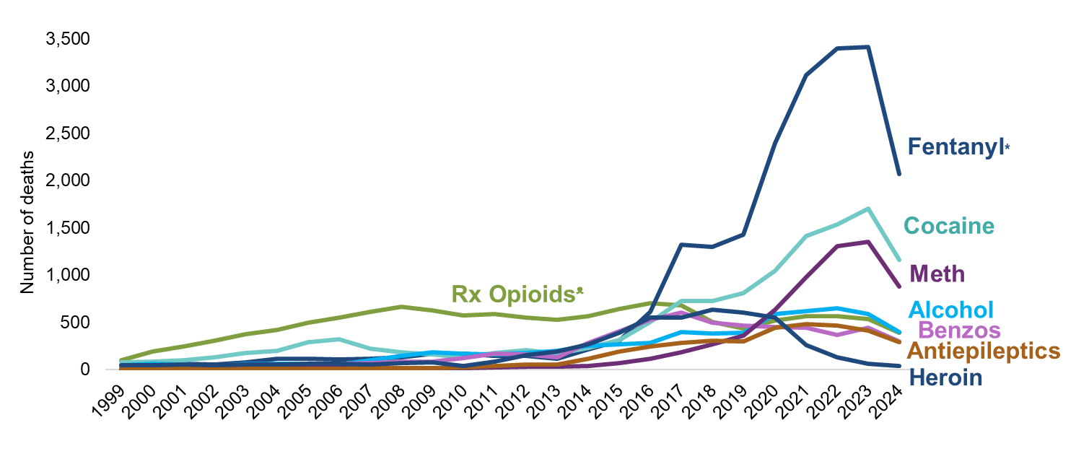
Illicitly manufactured fentanyl* remains the main contributor to overdose deaths
A growing number of deaths involve multiple substances in combination (i.e., polysubstance use)
*Fentanyl surveillance based on Other Synthetic Narcotics (T40.4), which consists of mainly illicitly manufactured fentanyl and fentanyl analogues ᵜCommonly Prescribed Opioid Medications
Technical Notes: These counts are not mutually exclusive; If the death involved multiple substances, it can be counted on multiple lines; Toxicology data is unable to distinguish whether the presence of multiple substances indicate intentional polysubstance use or if one substance was tainted with other drugs (e.g. cocaine laced with fentanyl); All intent medication, drug, alcohol poisoning: X40-X45, X60-64, Y10-Y14, X85 with any mention of specific T-codes by drug type; limited to NC residents
Source: Deaths-NC State Center for Health Statistics, Vital Statistics, 1999-2024
Analysis by Injury Epidemiology and Surveillance Unit
Notes:
The overdose epidemic is mostly driven by fentanyl.
Historically, prescription opioids (drugs like hydrocodone, oxycodone, morphine) contributed to an increasing number of medication/drug overdose deaths. In more recent years, synthetic narcotics such as fentanyl, and fentanyl analogues* have resulted in increased deaths. The number of deaths involving stimulants like cocaine and psychostimulants (which includes methamphetamine) also continue to rise.
These counts are not mutually exclusive. If a death involved multiple substances, it can be counted on multiple lines. A growing number deaths involve multiple substances in combination. Toxicology data is unable to distinguish whether the presence of multiple substances indicate intentional polysubstance use or if one substance was tainted with other drugs (e.g. cocaine laced with fentanyl).
*Fentanyl analogues are drugs that are similar to fentanyl but have been chemically modified in order to bypass current drug laws.

Slide 21
Where do overdoses occur in North Carolina?
Where?

Slide 22
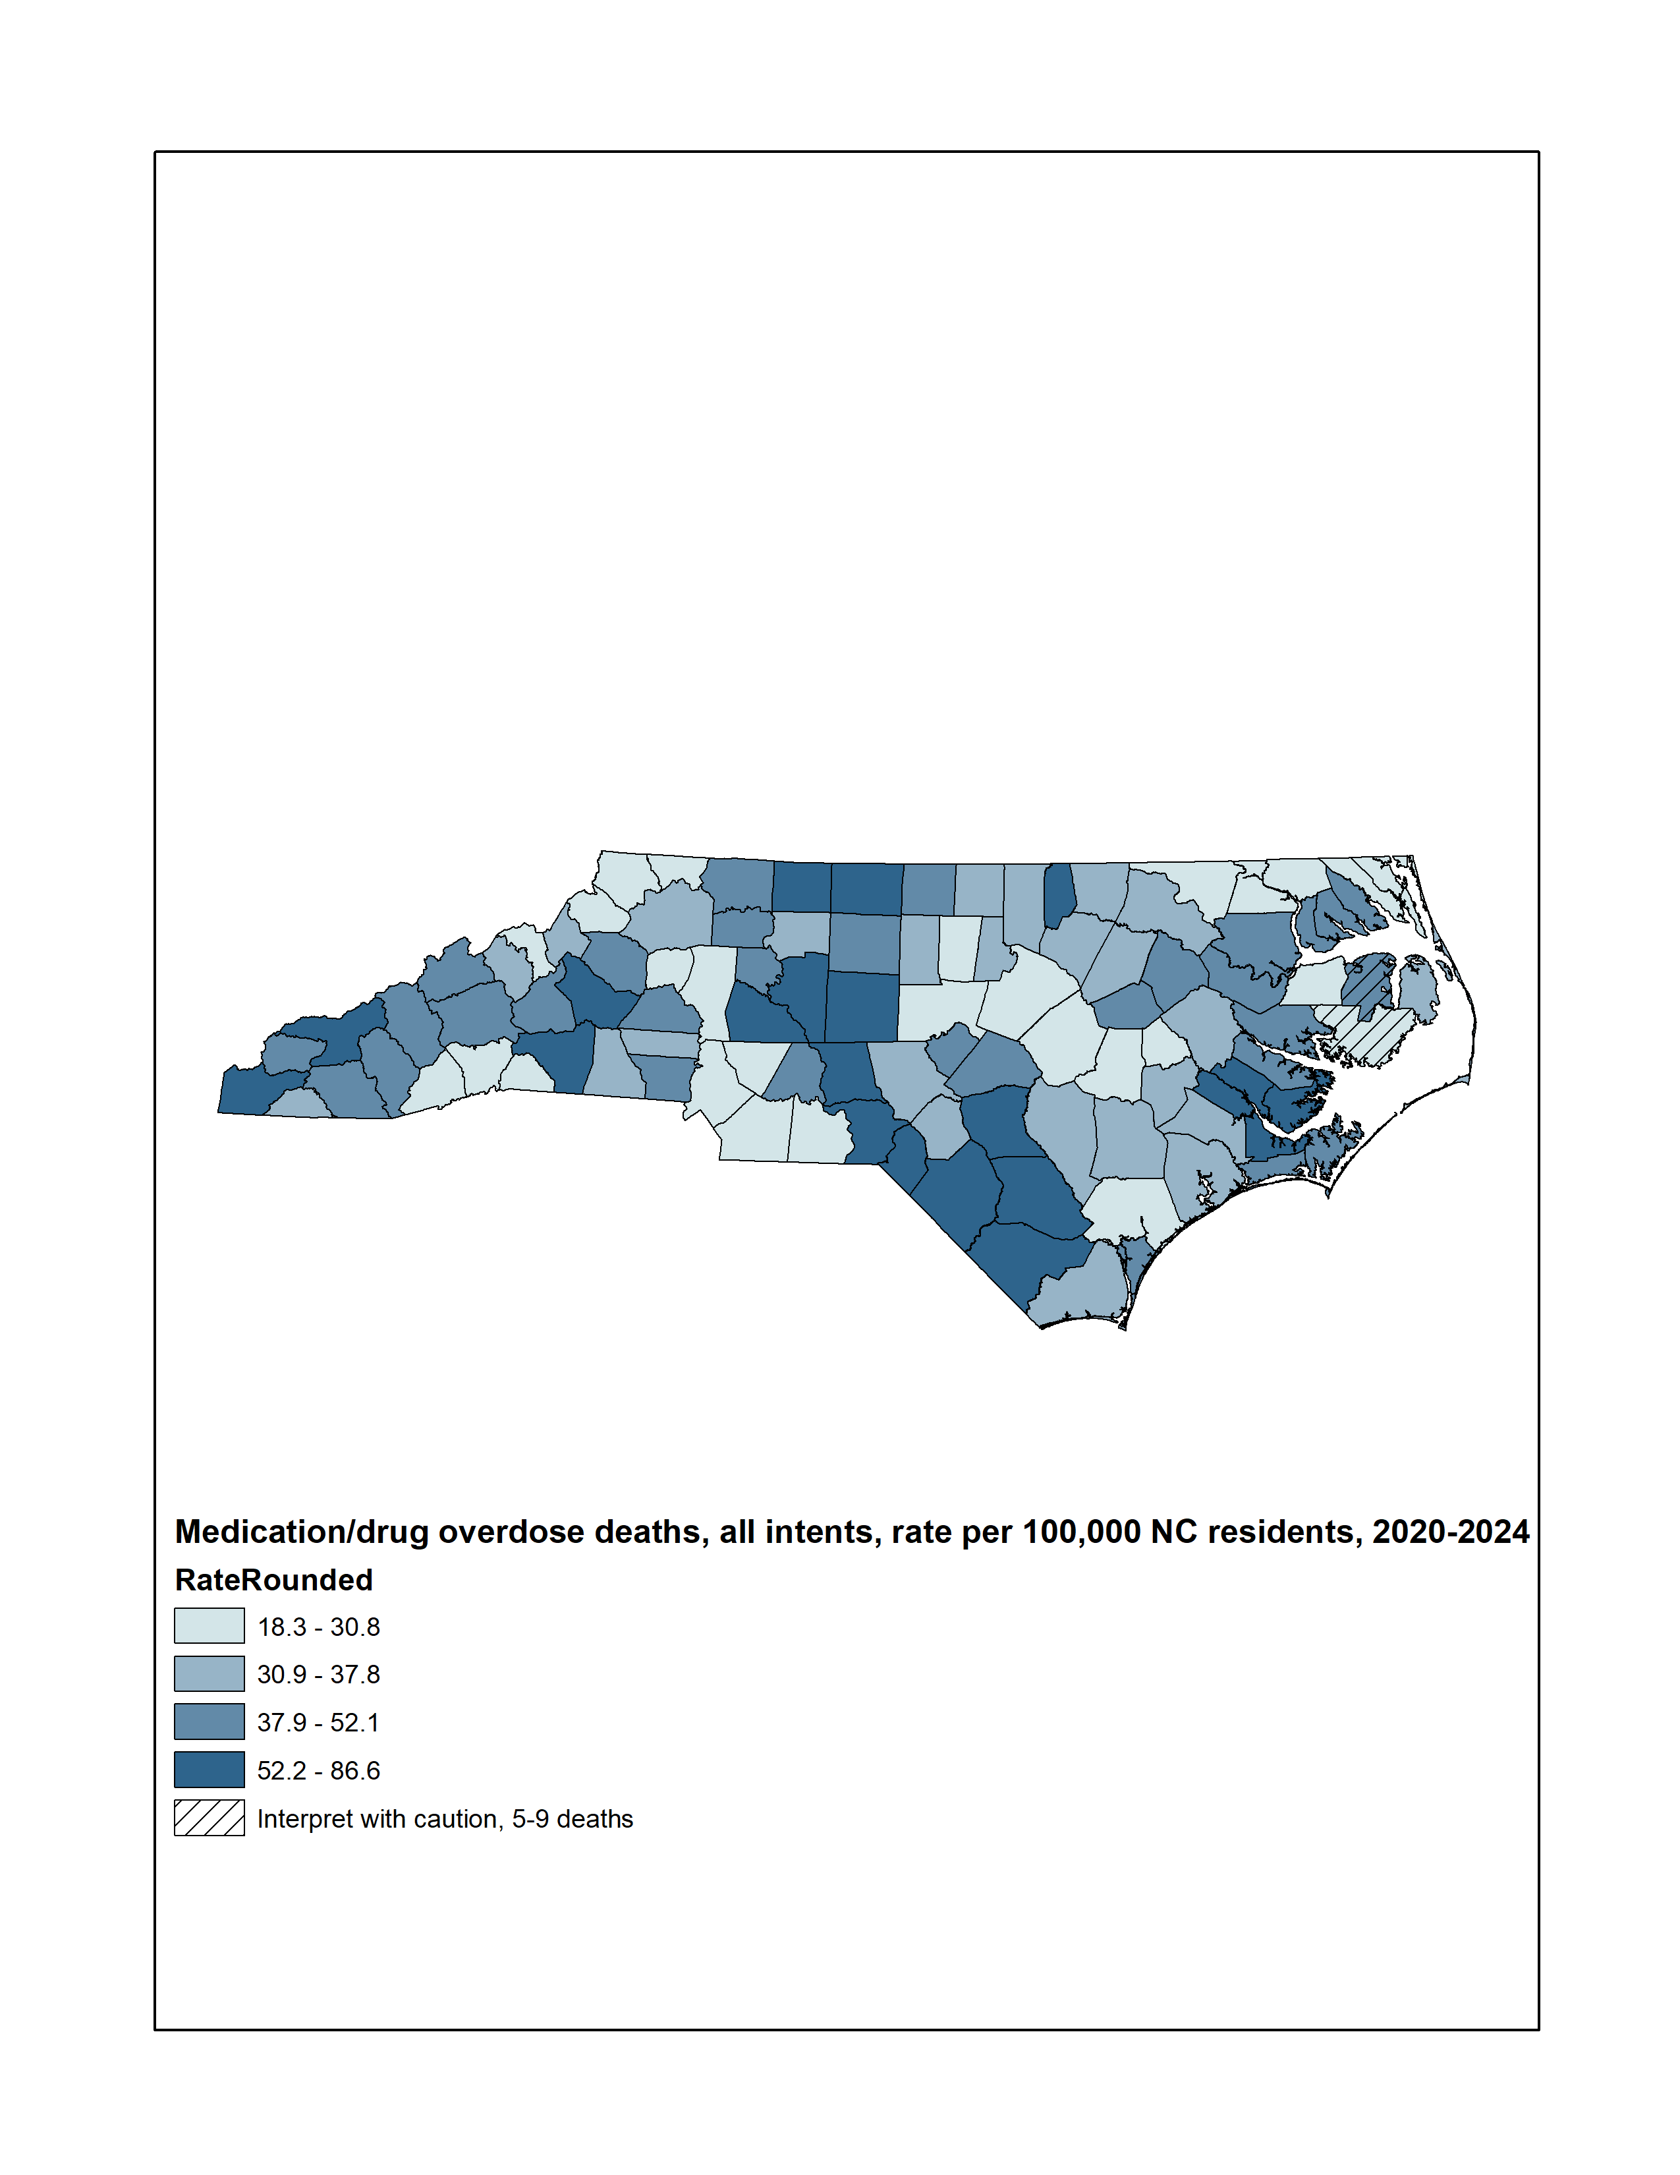
Statewide, the overdose death rate from 2020-2024 was 35.5 deaths per 100,000 residents
Medication/drug overdose deaths, all intents, rate per 100,000
Technical Notes: Rates are per 100,000 NC residents; All intent medication and drug overdose: X40-X44, X60-X64, Y10-Y14, X85
Source: Deaths-NC State Center for Health Statistics, Vital Statistics, 2020-2024; Population-NCHS, 2020-2024
Analysis by Injury Epidemiology and Surveillance Unit
Notes:
This map shades the counties of NC based on their respective overdose death rate. The statewide rate was 35.5 per 100,000 residents from 2020-2024. This five-year period was used in order to provide greater reliability in county-level rate estimates.
All counties had more than four deaths, so all rates were calculated. Interpret rates with caution in counties with fewer than 10 deaths.

Slide 23
What are the overdose trends over time in North Carolina?
When?

Slide 24
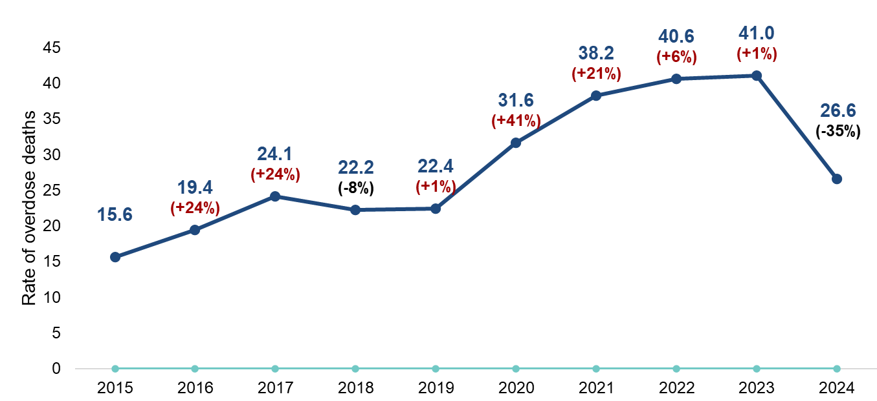
Overdose death rates in North Carolina decreased in 2024
n=2,934
n=1,566
From 2015 to 2024, the fatal overdose rate increased 71%.
Technical Notes: All intent medication and drug overdose: X40-X44, X60-X64, Y10-Y14, X85; Limited to NC residents
Source: Deaths-NC State Center for Health Statistics, Vital Statistics, 2015-2024
Analysis by Injury Epidemiology and Surveillance Unit
Notes:
Disruption to public health, healthcare, and social services from COVID-19 all contributed to the 41% increase in 2020 and the continued increases in our state.
This slide looks at the rate of med/drug overdose deaths among NC residents. From 2023, with a death rate of 41.0 per 100,000, to 2024, with a death rate of 26.6 per 100,000, North Carolina saw a 35% decrease in the rate of overdose deaths.
The number of overdose deaths increased from 1,566 in 2015 to 2,934 in 2024, a 87.4% increase. Similarly, the rate of overdose deaths increased from 15.6 in 2015 to 26.6 in 2024, a 70.5% increase.

Slide 25
What are factors that may have led to a person’s overdose?
Why?

Slide 26

There are many things the data may not be able to tell us, but NC-SUDORS offers additional insights into the circumstances leading to an overdose death.
Death Certificates
-Demographics
-Decedent resident information
-Cause of death information
Medical Examiner Reports
-Scene evidence of drug use
-Timing and context of overdose
-Medical and social history/circumstances
Toxicology Results
-All substances detected
-Substances that caused death
North Carolina State Unintentional Drug Overdose Reporting System (NC-SUDORS)
Circumstance data are gathered during the initial death investigation, often during interviews with the decedent’s family and friends. These data are not always known or relayed.
Notes:
The North Carolina State Unintentional Drug Overdose Reporting System (NC-SUDORS) is made up of multiple sources of data including death certificates, medical examiner/coroner reports, and toxicology results. The incorporation of different sources of data provide a unique opportunity to analyze circumstance data for these unintentional or undetermined overdose deaths.
SUDORS, a program developed by the Centers for Disease Control and Prevention (CDC) enables states to collect detailed overdose death information. SUDORS provides rich circumstance data and highlights opportunities where intervention could save lives. Circumstance data is gathered during the initial death investigation oftentimes during interviews with the decedent’s family and friends. All circumstance data are not always known or relayed during the investigation.

Slide 27
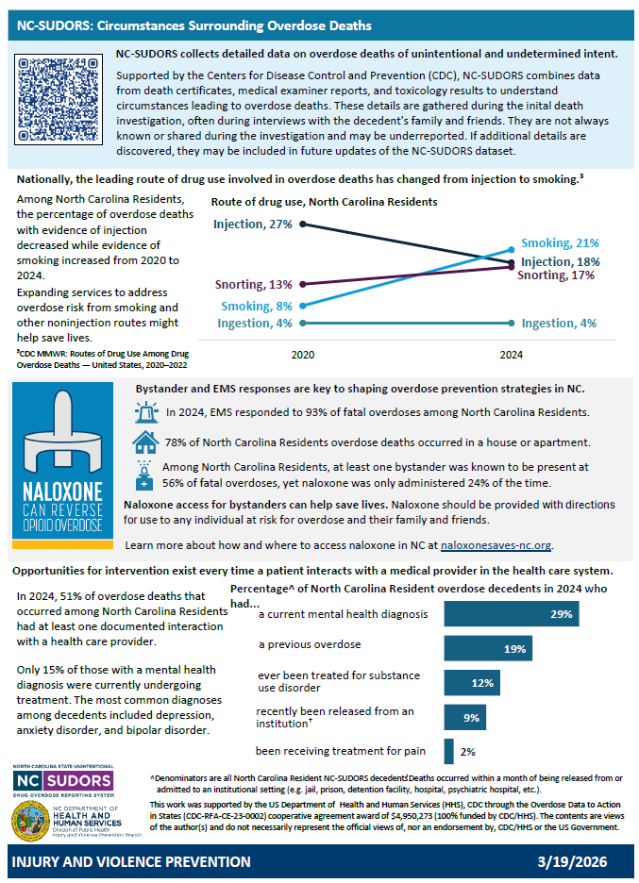
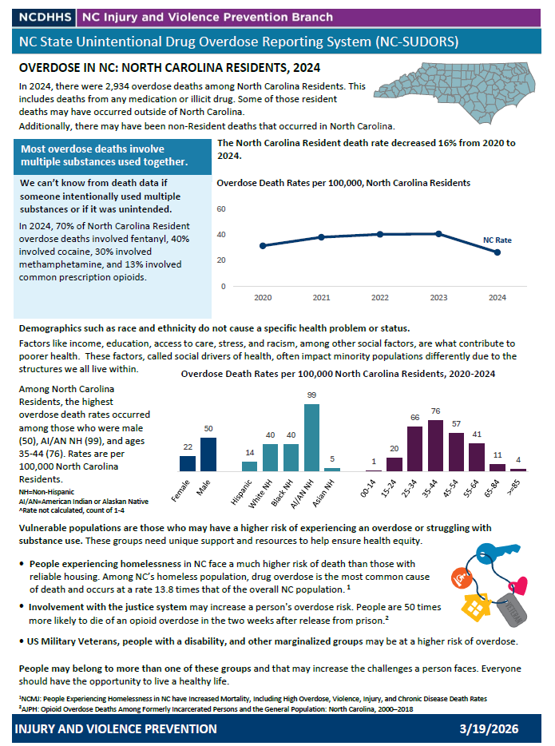
NC-SUDORS resources
Notes:
NC-SUDORS data is available to request. Researchers can request line level data to conduct their own research. Local health department’s can request their jurisdiction’s data, summarized by decedent, to aid in things such as overdose fatality reviews.
A new NC-SUDORS factsheet is available with aggregate data by county or congressional district. The two-page fact sheet gives an overview of overdose in the specified region over the past five years. It includes rates, demographics, and NC-SUDORS circumstance data such as route of drug administration, if a bystander was present, and more information surrounding the decedent’s fatal overdose. Factsheets for those counties with an average of ten or more fatal overdoses over the last five years will be available on our website. If you do not see your jurisdiction posted, please contact us and we will work with you to get the data you need.

Slide 28
Active Surveillance

Slide 29
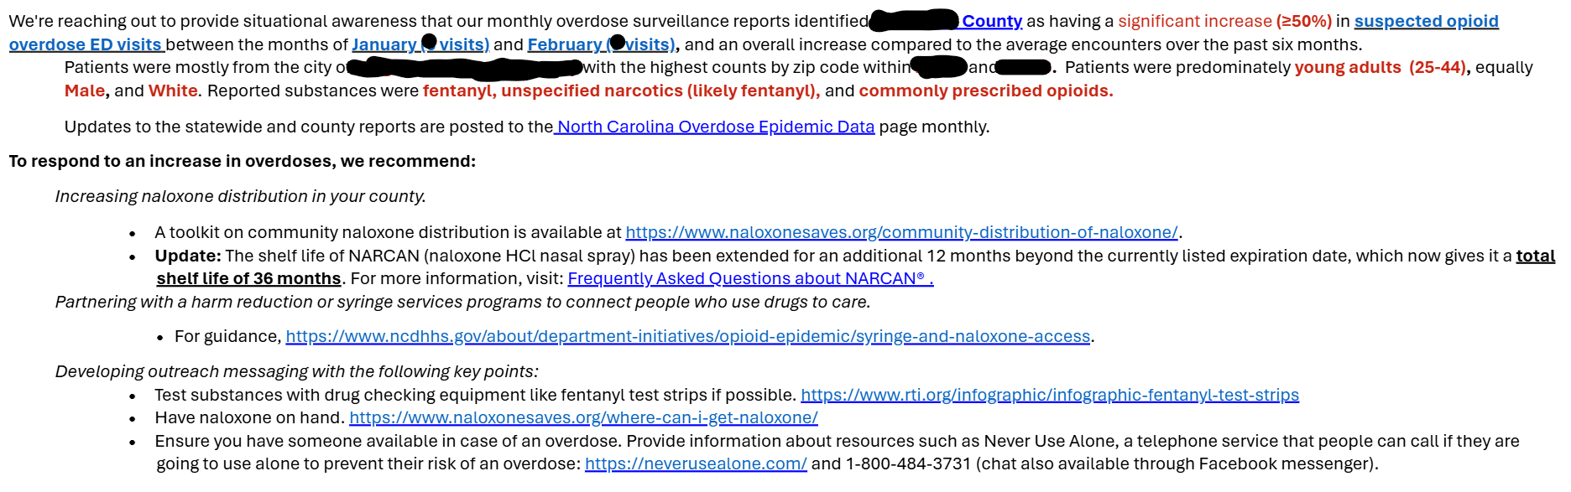
Monthly Increase Notifications

Slide 30
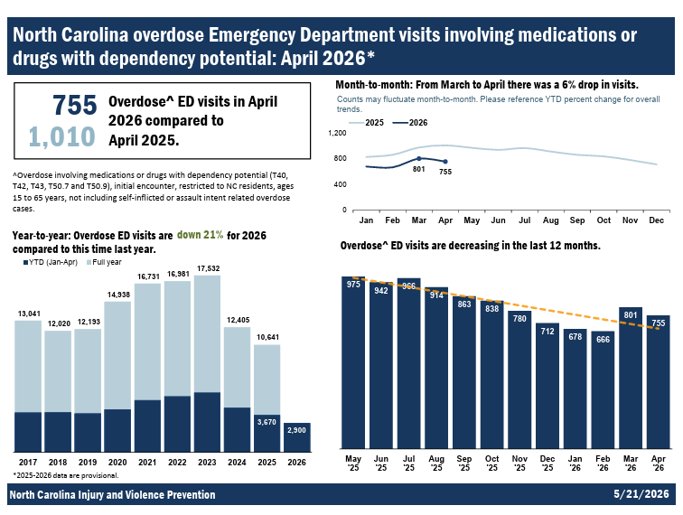
Emergency Department (ED) visit data have a shorter lag time (~2 weeks).
Available at the county level.
Comprehensive tox testing usually not completed.

Slide 31
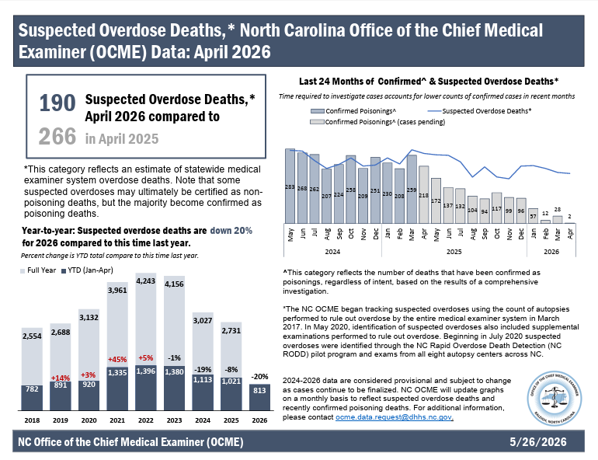
NCDHHS DPH developed a measure of suspected overdose deaths.
This measure only lags by ~2 weeks.
Suspected overdose counts are only available at the state level.

Slide 32
Suspected overdose death trends closely align with the confirmed (or final) overdose death trends.
NCDHHS, Division of Public Health, Injury and Violence Prevention Branch | CORE Overdose Slides | 2024 Data Year

Slide 33
From 2024 to 2025, NC saw a 10% decrease in suspected overdose deaths. ED visits for overdose in NC decreased 14% from 2024 to 2025.
NCDHHS, Division of Public Health, Injury and Violence Prevention Branch | CORE Overdose Slides | 2024 Data Year

Slide 34
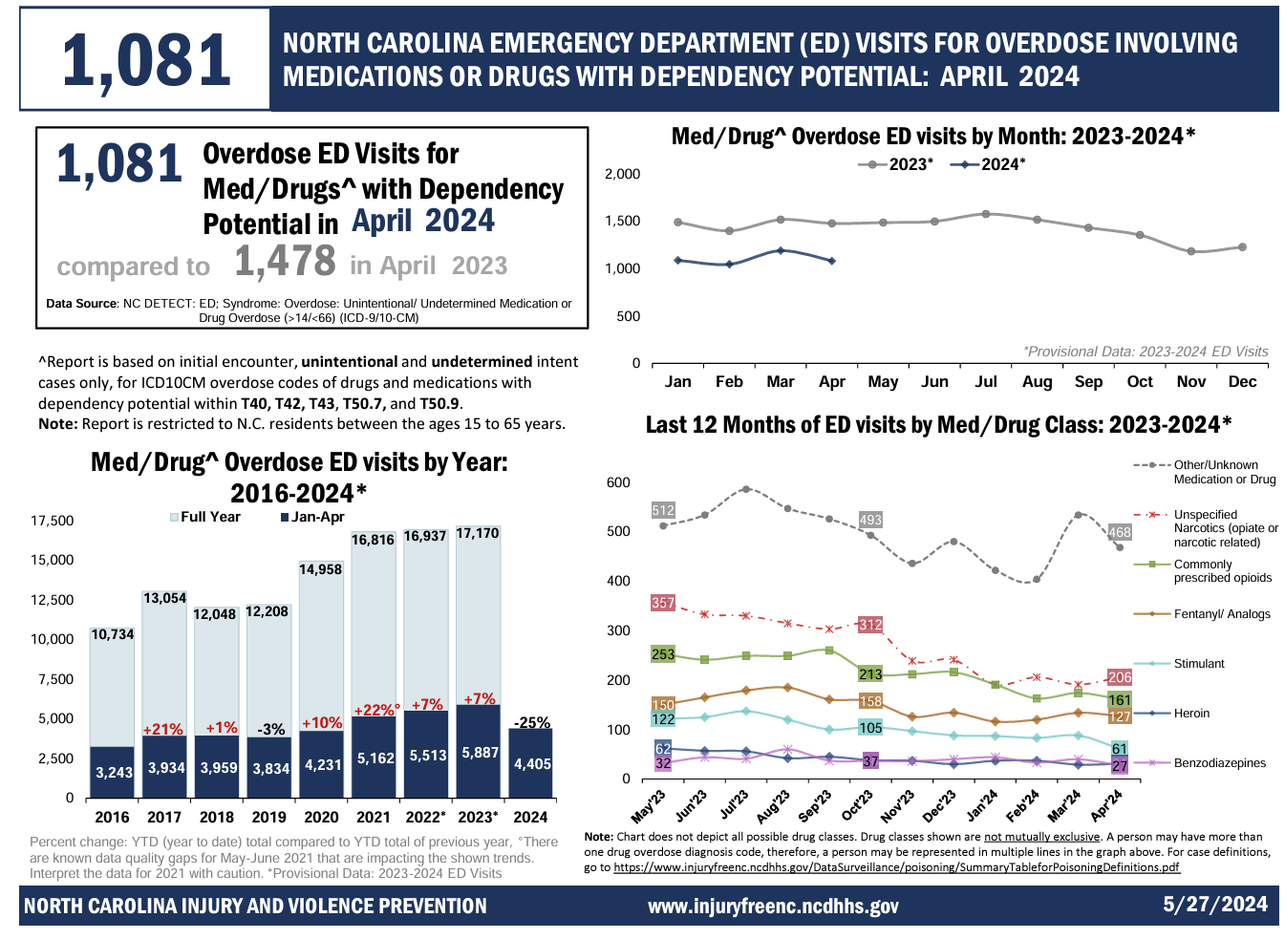
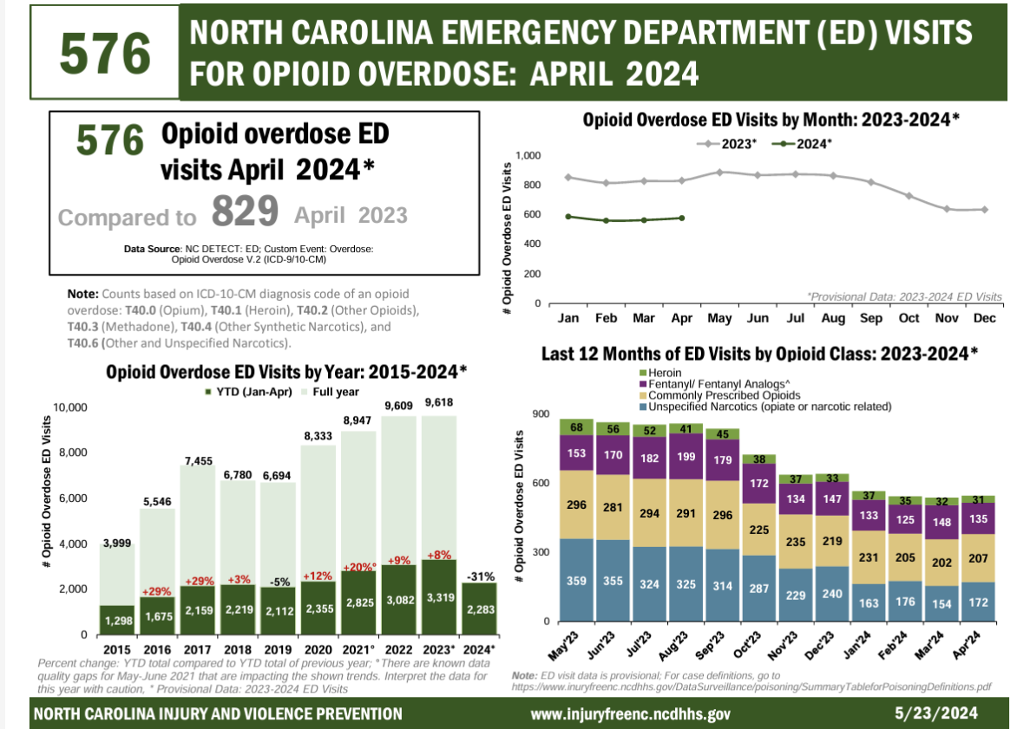
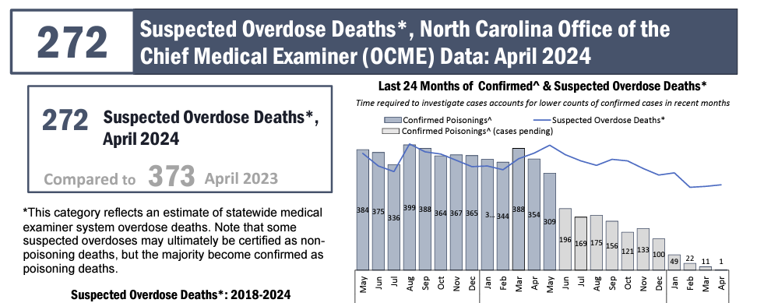
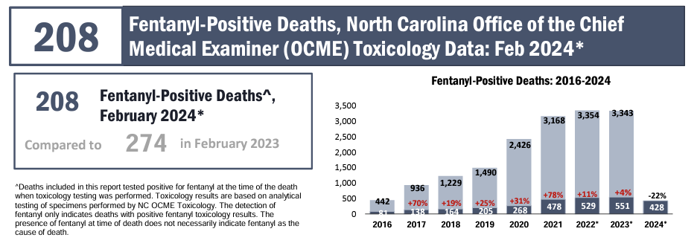
Email
SubstanceUseData
@dhhs.nc.gov
to receive monthly data updates
Notes:
Monthly overdose reports including Fentanyl-Positive Deaths, Suspected Overdose Deaths, Med/Drug Overdose ED Visits, and Opioid Overdose ED Visits are available.
Email SubstanceUseData@dhhs.nc.gov to receive monthly updates.
Reports are posted at https://www.dph.ncdhhs.gov/programs/chronic-disease-and-injury/injury-and-violence-prevention-branch/north-carolina-overdose-epidemic-data#monthly-reports

Slide 35
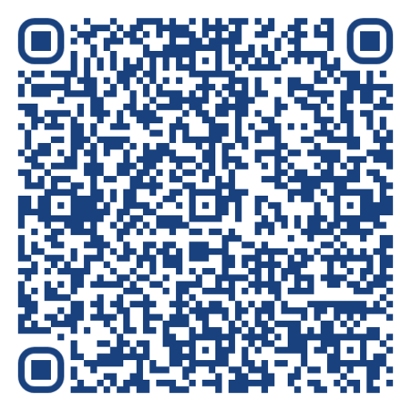
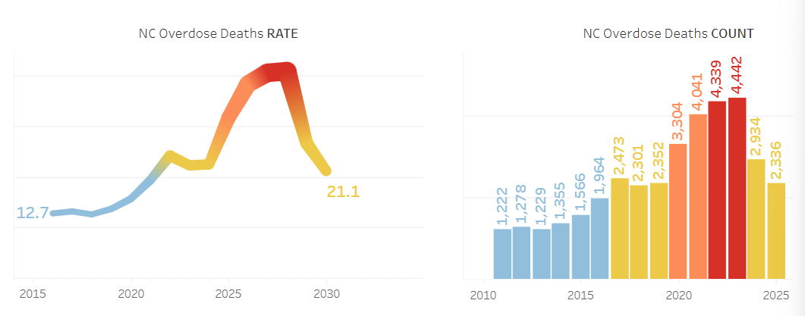
The NC Overdose Data Page uses provisional death certificate data to estimate full year trends at the state and county levels.
The estimated Overdose Death rate in NC is 21.17 out of 100,000 residents in 2025, representing a projected 2,336 people who died of an overdose.
Partial year: n=584 at 3/12 months
NCDHHS, Division of Public Health, Injury and Violence Prevention Branch | CORE Overdose Slides | 2024 Data Year

Slide 36

Injury Data Toolkit
Notes:
Characters will make more sense as we go along.

Slide 37

Understand Injury Data with
Eddie the Epidemiologist
IVPB Injury Data Users Toolkit
What is it?
Tool to help partners understand IVPB data processes, interpret injury data, and effectively use IVPB data resources.
  Enhance injury data literacy
  Promote the use of injury data to guide prevention strategies
What is included?
Injury Data Briefs
  Overviews of IVPB data and data processes
  Epidemiology Concepts (Epi 101)
  Injury Topic Specific Briefs
IVPB Data Resource Inventory
  Tool to help find the right IVPB data resource
Other Injury Data Resources
Notes:
Purpose is to help share how we do things, where things are, what data partners should use and how

Slide 38
How to use them
We want people to know…
How we do things
Where things are
What they should use
Notes:
So ultimately, we really want people to know how we're doing things, where things are, what they should be using when, and then how to use it.

Slide 39
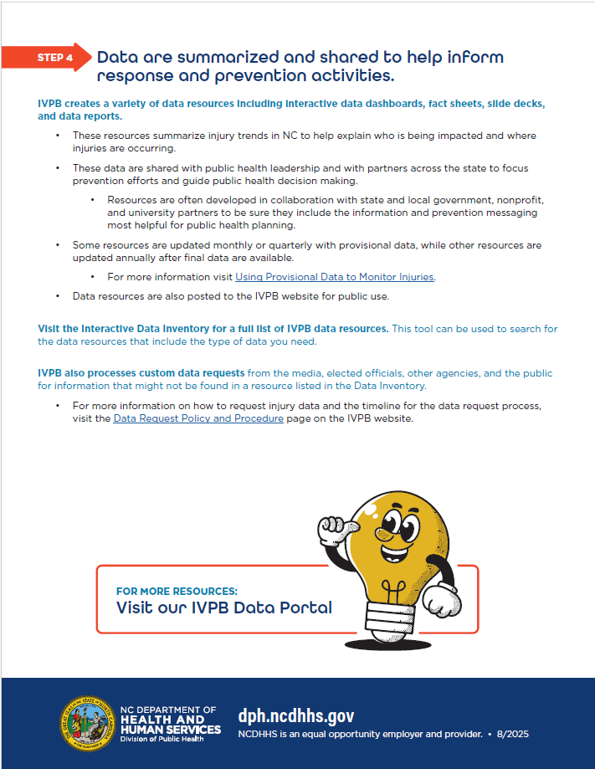
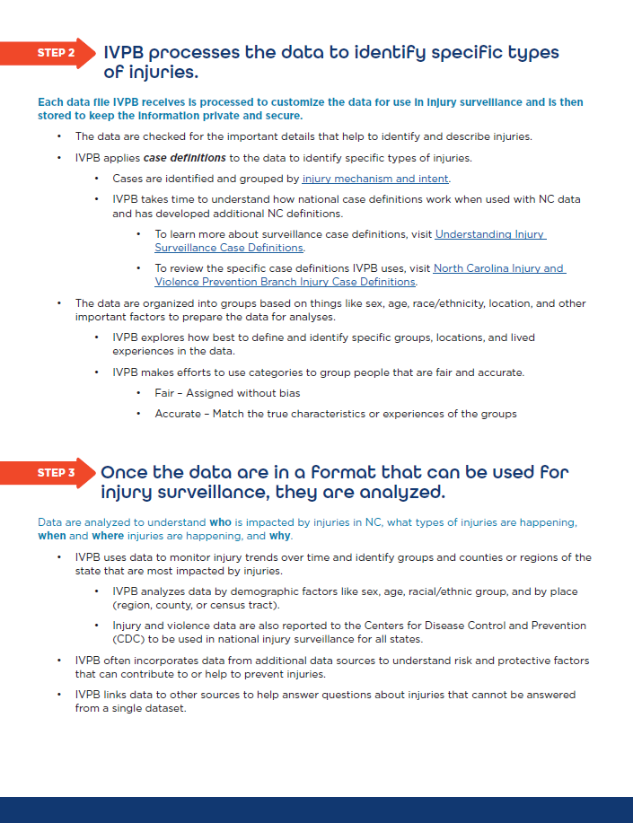
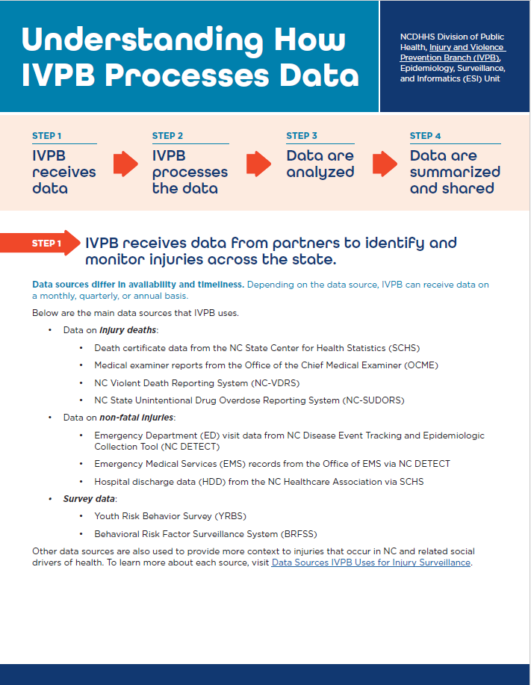

Slide 40
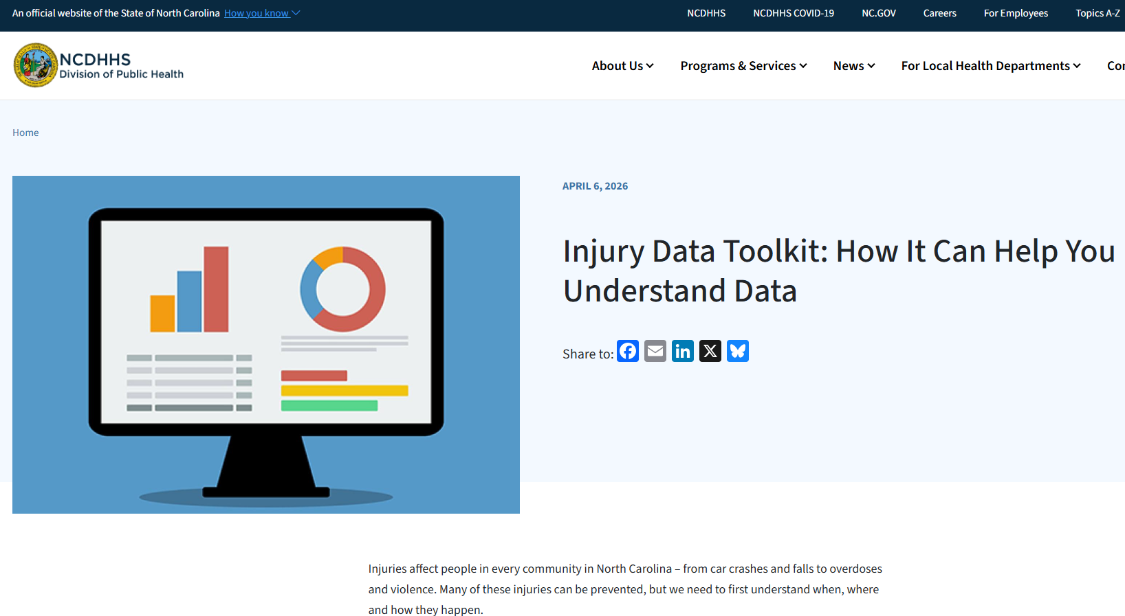
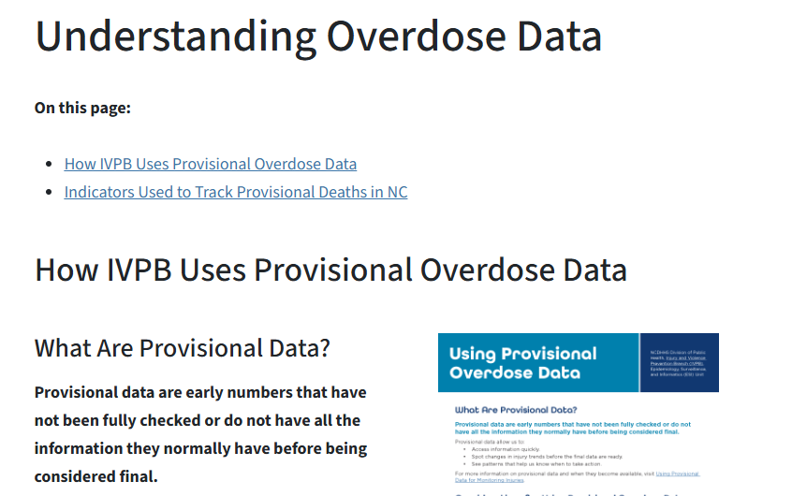

Slide 41
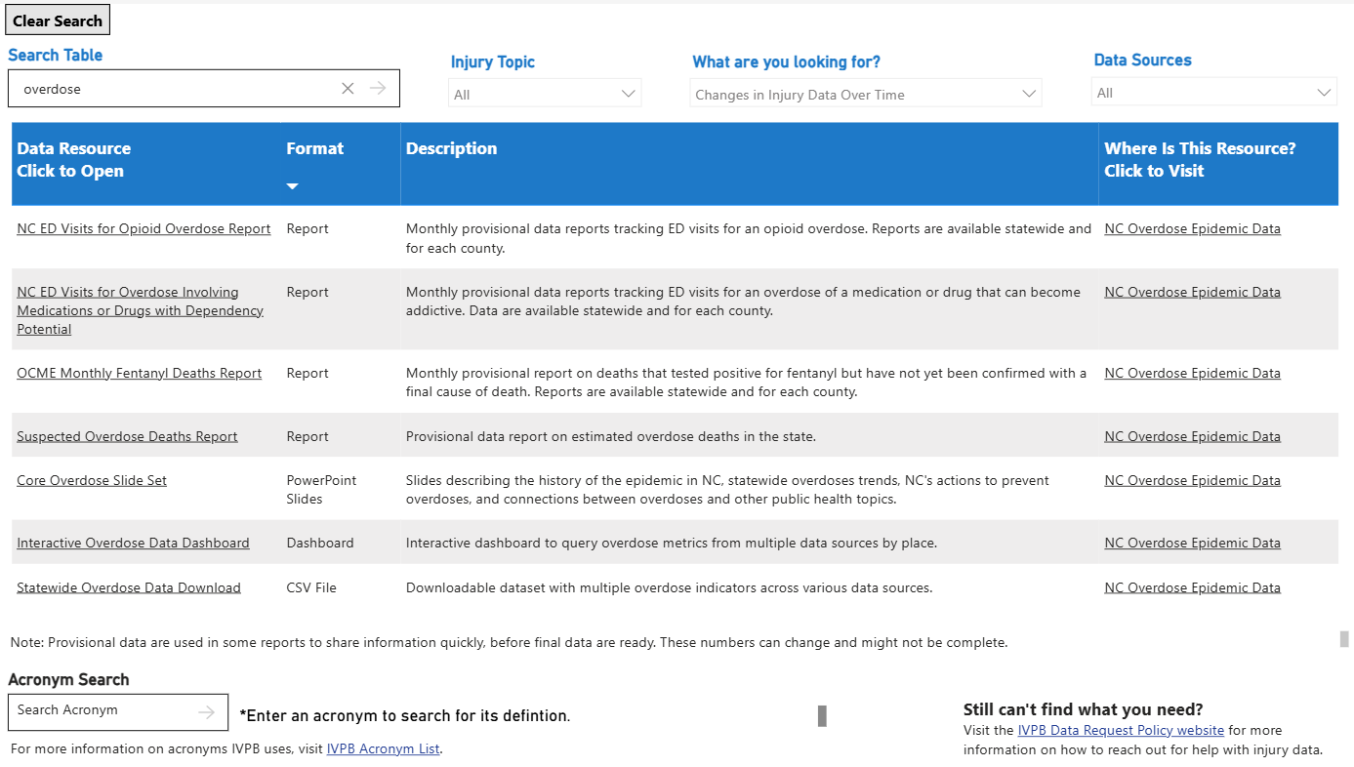
Data Resource Inventory

Slide 42

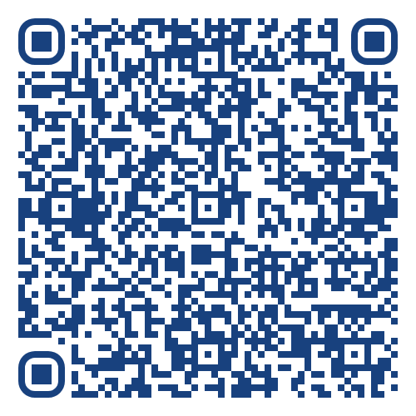
Questions?
SubstanceUseData@dhhs.nc.gov
NC Overdose Data
Injury Data Toolkit
Schedule Data Support

Slide 43
NC Department of Health and Human Services
Division of Mental Health, Developmental Disabilities, and Substance Use Services
NC Controlled Substance Reporting System:
Data Request Process
Stella Bailey,
Assistant Director for Controlled Substances
June 12, 2026

Slide 44

Stella Bailey, MSPH
Assistant Director for Controlled Substances
NCDHHS, Division of Mental Health, Developmental Disabilities and Substance Use Services

Slide 45
Objectives
Provide an overview of the NC Controlled Substances Reporting System.
Discuss NC CSRS data limitations and de-identified data elements that can be requested.
Walk through the NC CSRS data request process; including required documents, how data requests are reviewed and tips for requesting data.

Slide 46
NC Controlled Substances Reporting System

Slide 47
NC Controlled Substances Reporting System (NC CSRS)
Established by Chapter 90 Article 5e
Began in 2005, significant enhancements made in 2018
Electronic database that collects prescription dispensation data for all Schedule II-V controlled substances and substances of concern in North Carolina
Allows prescribers and dispensers to view patient’s controlled substance dispensation history
A tool to support practitioners clinical decision making and improve patient health outcomes

Slide 48
Chapter 90 Article 5e
Establishes NC Controlled Substances Reporting System
Defines what dispensation information is required to be reported
Defines confidentiality and data sharing principles
Establishes mandatory NC CSRS practices for controlledsubstance practitioners
Source: https://www.ncleg.net/enactedlegislation/statutes/html/byarticle/chapter_90/article_5e.html

Slide 49
NC CSRS Reported Opioid Dispensations by Year
(2018- 2025)
44% Decrease
Source: 2025 NC CSRS Annual Legislative Report
Notes:
Impact of the NC CSRS on the number of reported opioid dispensations over time.

Slide 50
NC CSRS Data

Slide 51
NC CSRS Data Confidentiality
Prescription information submitted to the NC CSRS is privileged and confidential.
The Department may provide data to public or private entities for statistical, research, or educational purposes only after removing information that could be used to identify individual patients who received prescription medications from dispensers

Slide 52
NC CSRS Data Limitations
Only de-identified, aggregated data may be released
72-month dispensation data history restriction
No ICD 10 code collection
Small cell suppression guidelines (<5)
Only North Carolina reported dispensation data

Slide 53
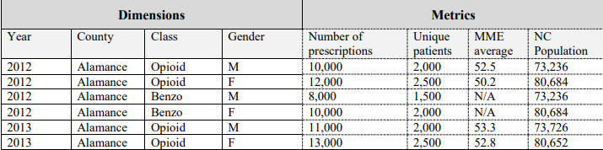
De-Identified NC CSRS Data Elements
Generic Drug Name | Patient Gender | Prescriber County
Dispensed Date | Patient State (NC) | Dispenser County
Days Supply | Patient County (NC) | Drug Class
Dispensed Units/Pill Count | Veterinarian Prescription (Y/N) | Average MME
Compound Drug (Y/N) | Age Group (ex. 70-79, 80+) | Number of Patients
Authorized Refill Count | Partial Fill (Y/N) | Number of Prescriptions
Example of De-identified NC CSRS Data
*This example is provided only for illustrative purposes and is fictitious. This data should not be utilized.
Notes:
Requests are aggregated before delivery by requested dimensions ex. year/county/drug/gender.

Slide 54
NC CSRS Data Request Process

Slide 55
NC CSRS Data Request Process
Complete Documentation
1
Submit Documentation
2
Research Review Committee
3
Committee Decision
4

Slide 56
Complete Documentation
1
CSRS Access for Health Information for Research Form
Data Use Agreement for CSRS Data
Supporting Documentation

Slide 57
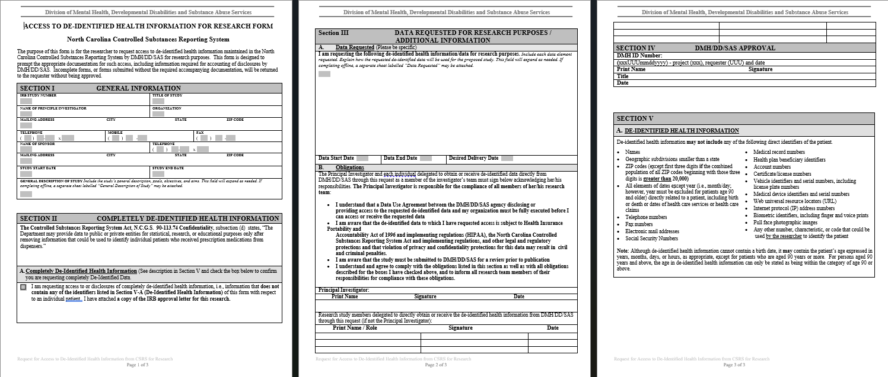
Access to Health Information for Research Form
Notes:
Section 1- General Information
Section II- De-Identified Health Information Acknowledgement
Section III- Data Requested
Include each de-identified data element being requested, the requested data set start and end date and the desired delivery date.
The Principal Investigator and all individuals that will have access to the data must sign.
Section IV- DMH Approval
This section is completed by the data steward after your data request is approved.
Section V- De-Identified Health Information
Includes direct patient identifiers that may not be requested data elements.

Slide 58
Data Use Agreement (DUA) for CSRS Data
Attachment A: Data Points
Attachment B: Project Description and Data Use
Attachment C: Data Security Summary
DUA can be effective for up to three (3) years
DUA must be signed by all individuals that will have access to the data
Data can only be released from NCDHHS to individuals listed on the DUA

Slide 59
Supporting Documentation Examples
Approved Institutional Review Board (IRB) Letter
Institution Data Security Policy and Procedures
Program documents supporting the need for your data request
Research study, publication, or presentation proposal documents
Notes:
All of these may not be applicable to your data request.

Slide 60
Submit Documentation
2
Email to DMH.CSRSData@dhhs.nc.gov
Include signed documentation and all supporting documentation as attachments

Slide 61
Research Review Committee
3
All data requests must be reviewed and approved by the Committee
The committee meets monthly

Slide 62
Committee Decision
4
Approval
The NC CSRS data steward will follow up with you to begin processing your data request.
Alternate Decision
The committee may have additional questions or ask for additional documentation.

Slide 63
Tips for Requesting NC CSRS Data
Ensure all documents are fully completed with signatures.
Request only de-identified data elements within the NC CSRS data limitations.
Include required documentation and all supporting documentation during data request submission.
Request a NC CSRS data request consultation!
If you do not have IRB approval for your data request, indicate why on your data request.
Submit your data request at least 45-60 days before the desired delivery date.
If you will be using NC CSRS data, in a publication or presentation, it must have a NCDHHS attribute and CSRS disclaimer. Publications must be reviewed by NCDHHS at least 30 days prior to publication.
Include as much information as possible in your documentation.

Slide 64
Things to Remember
Prescription data is HIPAA Protected
There is no diagnosis or prescribing reason associated with prescription dispensation data.
Accuracy of the data is not guaranteed and errors at input are encountered.

Slide 65
Q&A
All NC CSRS data request documents are available on the NCDHHS CSRS webpage.
Questions and feedback are welcome at DMH.CSRSData@dhhs.nc.gov

Slide 66
Naloxone Distribution Dashboard Preview
Anita Nsubuga, MPH
OPDAAC June Meeting
Friday June 12, 2026

Slide 67

Anita Nsubuga, MPH
NC Technical Specialist, Opioid Data
NCDHHS, Division of Mental Health, Developmental Disabilities and Substance Use Services
Vital Strategies

Slide 68
Agenda
Naloxone
SOR Naloxone Distribution Plan
Naloxone Distribution Dashboard Preview

Slide 69
Naloxone

Slide 70
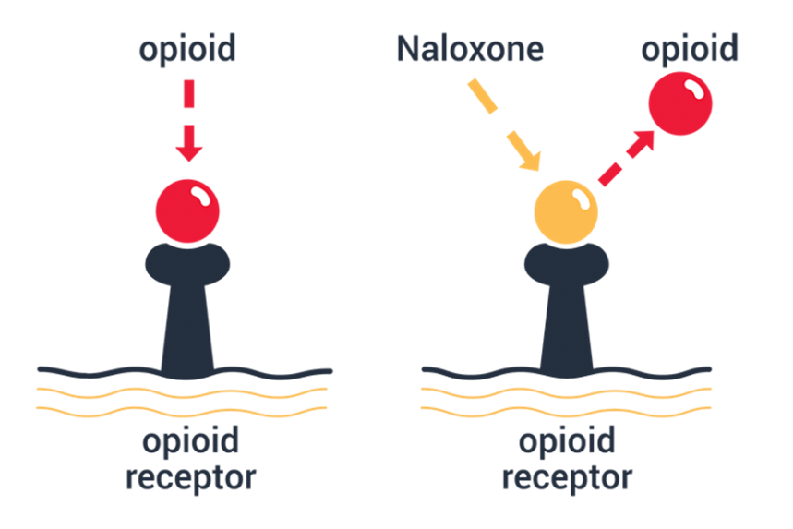
What is Naloxone?
Naloxone Reverses Opioid Overdose
Naloxone is a safe, life-saving medication that reverses the effects of an opioid overdose.
Naloxone is an opioid antagonist: it binds to the opioid receptors in the brain, knocking off the opioids that are causing the overdose
Naloxone has no effect on someone if they do not have opioids in their system.
Notes:
As you may know, naloxone is a safe, FDA-approved, life-saving medication that reverses an opioid overdose.
Opioids like heroin, fentanyl, morphine, etc. attach to our opioid receptors in the brain. Opioid receptors affect our breathing so if all the receptors are highly activated it can stop breathing, which is what happens when people overdose. The amount of opioids needed to overdose will depend on the strength of the opioid, the persons tolerance, body size, metabolism, there are all kinds of things.
Naloxone is an opioid antagonist which means it binds to the opioid receptor without activating it. So it basically takes over the receptor, releasing the opioids and allowing the person’s breathing to return.
You cannot do harm with naloxone. Even if someone doesn’t have opioids in their system, it just has no effect.
There is no potential for misuse or for it to be used in unethical ways. It can only be used to save lives, it has no other purpose or function.

Slide 71
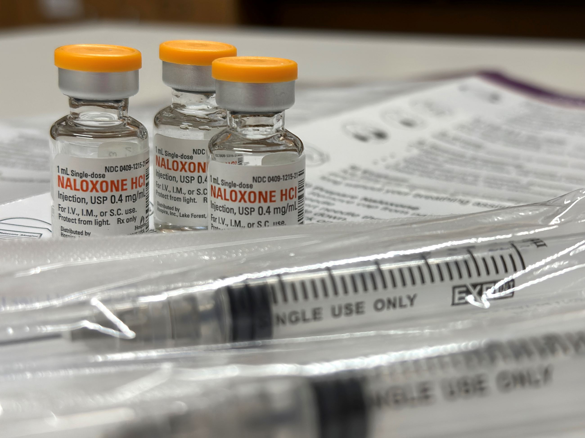
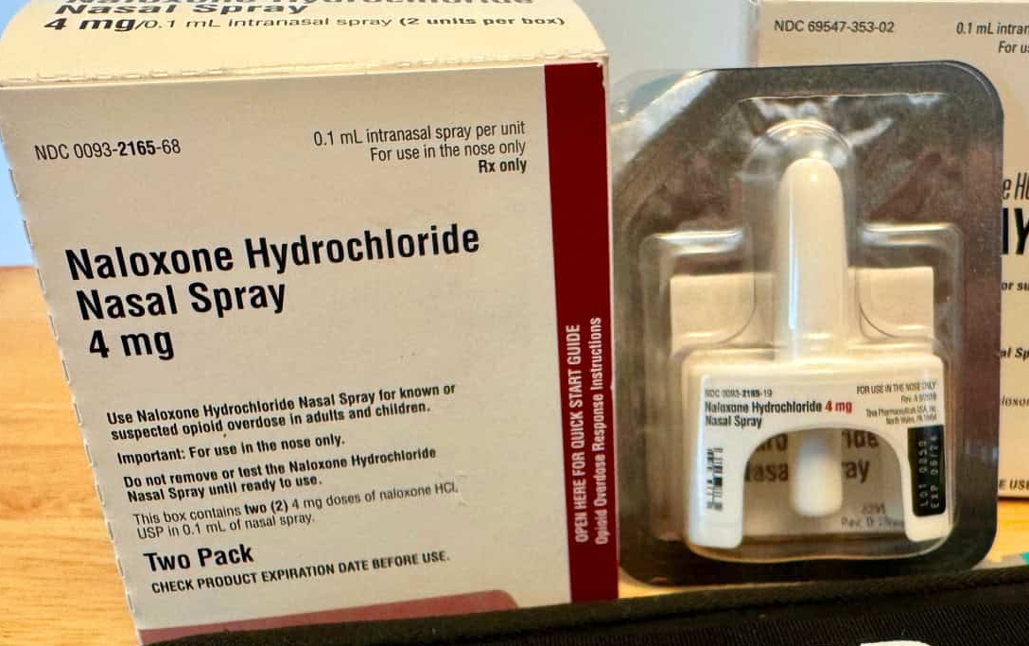
Types of Naloxone
Injectable
Nasal
Includes 2 doses
More controlled dosage
Preferred by injection drug users
Less likely to precipitate withdrawal
Significantly cheaper
Includes 2 doses
Easy to administer
More expensive
Some formulations available over the counter
Not recommended at doses higher than 4mg
Notes:
There are two major categories of naloxone: Injectable and nasal. Each have their pros and cons
I’ll start with the injectable. We can get a little nervous about the injectable because people are scared of needles or don’t feel confident using them. But I will say the injectable is often preferred by injection drug users who do feel confident and comfortable around needles. The reason it’s preferred is because it’s easier to titrate so it’s less likely to precipitate withdrawal or make people feel sick.
Nasal on the other hand is very easy to use. Anyone can figure out how to use nasal naloxone, which is important during an emergency.
Ultimately, both are really great options that are good to have on hand when distributing so that people have choice.

Slide 72
SOR Naloxone Distribution Plan

Slide 73
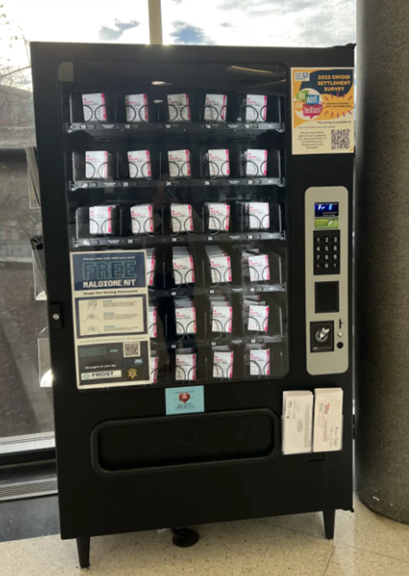
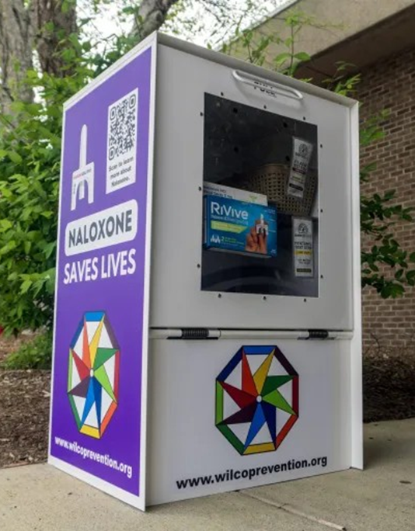
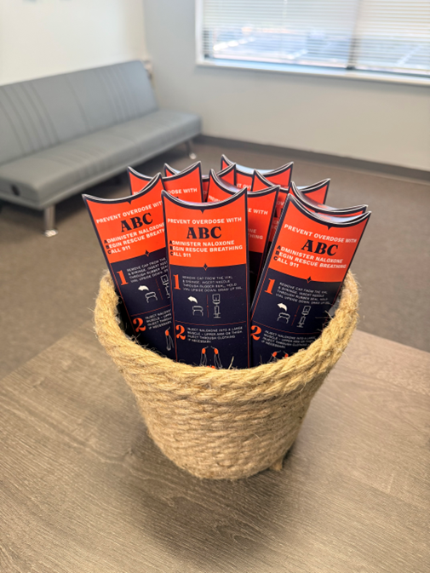
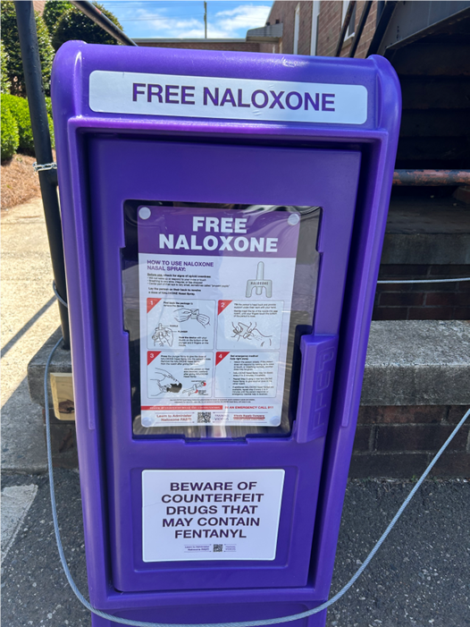
State Opioid Response (SOR) Naloxone Distribution Plan
The goal of this plan is to reduce opioid overdose deaths
How?
Increase overdose education
Increase naloxone distribution among communities with high overdose rates
Notes:
The SOR is a federally funded grant that enables states combat the opioid epidemic.
The purpose of this program is to address the opioid overdose crisis by providing resources to states and territories for increasing access to FDA-approved medications for the treatment of opioid use disorder (MOUD), and for supporting the continuum of prevention, harm reduction, treatment, and recovery support services for opioid use disorder (OUD) and other concurrent substance use disorders.
In North Carolina (and other states), our goal is to reduces opioid overdose deaths by:

Slide 74
SOR Naloxone Purchasing Program
To be distributed to people most likely to reverse an overdose:
  People who use drugs
  People leaving incarceration
  Their close contacts who may witness an overdose (family & friends)
DMHDDSUS uses federal funds to purchase:
  Naloxone
    Intramuscular kits
    Nasal kits
    Intramuscular vials

Slide 75
Purchasing Program Policy
Naloxone must be distributed to the community
  Not meant for agencies to keep on hand for "on-site emergency" or staff use (ex. law enforcement/EMS/fire department use for administration during calls, schools, hospitals/healthcare entities for in-hospital use, employers/workplaces)

Slide 76
Naloxone for your program
We take requests from programs on a quarterly basis
  Email Amy O’Regan (amy.oregan@dhhs.nc.gov) to get on alert
Technical Assistance is also available
  Naloxone distribution planning
  Purchasing naloxone and product comparisons
  What to do with expired naloxone
  Overdose prevention
  Saturation planning
  Reversal reporting
For naloxone requests, please visit: https://naloxonesaves-nc.org/
Notes:
We also offer technical assistance around all things overdose prevention and naloxone distribution. We have access to lots of resources and connections to support you in thinking about how to get naloxone and how to distribute it.

Slide 77
Naloxone Distribution Dashboard
Preview

Slide 78
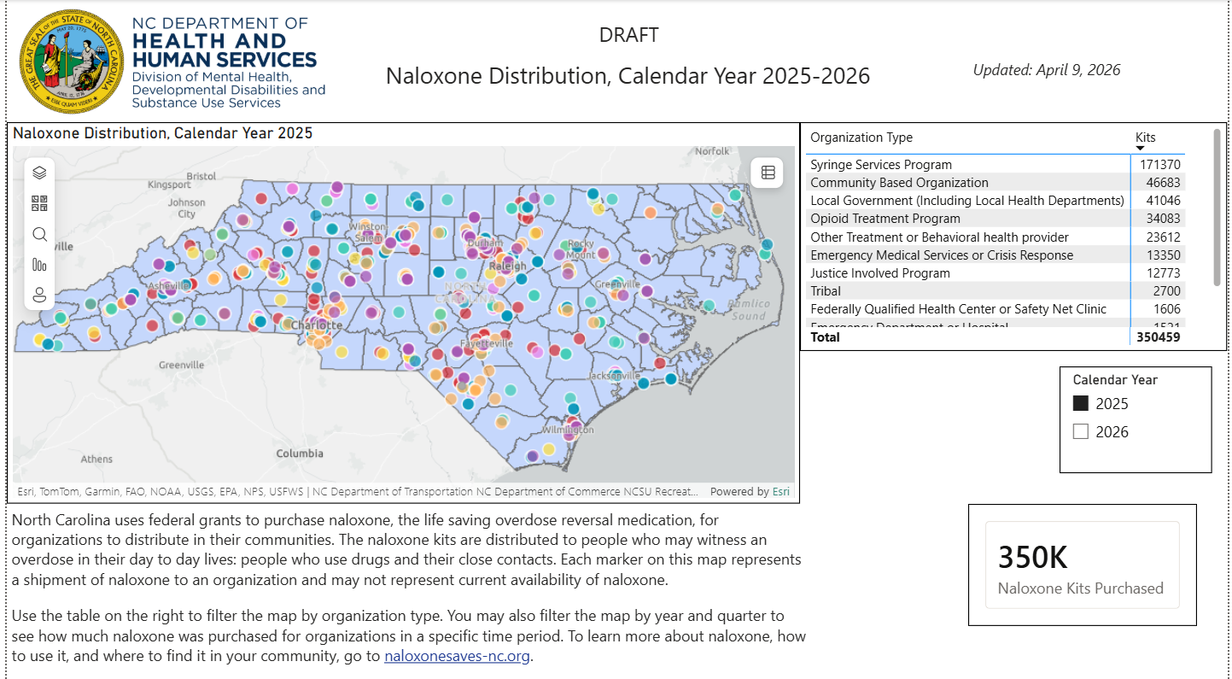
Dashboard Draft
Notes:
This is a draft.
When you click on each organization type, the map changes to reflect the kit locations on the map.
Also, when you click on the year, the map will reflect the kits for that year.
The number of kits also reflects the number kits that are selected
The naloxone-saves website is also on this page for anyone to click to obtain the form for orders
Additionally, many of these organizations deliver to counties that surround them.

Slide 79
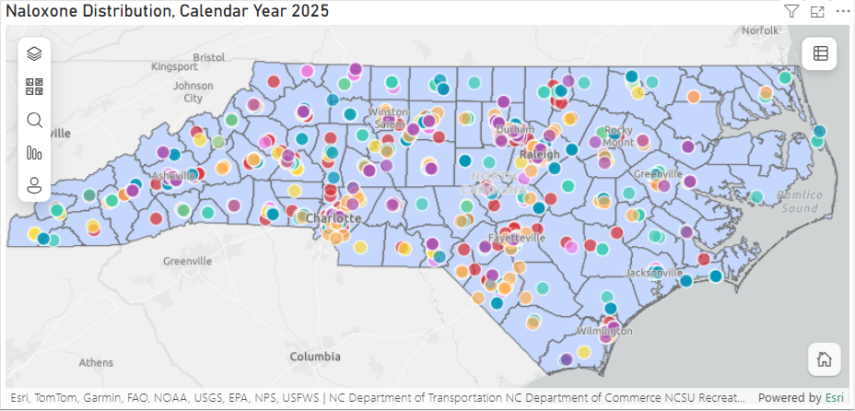
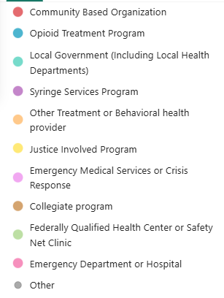
Naloxone Distribution Legend, CY 2025
Notes:
This is the legend for the colors on the map. When click the list on the top right of the map, this shows the legend.
In the next few slides, I will show a few screenshots of a few organization types to display their reach in CY 2025

Slide 80
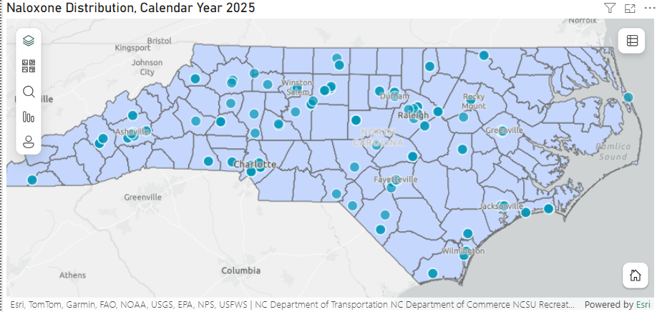
Opioid Treatment Program – CY 2025
Notes:
Here is a look at the OTPs that the state delivered naloxone.
Again, it should be noted that some organizations spread to surrounding counties

Slide 81
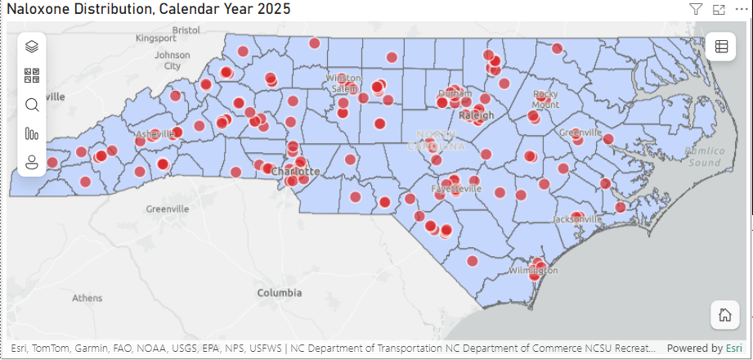
Community Based Organization – CY 2025

Slide 82
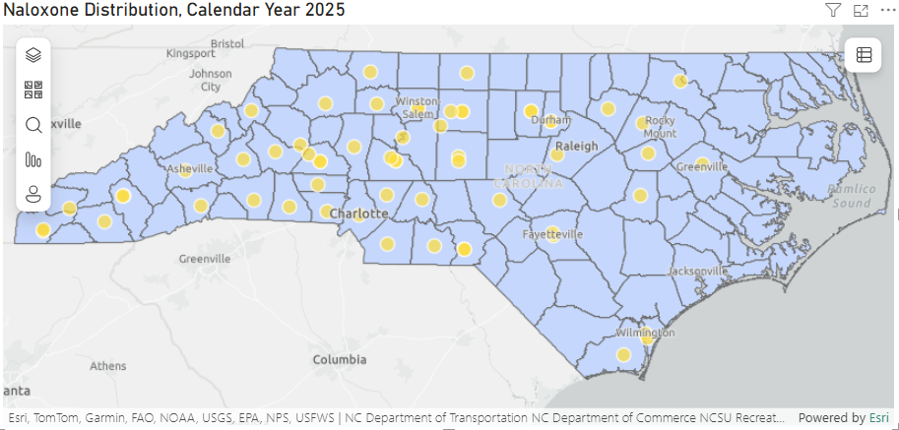
Justice Involved Programs – CY 2025
Notes:
Justice-involved programs include: detention centers, correctional facilities, re-entry programs, etc.

Slide 83
Intended Uses for Dashboard
At the division:
  Display where state-funded naloxone has been distributed throughout the state.
  Identify any places with low distribution of naloxone and focus future naloxone distribution to those areas.
  Show trends in focused, naloxone distribution among key populations.
Partners:
  Illustrate the reach of the state-funded naloxone distribution program through the state.
  Display the types of organizations that request and distribute naloxone in the state.
Communities
  Share how much naloxone has been purchased for local communities.

Slide 84
Dashboard Limitations
This dashboard is a draft.
  It is going to the internal governance/approval process before it is published to the public.
  Once public, the link will be shared.
It only shows the calendar year information for 2025 and forward.
No addresses of organizations are shown on the dashboard.
The data is based on the orders received from the order website (https://naloxonesaves-nc.org/).
  Other organizations who distribute naloxone are not represented on this dashboard.

Slide 85
Q&A
Questions and feedback are welcome at
Anita Nsubuga: anita.nsubuga@dhhs.nc.gov

Slide 86

CORE-NC:
Tracking Opioid Settlement Funds
June 12, 2026
COMMUNITY OPIOID RESOURCES ENGINE

Slide 87



Cecilia Gonzales
Project Director, CORE-NC

Slide 88
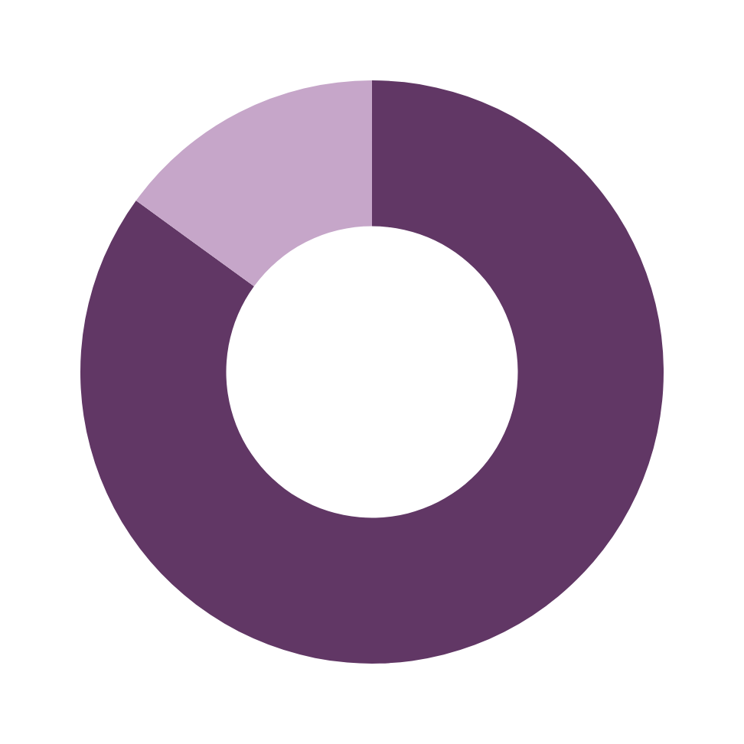
15% to state government
North Carolina will receive over $1.6 billion over a 20-year period, which began in 2022
85%
to local
governments
directly
NCOPIOIDSETTLEMENT.ORG/ABOUT/NC-MOA
Notes:
Mention that other states have different models

Slide 89
North Carolina’s approach to the opioid settlements
is built on two pillars: transparency and accountability.

Slide 90
NC Memorandum of Agreement directs how opioid settlement funds are distributed, used, and reported in our state.
NCOPIOIDSETTLEMENT.ORG/ABOUT/NC-MOA

Slide 91
NC Memorandum of Agreement includes 5 broad requirements for local governments:
Establish and use a special revenue fund
Authorize spending ahead of time
Understand and follow Option A and Option B
Follow all reporting requirements
Hold annual public meeting

Slide 92
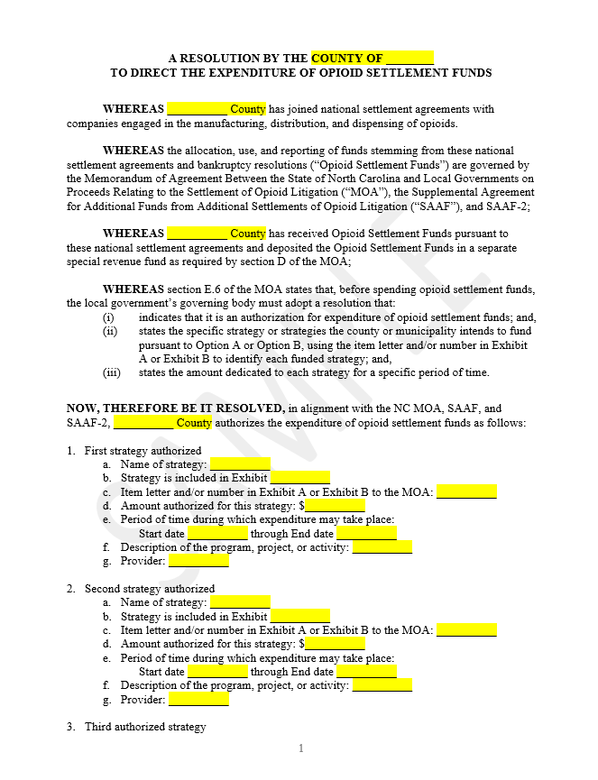
2. Authorize spending ahead of time
Must do so in a resolution and include the following details:
  Name of strategy you are authorizing
  Amount authorized for each individual strategy
  Period of time in which funds may be spent (start and end dates)

Slide 93




NCOPIOIDSETTLEMENT.ORG/REPORTING
4. Follow all reporting requirements
Local Spending Authorization Report
Annual Impact Report
  How a local government plans to make use of their opioid settlement funding​
  Due within 90 days of the passage of a resolution/ordinance authorizing expenditures
  The impact of the programs/strategies funded
  Due within 90 days of the end of fiscal year (9/27)
Option B Report and Recommendations (R&R)
Annual Financial Report
  How a local government spent their opioid settlement funding each fiscal year
  Due within 90 days of the end of fiscal year (9/27)
  Required only for local governments that pursue Option B
  Due within 90 days of presentation to the local governing body
Ensuring transparency and accountability

Slide 94
4. Follow all reporting requirements
Local Spending Authorization Report
Annual Impact Report
  How a local government plans to make use of their opioid settlement funding​
  Due within 90 days of the passage of a resolution/ordinance authorizing expenditures
  The impact of the programs/strategies funded
  Due within 90 days of the end of the fiscal year (9/27)
Annual Financial Report
  Includes quantitative evaluation measures and qualitative/
  narrative information
  Collects expenditure information, including strategy-specific spending
  How a local government spent their opioid settlement funding each fiscal year
  Due within 90 days of the end of the fiscal year (9/27)
NCOPIOIDSETTLEMENT.ORG/REPORTING

Slide 95

Empower Local Communities
KEY PRINCIPLES OF THE NC MODEL
Build Local Government Capacity
Promote Transparency and Accountability

Slide 96




Launched in 2021,
CORE-NC aims to ensure transparency of and accountability for the use of opioid settlement funds by NC local governments.

Slide 97
NC Department of Justice
NC Association of County Commissioners
Enforcement of the NC Memorandum of Agreement
Support and technical assistance
UNC Injury Prevention
Research Center
NCDHHS - Division of
Public Health
Collection, processing, and visualization data
Support and technical assistance

Slide 98

Information Clearinghouse
(Operations housed at UNC IPRC)
Reporting Portals
Document Library
Data
Displays

Slide 99
Reporting Portals
Programmed online surveys to collect required local government reports​
Continuously monitor for completeness &
data quality​

Slide 100
Document Library
Repository of all submitted reports
Filterable by local government, report type, and period
NCOPIOIDSETTLEMENT.ORG/DOC-LIBRARY

Slide 101
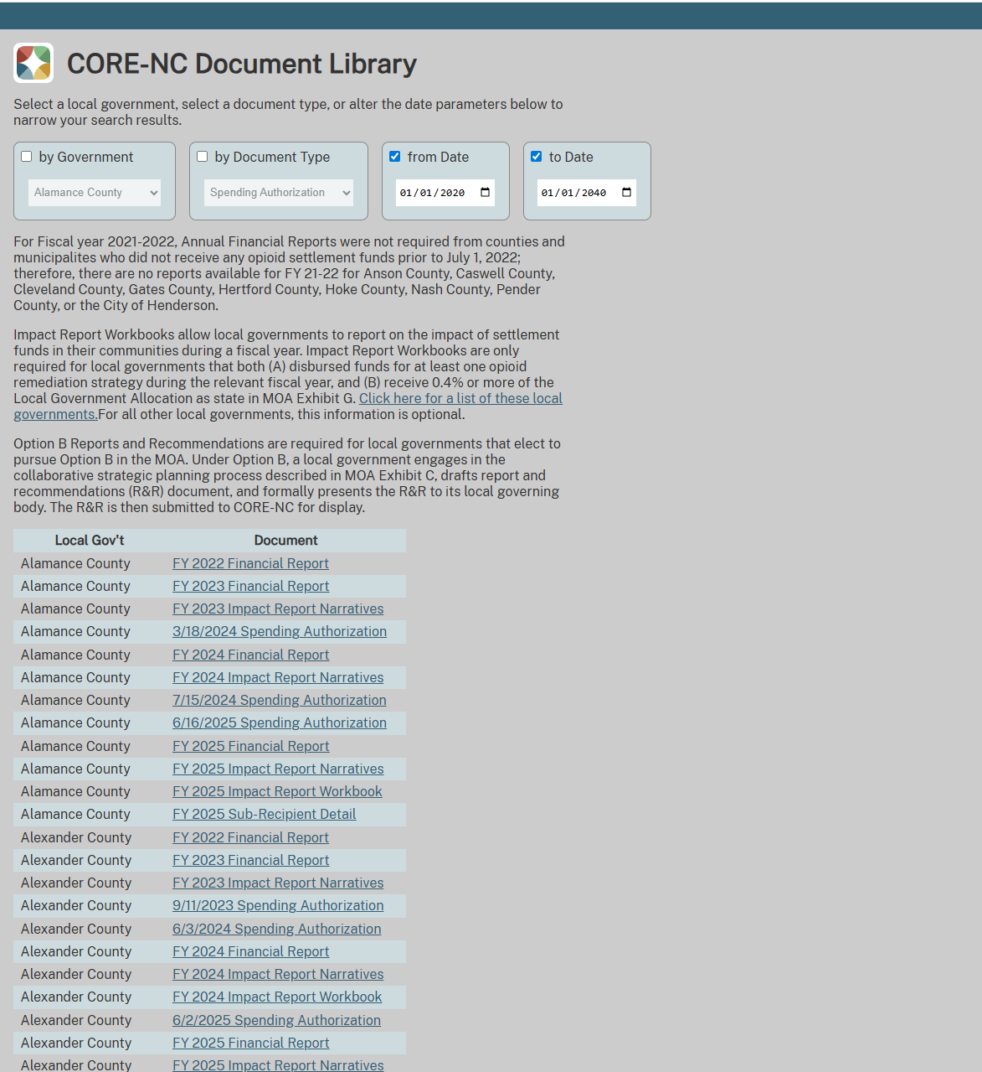

Slide 102
Data Displays
Emphasis on interactive, place-based data so local governments can make informed decisions for their community​
All data provided through required reporting
NCOPIOIDSETTLEMENT.ORG/TRENDS

Slide 103
Currently Available
  Payment Schedule
  Local Spending Plans
  Past Spending
  Local Progress
  Strategy Implementation
NCOPIOIDSETTLEMENT.ORG/TRENDS

Slide 104
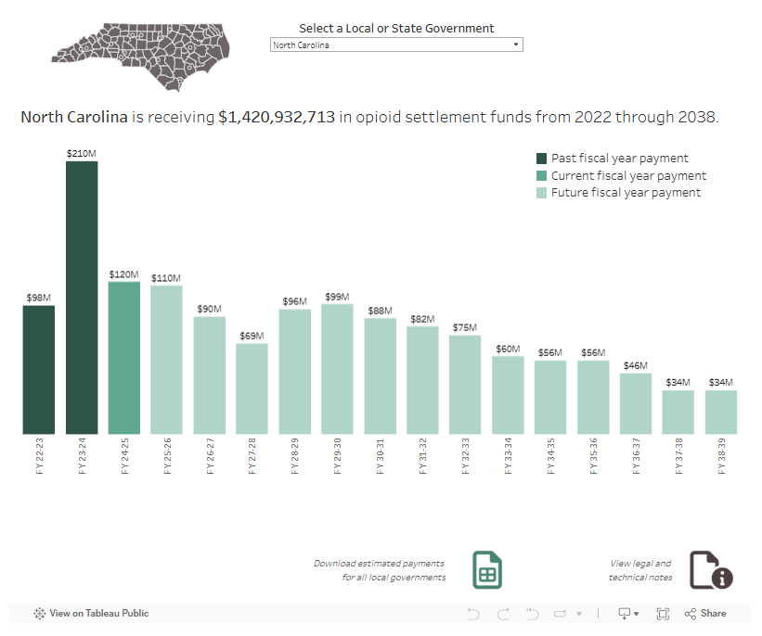
Payment Schedule
Schedule of estimated payments for each of the 114 North Carolina counties and cities receiving payments from the national opioid settlements

Slide 105
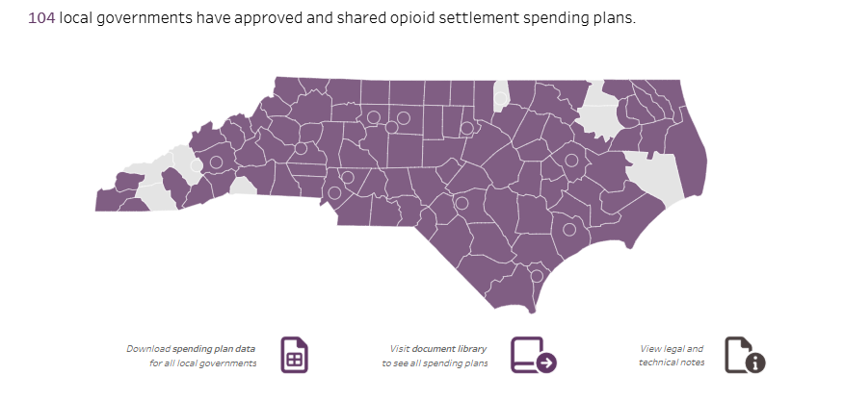
Local Spending Plans
How local governments plan to spend opioid settlement funds to address the opioid overdose epidemic in North Carolina

Slide 106
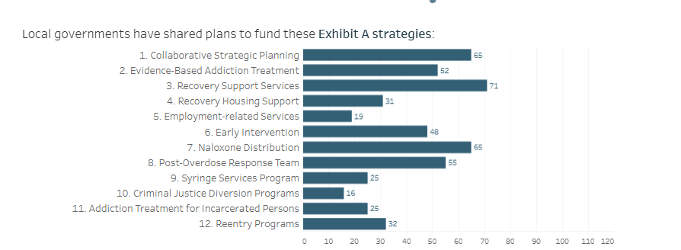
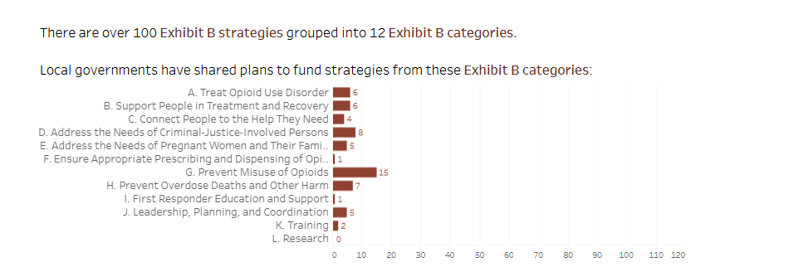

Slide 107

Past Spending
Past spending from local governments who have used opioid settlement funds to address the opioid overdose epidemic in North Carolina

Slide 108


Slide 109

Local View
Explore the current status of the opioid settlements in each local government
All their data in one place

Slide 110


Stages of Implementation
Explore the current stages of implementation for each strategy funded by local governments.

Slide 111


Since the start of the settlement period in 2022, North Carolina has seen an increase in opioid settlement planning, implementation, and evaluation.
20%
increase
in local spending plans submitted in FY24-25 compared to the prior FY
>90%
of eligible local governments have submitted plans to fund at least one opioid abatement strategy

Slide 112

Since the start of the settlement period in 2022, North Carolina has seen an increase in opioid settlement planning, implementation, and evaluation.
$46.3M
spent
on opioid settlement strategies in FY24-25, more than double the prior FY. This spending is across 375 strategy implementations, an average of 4 strategies per local government.

Slide 113


Local governments are also moving further in their strategy implementation, with more local governments reporting at least one strategy at Full Implementation or Further Expansion.
FY23-24
FY24-25

Slide 114
Key Collaborative Partners
60k

Slide 115



Supporting Partners
Funding Partners
CORE-NC Activities are supported by an award from NC Collaboratory using Opioid Abatement Funds, as authorized under NCGA Session Law 2023-134, Section 9G.8.(b), with additional support from the Duke Energy Foundation and the Governor’s Institute.

Slide 116
OPIOID SETTLEMENT
@NCDOJ.GOV | @NCACC.ORG | @UNC.EDU | @DHHS.NC.GOV

Slide 117
Question and Answer Session
Questions and feedback are welcome at OPDAAC@dhhs.nc.gov
The agenda, presentation slides, and recording for this webinar will be posted to the OPDAAC Meetings and DMH/DD/SUS Community Engagement & Training webpage.

Slide 118
Reminders:
The next OPDAAC on Sept. 25, 2026, from 9:30AM-12PM. This meeting will be 100% virtual.
The September topic will be announced at a later date.
You can register for the next OPDAAC meeting using this link: https://www.zoomgov.com/meeting/register/1awndEqNT5K7FTOlGvDBVA#/registration
If you have questions regarding today’s meeting, OPDAAC or other overdose prevention topics in North Carolina, please email OPDAAC@dhhs.nc.gov

Slide 119





Stay Connected with DMH/DD/SUS
Join our Side by Side Webinars
Join our Mailing List

