Slide 1

Welcome to NC CACFP Monthly Institution Call
All information presented on this call is true and accurate as of the date of the call (June 4, 2021).
Notes:
First Friday of every month @ 1:00 pm
Questions should be submitted through chat function
State agency encourages topic suggestions

Slide 2

P-EBT for Child Care
Emergency Cost Information Update
Policy Memos
COVID Nationwide Waivers for School Year 2021-2022
Application Update
Upcoming SA Trainings
Q&A

Slide 3

P-EBT for Child Care
Child and Adult Care Food Program

Slide 4
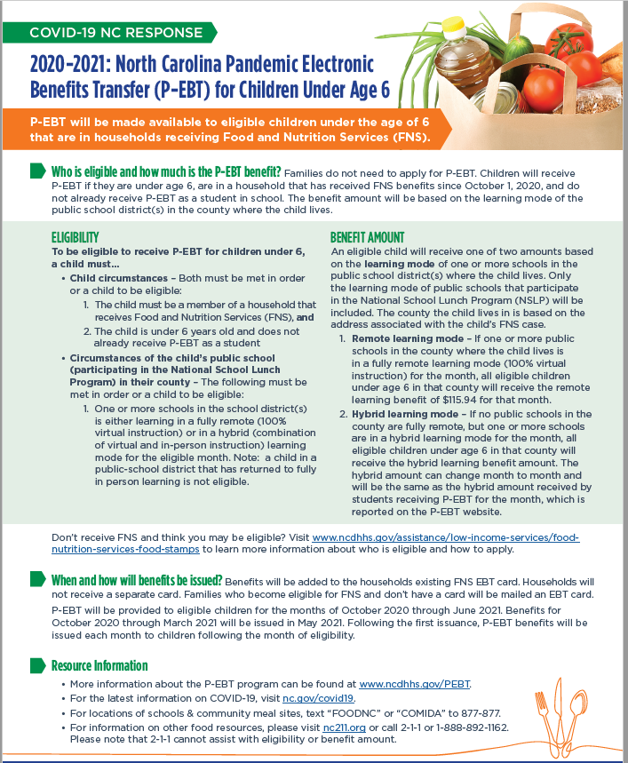
Updates
The toolkit was distributed May 19, 2021
Purpose: To provide resources and communication materials to help inform populations in the community who may inquire about P-EBT.

Slide 5


Updates
01
P-EBT for children under six are being issued at this time.
02
To learn more about P-EBT for children under the age of six, please visit www.ncdhhs.gov/PEBT

Slide 6

What questions do you have?

Slide 7
Emergency Cost Reimbursement
Child and Adult Care Food Program

Slide 8
Emergency Cost Reimbursement Benefits Timeline
The State agency will begin disbursing funds to institutions
Funds obligation deadline
The State agency must submit a summary of the use of funds to FNS
May 30, 2021
June 30, 2021
July 31, 2021
Sept 30, 2021
Jan 31, 2022
March 31, 2022
Institutions will receive an official notice from the State agency
Anticipated reimbursement amount
Acceptable use of funds
Any institution not eligible will have to provide assurance by June 15, 2021
Requirement to report use of funds
The State agency will request additional funds from FNS (if applicable)
Funds liquidation deadline
Recovery process begins
Institutions must report to the State agency of the use of funds
All institutions receiving Emergency Cost Reimbursement must report back to the State agency how the funds were used.

Slide 9
What questions do you have?

Slide 10
Policy Memos
Child and Adult Care Food Program

Slide 11
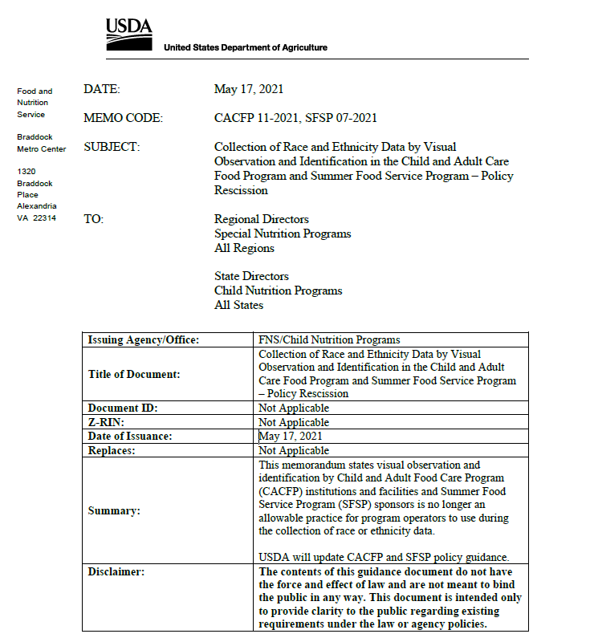

CACFP 11-2021
New Policy Memo

Slide 12
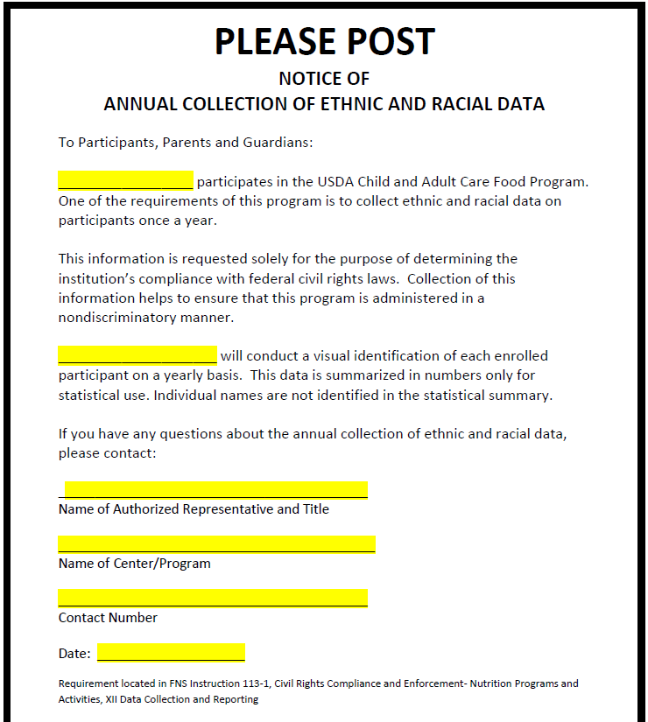
Policy Memo CACFP 11-2021
Visual observation and identification is no longer an allowable practice

Slide 13

CACFP Policy Memo 11-2021
Preferred method for collection of Ethnic
and Racial data:
Self-identify
Self-report
Alternative means of obtaining information:
Utilizing data from other sources
(School databases)

Slide 14
COVID – 19 Nationwide Waivers
Child and Adult Care Food Program

Slide 15
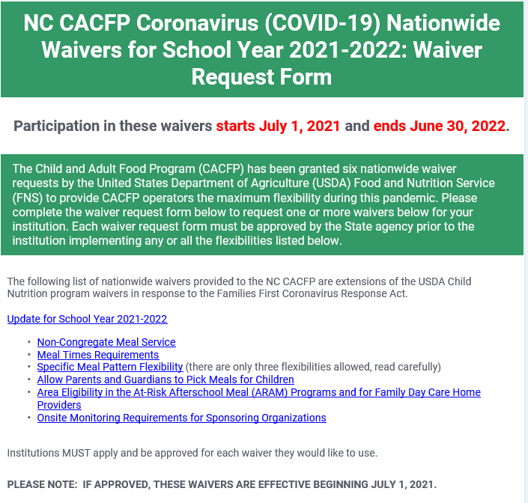
COVID-19: Child Nutrition Nationwide Waivers
Waiver Request Form for the Nationwide Waivers for School Year 2021-2022, for the set of waivers that become effective beginning July 1, 2021.

Slide 16
What questions do you have?

Slide 17
Application Update 2022
Child and Adult Care Food Program

Slide 18




Application Update 2022
Here are some helpful tips to remember about this year’s Annual Application Update 2022.
Tip 01
Tip 02
Tip 03
Tip 04
Application Update State agency training will begin end of June into July:
Live Webinars
Recorded Webinars
Anticipated Rollover will be mid July 2021
Application Update is due September 30, 2021
SD Notices will be issued starting October 1, 2021

Slide 19
Application Update 2022
Sponsoring Organizations of Unaffiliated Centers will be required to submit a sponsored center budget for all their sponsored facilities.
State Forms added to application update 2022
  IRS Tax Exemption Verification (Non-Profits Only)
  Conflict of Interest Acknowledgement and Policy-all institutions
SAM Registration (Required for ALL Institutions)
  For information regarding SAM Registration go to:
  https://www.sam.gov/SAM/

Slide 20
What questions do you have?

Slide 21
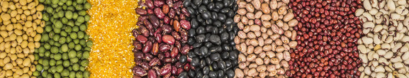
Upcoming NC CACFP Live Training Webinars
Grain Ounce Equivalents
Wednesday, June 9th | 1:00-2:30pm | 1:00-2:30pm
Friday, June 11th | 9:00-10:30am
Tuesday, June 15th | 2:00-3:30pm | 1:00-2:30pm
Thursday, June 17th | 10:00-11:30am
Notes:
We are going to be offering some new trainings starting next week:
The first is Grain Ounce Equivalents - This webinar will cover how to measure and serve grains using ounce equivalents and identify resources that will help CACFP operators to determine amounts of grains needed to meet CACFP meal pattern requirements. Remember the CACFP requirement to measure grains using ounce equivalents will become effective on October 1, 2021.

Slide 22

Upcoming NC CACFP Live Training Webinars
Application Update 2022
Tuesday, June 29th | 9:30-11:00am or | 1:00-2:30pm
Wednesday, June 30th | 10:00-11:30am or | 2:30-4:00pm
Thursday, July 1st | 9:30-11:00am or | 1:00-2:30pm
Wednesday, July 7th | 1:00-2:30pm
Thursday, July 8th | 10:00-11:30am
Friday, July 9th | 10:00-11:30am or | 2:30-4:00pm
Thursday, July 15th | 1:00-2:30pm
Notes:
The second upcoming training is Application Update for 2022. It is almost that time of year again. This coming year’s Application Update does have some changes that institutions need to know so it is important to attend this virtual training.

Slide 23

Upcoming NC CACFP Live Training Webinars
Build A Better Menu
Tuesday, July 20th | 9:00am-1:00pm
Website:
www.nutritionnc.com/snp
Training Team Email:
CACFPtraining@dhhs.nc.gov
Duties and Documents
Tuesday, July 27th | 1:00-4:00pm Sponsoring Organizations
Wednesday, July 28th | 1:00-4:00pm Independent Centers
Notes:
Also coming later in July are Build a Better Menu and Duties and Documents for SOs and ICs.
Registration for all of these trainings are available on our website under Training.
For any questions about any of the upcoming trainings, please contact the training team at CACFPtraining@dhhs.nc.gov

Slide 24
What questions do you have?

Slide 25
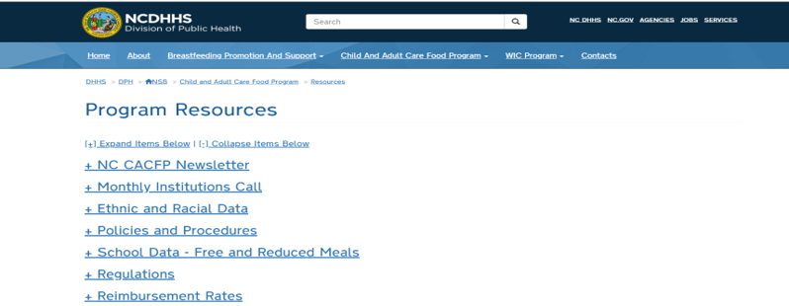
Monthly Institution Calls
The PowerPoints for the institution calls can now be found on our website www.nutritionnc.com
  Click on Child and Adult Care Food Program
  Click on Program Resources
  Click on Monthly Institution Calls

Slide 26
Q&A Session
1) Please use the chat function
to submit your questions.
2) We will review what we have
time for that pertains to the good
of the group.
3) Questions that apply to one
specific institution will be handled
offline.

Slide 27

Just Want to Say…….

