Slide 1
NC Department of Health and Human Services
Division of Mental Health, Developmental Disabilities, and Substance Use Services
Opioid and Prescription Drug Abuse Advisory Committee Meeting
September 25, 2026

Slide 2

Housekeeping
Reminders about the webinar technology:
  Please make sure you are using a computer or smart phone connected to the internet, and the audio function is on, and the volume is turned up.
  Please make sure your microphone is muted for the duration of the call.
  Questions can be submitted any time during the presentation using the “Q&A” box located on your control panel. We will answer as many questions as time allows after the presentation.

Slide 3


Housekeeping
American Sign Language (ASL) Interpreters and Closed-Captioning
  ASL Interpreters and Closed-Captioning options will be available for today’s event.
  For closed-captioning options select the "Closed Caption" feature located on your control panel.
Adjusting Video Layout and Screen View
  Select the "View" feature located in the top-right hand corner of your screen.
Intérpretes en lengua de signos americana (ASL) y subtítulos:
Habrá intérpretes de ASL y opciones de subtítulos disponibles para el evento de hoy. Para opciones de subtítulos, seleccione la función "Subtítulos" ubicada en su panel de control.

Slide 4
Agenda
Welcome and Introductions
Remarks from Kelly Crosbie
Presentation- Medications for Opioid Use Disorder
Presentation-MOUD In Pregnancy
Panel Discussion
Q&A
Adjourn

Slide 5

Kelly Crosbie, MSW, LCSW
DMH/DD/SUS Director
30 years in MH/SU/IDD Field
13 years in NCDHHS
DMHDDSUS since Dec 2022
Licensed Clinical Social Worker (LCSW)
Person with lived experience

Slide 6
Opioid and Prescription Drug Abuse Advisory Committee
OPDAAC meets quarterly to highlight and discuss priority topics that align with the North Carolina Opioid and Substance Use Action Plan
Topic: Medications for Opioid Use Disorder
The meeting is being recorded. The slides and recording will be available on the OPDAAC website in the coming weeks after the meeting.
  We will send out the materials when they become available.
For questions, please email: OPDAAC@ncdhhs.nc.gov

Slide 7

Guest Speaker
Shuchin Shukla
Addiction Medicine Physician
North Carolina Technical Assistance Center

Slide 8

Medications for Opioid Use Disorder
Shuchin Shukla MD MPH

Slide 9
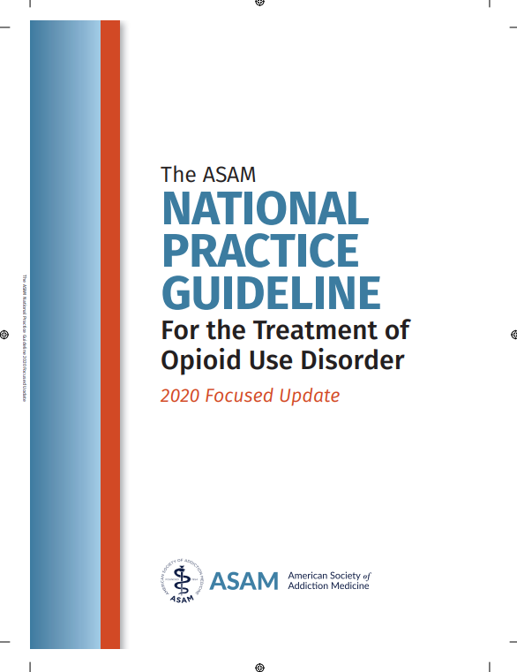
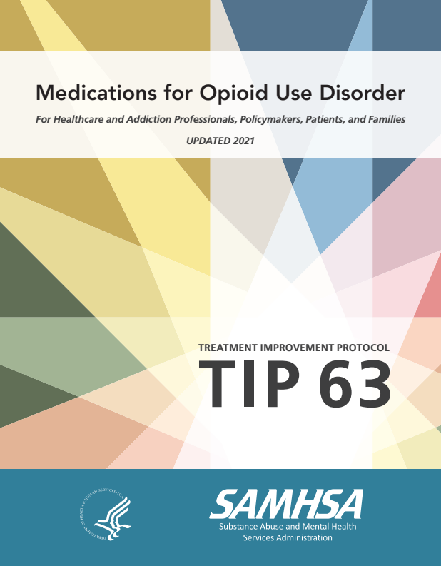
AGENDA
Overview of NC OUD
Neurobiology of Addiction
OUD Evidence-Based Management
Ongoing Challenges

Slide 10
AGENDA
Overview of NC OUD
Neurobiology of Addiction
OUD Evidence-Based Management
Ongoing Challenges

Slide 11
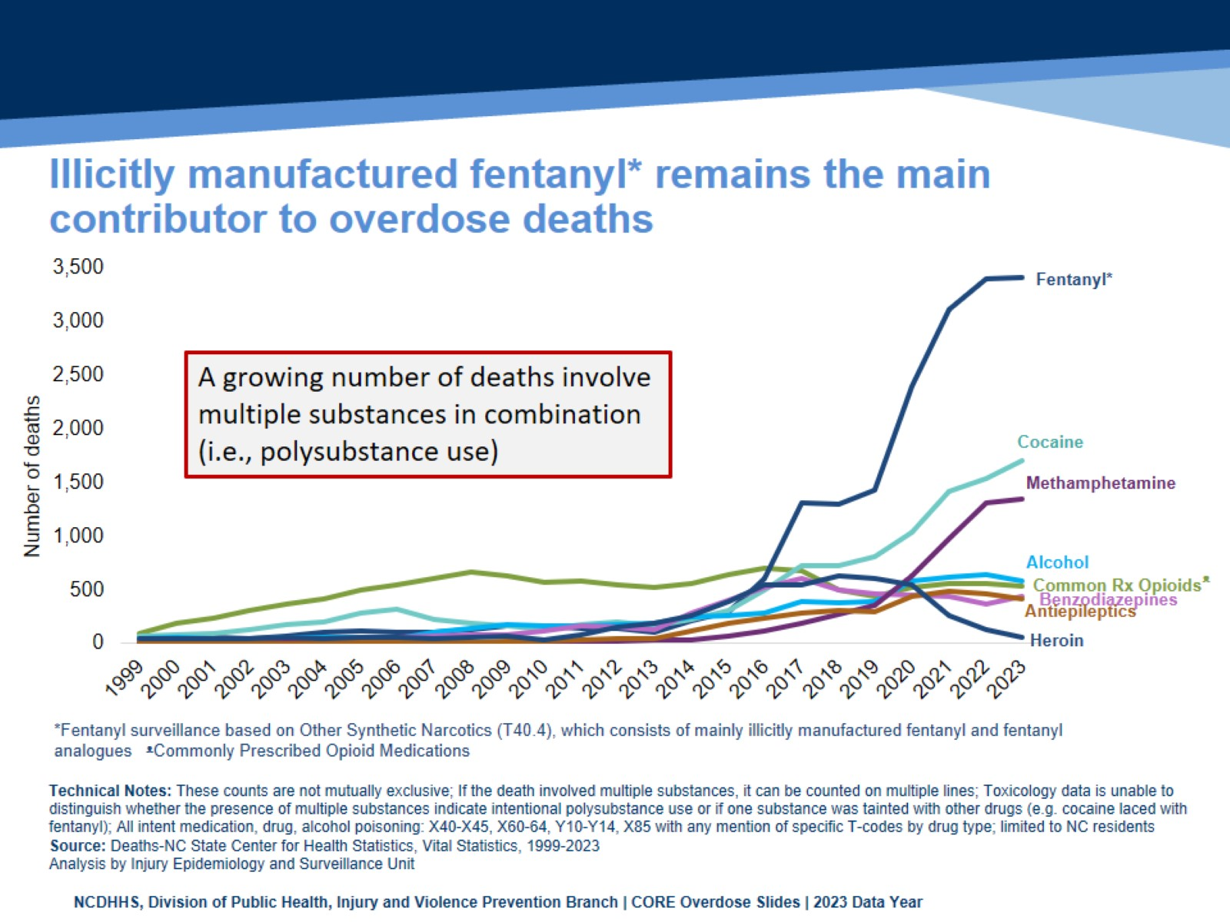
Illicitly manufactured fentanyl* remains the main contributor to overdose deaths
Notes:
The overdose epidemic is mostly driven by fentanyl.
Historically, prescription opioids (drugs like hydrocodone, oxycodone, morphine) contributed to an increasing number of medication/drug overdose deaths. In more recent years, synthetic narcotics such as fentanyl, and fentanyl analogues* have resulted in increased deaths. The number of deaths involving stimulants like cocaine and psychostimulants (which includes methamphetamine) also continue to rise.
These counts are not mutually exclusive. If a death involved multiple substances, it can be counted on multiple lines. A growing number deaths involve multiple substances in combination. Toxicology data is unable to distinguish whether the presence of multiple substances indicate intentional polysubstance use or if one substance was tainted with other drugs (e.g. cocaine laced with fentanyl).
*Fentanyl analogues are drugs that are similar to fentanyl but have been chemically modified in order to bypass current drug laws.

Slide 12
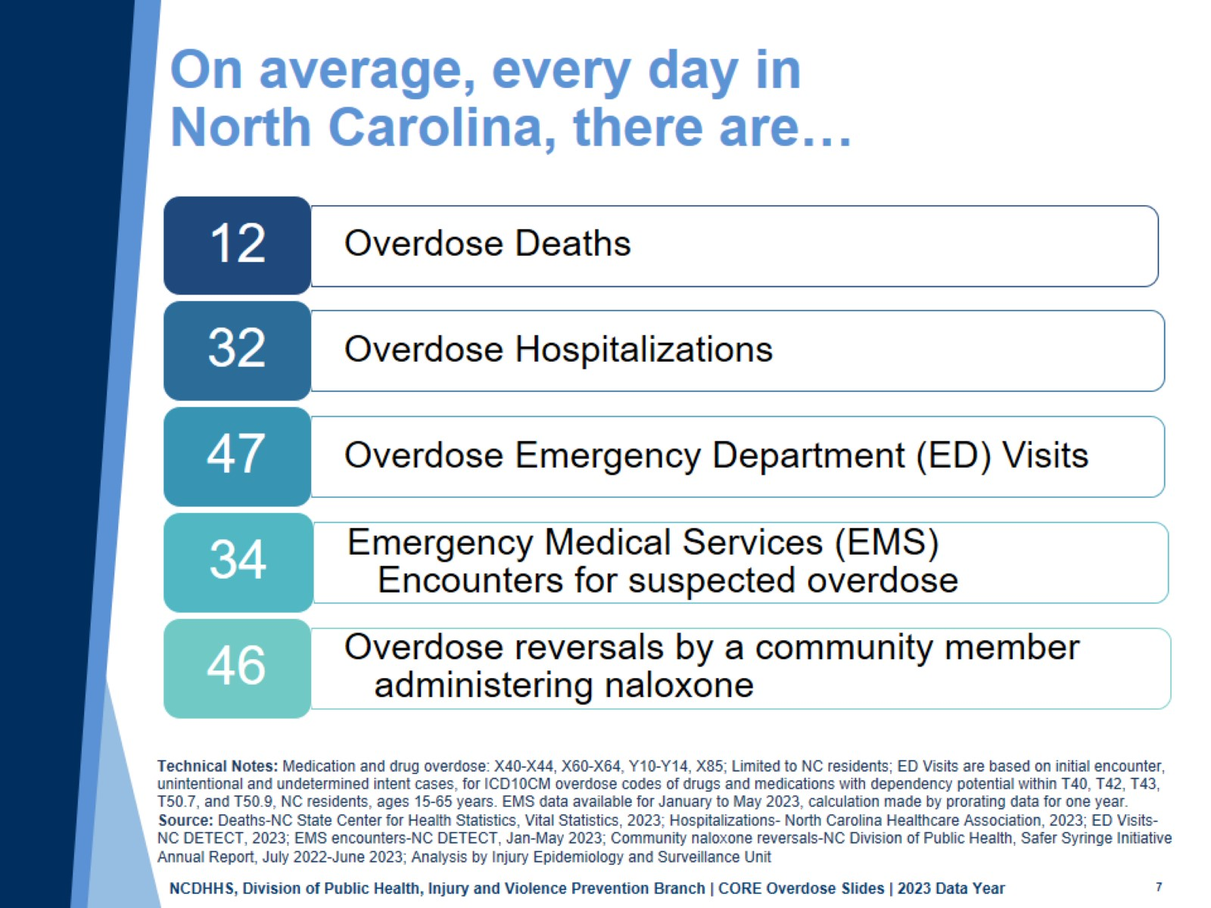
On average, every day in North Carolina, there are…
Notes:
An overdose is an injury with a range of outcomes and impacts.
In North Carolina, there are on average, 12 overdose deaths, 32 overdose hospitalizations, 47 overdose-related emergency department visits, 34 emergency medical services (EMS) encounters for suspected overdoses, and 46 naloxone reversals by community members each day. Addressing this issue requires a collaborative effort between communities, healthcare providers, and public health organizations to reduce the impacts on both individuals and the healthcare system.

Slide 13
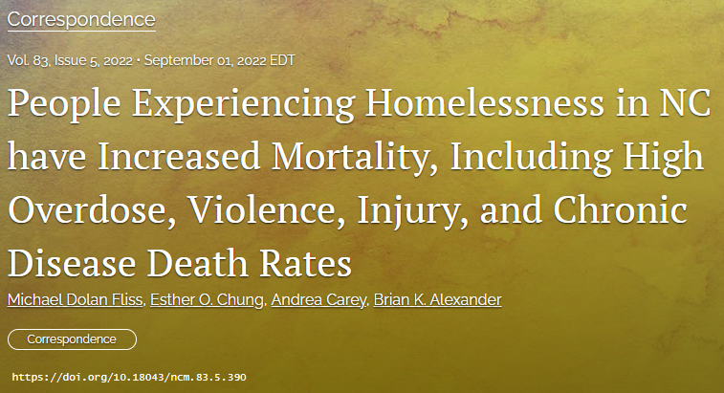
Overdose in NC: Unhoused vs General Population
7x higher all-cause mortality rate
  13.8x higher overdose mortality rate
  9x higher suicide mortality rate
  6x higher motor vehicle/pedestrian mortality rate
  10x higher firearm mortality

Slide 14
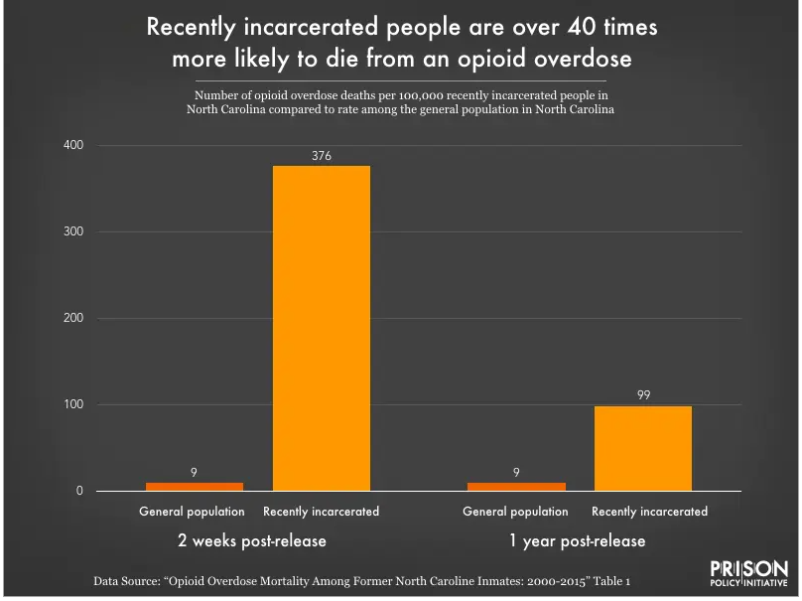
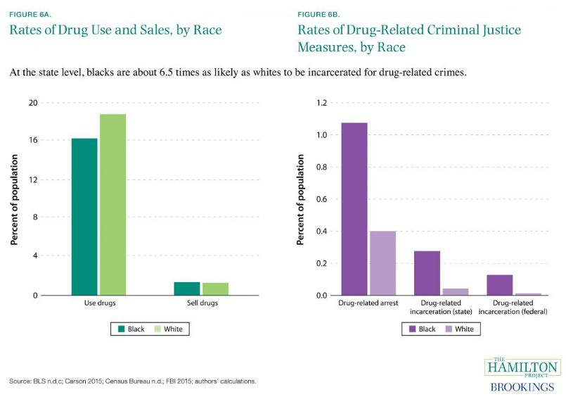
Overdose in NC: Post-Incarceration
Image Source: The Hamilton Project. (2016, October 21). Rates of drug use and sales, by race; Rates of drug related criminal justice measures, by race. https://www.hamiltonproject.org/data/rates-of-drug-use-and-sales-by-race-rates-of-drug-related-criminal-justice-measures-by-race/

Slide 15
Weiner SG, Baker O, Bernson D, Schuur JD. One-Year Mortality of Patients After Emergency Department Treatment for Nonfatal Opioid Overdose. Ann Emerg Med. 2020;75(1):13-17. doi:10.1016/j.annemergmed.2019.04.020
Notes:
NOTE: blue graph on this is directly lifted from the publication, and so this presentation should not be used in commercial settings or shared

Slide 16
AGENDA
Overview of NC OUD
Neurobiology of Addiction
OUD Evidence-Based Management
Ongoing Challenges

Slide 17

Why do people keep using substances?
See figure 2 from:
Evans CJ and Cahill CM. Neurobiology of opioid dependence in creating addiction vulnerability [version 1]. F1000Research 2016, 5:1748 (doi: 10.12688/f1000research.8369.1)
Notes:
Figure 2. Laura’s pathway to heroin addiction.
Here we provide a hypothetical scenario of how learned association of relief of aversive states could lead to the development of addiction and the key role of opioid dependence. Let us consider a disappointed teenager (Laura) who sprained her ankle during tryouts for the cheerleading team and was rejected, not making the squad. Knowing that opioids will alleviate the pain caused by the sprained ankle, Laura takes an opioid analgesic pill she knows is in the bathroom medicine cabinet, left over from her older brother’s prescription for a wisdom tooth extraction. The opioid pill takes away Laura’s pain from the sprained ankle and makes her feel relaxed (mellow and with elevated mood). She is less bothered about the tryout rejection while under the influence of the opioid. The next day, Laura decides to take another pill as the drug effects have worn off and both the ankle (physical) pain and the (psychological) pain of rejection have returned and are just as bad as the day before. The taking of the opioid medication again relieves the physical pain and takes her mind off her failure. Over the next 10 days, the drug taking cycle continues, but each day the pain-relieving effects are less (development of tolerance) and she develops a modest anxiogenic state prior to taking the drug each day (early signs of withdrawal). As the pain from the ankle sprain subsides, the association of drug taking becomes the relief of the anxious and dysphoric states that emerge as the drug wears off. On day 10, the supply of drugs from the medicine cabinet is exhausted and withdrawal sets in. Drug seeking would be a consequence during this withdrawal phase given the learned association that the aversive symptoms she is experiencing could be effectively relieved by taking the opioid (negative reinforcement). Although unlikely, given the ready access to illicit opioids throughout society, let’s assume that at this point in Laura’s life, she doesn’t actively seek out prescription or other opioids. The teen goes through physical withdrawal (over days) with protracted mood disturbances accompanied by drug craving that is triggered by memories that she could relieve dysphoric states by taking opioids. She doesn’t continue to seek opioids at this stage because the pain of rejection has dissipated and she is now engaged with other activities in her peer group. Over a year later, her boyfriend breaks up with her, her grades are not stellar, and she may not get accepted to the colleges she wants to go to. Laura becomes extremely stressed and feels unable to cope. The emergence of these negative symptoms initiates a craving for opioids that is triggered by learned associative memories. At this point in her life, she has the resources to access heroin and relapses. Laura’s relapse reinforces the associative memories that aversive states are relieved by opioids and the foundation for further addictive behaviors is strengthened. In this example, drug dependence and withdrawal contributes to the addiction vulnerability and the learned associative memories are of the negative reinforcement provided by opioid relief of anxiogenic and dysphoric states, and are triggered by a different stressor.
Evans CJ and Cahill CM. Neurobiology of opioid dependence in creating addiction vulnerability [version 1]. F1000Research 2016, 5:1748 (doi: 10.12688/f1000research.8369.1)

Slide 18
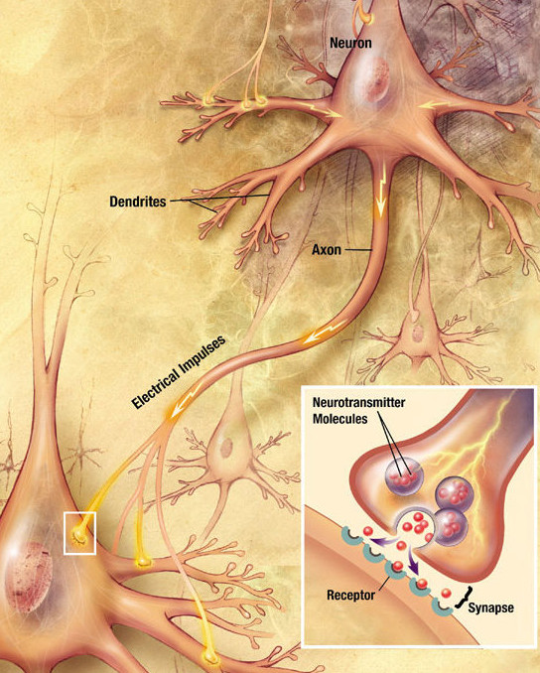
Neurochemistry and Neuroanatomy
See figure 1 from:
Volkow ND, Koob GF, McLellan AT. Neurobiologic Advances from the Brain Disease Model of Addiction. N Engl J Med. 2016;374(4):363-371. doi:10.1056/NEJMra1511480

Slide 19
SUD DSM-V definition: at least 2 elements
Physiologic
Tolerance:
Withdrawal:
Risk/Harm
Recurrent substance use resulting in failure to fulfill major role obligations at work, school or home
Continued substance use despite having persistent or recurrent social or interpersonal problems caused or exacerbated by the effects of substances
Lack of Control
Substance is often taken in larger amounts or over a longer period than was intended
Persistent desire or unsuccessful efforts to cut down or control use
Great deal of time is spent in activities necessary to obtain substance, use substance, or recover from its effects
Craving, or a strong desire to use substance
Important social, occupational or recreational activities are given up or reduced because of substance use
Recurrent substance use in situations in which it is physically hazardous
(a) a need for markedly increased amounts of substances to achieve intoxication or desired effect, or
(b) markedly diminished effect with continued use of the same amount of an substance
(a) the characteristic substance withdrawal syndrome, or
(b) the same (or a closely related) substance are taken to relieve or avoid withdrawal symptoms
Continued use despite knowledge of having a persistent or recurrent physical or psychological problem that is likely to have been caused or exacerbated by opioids
*tolerance and withdrawal cannot be the only criteria for SUD diagnosis

Slide 20
AGENDA
Overview of NC OUD
Neurobiology of Addiction
OUD Evidence-Based Management
Ongoing Challenges

Slide 21
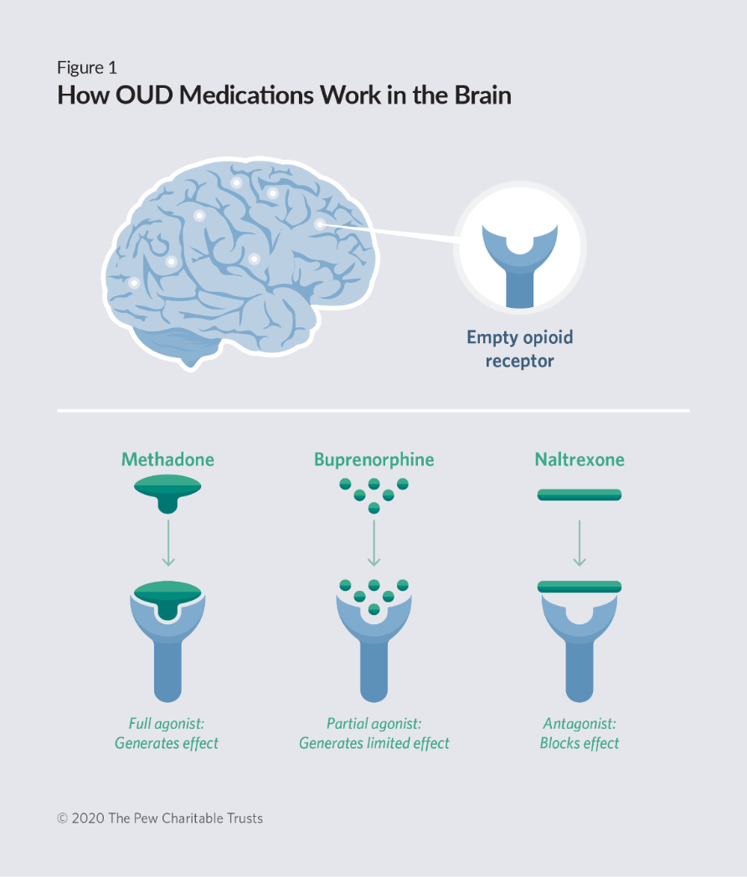
MOUD: Medication for Opioid Use Disorder
OTP = opioid treatment program
  Only possible site for methadone treatment
  Meds administered or dispensed, never prescribed: daily observed dosing initially, and increasingly longer “take-homes”
  Slow dose titration due to higher risks
  Buprenorphine also available
  Regular counseling required
OBOT = office based opioid treatment
  Anyone with a DEA can prescribe buprenorphine
  Counseling optional
  Often integrated with other health services (primary care, psychiatry, OBGYN)
Both utilize drug testing

Slide 22
Methadone
Full Agonist at mu receptor
Long acting
Half-life ~ 15-60 Hours
Weak affinity for mu receptor
Can be displaced by partial agonists (e,g. burprenorphine) and antagonists (e.g.naloxone, naltrexone), which can both precipitate withdrawal
Monitoring
Significant respiratory suppression and potential respiratory arrest in overdose
QT prolongation
full agonist
(e.g. morphine,
methadone)
partial agonist
(buprenorphine)
mu opioid effects
antagonist
(naloxone,
naltrexone)
dose
¹CSAT 2005
Notes:
Speaker Notes:
Methadone allows for a slow titration to a high dose that substitutes, prevents withdrawal and reduces craving. It can also produce tolerance, often resulting in attenuation or blockade of the effects of other opioids.
Respiratory depression but also respiratory arrest due to the effect on the medullary respiratory center of no longer responding to CO2
Note: Fentanyl (also a full mu-receptor agonist) has a very high affinity for mu-receptor
Citation: Slide from…
Center for Substance Abuse Treatment. Provider Clinical Support System The Half and Half Course, Waiver Eligibility Training (part 1). Presented at: 2005.

Slide 23
Buprenorphine
Partial agonist at mu receptor
Comparatively minimal respiratory suppression and no respiratory arrest when used as prescribed
Long acting
Half-life ~ 24-36 Hours
High affinity for mu receptor
Blocks other opioids
Displaces other opioids
  Can precipitate withdrawal
Slow dissociation from mu receptor
Stays on receptor for a long time
full agonist
(e.g. morphine,
methadone)
partial agonist
(buprenorphine)
mu opioid effects
antagonist
(naloxone,
naltrexone)
dose
¹ SAMHSA 2018
² Oman & Keating, 2009
Notes:
Notes:
Speaker Notes:
Emphasize and review High Affinity (because of high K value and intensity of binding to the mu receptor) and Slow Dissociation features of buprenorphine
In contrast to buprenorphine, heroin has a very short half-life. This leads to frequent cycles of use and withdrawal that interferes with normal activity and functioning
Caution: Although buprenorphine has comparatively minimal respiratory suppression when used as prescribed, it can result in significant respiratory depression when combined with high enough doses of alcohol and/or benzodiazepines or when ingested by children
Buprenorphine is also an antagonist at the kappa opioid receptor
Kappa antagonists have been hypothesized to decrease craving.
Reference: Carroll FI and Carlezon WA. Development of Kappa Opioid Receptor Antagonists. J Med Chem. 2013 Mar 28; 56(6): 2178–2195.
Citation: Slide from…
Center for Substance Abuse Treatment. Provider Clinical Support System The Half and Half Course, Waiver Eligibility Training (part 1). Presented at: 2005.

Slide 24
Naltrexone
Full Antagonist at mu receptor
Competitive binding at mu receptor
Long acting
Half-life:
  Oral ~ 4 Hours
  IM ~ 5-10 days
High affinity for mu receptor
Blocks other opioids
Displaces other opioids
  Can precipitate withdrawal
Formulations
Tablets: Revia®: FDA approved in 1984
Extended-Release intramuscular injection: Vivitrol®: FDA approved in 2010
full agonist
(e.g. morphine,
methadone)
partial agonist
(buprenorphine)
mu opioid effects
antagonist
(naloxone,
naltrexone)
dose
¹SAMHSA 2018
Notes:
Notes:
Speaker Notes:
Speaker Notes:
Other Considerations:
Avoid in patients with severe hepatic impairment, moderate to severe renal insufficiency. Have
Discuss risks and benefits with provider if patient becomes pregnant
Citation: Slide from…
1. Center for Substance Abuse Treatment. Provider Clinical Support System The Half and Half Course, Waiver Eligibility Training (part 1). Presented at: 2005.

Slide 25
Santo T, Clark B, Hickman M, et al. Association of Opioid Agonist Treatment With All-Cause Mortality and Specific Causes of Death Among People With Opioid Dependence: A Systematic Review and Meta-analysis. JAMA Psychiatry. 2021;78(9):979–993. doi:10.1001/jamapsychiatry.2021.0976
Notes:
Fifteen RCTs including 3852 participants and 36 primary cohort studies including 749 634 participants were analyzed.

Slide 26
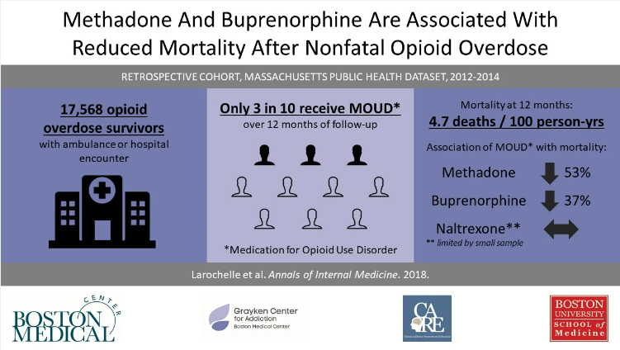

Slide 27
What about Naltrexone?
See graph from:
https://dev.recoveryanswers.org/research-post/buprenorphine-naltrexone-vivitrol-overdose-risk/
Unlike methadone/buprenorphine, naltrexone does NOT induce opioid tolerance, thus has increased risk of overdose with return to use
MULTIPLE studies show NO IMPROVEMENT in overdose risk with naltrexone compared to placebo, and WORSE overdose risk compared to buprenorphine/methadone²³
2 wakeman 2020
3 Morgan 2019
Notes:
https://www.npr.org/sections/health-shots/2017/06/12/523774660/a-drugmaker-tries-to-cash-in-on-the-opioid-epidemic-one-state-law-at-a-time
Wakeman SE, Larochelle MR, Ameli O, et al. Comparative Effectiveness of Different Treatment Pathways for Opioid Use Disorder. JAMA Netw Open. 2020;3(2):e1920622. doi:10.1001/jamanetworkopen.2019.20622
Morgan JR, Schackman BR, Weinstein ZM, Walley AY, Linas BP. Overdose following initiation of naltrexone and buprenorphine medication treatment for opioid use disorder in a United States commercially insured cohort. Drug Alcohol Depend. 2019;200:34-39. doi:10.1016/j.drugalcdep.2019.02.031

Slide 28
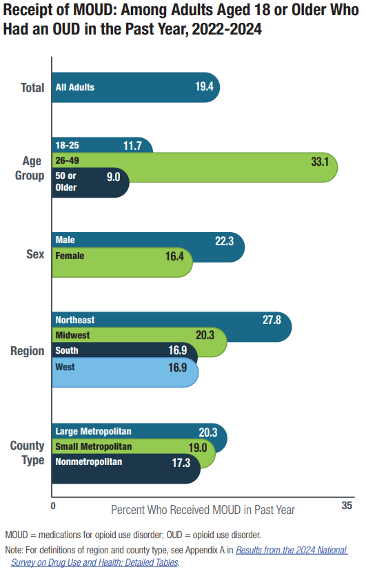
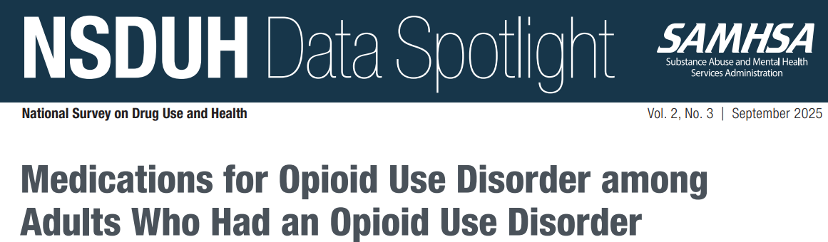

Slide 29
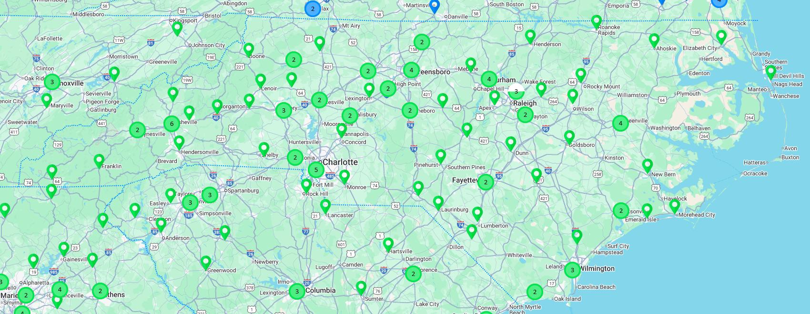
97 licensed OTPs across 55 NC counties!

Slide 30




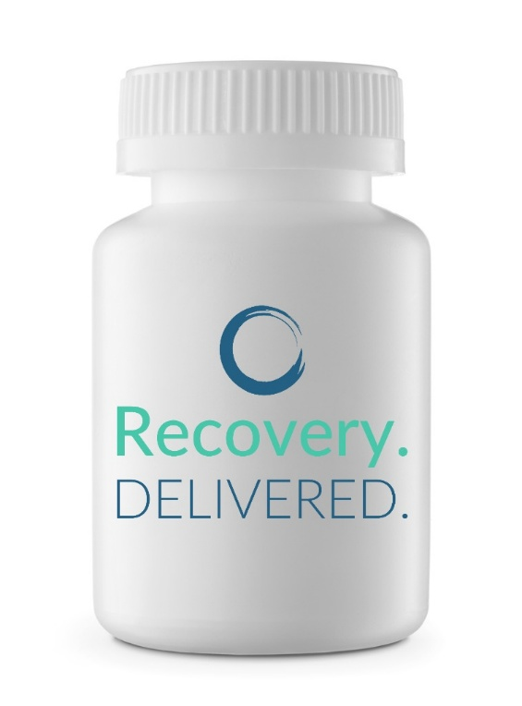



Telehealth MOUD

Slide 31
AGENDA
Overview of NC OUD
Neurobiology of Addiction
OUD Evidence-Based Management
Ongoing Challenges

Slide 32
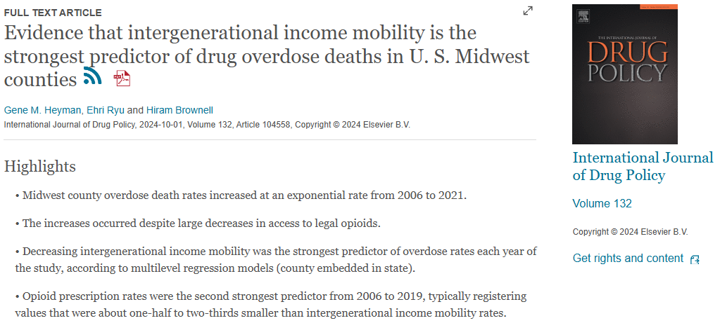
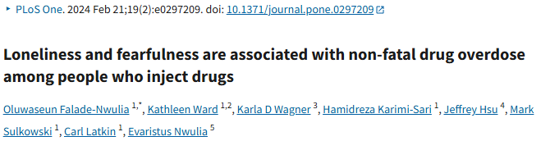
ONGOING CHALLENGES
STIGMA:
  Providers (clinics, hospitals, social services)
  Criminalization
  Employers, landlords
  Internalized
Paying for treatment
Not enough access:
  providers of evidence based medicine
  ERs, hospitals, jails/prisons, shelters, low income communities, black/latino/native communities
Treatment REQUIREMENTS that are not patient centered
  Transportation
  Counseling
  Other substances
No “medications for stimulant use disorder”
Rapidly evolving drug market
Worsening socioeconomic disparities, loneliness

Slide 33
OVERCOMING CHALLENGES
STIGMA:
  Antistigma training for ALL court staff AND ALL providers
  Leave treatment decisions to treatment providers
  Ensure treatment providers are facilitating access to MAT
    Expect data from providers on who is being offered what, and why/whynot? Patients with alcohol or opioid use disorder who are NOT receiving medication are almost always NOT getting good clinical care!
Paying for treatment: SCAO!
Not enough providers of evidence based medicine
  Meet with local providers to gauge their attitudes/practices around MAT. Communicate your expectations that patients SHOULD receive MAT for optimal outcomes. Utilize virtual providers if no good local providers.
Treatment REQUIREMENTS that are not patient centered
  Meet regularly with treatment providers to understand why patients are not on MAT
    Eliminate court requirements that are access barriers, do not use MAT as a “carrot”
    Ensure a MAT-friendly culture in the courts and provider community
No “medications for stimulant use disorder”
  Enhance contingency management—one of the few things courts can do that providers cannot!
Rapidly evolving drug market
  No offense, but don’t be naïve. There are plenty of untestable drugs that are more dangerous than what your court/probation/provider can test for. Embrace harm reduction.
Worsening socioeconomic disparities, loneliness
  Create community, support livelihood-making, expand peer support, advocate for fair housing and fair wages

Slide 34
STIGMA MISUNDERSTANDING around MOUD
Are we just replacing one addiction for another?
They’re all just trying to get high!
Thought exercise: sugar overdose…

Slide 35
Recovery Timeline
See images:
https://dev.recoveryanswers.org/media/addiction-course-of-recovery-timeline/
https://dev.recoveryanswers.org/media/hierarchy-of-needs-model-for-recovery/

Slide 36
PEER SUPPORT
Utilizes persons with lived experience to engage with patients with mental health, substance use, or other medical disorders.
Low barrier, interpersonal relationship building, outreach, community resource linkage… and more!
Helps empower those with lived experience as an asset to help others struggling with recovery
Addresses internalized stigma/bias for patients, and addresses cultural stigma/bias for healthcare worker-learners like you!
>50% relative risk reduction of opioid overdose and >50% relative risk benefit of MOUD initiation!
Winhusen T, Wilder C, Kropp F, Theobald J, Lyons MS, Lewis D. A brief telephone-delivered peer intervention to encourage enrollment in medication for opioid use disorder in individuals surviving an opioid overdose: Results from a randomized pilot trial. Drug Alcohol Depend. 2020 Nov 1;216:108270. doi: 10.1016/j.drugalcdep.2020.108270. Epub 2020 Sep 1. PMID: 32911132; PMCID: PMC7462596.

Slide 37
THANKS!
Shuchin@email.unc.edu

Slide 38

Guest Speaker
Nathan Mullins, MD FACOG/FASAM
Regional Medical Director for BHG NC OTPs
Program Director, Addiction Medicine Fellowship at MAHEC

Slide 39

MOUD In Pregnancy
Nathan Mullins, MD

Slide 40
Epidemiology
OUD affected 8.2 per 1000 deliveries by 2017¹
2017-2020: 1229/7642 pregnancy-associated deaths were due to overdose
  Overdose mortality rate – 8.5 per 100,000
Rate ↑ from 6.56 to 11.85²
81% ↑ in drug overdose mortality
Highest rates in late postpartum period (43 to 365 days)
↑ driven by rise in fentanyl/other synthetic deaths²

Slide 41
Medically Supervised Withdrawal (MSW)
VS.
Opioid Agonist Treatment

Slide 42
Medically Supervised Withdrawal
Traditionally discouraged due to case reports of fetal demise
Zuspan, et al. 1975
  Serial amniocentesis on pregnant patient undergoing methadone taper
  Low catecholamine levels in amniotic fluid during MTD treatment
  ↑ catecholamine levels noted during methadone taper³
Past 20 years → studies w/ ~500 patients undergoing MSW
  No fetal losses⁴
  Can be done safely
High return to use rates = illicit use exposes pregnant patient/fetus to associated risks⁴
If MSW successful, NOWS rates may be reduced

Slide 43
Medically Supervised Withdrawal
Bottom Line:
Can be done without increase in fetal mortality
Case studies show high rates of return to use
  Range from 17-96%, average 48%⁴
Return to use rates lower on medication treatment when compared to MSW in pregnancy⁴
NOWS rates may be reduced when women successful w/ MSW in pregnancy⁷ → overall, not been shown due to ↑ RTU rates⁴
Concern maternal/fetal stress may induce epigenetic modifications that could have an effect on development of chronic disease⁴

Slide 44
Medications for Opioid Use Disorder
Standard of care per:
  World Health Organization
  National Institute on Drug Abuse
  American Society of Addiction Medicine
  Centers for Disease Control and Prevention
  ACOG

Slide 45
Role of Medications
Medications alone improve mortality rates
All FDA-approved medications for OUD should be available for all patients with an OUD⁵

Slide 46
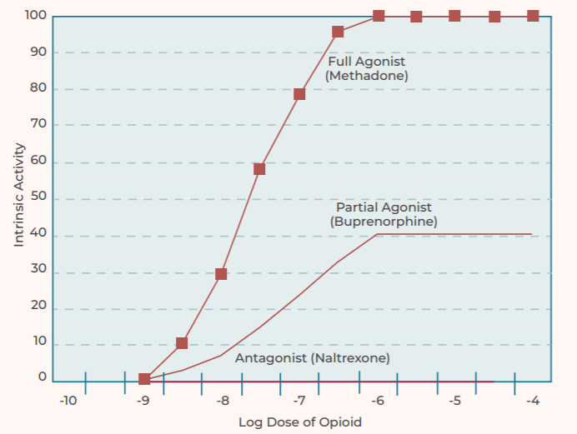
Medications for Opioid Use Disorder (MOUD)
Three FDA Approved agents⁶:
  Methadone
  Buprenorphine-containing products
  Naltrexone
All Category C in pregnancy

Slide 47
Teratogenicity of Opioids
Observational studies suggest possible ↑ risk of specific birth defects
  Absolute risk = low
  Methodological problems exist
Meta-analysis of multiple studies comparing methadone and buprenorphine treatment in pregnancy
  No increased risk of congenital anomalies
  Frequency/type of anomalies similar to general population⁷

Slide 48
Opioid Agonist Treatment
70% reduction in overdose related deaths
Decreased risk of HCV, HIV, HBV
Increased engagement in PNC⁸
Fetal benefits
  ↓ fetal demise
  ↓ FGR
  ↓ preterm delivery⁸

Slide 49
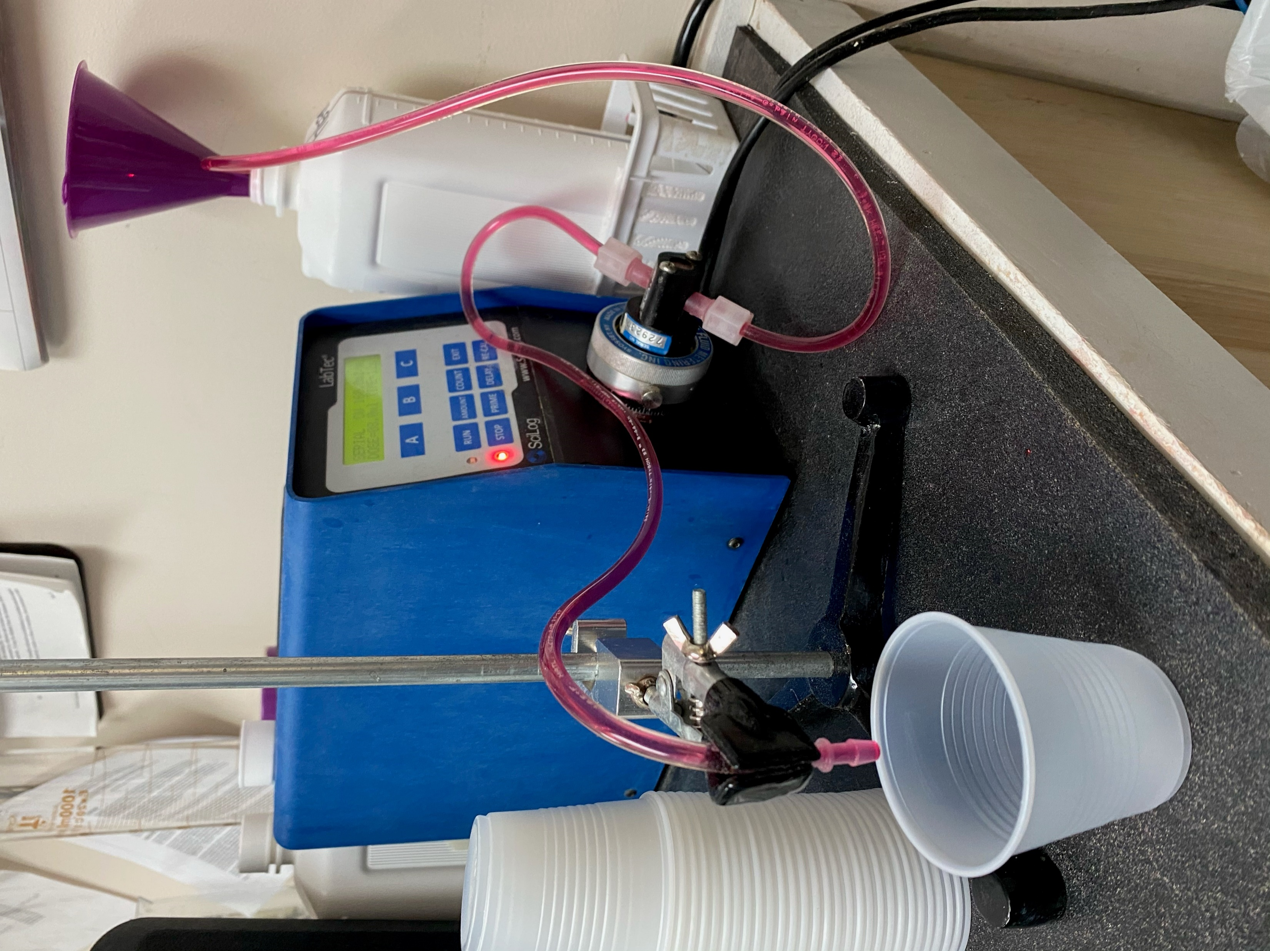
Methadone in Pregnancy
Typically require 50-150 mg to suppress withdrawal/cravings⁹
Expected dose will increase during pregnancy
  ↑ absorption, expanded volume of distribution, ↑ hepatic clearance and ↓ protein binding
  Change in half-life from 22-24 hours to 8.1 in pregnancy⁹
Rate of NOWS ~50%¹⁰
  Wide range in studies from 13-94%¹¹
  Dose does not effect rate¹⁰
  One study in pregnancy showed divided (split) doses reduced NOWS = 29%¹²

Slide 50
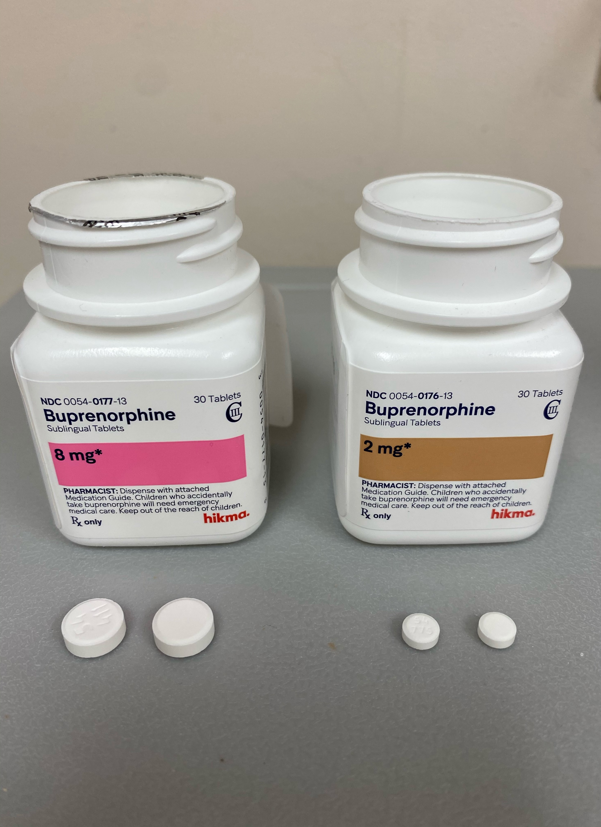
Buprenorphine in Pregnancy
Pharmacokinetic studies have shown lower BUP plasma concentration/dose in pregnancy vs. post partum¹³
  ↑ CYP3A and UGT Enzymes
  ↓ protein levels and ↑ maternal body fat = greater volume of distribution
  ↓ salivary pH which may affect transmucosal absorption
Some women may need increase in pregnancy¹⁰
Limited data to support split dosing, relationship to NOWS unknown¹⁴
Rate of NOWS ~50% → not effected by dose¹⁰

Slide 51
Buprenorphine vs. Methadone
MOTHER Study¹⁵
Randomized trial of methadone vs buprenorphine
Primary outcome: NAS rates
No difference in NAS treatment rates (M = 57%, B = 47%)
NAS less severe, shorter neonatal LAS in BUP vs. MTD
  89% less morphine to treat NAS
  43% less time in hospital (10 vs. 17.5 days)

Slide 52
Buprenorphine vs. Methadone
MOTHER Study¹⁵
Similar maternal tx/delivery outcomes
More d/c’d treatment on BUP vs. MTD

Slide 53
Buprenorphine vs. Methadone
Suarez et al. 2022¹⁶
Large retrospective cohort study
Findings:
BUP associated w/ lower rates of
NOWS (52% vs 69.2)
Preterm birth (14.4% vs 24.9%)
Small size for gestational age (12.1% vs 15.3%)
No association found between cesarean section and severe maternal complications

Slide 54
Buprenorphine vs. Buprenorphine/Naloxone
Naloxone added to discourage medication misuse, i.e. IV
Naloxone has poor sublingual bioavailability = 3%¹³
Historically, BUP recommended over BUP/NAL in pregnancy¹⁰
  Exposure to naloxone
  Risk of precipitated withdrawal if injected
Meta-analysis of limited studies:¹⁷
  Neonatal and maternal outcomes comparable between the 2 formulations
Decision of which formulation to use should be based on consultation with patient
Notes:
SAMHSA pregnancy guidelines
Buprenorphine pharmacology study for naloxone bioavailability

Slide 55
Extended-Release Buprenorphine In Pregnancy
Winhusen et al. 2026
  Randomized trial in pregnancy/postpartum
  GA 6-30 weeks
  N = 140 (69 ER BUP/71 SL BUP)
ER BUP (weekly, Brixadi©) vs SL BUP
Primary Outcome = abstinence from illicit opioids¹⁸

Slide 56
N-Methyl-2-Pyrrolidone (NMP)
Excipient used in monthly ER BUP to form the depot injection
Preclinical animal studies raised concerns at high doses and repeated administration
Subsequent reproductive and developmental studies in rats and rabbits:
- No fetal external, visceral, or skeletal abnormalities
- No maternal toxicity at human-equivalent doses
Exposure from ER BUP is limited to one monthly peak that declines within 2 days
US product label updated: NMP effects language removed based on newer safety data
ER BUP is not contraindicated in pregnancy in any approved markets globally¹⁹

Slide 57
Standard Drink
1/229
14 g EtOH
32 mg ER BUP
61 mg EtOH
Notes:
32 mg ER BUP alcohol content equals 1/229 of a standard drink
Thought experiment:
Woman on weekly 32 mg ER BUP, becomes pregnant and delivers at 42 weeks gestation. This would be 38 doses of ER BUP during pregnancy = total of 2318 mg of EtOH exposure = < 2/10 of standard drink

Slide 58
Extended-Release Buprenorphine In Pregnancy
Pregnancy
ER BUP = 82%
SL BUP = 72.6%
Postpartum
ER BUP = 60.2%
SL BUP = 59.5%
NOWS
ER BUP = 30.2%
SL BUP = 26.5%
Notes:
Illicit opioid abstinence rates greater on ER BUP vs SL BUP during pregnancy, no difference postpartum
34 patients in ER BUP group switched from weekly to monthly injections postpartum
Conclusion: ER BUP non-inferior to SL BUP in pregnancy

Slide 59
Naltrexone in Pregnancy
2024 Systematic Review²¹
  5 cohort studies
  Primary outcomes:
    GA at delivery
    Neonates diagnosed w/ NAS
3/5 reported rates of NAS
Similar obstetric outcomes for gestational age at delivery, mode of delivery and preterm birth compared to OAT
Lower rates of NAS compared to OAT

Slide 60

MOUD in Pregnancy
Opioid agonist medication recommended treatment in pregnancy
Buprenorphine offers some advantages over methadone (less severe and possible lower rate of NOWS, preterm birth and small for gestational age)
Methadone vs BUP – lower rates of discontinuation
Risk of precipitated withdrawal with buprenorphine, not with methadone

Slide 61
MOUD in Pregnancy
Medication dose not correlated with risk of NOWS
Childhood developmental outcomes appear wnl in BUP/MTD exposed children
Naltrexone appears safe in pregnancy, but data is limited

Slide 62
References
Suarez EA, et al. Buprenorphine versus methadone for opioid use disorder in pregnancy. N Engl J Med 2022;387:2033-44.
Bruzelius E and Martins SS. US trends in drug overdose mortality among pregnant and postpartum persons, 2017-2020. JAMA 2022 Dec 6;328(21):2159-61.
Zuspan FP, et al. Fetal stress from methadone withdrawal. Am J Obstet Gynecol 1975;122:43-46.
Jones HE, et al. Medically Assisted Withdrawal (Detoxification): Considering the Mother-Infant Dyad. J Addict Med 2017;11:90-92.
National Academies of Sciences, Engineering, and Medicine. 2018. Medication-assisted treatment for opioid use disorder: Proceedings of a workshop—in brief. Washington, DC: The National Academies Press.
Substance Abuse and Mental Health Services Administration. Medications for Opioid Use Disorder. Treatment Improvement Protocol (TIP) Series 63, Full Document. HHS Publication No. (SMA) 18- 5063FULLDOC. Rockville, MD: Substance Abuse and Mental Health Services Administration, 2018.
Zedler BK, et al. Buprenorphine compared with methadone to treat pregnant women with opioid use disorder: a systematic review and meta-analysis of safety in the mother, fetus and child. Addiction 2016;111:2115-28.
Klaman SL, et al. Treating Women Who Are Pregnant and Parenting for Opioid Use Disorder and the Concurrent Care of Their Infants and Children: Literature Review to Support National Guidance. J Addict Med 2017;11:178-190.
Albright B, et al. Changes in methadone maintenance therapy during and after pregnancy. Journal of Substance Abuse Treatment 2011;41:347-53.
Clinical guidance for treating pregnant and parenting women with opioid use disorder and their infants. HHS Publication No. (SMA) 18-5054. Rockville, MD: Substance Abuse and Mental Health Services Administration, 2018.

Slide 63
References
Cleary BJ, Donnelly J, Strawbridge J, et al. Methadone dose and neonatal abstinence syndrome-systematic review and meta-analysis. Addiction 2010;105:2071–2084.
McCarthy JJ, et al. The effect of methadone dose regimen on neonatal abstinence syndrome. J Addict Med. 2015;9:105-110.
Bastian JR, et al. Dose-adjusted plasma concentrations of sublingual buprenorphine are lower during than after pregnancy. AJOG. 2017 Jan; 216(1):64.e1-64.e7
Caritis SN, et al. An evidence-based recommendation to increase the dosing frequency of buprenorphine during pregnancy. AJOG. 2017; 217:459.e1-6
Jones HE, et al. Neonatal abstinence syndrome after methadone or buprenorphine exposure. N Engl J Med 2010; 363:2320-31.
Suarez EA, et al. Buprenorphine versus methadone for opioid use disorder in pregnancy. N Engl J Med 2022;387:2033-44.
Link HM, et al. Buprenorphine-naloxone use in pregnancy: a systematic review and metaanalysis. AJOG MFM August 2020:1-12.
Winhusen TJ, et al. Extended-release vs sublingual buprenorphine in pregnancy through 12 months post partum. JAMA Intern Med. 2026;186(5):533-543.
Ramge M, et al. Monthly buprenorphine depot injection (SUBLOCADE®) for opioid use disorder during pregnancy. Am J Addict. 2025 Sep;34(5):485-494.
Lofwall MR, et al. What to expect with pregnant or postpartum prescribing of extended-release buprenorphine (CAM2038). J Clin Gynecol Obstet. 2023 December;12(3):110-116.

Slide 64
References
Atluru S, et al. Naltrexone compared with buprenorphine or methadone in pregnancy: a systematic review. Obstet Gynecol. 2024 Mar 1;143(3):403-410.

Slide 65




Panel Discussion
C. Jamie Edwards, MA, M.Ed, LCAS, CCS, CPS
Hendrée E. Jones, PhD, LP
Matthew Ruffner, MHA, CADC
Sara Clark, LCSW, LCAS
Director of Substance Use Disorder Treatment
High Country Community Health
Professor and Senior Advisor
School of Medicine, The University of North Carolina at Chapel Hill (UNC-CH) / UNC Horizons Obstetrics and Gynecology
Professor (Joint appointment), Department of Psychology, UNC-CH
VP of New Center Development
New Season
Director
Surry County Office of Substance Abuse Recovery

Slide 66
Question and Answer Session
Questions and feedback are welcome at OPDAAC@dhhs.nc.gov
The agenda, presentation slides, and recording for this webinar will be posted to the OPDAAC Meetings and DMH/DD/SUS Webinars webpage.

Slide 67





Stay Connected with DMH/DD/SUS
Join our Side by Side Webinars
Join our Mailing List

