Slide 1
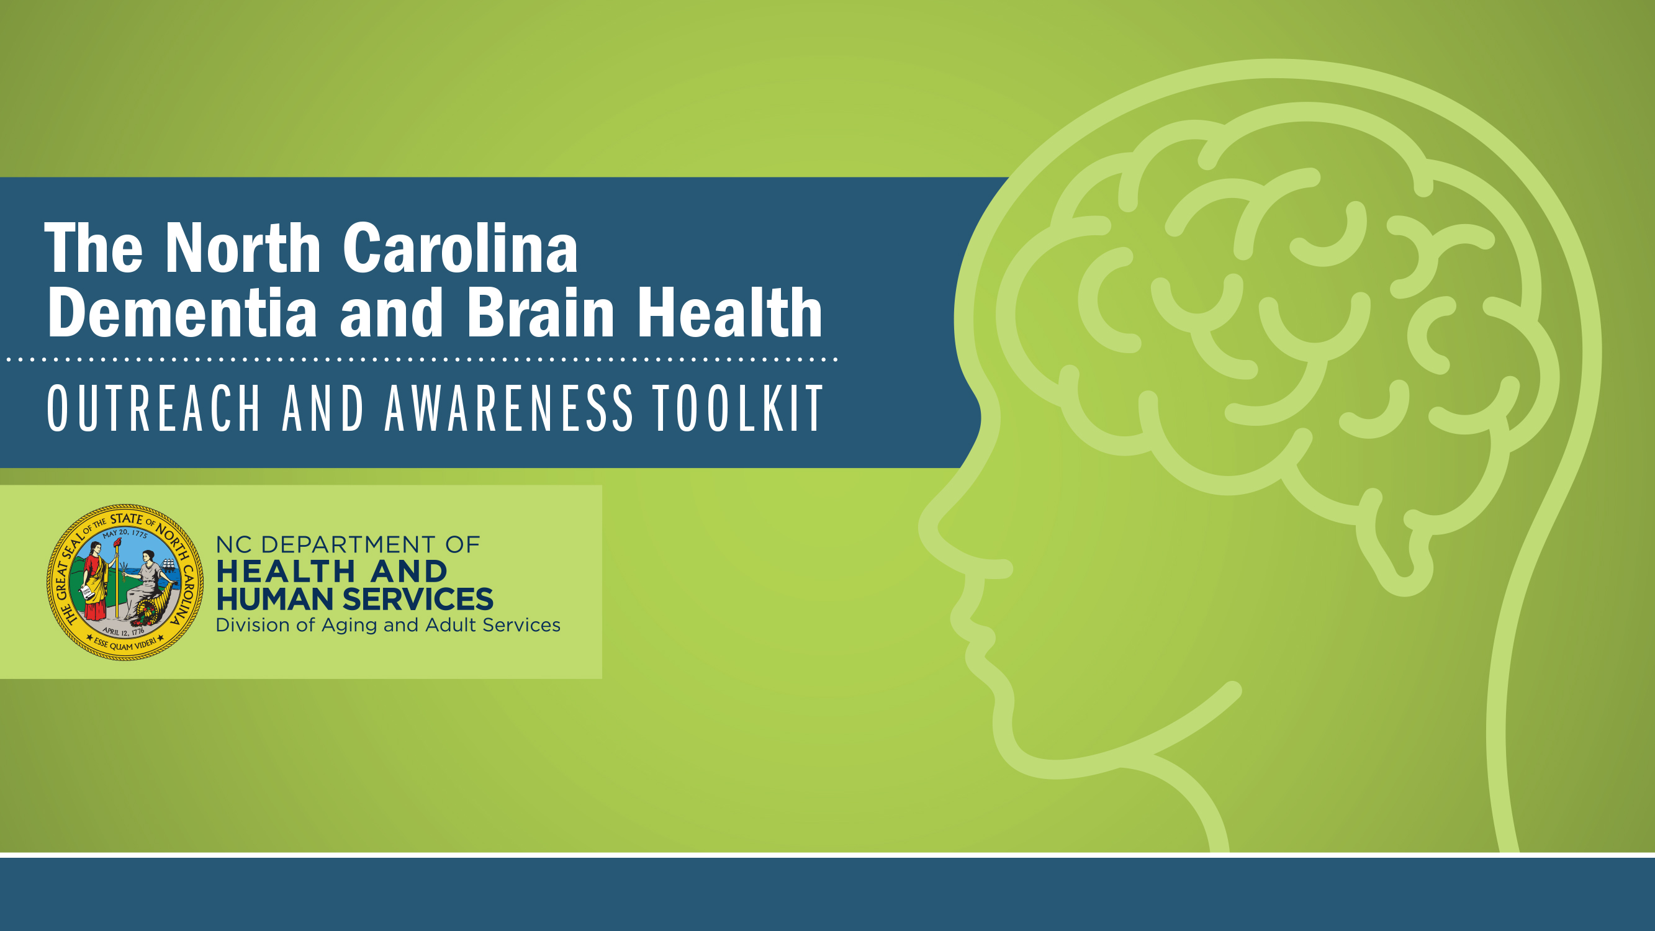

AFRICAN AMERICANS, AGING AND DEMENTIA
North Carolina Building Our Largest
Dementia (NC BOLD) Infrastructure Project

Slide 2
African Americans, aging and Dementia
North Carolina Building Our Largest
Dementia (NC BOLD) Infrastructure Project

Slide 3
Risk of Alzheimer’s disease
African Americans
2x
North Carolina Building Our Largest
Dementia (NC BOLD) Infrastructure Project
Notes:
In the U.S., non-Hispanic African American/Black and Hispanic older adults are disproportionately more likely than White older adults to have Alzheimer’s or other dementias.
African American older adults are about twice as likely to have Alzheimer’s or other dementias as White older adults.
https://www.alz.org/help-support/resources/black-americans-and-alzheimers#:~:text=While%20older%20Black%20Americans%20are,disease%20may%20play%20a%20role.

Slide 4

Among African Americans ages 70 and older, 21.3% are living with Alzheimer‘s
Alz.org, 2023
Diverseelders.org
North Carolina Building Our Largest
Dementia (NC BOLD) Infrastructure Project
Notes:
Again, there is a disproportionate number of Black older adults living with Alzheimer’s disease (AD). African American Elders make up 9% of the elder population, yet make up over 21% of those living with Alzheimer’s disease.
https://diverseelders.org/who-we-are/diverse-elders/black-elders/#:~:text=While%20African%20American%20older%20adults,the%20rate%20for%20all%20elders.

Slide 5

Racial Disparity in Alzheimer’s
African Americans
Health Disparities
STROKE
44% more likely to die from a stroke
OBESITY
23% more likely to be obese
HEART DISEASE
25% more likely to die from heart disease
DIABETES
72% more likely to be diabetic
2X AS LIKELY TO HAVE ALZHEIMER’S
North Carolina Building Our Largest
Dementia (NC BOLD) Infrastructure Project
UsAgainstAlzheimer’s, 2019
Notes:
These health conditions, which disproportionately affect African American/Black individuals, may partially explain the elevated risk of dementia among African American populations. Studies suggest that racial and ethnic differences in dementia risk do not persist in rigorous analyses that account for health and socioeconomic factors. For example, some studies indicate that early life experiences with residential and school segregation can have detrimental effects on the cognitive health of Black Americans in later life.
Resources:
Adkins-Jackson PB, Weuve J. Racially Segregated Schooling and the Cognitive Health of Black Adults in the United States—Why It Matters. JAMA Netw Open. 2021;4(10):e2130448. doi:10.1001/jamanetworkopen.2021.30448
Lamar, M., Lerner, A. J., James, B. D., Yu, L., Glover, C. M., Wilson, R. S., & Barnes, L. L. (2020). Relationship of Early-Life Residence and Educational Experience to Level and Change in Cognitive Functioning: Results of the Minority Aging Research Study. The journals of gerontology. Series B, Psychological sciences and social sciences, 75(7), e81–e92. https://doi.org/10.1093/geronb/gbz031

Slide 6
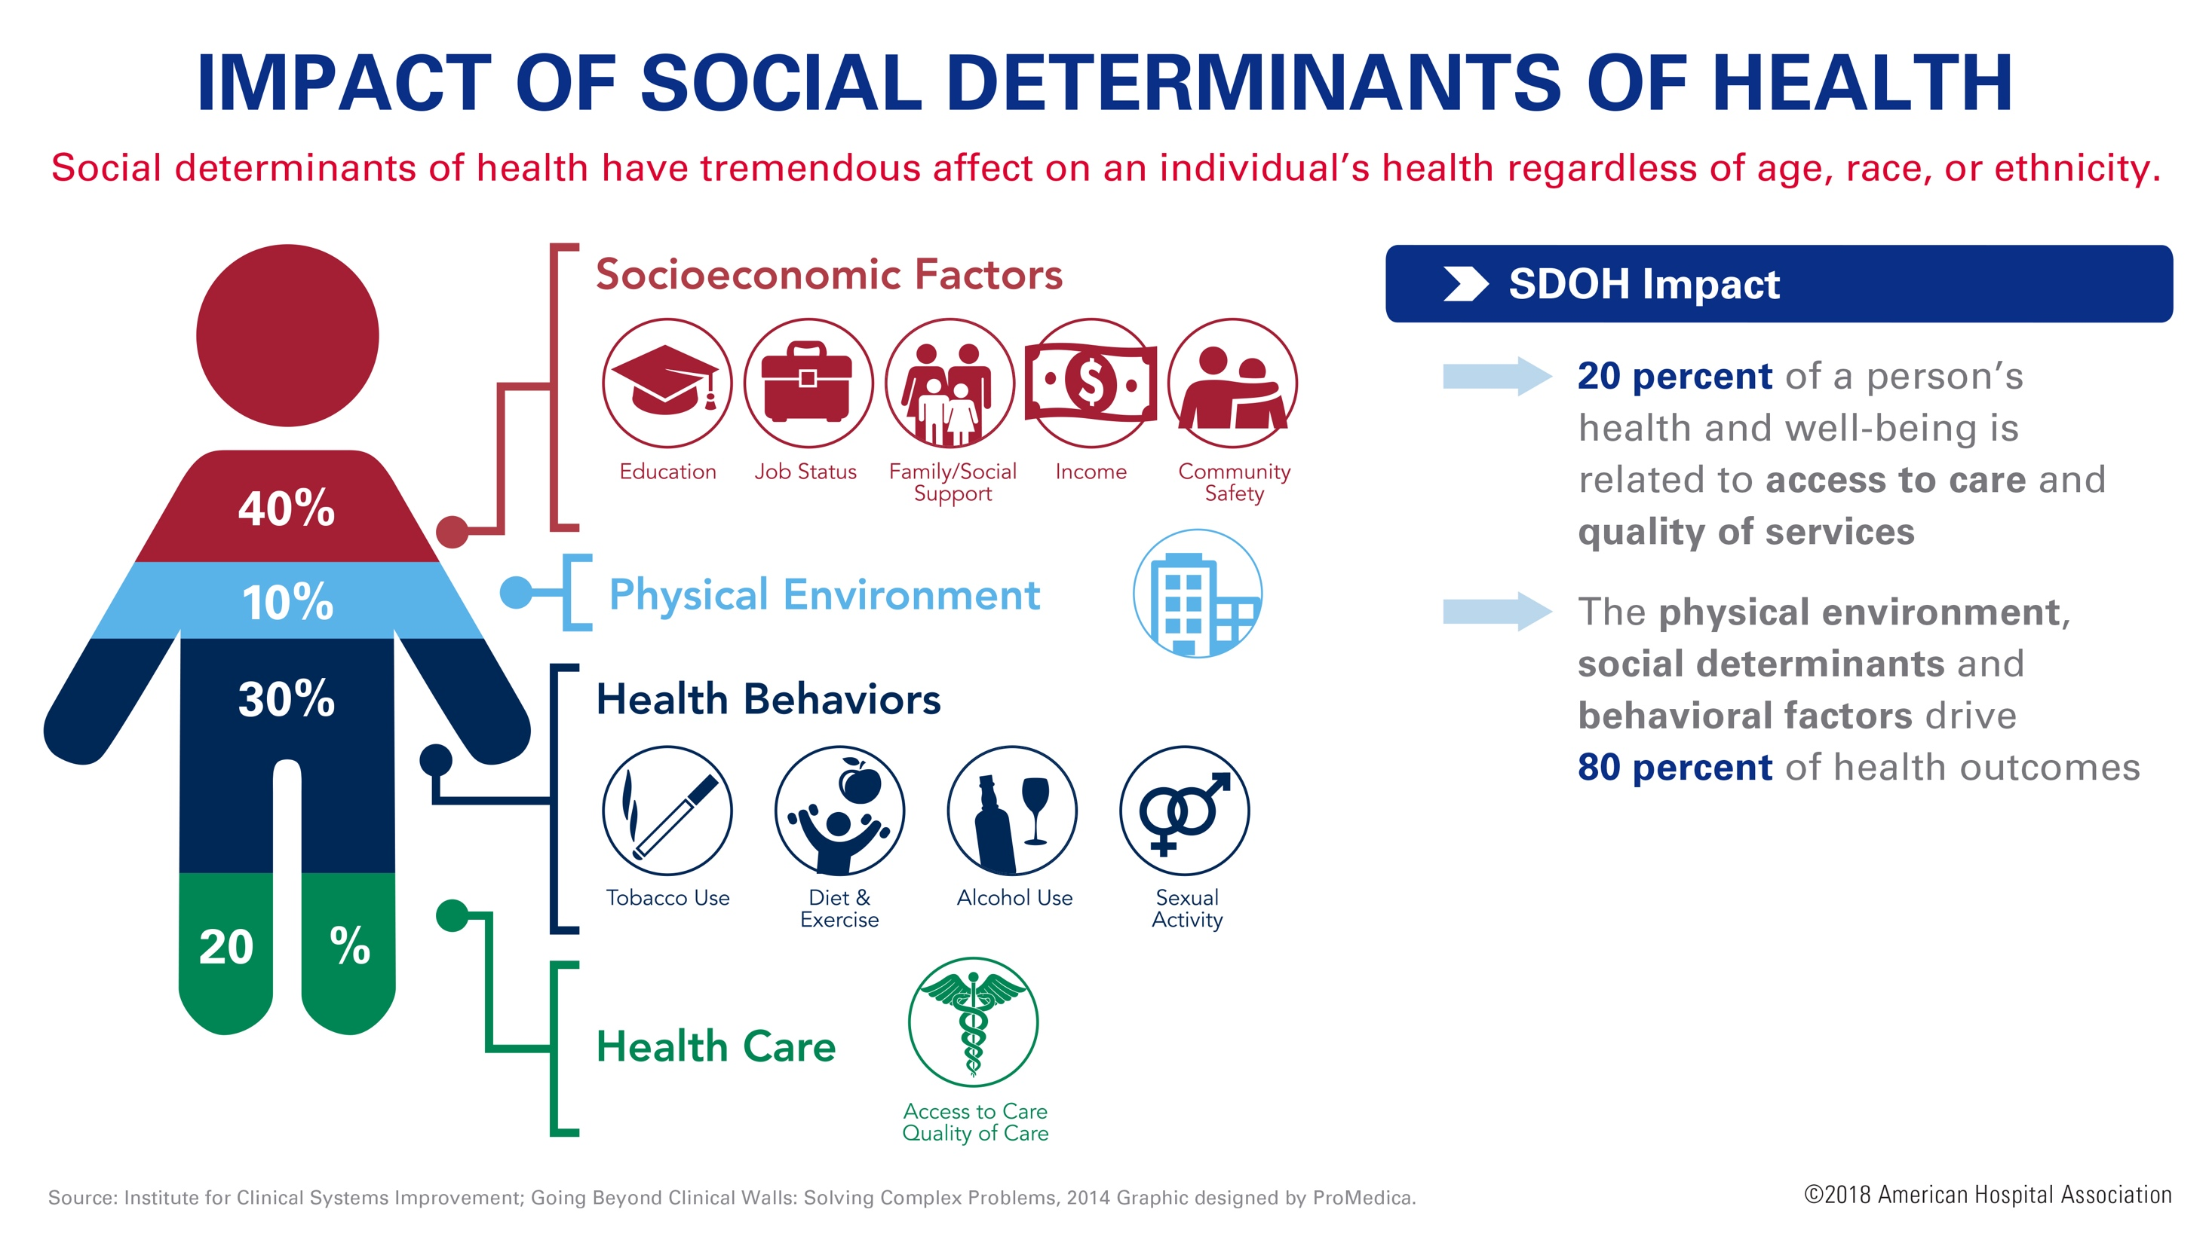
Why the Disparities?
North Carolina Building Our Largest
Dementia (NC BOLD) Infrastructure Project
Notes:
What Are Social Determinants of Health?
Social determinants of health (SDOH) are the nonmedical factors that influence health outcomes. They are the conditions in which people are born, grow, work, live, and age, and the wider set of forces and systems shaping the conditions of daily life. These forces and systems include economic policies and systems, development agendas, social norms, social policies, racism, climate change, and political systems. Centers for Disease Control and Prevention (CDC) has adopted this SDOH definition from the World Health Organization. (Source: https://www.cdc.gov/about/sdoh/index.html)
The conditions in places where people are born, live, learn, work, and play are known as social determinants of health (SDOH). These conditions can have a profound effect on a person’s health, including their risk for Alzheimer’s disease and related dementias.
Differences in SDOH contribute to the stark and persistent chronic disease disparities in the United States among racial, ethnic, and socioeconomic groups by systematically limiting opportunities for members of some groups to be healthy. While public health crises and economic uncertainty may focus attention on disparities, health inequities have persisted across generations because policies and practices have systematically limited access to health care and other opportunities.
A growing body of work exists around social and economic factors that may contribute to a person’s health status, including a person’s risk for dementia. More work needs to be done to determine the exact relationship between these factors and dementia. (Source: https://www.cdc.gov/aging/disparities/social-determinants-alzheimers.html)

Slide 7
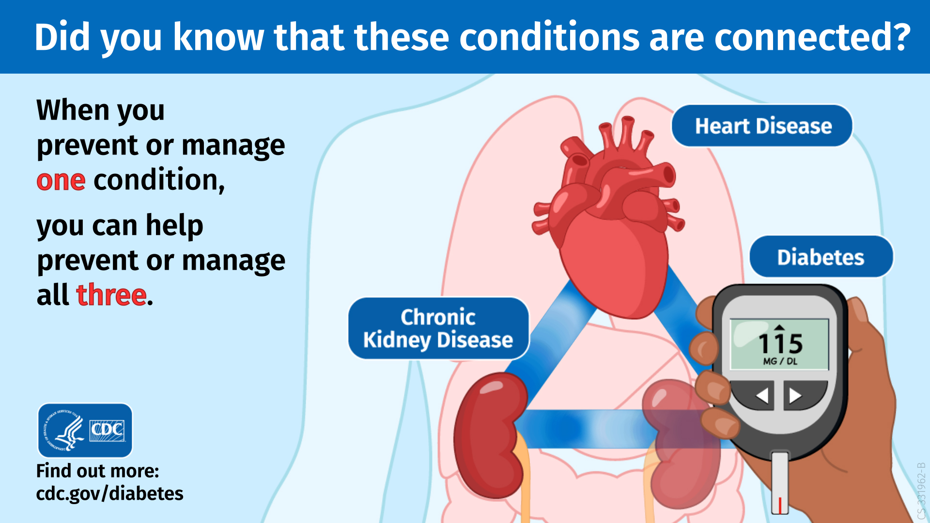
Did you know these diseases are connected?
North Carolina Building Our Largest
Dementia (NC BOLD) Infrastructure Project

Slide 8
HYPERTENSION AND RISK OF DEMENTIA
North Carolina Building Our Largest
Dementia (NC BOLD) Infrastructure Project
https://www.alz.org/media/Documents/alzheimers-hypertension-and-risk-of-dementia-ph-fs.pdf
Notes:
Hypertension affects many Americans, and it disproportionately affects people of color and traditionally underserved communities. • According to the American Heart Association, an estimated 121.5 million adults in the United States have hypertension. • African Americans and American Indian/Alaska Natives are about 30% more likely to have hypertension than Whites. • Black and Hispanic Americans with hypertension are less likely to have their blood pressure controlled than their White peers.
Addressing high blood pressure —. by preventing, delaying, or managing hypertension — may reduce the risk of cognitive decline. • Hypertension is a risk factor not only for stroke and heart disease, but also for cognitive impairment, including vascular dementia. • A recent study demonstrated that the risk of developing mild cognitive impairment (MCI) among older adults can be significantly reduced through intensive blood pressure control. • Additionally, many risk factors for developing hypertension are also risk factors for cognitive decline. These include smoking, diabetes, and obesity.

Slide 9
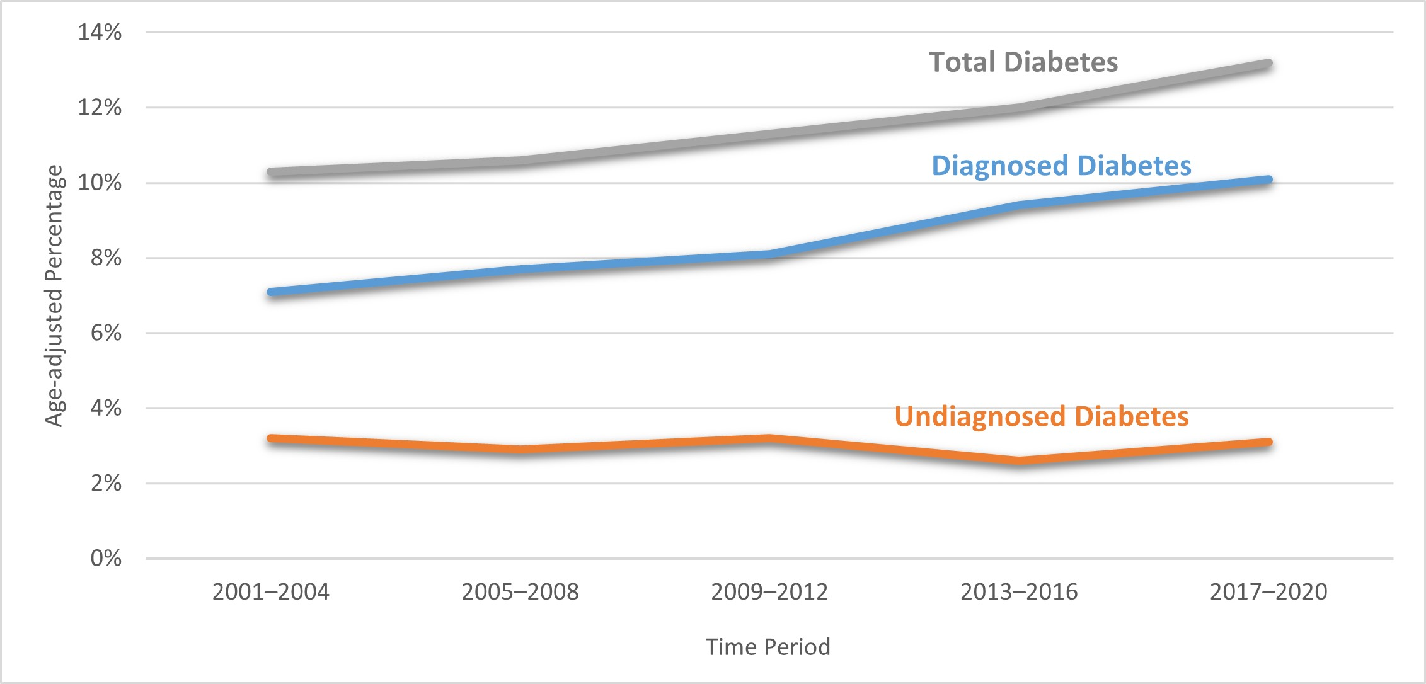
Rates of Diabetes among US Adults Ages >18 years
UNDERSTANDING BLOOD GLUCOSE/DIABETES
North Carolina Building Our Largest
Dementia (NC BOLD) Infrastructure Project
https://www.cdc.gov/diabetes/library/reports/reportcard/national-state-diabetes-trends.html
Notes:
Fix

Slide 10

Diagnosis
When African Americans are diagnosed, it is often in the later stages of disease when more care and hospitalization may be required.
Though African Americans make up over 13% of the population, they bear 33% of the total cost of Alzheimer’s care.
Alzimpact.org, March 2020
Alzheimer’s Association, 2023
North Carolina Building Our Largest
Dementia (NC BOLD) Infrastructure Project
Notes:
Further, when Black Americans are diagnosed with AD, it tends to be at a later stage of the disease.
The more significant amount of care with later diagnosis also results in a heavier financial burden of care.
This emphasizes the need for an early diagnosis so that successful medical intervention will be more likely.

Slide 11
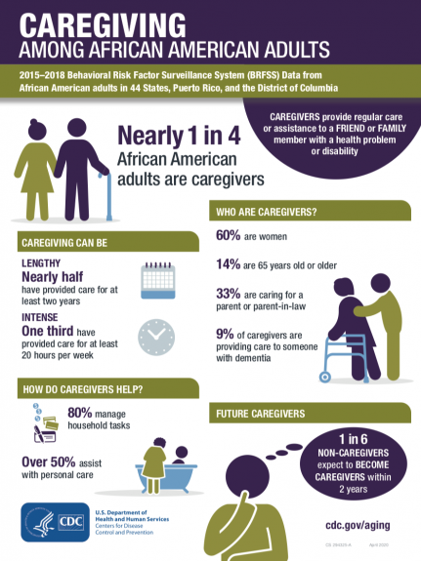
DISPARITIES IN CAREGIVING
North Carolina Building Our Largest
Dementia (NC BOLD) Infrastructure Project
Notes:
Racial disparities in Alzheimer’s disease also extend to caregiving, as well. Recent studies that have examined racial disparities in caregiving have found that as compared to White caregivers, Black caregivers are more likely to provide more than 40 hours of care per week (54.3% versus 38.6%) and are also more likely to care for someone with dementia (31.7% versus 11.9%). Black dementia caregivers were found to be 69% less likely than White caregivers to use respite services. (Alzheimer’s Association Facts and Figures, 2021)
Being aware of local services that are available to support caregivers is important.

Slide 12
African Americans and
Research Participation
African Americans make up
approximately 2.5% of Alzheimer’s disease
and Related Disorders trial participants
Why does this matter?
North Carolina Building Our Largest
Dementia (NC BOLD) Infrastructure Project
Notes:
Shaw, A. R., Perales-Puchalt, J., Moore, T., Weatherspoon, P., Robinson, M., Hill, C. V., & Vidoni, E. D. (2022). Recruitment of Older African Americans in Alzheimer's Disease Clinical Trials Using a Community Education Approach. The journal of prevention of Alzheimer's disease, 9(4), 672–678. https://doi.org/10.14283/jpad.2022.82

Slide 13
RACE OF PARTICIPANTS IN TRIALS FOR ADUCANEMAB AND LECANEMAB
Race | Number | %
American Indian or Alaska Native | 1 | 0.02
Asian | 598 | 11.92
Black or African American | 63 | 1.26
Native Hawaiian or other Pacific Islander | 1 | 0.02
White | 3,855 | 76.82
Not reported due to confidentiality regulations | 422 | 8.41
Other | 78 | 1.55
Total For All Races | 5,018 | 100
North Carolina Building Our Largest
Dementia (NC BOLD) Infrastructure Project
Notes:
Though African Americans are at twice the risk of AD, they made up only 1% of participants in the trials for the newest medications for AD. If the side effects are any different for AAs, it will not be until they are receiving the medication that they will know the consequences. Medications will be distributed to everyone, but have only been tried on a few groups.
Resources:
Budd Haeberlein, S., Aisen, P., Barkhof, F. et al. Two Randomized Phase 3 Studies of Aducanumab in Early Alzheimer’s Disease. J Prev Alzheimers Dis 9, 197–210 (2022);
van Dyck, C. H., Swanson, C. J., Aisen, P., Bateman, R. J., Chen, C., Gee, M., Kanekiyo, M., Li, D., Reyderman, L., Cohen, S., Froelich, L., Katayama, S., Sabbagh, M., Vellas, B., Watson, D., Dhadda, S., Irizarry, M., Kramer, L. D., & Iwatsubo, T. (2023). Lecanemab in Early Alzheimer's Disease. The New England journal of medicine, 388(1), 9–21. https://doi.org/10.1056/NEJMoa2212948; Tampi, R. R., Forester, B. P., & Agronin, M. (2021). Aducanumab: evidence from clinical trial data and controversies. Drugs in context, 10, 2021-7-3. https://doi.org/10.7573/dic.2021-7-3

Slide 14
Without information there is little progress
Without having participation of
African Americans in AD research,
it is unclear to what extent new
medical discoveries will benefit this group that is at higher risk for ad
North Carolina Building Our Largest
Dementia (NC BOLD) Infrastructure Project

Slide 15


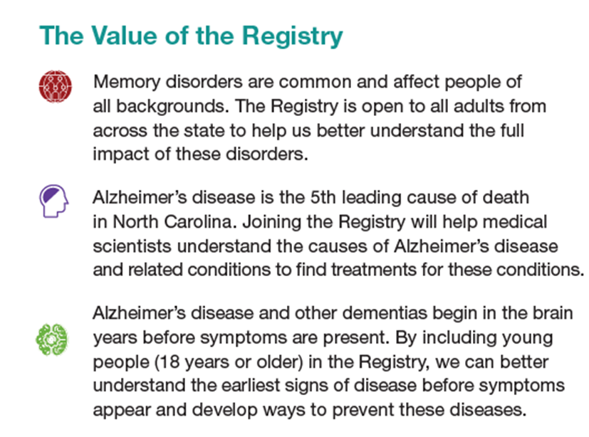


North Carolina Building Our Largest
Dementia (NC BOLD) Infrastructure Project
Notes:
The NC Registry for Brain Health provides an opportunity for adults age 18 and over to learn about an potentially join brain health research. By signing up, participants will be alerted when they are eligible for a research study, and will have the opportunity to join. Not all research involves taking a medication. Connect with the registry to learn more.

Slide 16

Thoughts and Questions?
North Carolina Building Our Largest
Dementia (NC BOLD) Infrastructure Project

