Slide 1
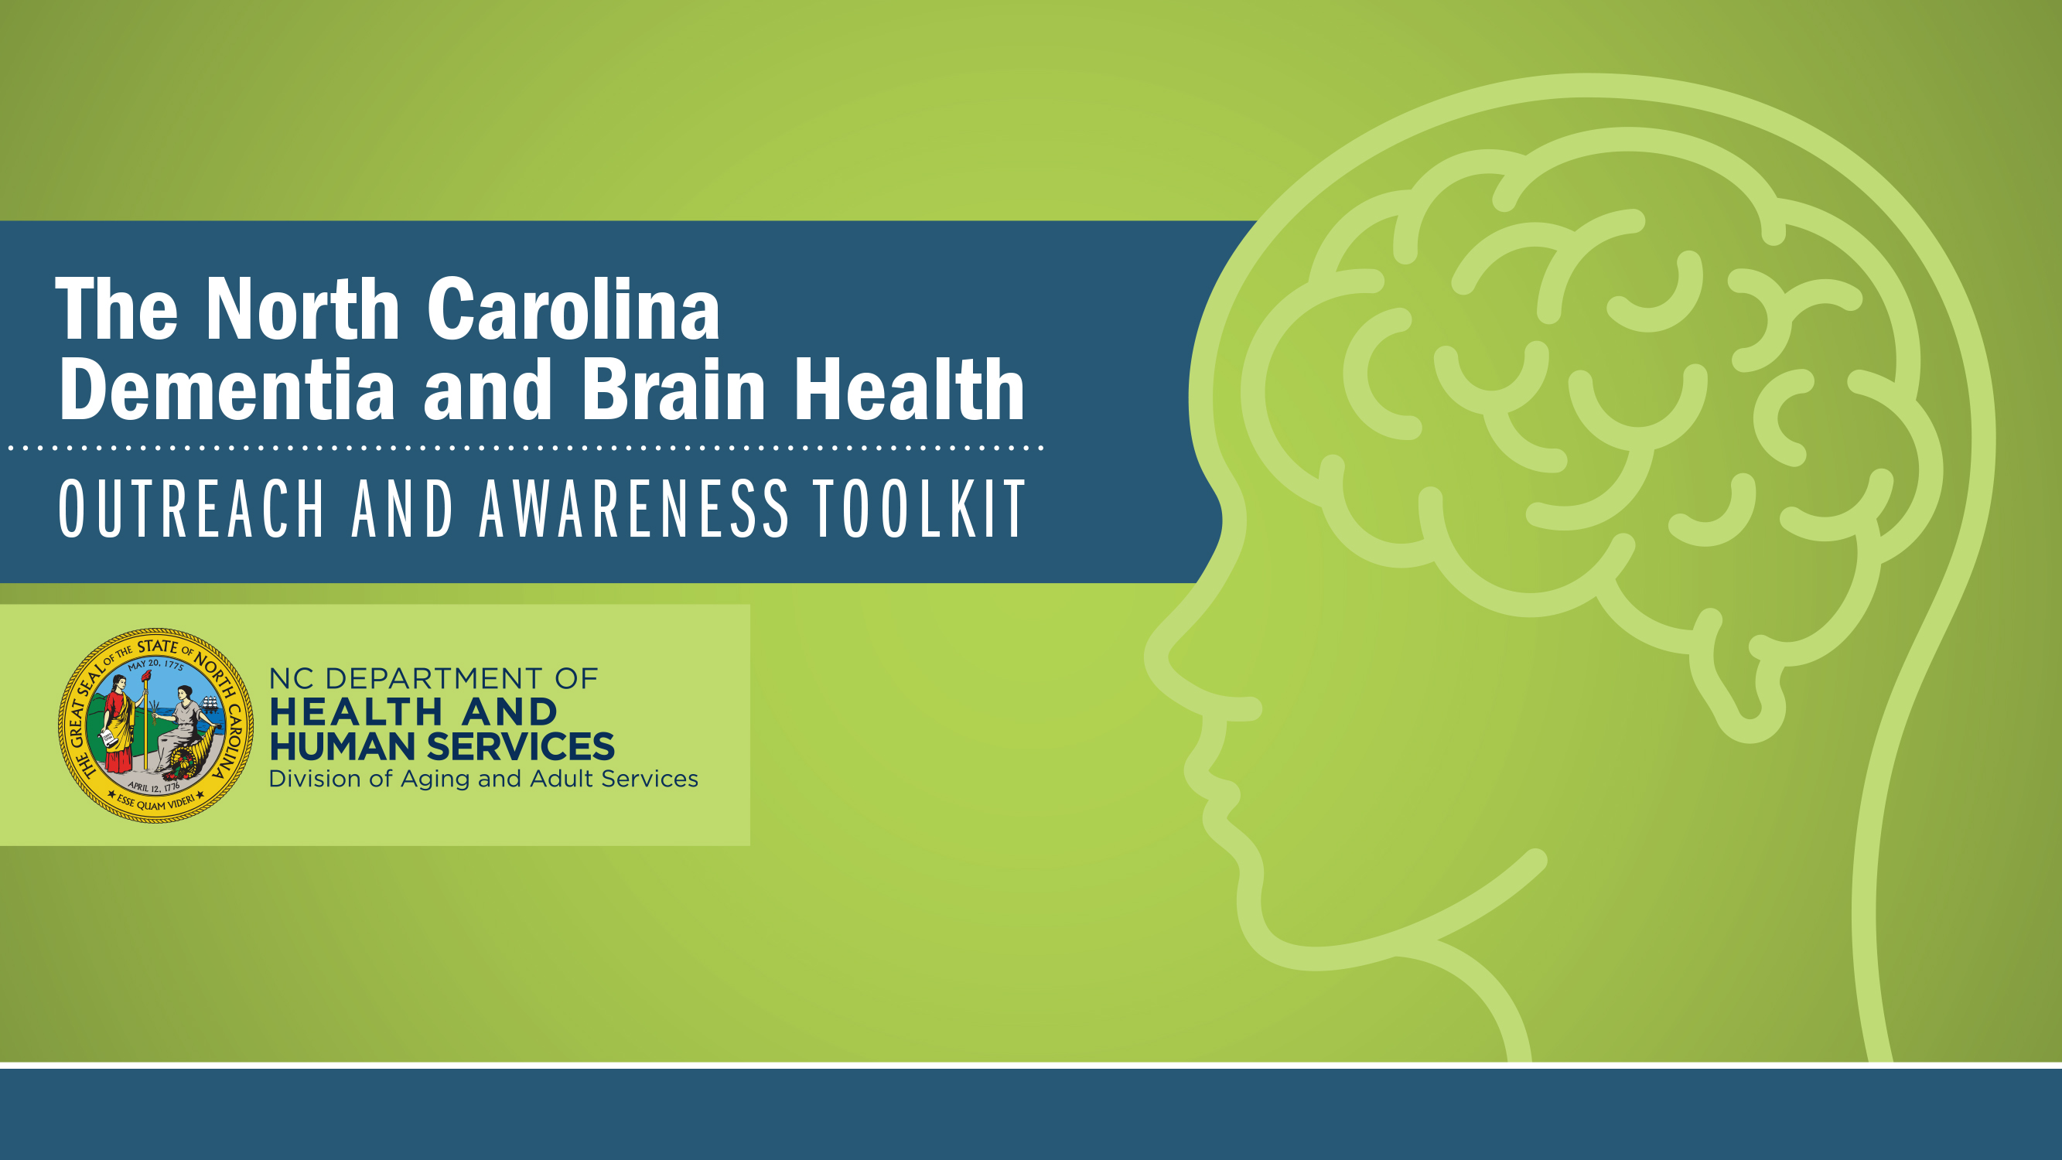

ALZHEIMER'S AND DEMENTIA
North Carolina Building Our Largest
Dementia (NC BOLD) Infrastructure Project

Slide 2
Alzheimer's and Dementia
North Carolina Building Our Largest
Dementia (NC BOLD) Infrastructure Project

Slide 3

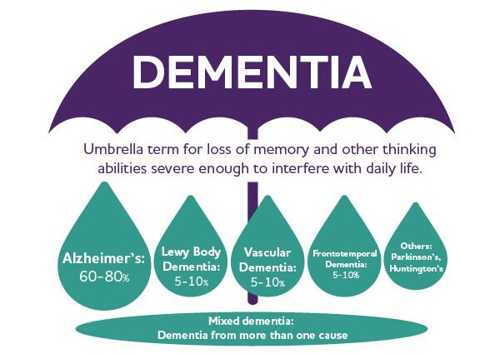
Notes:
Just to make sure we’re all on the same page with some important definitions….our mission references Alzheimer’s AND dementia. Raise your hand if you feel like you know the difference. {call on a participant if possible}
Let me tell you a bit about dementia and Alzheimer’s. Dementia is a general term for loss of memory, language, problem-solving and other thinking abilities that are severe enough to interfere with daily life. Alzheimer's is the most common cause of dementia.
Dementia is not a single disease; it’s an overall term — like heart disease — that covers a wide range of specific medical conditions, including Alzheimer’s disease. Disorders grouped under the general term “dementia” are caused by abnormal brain changes. These changes trigger a decline in thinking skills, also known as cognitive abilities, severe enough to impair daily life and independent function. They also affect behavior, feelings and relationships.
Alzheimer's disease accounts for 60-80% of cases. Vascular dementia, which occurs because of microscopic bleeding and blood vessel blockage in the brain, is the second most common cause of dementia. Those who experience the brain changes of multiple types of dementia simultaneously have mixed dementia. There are many other conditions that can cause symptoms of dementia, including some that are reversible, such as thyroid problems and vitamin deficiencies.
Often dementia will start out slowly and gradually get worse. If you or someone you know is experiencing memory difficulties or other changes in thinking skills, don't ignore them. See a doctor soon to determine the cause. And also get connected to help and support to answer your questions and guide you through this diagnosis.

Slide 4
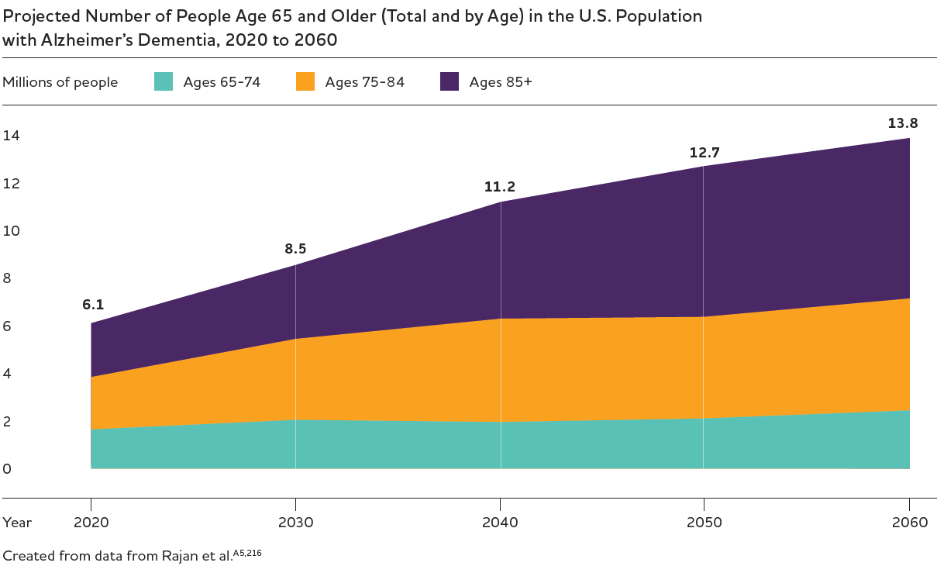
THE NUMBER OF AMERICANS 65+ LIVING WITH ALZHEIMER’S IS EXPECTED TO NEARLY DOUBLE BY 2050.

Slide 5

GENDER AND RACIAL DIFFERENCES IN ALZHEIMER’S PREVALENCE
Almost two-thirds of Americans with Alzheimer’s are women.
Older Blacks/African Americans and Hispanics/Latinos are disproportionately more likely than older whites to have Alzheimer’s or other dementias.

Slide 6

MORTALITY & MORBIDITY
1 in 3 seniors dies with Alzheimer’s or another dementia.

Slide 7
DEATHS DUE TO ALZHEIMER’S ARE MOST LIKELY HIGHER THAN REPORTED
121,499
Americans who
died from Alzheimer’s in 2019
(listed on the death certificate)
700,000
Americans age 65 and older who had Alzheimer’s at death in 2020
CDC Reports
Projections Using Population-based Studies

Slide 8
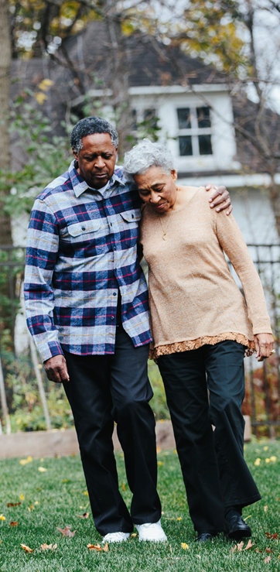
THE PROGRESSION OF ALZHEIMER’S IS SLOW AND BURDENSOME
People age 65+ survive an average of four to eight years after a diagnosis, yet some live as long as 20 years.
Individuals who live from age 70 to age 80 with Alzheimer’s dementia will spend an average of 40% of this time in dementia’s most severe stage.
The long duration of the disease contributes significantly to the public health impact of Alzheimer’s.

Slide 9
Thoughts and Questions?
North Carolina Building Our Largest
Dementia (NC BOLD) Infrastructure Project

