Slide 1
Behavioral Health Supports During a Disaster
Christina Bauman
Disaster Integration Coordinator
August 26, 2021
N.C. Department of Health and Human Services
Division of Mental Health, Developmental Disabilities and Substance Abuse Services

Slide 2
Primary Focus
Increase behavioral health supports during disasters
  People with significant behavioral health needs disproportionately represented seek emergency sheltering
  A disaster can have traumatic effects on everyone
  Shelter staff may need support

Slide 3
Behavioral Health Providers in Shelters
State resource request
DMHDDSAS coordinate with the local LME/MCOs to find suitable providers who are willing and able to deploy
  Started working with the Prepaid Health Plans (PHPs)
Shelter resident needs:
  Behavior
  Mental health
  Personal Assistance Services

Slide 4
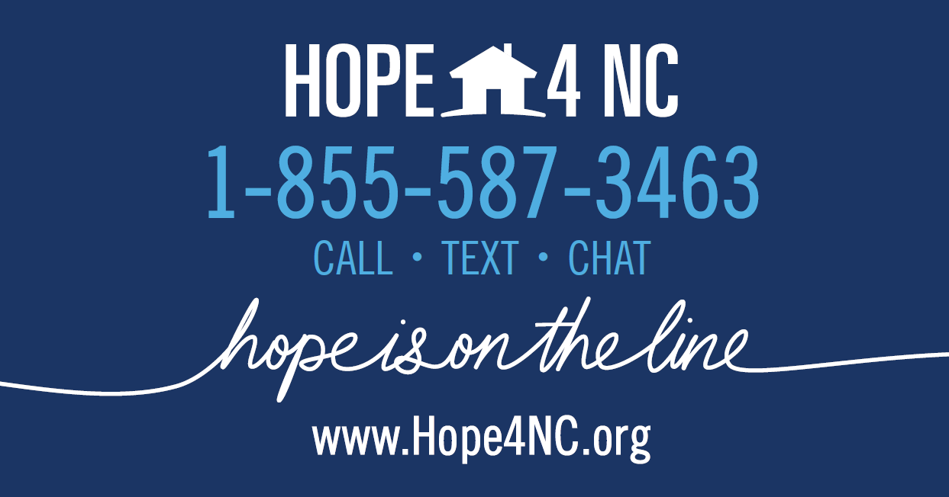
Hope4NC: Crisis Counseling Program
Resource for all North Carolinians
Support via call/text/chat, option for referral to local LME/MCO CCP staff for one or more counseling sessions
May link uninsured or underinsured to local LME/MCO for other services
CCP is ending October 18, but the number will remain active
    REAL Intervention, Inc. Call Center assists with an array of crisis calls

Slide 5
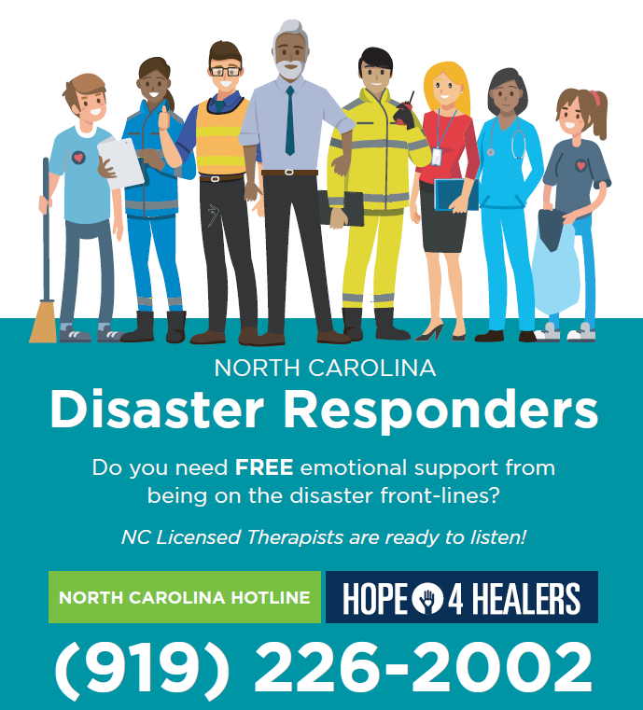
Hope4Healers
Support for Shelter Staff and other Disaster Responders
  Stress
  Secondary Traumatic Stress
  Compassion Fatigue
Call 24/7
Speak with REAL Crisis Intervention Inc. Call Center
Optional referral to NC Licensed Therapists ASAP within 24 hours

Slide 6

NC Functional Assessment Support Teams (FAST)
Trained, deployable teams, available upon request, to work in Disaster Service Centers
Assist with assessments and recommendations to meet the needs of people with access and functional needs
Mission:
  Retention of independence and self-determination
  Reduce impact on medical support and shelter staff services
  Individuals receive needed services & equipment
People with Access and Functional Needs
People with Disabilities

Slide 7

NC FAST
2-hour informational presentation: can request
8-hour training to become a FAST member (offered quarterly)
  ICS courses
  Red Cross courses
Next FAST class – Sept. 9, 8:30 am – 4:00 pm (SEOC)
  Register on NC TERMS
For more information, contact Cheri Dean, NCEM Disability Integration Coordinator at Cheri.Dean@ncdps.gov

Slide 8
THANK YOU!
Contact Information
Christina Bauman
Disaster Integration Coordinator
DMHDDSAS
Christina.Bauman@dhhs.nc.gov
Mobile 984-302-0122

