Slide 1
Non-congregate Sheltering
Sandra Bridges
Human Services Branch Manager
North Carolina Emergency Management

Slide 2
Tiered Approach to Sheltering for Large-scale Evacuations
County plans
Non-congregate shelters
CRES shelters
State-coordinated Shelter

Slide 3
What’s the process for evacuees?

Slide 4
Introducing: Reception Centers
Purpose
Assign evacuees to non-congregate shelters
Screening
Location
Multiple sites
Out of risk area
Along evacuation routes

Slide 5
Reception Center Process: Self Evacuees
NCS
Reception Center
CRES
CRES Shelter
SCS

Slide 6
Reception Center Process: County Transported (Early Evacuation)
NCS
*
County Transported
CRES
CRES Shelter
* Evacuees screened before getting on the bus
SCS

Slide 7
Reception Center Process: County Transported (Late Evacuation)
NCS
Reception Center
County Transported
CRES
CRES Shelter
SCS

Slide 8
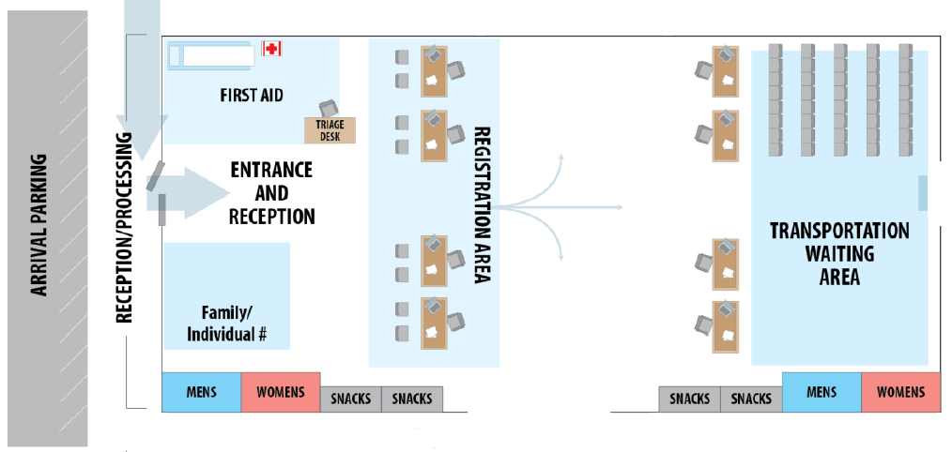
Sample Reception Center Layout
Waiting
Area
SCREENING
Waiting Area
Waiting Area
Waiting Area

Slide 9
Registration Worker
Verifies clients have been through screening and that only one family member has come inside (some exceptions may apply)
Assists clients in filling out registration forms
Verifies client is from an impacted area
Instructs clients to keep registration form until hotel (this is their “ticket” into the hotel)
Directs clients to the Lodging Coordinator

Slide 10
Lodging Coordinator
Determines what types and how many rooms each family needs
How many people are in the family unit?
Do any members of the family require ADA accessible accommodations?
Is the family traveling with pets?
Uses our internal system to view blocked rooms and make room assignment based on needs
Provides clients with hotel information

Slide 11
Hotel Liaison
Verifies evacuees arriving at the hotel are listed in the system and mark them as checked in
Collects registration forms
Directs evacuees to the hotel’s front desk for check-in and room/key assignment
Serves as liaison between hotel and SEOC
Serves as point of contact for food vendors and any other wrap around services that may arrive on site

Slide 12
What if there is no large-scale evacuation?

Slide 13
NCS for Local Events: It’s not easy!
NCS is available for local events, but requires much more engagement from the local jurisdiction.
Kick-off meeting
Local EM, DSS, Human Services, BEOC, and others
Current and projected needs – expect it to grow
Limitations and restrictions for NCS locations
Eligibility
Must be from impacted area
Locals must determine how to verify this

Slide 14
NCS for Local Events: It’s not easy!
Call Center/Entry Process
How will people let you know they need housing?
Single point of entry
WebEOC request for NCS
Must allow 24 hours lead time to secure rooms (some exceptions may apply)
Local jurisdiction will take over on-site NCS functions and wrap-around services after 7 days
Local staff (DSS/EM/Others) will have staff engaged to coordinate with Human Service, BEOC, and American Red Cross
Local staff will be key to MASTT process

Slide 15
MASTT
Multi-agency Shelter Transition Team
Determine needs, identify barriers, and transition to more permanent housing
Variety of partners, including:
State DSS (lead)
Local DSS
Local Housing and Assistance Resources and Programs
State Housing and Assistance Resources and Programs
NCEM Human Services
NCEM Individual Assistance
Begins almost immediately!

Slide 16
Non-Congregate Sheltering: Things to Know
Wrap-around services
On-site Liaison
Feeding
Telemedicine or On-site Health Services
Mental Health (virtual or in person)
Pet support
NCEM Partnership with American Red Cross
NCS is a State-managed program with Red Cross support
Red Cross will staff hotel liaison and some wrap around services for 7 days

Slide 17
Non-Congregate Sheltering: Things to Know
BEOC working with private industry to recruit hotels willing to be part of our NCS program
Currently focused on most commonly impacted areas, but add new hotels when needs arise (Bertie, Haywood, Transylvania)
Not a guaranteed number of hotels
Dependent on vacancies at the time of reservation
NCEM to potentially reserve or hold rooms in advance
FEMA approved through November 30, 2021

Slide 18
Thank you!
For questions or comments, please call or email anytime!
(919) 825-2348
Sandra.bridges@ncdps.gov

