Slide 1


LONG-TERM RECOVERY ORIENTATION
Notes:
TITLE SLIDE: Long-term Recovery Orientation
Welcome participants, affirm their interest in building a robust community long-term recovery group.
Make sure everyone knows where the restrooms are located and where they are to go in the event of an emergency.
Thank the host for the location and any others who have provided support, snacks, printing, etc.
Ask everyone in the room (as time allows) to make a short introduction, including their agency (if affiliated) and their involvement with the community recovery to date.
SAY: National Voluntary Organizations Active in Disaster has a long history in disaster preparation and response.
National VOAD’s MISSION--National Voluntary Organizations Active in Disaster is a nonprofit, nonpartisan, membership-based organization that builds resiliency in communities nationwide. It serves as the forum where organizations share knowledge and resources throughout the disaster cycle — preparation, response, recovery and mitigation — to help disaster survivors and their communities.
Since its founding in 1970, more than 100 member organizations have been guided by the core principles of the 4Cs — cooperation, communication, coordination, and collaboration — National VOAD Members provide the leadership that builds strong communities and delivers hope.
This orientation has been designed to assist communities as they face response and recovery following natural disaster. The concepts within it have been tested over time and experience and surface as National VOAD’s best recommendations for successful community disaster response.

Slide 2
LONG-TERM RECOVERY GROUP (LTRG)
A long term recovery group (LTRG) is a cooperative body that is made up of representatives from faith-based, non-profit, government, business and other organizations working within a community to assist individuals and families as they recover from disaster.
Notes:
TITLE SLIDE: Long-term Recovery Group
SAY: Please look at the definition of a long term recovery group.
A long term recovery group is needed when personal resources, insurance, government grants/loans are insufficient to meet the need of disaster survivors. Long term recovery groups assure that disaster survivors receive assistance from local neighbors, coalesce community members around the response and include as many participants as possible in order to maximize resources and minimize duplication of effort. There are many ways to develop LTRGs; each community is encouraged to put its own special “stamp” on the recovery because each community is unique and each disaster is different. There are many things that a long term recovery group is NOT. It is not the government; it is not the “boss”; it is not a resource for on-going human need. It IS a response to a particular disaster at a particular time in a particular place.
ASK:
What is the experience of people in the room? Have there been LTRGs here in the past? Have those in the room had experience with previous LTRGs?

Slide 3
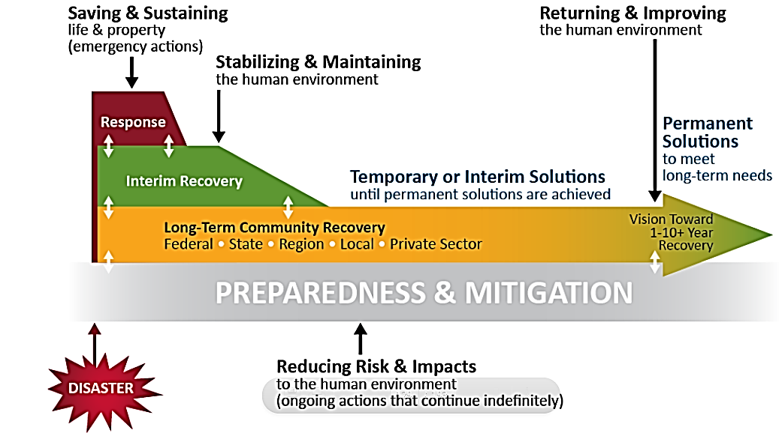
Notes:
Modern Phases of disaster

Slide 4
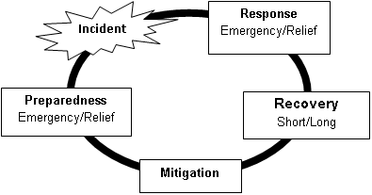
PHASES OF DISASTER
Notes:
TITLE SLIDE: Phases of Disaster
SAY: Every community is in one of these phases right now. Consider what it means to be prepared and whether or not your community… all its people, churches, businesses and government... was prepared for the disaster you’ve experienced. Response is not only about the restoration of structures, systems and services but considers individual’s and families’ ability to rebound from their losses and sustain their physical, social, economic and spiritual well-being. Emergencies, the first part of response, are well understood by emergency managers, professionals in hospitals and law enforcement. Many groups, including National VOAD member groups mentioned earlier, respond during relief, the second part of response, to help “stop the bleeding” and stabilize structures so that more damage does not occur. It is what happens during recovery that can make the difference between stability and despair for homeowners, renters and fragile community members. That’s why you’re here today…to discuss what a community can develop to assure its most vulnerable receive support for recovery. Because National VOAD members believe that a community is only as strong as its weakest members, this overview is designed to help you develop a means to efficiently, strategically and successfully respond to the recovery needs of your community members. Mitigation doesn’t just happen after recovery and before preparation. These phases interlace in ways that mean many are happening simultaneously. Mitigation can lessen the damage residents experience in the future, so mitigation conversations and strategies need to be part of the dialogue before, during and after every recovery.
ASK: Considering these phases, are there “peace-time” responsibilities for long-term recovery groups? After you have completed the recovery for this disaster, what should your LTR be doing to be ready for the next disaster?

Slide 5
Notes:
TITLE SLIDE: Principle of 10s
SAY: There is no magic in this formula that experienced disaster responders have used for many years. The calculations simply help communities estimate how long recovery may take. Many factors affect this calculation, such as economically distressed communities and aging infrastructure. The calculation works like this: if the Rescue lasts 10 days, then Relief would take about 100 days and Recovery about 1000 days…or 3 years. There are many different factors that will affect this principle. If there is an existing Long-Term Recovery Group, or previous experience, this may shorten the time frame exponentially.
ASK: Why does this matter? Why bother to calculate how long recovery will take?
Facilitator note: Help participants to understand that disasters begin with the event and have a (fairly) predictable end. The community will not be in perpetual recovery. The calculation helps assure LTRGs and response organizations that reaching out to help will be manageable, not insurmountable.

Slide 6
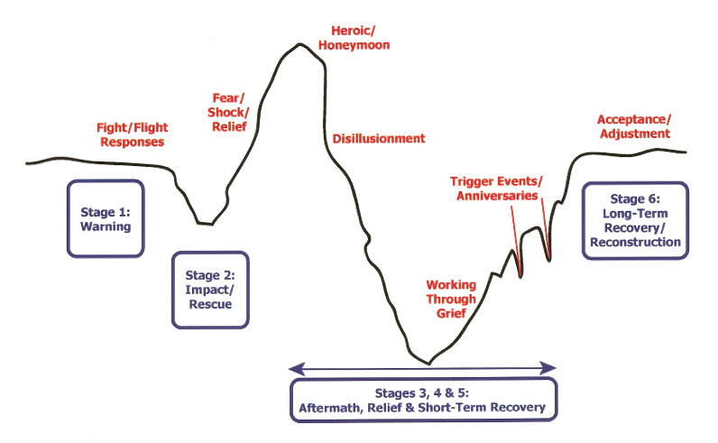
The Emotional Impact of Crises
Notes:
TITLE SLIDE: The Emotional Impact of Crisis
SAY: Individuals, groups within the community and the entire community itself travel this well-worn emotional roller coaster when disasters strike. You may see where you are on the spectrum at this moment, but, understand that the path is specific to each person and each community. We all face shock, fear, relief (and guilt, if not affected). We all believe that we’re going to be all right as a community while the media, FEMA, the American Red Cross and all the early responders are still with us. We all despair when they leave and fear we’ll never be okay again. As we work through the experience, a long-term recovery group—with its trained and caring disaster case managers, its construction experts, its volunteer rebuilders and its gathered resources—can support us from the deep valley of grief (see diagram) to the grace-filled pinnacle of recovery. It truly does take a village!
SAY: Consider the fact that the acceptance/adjustment level is actually a bit higher than when the disaster warning hit.
ASK: Why would a community’s emotional well-being be higher…why would an individual’s…at the end of this roller coaster of emotion?
FACILITATOR NOTE: People and communities who have traveled this path, accompanied by the caring support of disaster case managers and the strength of a well-developed long-term recovery group, are stronger and more resilient, better able to face the next disaster that is coming. And one is coming! It may be death, divorce, illness, financial calamity, but something is coming. If we leave survivors stronger to face the next challenge---with new skills, new coping mechanisms and new strengths—we’ve done our job well and the next natural disaster will find them ready for handling their own recovery.

Slide 7

Types Of Disasters
Undeclared
  Most common type of Disaster
State Declared
  Beyond the local community’s capacity
Federally Declared Disasters and Emergencies
  The Robert T. Stafford Disaster Relief and Emergency Assistance Act (the Stafford Act)
Notes:
TITLE SLIDE: Types of Disasters
SAY: There are many kinds of disasters, ranging from human-caused ones, such as 9/11; to economic ones, an example of which is the financial collapse of 2007; to hurricanes, tornados, ice storms and earthquakes. The most typical long-term recovery develops in preparation and response to natural disasters, where no human responsibility can be assigned or where the causative factors are inadequate to help the community recover (examples are, again, 9/11and the West, Texas, fertilizer plant explosion).
The best and most enduring long-term recovery groups remain ready (though in hibernation between events) to respond to any kind of natural disaster striking the community. State and federal resources will not always be available, but the community—the neighbors—should ALWAYS be ready to embrace the recovery in their own community. Communities should never determine that recovery work only depends on the arrival of outside (state, federal) resources. All disasters are local and most do not receive federal declarations.
Undeclared—Most disasters in the United States do not trigger assistance from state or federal governments. Communities deal with smaller disasters with the help of emergency responders, local community, civic and non-profit organizations gathered into long-term recovery groups, using locally-identified resources.
State declared—When a natural disasters impact exceeds the local community’s capacity for recovery, state governments have an opportunity to respond to the emergency needs of their citizens. To do this, each state works in concert with local governments, voluntary agencies, business/industry and others in the community to develop an all hazards Emergency Operations Plan (EOP). Should the severity of an emergency and/or disaster be at a level that will require a coordination of state, as well as local government resources, the governor of a state can declare a state of emergency, activating the state’s EOP. Once a state of emergency has been declared, the full resources of the state can be accessed in order to respond to the incident.
Federally declared-The Robert T. Stafford Disaster Relief and Emergency Assistance Act, Public Law 93-288, as amended (the Stafford Act) was enacted to support tribal, state, and local governments and their citizens when disasters overwhelm local capacity. This law establishes a process for requesting and obtaining a Presidential disaster declaration, defines the type and scope of assistance available, and sets the conditions for obtaining that assistance.
ASK: What is the community’s responsibility to its most fragile citizens when they are overwhelmed by disaster? Does that responsibility only begin with federally-declared disasters? What do citizens know in advance of disaster about the federal program outlined in the Stafford Act?

Slide 8
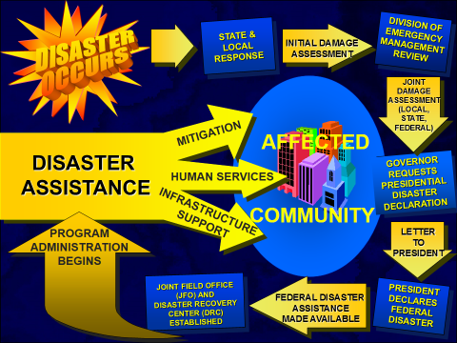
Notes:
Visual illustration of the process for a Federally Declared Disaster. The disaster occurs with response from the local and state. There will be an initial Damage Assessment that will be reviewed by the Division of Emergency Management. Then a Joint Damage Assessment is preformed by the Local, State and Federal. The Governor then requests a Federal Disaster Declaration by a letter to the President. Upon the President’s review, Federal Disaster Assistance program(s) is/are made available. A Joint Field Office (JFO) and a Disaster Recovery Center (DRC) are established and Program Administration Begins. Depending on the Type of Disaster Declaration one or multiple programs may be available.

Slide 9
SEQUENCE OF DISASTER ASSISTANCE
Voluntary Organizations
Insurance
FEMA Programs
Mass Feeding
Homeowners
Renters
Flood
Home Repair
Medical, Dental, Funeral
SBA Programs
Real Property Loans up to $200,000
Personal Property Loans up to $40,000
FEMA Programs
Personal Property
Moving & Storage
Transportation
Voluntary Organizations
Long-term, disaster-related unmet needs
Sheltering
Emergency Assistance
Clean-up/muck-out
Fire
Earthquake
Other
Temporary Housing
Childcare
Notes:
TITLE SLIDE: Sequence of Disaster Assistance
SAY: No one knows better than FEMA that, in any disaster—declared or undeclared—many survivors will not recover completely without additional help. Long-term recovery groups form in order to address those needs that continue after survivors have exhausted their personal and outside resources (including FEMA) and still are unable to complete their recovery.
National VOAD members understand FEMA’s process (one version seen in this slide), which applies to all FEMA registrants. LTRs…and especially disaster case managers...consider this sequence as they partner with survivors towards recovery. The FEMA SoD assures that survivors will maximize resources and minimize duplications so that donated dollars stretch as far as possible.
If survivors have moved through the sequence, addressing their own resources and other resources available to them, those recovery needs that remain are the focus of their recovery plans. Unmet needs do not have a dollar sign attached to them; one survivor may only need a refrigerator, another may need counseling for troubled children, a third may need advocacy with a lender, another may lack the means to replace a broken home. Long-term recovery groups, through the disaster case management system, help survivors determine where additional resources can be found, assure that resources are not being duplicated, and establish an unmet needs process, where funders can confidently bring donated resources, to complete recovery.

Slide 10
BASIC COMPONENT INFORMATION AND RELATIONSHIPS
Notes:
TITLE SLIDE: Recovery Management
SAY: Each community long-term recovery group has the opportunity to be exactly what it wants to be. There will be lots of opinions and suggestions about how your organization should form, but be assured that you are in complete control of your mission and process…as long as you assure that you will work ethically, honestly and with respect for your community.
Nevertheless, National VOAD organizations have been involved in long-term recovery formation for decades and have the following suggestions:
Some or all of the following committees can expedite recovery: communications, education, spiritual and emotional care, resources, volunteer management, donations, construction and disaster case management.
Development of each of these functions is more fully explained in the National VOAD Long-term Recovery Manual at nvoad.org. Member organizations have experience in these functions and will support you as you develop. Please refer to the matrix of member organizations and contact provided to you during today’s workshop.
This circle rightly implies that the functions are interconnected; what it does not demonstrate is how the a client is guided throught the vaious functions with the strong support of a disaster case manager, who continues to be the client’s single point of contact, even after construction and volunteers are assigned.
In order to support the functions on this slide, long-term recovery groups will need to consider where fiscal management will reside (an existing 501(c)3 perhaps?), as well as whether adminstrative support and data management will be needed.

Slide 11

TYPES of Long-term Recovery Groups
LTRC
LTRO
Interfaith
Everything in between
Notes:
TITLE SLIDE: Types of Long-term Recovery Groups
SAY: The distinctions between types of groups matter less than the important work of community members and agencies offering their time and talents to collaborate after a disaster on behalf of those vulnerable neighbors who will need additional support in order to recovery. The best long-term recovery groups are the ones that have representation from every sector—faith, civic, government, business, industry. The people who care about what their community looks like and feels like after having experienced a devastating disaster are those who should be involved. This is the one time that bigger IS better, the more the merrier, a big tent. The LTR should look like the community, with representation from cultures present, including age and functional needs. Since the government does not typically fund (after FEMA has completed its work) recovery, success depends on every good effort from every existing corner of the community. Coordination is critical I n order to “first, do no harm.”
The following is how the National VOAD Long-term Recovery Manual defines the various possibilities.
LTRO: An organization, operating under the auspices of another agency or independently, that works to address the needs of the community and individuals following a disaster. May be entirely faith-based or may be a collaboration of faith-based and secular agencies.
LTRC: A committee of agency representatives who cooperate in addressing the needs of the community and individuals following a disaster. Usually involves a variety of community, government and faith-based organizations.
Interfaith: Local congregations and worshipping communities working together for long-term recovery.
It may be as simple as developing memoranda of understanding, so services can be coordinated.
Regardless of what organizational structure is formed, the most important consideration is whether this structure will function in your community, in your disaster, to enable individuals and families to gain assistance in a timely fashion.
ASK: What approach will work best in your community? What are the obstacles? If efforts are already underway, have they been inclusive of all faith and non-profit entities? Will government be present in a supporting/coordinating role?

Slide 12
ELEMENTS OF ORGANIZING
  Engaging stakeholders
  Assess Need
  Mission statement
  Organizational documents
  Identification of resources
  Financial Management
Notes:
TITLE SLIDE: Elements of Organizing
SAY:
It is important to ensure that a local long term recovery group includes people from all sectors of the community. Leaders often surface from the faith, non-profit and business communities. As the group forms, it’s important to look around the room and make sure that cultural diversity has been considered, that community leaders and experienced networkers, as well as those who have social service experience and experience advocating for vulnerable populations have brought their focus and compassion into the mix.
Assess Need: What needs to be done? Cleanup only or rebuilding, casework, resources?
Mission statements explain why a group exists. Long term recovery groups often have similar purposes, but your group should consider if there are things that are unique to your work. There are examples in the National VOAD Long Term Recovery Guide.
Organizational documents identify the administrative structure. It is important to remember your mission and your community as these are being developed, but don’t make this a point of contention that does not allow assistance and progress in the long term recovery group. Most importantly, various sub-committees will need to begin to develop the documents to assist in their work. National VOAD partner agencies have VAST amounts of templates to assist.
What resources are in the long term recovery group and community? Resources can be monetary, but include office and warehouse space, communication avenues, volunteers or labor force. Remember money, material, and muscle and, of course, management. Do a bit of asset mapping and remember that EVERYONE in the community is a potential resource. As you focus your attention on the sizeable donors and the national resources, remember that the local restaurant owner has vouchers for meals for volunteers and the small businesses can donate services or products. Even disaster survivors should be considered for what they can bring to their own and others’ recoveries, as well.
Your LTRG will operate as a not-for-profit entity. You will be handling money entrusted to you by individuals, foundations and/or other organizations. The LTRG may seek out an existing not-for-profit agency within the community to serve as its fiscal agent. More valuable information is available in the National VOAD Long Term Recovery Guide

Slide 13
ADMINISTRATION
DOING THE WORK
Administration Business
Policies / Guidelines
Management Structure
Financial Accountability
Unmet Needs Process
Budget and Fundraising
Notes:
TITLE SLIDE: Administration Business
In order to develop a long term recovery that will be trusted and sustainable into the future, some consideration of policies and guidelines will provide directions on priorities, eligibility and services. Try not to be too restrictive since flexibility is the name of the game in long term recovery. When you set off in one direction, determining what services you are able to assist with and for how long, you may find that your hard work has generated sufficient resources to expand your services.
Long term recovery groups may have paid staff, though many use the donated services of community leaders. In the event your long-term recovery employs staff, human resource policies should be in place, along with a management structure.
Long term recovery groups will benefit from the combined resources of numerous donors, however funds that are generated and dispersed by the long term recovery are usually necessary for a community to supplement the unmet needs of survivors. The careful and confidential
While the disaster is still fresh in the minds of a community, plan for fund-raising. The sooner after an event, the easier it is to ask for and receive donations. Determine the staffing needs and the funding needed, as well as indirect costs, such as computers, office space, phones and internet needs.
Special attention needs to be given to the development of the unmet needs or funding table. When confidentiality issues, protocol and process are established, funders will be reassured and disaster case managers will also be confident.

Slide 14

NEED A BRIDGE
How to build capacity?
Mentoring
Web based learning
Reviewing the Long Term Recovery Guide
Train the Trainer
State VAL and State VOAD Training
FEMA VAL Recovery Training- (Informational Overviews)
How to request more in-depth training?
MENU OF OPTIONS

Slide 15
NATIONAL PARTNERS
Organizational Development
  Church World Service
    Community Arise
    Recorded Webinars
  Lutheran Disaster Response
  National VOAD
  Presbyterian Disaster Assistance
  State VOAD
  World Renew
Organizational Development

Slide 16
Case Management
  United Methodist Committee on Relief (Training)
  Catholic Charities
  American Red Cross
  Saint Vincent DePaul
  Lutheran Disaster Response
  ICNA
Community Needs Assessment
  World Renew
Construction Management
  Lutheran Disaster Response
Disaster
Case Management
Community Needs Assessment
Construction Management

Slide 17
Long Term Rebuilding Teams
  NVOAD Member Agencies
Volunteer Management/Hosting
  Presbyterian Disaster Assistance
  Lutheran Disaster Response
Warehouse/Donations Management
  Adventist Community Service
Emotional Spiritual Care
  Presbyterian Disaster Assistance
    Light Our Way
Emotional Spiritual Care
Warehousing and Donations Management
Volunteer Management and Hosting
Long Term Rebuilding Teams
Notes:
UMCOR, PDA, LDR, BDM, MDS, ICNA, SP,
(Money, Muscle, Materials and Training)

Slide 18

NEXT STEPS
  Process to Schedule a Recovery Tools Workshop
    Type of Training Team
    Locations/Logistics to conduct training
    Publications/Printed Materials
    Flyer distribution
    Registration process for participants
Notes:
General Discussion; Overview of topics discussed. Highlight/notate best practices and lessons learned from participants experience.
Open for questions on topics discussed
Questions on requesting RTW
Closing remarks

Slide 19
Recovery Tools Orientation and Workshop
State VOAD, FEMA VAL
Request for an Orientation or a RTW starts here. One point of contact to NVOAD Office
NVOAD Office contacts LTRG Committee (Taskforce /Subcommittee Chair) with request (info/details)
NVOAD Office
Taskforce / Subcommittee Chair?
LDR, UMCOR, WR, PDA
LTRG Committee Taskforce/Subcommittee Chair contacts member organization(s) that are “on the ground” (or can be) in the requested area
LTRG Committee (Taskforce/Subcommittee Chair) investigates FEMA IT or other funding source(s)
?
?
?
?
Boots on the Ground
Standardized LTR Orientation and RTW in development
Orientation or Workshop Presented

Slide 20






Your Community
Your
Piece
Have a Great Day

Slide 21
QUESTIONS????
George Strunk, LTRG Committee Chair
North Carolina Voluntary Organizations Active in Disaster
PO Box 10636
Goldsboro, NC 27532-0636
919-778-8324 ncvoad.ltrg@gmail.com
WWW.ncvoad.org

