Slide 1
Americans with Disabilities Act
Auxiliary Aids and Services for Effective Communication
Lee M. Williamson
Division of Services for the Deaf and Hard of Hearing
January 27, 2021

Slide 2
Special Thanks
NC Department of Health and Human Services
Division of Social Services
NC County Departments of Social Services

Slide 3
Learn about services offered by DSDHH
Understand obligations under Title II of the ADA
Recognize Individuals with Hearing Loss.
Discuss communication techniques that can be used between hearing individuals and individuals with hearing loss for best outcomes.
Learn about the auxiliary aids and services that can eliminate barriers frequently encountered by Deaf, Hard of Hearing, Late Deafened, or DeafBlind people.
Training Objectives
Notes:
Know that most hard of hearing people are not good at self advocating for their communication needs. Be proactive

Slide 4




Communicate
Collaborate
Connect

Slide 5
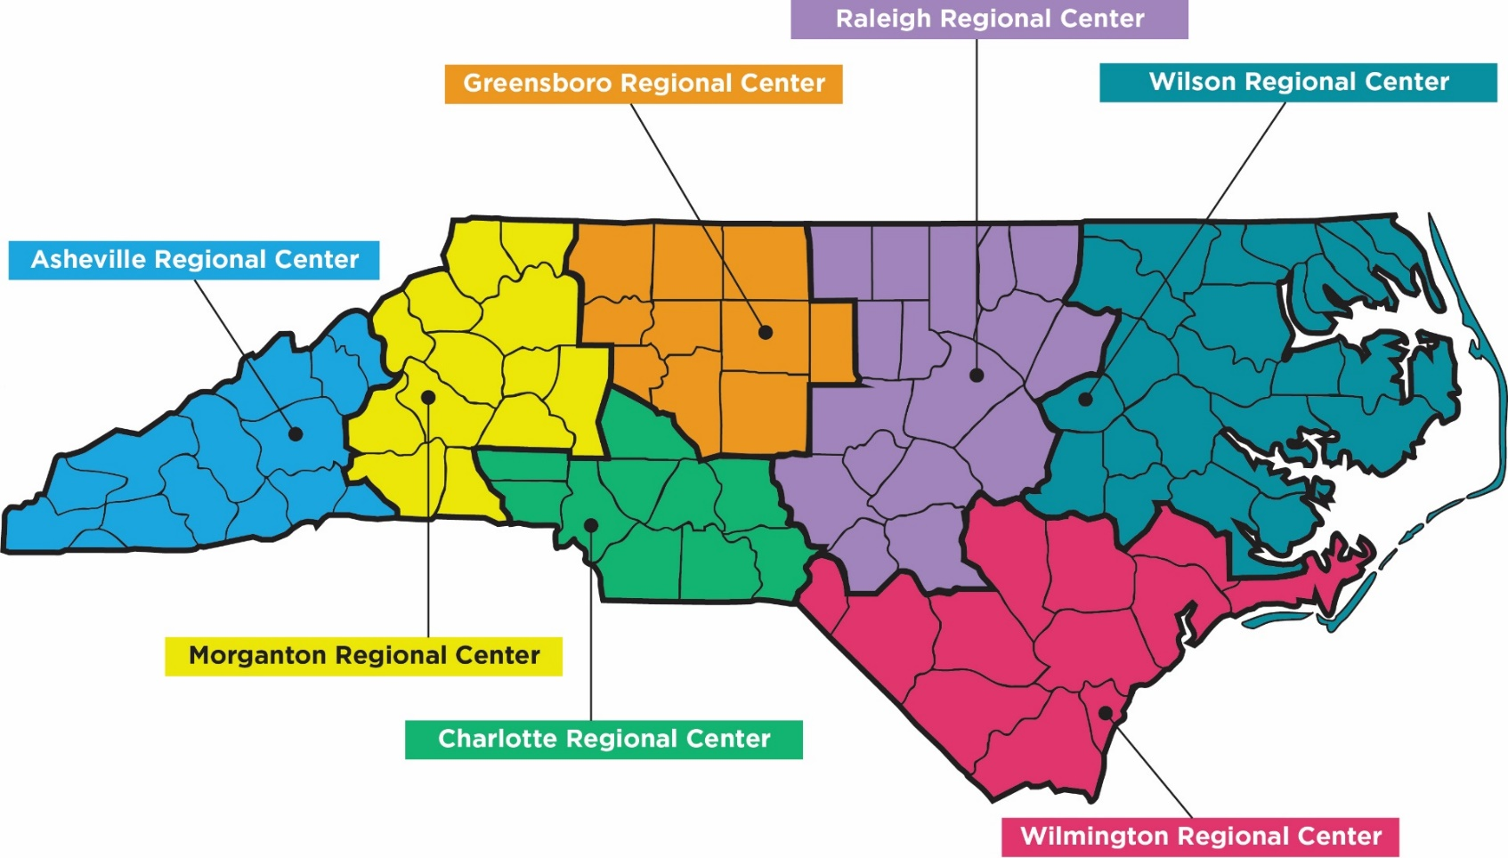
Where Are We?

Slide 6
Regional Center Staff
Regional Manager
Community Accessibility Specialist
Deaf Services Specialist
Hard of Hearing Services Specialist
Interpreting Services Specialist
Telecommunications Consultant
Deaf-Blind Services Specialist (Raleigh and
Greensboro)

Slide 7
DSDHH Regional Centers
What do we do?
Advocacy
Consultation
Education
Information and Referral
Outreach
Equipment Distribution

Slide 8
Division of Services for the Deaf and Hard of Hearing
Our Services:
  Deaf Support
  Deaf Blind Support
  Hard of Hearing Support
  Interpreting Support
  Communication Support
  Equipment Distribution
  Emergency Preparedness
  Relay Services
We Provide:
  Advocacy
  Consultation
  Information/Referrals
  Technical Assistance
  Communication Access
  Outreach
  Assistive Devices
  Resource Library

Slide 9
Why DSDHH?
Two Major Barriers:
  Many Deaf, Hard of Hearing, and DeafBlind people
    Do not know how to advocate for themselves
    Do not know where to find support and resources
    Do not have the technology to communicate
  Health care and other service providers (social services, public health, etc.), law enforcement, judiciary, and businesses
    Do not know their legal obligations and/or how to make sure D/HH/DB people have the same access to their services and resources as the general population

Slide 10
Demographics
Total number of people with hearing loss:
  Statewide:
    Over one million people
    Expected to increase 35 percent by 2030
  Stanly County:
    8,198 (17.12 percent)
Source: N.C. Office of State Budget and Management (2015 county population by age) and National Health Interview Survey (average of U.S. population age-adjusted percentages of population with hearing loss)
Notes:
Number of people with hearing loss age 18 and above – this apply to all type of hearing loss (mild to profound deaf)
Percent for general population with hearing loss varies for each county – need to check and change as needed
Change name of county and numbers – check the chart for info
This number will increase due to aging population, environmental, medical
NC popular for retired people
Baby boomers
Veterans
others

Slide 11


DSDHH: What We Do and Why?
Technology: Equipment and Services
Relay NC & CapTel NC
Equipment Distribution Service
  smart phones and tablets
National DeafBlind Equipment Distribution Program

Slide 12
Equipment Distribution Program
State funded
Application process
Information sessions
Supporting documents
Free of Charge
Notes:
Lipreading not an effective communication method, as Julia stated. Ex Sookie vs. Scooby
Environment: right lighting, quiet area if possible
Writing back and forth – use resources you already have, your cell phone, pen and paper, white board. Also, if you have to write back and forth keep it simple as possible
Get the person’s attention first
Face the person
Do not speak with objects in mouth
Speak clearly
Don’t shout
Use facial expressions and gestures
Never say, “Never mind”
Rephrase
Be patient
Talk to, not about
Provide breaks when needed
Write important information
Ask the HOH person the best mode of communicating

Slide 13
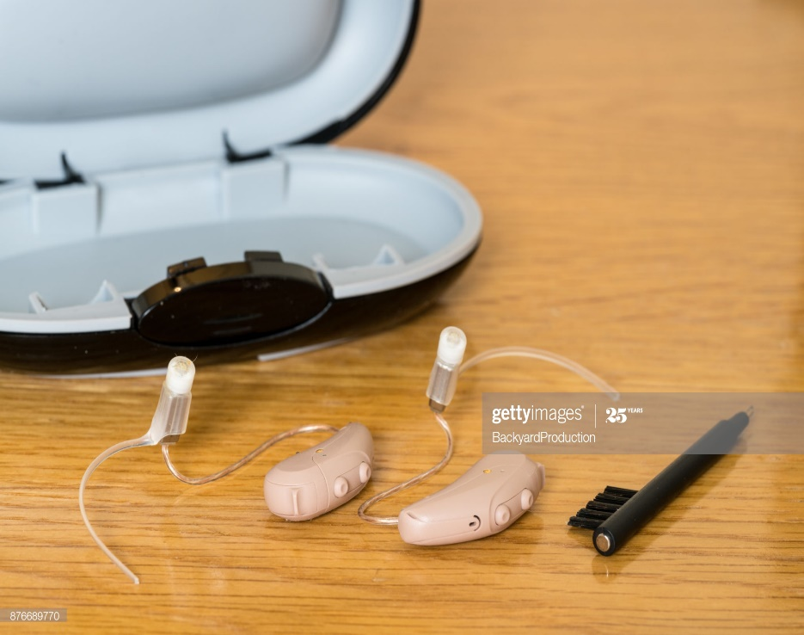
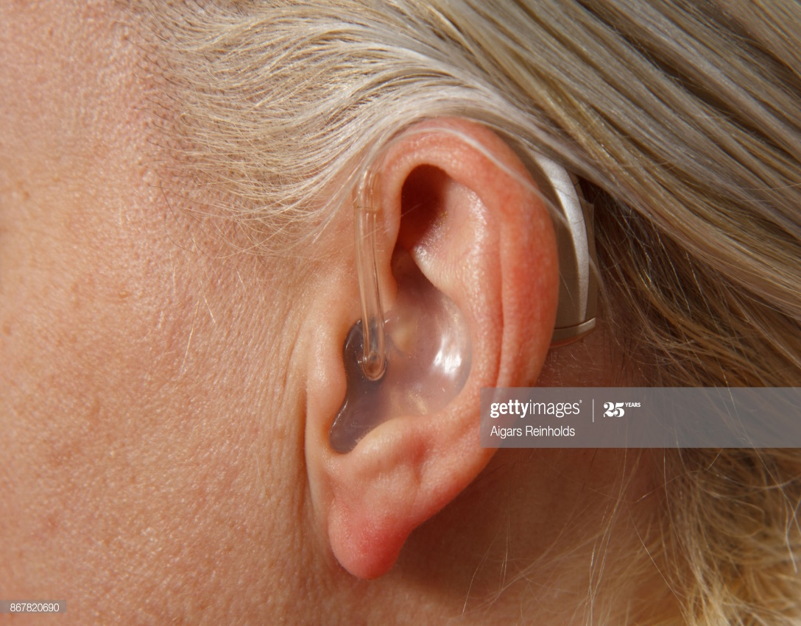
Equipment
Distribution
Program:
Hearing Aids

Slide 14
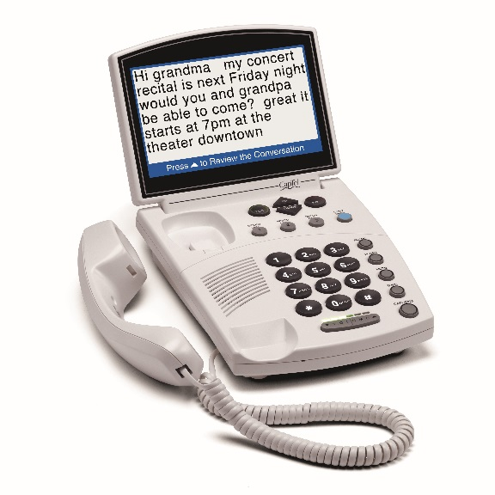
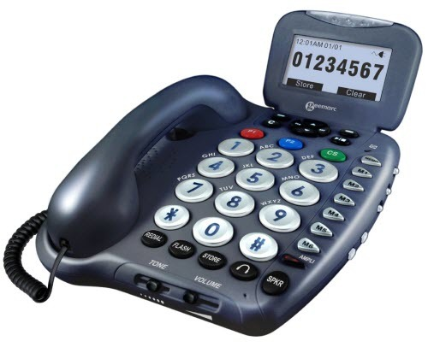
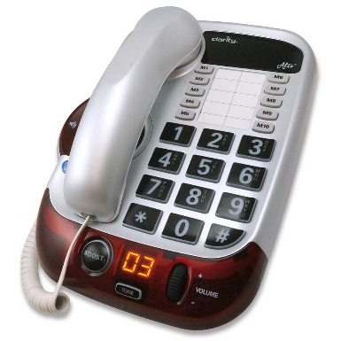
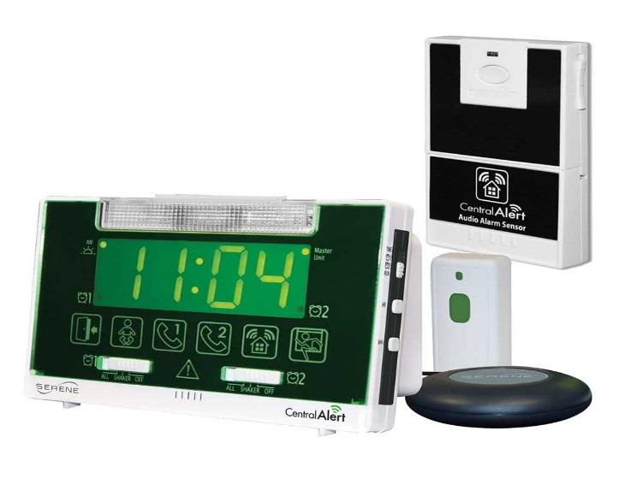
Amplified Phones and Alerting Devices

Slide 15
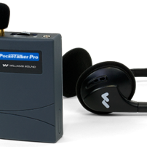
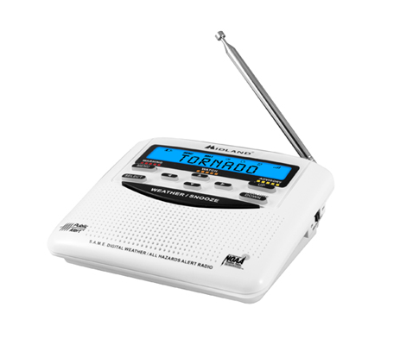
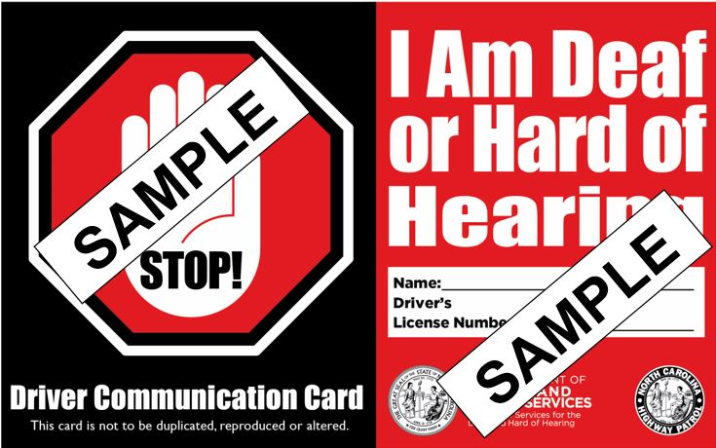
Assistive Technology

Slide 16
Hard of Hearing
  Born hard of hearing or gradually lost hearing over time.
Late Deafened
  Born hearing, but lost hearing over time until becomes deaf.
Deaf
  Born deaf or became deaf prior to spoken language development.
Deaf Plus
  Deaf and have another disability that effects cognitive abilities.
Hearing Loss – not all the same
Notes:
Know that most hard of hearing people are not good at self advocating for their communication needs. Be proactive

Slide 17
Strongly encouraged that your agency have one in place.
Clearly defined expectations.
Instructions on where to find and how to use personal amplification devices and other auxiliary aids and services.
Include a list of qualified licensed interpreters.
DSDHH Regional Center staff can assist you with developing one.
Example
  https://www.hhs.gov/civil-rights/for-providers/clearance-medicare-providers/auxiliary-aids-persons-disabilities/index.html
Policy for Providing Auxiliary Aids for Persons with Disabilities
Notes:
Know that most hard of hearing people are not good at self advocating for their communication needs. Be proactive

Slide 18
Americans with Disabilities Act
Title I - Employment,
Title II - State and Local Governments,
Title III - Public Accommodations,
Title IV - Telecommunications, and
Title V - Miscellaneous
https://www.ada.gov/index.html

Slide 19
Americans with Disabilities Act
Title II Entities (State and local governments)
Required to communicate effectively with people who have disabilities and use different ways to communicate.
Goal is to ensure that communication is equally effective as communication with those without disabilities.
Includes “companions”.
  Parents, relatives, friends, and other associates of a person seeking services.
https://www.ada.gov/index.html

Slide 20
In order to provide equal access, a public accommodation is required to make available appropriate auxiliary aids and services where necessary to ensure effective communication.
The type of auxiliary aid or service necessary to ensure effective communication will vary in accordance with the length and complexity of the communication involved.
Effective Communication
https://www.ada.gov/index.html
Notes:
Know that most hard of hearing people are not good at self advocating for their communication needs. Be proactive

Slide 21
Effective Communication
The ADA discourages the use of accompanying adults or children as interpreters
  Cannot require a person to bring someone to interpret for him or her.
  Lack impartiality and specialized vocabulary needed to interpret accurately and effectively
Title II entities are required to give primary consideration to the choice of aid or service requested by the person who is deaf, hard of hearing, late-deafened, or deafblind.
https://www.ada.gov/index.html

Slide 22
Effective Communication
Provision of auxiliary aids and services
  Qualified interpreters
  Communication or picture boards
  Assistive listening devices and systems
  Speech output devices
  Note takers
  Telephone handset amplifiers
  Video interpretive services
  Telephone communication devices for deaf persons
  Open, closed, and real-time captioning
https://www.ada.gov/effective-comm.htm

Slide 23

Keys to Effective Communication

Slide 24
Myths about Hearing Loss
All people with hearing loss can speech read.
All people with hearing loss use sign language.
People with hearing loss are stubborn,
uncooperative, demanding, negative, or unfriendly.
Good speech equals good hearing.
Problems related to hearing are limited solely to the physical perception of sound and do not affect the person cognitively and emotionally.
People with hearing loss cannot use the phone/drive.
If the person is wearing a hearing aid, he/she can hear fine

Slide 25
Labels
Hearing
Impaired Deaf-Mute
Deaf-Dumb Death
Notes:
Examples of terms to identify deaf people. All are old terms except death
Hearing Impaired is old term – it is not being used any more. It is considered as medical viewpoint. People prefer to be called deaf, deaf-blind or hard of hearing. Some individuals may identify themselves as hearing impaired – especially those who may live in rural area or haven’t updated with language usage.
Same concept trying to find the right words to substitute vulnerable population, special needs, etc especially for Functional and Access Needs area.
Deaf-Mute and Deaf-Dumb = very old term. No longer in use – people may not be updated with current resources as using appropriate words. Mute is considered as insult. Some deaf people choose not to use their voice even though they can use it.
As for Death and Deaf, both f and th have no sound – can be easily misunderstood.

Slide 26
A Broad Spectrum
Hearing
Deaf
Mild
Moderate
Moderate-Severe
Severe
Profound
Notes:
All hearing loss is not the same, it depends on audiogram showing degrees of hearing loss
It covers a broad spectrum from mild to profound and affects each individual differently.

Slide 27
Recognizing Someone with Hearing Loss
Frequently misunderstands and needs to have information repeated
Watching a person’s face intently when listening
Might complain that others are mumbling or does not speak clearly
Might appear a little slow or unfocused when communicating.
Might say things that do not make sense within the context of the conversation.
Points to his/her ear and shakes head

Slide 28
Keys to Effective Communication
Ask the person what is the best way to effectively communicate.
Ensure good eye contact.
Communicate in a quiet, well-lit environment.
Separate talking from demonstration.
Write the most important information.
Speak slowly and clearly, but do not exaggerate.
Do not shout.
Allow additional time.
Hard of Hearing Individuals
Notes:
Know that most hard of hearing people are not good at self advocating for their communication needs. Be proactive

Slide 29
Keys to Effective Communication
Write notes only for very simple, straightforward communication.
Use captioning, which is generally the best means of access to communication
Late-Deafened Individuals
Notes:
Know that most hard of hearing people are not good at self advocating for their communication needs. Be proactive

Slide 30
Keys to Effective Communication
Deaf Individuals
A licensed, qualified sign language interpreter may be the most effective way to communicate with someone who is Deaf
Use visual aids and written communication for very basic information.
Use current technology to type information or utilize applications which allow you to change English text to ASL.
Notes:
Know that most hard of hearing people are not good at self advocating for their communication needs. Be proactive

Slide 31
Keys to Effective Communication
A licensed, qualified Deaf sign language interpreter, teaming with a hearing sign language interpreter is most effective.
Communication methods will vary significantly depending on the degree of their linguistic and cognitive ability.
Deaf-Plus Individuals
Notes:
A Deaf Interpreter is a specialist who provides interpreting, translation, and transliteration services in American Sign Language and other visual and tactual communication forms used by individuals who are Deaf, hard-of-hearing, and Deaf-Blind. As a Deaf person, the Deaf Interpreter starts with a distinct set of formative linguistic, cultural, and life experiences that enables nuanced comprehension and interaction in a wide range of visual language and communication forms influenced by region, culture, age, literacy, education, class, and physical, cognitive, and mental health. These experiences coupled with professional training give the Deaf interpreter the ability to successfully communicate across all types of interpreted interactions, both routine and high risk. NCIEC studies indicate that in many situations, use of a Deaf Interpreter enables a level of linguistic and cultural bridging that is often not possible when hearing ASL-English interpreters work alone.

Slide 32
Keys to Effective Communication
A licensed, qualified sign language interpreter who has training and experience working with Deaf-Blind individuals is most effective.
Communication methods will vary significantly depending on the degree of their hearing and vision loss.
Large print and Braille versions of printed materials may be beneficial.
DeafBlind Individuals
Notes:
Know that most hard of hearing people are not good at self advocating for their communication needs. Be proactive

Slide 33
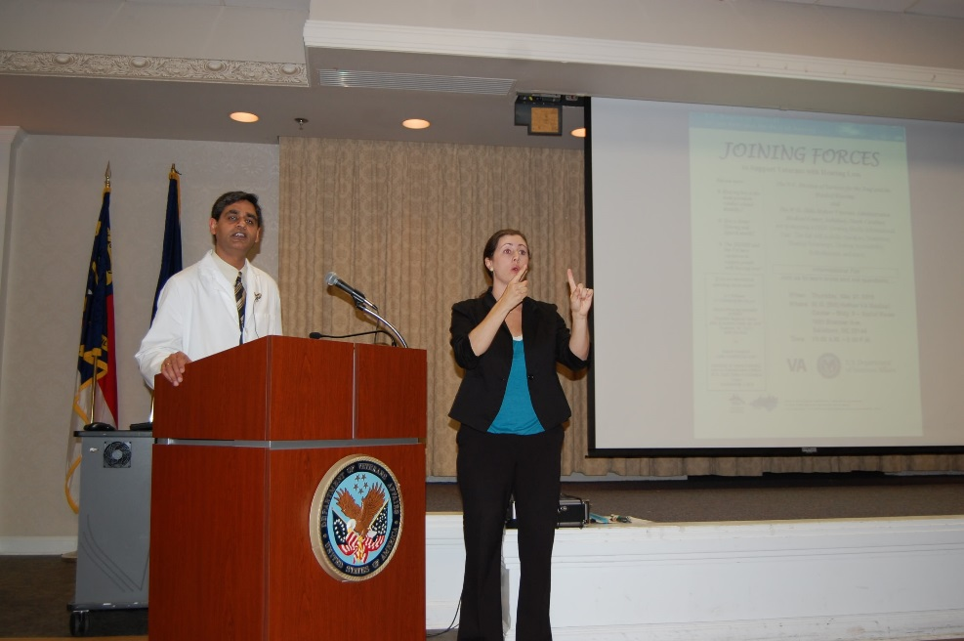
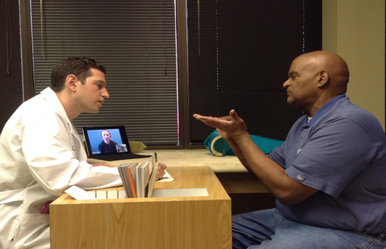
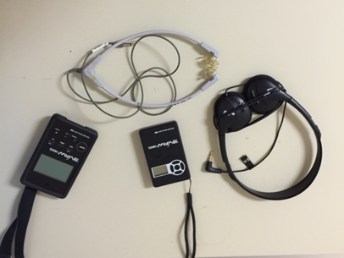
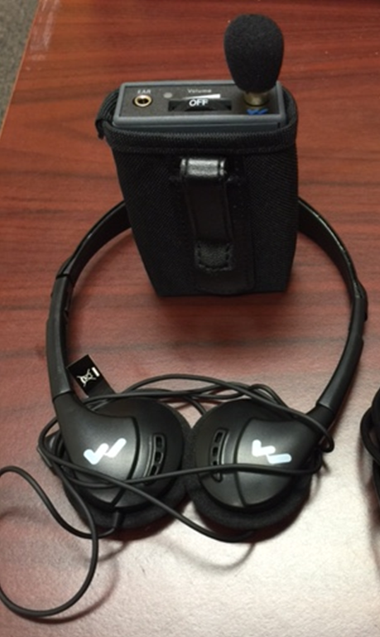
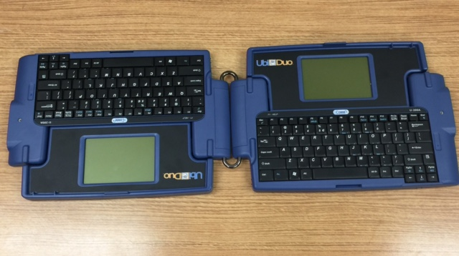
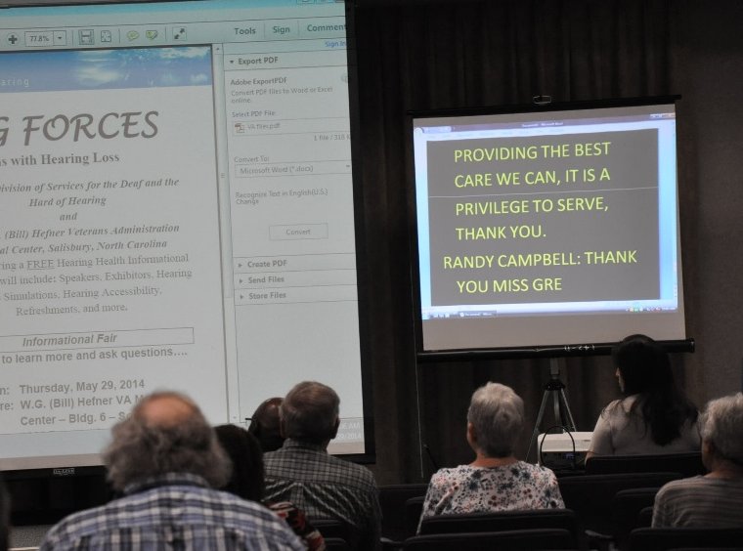
Auxiliary Aids & Servies
Notes:
ALDs – one to one and group settings.
Some apps have assistive listening which can be downloaded to smart phones (and maybe tablets) to help consumers hear better - will need earphone and/or speaker
Video Remote Interpreter (VRI)- useful for a meeting (one to one or few people) between hearing and deaf people. Need to have a device with webcam and microphone connected to internet in order to connect to video interpreter (contract with an agency to provide such services).
Real-time captioning (also known as computer-assisted real-time transcription, or CART) – typed by a person trained in court reporting
UbiDuo device – one to one communication.

Slide 34
Auxiliary Aids and Services
Most types of hearing loss are permanent – there is no cure.
Makes Communication and Information Accessible for People who are Deaf, Hard of Hearing, Late Deafened, and DeafBlind
Bridges the gap of missed communication created by hearing loss.
Notes:
Know that most hard of hearing people are not good at self advocating for their communication needs. Be proactive

Slide 35
Assistive Listening Devices
Telephones
Teletypewriter (TTY)
Captioning Telephones
Hearing Aid Compatible Telephones
  In-line or other amplifiers
  Loud phone ringer for hard of hearing persons
CART (Communication Access Realtime Translation) –captioning services
Auxiliary Aids and Services
Notes:
Know that most hard of hearing people are not good at self advocating for their communication needs. Be proactive

Slide 36
American Sign Language Interpreter
  On-site
  Video Remote
Tactile ASL Interpreter
Video Relay Service
Cued Language Transliterator
Auxiliary Aids and Services
Notes:
Know that most hard of hearing people are not good at self advocating for their communication needs. Be proactive

Slide 37
Auxiliary Aids
Tablets/laptops/smart phones
  Connect to Video Remote Interpreters
Apps
  Personal amplification apps
  Speech-to-text apps
  Note-taking
Wired/wireless personal amplification devices
  Handheld microphone and headphones/earbud
  FM System
Notes:
Expand on types of technology/equipment that can be used .

Slide 38
Services
Qualified Sign Language Interpreters
  Tactile Sign Language Interpreter
  Deaf Interpreter
Communication Access Realtime Translation (CART)
  Instantaneous translation of what is being said into visual print display.

Slide 39

What is American Sign Language?
What ASL is not:
  Written
  Singed English
  Bad English
  Broken English
  ENGLISH
What ASL is:
  A visual language with its own grammatical rules and syntax
  Every bit as precise, versatile and subtle as English. In some ways, more so.
Notes:
For the last bullet, every bit as precise, explain during slide 9***

Slide 40
What is ASL (continued)
Visual
  The entire body and movement is used in proper ASL
  The face can be used as a grammatical marker
  Has directional verbs
Adaptive
  Signs can change to reflect mood, feelings, or attitude
Has variations
  Signed Exact English
  Pidgin Signed English
  American Sign Language
Notes:
SEE, PSE, ASL important for you to know, why? Deaf people will code switch. All deaf people are different in how they want to communicate

Slide 41

Some examples
Structure:
  What’s your name?
  Do you want a soda?
Movement:
  Cars
  Handshape for B
Classifiers (verbs):
  Airplane vs. fly
  Chair vs. sit
Notes:
Your + name + what
You + want + soda (PSE)
Soda + you + want (ASL)
In questions like this, we see that the eyebrows are grammatical markers, indicating if this is a WH question or Yes/No question
Car
Drive forward
Backing out
Traffic
Parking lot
B: boston, blue, painting the wall and my name sign!

Slide 42
Do I have to get an interpreter?
Generally, not required for simple transactions – setting up an appointment, picking up vouchers.
BUT – when it’s a lengthy or complex transaction with a Deaf person who uses ASL, you need an interpreter
  Interviews, intakes, meetings
  Family team meeting
No children, family members – unless urgent, uncomplicated
Notes:
Miranda – videotaped, get two, think consequences of ineffective interpretations

Slide 43
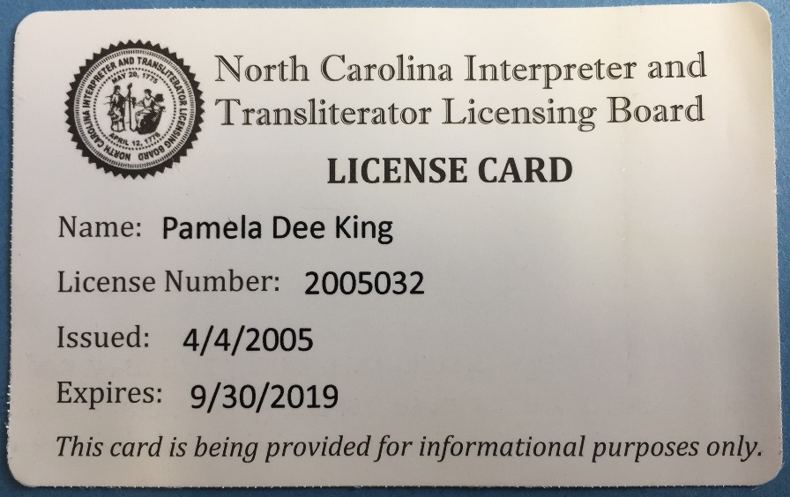
North Carolina Interpreter and Transliterator Licensing Board
(NC General Statute 90D)
Interpreters and transliterators must be licensed
Types of license:
  Full
  Grandfather (Full –
  one time issue)
  Provisional – temporary
Source: http://www.ncleg.net/gascripts/statutes/StatutesTOC.pl?Chapter=0090D
Notes:
Ask interpreter to show her/his card or give the license number.
What does their SOP or communication plan say about sign language interpreter?
Provisional – temporarily licensed while they continue to work on their skills while they strive for certification and full licensure.
Licensed if compensated except for Religious, Educational, or in emergency circumstances TILL licensed interpreter can be obtained.
Certification/Licensure – doesn’t prove qualification
OK to use unqualified and unlicensed for temporary as emergency that affects life or death

Slide 44
Qualified Interpreters
Certified interpreters are considered “generalists”
Specialization in legal (SC:L)
In the state of NC, the interpreter must have an interpreting license and be able to present it upon request
  Full – Nationally Certified
  Provisional – newer interpreters
  Or does it even matter?

Slide 45
Types of Interpreting Services
Hearing Interperters
  Facilitate communication between deaf individuals and those who are hearing.
Deaf Interpreters
  Help providers meet the letter and spirit of “effective communication”.
  Often work as part of a deaf/hearing team.
  Trained specialists with keen understanding of the complexities of the communication exchange.
Tactile Interpreters
  Used by DeafBlind individuals.
  Interpreter creates signs in the person’s hand, while using other tactile cues to describe affect and the environment.
https://www.nationaldeafcenter.org/sites/default/files/Sign%20Language%20Interpreters_%20An%20Introduction.pdf

Slide 46
Onsite vs VRI vs VRS
Onsite Interpreting – interpreter, Deaf person and hearing person are all in the same location.
Video Remote Interpreting – interpreter is in a different location.
Video Relay Service – interpreter, Deaf person, hearing person are in 3 separate locations.

Slide 47
Computer Assisted Realtime Transcription (CART) Services
Often preferred by late deafened adults and some hard of hearing people.
Can accommodate special vision requirements.
CART providers are NOT interpreters.
Captions can be displayed on a screen, computer monitor, tablet, or smart phone.
Services are acquired by contacting CART providers/agencies.

Slide 48
Other Ways to Ensure Effective Communication
People with hearing loss may not hear less explicit ways of communicating.
  Knocking
  Alarms
  Intercoms (chime when called/speech over the intercom)
  Recordings or television programs (i.e., during educational programs)
Notes:
VRS – interpreters can stay on the line until arrival of first responders
In SOME instances, the interpreter can continue interpreting if first responders need to communicate with Deaf person. Life or Death situations
Best practice – NO VRI for Miranda NO VRS for Miranda

Slide 49
Other Ways to Ensure Effective Communication
Everyday items can be used as auxiliary aids.
  White boards or pen and paper
  E-mail communication in lieu of phone calls
  Text messaging
  Smartphones/Tablets with Voice to Text apps
  Typing on a computer
  Pictures for commonly used words
  Clear face mask to communicate with those who depend on lipreading

Slide 50

Contact Us
If you would like more
information, check
our website:
www.ncdhhs.gov/dsdhh
or call us at (800) 681 – 7998

Slide 51


Questions?

