Slide 1

Cannabis Legislation Considerations for Children
Emily Vander Schaaf, MD, MPH, FAAP
Chair North Carolina Pediatric Society Policy Committee

Slide 2
Plan
Impacts of cannabis on children and adolescents
Youth cannabis trends
American Academy of Pediatrics recommendations
Notes:
Reminders re: definitions
Legalization Allowing cultivation, sale, and use of cannabis (restricted to adults $21 years of age).
Legalization of Medical Marijuana Allowing the use of marijuana to treat a medical condition or symptom with a recommendation from a physician.
Decriminalization Reducing penalties for cannabis related offenses to lesser criminal charges or to civil penalties.

Slide 3
Cannabis Effects

Slide 4
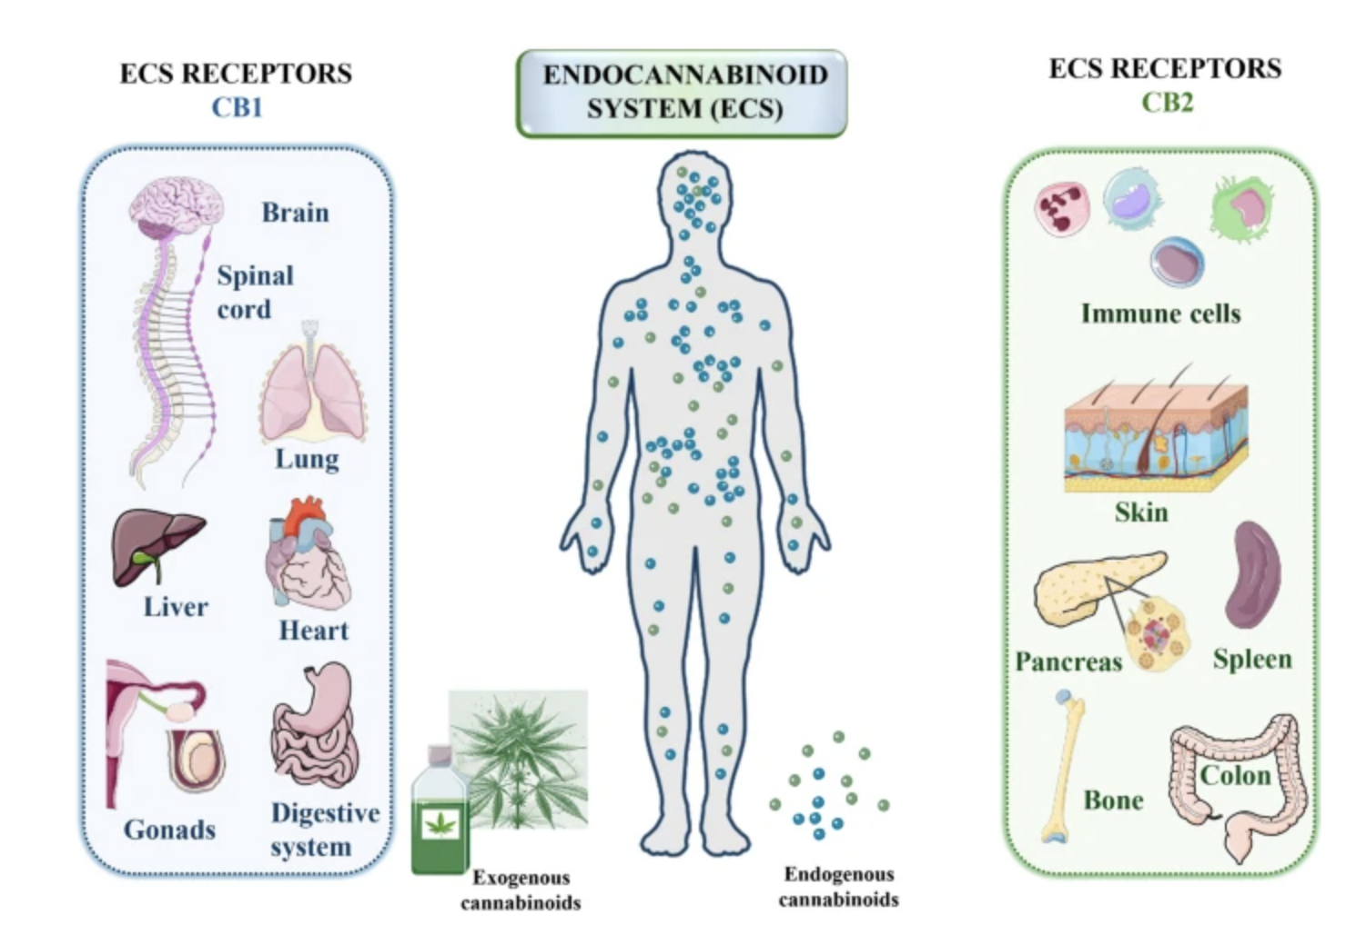
Cannabis Effects
Rabinow 2025 Pediatrics in Review, Faiz 2024 Discov Onc
Notes:
Lily Rabinow, Emily Dries, Neal D. Hoffman; Cannabis Use in Adolescents. Pediatr Rev September 2025; 46 (9): 482–493. https://doi.org/10.1542/pir.2024-006514
Image from: Faiz, M.B., Naeem, F., Irfan, M. et al. Exploring the therapeutic potential of cannabinoids in cancer by modulating signaling pathways and addressing clinical challenges. Discov Onc 15, 490 (2024). https://doi.org/10.1007/s12672-024-01356-8

Slide 5
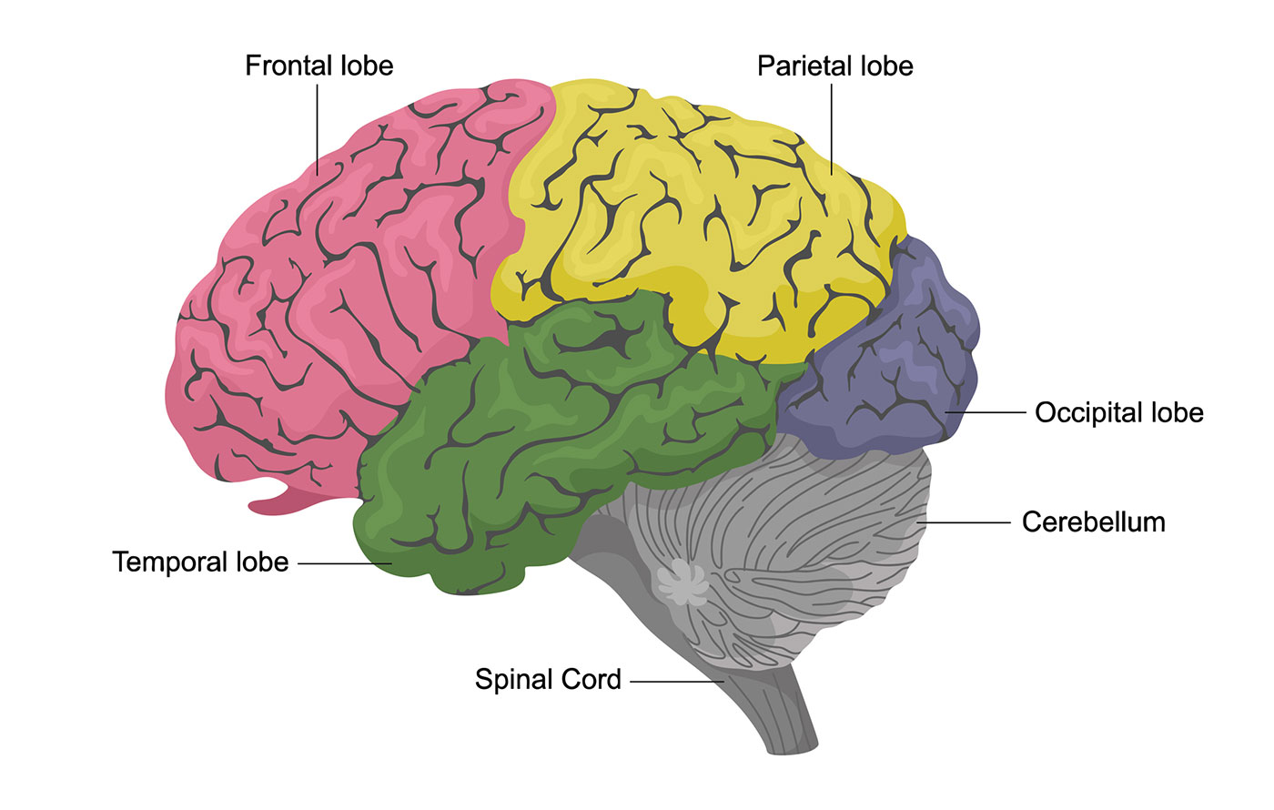
Cannabis Effects on Youth
Rabinow 2025 Pediatrics in Review
Notes:
Lily Rabinow, Emily Dries, Neal D. Hoffman; Cannabis Use in Adolescents. Pediatr Rev September 2025; 46 (9): 482–493. https://doi.org/10.1542/pir.2024-006514
Brain image: https://www.hopkinsmedicine.org/health/conditions-and-diseases/anatomy-of-the-brain

Slide 6
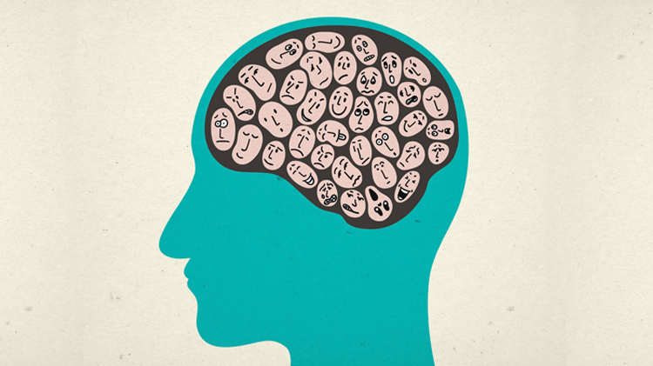
Cannabis Effects on Youth
Rabinow 2025 Pediatrics in Review
Notes:
Lily Rabinow, Emily Dries, Neal D. Hoffman; Cannabis Use in Adolescents. Pediatr Rev September 2025; 46 (9): 482–493. https://doi.org/10.1542/pir.2024-006514
Image from: https://www.mdanational.com.au/advice-and-support/library/articles-and-case-studies/2019/11/what-i-like-about-psychiatry

Slide 7
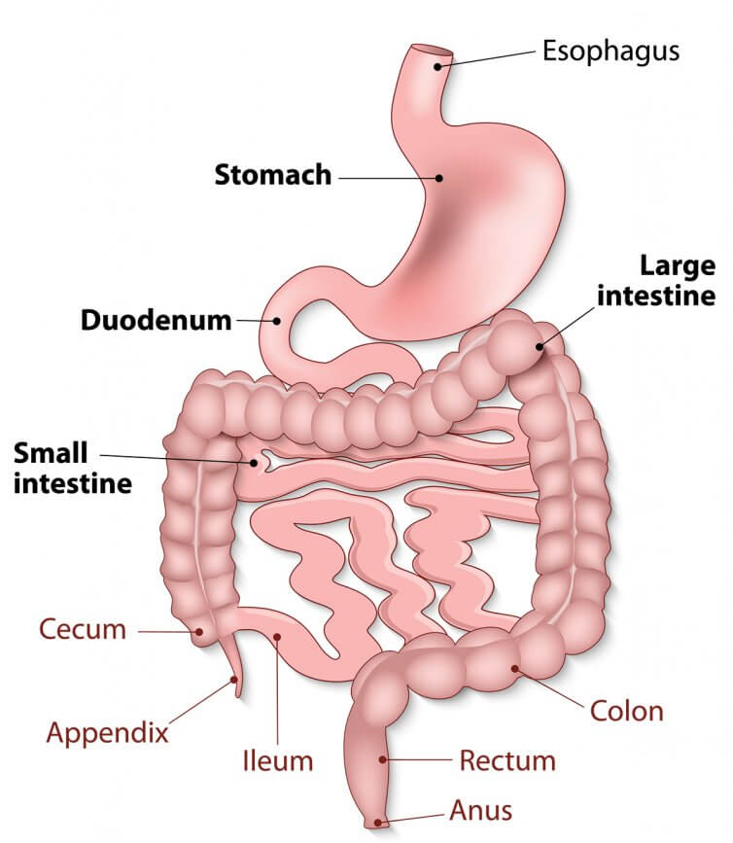
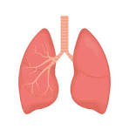
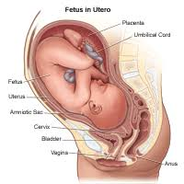
Cannabis Effects on Youth
Rabinow 2025 Pediatrics in Review
Notes:
Lily Rabinow, Emily Dries, Neal D. Hoffman; Cannabis Use in Adolescents. Pediatr Rev September 2025; 46 (9): 482–493. https://doi.org/10.1542/pir.2024-006514
Images from:
- https://bgapc.com/all-about-the-upper-gi-tract/
- https://stock.adobe.com/search?k=lung+anatomy
- https://www.hopkinsmedicine.org/health/wellness-and-prevention/anatomy-fetus-in-utero

Slide 8
Youth Cannabis Trends

Slide 9
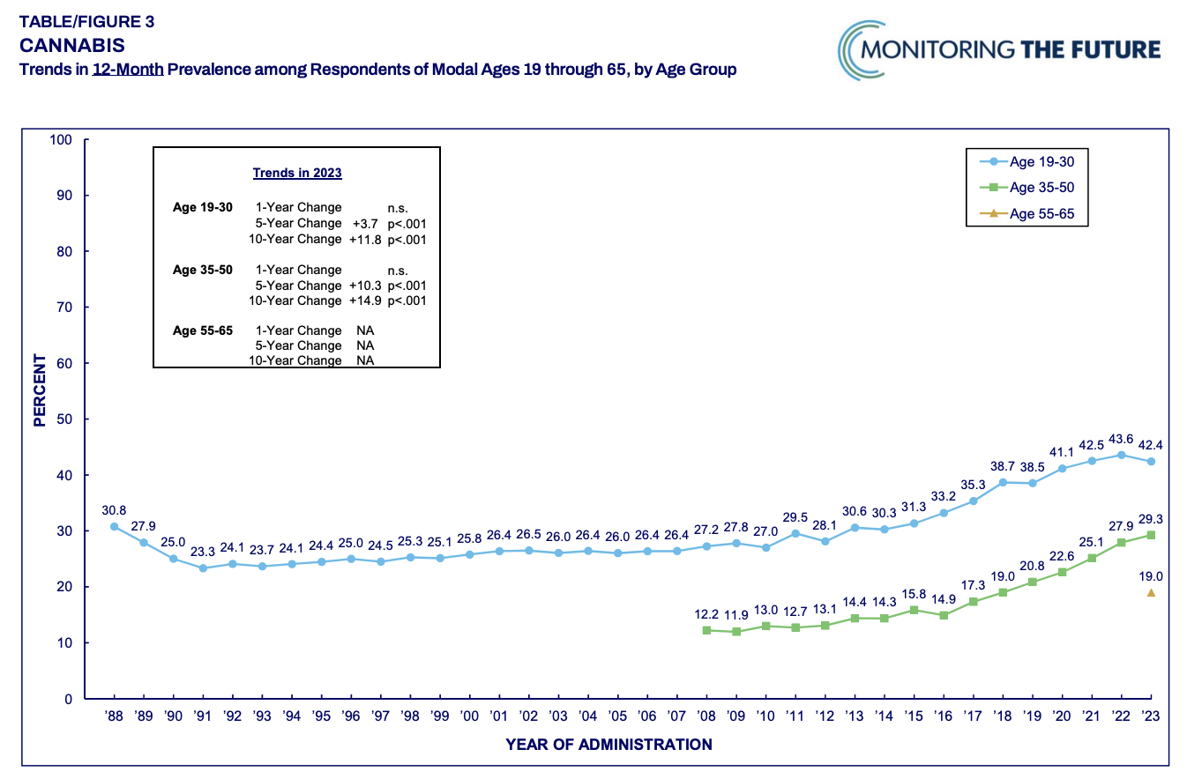
Cannabis trends
Record high young adult use
Rabinow 2025 Pediatrics in Review
Notes:
https://nida.nih.gov/news-events/news-releases/2024/08/cannabis-and-hallucinogen-use-among-adults-remained-at-historic-highs-in-2023
https://monitoringthefuture.org/wp-content/uploads/2024/07/mtfpanel2024.pdf

Slide 10
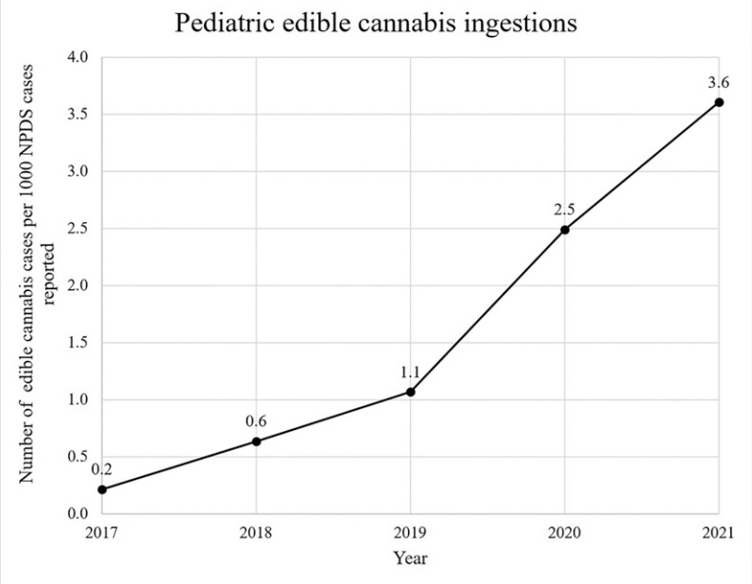
Cannabis trends
1,375% increase in kids under 6 accidental ingestion
207 in 2017
3,054 in 2021
Tweet et al 2023 Pediatrics
Notes:
9% of these patients in 2021 admitted to the intensive care unit and 16% hospitalized in other units

Slide 11
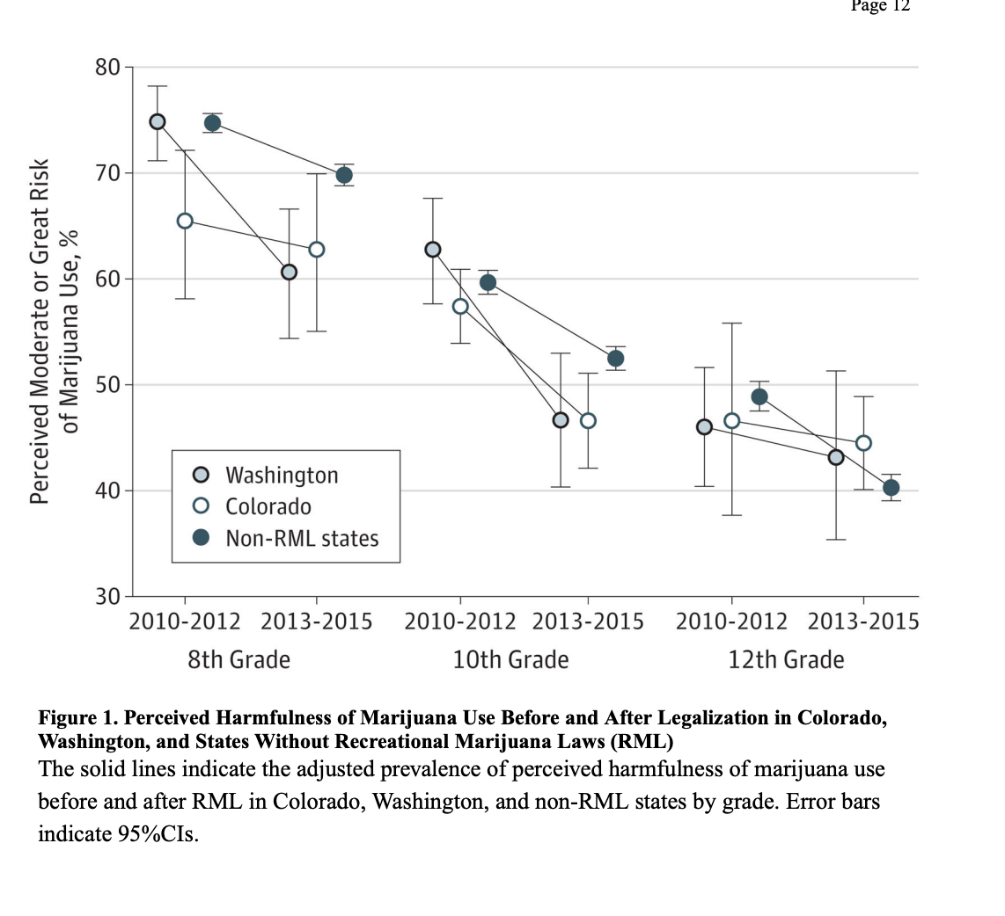
Cannabis trends
Fewer teens perceive cannabis as harmful
Cerda et al 2017 JAMA Peds
Notes:
Cerdá M, Wall M, Feng T, Keyes KM, Sarvet A, Schulenberg J, O'Malley PM, Pacula RL, Galea S, Hasin DS. Association of State Recreational Marijuana Laws With Adolescent Marijuana Use. JAMA Pediatr. 2017 Feb 1;171(2):142-149. doi: 10.1001/jamapediatrics.2016.3624. PMID: 28027345; PMCID: PMC5365078.

Slide 12
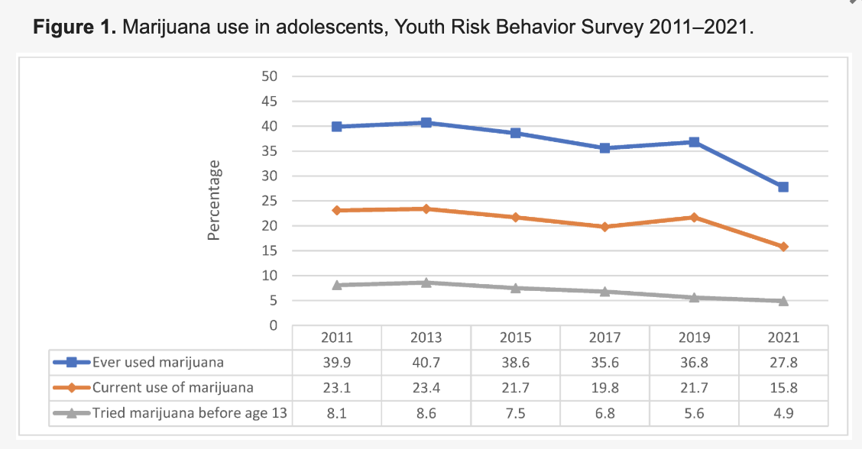
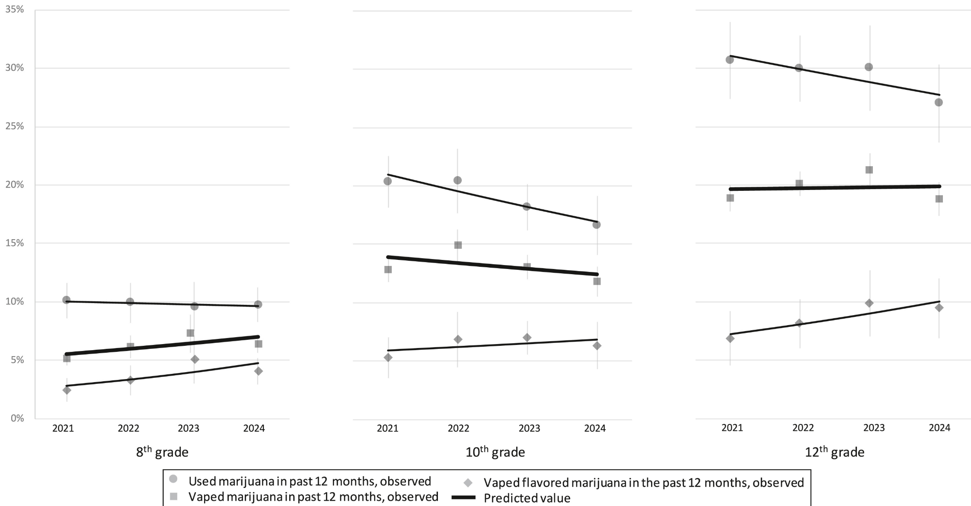
Cannabis trends
Mixed data on teen use over time
Remember 2021 was an unusual year
Yang 2024 Pediatric Rep; Miech 2025 Journal of Adolescent Health; Coley 2024 JAMA Peds
Notes:
https://www.mdpi.com/2036-7503/16/4/74#:~:text=Results:%20The%20percentage%20of%20adolescents,;%20cannabis;%20students;%20United%20States
Richard Miech, Megan E. Patrick, Adam M. Leventhal, Trends in U.S. Adolescent Use of Vaping and Flavored Solutions for Marijuana Consumption, 2021–2024, Journal of Adolescent Health, Volume 77, Issue 5, 2025, Pages 924-930, ISSN 1054-139X, https://doi.org/10.1016/j.jadohealth.2025.07.004.
Coley RL, Carey N, Kruzik C, Hawkins SS, Baum CF. Recreational Cannabis Legalization, Retail Sales, and Adolescent Substance Use Through 2021. JAMA Pediatr. 2024;178(6):622–625. doi:10.1001/jamapediatrics.2024.0555

Slide 13
Cannabis trends
Meta-analysis
- Medical cannabis did not appear to increase youth use
- Legalization of recreational cannabis did appear to increase use
Pawar 2024 J American Academy of Child and Adolescent Psychiatry
Notes:
Pawar AKS, Firmin ES, Wilens TE, Hammond CJ. Systematic Review and Meta-Analysis: Medical and Recreational Cannabis Legalization and Cannabis Use Among Youth in the United States. J Am Acad Child Adolesc Psychiatry. 2024 Nov;63(11):1084-1113. doi: 10.1016/j.jaac.2024.02.016. Epub 2024 Mar 27. PMID: 38552901.

Slide 14
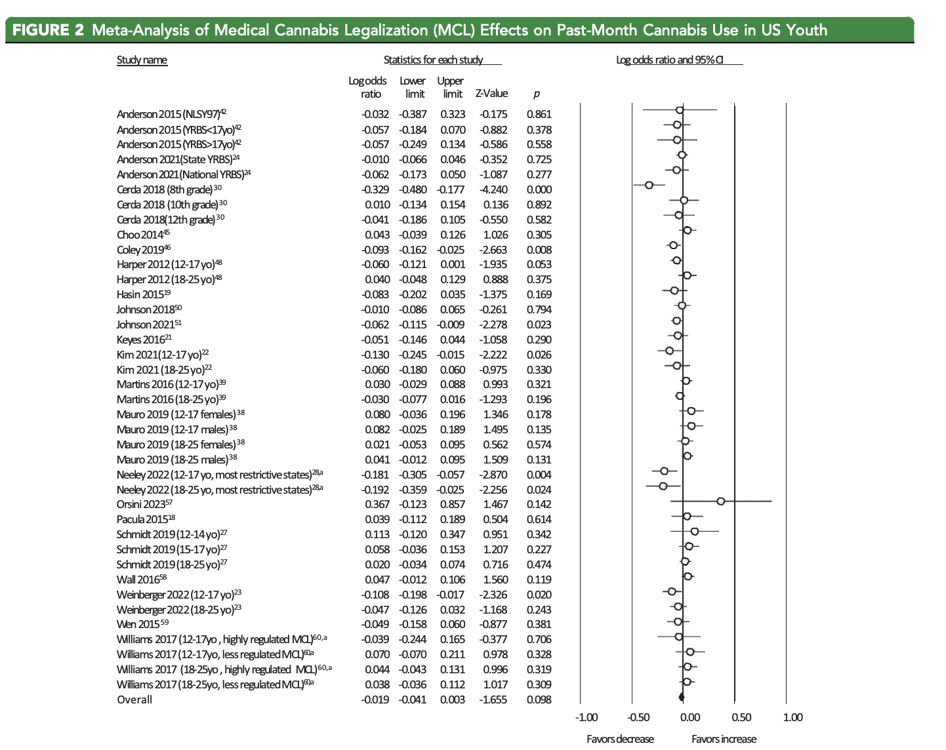
Cannabis trends
Impact of Medical Cannabis
Less Use Past Month
More Use Past Month
Meta-analysis
Pawar 2024 J American Academy of Child and Adolescent Psychiatry
Notes:
Pawar AKS, Firmin ES, Wilens TE, Hammond CJ. Systematic Review and Meta-Analysis: Medical and Recreational Cannabis Legalization and Cannabis Use Among Youth in the United States. J Am Acad Child Adolesc Psychiatry. 2024 Nov;63(11):1084-1113. doi: 10.1016/j.jaac.2024.02.016. Epub 2024 Mar 27. PMID: 38552901.

Slide 15
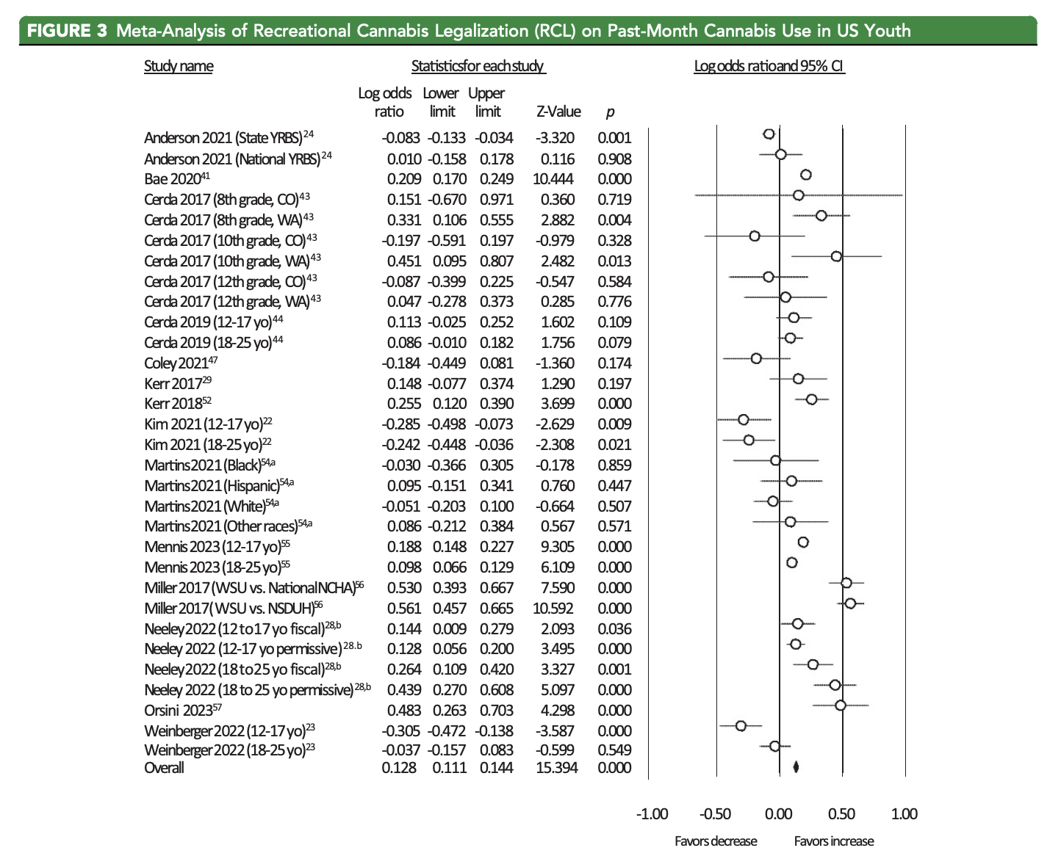
Cannabis trends
Impact of Recreational Legalization
Less Use Past Month
More Use Past Month
Meta-analysis
Pawar 2024 J American Academy of Child and Adolescent Psychiatry
Notes:
Pawar AKS, Firmin ES, Wilens TE, Hammond CJ. Systematic Review and Meta-Analysis: Medical and Recreational Cannabis Legalization and Cannabis Use Among Youth in the United States. J Am Acad Child Adolesc Psychiatry. 2024 Nov;63(11):1084-1113. doi: 10.1016/j.jaac.2024.02.016. Epub 2024 Mar 27. PMID: 38552901.

Slide 16
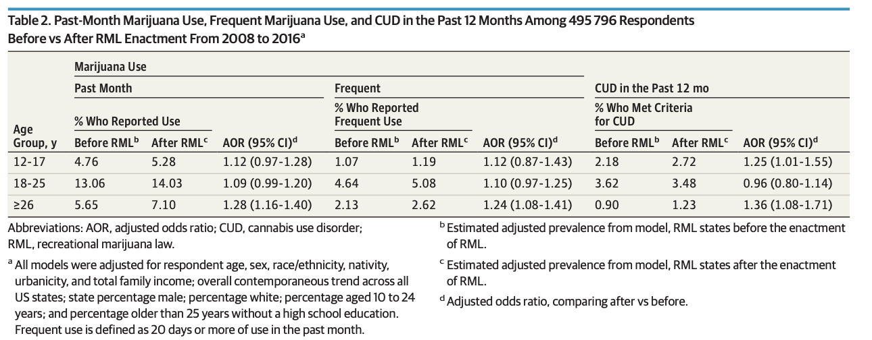
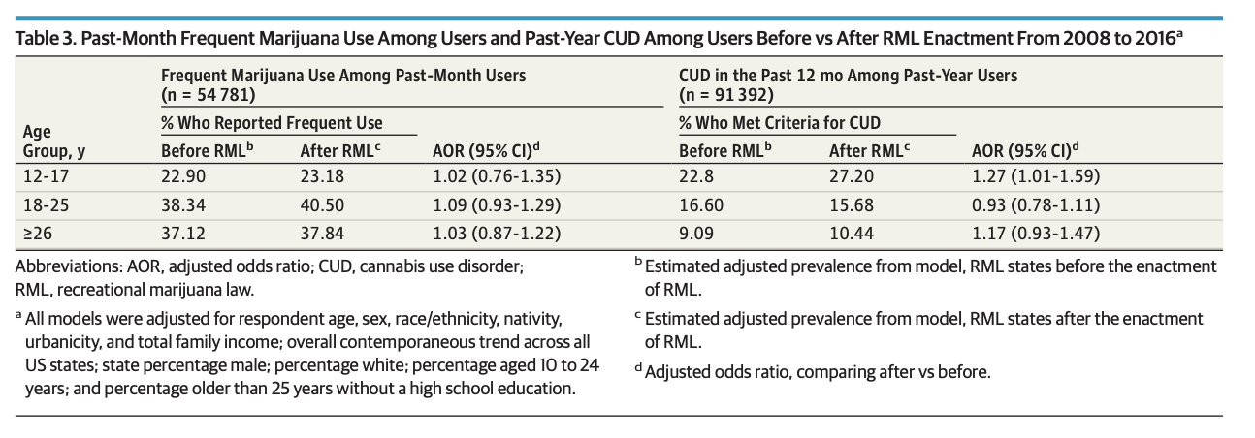
Cerda 2020 JAMA Psychiatry
Notes:
Cerdá M, Mauro C, Hamilton A, Levy NS, Santaella-Tenorio J, Hasin D, Wall MM, Keyes KM, Martins SS. Association Between Recreational Marijuana Legalization in the United States and Changes in Marijuana Use and Cannabis Use Disorder From 2008 to 2016. JAMA Psychiatry. 2020 Feb 1;77(2):165-171. doi: 10.1001/jamapsychiatry.2019.3254. PMID: 31722000; PMCID: PMC6865220.

Slide 17
AAP Recommendations

Slide 18
AAP Recommendations
Oppose marijuana use in children and adolescents 0 to 21 years of age
Opposes “medical marijuana” outside FDA regulation (recognizing potential benefit for some children with life-limiting or severely debilitating conditions)
Support research and development of pharmaceutical cannabinoids for medical use, changing from schedule I to II
Committee on Substance Abuse, Committee on Adolescence 2024 Pediatrics
Notes:
COMMITTEE ON SUBSTANCE ABUSE, COMMITTEE ON ADOLESCENCE, Seth D. Ammerman, Sheryl A. Ryan, William P. Adelman, Sharon Levy, Pamela K. Gonzalez, Lorena M. Siqueira, Vincent C. Smith, Paula K. Braverman, Elizabeth Meller Alderman, Cora C. Breuner, David A. Levine, Arik V. Marcell, Rebecca Flynn O’Brien; The Impact of Marijuana Policies on Youth: Clinical, Research, and Legal Update. Pediatrics March 2015; 135 (3): 584–587. 10.1542/peds.2014-4146
Reminders re: definitions
Legalization Allowing cultivation, sale, and use of cannabis (restricted to adults $21 years of age).
Legalization of Medical Marijuana Allowing the use of marijuana to treat a medical condition or symptom with a recommendation from a physician.
Decriminalization Reducing penalties for cannabisrelated offenses to lesser criminal charges or to civil penalties.

Slide 19
AAP Recommendations
Oppose legalization for recreational use due to potential harms to children and adolescents
Strongly support decriminalization for minors and young adults, with response focusing on treatment and support.
Committee on Substance Abuse, Committee on Adolescence 2024 Pediatrics
Notes:
COMMITTEE ON SUBSTANCE ABUSE, COMMITTEE ON ADOLESCENCE, Seth D. Ammerman, Sheryl A. Ryan, William P. Adelman, Sharon Levy, Pamela K. Gonzalez, Lorena M. Siqueira, Vincent C. Smith, Paula K. Braverman, Elizabeth Meller Alderman, Cora C. Breuner, David A. Levine, Arik V. Marcell, Rebecca Flynn O’Brien; The Impact of Marijuana Policies on Youth: Clinical, Research, and Legal Update. Pediatrics March 2015; 135 (3): 584–587. 10.1542/peds.2014-4146

Slide 20
AAP Recommendations
If legalized, recommend strict enforcement of rules and regulations to limit marketing and access to youth
If legalized, regulate with minimum age of purchase 21 years, public health education, diversion for selling to youth.
If legalized, ensure childproof, well-labeled packaging to avoid accidental ingestion
Committee on Substance Abuse, Committee on Adolescence 2024 Pediatrics
Notes:
COMMITTEE ON SUBSTANCE ABUSE, COMMITTEE ON ADOLESCENCE, Seth D. Ammerman, Sheryl A. Ryan, William P. Adelman, Sharon Levy, Pamela K. Gonzalez, Lorena M. Siqueira, Vincent C. Smith, Paula K. Braverman, Elizabeth Meller Alderman, Cora C. Breuner, David A. Levine, Arik V. Marcell, Rebecca Flynn O’Brien; The Impact of Marijuana Policies on Youth: Clinical, Research, and Legal Update. Pediatrics March 2015; 135 (3): 584–587. 10.1542/peds.2014-4146

Slide 21
AAP Recommendations
Oppose smoking marijuana for primary and secondary lung damage concerns
Discourage use by adults in presence of minors for positive role modeling
Committee on Substance Abuse, Committee on Adolescence 2024 Pediatrics
Notes:
COMMITTEE ON SUBSTANCE ABUSE, COMMITTEE ON ADOLESCENCE, Seth D. Ammerman, Sheryl A. Ryan, William P. Adelman, Sharon Levy, Pamela K. Gonzalez, Lorena M. Siqueira, Vincent C. Smith, Paula K. Braverman, Elizabeth Meller Alderman, Cora C. Breuner, David A. Levine, Arik V. Marcell, Rebecca Flynn O’Brien; The Impact of Marijuana Policies on Youth: Clinical, Research, and Legal Update. Pediatrics March 2015; 135 (3): 584–587. 10.1542/peds.2014-4146

Slide 22
Summary
Cannabis is harmful to children, especially at younger ages and higher doses
Cannabis use disorder is a medical diagnosis and should be treated medically, not criminally
AAP opposes legalization for recreational use
If medical cannabis, regulate as medication
If recreationally legalized, treat like alcohol, limiting access to children

