Slide 1
Harm Reduction and Cannabis in North Carolina
Elyse Powell, Ph.D.
Executive Director
North Carolina Harm Reduction Coalition

Slide 2
What is Harm Reduction?
Harm reduction is a set of practical strategies and ideas aimed at reducing negative consequences associated with drug use.
Harm Reduction is also a movement built on a belief in, and respect for, the rights of people who use drugs.

Slide 3




Harm Reduction is part of our every day lives
Sun Exposure
Driving Cars
Junk Food
Drinking Alcohol

Slide 4
Types of Cannabis
Type | Molecule | Profile
Phyto-cannabinoids | THC delta 9 | “Garden variety” from the plant THC. These are partial agonists for the receptor. No associated deaths per OCME
Semi-synthetic cannabinoids | Present in hemp in small levels, but you can make them from CBD, or you can make them in lab. Examples: Delta 8 THC, HHC, THCP, THC Acetate | Various levels of potency (delta 8 is slightly weaker than delta 9, THCP is much stronger). Issue is there is absolutely no quality control, super inaccurate marketing. Study in VA from pre-legalization shows that the labelling is highly inaccurate, including what molecules and potency
Synthetic cannabinoids | Technically not cannabinoids, but are cannabinoid receptor agonists Examples: JWH-018 (most common), HU-210, CP-47,497 and its homologues, | This is a completely different molecule, but activates the same brain receptors. Like oxycontin vs fentanyl. Are more potent and are a full agonist for the receptor. There have been about 5 deaths statewide, almost all linked to NC prisons

Slide 5
Benefits and Risks of Cannabis
Benefits
Less overdose risk than other drugs, including alcohol
Pain management
Anxiety relief
Treatment or symptom management for PTSD, epilepsy, multiple sclerosis
Support, pain management and symptom management for cancer patients
Harms
Legal consequences
Substance Use Disorder
Memory impairment
Can cause seizures, psychosis, respiratory depression (young children)

Slide 6
Is Cannabis a Gateway Drug?
Most people who use cannabis do not go on to use other, "harder" drugs.(1)
This has been supported by decades of research, and is said explicitly by the CDC, SAMSHA and other mental health leaders.(2)
Early studies that had associated cannabis use with other drug use failed to control for confounding variables, which eliminated the effect.
There is research emerging that cannabis use can also reduce consumption of alcohol and opioids. (3,4)
NO
(1) https://pubmed.ncbi.nlm.nih.gov/33367882/ (2) https://www.cdc.gov/cannabis/risk-factors/using-other-drugs.html (3) https://www.upmc.com/media/news/071221-drake-cannabisrcl (4) https://www.sciencedirect.com/science/article/abs/pii/S0376871625003138

Slide 7
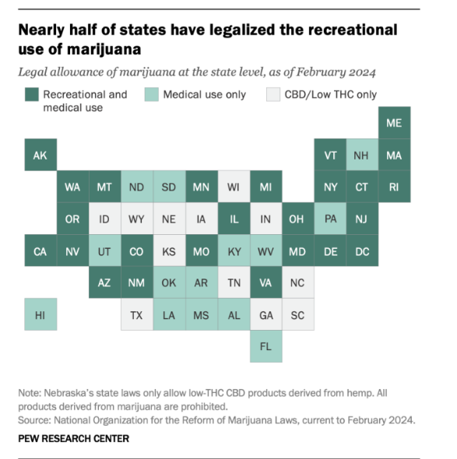
More than half the US population is living where cannabis is legal
States with legalized, well-regulated cannabis had reduced fentanyl deaths, reduced alcohol consumption
There are well established harm reduction models already

Slide 8
Reducing individual harms associated with cannabis use
There are numerous, well established models and strategies for harm reduction with cannabis
Start Low, Go slow: Educating people on starting with a low dose, and increasing slowly
Never Use Alone: Always use with someone
Route of administration: edibles and oils are safer for your body than smoking
Avoid mixing substances: Don’t mix cannabis with alcohol or other drugs
Talk about it: Discuss your cannabis use with others. Create safe non-judgmental spaces where people can discuss if they are concerned with their cannabis usage, including if they are using too frequently or worried about their consumption
Know what you’re consuming: As much as is possible, know what you’re consuming and what the dose is

Slide 9
Reducing Population Harms
The greatest harms from cannabis use come from an unsafe, unregulated supply and justice involvement due to it being criminalized

Slide 10
Harms from Justice System Involvement
North Carolina Arrests over 10,000 people every year on cannabis possession charges.
That’s 37% of all drug possession charges in the state
Only 800 arrests were due to sale or manufacturing of cannabis products
Possession- Marijuana
Possession- Opium and Cocaine
Possession- Synthetic Narcotics
Possession- Other Drugs
Source: NC SBI, 2024

Slide 11
Justice Involvement Harms
Despite use rates being higher among white populations, Black and Hispanic people are 3.5 times more likely to be arrested for cannabis related charges
Any arrest and conviction has lifelong, downstream consequences. This includes making it much more difficult to obtain housing, jobs, and education.
It costs NC over $50,000 per person per year to incarcerate someone. This is contributing to prison overcrowding and a drain on law enforcement, jail, court and prison resources
Notes:
https://northcarolinastatecannabis.org/laws/arrests

Slide 12
Harms of an unregulated supply
No Accuracy in Labelling- In a black and grey market, you have no idea what you’re actually consuming. Even in items labelled from vape shops may not accurately represent what is in them or how strong the dosage is.
  A study in VA prior to their legalization found that of 9 vapes that were advertised as “CBD only”, seven contained THC or a synthetic cannabinoid. There was no indication on the website, box, ingredients or labelling that these vapes would contain any active ingredient other than CBD.
Contamination- Heavy metals, mold, and pesticides are common contaminants currently found in cannabis products. There are no enforced safety standards to ensure that contaminants are under a safe level.
Funds the black market and drug cartels- Unregulated supply means money passes hands through illegal suppliers and distributors. Studies found that when states legalized cannabis, violent crime and cartel activity dropped.

Slide 13
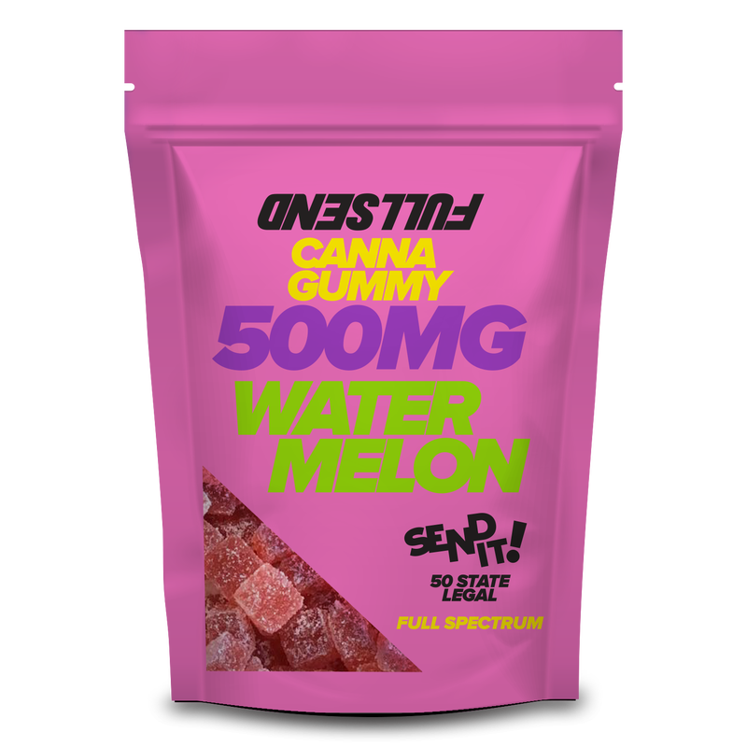
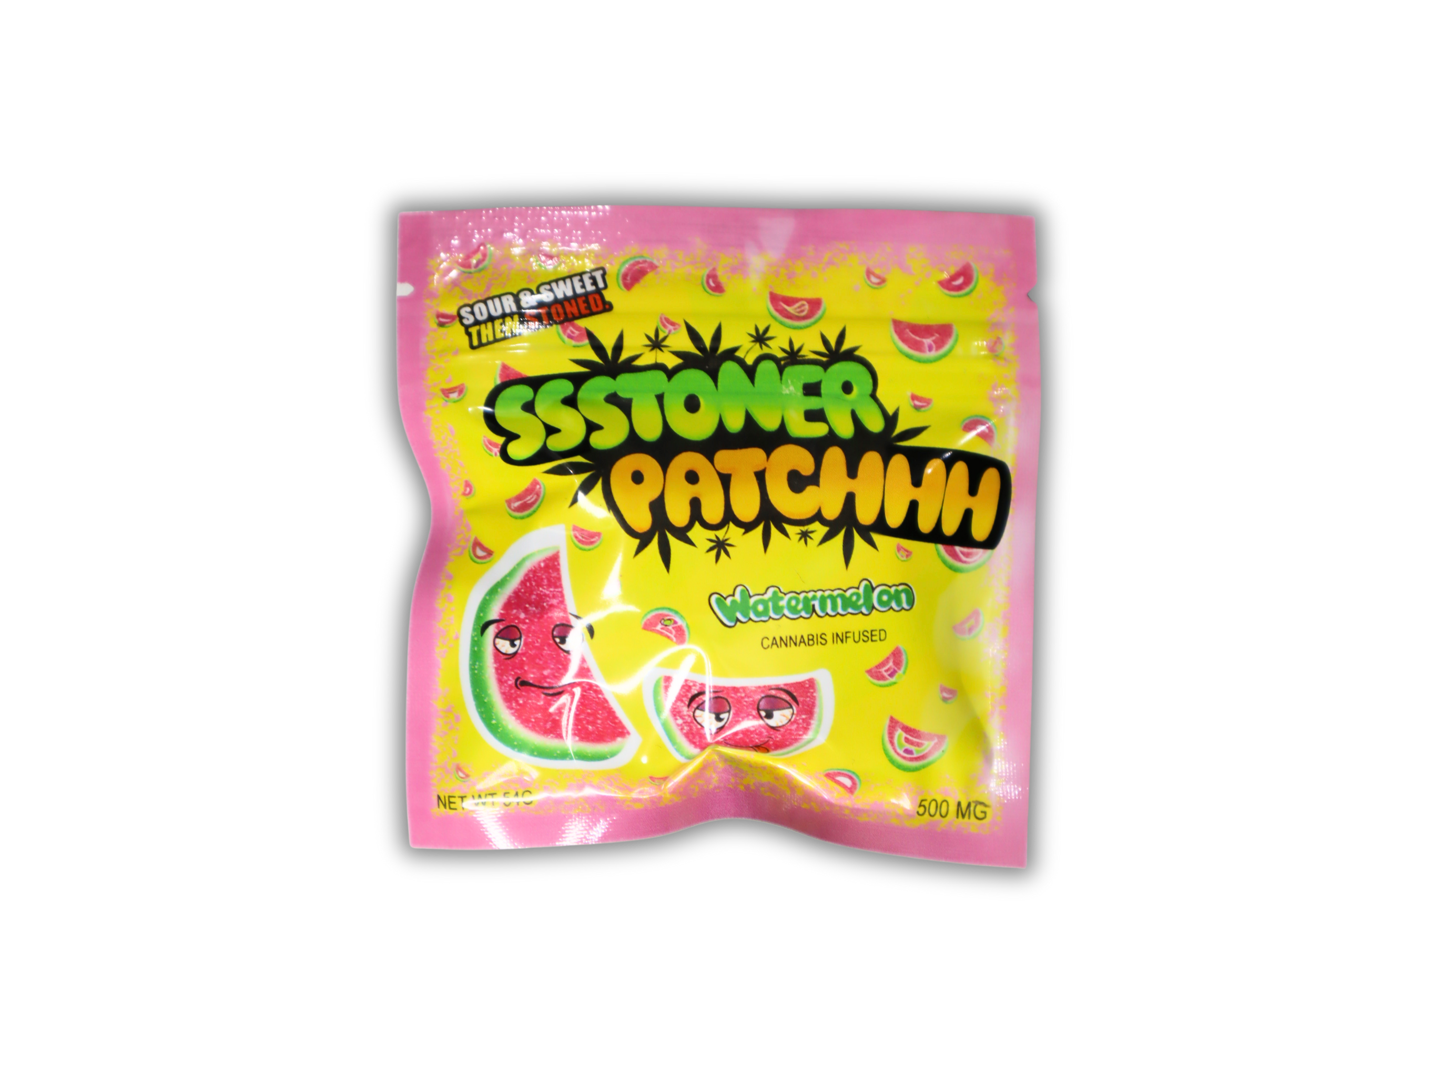
Harms of an unregulated supply
No Potency Limits- States with regulated markets are able to enact potency limits. Nearly all recorded acute adverse experiences have been associated with synthetic and very high dose products
No Marketing controls, including market tactics that specific market youth. There are numerous models from other states that limit products ability to look and taste like candy, including
Makes it harder to seek care- As we see across all illicit substances, it is dramatically harder to seek care when people have to admit to doing something illegal

