Slide 1
Creating and Processing a Low Income Energy Assistance Program (LIEAP) Application in NC FAST

Slide 2
Agenda
Creating a LIEAP Application in NC FAST
Processing a LIEAP Application in NC FAST

Slide 3
LIEAP
Energy Assistance programs (LIEAP ) use a customized application (Guided Interview) that is separated from the integrated application used for other benefit programs in NC FAST (e.g., FNS, Medicaid, CA, Subsidized Child Care Assistance, etc.). Therefore, only Energy Assistance can be included on an Energy Assistance application and only Eligibility workers can complete a separate, non-Energy application in NC FAST.
It is critical to perform a thorough, exhaustive Person Search in NC FAST for everyone included on the application. This will help prevent duplicate person registrations and incorrect eligibility determinations.
Search NC FAST for each household member to see if they are already registered in NC FAST. Refer to the Searching for Persons job aid.
If any Household Member is not registered in NC FAST, register each household member before continuing the application process. Refer to the Registering Persons job aid for detailed instructions. This step should occur before starting any Energy application.

Slide 4

Review each household member’s Person page for accuracy, and whether they were previously registered. Update Person page information, as necessary.
Energy Applications and Cases are based on the Head of Household’s Private Address, where the client resides, which indicates the location requiring heating or cooling. A Mailing Address is not required for Energy cases and will not be transferred to the Energy Assistance application.
If the Mailing Address exists, on the person page or the Energy Assistance Integrated Case, it will be printed on all Energy Assistance notices. If evidence needs to be added, users can end date an existing Private Address and add a new record. Do not delete any existing evidence on a Person page.

Slide 5
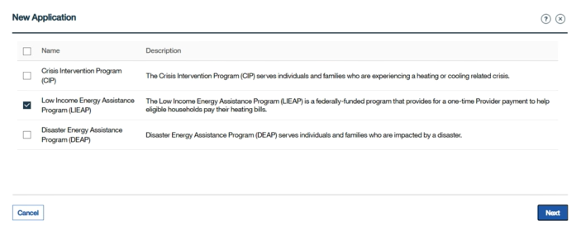
Initial LIEAP Application
Navigate to the Head of Household’s Person page. Click the Applications tab.
The Applications page displays. Click the New Application hyperlink.
The New Application pop-up appears. Select the Low Income Energy Assistance Program (LIEAP) check box then click Next.

Slide 6
Information About the Claimant
Enter or select the applicable information then click Next.
An asterisk (*) indicates mandatory information. Some mandatory information (like Race and Ethnicity) may not always be marked with an asterisk. After entering or selecting all mandatory information on a Guided Interview page, click Next to progress to the next page.

Slide 7
LIEAP
The question, Does this person have an SSN? is a required field.
Select Yes if the Head of Household has an SSN. The Head of Household’s SSN then appears in the field below (if SSN evidence was to the Head of Household’s Person page).
Select No if the Head of Household (an ineligible alien, for example) does not have an SSN. Select N/A for the Has the claimant applied for an SSN? question that appears. Answering Yes to Is this person disabled? will trigger NC FAST to apply the $85 Medical Deduction (if SSI is chosen as the client’s Benefit income type later in the Guided Interview).
Selecting Yes in response to the question: Has the claimant lived at this address for 12 months or longer? triggers NC FAST to ask questions later about all the household’s Energy providers.

Slide 8
The Claimant’s Home Section
Select the Energy Provider from the Provider Name drop-down menu.
All fields are mandatory on the Energy Provider Search page.
On the Select Energy Provider screen, a provider must be selected.
Housing Status is mandatory for the application to be submitted. Select an applicable option from the drop-down menu.
The application date for LIEAP applications submitted after 5:00 pm, weekends and holidays will be updated to the next business day in NC FAST.

Slide 9
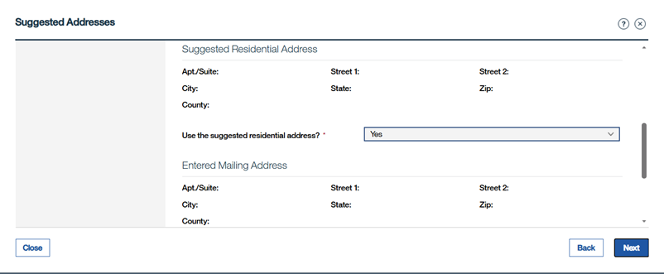
Suggested Addresses
Suggested Residential Address Displays.
Review address and click Yes if applicable and then click Next to progress to the next page.

Slide 10
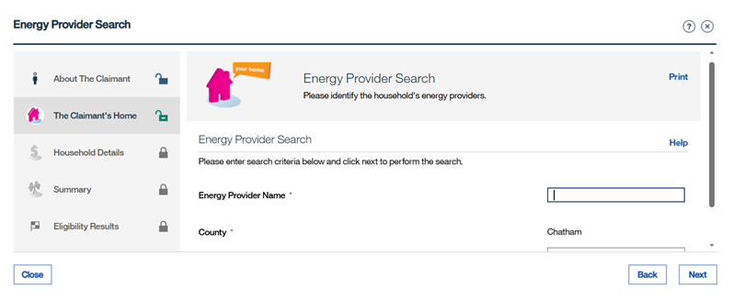
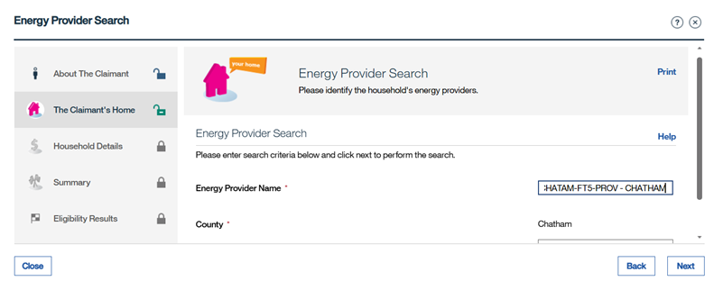
Energy Provider Search
Energy Provider Search: Enter the applicable information then click Next.
Select the Energy Provider from the Provider Name drop-down menu.

Slide 11
Household Details
Enter or select information about the Household.
A validation message will display when a negative value is entered for household resources, expenses and income in ePASS and NC FAST. The validation message will display as follows: A negative amount must not be entered for household resources, income or expenses..
Add income, expenses, and resources (resources are not applicable for FY 7/1/2025-6/31/2026) for all household members. LIEAP requires the month prior to the application amounts for these.

Slide 12
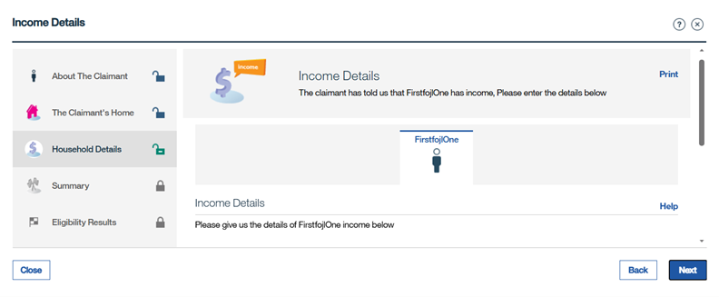
If any household member has income, the Income Details screen display.
Enter any applicable information and then click Next.

Slide 13
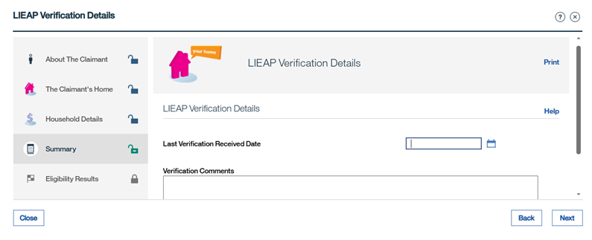
LIEAP Verification Details
Enter the last verification received date and comments then click Next.
The application cannot be authorized if the last verification received date is not entered.

Slide 14
Heat and Electric Vendor Section
Select the household’s primary heat vendor from the drop-down menu.
Select the household’s electric vendor from the drop-down menu then click Next.
An authorized rep will be assigned to an application only if the Energy Provider is not registered with FIS.

Slide 15
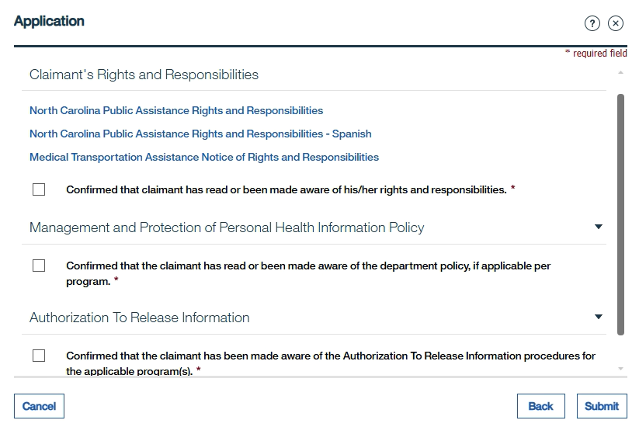
Claimant’s Rights and Responsibilities
Claimant’s Rights and Responsibilities: Select each check box then click Submit.
Note: If needed, Energy workers can open the Client Rights and Responsibilities document (in either English or Spanish) and print it using the hyperlinks on this page.

Slide 16
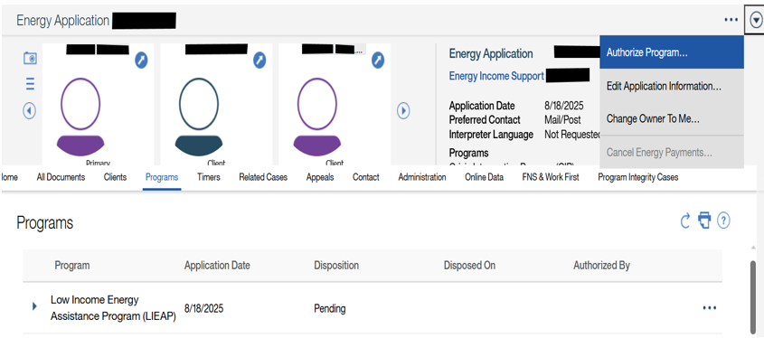
Enhancing your presentation
  To authorize the application: Click the Tab Actions Menu then select Authorize Program.

Slide 17
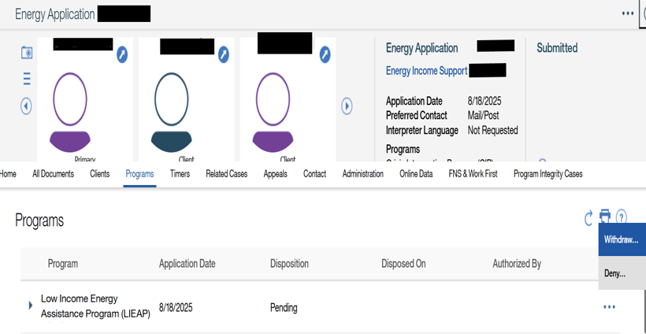
  To Deny or Withdraw the application:
  Click Programs tab
  Click the List Actions Menu then select Deny or Withdraw.
Enhancing your presentation

Slide 18
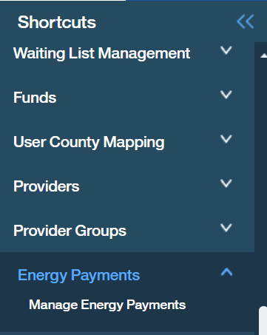
All Energy payments must be added to a payment request in NC FAST. Recording that a check was issued is no longer required in NC FAST. All payments are “State Issued” and sent electronically to the Energy provider or Authorized Representative (AR).
From the Home page, click the Clients and Outcomes tab.
Click the toggle to expand the Shortcuts panel
Click the Energy Payments folder and then select the Manage Energy Payments hyperlink
The Manage Energy Payments page displays. Click the Tab Actions Menu then select New Payment Request.

Slide 19
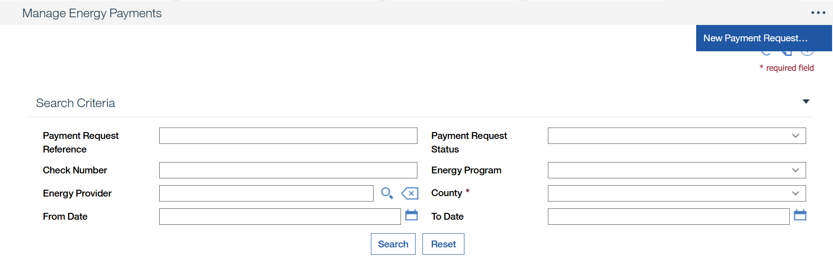
Manage Energy Payments Contd.
The Provider Payment Request wizard appears. Click the Energy provider magnifying glass
This wizard allows the user to search for, select, and view pledge payment records to be sent to the County Finance Office for payment processing to the provider(s).

Slide 20
Manage Energy Payments Contd.
The Energy Provider Search pop-up appears. Select or enter the applicable information then click Search.

Slide 21
Manage Energy Payments Contd.
The search results display. Click the Select hyperlink for the applicable Provider Name.
The Provider Payment Request wizard displays with the Energy Provider
Select LIEAP from the drop-down menu to filter by Energy Program.
Select the County in which the Energy provider is enrolled.

Slide 22
Manage Energy Payments Contd.
Enter, at least one date.
Click Search.
The search results display. Select the check box(s) for all applicable clients to include in the Payment Request then click Next.

Slide 23
Manage Energy Payments Contd.
The Payment Request Summary wizard appears. Click Submit.

Slide 24
Questions

