Slide 1

Crisis Intervention Program (CIP)
Creating and Processing
(CIP)Application in NC FAST
Energy Program

Slide 2
Creating a CIP Application in NC FAST
Processing a CIP application in NC FAST
Agenda

Slide 3
Energy Assistance programs (CIP ) use a customized application (Guided Interview) that is separated from the integrated application used for other benefit programs in NC FAST (e.g., FNS, Medicaid, CA, Subsidized Child Care Assistance, etc.). Therefore, only Energy Assistance can be included on an Energy Assistance application and only Eligibility workers can complete a separate, non-Energy application in NC FAST.
It is critical to perform a thorough, exhaustive Person Search in NC FAST for everyone included on the application. This will help prevent duplicate person registrations and incorrect eligibility determinations.
Search NC FAST for each household member to see if they are already registered in NC FAST. Refer to the Searching for Persons job aid.
If any Household Member is not registered in NC FAST, register each household member before continuing the application process. Refer to the Registering Persons job aid for detailed instructions. This step should occur before starting any Energy application.
CIP

Slide 4

Review each household member’s Person page for accuracy, and whether they were previously registered. Update Person page information, as necessary.
Energy Applications and Cases are based on the Head of Household’s Private Address, where the client resides, which indicates the location requiring heating or cooling. A Mailing Address is not required for Energy cases and will not be transferred to the Energy Assistance application.
If the Mailing Address exists, on the person page or the Energy Assistance Integrated Case, it will be printed on all Energy Assistance notices. If evidence needs to be added, users can end date an existing Private Address and add a new record. Do not delete any existing evidence on a Person page.

Slide 5
Navigate to the Head of Household’s Person page. Click the Applications tab.

Slide 6
The Applications page displays. Click the New Application hyperlink.

Slide 7
The New Application pop-up appears. Select the Crisis Intervention Program (CIP) check box then click Next.

Slide 8
The Guided Interview is divided into several sections. Enter or select the applicable information on each page.

Slide 9
The Guided Interview is divided into several sections. Enter or select the applicable information on each page.
Information About The Claimant: Enter the applicable information then click Next.

Slide 10
Suggested Addresses: Select the applicable information then click Next.

Slide 11
About the Claimant (Claimant Details): Enter the applicable information then click Next.
An asterisk (*) indicates required information After entering or selecting all mandatory information on a Guided Interview page, click Next to progress to the next page.

Slide 12

Does this person have an SSN? is a required field. Select Yes if the Head of Household has an SSN. The Head of Household’s SSN then appears in the field below (if SSN evidence has been added to the Head of Household’s Person page).
Select No if the Head of Household (an ineligible alien, for example) does not have an SSN. Select N/A for Has the claimant applied for an SSN?
Selecting Yes to Is this person disabled? will trigger NC FAST to apply the $85 medical deduction (if SSI is chosen as the client’s Benefit income type later in the Guided Interview).
Selecting Yes to Has the claimant lived at this address for 12 months or longer? triggers NC FAST to ask questions later about all the household’s Energy providers.

Slide 13
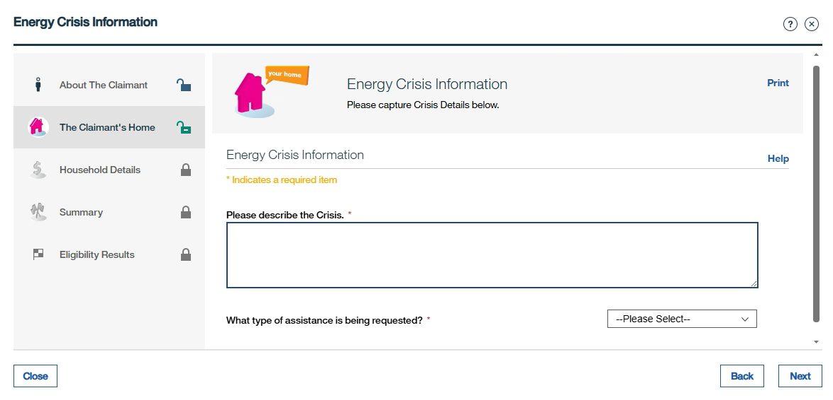
Energy Crisis Information: Enter the applicable information then click Next.
An asterisk (*) indicates required information After entering or selecting all mandatory information on a Guided Interview page, click Next to progress to the next page.

Slide 14

If an Energy worker does not enter or select an answer to a required question, clicking Next generates a validation message that lists the information that must be supplied to progress further. Enter or select answers to those questions then click Next.
When the application progresses successfully to the next page, NC FAST automatically saves all information entered on the previous page. The Energy worker can select Close (at bottom left) at any time to end the Guided Interview. The next page allows the worker to choose whether to save the application and continue later (In-Progress status) or quit/delete it.

Slide 15
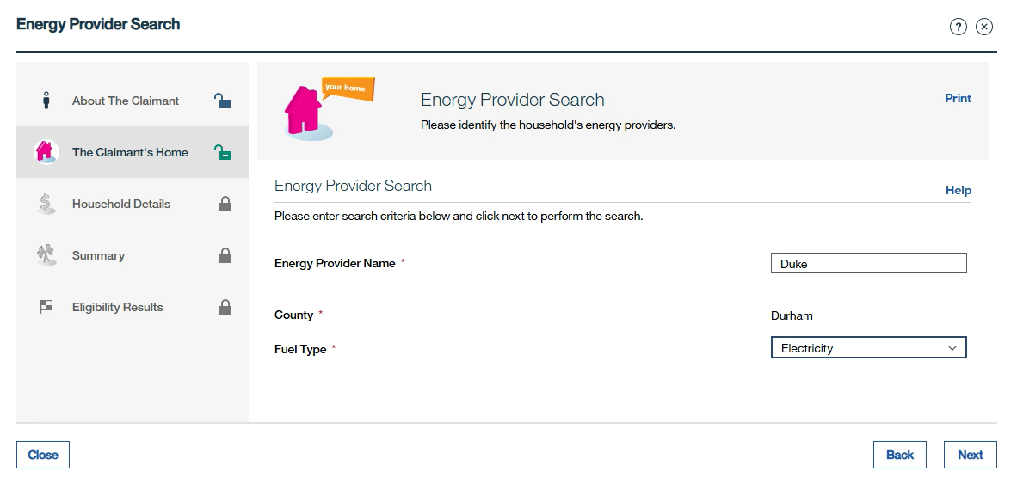
Energy Provider Search: Enter the applicable information then click Next.

Slide 16
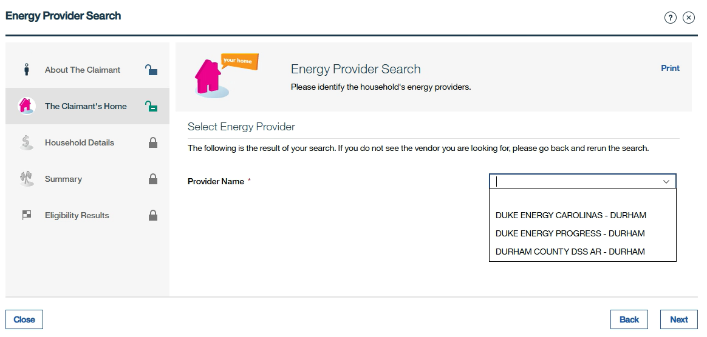
Select Energy Provider: Select the applicable information then click Next.

Slide 17
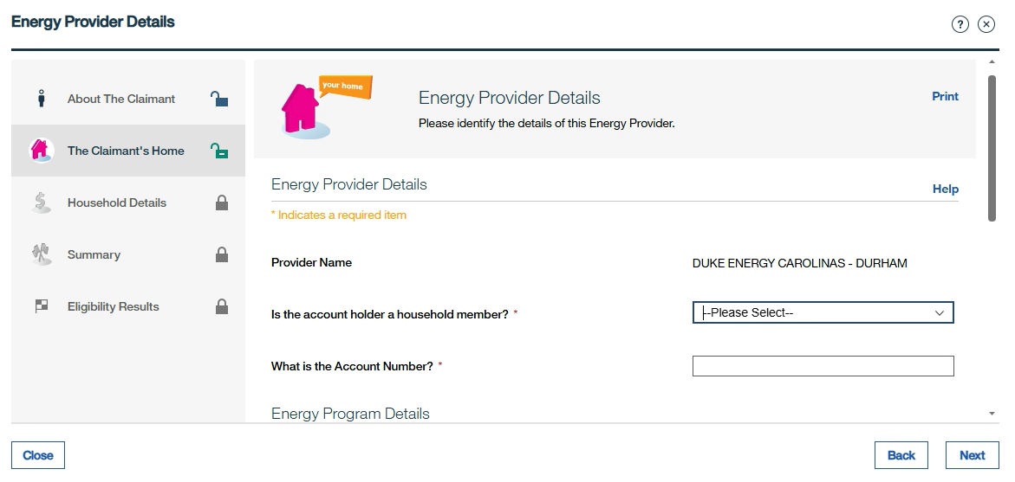
Energy Provider Details: Select or Enter the applicable information then click Next.

Slide 18
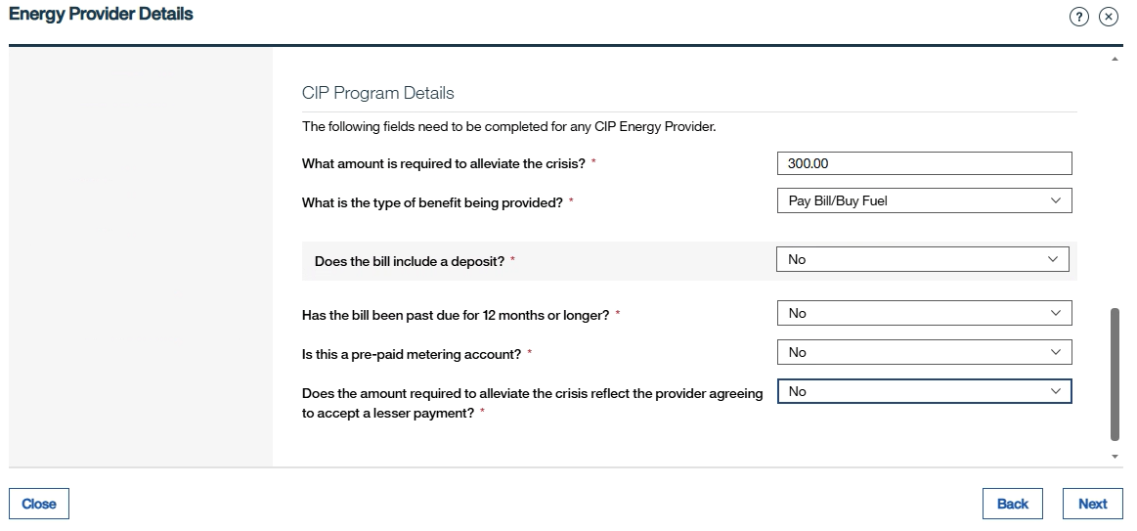
CIP Program Details: Select or Enter the applicable information then click Next.

Slide 19
Household Details: Select the applicable information then click Next.

Slide 20

If Yes is selected from any of the drop-down menus from the previous slide, select the radio button beneath the Head of Household’s name.
Add income, expenses, and resources for all household members. CIP requires current month amounts for these.
NC FAST classifies some sources of income as Benefit Income instead of as Unearned Income. For example, SSI is Benefit Income, not Unearned Income.

Slide 21
Review The Claimant’s Answers: Confirm all the information is accurate then click Next.
The Review the Claimant’s Answers page summarizes all information entered on the Guided Interview. Review this page thoroughly. Edit, delete, or add information as necessary on this page.

Slide 22
CIP Verifications Details: Click the Have All Verification Been Received drop-down menu then select the applicable option.
Enter the Last Verification Received Date.
Select the check box that states, “You are confirming that all verifications have been received, and the last verification date has been entered correctly. The application timer will now begin to show 1 or 2 business days, depending on the status of the account.”

Slide 23
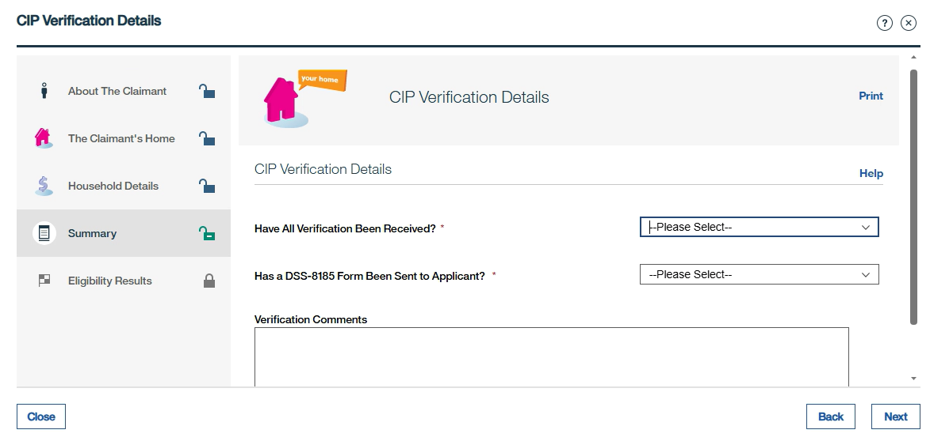
CIP Verification Details Continued: Enter the applicable information then click Next.

Slide 24
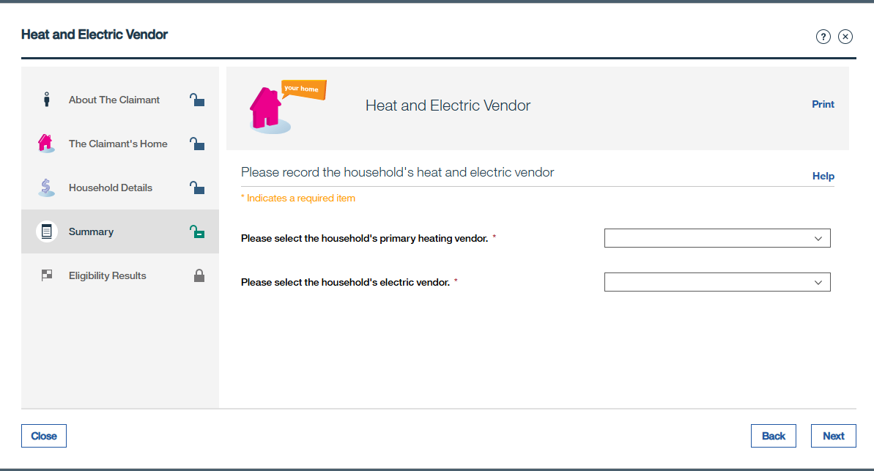
Select the household’s primary heat vendor from the drop-down menu.
Select the household’s electric vendor from the drop-down menu then click Next.
An authorized rep will be assigned to an application only if the Energy Provider is not registered with FIS.

Slide 25
Eligibility Results: Review all information to make certain the eligibility determination matches expectations then click Next.

Slide 26

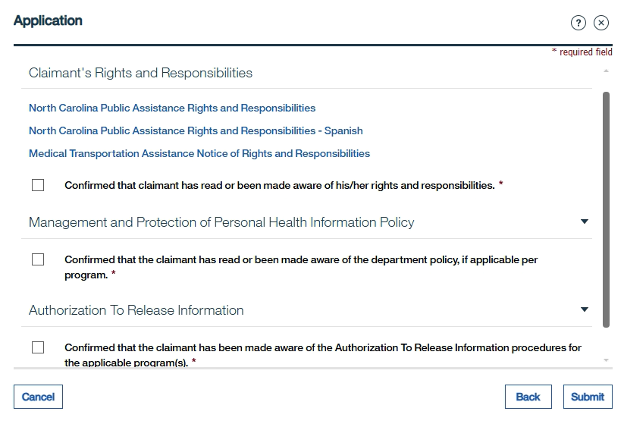
Claimant’s Rights and Responsibilities: Select each check box then click Submit.
Note: If needed, Energy workers can open the Client Rights and Responsibilities document (in either English or Spanish) and print it using the hyperlinks on this page.

Slide 27

The Application tab on the Head of Household’s Person page displays. Click the reference number hyperlink for this application.
Note: The application status must be Submitted for the reference number to become a hyperlink. Click the refresh icon to update the application status to Submitted.
The Energy Application home page displays. Click the Clients tab to confirm that NC FAST has matched all household member information entered on the Energy application with information (name, SSN, date of birth) that appears on each household member’s Person page:
A list of household members included on this application display. A status of No in the registered column indicates that the person’s name, date of birth, and/or SSN as entered on the application does not match these same details on their Person page.
For each household member with No in this column, click the List Actions Menu then select Match Client or Potential Match. Refer to the Match Client job aid for guidance on completing the Match Client process.

Slide 28

After successfully completing the Match Client process, Yes should now appear in the Registered column for every household member.
Note: NC FAST automatically matches name, SSN, and date of birth (Status = Yes) if what is entered on an application matches this same information on the Person page.
Click the Online Data tab to check multiple online databases that might verify evidence included on the application. Refer to the Requesting and Viewing Online Data OVS job aid. Make a note of any OVS results that do not match the details recorded during the Guided Interview.
Click the FNS & Work First tab to view any income, resources and/or expenses used to determine a household member’s eligibility for active Food & Nutrition Services (FNS) or Work First/Cash Assistance case. Note any details that affect the household’s Energy Assistance application.
If either OVS results or information found on the FNS & Work First tab indicate that evidence or verification source needs to be edited/updated on the Guided Interview:

Slide 29


Click the Tab Actions Menu then select Edit Application Information.
The Summary page of the Guided Interview pop-up appears. Select Edit, Delete or Add (if available) for any section of the Summary page to change information recorded earlier on the Guided Interview.
Update information, as necessary.
Change the verification method, if necessary.
Select Yes When all verifications have been received.
Enter the Last Verification Received Date.
Select the check box that states You are confirming that all verifications have been received, and the last verification date has been entered correctly. The application timer will now begin to show 1 or 2 business days, depending on the status of the account.
Note: Add additional required verification comments. Do not delete previous comments.

Slide 30
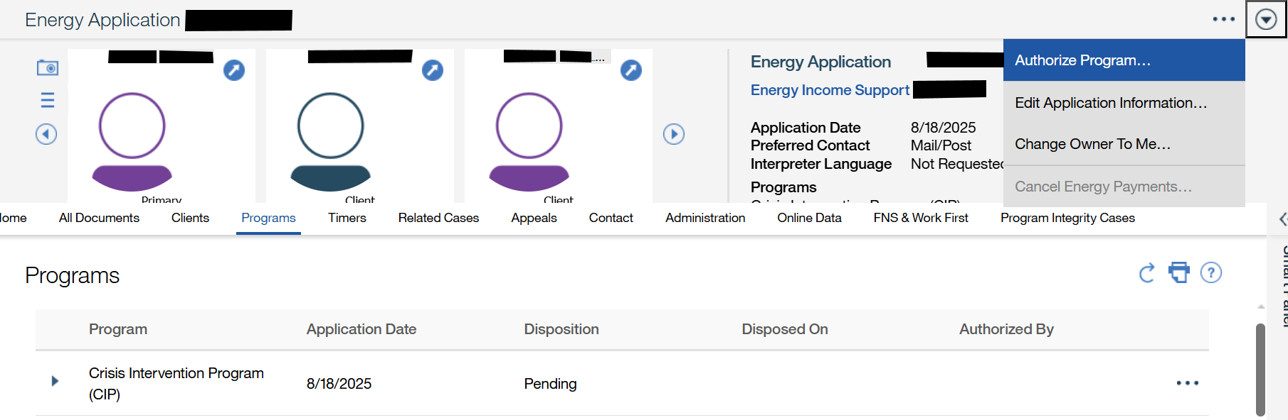
To authorize the application:
Click the Tab Actions Menu then select Authorize Program.
Navigato the Head of Household’s Person page. Cick the Applications tab.

Slide 31
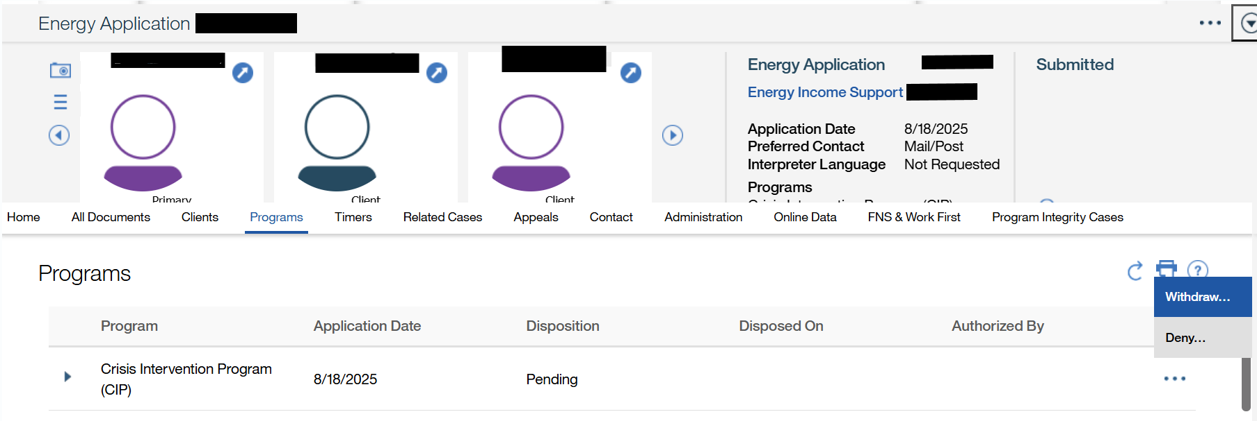
To Deny or Withdraw the application:
Click Programs tab
Click the List Actions Menu then select Deny or Withdraw.
Navigato the Head of Household’s Person page. Cick the Applications tab.

Slide 32
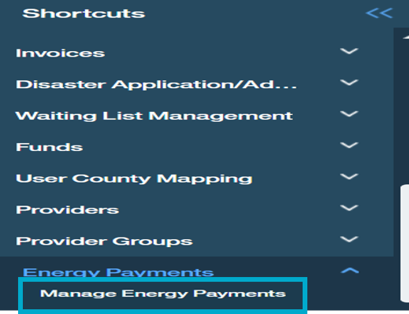
All Energy payments must be added to a payment request in NC FAST. Recording that a check was issued is no longer required in NC FAST. All payments are “State Issued” and sent electronically to the Energy provider or Authorized Representative (AR).
From the Home page, click the Clients and Outcomes tab.
Click the toggle to expand the Shortcuts panel
Click the Energy Payments folder and then select the Manage Energy Payments hyperlink
The Manage Energy Payments page displays. Click the Tab Actions Menu then select New Payment Request.

Slide 33

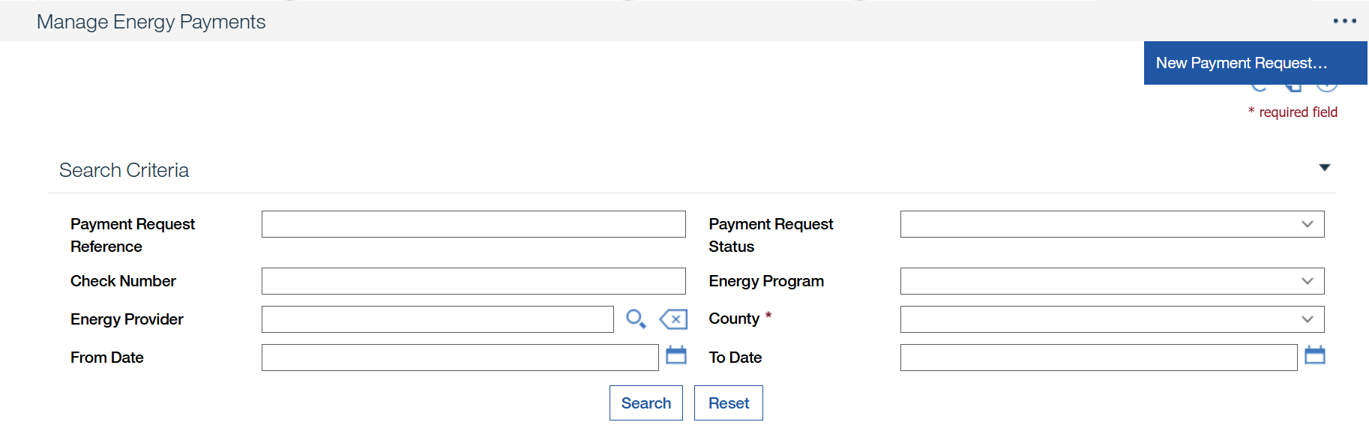
All Energy payments must be added to a payment request in NC FAST. Recording that a check was issued is no longer required in NC FAST. All payments are “State Issued” and sent electronically to the Energy provider or Authorized Representative (AR). - Continued
The Manage Energy Payments page displays. Click the Tab Actions Menu then select New Payment Request.
The Provider Payment Request wizard appears. Click the Energy provider magnifying glass
This wizard allows the user to search for, select, and view pledge payment records to be sent to the County Finance Office for payment processing to the provider(s).

Slide 34
All Energy payments must be added to a payment request in NC FAST. Recording that a check was issued is no longer required in NC FAST. All payments are “State Issued” and sent electronically to the Energy provider or Authorized Representative (AR). - Continued
The Energy Provider Search pop-up appears. Select or enter the applicable information then click Search.

Slide 35
All Energy payments must be added to a payment request in NC FAST. Recording that a check was issued is no longer required in NC FAST. All payments are “State Issued” and sent electronically to the Energy provider or Authorized Representative (AR). - Continued
The search results display. Click the Select hyperlink for the applicable Provider Name.
The Provider Payment Request wizard displays with the Energy Provider
Select CIP from the drop-down menu to filter by Energy Program.
Select the County in which the Energy provider is enrolled.

Slide 36
All Energy payments must be added to a payment request in NC FAST. Recording that a check was issued is no longer required in NC FAST. All payments are “State Issued” and sent electronically to the Energy provider or Authorized Representative (AR). - Continued
Enter, at least one date.
Click Search.
The search results display. Select the check box(s) for all applicable clients to include in the Payment Request then click Next.

Slide 37
All Energy payments must be added to a payment request in NC FAST. Recording that a check was issued is no longer required in NC FAST. All payments are “State Issued” and sent electronically to the Energy provider or Authorized Representative (AR). - Continued
The Payment Request Summary wizard appears. Click Submit.

Slide 38

Questions

