Slide 1
Crosswalk from the XS337 to the WC302 Report
Presented by: Pamela Bell & Caroline Hedrick
SEPTEMBER 21, 2021

Slide 2
XS337 REPORT

Slide 3
XS337 REPORT
Can be pulled monthly along with other reports in NCXCloud.
DSS Report Titled: DHRWCA WCA375 XS337 CTY SUM REP
XS337 shows a county’s cumulative, year to date reimbursement.
Total of Federal and State % is average reimbursement.
Fiscal year end 1571 reimbursement (June-May service month; July-June payments) is shown on the year end WC302 Report along with other program reimbursement.
CFDA (Catalog of Federal Domestic Assistance) Summary Report – can be used to reconcile revenues monthly. You would reconcile based on how your county records it’s revenues.

Slide 4
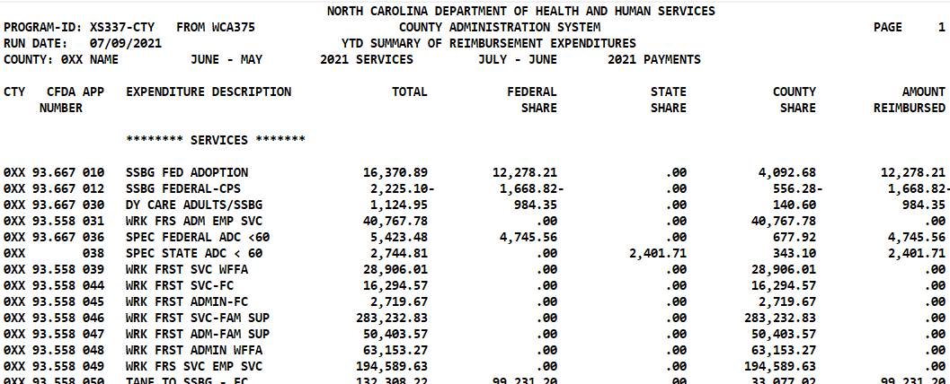
XS337 REPORT
NCXCloud Name:
DHR/WCA/WCA375 XS337 CTY SUM REP

Slide 5
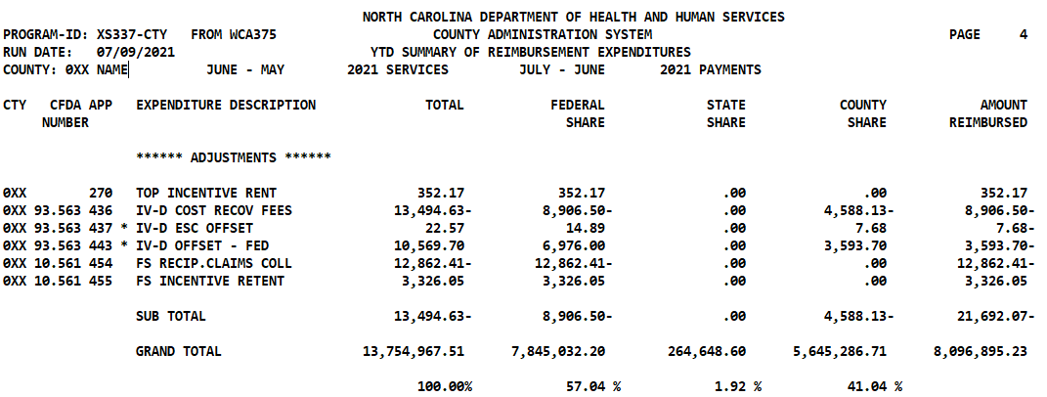
*THESE ARE MEMO FIGURES AND THEY ARE NOT INCLUDED IN THE SUB TOTAL FIGURE OR THE GRAND TOTAL
Out of $13.7 million in expenses, county was reimbursed a total of $8,109,680.80.
58.96% of the county’s 1571 reported expenditures were reimbursed.
41.04% of 1571 expenses were funded by county dollars.

Slide 6
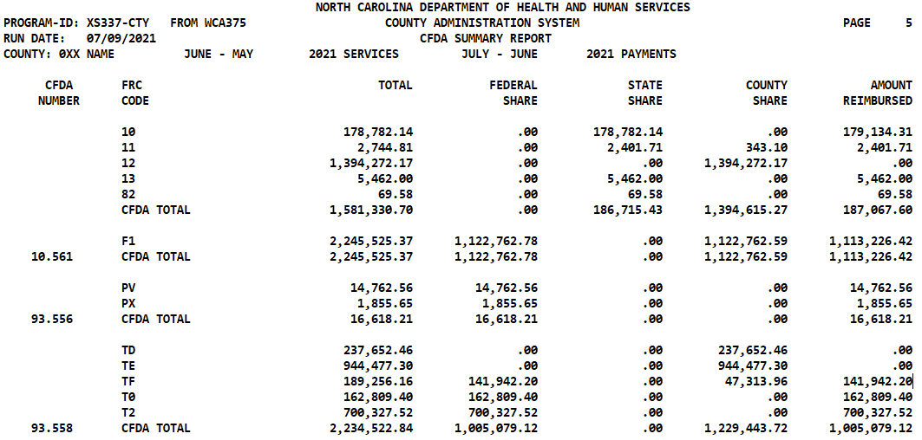
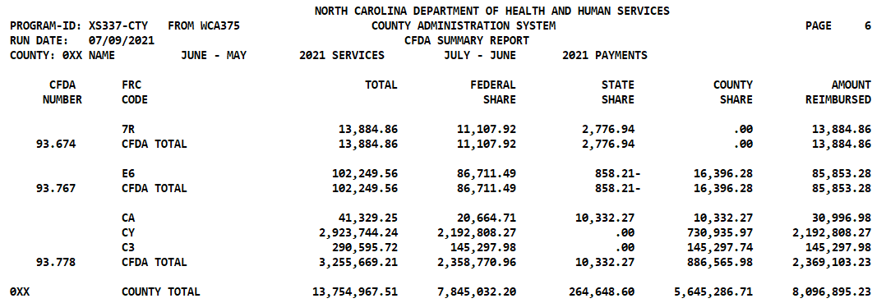
Last pages of 337 report groups 1571 reimbursement by CFDA

Slide 7
WC302 REPORT

Slide 8
WC302 REPORT
Updated monthly and is located in NCXCloud. Title: DHR/WCA 302 BUDGETED CTY EXP. RPT
(Note: Stand-alone CSS does not have a WC302 report. IV-D information is included in the county DSS report.)
Summarized by program and shows expenditures for County Administration and Services, adjustments to County Administration, and Public Assistance.
Shows expenses / revenues from 1571 and additional sources
Grouped by CFDA number
Shows overall ratio of percentages of Federal, State, and County
Auditors will request report in order to select programs for audit and to reconcile to county ledger

Slide 9
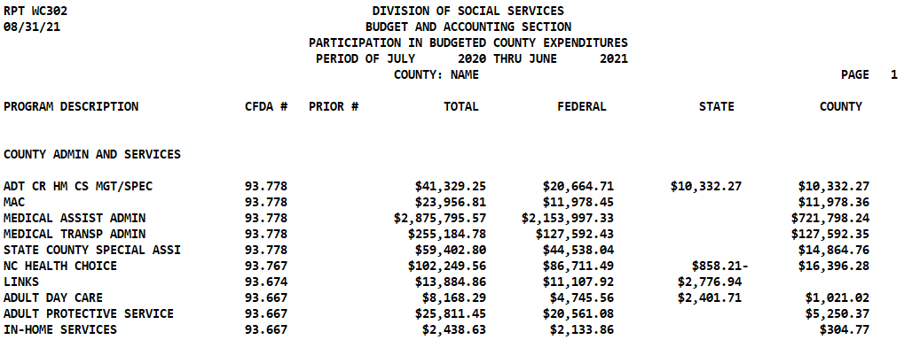
NCXCloud Name:
DHR/WCA 302 BUDGETED CTY EXP. RPT
WC302…A closer look…
This report is for a full fiscal year. June - May service months REIMBURSED July - June

Slide 10
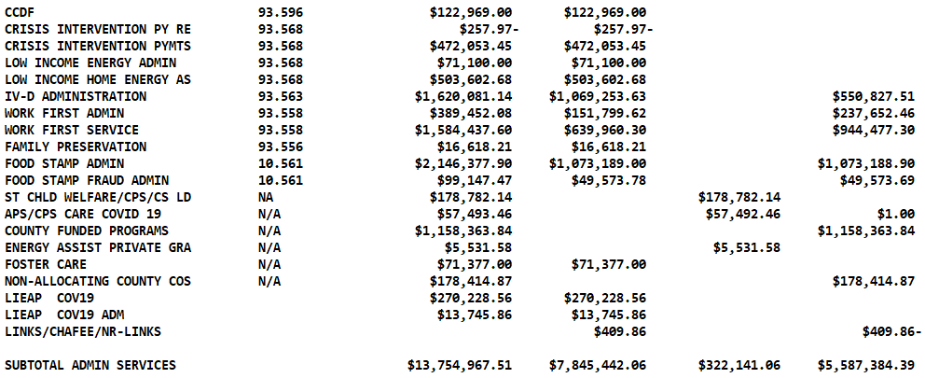
WC302…

Slide 11
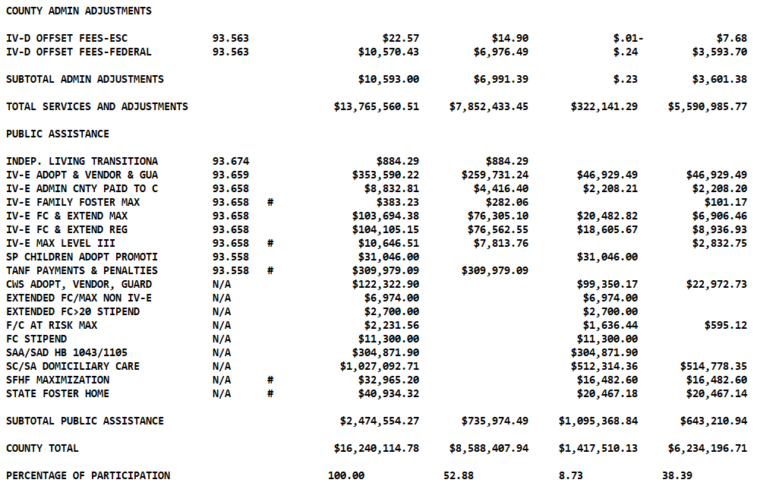

Slide 12
WC302 Report Footnotes
* FOR PROGRAM DESCRIPTION PRECEDED BY AN '*', PLEASE REFER TO THE XS337 FOR THE CORRECT STATE AND COUNTY AMOUNTS.
* FOR DETAILS ON ALL FOOD STAMP PROGRAM INCENTIVES PLEASE REFER TO THE EPICS PRODUCED FRD 428 REPORTS.
* THE # INDICATES THE REPORTING IS FROM PRIOR MONTH.
* THE @ INDICATES THE REPORTING FROM VENDOR PAYMENT IS PRIOR MONTH, BUT THE REPORTING FROM ADOPTION IS CURRENT MONTH.
FOR QUESTIONS ON COUNTY ADMIN AND SERVICES CONTACT MYRA DIXON AT Myra.Dixon@dhhs.nc.gov

Slide 13
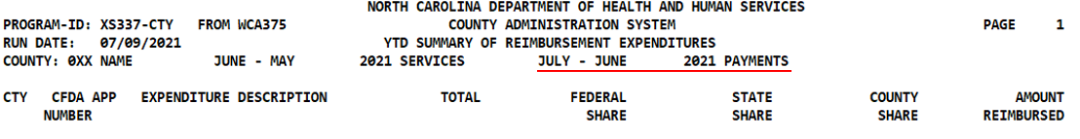
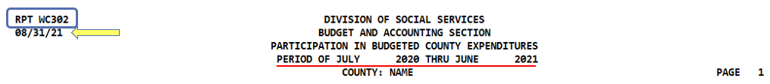
Compare reporting period…

Slide 14

XS337
WC302
. . . . . . . . . .
. . . . . . . . . .

Slide 15
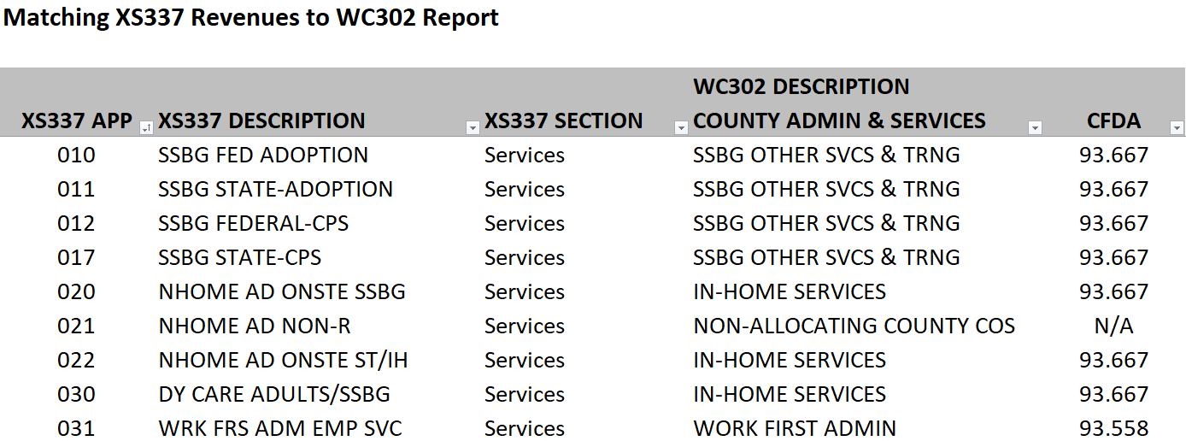
Crosswalk XS337 to WC302 Report
Protected Excel Spreadsheet that can be filtered by XS337 information, WC302 description, and CFDA number.

Slide 16
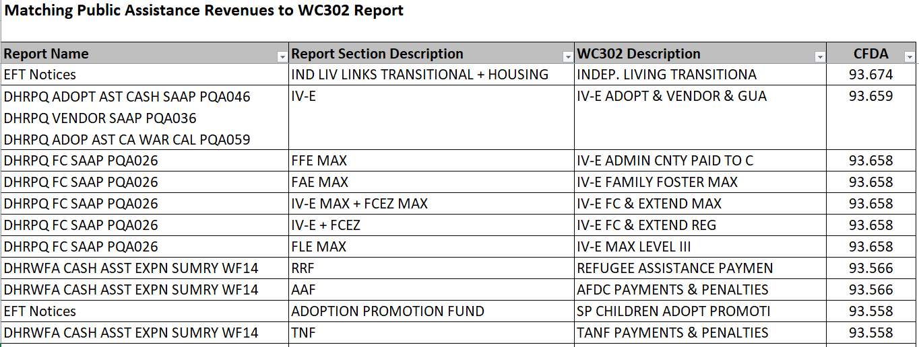

Slide 17
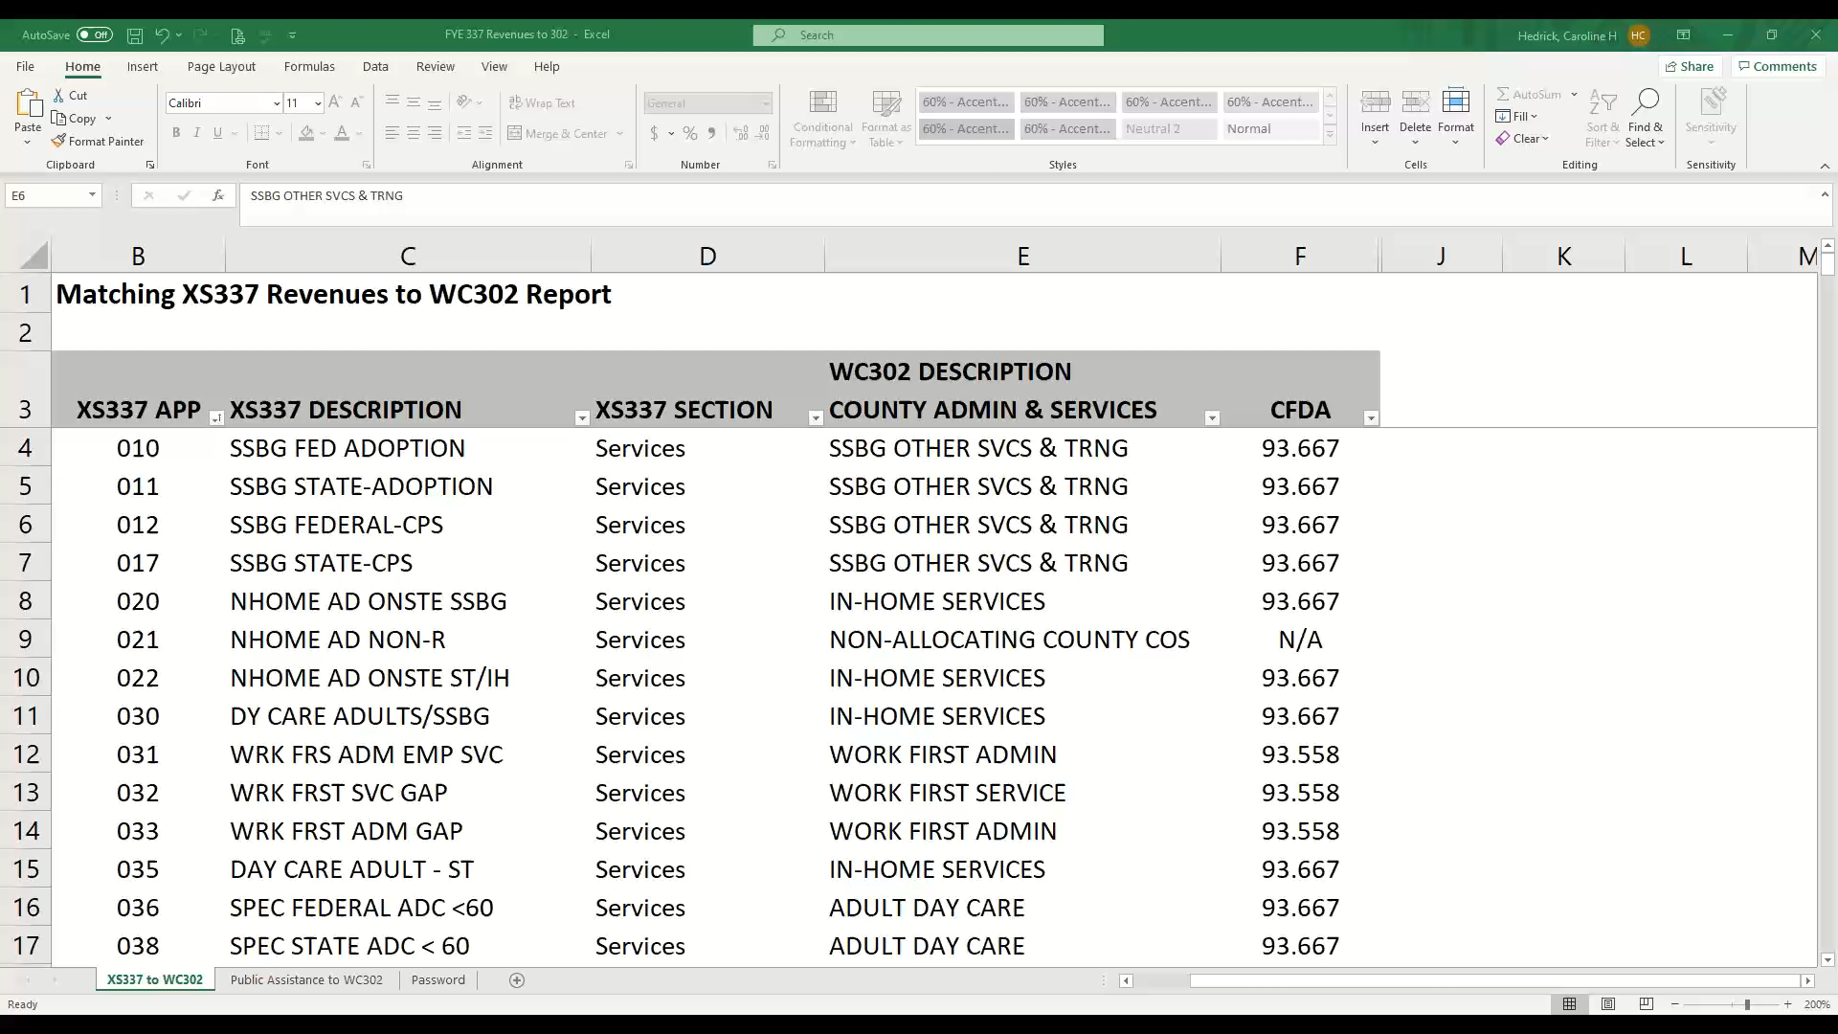
Crosswalk Demo Video…
Hover cursor over video, then click
at bottom to start…

Slide 18

Use Crosswalk to FIND…
All XS337 App Codes for 302 Description “PERM PLAN SVC & ADM”
Find these app codes on your XS3337 report and add the values (exclude * app codes)
All XS337 App Codes for CFDA 93.568
Find these app codes on your XS3337 report and add the values (exclude * app codes)
LET’S PRACTICE
Did the app codes equal the WC302 line PERM PLAN SVC & ADM?
Did the app codes equal the XS337 CFDA 93.568?

Slide 19

QUESTIONS

Slide 20
How can I use these reports?
XS337 Year to Date totals can be used for:
  Monthly monitoring of federal, state, and county reimbursements processed through the 1571.
  Monthly 1571 revenue reconcilement.
  Monthly monitoring of total county dollars usage (1571 reporting).
    Drilling down to county spending by App Code
  Quick access of total federal, state, and county reimbursement percentages.
  Tracking revenue reimbursement by App Code Totals.

Slide 21
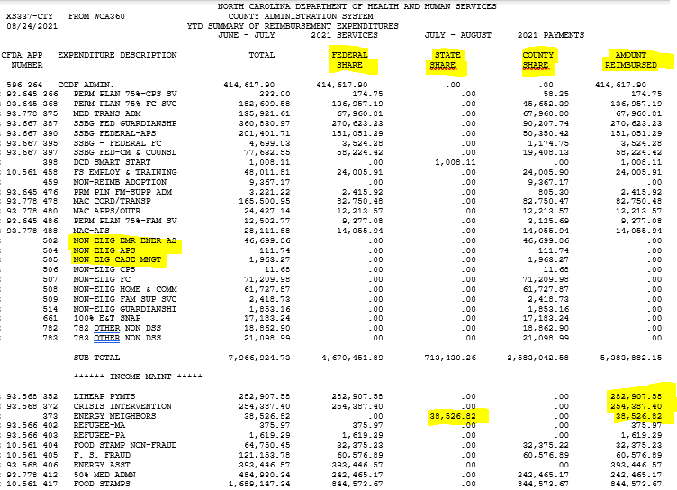
XS337 REPORT

Slide 22
XS337 REPORT
NORTH CAROLINA DEPARTMENT OF HEALTH AND HUMAN SERVICES
PROGRAM-ID: XS337-CTY FROM WCA360 COUNTY ADMINISTRATION SYSTEM
RUN DATE: 08/24/2021 YTD SUMMARY OF REIMBURSEMENT EXPENDITURES
JUNE - JULY 2021 SERVICES JULY - AUGUST 2021 PAYMENTS
CFDA APP EXPENDITURE DESCRIPTION TOTAL FEDERAL STATE COUNTY AMOUNT
NUMBER SHARE SHARE SHARE REIMBURSED
******** SERVICES *******
103 ST CPS CASELOAD REDU 250,076.51 .00 250,076.51 .00 250,076.51
115 CPS STATE 20,716.87 .00 20,716.87 .00 20,716.87
117 CWS NH EXP 273,900.55 .00 273,900.55 .00 273,900.55
124 ADOPT ACCESS CI 13,880.42 .00 .00 13,880.42 .00
93.667 127 CPS TANF TO SSBG 569,778.00 569,778.00 .00 .00 569,778.00
93.778 128 ADULT HOME SPEC 125,958.27 62,979.15 31,489.56 31,489.56 94,468.71
93.659 132 IVE OPTNL ADOPT TNG 28,492.66 14,246.33 .00 14,246.33 14,246.33
93.556 136 COM RESPONSE PGM 14,423.21 14,423.21 .00 .00 14,423.21
93.667 156 INH AIDE OFF 60 & UP 23,176.01 20,279.01 .00 2,897.00 20,279.01
93.667 170 ADULT PRO SVC 23,613.92 17,710.45 .00 5,903.47 17,710.45
93.667 214 SSBG FED AT RSK CM 72,852.09 54,639.08 .00 18,213.01 54,639.08
93.556 220 FAMILY REUNIFICATION 5,552.55 5,552.55 .00 .00 5,552.55

Slide 23
XS337 REPORT
NORTH CAROLINA DEPARTMENT OF HEALTH AND HUMAN SERVICES
PROGRAM-ID: XS337-CTY FROM WCA360 COUNTY ADMINISTRATION SYSTEM
RUN DATE: 08/24/2021 CFDA SUMMARY REPORT
JUNE - JULY 2021 SERVICES JULY - AUGUST 2021 PAYMENTS
CFDA FRC TOTAL FEDERAL STATE COUNTY AMOUNT
NUMBER CODE SHARE SHARE SHARE REIMBURSED
09 1,008.11 .00 1,008.11 .00 304.11
10 544,693.93 .00 544,693.93 .00 545,221.93
11 14,292.56 .00 12,505.99 1,786.57 12,505.99
12 290,794.79 .00 .00 290,794.79 .00
13 38,526.82 .00 38,526.82 .00 38,526.82
CFDA TOTAL 889,316.21 .00 596,734.85 292,581.36 596,558.85
F1 1,990,156.73 995,078.38 .00 995,078.35 984,812.29
10.561 CFDA TOTAL 1,990,156.73 995,078.38 .00 995,078.35 984,812.29
PT 14,423.21 14,423.21 .00 .00 14,423.21
PV 5,552.55 5,552.55 .00 .00 5,552.55
93.556 CFDA TOTAL 19,975.76 19,975.76 .00 .00 19,975.76
TD 295,712.32 .00 .00 295,712.32 .00
TE 789,986.19 .00 .00 789,986.19 .00
TF 90,674.99 68,006.26 .00 22,668.73 68,006.26
T0 282,510.21 282,510.21 .00 .00 282,510.21
T2 1,338,569.39 1,338,569.39 .00 .00 1,338,569.39
93.558 CFDA TOTAL 2,797,453.10 1,689,085.86 .00 1,108,367.24 1,689,085.86

Slide 24
Monthly Reconcilement – Sample Template
 | Monthly Reimbursement Template - 337 Report
APP CODE | CFDA | Revenue Source | Federal | Revenue Source | State | Total

Slide 25
How can these reports be used?
WC302 Year to Date totals can be used for:
  Preparation of yearly SEFSA report (this may only involve County Finance and not DSS fiscal in some counties).
    Monthly 337 reconcilement helps identify incorrect revenue posting and allows for timely corrections.
  Tracking Program spending by CFDA Totals
    This report includes revenues through 1571 and other reporting processes.
    Use Crosswalk to match App Codes to CFDA totals
    Identify State Program Totals or Private Grants (Ex. Smart Start, Energy Programs – Energy Neighbors)

Slide 26
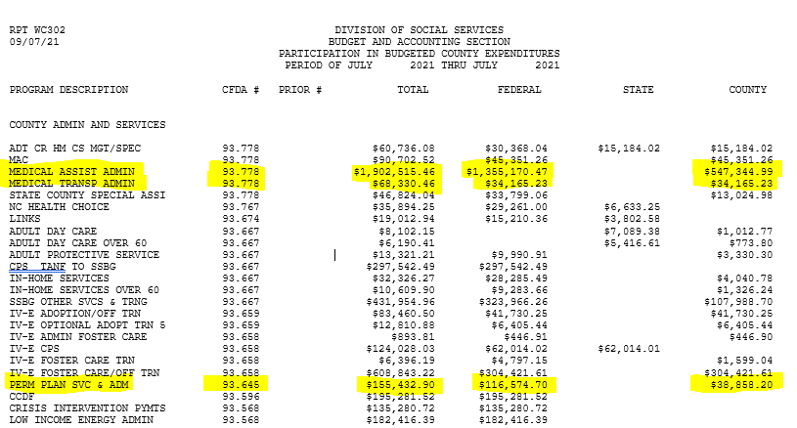
WC302 REPORT

Slide 27
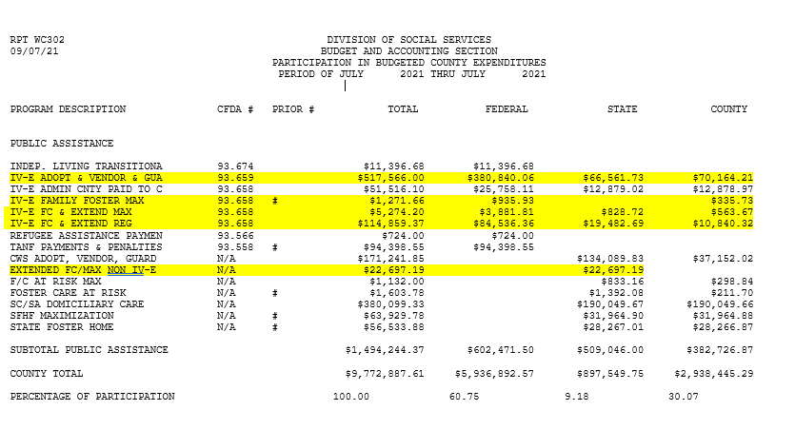
WC302 REPORT

Slide 28
SEFSA
The Schedule of Expenditures of Federal and State Awards (SEFSA) reports are usually part of each county’s Independent Auditor’s report on compliance and internal controls.
The single audit requirement is triggered when the federal expenditures reported on the SEFSA exceed $750,000 or more during an organization's fiscal year.
Simply put, the SEFSA is a supplemental schedule to an organization's financial statements recapping expenditures of federal awards during the organization's fiscal year by federal agency and program. A more detailed definition is provided in the Uniform Guidance, CFR Section 200.510.

Slide 29
Preparing the Yearly SEFSA Report
When completing the SEFSA, three different WC302 reporting periods are used in order to match to the county’s fiscal year. It is a good idea to also have the same XS337 reports readily available.
For example, when completing the 2021 report, the following reports are needed:
Period of July 2020 thru July 2020 (June 2020 service month)
Period of July 2020 thru June 2021 (June 2020 – May 2021 service month)
Period of July 2021 thru July 2021 (June 2021 service month)

Slide 30
Yearly SEFSA Report – Sample Template
 |  |  | June 2020 - May 2021 |  |  | Less June 2020 |  |  |  | Add: June 2021 |  |  | Total 2021 Reimbursement |  |  | Reimbursement Percentages
Program Description | CFDA | Revenue Source | Federal | State | Subtotal | Federal | State | Subtotal |  | Federal | State | Subtotal | Federal | State | Total | Federal | State | County

Slide 31
QUESTIONS

Slide 32

Fiscal Monitors
Joyce Blackburn
Joyce.Blackburn@dhhs.nc.gov
Charles Robertson
Charles.Robertson@dhhs.nc.gov
Local Business Liaisons
Pamela Bell
Pamela.Bell@dhhs.nc.gov
Jennifer Gonzales Jennifer.Gonzales@dhhs.nc.gov
Pam Graham
Pamela.Graham@dhhs.nc.gov
Caroline Hedrick Caroline.Hedrick@dhhs.nc.gov
Vacant LBL Position
LOCAL BUSINESS LIAISON
& FISCAL MONITOR TEAM

