Slide 1
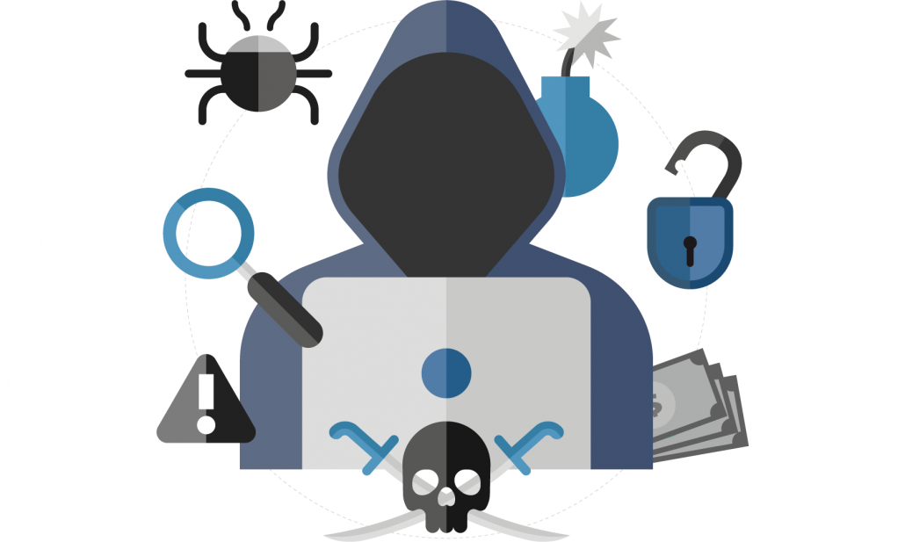
PROTECT AGAINST PHYSICAL SECURITY THREATS

Slide 2
These days if you mentioned security to someone in a business context, they’ll most likely assume you’re talking about the protection of online, digital, and technology resources within a company.
But until the early 2000s, they likely would have thought of alarm systems and key cards or locks on doors.
For many companies, physical security is no longer the top concern. For example, to receive a popular security certification, the certified information systems security professional (CISSP), people used to be tested specifically on physical and environmental security.
But by 2015, physical security had been lumped together with other subtopics such as software development security, security operations, security assessment and testing, security architecture and engineering, security and risk management etc reflecting its decreasing importance.

Slide 3
In this era of rampant cybercrime, it can be easy to overlook physical security, but criminals don’t necessarily need to be expert hackers to access your information, they can also gain physical access to your office and take what they want.
When it comes to securing information: don’t overlook physical security.

Slide 4

In this era of rampant cybercrime, it can be easy to overlook physical security, but criminals don’t necessarily need to be expert hackers to access your information, they can also gain physical access to your office and take what they want. When it comes to securing information: don’t overlook physical security.

Slide 5
Data security includes physical security: part of protecting your data is securing your office.
PROMOTE STRONG PHYSICAL SECURITY:
Control access
Lock data centers
Keep a clean desk
Vet visitors

Slide 6

TO ENSURE RESPONSIBLE PHYSICAL DATA SECURITY:
Control Access. Systems requiring keycards for entry are now common, and for good reason. They keep track of all entries and restrict access to authorized personnel. The more doors requiring card or badge authentication, the better.
Lock Data Centers. Those with physical access to a system can do a lot more harm than an online intruder could. Data centers or server rooms of any size need to be locked and restricted only to those who need to gain entry.
Keep a Clean Desk. Physical Data – printed documents, handwritten notes, etc. can be just as valuable as digital data. So don’t leave sensitive items out in the open.
A key aspect of physical security is what we call a clean desk policy. When we talk about a clean desk policy, what we mean is when you are not at your desk, you’re making sure that no sensitive information is left out in visible sight. Anything that’s particularly sensitive is locked up. You check printers and other areas for content that could have accidently been left out. Because all of this information creates exposure and creates risk. Make sure you are aware of who is walking around the office, who you are letting in and who is holding the door for so that we can keep content safe.
VET Visitors- A common form of physical intrusion is tailgating: when someone “harmlessly” follows an authorized employee into a restricted area. Typically, these intruders pretend to be someone they’re not, like a delivery person. Whenever a visitor requests entry to your office, notify the office manage and don’t leave them unattended.

Slide 7
QUIZ
Sheryl’s team has a client coming in this afternoon to tour the office. What should Sheryl and her team members do to ensure data security during the client visit?
A. Make sure no sensitive data is out in the open or on their computer screens
B. Unlock all the doors so that the client can easily come upstairs and to their side of the office.
C. Get the IT team to create a keycard for the client, granting them access to their office.
D. Install new security cameras monitoring their specific section of the office.

Slide 8
Sheryl and her team should minimize the amount of sensitive information that will be visible during the client’s visit.
Correct Answer: A

Slide 9
Consider this:
Do you keep any physical documents containing sensitive information that only you or certain colleagues should see? Where do you store these documents? Are they easily accessible to people who shouldn’t have access?
Remember: Criminals don’t necessarily need to be expert hackers to access your information, they can also gain physical access to your office and take what they want.
When it comes to securing information: don’t overlook physical security.
02/2023

