Slide 1

Data Incidents & Breaches

Slide 2
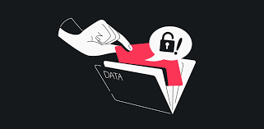
DATA INCIDENTS
A data incident is any event that compromises the security of data such as:
Unauthorized access attempts
Data breaches
Data exposure
Personal data breaches
Data incidents can also be caused by:
Human error, such as sending an email to the wrong recipient or accidentally deleting records
Sharing passwords or other credentials with third parties
Deliberate acts, such as phishing attacks
Data loss in storage, transmission, processing, or within a network

Slide 3
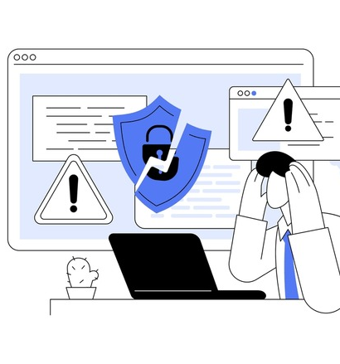
Data Breach
DATA BREACH:
An incident involving the loss or theft of an IRS asset containing FTI, or the loss or theft of a physical document that includes FTI, or the inadvertent disclosure of FTI, is known as a data breach.
Often, an occurrence may be first identified as an incident, but later identified as a data breach once it is determined that the incident involves FTI. This is often the case with a lost or stolen laptop or electronic storage device.

Slide 4
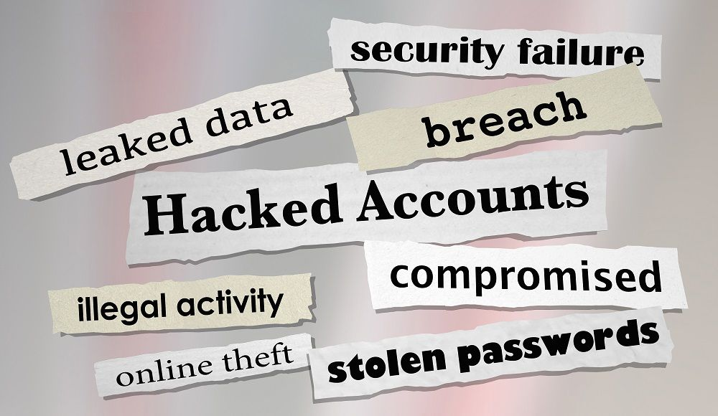
Data Breach Occurrence
A data breach is not limited to an occurrence where a person other than an authorized user potentially accesses FTI by means of a network intrusion, a targeted attack that exploits website vulnerabilities, or an attack executed through an email message or attachment.
A data breach may also include the loss or theft of physical documents that include FTI and portable electronic storage media that store FTI, the inadvertent disclosure of FTI on a public website or an oral disclosure of FTI to a person who is not authorized to receive that information.
It may also include an authorized user accessing FTI for an unauthorized purpose.

Slide 5
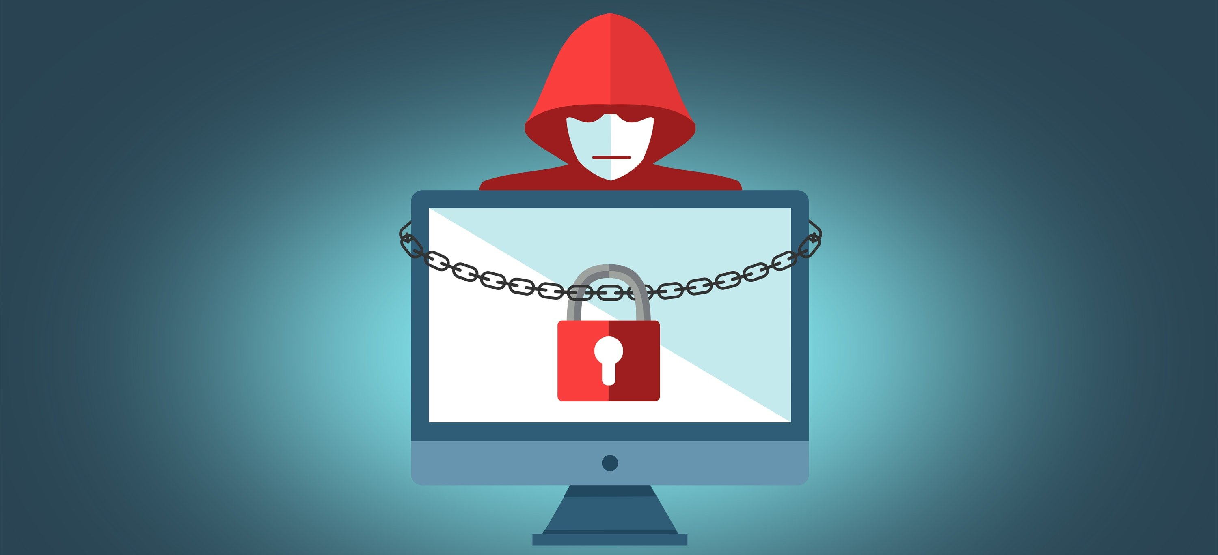
Major Data Breached
Major Company Data Breaches

Slide 6

UnitedHealth’s $872 Million Cyberattack
Be in no doubt that ransomware continues to be a massive problem. A Q1 financial report from UnitedHealth Group in April 2024 revealed a massive $872 million loss attributable to ransomware.
The report states: "Cash flows from operations from the first quarter 2024 were $1.1 billion and were affected by approximately $3 billion due to the company's cyberattack response actions, including funding acceleration to care providers, and were additionally impacted due to the timing of public sector cash receipts."
UnitedHealth’s ChangeHealthcare platform was impacted by the attack. This payment platform handles transactions between doctors, pharmacies, and healthcare professionals across the USA. The attack resulted in the ChangeHealthcare platform being suspended, with the BlackCat/ALPHV group claiming it stole 6 TB of data.
The attack is currently believed to have been executed via a vulnerable Citrix portal.
At a federal hearing in May 2024, UnitedHealth Group CEO Andrew Witty estimated one-third of Americans had been affected by the attack.

Slide 7
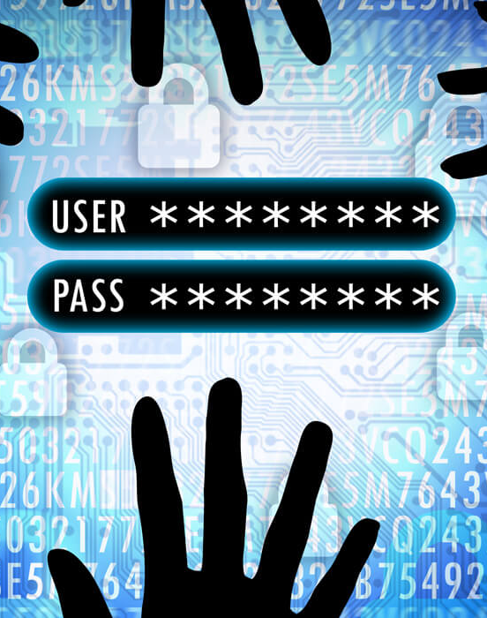
Tangerine Telecom
Australian ISP Tangerine was breached on February 18, 2024, with over 200,000 records stolen by hackers. Full personal information (names, date of birth, phone numbers, and email addresses) was taken; bank and password details were not.
This doesn’t seem to be the usual external cyberattack attempt, however. Instead, it seems to have been traced to either a known individual or someone with their credentials. “We know that the unauthorized disclosure relates to a legacy customer database and has been traced back to the login credentials of a single user engaged by Tangerine on a contract basis.”
Tangerine has informed the relevant authorities of the breach, along with all of the affected customers. It seems likely that leaked emails will be targeted by phishing operations.

Slide 8

US Local Governments
Local governments and associations around the world are routinely victims of cyberattacks. Often the fallout impacts taxpayers and the people who use the services provided.
In early 2024, two US county departments were hit in FL and MO.
All appeared to be coordinated ransomware attacks, confirmed within days of each other.

Slide 9
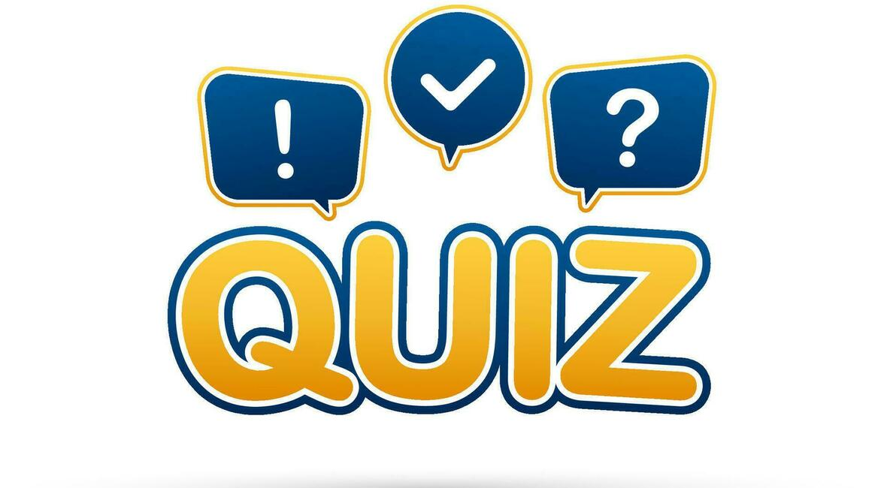
Quiz

Slide 10
What is a Data Incident?
Display of an information system that outlines the parameters for system or information use.
The act of obscuring data so that it cannot be read or reconstructed.
An independent examination of security controls associated with a representative subset of organizational information systems to determine the operating effectiveness of system controls; to ensure compliance with established policy and operational procedures; and to recommend changes in controls, policy or procedures where needed.
An occurrence that actually or imminently jeopardizes, without lawful authority, the integrity, confidentiality or availability of information or an information system; or constitutes a violation or imminent threat of violation of law, security policies, security procedures or acceptable use policies. Incidental and inadvertent accesses.
A
B
C
D

Slide 11
What is a Data Breach?
An incident involving the loss or theft of an IRS asset containing FTI, or the loss or theft of a physical document that includes FTI, or the inadvertent disclosure of FTI.
A computer dedicated to providing services to many users. Examples of such systems include mainframes, minicomputers or servers that provide dynamic host configuration protocol services.
The protection of information systems and information against unauthorized access, use modification or disclosure to ensure the confidentiality, integrity and availability of information systems and information.
Information used to establish and periodically change the operations performed in cryptographic devices for the purpose of encrypting and decrypting information.
A
B
C
D

Slide 12
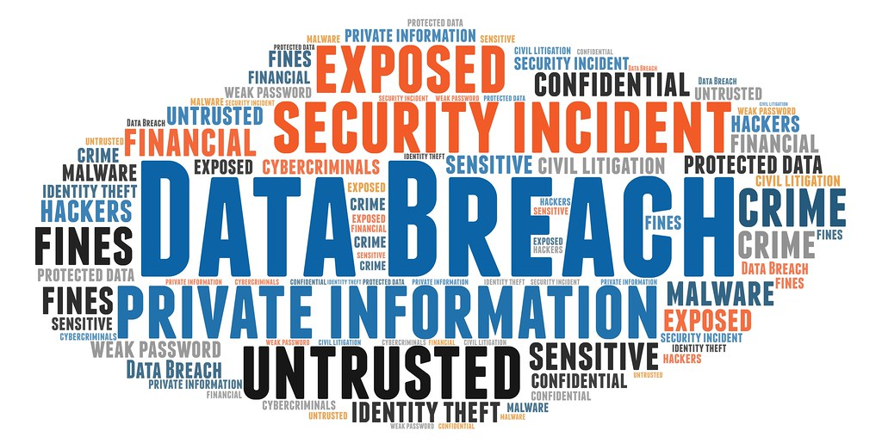
WHAT ARE SOME COMMON EXAMPLES OF DATA BREACHES?
Pick the correct group.
Group 1 | Group 2 | Group 3
Laptop or portable storage device storing FTI is lost or stolen | A box of documents with FTI is lost or stolen during shipping. | Hackers employing cyber attack vectors.
An email containing FTI is inadvertently sent to the wrong person. | Each column contains common examples of data breaches | Lost or stolen devices.
Hint: choose Group 3 | An unauthorized third party overhears agency employees discussing FTI. | Insider with malicious intent.

Slide 13
Answers
ANSWERS:
What is a Data Incident?
Correct Answer: D
An occurrence that actually or imminently jeopardizes, without lawful authority, the integrity, confidentiality or availability of information or an information system; or constitutes a violation or imminent threat of violation of law, security policies, security procedures or acceptable use policies. Incidental and inadvertent accesses.
What is a Data Breach?
Correct Answer: A
An incident involving the loss or theft of an IRS asset containing FTI, or the loss or theft of a physical document that includes FTI, or the inadvertent disclosure of FTI.
What are some common examples of a data breach?
Correct Answer: Group 3

Slide 14
REPORTING IMPROPER INSPECTION OR DISCLOSURE OF FTI:
Upon discovering a possible improper inspection or disclosure of FTI, including breaches and incidents, the individual making the observation or receiving information must report to your Supervisor, CSS Security, and the IRS Office of Safeguards immediately but no later than 24 hours after incident.
Report an incident to: https://security.ncdhhs.gov/
12/2024

