Slide 1
Social
Engineering
Red Flags

Slide 2

5 Red Flags Of A Phishing Email
1. The “Too Urgent to Be True” Subject Line
Phishing emails love to hit you where it hurts: your sense of urgency. Look out for subject lines like “URGENT: Your Account Has Been Locked!” or “Final Warning: Verify Now or Lose Access”.
2. Sketchy Email Address
The sender’s email address is often the easiest way to spot a scam. If it claims to be from “Netflix,” but the email address reads something like “netf1ix-support@randomletters.com,”It’s probably not legit”. Phishing emails often mimic the names of trusted companies but slip in small changes that are easy to miss if you’re not paying attention.

Slide 3
Red Flags Of A Phishing Email
3. Poor Grammar and Spelling Mistakes
Phishing emails tend to be riddled with grammatical errors and awkward phrasing
4. Suspicious Links or Attachments
Phishing emails usually come packed with links or attachments they want you to click on. These links might direct you to a fake website designed to steal your login details, while attachments might contain malware.
5. Requests for Personal Information
No legitimate company is going to ask you to provide personal information—like your password or credit card details—over email

Slide 4
Do you notice the red flags?
Reply: Flag, Red
To: name@yourcounty.com
From: flagblue@yourorganization.com
CC: security@dhhs.nc.gov, laurel@dhhs.nc.gov, shewanda@dhhs.nc.gov
Date: Wednesday, September 19, 2025, 3:00 AM
Subject: Your attention is needed.
Hi,
Now that our new Secretary has been selected and started in January, CSS Security is asking everyone to fill out this quick survey so all the accounting functions can be captured. It should take you only few minutes. Must be completed by the end of the day.
Click here to take the Survey.
Thanks in advance for your cooperation!

Slide 5

Do you notice the red flags?
If you look closely, the Reply-To address doesn’t match the From line—BIG RED FLAG! The sad thing is that if you don’t notice these red flags, you’ll probably click the link, take the survey, and have no clue that the hacker installed malware on your device and is now tunneling into your network locating your organization’s information.

Slide 6
Noticing the red flags:
An email coming from an unknown address is an obvious red flag.
If you know the sender (or the organization) but the email is unexpected or out of character, it’s a red flag.
You were copied on an email, and you don’t know the other people it was sent to.

Slide 7
Red flags:
The “To:” line: If you were copied on an email and you don’t know the other people it was sent to, it’s a red flag
• The “Date:” line: If you receive an email that you would usually get during normal business hours, but it was sent at 3:00 a.m., this is a red flag

Slide 8
Additional red flags:
The “Subject:” line: If the subject line of an email is irrelevant or doesn’t match the message content, it’s a red flag. If it’s an email about something you never requested or a receipt for something you never purchased, it’s a definite red flag.
Attachments: Any attachment you receive that you aren’t expecting is a red flag. Being asked to click on a link or open an attachment to avoid a negative consequence is a favorite trick of hackers. So, if the sender is asking you to click on a link or open an attachment, be on alert.

Slide 9
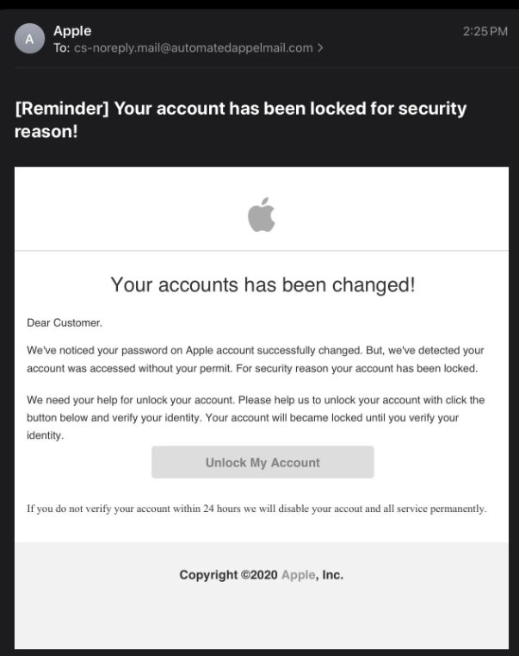
Quiz: What are the red flags?
What are the red flags that make this email suspicious?
Circle the error before looking at the answers.

Slide 10
Answers
While the email appears to come from Apple, the sender’s address (cs-noreply.mail@automatedappelmail.com) gives it away. Notice the misspelling of “appel” instead of “apple.”
The subject line says, “[Reminder] Your account has been locked for security reason!” The urgency here is meant to make you panic.
The body of the email is full of awkward phrasing and grammatical errors:
Please help us to unlock your account with click the button” makes no sense in proper English.
The email urges you to “Unlock My Account” by clicking a button but hovering over this link would likely reveal a URL that’s not associated with Apple. Always double-check where a link is taking you before you click it.
The urgency here is another classic tactic. Scammers want to stress you out, so you act quickly without thinking.
The email says “Copyright ©2020 Apple, Inc.” This is another dead giveaway. Why would Apple use outdated copyright information in a 2026 email.

Slide 11

Report
Now that you know the red flags, you’re better equipped to spot phishing emails before they hook you. Remember, the best defense is a little skepticism and a lot of caution. If something feels off, trust your instincts and don’t rush to act.
Stay safe out there! Your online security is worth taking the extra time to think before you click.
Report the email by clicking the Report Button.

