Slide 1

Cyber Security: Recognizing and Avoiding Cyber Threats:
Preventing Cyber-Attacks

Slide 2

Cyber-attack
Cyber-attacks are preventable, and each of us can do our part by being able to recognize cyber threats, know how to avoid them, and know where to make a report if we become aware of a possible cyber-attack on our company.

Slide 3
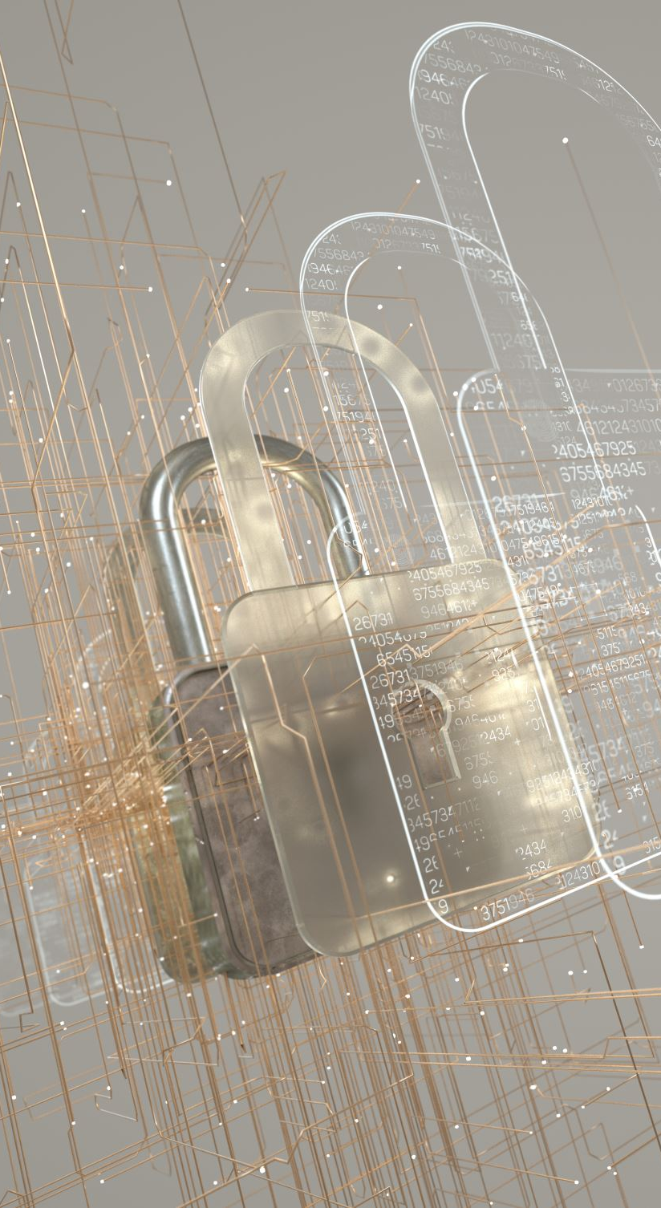
Phishing and Spear Phishing
Common cyber-attacks on individuals and organizations are accomplished through phishing and spear phishing.
  Phishing is when a cyber-criminal attempts to trick individuals into giving information or access, usually from an email that looks legitimate.
  Spear phishing is a phishing attempt directed at very specific victims, whether they are organizations or individuals. Cyber-criminals send emails or other messages that appear to be from someone the victims would know or be associated with such as the company's IT or HR team, a coworker, or other trusted source.
Cyber-criminals will send an email, text, cell phone or social media message that appears to be from a legitimate source, such as a bank, and even from someone within the company.
The purpose of the phishing or spear phishing message is to try to trick employees into sharing personally identifiable information (PII), company confidential information, or company system information such as access codes, login IDs, and passwords.
In some cases, these phony messages can contain links to malicious sites or attachments that download malicious software such as malware or ransomware.

Slide 4

Malware and Ransomware
Malware, or malicious software, are computer programs designed to infiltrate and damage computers and networks. Malware can include viruses, worms, Trojan horses, spyware, adware, and ransomware. Cyber-criminals hide malware in attachments to emails and messages, or as documents or software on websites. Opening or clicking on these attachments can download the malware onto company devices and can allow them to access company information systems, often without the user being aware of it.
Ransomware is a type of malware that, once downloaded to a computer or network, locks the users out of the system and/or encrypts certain files and data. The ransomware then notifies the users of a ransom demand that must be paid, or else the data will be deleted or the key to unlock the encryption will be destroyed, eliminating any chance of recovery.

Slide 5
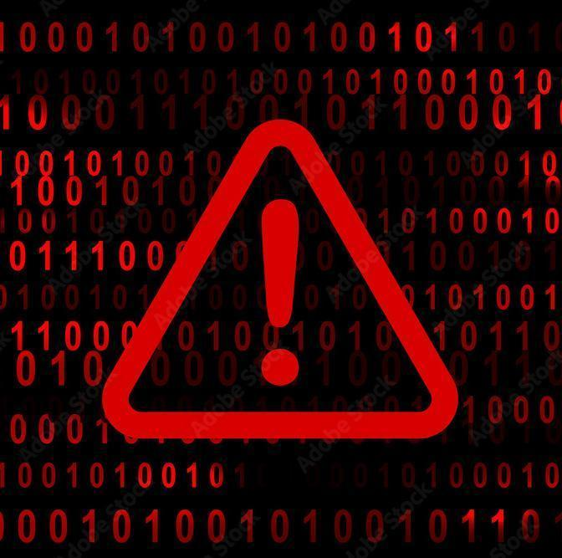
Warning Signs
It can be difficult to tell the difference between a legitimate email and a fraudulent one. However, there are certain warning signs that an email may be fake or malicious:
1. Suspicious emails from unknown senders, or with misspelled words or awkward phrasing.
2. Emails requesting personally identifiable information, such as bank account or credit card numbers, PINs, or passwords.
3. Emails with wording indicating a sense of urgency in your response time.
4. Requests for you to open attachments (which could include malware).
5. Requests for you to click on links (which often look legitimate but can direct you to a malicious site different from the one displayed in the message).

Slide 6
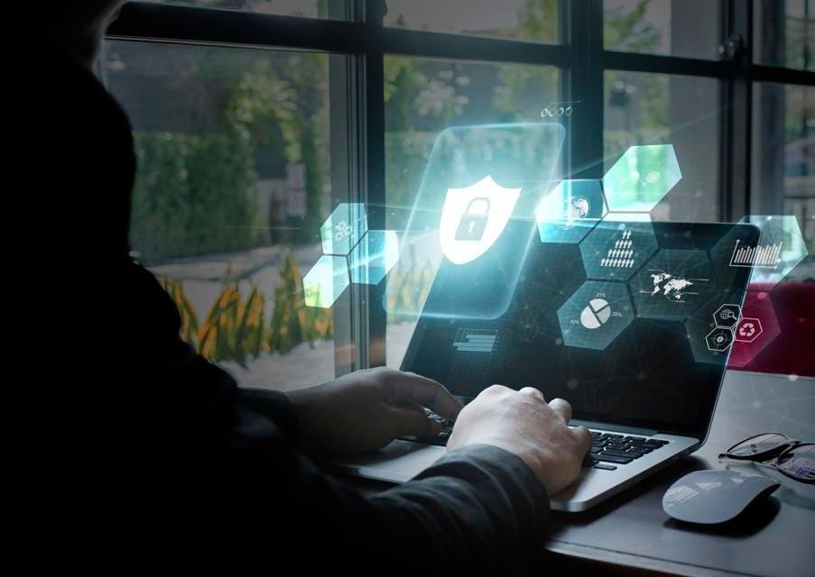
Actions to Take
There are several things you can do to guard against cyber-attacks:
Verify the sender. Before opening an email from someone who is not absolutely familiar to you, call the person to verify the email was sent. Use your own contact list, not the phone number listed in the email.
Never click on links, download files, or open attachments unless you have verified the sender. It's a good idea to hover over a link to see what actual URL the link is pointing to, or type in a URL instead of clicking on it or copying and pasting.
Trust your instincts. If you receive any type of communication that seems suspicious, wrong, awkward, or just "off," it is most likely not legitimate. Cyber-criminals will play on your emotions to get the information they want.
Report real or suspected incidents. If you think you may have received an email or other form of communication that could be a cyber threat report to your Supervisor and CSS Security immediately and report an incident to: https://security.ncdhhs.gov/ . Also, the IRS Office of Safeguards must be notified immediately, but no later than twenty-four (24) hours after identification.

