Slide 1
NC Department of Health and Human Services
NC Opioid and Prescription Drug Abuse Advisory Committee (OPDAAC)
April 1, 2021

Slide 2
Welcome to OPDAAC!
We will start promptly at 10:00AM!
For questions during the meeting:
  Please put your questions in the chat box, which will be monitored for the duration of the meeting. Note: you need to send to all panelists and attendees to ensure your question is addressed in a timely manner.
  If you would like to ask a question to a specific presenter, please be sure to include their name in your question.
  The meeting recording, agenda and PowerPoint slides will be added to our NC DHHS Opioids/OPDAAC page
  https://www.ncdhhs.gov/about/department-initiatives/opioid-epidemic/nc-opioid-and-prescription-drug-abuse-advisory
  Please note, it can take up to 7 days for materials to be posted to the website. An email will be sent out to all attendees once materials have been posted.

Slide 3
Overview of Substance Use Treatment Resources in North Carolina
Judith Johnson-Hostler

Slide 4
Objectives
Participants will increase their knowledge on NC resources for pregnant and parenting women with a Substance Use Disorder (SUD).
Participants will increase their understanding of how to access care for pregnant or parenting women with a SUD.

Slide 5

Why It Is Important to Be Gender Responsive
Gender-responsive services create an environment that reflects the understanding of the reality of women’s lives and addresses women’s issues.
Gender-responsive services help improve the effectiveness of services for women and girls.
Source: Substance Abuse and Mental Health Services Administration.(2017)
Addressing the Gender-Specific Treatment Needs of Women
Notes:
Learning about, and implementing, gender-responsive principles will help you improve prevention, treatment, and recovery programs for the women and girls you serve and lead to more positive outcomes. Gender-responsive differs from gender-specific in that gender-specific are services those designed solely for women. Gender-responsive is a broader way of looking at services, environment, and experiences and how they address the lives of women.
We will introduce you to the principles of gender-responsive services as they relate to women with SUDs.

Slide 6
Perinatal Substance Use Project
  Provides screening, information & referral for pregnant and parenting women with dependent children
  Provides consultation, training & technical assistance for the public and for professionals regarding perinatal substance use, treatment and resources
  Weekly Bed Availability List-800-688-4232
  (jjones@alcoholdrughelp.org)
Notes:
Read the slide

Slide 7
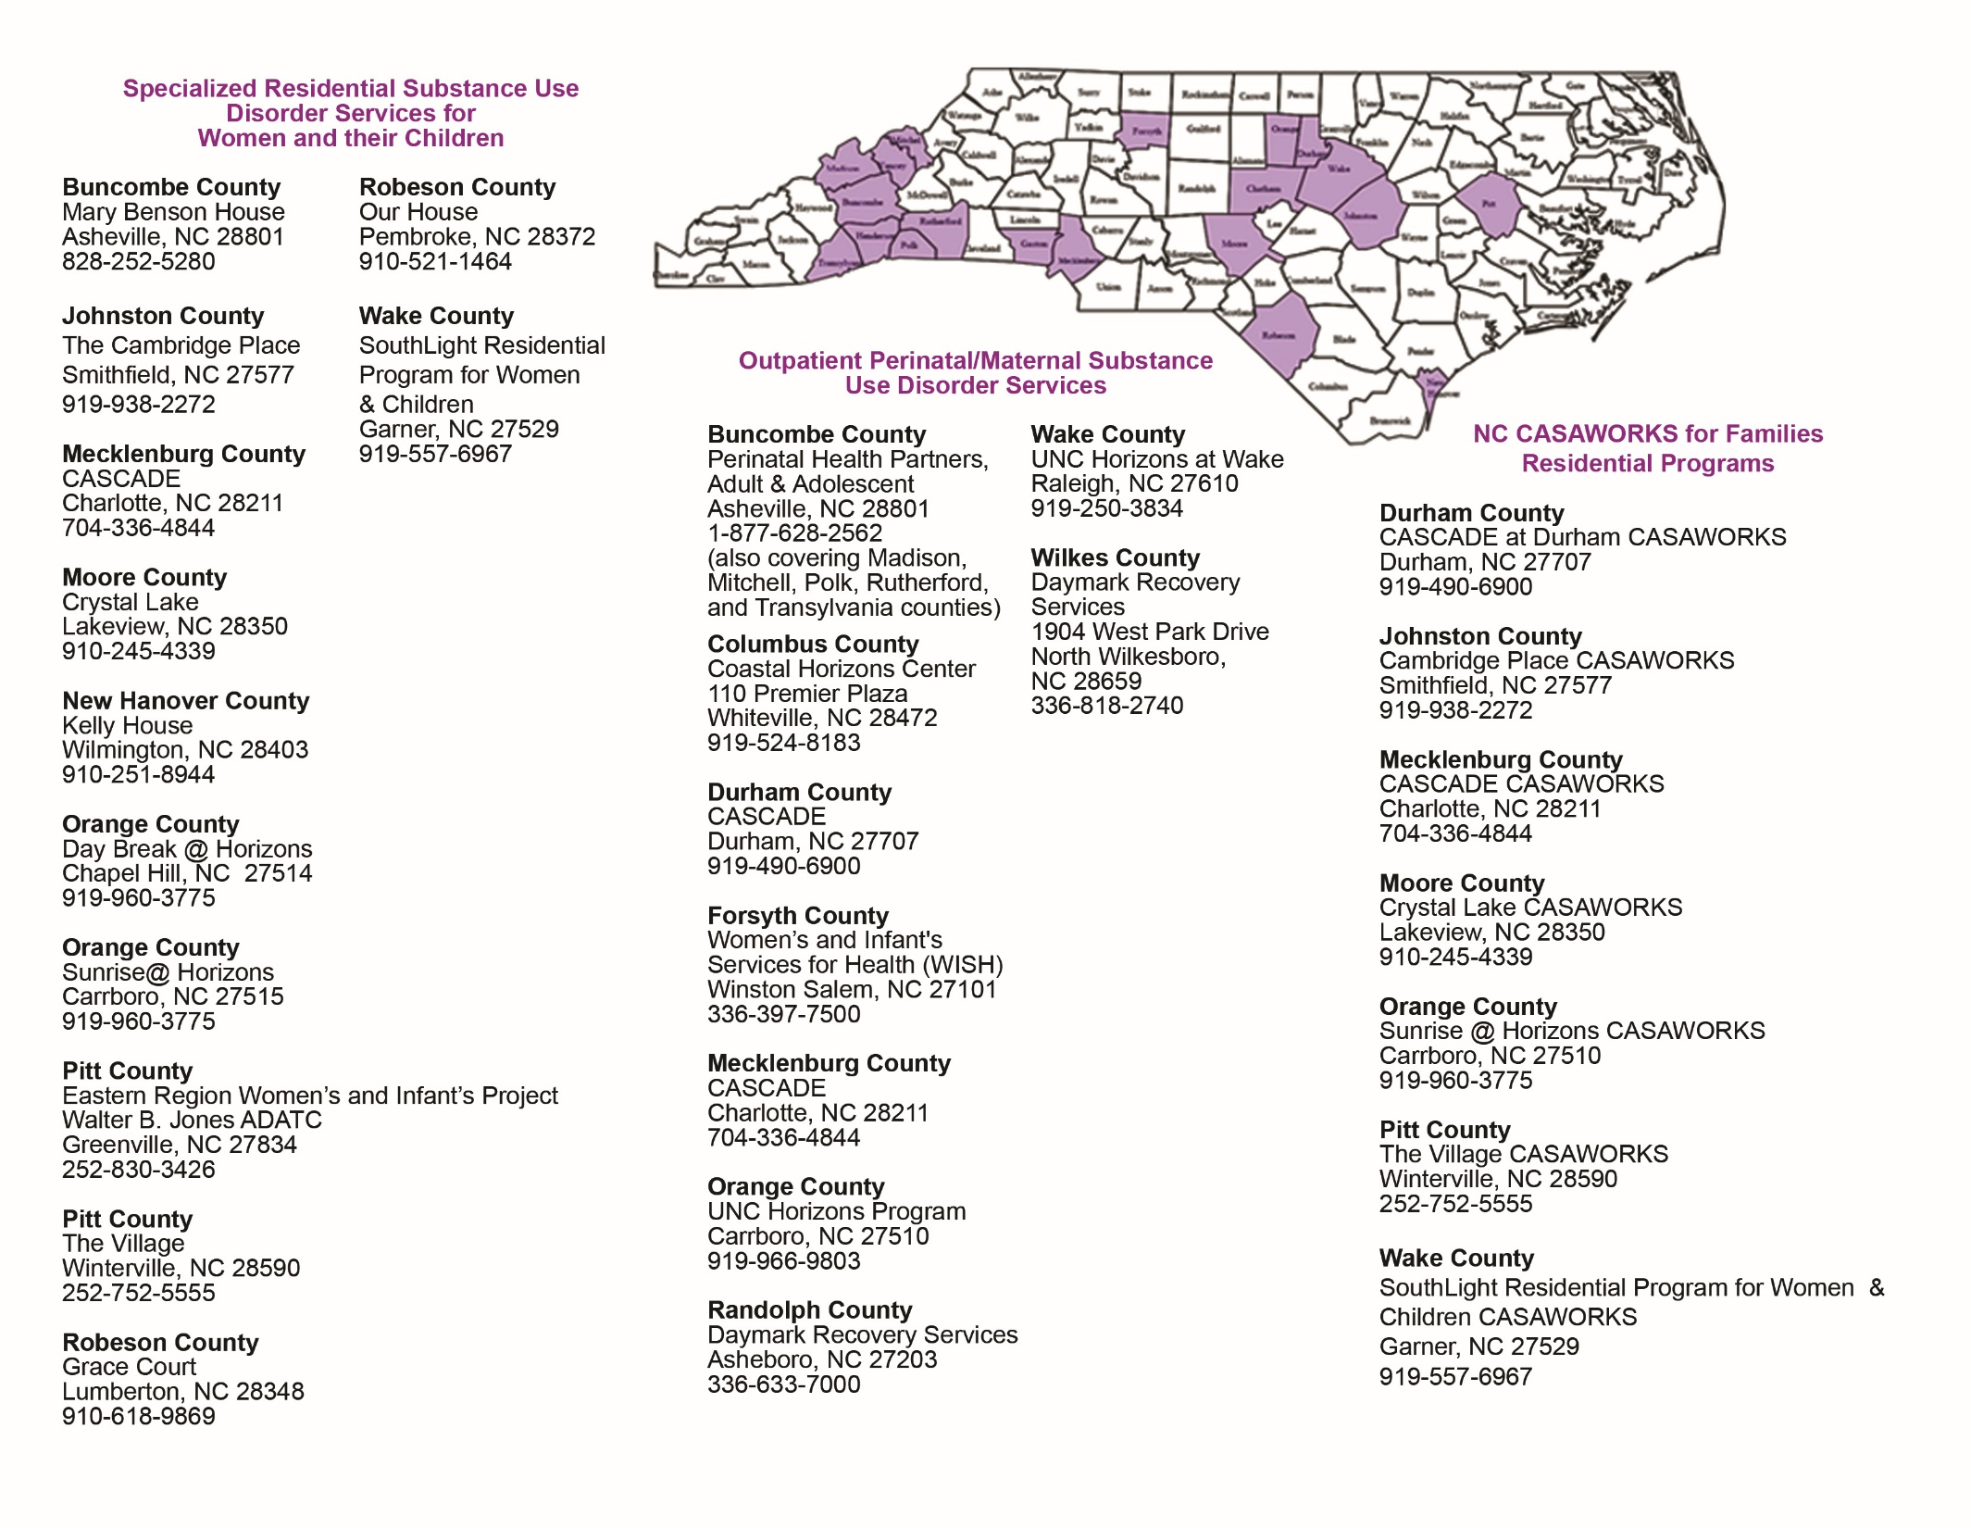
Notes:
Explain the geographically locations of the programs for example the West vs Eastern part of the state
Explain different initiatives
Address how the programs are geographically positioned and the customs of some of the natives in Western part of the state.
Provide the difference between the house and apartment setting.
Discuss Grace Court transitional services and the timeframe.
Give an explanation of the program and the difference between the PSU project and the Perinatal/Maternal/CASAWORKS Initiative
The programs listed as Kelly House, Our House, and Mary Benson House are set up as community living space. The mom must meet the 3.5 ASAM criteria for residential care, she is either pregnant or parenting a young child
The others Perinatal/Maternal/CASAWORKS are set up as apartment living and all are clinically managed. Will further discuss the services in upcoming slides. All the outpatients listed are also state funded Gender-Responsive services.
Transitional- at least 3 months in recovery up 2 years
The family size that is accepted is based on the apartment size. The age of children is up to 11 years old

Slide 8
NC Perinatal & Maternal Substance Use Initiative
Family centered, trauma informed services for pregnant and parenting women with a primary substance use disorder & their children
12 residential programs & 9 comprehensive outpatient programs
Residential programs are Cross Area Service Programs (CASPs)
Services include: screening, assessment, case management, substance use disorder and co-occurring services, parenting education/skills, and referrals & coordination with primary and preventative health care.
The children also benefit from the services provided by the local health departments (pediatric care, CMARC previously known as CC4C), early intervention programs, behavioral health services, & substance use prevention services.
Notes:
Care Management for At-Risk Children (CMARC) was previously known as CC4C they still serve the same population 0-5 years old

Slide 9
NC CASAWORKS for Families Residential Initiative
The CASAWORKS for Families model was developed by the Center for the Study of Addiction and Substance Abuse (CASA) at Columbia University in response to the impact of welfare reform on families who are substance use involved.
The model philosophy is built on the best way to help families receiving TANF become economically self-sufficient is to provide an integrated and concurrent gender-specific substance use disorder and co-occurring treatment and job readiness, training, coaching and employment programming.
7 comprehensive residential programs for women with a primary substance use disorder and their children
Programs are Cross Area Service Programs (CASPs)
Notes:
Gender
Age
Number of the children

Slide 10
Alcohol Drug Treatment Centers (ADATC)
Julian F. Keith Alcohol and Drug Abuse Treatment Center
R J Blackley Alcohol and Drug Treatment Centers
Walter B. Jones Alcohol and Drug Abuse Treatment Center
Notes:
Explain the case that would be sent to ADATC
Process of induction include MAT provider and why
Address the accepted weeks of pregnancy and it could be specific to the clients needs

Slide 11


Slide 12
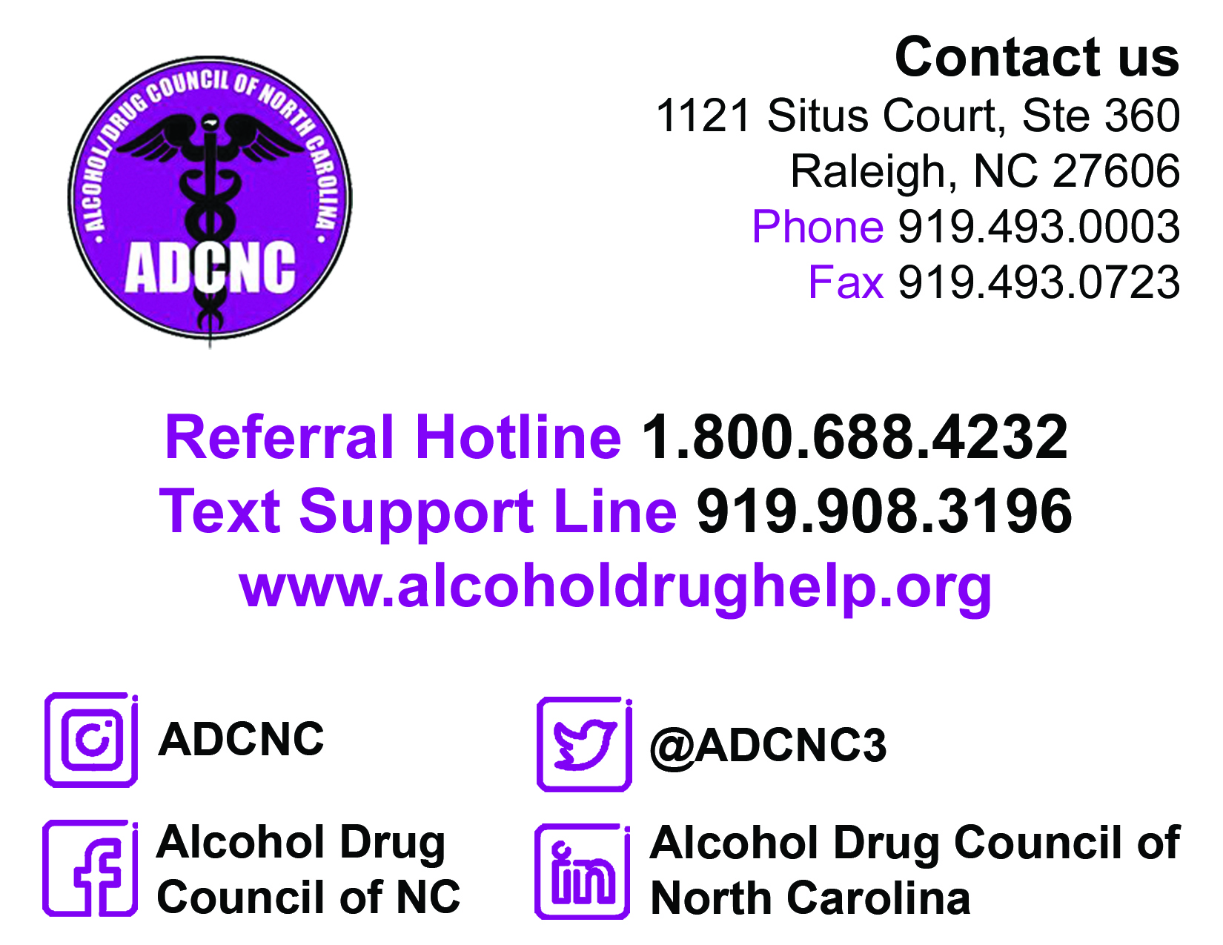

Slide 13


Proof Alliance NC strives to prevent alcohol exposed pregnancies by providing training, education, and resources to women of childbearing age and the professionals that serve them.
To Learn More About the Program:
Lauren Borchert | lborchert@arcnc.org
Program Coordinator
11010 David Taylor Drive | Charlotte, NC 28262
Main 800.662.8706 | Mobile 919.215.4783
FASDinNC.org
To Schedule a Free Training:
Amy Hendricks, BS | ahendricks@arcnc.org
FASD Training Coordinator
30-D Garfield Street | Asheville, NC 28803
Mobile 919.612.0166
FASDinNC.org

Slide 14
References
Substance Abuse and Mental Health Services Administration. (2017) Addressing the Gender-Specific Treatment Needs of Women.

Slide 15
The UNC Horizons’ Model of Compassionate Care for Mothers with Opioid and Other Substance Use Disorders and Their Children
Hendrée E. Jones

Slide 16

Objectives
Disseminate information about this model including programming that has helped pregnant women, postpartum women and mothers who have a substance use disorder
Provide data gathered from this program
Discuss lessons learned and future directions

Slide 17

UNC Horizons: History and Funding
Early 1990s, the NC General Assembly used newly available federal and state substance abuse dollars to fund several gender-specific treatment programs targeting perinatal substance use.
Since 1993 Horizons has treated approximately
  5,000 women from all of NC’s 100 counties
  First residential site 2001
Primary sources of funding:
  Federal and State Block Grants
  Medicaid
  State funding for uninsured residents

Slide 18

Who We Serve
230 women a year
Mean age of 29 years
100% Medicaid or uninsured
50% pregnant
55% are Child Protective Service (CPS) involved
Poly-substance problems
77% come from families with substance use disorder issues and 75% with mental illness
83% have been arrested at least once (average of 4 arrests)
84% have experienced at least one type of interpersonal violence
32% have attempted suicide

Slide 19

Trauma and
Addiction
Treatment
Residential
and/or Outpatient
Care
Childcare and
Transportation
Medication to Treat Opioid Use Disorder
Trauma Responsive Care
Medical Care
OB/GYN
Psychiatry
Vocational
Rehabilitation
Housing
Legal aid
Parenting
Education and
Early
Intervention
Unified Philosophy of Treatment Informed by Social Learning, Relationship and Empowerment Theories
Notes:
19

Slide 20
UNC Horizons Program
Medical Care
OB/GYN
Psychiatry
Behavioral Health Care
Perinatal care
Medication for Opioid Use Disorder

Slide 21
UNC Horizons Program
Residential
and/or Outpatient
Care
Residential Programs
Average of 9 months then continuing care
Services:
  Attend outpatient groups
  Childcare services • Transportation
  Case management • Peer-support
  Individual counseling • Parenting/ Family therapy
  Urine drug screens • Crisis contingency plans
  Disease management • OB/GYN and psychiatry
  Goals Set with Shared Decision Making:
      Alcohol and drug abstinence
      Employment and/or on educational path
      Resolve or address legal issues
      Secure housing
      Positive parenting
      Physical and mental health
    Child
      Child outcomes are in normal limits
    Dyad
      CPS case resolved with reunification

Slide 22

Health and Wellness in Recovery
SAMHSA’s Eight Dimensions of Wellness for everyone to incorporate into their lives.
These dimensions are:
Emotional
Environmental
Financial
Intellectual
Occupational
Physical
Social
Spiritual

Slide 23

Evidence-Based Curricula
Beyond Anger and Violence
Beyond Trauma
CENAPS model of relapse prevention
Circle of Security
Dialectical Behavior Therapy (DBT)
Helping Women Recover
The Matrix Model (modified for women)
Nurturing Parenting Program
A Woman’s Way Through
the 12 Steps
Plus, CBT, MI, CPP, CM etc.

Slide 24

Treatment for Children
Childcare
Psychiatry
Early intervention Services

Slide 25
UNC Horizons Program: Early Intervention and Therapeutic Services for Children
Parenting
Education and
Early
Intervention
All children receive age-appropriate mental health and social/emotional assessments; and individual, group, and/or family therapy as needed
All children screened for speech and language, occupational therapy, physical therapy, dental, hearing and vision and referred for developmental evaluations
About 90% of the residential children ages 0-5 qualify for and receive early intervention services

Slide 26


UNC Horizons Postnatal Protocol
Visit from child therapist within first week of delivery, even if in NICU
Focus on infant strengths, learning infant cues (Hug Your Baby)
Continue on going parent education (twice per week)
At 6 weeks: Referrals for developmental assessments (Early Intervention) including Speech/Language, Occupational Therapy, Physical Therapy, and Social-Emotional Assessment
Support Dyad: Weekly Child Parent Psychotherapy (CPP)

Slide 27

Measuring Success
Personal Treatment Goals
Substance Abstinence
Housing and Employment
GED/Education
CPS Case Status
Legal status
Birth Outcomes
Parenting knowledge
Coping Skills and Perceived Stress
Client Satisfaction
Child outcomes

Slide 28
Measuring Success

Slide 29

Graduate Family Outcomes
77% of RESIDENTIAL WOMEN HAD A JOB WHEN THEY LEFT
95% of residential families MAINTAINED OR IMPROVED CPS CASE STATUS

Slide 30

Estimated Cost Savings
UNC Horizons saves North Carolina an estimated $3,366,815 every year

Slide 31

Horizons Around the World

Slide 32
Looking Back and Looking Forward
Lessons Learned
Mothers and children need strength-based support
Your language choice matters
Pictures and visuals matter
Help tell stories of recovery and success
Consider mother and child not mother vs. child
Be familiar with toolkits like ACOG’s on state legislation regarding Pregnant Women & Prescription Drug Abuse, Dependence and Addiction
The Future
Continue to increase Tobacco cessation support
Advocate for compassionate care mother and child NAS hospital policies
Ensure post-partum and life span care
Continue to work towards eliminating stigma and discrimination against women with substance use disorders

Slide 33



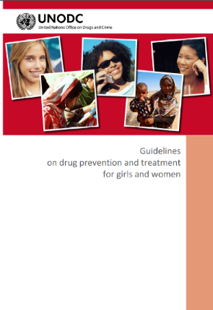




Key Documents
Notes:
33

Slide 34

Hendree_Jones@med.unc.edu
Direct Line: 1-919-445-0501
Main Office: 1-919-966-9803
Fax: 1-919-966-9169

Slide 35
Panel: UNC Horizon’s Program Participants

Slide 36

2021 Opioid Misuse and Overdose Prevention Summit
Registration is now open for the 2021 Opioid Misuse and Overdose Prevention Summit!
May 4-6, 2021; Virtual
Theme: More than Opioid: Bolster Equity, Center Lived Experiences, Address Poly-drug Use
Cost is $25
Summit website
Register here

Slide 37
Wrap up and THANK YOU!
    Alan Dellapenna, Branch Head, Injury and Violence Prevention Branch, Division of Public Health
  The meeting recording, agenda and PowerPoint slides will be added to our NC DHHS Opioids/OPDAAC page
  https://www.ncdhhs.gov/about/department-initiatives/opioid-epidemic/nc-opioid-and-prescription-drug-abuse-advisory
  Please note, it can take up to 7 days for the materials to be posted to the website. An email will be sent out to all attendees once materials have been posted.
    Next Virtual OPDAAC Meeting: TBD; stay tuned for more information later this spring!

