Slide 1
NC Department of Health and Human Services
NC Opioid and Prescription Drug Abuse Advisory Committee (OPDAAC)
December 9, 2022

Slide 2
Welcome to OPDAAC!
Sara Smith, Communication Lead, Injury and Violence Prevention Branch, Chronic Disease and Injury Section, Division of Public Health
Housekeeping
Take breaks as needed
For questions during the meeting:
Please put your questions in the Q&A box, which will be monitored for the duration of the meeting. Note: you need to send to all panelists and attendees to ensure your question is addressed in a timely manner.
If you would like to ask a question to a specific presenter, please be sure to include their name in your question.

Slide 3
Environmental Scan of Substance Use-related Pre- and Post-Arrest Diversion Programs in North Carolina, 2022
Madeline Frank
Eliza Filene

Slide 4
Agenda
1. Brief overview of methods
2. Results:
Substance Use-Related Pre-Arrest Diversion Programs
Substance Use-Related Post-Arrest Diversion Programs
Family Drug Treatment Courts and NC G.S. 90-96
3. Diversion Program Needs and Conclusions
Notes:
MF

Slide 5
Methods
Aim:
Identify and examine substance-use related pre- and post-arrest diversion programs in all 100 counties in NC
Data collection:
Developed survey, created database of contacts with the help of NC DPH
Reached out via email and phone to a minimum of 3 contacts 3-4 times per county
Asked programs for data on participant enrollment, completion, and any other evaluation measures.
Notes:
EF
Aim: identify and examine substance use related pre and post arrest diversion programs in all 100 counties in NC
Defined Diversion as interventions that aimed to reduce the number of people sent to jail and prison for substance use related charges
- We only included programs whose populations of focus included individuals with substance use disorders, thus we unfortunately had to leave out programs like mental health treatment courts, community policing and crisis response teams, misdemeanor diversion, street outreach programs, and programs that provide medications for opioid use disorder (MOUD) to incarcerated individuals in jails and prisons
- we recognize the importance of these programs and the somewhat arbitrary nature of our definition
MF
Data collection:
- developed a survey to capture existing programs and key programmatic characteristics
- We created a database of contacts in each county with potential knowledge of these programs. We started from a publicly available list of known diversion program contacts across NC counties, supplied by the NC Division of Public Health and collected through their Opioid and Substance Use Action Plan Data Dashboard data collection efforts. We supplemented this list with web searches on potential contacts from District Attorneys’ offices, Sheriffs’ offices, local health departments, and/or other organizations that tend to coordinate these programs
- reached out through both email and phone using standardized templates to a minimum of 3 contacts 3-4 times per county
- conducted interviews using a structured interview guide primarily through phone and zoom, recorded interviews if consented and took detailed notes throughout the interviews. Lasted usually between 45 minutes-1 hour
- asked programs for outcome data if available so it is self-reported and not verified

Slide 6
Results
Contacted: all 100 counties
Heard back from: 98 counties (only missing Stokes Co. and Alexander Co.)
Only 1 county (Union) would not speak with us about the status of programs
Pre-arrest diversion programs: 30 counties
Post-arrest diversion: 43 counties (some programs, like the Stepping up Initiative, counted as both pre- and post-arrest)
Counties with both pre- and post-arrest: 16
Notes:
EF
Hearing from a county meant that we spoke with someone who told us the status of programs in that county
Conducted interviews with people who were representatives of a county with a program
MF (numbers)
Heard back from 98 counties who shared with us that they either did or did not have a substance use related pre or post arrest diversion program
Only 1 county would not speak with us about the status of their program

Slide 7
Post-arrest:
Pre-arrest:
1. Drug treatment courts (30 counties)
2. DWI/Sobriety courts (6 counties)
3. Veterans Treatment Courts (4 counties)
4. Stepping Up Initiative (6 counties)
5. Other post-arrest diversion (10 counties)
6. Prime for Life (7 counties)
7. Family Drug Treatment Court (9 counties)
1. LEAD (9 counties)
2. LEAD adjacent (8 counties)
3. Co-responder/ co-responder adjacent (5 counties)
Notes:
EF Pre-Arrest:
LEAD: law enforcement assisted diversion, usually out of police departments, varies greatly from county to county but is a national model
LEAD adjacent: programs that directly involve law enforcement referrals but are not called LEAD, more unique to each county's needs
Co-responder: programs where a behavioral health specialist and/or peer support specialist accompanies law enforcement to the scene where someone is having a substance use and/or mental health crisis
MF:
DTC: DTCs generally aim to serve individuals with substance use disorders, most of whom had prior involvement with the criminal-legal system. Program participation is usually offered post-arrest and post-conviction as a probationary condition. While the offense does not have to directly involve substances, a substance use disorder has to underly the charge. Operates in a phased system and involves a team approach
DWI: Similar to DTCs but courts serve individuals who have substance use disorders and have committed a DWI offense
VTC: Similar to DTCs and DWI courts but serve criminal-legal system involved veterans with substance use disorders and/or a co-occurring mental health diagnosis. A key differentiator of this program is the peer-mentorship component.
Stepping up: nationwide program that aims to reduce the number of individuals with co-occurring mental health and substance use disorders in jails and prisons. It is meant to be a pre or post arrest program, but in practice it is usually a post arrest program. While 46 counties have adopted resolutions to support the Stepping Up Initiative, only six counties shared with us using Stepping Up as a concrete diversion program. Post jail-booking, usually, individuals are connected to treatment as a conditional discharge
Other post arrest diversion: Programs that did not fit into any of the above categories and were highly unique to each county. 2 examples: DATA (District Attorney's Treatment Alternative) in Forsyth County which is a 1 year deferred prosecution program requiring Vivitrol injections, treatment, and electronic monitoring.
Another example is a program in New Hanover County called Underage Drinking and Fake IDs deferred prosecution program, which is a Deferred prosecution program for individuals accused of underage drinking or a fake ID offense. Defendants complete community service, alcohol education, and observe incoming traumas at New Hanover Regional Medical Center and Recovery Court as a pathway to charge dismissal
EF
PrimeForLife: Prime for Life is an evidence-based early intervention program primarily aimed at first-time or under-age low-level offenders deemed to benefit from guidance and education around substance use disorders.8 The program consists of a 12-hour prevention-focused curriculum taught by local organizations (including Mountain Project, Inc. and Appalachian Community Services) that focuses on both drug and alcohol use and they receive referrals from the District Attorney.
FDTC: Operate in a similar manner to DTC, VTC, and DWI court but operate in Abuse, Neglect, and Dependency Court
90-96 and conditional discharge: Many counties that do not have substance use-related pre- or post-arrest diversion programs cited NC General Statute 90-96 as a policy used to divert individuals following arrest. Under this statute, first-time offenders accused of minor drug and alcohol offenses must be given the option to have their charges deferred.
Another policy that counties without diversion programs cited was a conditional discharge and deferred prosecution program for low-level drug and alcohol charges. Generally, this means that the District Attorney offered to defer charges under the agreement that the defendant admits guilt to the charges and agrees to attend substance use disorder treatment. If the defendant completes treatment and provides the court with proof of completion, the charge is dismissed.

Slide 8
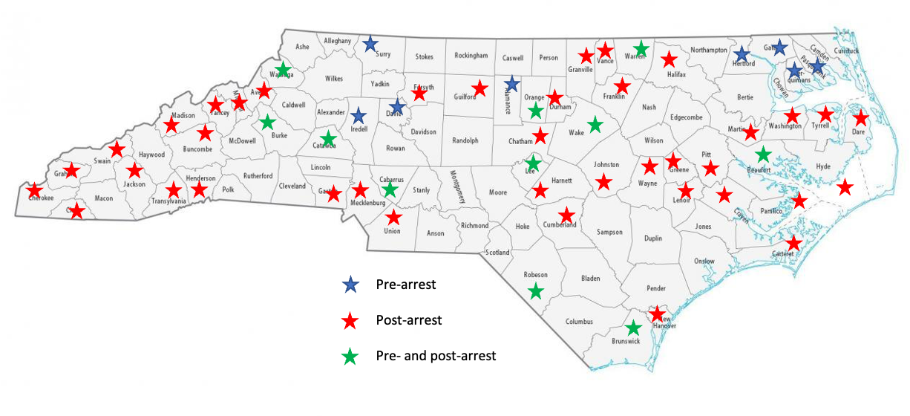
Layout of the report:
1. Introduction
2. Methods
3. Results (divided into Pre-and Post-Arrest)
4. Diversion Program Needs
5. Conclusions
Notes:
EF:
Pre and post arrest: key characteristics, statistics on counties that have these programs. These sections are divided by type of program

Slide 9
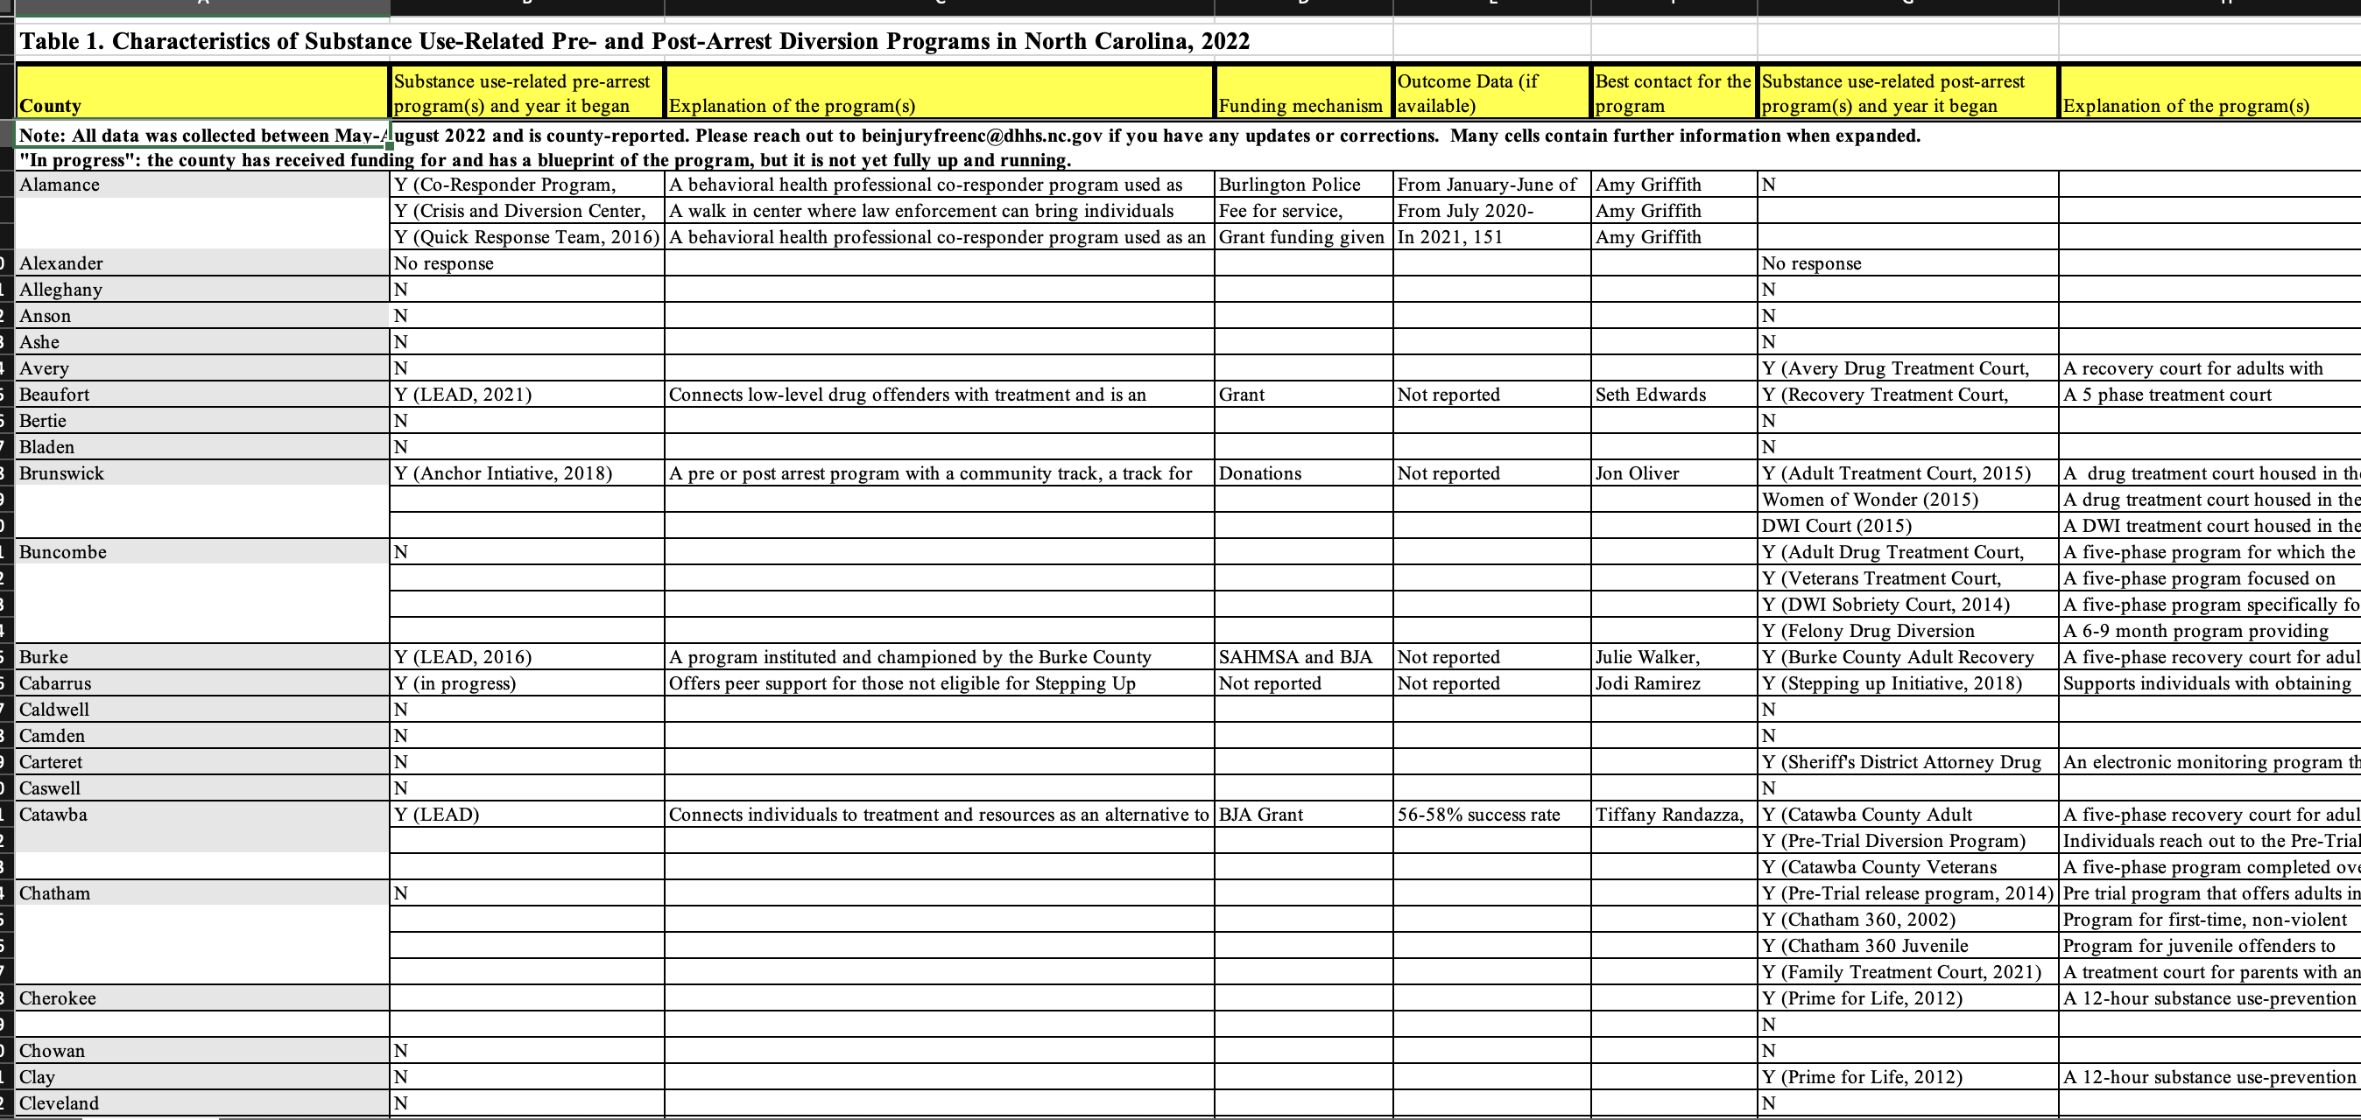
Overview table
Notes:
MF:
This is a screenshot of the table we have made in Excel, which includes the name of each county, whether they have a substance use pre and/or post arrest diversion program and the year it began, a brief explanation of the program, the program's funding mechanism, any available outcome data, and the best contact or contacts for the program

Slide 10
Conclusions
Staff are extremely dedicated to these programs
Programs consistently cited the need for increased funding
In rural areas especially, there is a high need for more, and higher quality, treatment facilities and local resources more broadly
Community partnerships and law enforcement buy-in are critical to program success
Need for community education around substance use and benefits of these programs
Need for increased technical assistance and data collection
Notes:
MF First 3, EF last 3
Staff are extremely dedicated to these programs and many have personal experience/connections to diversion and substance use that have drawn to them to this work in the first place
Funding was something we heard as a need from almost every program we spoke with, especially the drug treatment courts that shared with us their struggles in acquiring funding when the NC legislature stopped all funding in 2011 for these programs
Again and again we heard about the extraordinary lack of treatment facilities and social service resources more generally in rural counties. For example, one county shared that they often had no choice but to send individuals to facilities hours away and across the state. Program also cited a specific need for inpatient treatment facilities that accept folks with a history of violent offenses and for high needs individuals with dual diagnosis. There were many post arrest programs where severe and persistent mental illness, like schizophrenia, was an exclusion criteria for program participation due to capacity constraints. This is extremely problematic, as it leaves individuals with SPMI without other diversion options.
Further, rural counties spoke with us about the difficulties of connecting participants with transportation. This was discussed as a crucial resource gap, as many of these programs require, for example, drug tests several times a week. If participants are not able to acquire transportation to submit drug screens, they are considered noncompliant with programs and may be discharged.
EF – community partnerships are integral to these programs, and having law enforcement buy-in or not can either make or break a program
EF - Finally, specifically for pre-arrest diversion programs, counties spoke with us about the need for increased education around substance use among the community and law enforcement in particular. There were several pre arrest programs in place that spoke about difficulties getting law enforcement to utilize the programs even after they were established. Programs noted that law enforcement was often hesitant to refrain from engaging in programs that they viewed as not being “tough on crime.” These pre-arrest programs are utilized at the discretion of the arresting officer, inherently reflecting officer bias. This is especially important to note, as higher arrest rates for minoritized— and especially for black and brown folks— is well-documented. On the flip side, programs noted that an important facilitator to starting pre arrest diversion programs was when law enforcement was eager to engage. We want to emphasize that some of the programs that seemed to be most successful had law enforcement leadership and buy in at all levels.
Need for increased technical assistance and data collection, as many counties did not have manualized data collection methods and did not really know where to start

Slide 11
Next Steps
Many counties across the state, whether they had programs in place or not, recognized the importance of these programs and expressed interest in starting one if not already in place.
We have sent out the report and spreadsheet to interviewees and community partners
We have been accepted to present at the Academic Consortium on Criminal Justice Health (ACCJH) Conference in April in Raleigh, NC
Goal to assist programs develop minimum metrics for evaluation and streamlined processes to ease data collection
Notes:
MF
Many counties across the state, whether they had programs in place or not, recognized the importance of these programs and expressed interest in starting one if not already in place.
We have sent out the report and spreadsheet to interviewees and community partners and will continue to work to find ways to make this information as useful and accessible as possible to community partners statewide
We have been accepted to present at the Academic Consortium on Criminal Justice Health (ACCJH) Conference in April in Raleigh, NC
Goal to assist programs develop minimum metrics for evaluation and streamlined processes to ease data collection

Slide 12
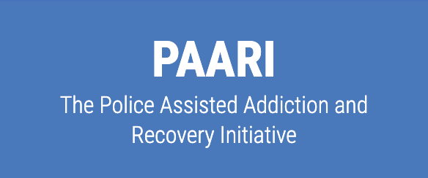
Additional Resources
Police Treatment and Community Collaborative
National Council for Mental Wellbeing
Police Assisted Addiction and Recovery Initiative
LEAD National Support Bureau
Notes:
The Police, Treatment, and Community Collaborative: https://ptaccollaborative.org/resources/ including core principles for programs, research syntheses, and action steps for diversion work during COVID. Several good resources to dig into!
The National Council for Mental Wellbeing: a variety of resources and toolkits to help diversion programs focused on substance use disorders and/or mental health:https://www.thenationalcouncil.org/resources/tools-resources/ including a compilation of what other orgs are doing in this space: https://www.thenationalcouncil.org/wp-content/uploads/2022/02/NC_7_DPAD_ToolsResources.pdf
The Police Assisted Addiction and Recovery Initiative: https://paariusa.org/ Provides technical assistance, webinars, and other resources.
LEAD National Support Bureau—Provide concreate case studies and resources. New toolkit and resources coming soon: https://www.leadbureau.org/

Slide 13
Thank you for your time! Questions? madeline.frank@unc.edu eliza_filene@med.unc.edu
Notes:
EF

Slide 14
Law Enforcement-Assisted Diversion (LEAD): a multi-site evaluation of North Carolina LEAD Programs
Allison Gilbert
Reah Siegel

Slide 15
LEAD program, Catawba County, NC, 2018

Slide 16
Presentation Overview
Background on LEAD in North Carolina
Overview of Duke LEAD evaluation
Evaluation findings
Dissemination
© 2021 Wilson Center for Science and Justice at Duke Law
2

Slide 17
Duke LEAD evaluation team
Allison R. Gilbert, PhD, MPH (Principal Investigator)
Reah Siegel, MPH, (Project Coordinator and Analyst)
Michele M. Easter, PhD, Marvin S. Swartz, MD, and Jeffrey W. Swanson
PhD (Co-investigators)
Josie Caves Sivaraman, PhD and Meret Hofer, PhD (Postdoctoral associates)
Deniz Ariturk (Research associate)
Ruth Wygle and Grace Feng (Senior research assistants)
Lillian Clark, Cameron Cucuzzella, Sydney LaPine, Ruthie Kesri, and Emely Gutierrez (Research assistants)

Slide 18
What is Law Enforcement Assisted Diversion (LEAD)?
Pre-arrest diversion program for people who use drugs and are at risk of being charged with low-level criminal offenses

Slide 19
LEAD in North Carolina
Current NC LEAD programs: Fayetteville, Wilmington, Washington (in Beaufort County), Catawba County, Burke County, Watauga County

Slide 20
Duke LEAD 4-site Evaluation
Evaluation sites: Fayetteville, Wilmington, Catawba County, and Waynesville

Slide 21
Duke LEAD Evaluation: Background
Project partners:
Funders:

Slide 22
Duke NC LEAD Evaluation: Methods & Data
Mixed-methods evaluation with both quantitative and qualitative data collection and analysis of program processes and outcomes
Data collection across 4 evaluation sites:
22 LEAD participant surveys/interviews
27 in-depth stakeholder interviews
4 focus groups with law enforcement officers
Administrative CJ, behavioral healthcare, and program data for 244 individuals

Slide 23
Findings – Citation/arrest rates before and after referral to LEAD
9

Slide 24
Findings – Citation/arrest rates before and after referral to LEAD
C/A rate 2 Xs lower in 6 months after referral vs. 6 months before
10

Slide 25
Findings – Citation/arrest rates before and after referral to LEAD
Actual C/A rate more than 2 Xs lower in 6 months after referral vs. what would have been expected if they hadn’t been engaged with the program

Slide 26
Participant service use during LEAD

Slide 27
Participant service use during LEAD
68% expressed
interest; 68% received services

Slide 28
Participant service use during LEAD
60% expressed
interest; 47% received services

Slide 29
Findings (highlights!) – Process evaluation
More social referrals (70%) than arrest diversions (30%)
LEAD referrals and enrollments were disproportionately composed of females (60%) and white people (83%) as compared to the demographics of people with LEAD-eligible drug charges living in the programs’ jurisdictions
White females were most likely to be referred and enrolled
On average, only 50% of individuals referred to LEAD went on to enroll (range of 31-67% across sites)

Slide 30
Select process evaluation findings – referrals and enrollments
Facilitators:
Supportive policing culture in law enforcement agencies fostered buy-in
Capacity to conduct warm hand-offs between officer and LEAD staff 24/7 may increase enrollment
Community-initiated referrals extended reach of the program
Barriers:
Restrictive eligibility requirements precluded referrals for some people who could benefit from LEAD
Lack of officer buy-in and awareness of LEAD decreased number of referrals
Lack of trust in law enforcement among referred individuals decreased participant acceptance of LEAD

Slide 31
All stakeholder groups strongly valued their LEAD programs and the impact it had
Impact on LEAD participants
Impact on LEAD program partners
Impact on community
“Without LEAD, I wouldn’t be where I’m at today – hands down. I mean it is a vital part of what got me clean and got me off the street and got my kids back in my home and made me feel like I’m doing what I need to do to contribute and be a better person. I mean I really owe every good thing I have in my life right now to signing them papers that day.” [program participant]
“I had [this attitude] for most of my career… I didn’t really understand the nature of the disease…you’re a police officer; you handle the
problem, you move on to the next call for service. You don’t really
receive…a lot of understanding of what’s going on from a neurological perspective. Now we're finally getting that.” [law enforcement officer]
“It keeps people out of the local jail, because like I said a lot of them can’t make bond, and they may stay in there for a while, which impacts their whole family system, so it’s a ripple effect. So, I think it’s got a huge impact in the trajectory of the individual and their family.” [Behavioral healthcare representative]
© 2021 Wilson Center for Science and Justice at Duke Law
17

Slide 32
Recommendations
Include field-based LEAD staff in program operations at all times
Hold regular officer trainings grounded in harm reduction principles to increase program awareness and buy-in
Expand eligibility to be as inclusive as possible of people who use drugs and could benefit from program services
Systematically track demographic data on referrals, including people not given referrals and people who were offered referrals but declined, to guide targeted outreach
Aim for warm hand-offs from law enforcement to LEAD staff after every
referral to increase the rate of enrollment
Encourage and strengthen participant and community engagement

Slide 33
Evaluation products

Slide 34
Thank you!
Questions?
Allison Gilbert, PhD, MPH allison.gilbert@duke.edu
Reah Siegel, MPH
reah.siegel@duke.edu

Slide 35
Justice-System Diversion Program Spotlight: Coastal Horizons' SOURCE
Jamie Melvin
Billy McGowan

Slide 36
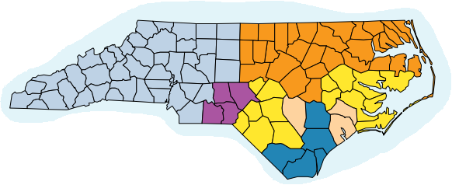
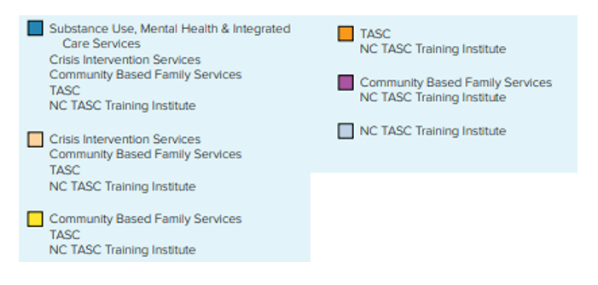

Slide 37
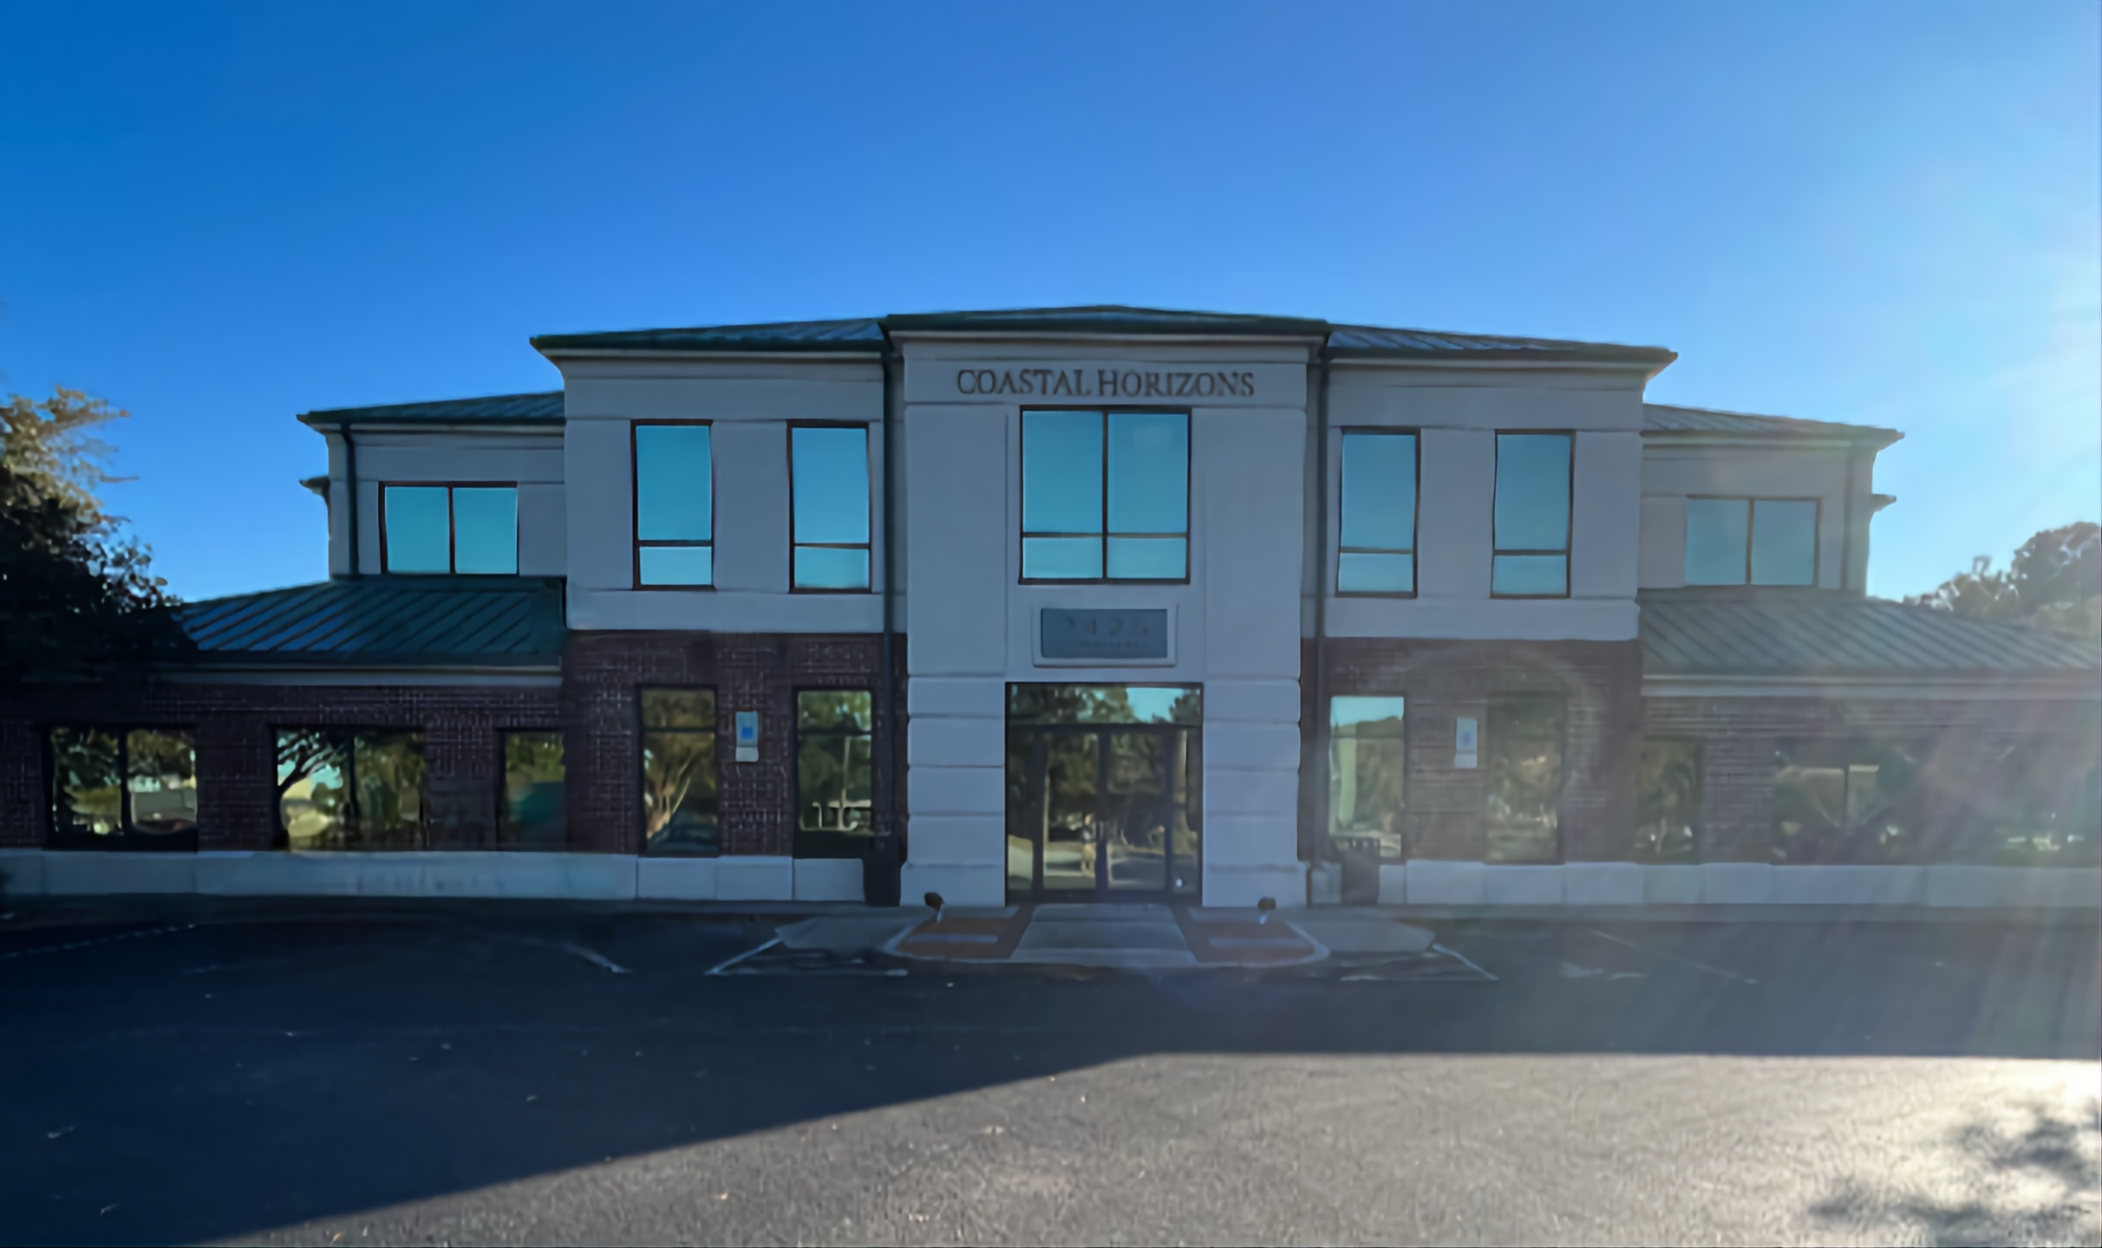
Survivors of the Opioid/covid epidemics Utilization of Resources and Community Engagement (SOURCE) & Law Enforcement Assisted Diversion (LEAD)
LEAD aims to divert people from the justice system and into needed services.
Grant funds have allowed LEAD participants to receive among other things, paid housing, transportation and medication assistance.
SOURCE was established in 2021 through DHHS
Additional funding received in 2022 to expand services

Slide 38
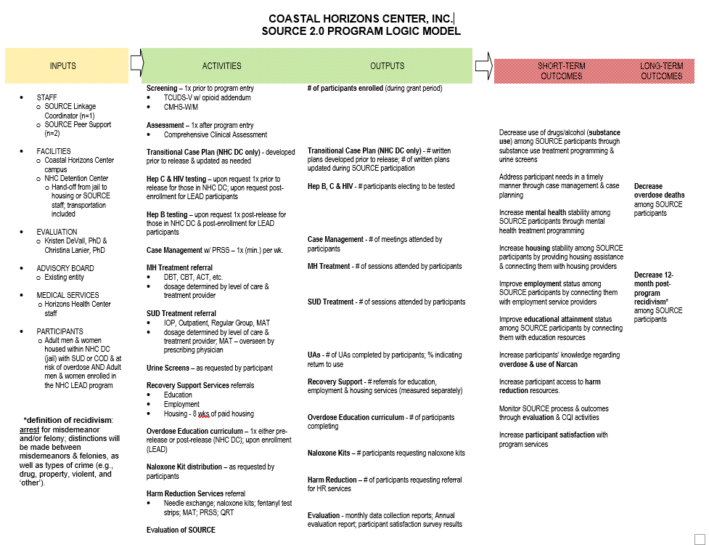

Slide 39
Program Highlights
Program staff have lived experience in recovery and the justice system.
Thus far, they have initiated more than 1500 contacts with participants.
Served over 100 individuals and distributed more than 140 naloxone kits.
SOURCE has linked 59 individuals to community recovery homes from incarceration
SOURCE has partnered with 8 different recovery homes in New Hanover county
78 individuals have engaged with outpatient treatment services
38 individuals have been linked with employment via SOURCE staff
We have a designated SOURCE van to assist individuals with daily transportation needs
72 have accepted NARCAN on at least one occasion, some have received multiple kits.
39 have engaged with MAT services.
Combined the SOURCE and LEAD programs have celebrated 17 program graduates

Slide 40
Survivors of the Opioid/covid epidemics Utilization of Resources and Community Engagement (SOURCE) & Law Enforcement Assisted Diversion (LEAD)
Staff Contact Information:
Billy McGowan, SOURCE Linkage Coordinator
wmcgowan@coastalhorizons.org
910-444-8152
Elke Hennecke, SOURCE Peer Support Specialist/Case Manager
Ehennecke@coastalhorizons.org
910-274-9736
Jamir Jumoke, Justice Services Peer Support Specialist/LEAD Case Manager
ojumoke@coastalhorizons.org
910-622-9531
Jamie Melvin, Reentry Services Director
jmelvin@coastalhorizons.org
910-622-0812

Slide 42
Medication for Opioid Use Disorder and Overdose Prevention Efforts in Criminal Legal Settings in NC
Hillary Chen
Yujung Choi

Slide 43
Duke Opioid Collaboratory Mission and Values
To convene diverse partners to save lives, reduce stigma, and mitigate the harmful impact of drugs through the development, implementation, and evaluation of system-level interventions
Values a harm reduction approach towards “Any Positive Change” that incorporates a spectrum of strategies

Slide 44
Naloxone Distribution in Jails - Background
The North Carolina Harm Reduction Coalition (NCHRC) and Overdose Response Strategy (ORS) developed a standardized overdose prevention education curriculum for jail-based settings
In 2019, two North Carolina rural county jails implemented:
Opioid overdose education
Naloxone distribution
Linkages to treatment, care, or supportive services

Slide 45
Naloxone Distribution in Jails - Project
Evaluation of Overdose Prevention Education and Naloxone Distribution Programs in Jails
Study team | Duke Opioid Collaboratory, NCHRC, and ORS
What | Semi-structured, in-depth interviews
When | August to October 2021
Who | 5 jail staff and peer support specialists involved in program implementation at 2 jails in rural North Carolina counties
Topics covered | Knowledge and attitudes about naloxone Barriers and facilitators to program implementation Perceived impact of the program on the jail, people who are incarcerated, and the broader community Program recommendations

Slide 46
Naloxone Distribution in Jails - Key Findings
Recommendations suggested to improve program implementation
Jail system and staff | Include harm reduction in onboarding training for jail staff Use destigmatizing language Allow ample time for relationship building between jail staff and peer support specialists Focus on the positive impacts of naloxone Explore options for naloxone and overdose education packet to remain with people upon release or when transferred between facilities
Program implementation team | Add a list of resources to the education packet, including locations for MOUD and support services such as food, housing, and transportation Share local overdose data and program successes with jail staff and community members Hire peer support specialists from the outset

Slide 47
Durham Detention Center MOUD - Background
In 2019, collaborators in North Carolina began work to implement a medication for opioid use disorder (MOUD) program at the Durham County Detention Center (DCDC).
Rollout was planned in two phases:
Upon release, individuals have the option to be linked to care through the local federally qualified health center

Slide 48
Durham Detention Center MOUD - Project
Documentation of Durham Detention Center MOUD Program
Study team | Duke Opioid Collaboratory
What | Semi-structured, in-depth interviews
When | June 2020 to February 2021
Who | 14 interviews with collaborators involved in design, implementation, and provision of the program
Topics covered | Barriers and facilitators to program implementation Stakeholder engagement Guidelines and protocols Linkages to care Impact of COVID

Slide 49
Durham Detention Center MOUD - Key Recommendations
Providing MOUD can help promote safety and reduce harm in a criminal legal setting
Assessing available local resources, especially for linking individuals to care post-release
Identifying champions that can advocate for the importance of MOUD and help design and implement the program
Engaging diverse stakeholders in the design and implementation process
Collaborating closely with community MOUD providers to formalize linkages to care
Providing ongoing education on MOUD and harm reduction principles to address stigma for everyone involved in the provision of the program
Including procedures for data collection and evaluation to measure reach and impact of the program
Identifying long-term funding sources is necessary for sustainability of an MOUD program

Slide 50
Overdose Prevention Efforts in CLS – Resource Links
Overdose Prevention in Two County Jails in North Carolina
5-page summary of interview findings, including facilitators and barriers to overdose prevention education and naloxone distribution program implementation and recommendations for program improvements
Recommendations from Stakeholder Interviews
2-page overview of key takeaways and common challenges and potential solutions one might experience when implementing MOUD in a CLS
Recommendations from a North Carolina case study Recommendations and considerations for each step of the
implementation process including quotes from the experts' interviewees
For any questions or comments: HarmReduction@Duke.edu

Slide 51
These projects were part of the Duke Opioid Collaboratory, funded by The Duke Endowment and administered through the Duke School of Medicine Department of Population Health Sciences.
10

Slide 52
Wrap up and THANK YOU!
Sara Smith, Injury and Violence Prevention Branch, Division of Public Health
The meeting recording, agenda and PowerPoint slides will be added to our NC DHHS Overdose/OPDAAC page within 7 days
https://www.ncdhhs.gov/about/department-initiatives/overdose-epidemic/nc-opioid-and-prescription-drug-abuse-advisory-committee
Next OPDAAC Meeting: March 2023, hybrid (in-person and virtual)

