Slide 1
NC Department of Health and Human Services
NC Opioid and Prescription Drug Abuse Advisory Committee (OPDAAC)
September 23, 2022

Slide 2
Welcome to OPDAAC!
Glorina Stallworth, Head, Injury and Violence Prevention Branch, Chronic Disease and Injury Section, Division of Public Health
Housekeeping
Take breaks as needed
For questions during the meeting:
Please put your questions in the Q&A box, which will be monitored for the duration of the meeting. Note: you need to send to all panelists and attendees to ensure your question is addressed in a timely manner.
If you would like to ask a question to a specific presenter, please be sure to include their name in your question.

Slide 3
Disparities in Overdose Deaths
Mary Beth Cox

Slide 4
Overview
National and State Overdose Trends
Disparities in overdoses
Surveillance Resources

Slide 5
National and State Overdose Trends

Slide 6
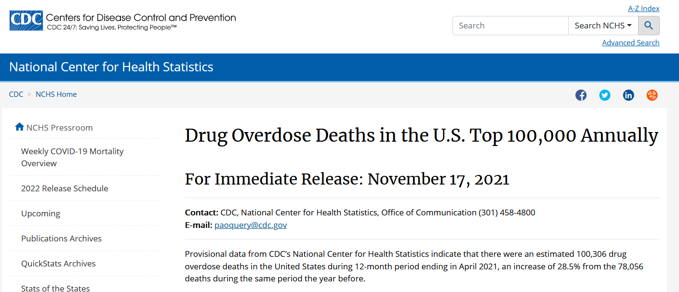
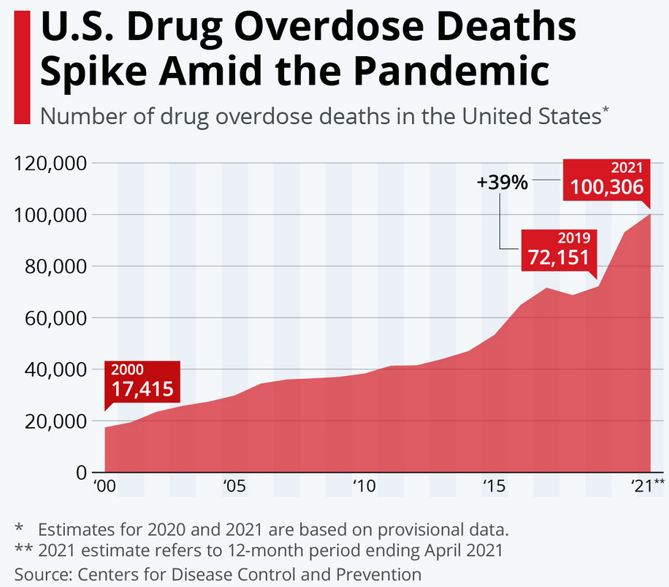

Slide 7
North Carolina has experienced similar increases.
*2021 data are provisional and subject to change as cases continue to finalize
Technical Notes: Medication and drug poisoning, all intents;
Source: Deaths-N.C. State Center for Health Statistics, Vital Statistics, 2010-2021
Analysis by Injury Epidemiology and Surveillance Unit

Slide 8
In 2021*, an average of 10 North Carolinians died each day from an overdose.
*2021 data are provisional and subject to change
Technical Notes: Medication and drug overdose: X40-X44, X60-X64, Y10-Y14, X85; Limited to N.C. residents
Source: Deaths-N.C. State Center for Health Statistics, Vital Statistics, 2021
Analysis by Injury Epidemiology and Surveillance Unit

Slide 9
The epidemic is still driven by fentanyl^.
*Other synthetic narcotic overdose (T40.4), most cases due to illicitly manufactured fentanyl; this category may also include prescription fentanyl and other synthetic narcotics like Tramadol ; ^2021 data are provisional and subject to change
Technical Notes: These counts are not mutually exclusive; If the death involved multiple substances, it can be counted on multiple lines; Medication/drug and alcohol poisonings: with any mention of specific T-codes by drug type; limited to N.C. residents
Source: Deaths-N.C. State Center for Health Statistics, Vital Statistics, 1999-2020
Analysis by Injury Epidemiology and Surveillance Unit

Slide 10
Disparities in Overdose

Slide 11
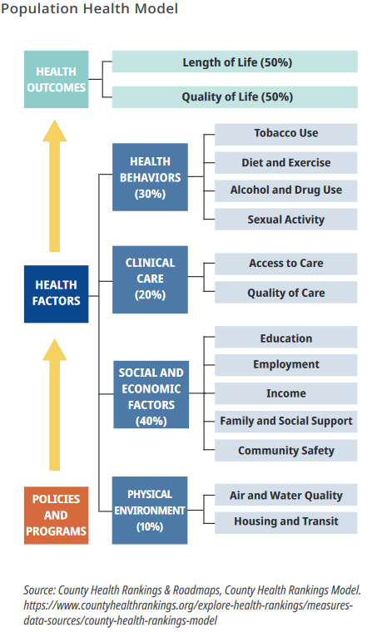
Health disparities are differences in health outcomes among groups of people.
Population Health Model/Drivers of Health
Reducing health disparities brings us closer to reaching health equity.

Slide 12
Overdose rates ranged from 12 to 50 deaths per 100,000 (2016-2020).
Statewide, the fatal overdose rate was 24 deaths per 100,000 residents from 2016-2020.
Technical Notes: Rates are per 100,000 NC residents; All intent medication and drug poisoning: X40-X44, X60-X64, Y10-Y14, X85
Source: Deaths-NC State Center for Health Statistics, Vital Statistics; Population-National Center for Health Statistics
Analysis by Injury Epidemiology and Surveillance Unit

Slide 13
Overdose rates are highest in rural counties.
2016 2020
2016 2020
Rural
Urban

Slide 14
Overdose death rates highest among males, American Indians* and NH whites*, and those 25-54 years old, 2016-2020
*NH = Non-Hispanic
Technical Notes: Rates are per 100,000 NC residents; All intent medication and drug overdose: X40-X44, X60-X64, Y10-Y14, X85
Source: Deaths-NC State Center for Health Statistics, Vital Statistics, 2016-2020; Population-NCHS, 2016-2020
Analysis by Injury Epidemiology and Surveillance Unit

Slide 15
NC Overdose Death Counts
*Non-Hispanic
Source: N.C. State Center for Health Statistics, Vital Statistics-Deaths, 2000-2020
Analysis by Injury Epidemiology and Surveillance Unit

Slide 16
NC Overdose Death Rates
*Non-Hispanic; Rates per 100,000 NC Residents
Source: N.C. State Center for Health Statistics, Vital Statistics-Deaths, 2000-2020
Analysis by Injury Epidemiology and Surveillance Unit

Slide 17
Overdose rates are increasing in historically marginalized populations.
*NH = Non-Hispanic
Technical Notes: Rates are per 100,000 NC residents; All intent medication and drug overdose: X40-X44, X60-X64, Y10-Y14, X85
Source: Deaths-NC State Center for Health Statistics, Vital Statistics, 2011-2020; Population-NCHS, 2011-2020
Analysis by Injury Epidemiology and Surveillance Unit

Slide 18
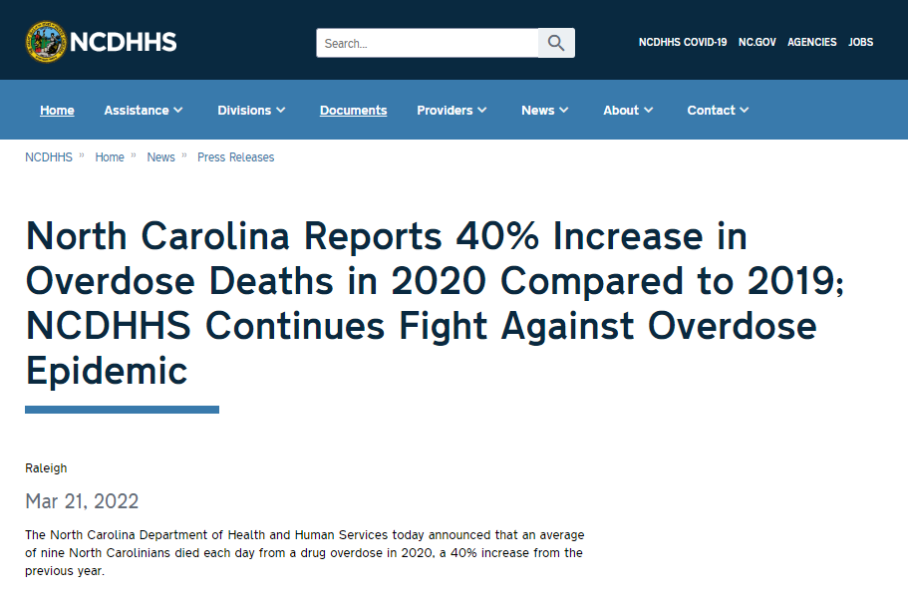
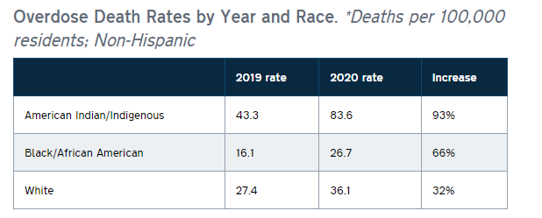

Slide 19
Overdose trends vary within populations.
*Non-Hispanic
Technical Notes: Rates are per 100,000 NC residents; All intent medication and drug overdose: X40-X44, X60-X64, Y10-Y14, X85
Source: Deaths-NC State Center for Health Statistics, Vital Statistics, 2017-2021; Population-NCHS, 2017-2020, 2020 used as proxy for 2021 pop data
Analysis by Injury Epidemiology and Surveillance Unit

Slide 20
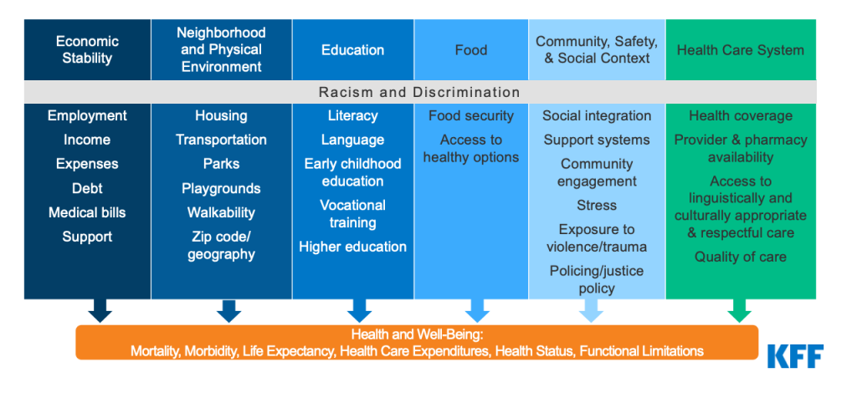
Data on many drivers of health are not often collected alongside health outcome data.

Slide 21
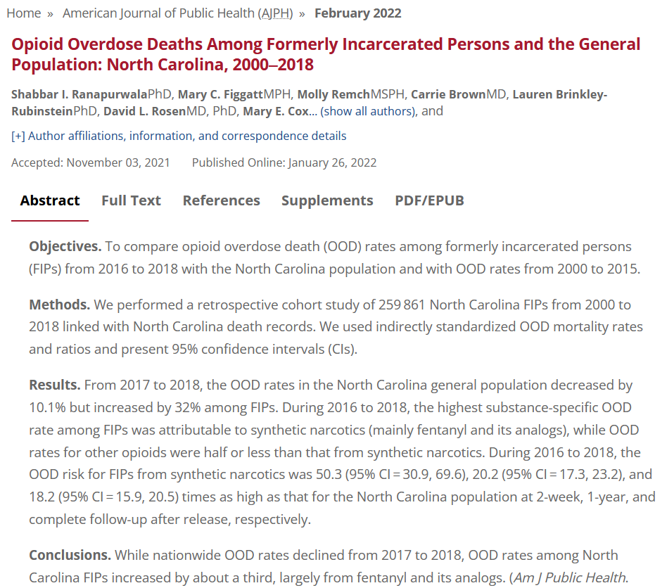
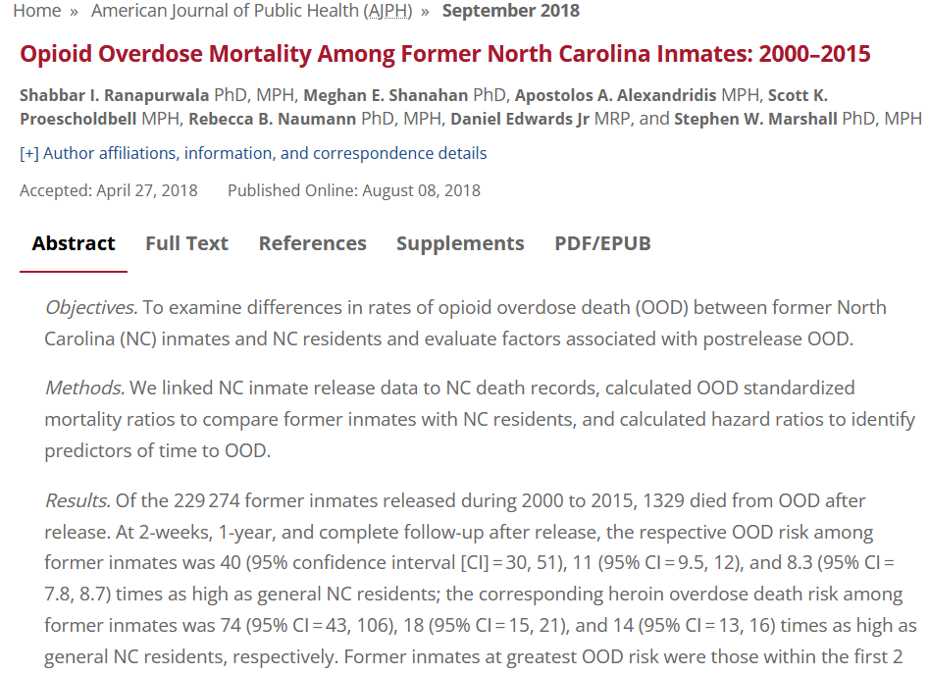
People are 40 times more likely to die of an opioid overdose in the two weeks post incarceration than the general population.

Slide 22
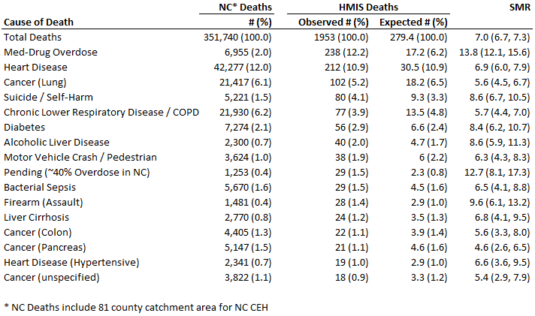
Preliminary findings show that the most frequent cause of death among people with a history of experiencing homelessness was overdose. 12% of the deaths were overdoses (vs. 2% in the NC population), over 10 times the rate of the general population.

Slide 23
Surveillance Resources

Slide 24
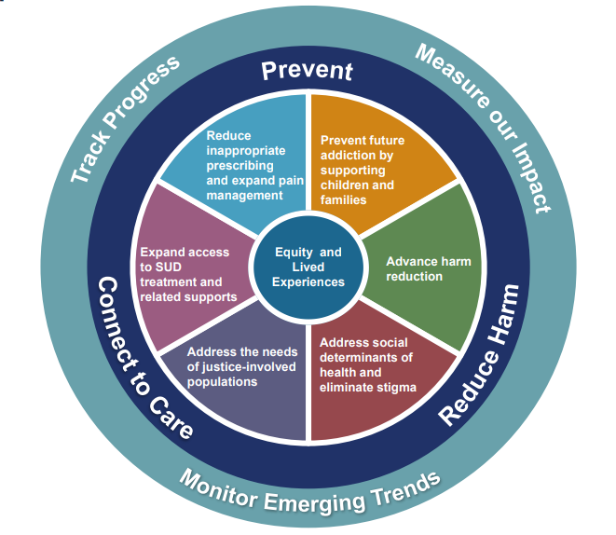
The NC Opioid and Substance Use Action Plan (NC OSUAP) has seven focus areas to address the overdose epidemic:
https://www.ncdhhs.gov/about/department-initiatives/opioid-epidemic/north-carolinas-opioid-action-plan

Slide 25
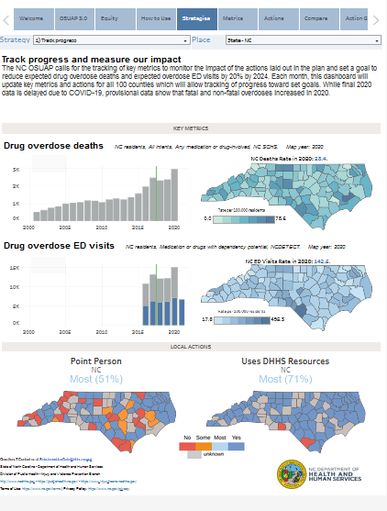
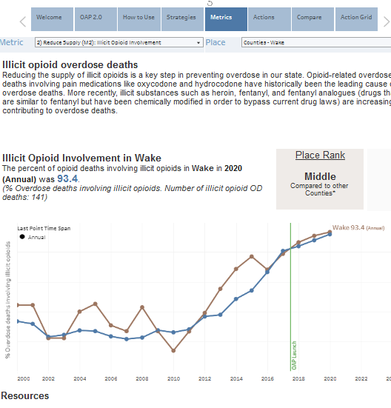
OSUAP Data Dashboard

Slide 26
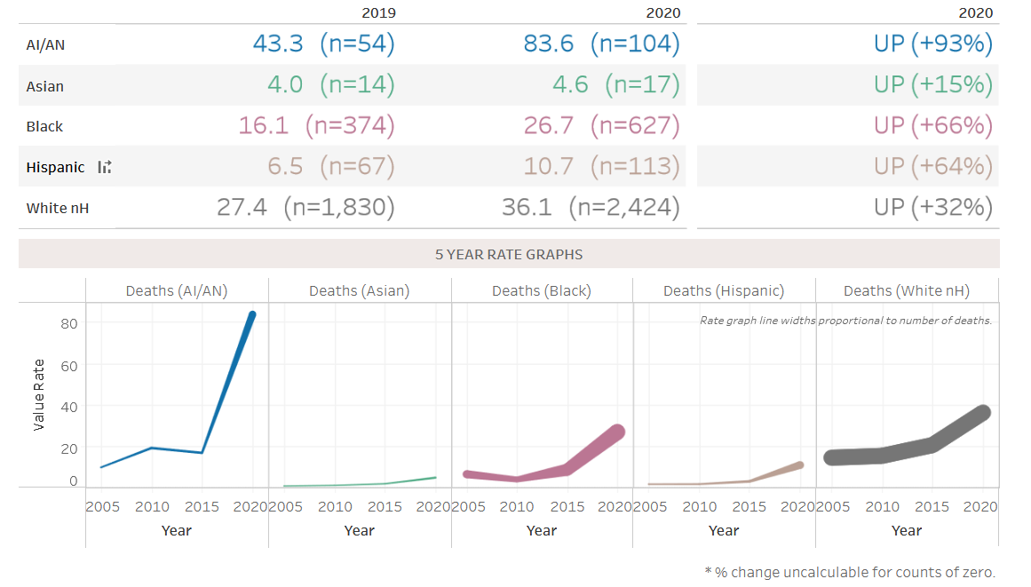
Local Equity Dashboard Page

Slide 27
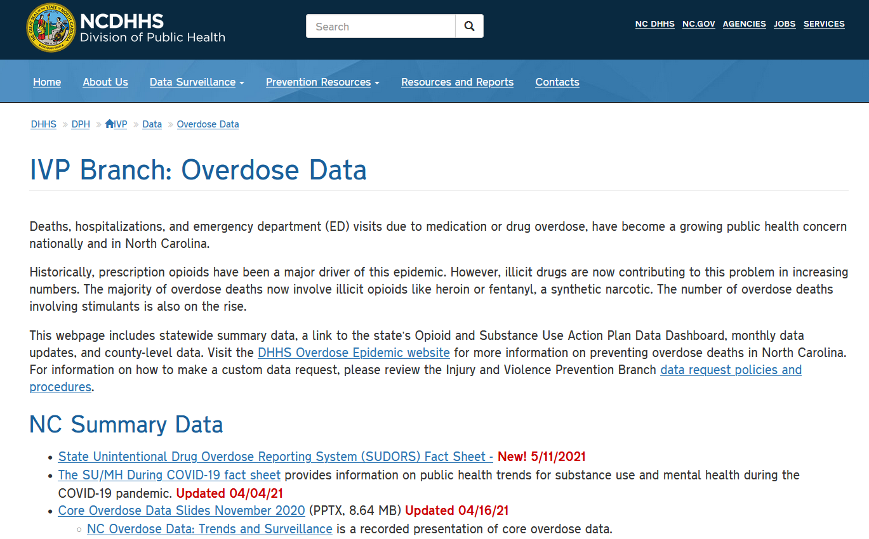
Additional Resources
Core Overdose Slides
County-level Slides
Factsheets
Deaths, ED, and Hosp by county and drug
SubstanceUseData@dhhs.nc.gov

Slide 28
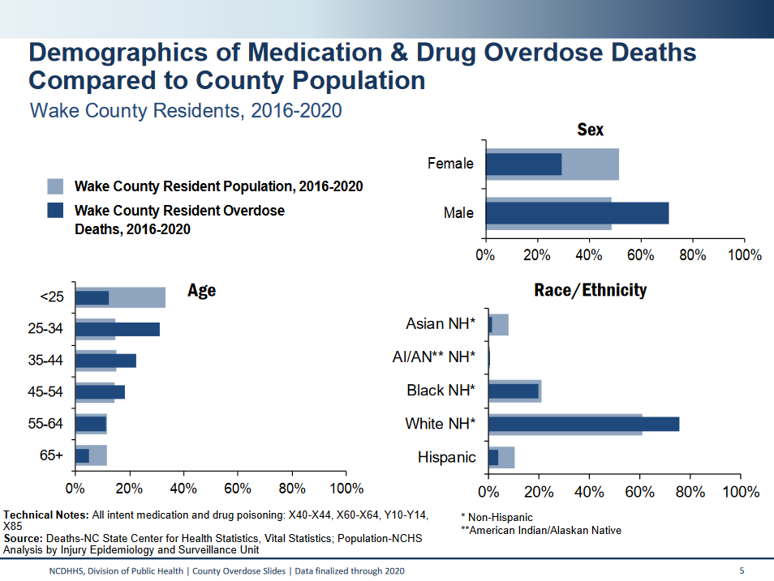
County Slides

Slide 29
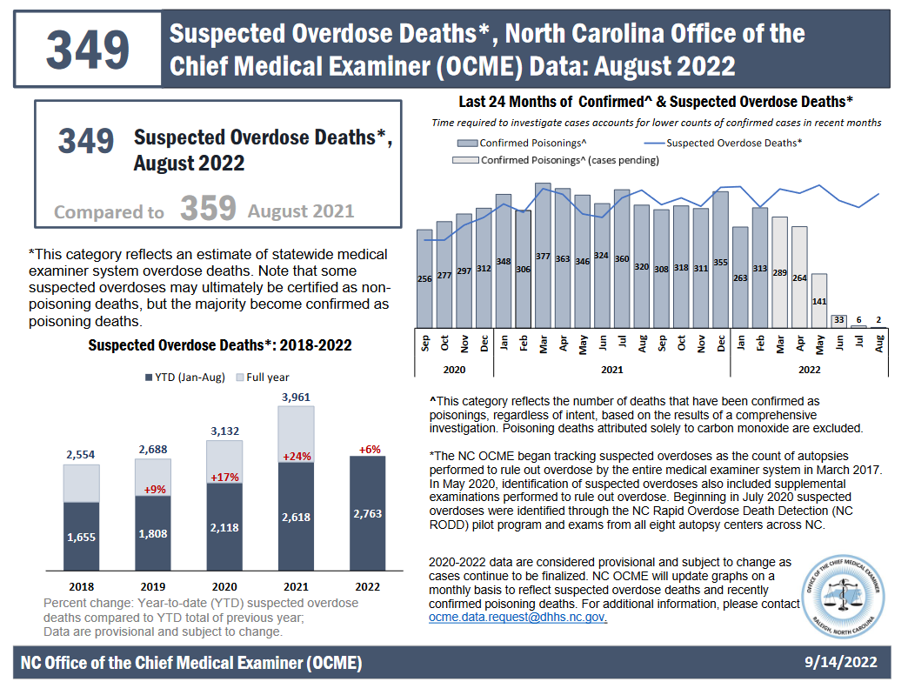
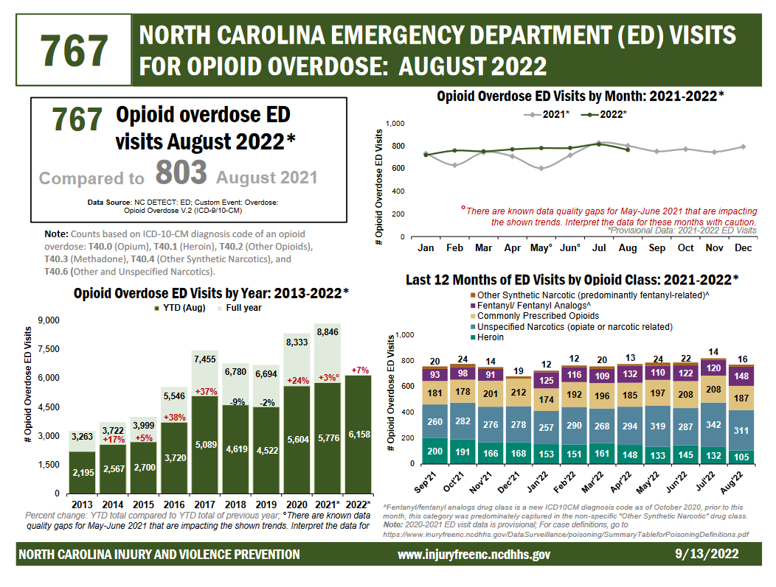
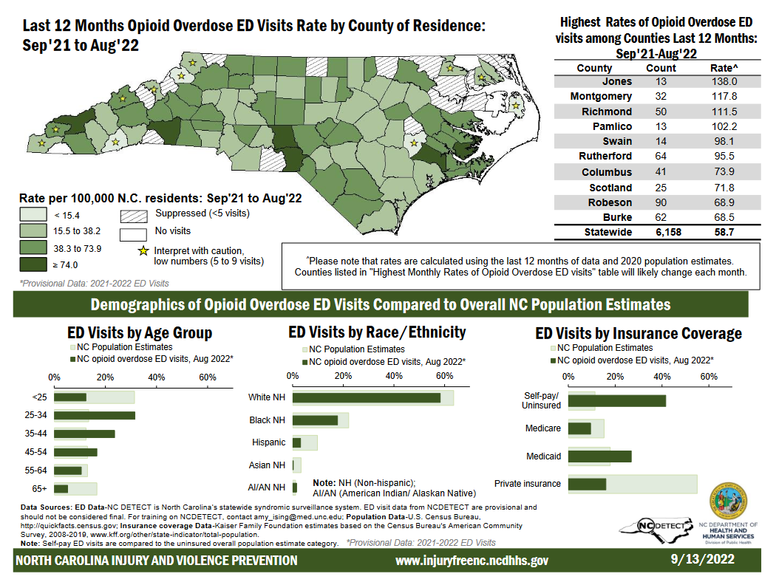
Monthly Surveillance Reports

Slide 30
Contact us with your data questions:
MaryBeth.Cox@dhhs.nc.gov
SubstanceUseData@dhhs.nc.gov
Injury and Violence Prevention Branch
NC Division of Public Health
www.injuryfreenc.ncdhhs.gov

Slide 31
Panel: Setting the Stage
Moderator: Sansanka Jinadasa
Margaret Bordeaux
Tony Locklear

Slide 32
Examples of Equity Focused Programs
Voni Simpson
Talya Williams

Slide 33
Race Equity and Harm Reduction in North Carolina
Louise Vincent
Summer Benton
Abby Coulter

Slide 34
The Mission of North Carolina Survivors Union - NCSU is a community-led, statewide grassroots organization made up of people who are directly impacted by drug use. Our mission is to improve the lives of people who have been targeted by the war on drugs by:
Organizing, growing, and strengthening community-led grassroots groups.
Educating, mobilizing, and advocating for policies and programs grounded in harm reduction, healing, and disability justice.
Providing direct services in areas where high-risk communities are denied even the most basic services.
NCSU is a Community Led Drug User Union

Slide 35
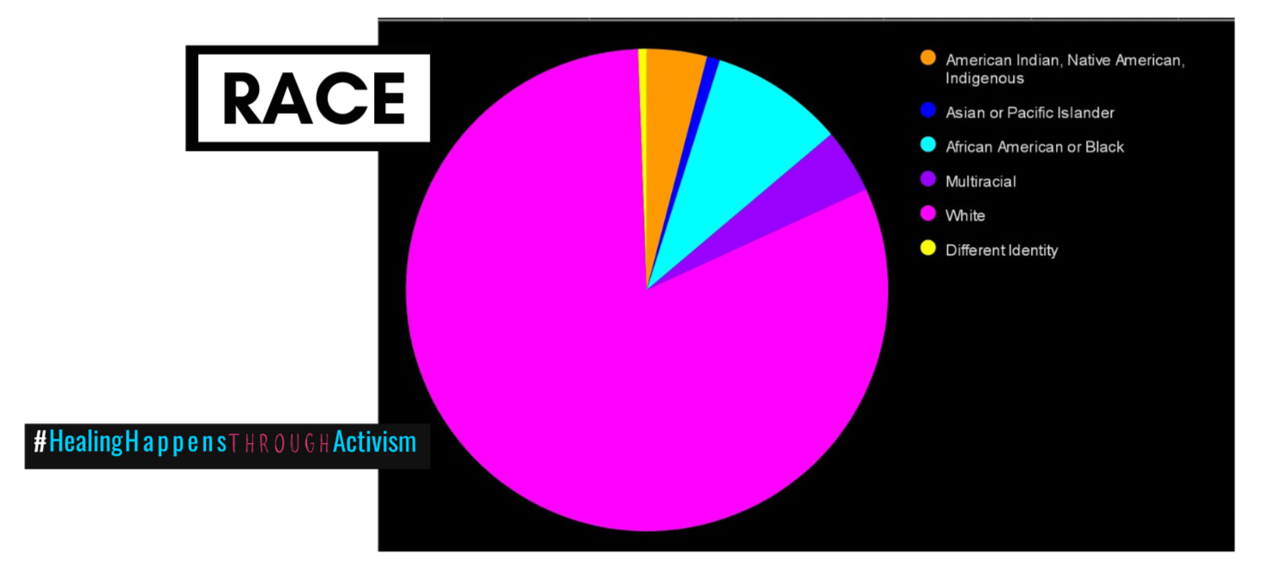

Slide 36
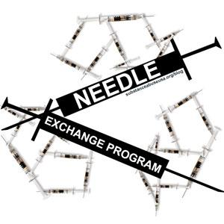
MORE than Syringe Service….
Drug User HEALTH HUBS

Slide 37
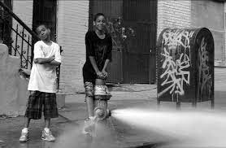
Reaching the Youth First
The Triad has a large minority population that doesn’t receive the proper education on safe drug use.
Outreach is one way we can inform these historically marginalized communities.
We are home to one of the largest HBCUs in the nation we are reaching out to find allies from the communities being affected.

Slide 38
The Perception Behind Drug Use in Historically Marginalized Communities
The Perception Drug Users vs. Drug Dealers
Reaching out to majority-minority neighborhoods
Connecting with organizations and business

Slide 40
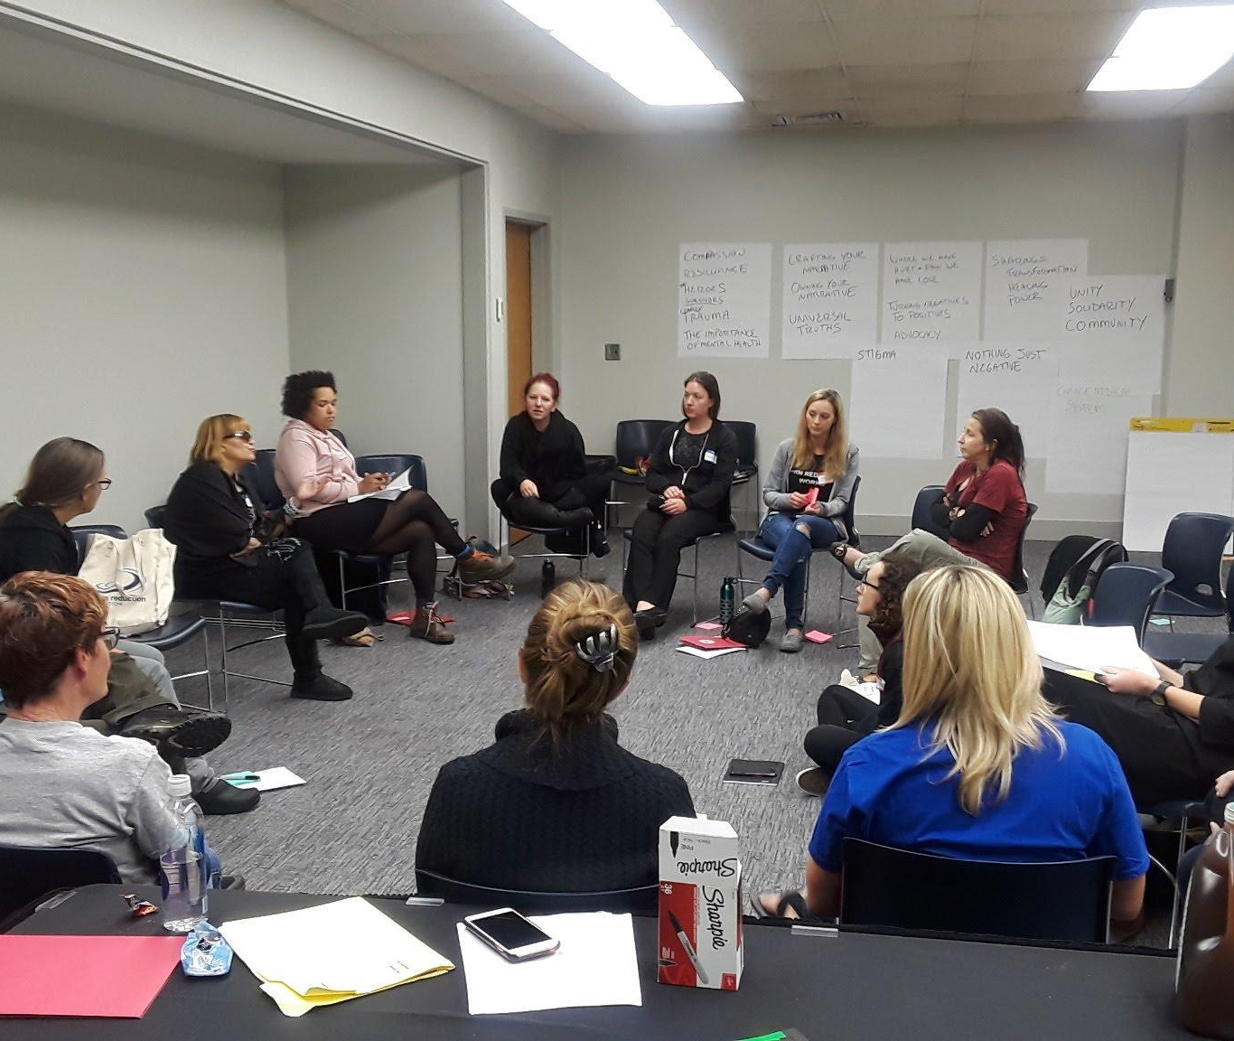
NarcoFeminism Storyshare

Slide 41
Created to help work with Pregnant and Parenting People Who Use Drugs
Help to empower PPWUD by disrupting current narratives
Help people to identify their own biases around PPWUD
Change hearts and minds

Slide 42
NarcoFeminism Storyshare Model

Slide 43
Thank You from NC Survivors Union
Contact information:
Louise Vincent – louise@ncsunion.org
Abby Coulter – abby@ncsunion.org
Summer Benton – summer@ncsunion.org

Slide 44
Examples of Equity Focused Programs
Lauren Kestner

Slide 45
Wrap up and THANK YOU!
Glorina Stallworth, Injury and Violence Prevention Branch, Division of Public Health
The meeting recording, agenda and PowerPoint slides will be added to our NC DHHS Overdose/OPDAAC page within 7 days
https://www.ncdhhs.gov/about/department-initiatives/overdose-epidemic/nc-opioid-and-prescription-drug-abuse-advisory-committee
Next OPDAAC Meeting: Friday, December 9, 2022, Virtual

