Slide 1
NC Department of Health and Human Services
Justice System Innovation Section
NC Comprehensive Opioid Abuse Site-Based Program: Justice System
January 2022

Slide 2
Table of Contents
Introduction
Background and Goals
Eligibility
Scope of Work
Program Requirements
Performance Measures and Expectations
Budget
Application Content
Anticipated Schedule
Resources

Slide 3
NC DHHS DMH/DD/SAS
Request for Applications
The North Carolina Department of Health and Human Services (DHHS), on behalf of the Division of Mental Health, Developmental Disabilities, and Substance Abuse Services (DMH/DD/SAS), is soliciting applications for organizations to develop or expand services in the areas of:
    (1) pre-arrest diversion programs,
    (2) jail-based overdose prevention education programs, and
    (3) comprehensive jail-based medication-assisted treatment programs
Funding will be available for a period beginning on April 1, 2022 and ending on September 30, 2023

Slide 4
Background and Goals
Strategic Goals
Implementation or Expansion
Advance health equity by reducing disparities in opportunity and outcomes for historically marginalized populations
Help North Carolinians end the pandemic, control the spread of COVID-19, recover stronger, and be prepared for future public health crises
Build an innovative, coordinated, and whole-person centered system that addresses both medical and non-medical drivers of health
Turn the tide on North Carolina’s opioid and substance use crisis
Improve child and family well-being
Support individuals with disabilities and older adults in leading safe, healthy, and fulfilling lives
Eligible applicants may apply to implement one, two, or all three of the following strategies, either by establishing a new program or expanding or augmenting an existing program:
Pre-arrest diversion programs
Jail-based overdose prevention education and naloxone distribution upon release programs
Comprehensive jail-based medication assisted treatment (MAT)

Slide 5
Eligibility
The following entities and organizations are eligible to receive funds under the program:
  Local government entities (e.g., local law enforcement agencies, jails, community corrections, health departments,
  EMS agencies, etc.)
  Substance use disorder treatment providers
  Hospitals
  Health centers
  Clinics
  Pharmacies, or
  Other non-profit or for-profit organizations that have a documented history of working with the justice involved persons or people with substance use/abuse disorder

Slide 6
Scope of Work
All proposals must include:
  A plan for identifying individuals to be served by the program, including any use of screening and assessment tools as appropriate
  A description of how programs will plan for warm transfers from justice partners to appropriate community services and supports; plan may include use of peer support, care coordination or case management.
  A clear statement on the readiness of the organization to engage in this work based on level of experience:
    Entry level: programs that have not delivered this work before but have demonstrated a clear understanding of the need and requirements to be successful;
    Mid-level programs, with demonstrated experience in one of the three options but wish to build on then initiative;
    Experienced programs seeking to expand geographically or begin delivering an additional element of the pathway (for example, a re-entry service wishing to expand into jail-based MAT).

Slide 7
Program Requirements
Pre-arrest and pre-trial diversion programs
Jail-based overdose prevention education and naloxone distribution upon release programs
Comprehensive jail-based medication assisted treatment (MAT) programs
Programmatic requirements depend on which type of program you will implement
Notes:
More to come on the next slide

Slide 8
Pre-arrest and Pre-trial Diversion Programs
Applications must:
  Identify law enforcement agency, sheriff’s offices, and local court system partners with commitment to implementation of these programs
  Include letters of support from partners
  Identify behavioral health services and supports committed to working with LEO and courts to ensure availability of tools to utilize for implementation

Slide 9
Jail-based Overdose Prevention Education and Naloxone Distribution Upon Release Programs
Applications in this category must:
  Utilize a standardized curriculum based on research and expertise in implementing best practice education programs that include components outlined in SAMHSA’s Opioid Overdose Prevention Toolkit
  Have staff, contractors or volunteers identified to implement the curriculum must attend training organized by the state in order to ensure program consistency and peer-to-peer learning opportunities
  Include naloxone distribution to individuals upon release from incarceration

Slide 10
Comprehensive Jail-based Medication Assisted Treatment (MAT) Programs
Comprehensive MAT programs, which include providing buprenorphine, methadone or both, are the gold standard for opioid use disorder treatment
  Sites may only utilize FDA approved medications for the treatment of opioid use disorder
  Applicants must detail how they are collaborating with organizations experienced in the provision of MAT, or appropriately training clinical staff in the provision of MAT
  Plan that includes in-reach strategies, when possible, for connecting individuals in jail-based MAT to continued treatment with community-based MAT programs upon release from jail

Slide 11
Performance Measures and Expectations
Options A-C
Number of unique individuals served
Number of contacts with individuals
Demographic information, including race, ethnicity, age, and gender identity of program participants and individuals served
Demographic information, including race, ethnicity, age, and gender identity of baseline population (demographics of detention center or current program participants if applicable, or demographics of population program is aiming to serve)
Number of connections to partner services
Type of partner services connected to (MAT, other treatment, other recovery supports, SSP services, social services, etc.)
Number of naloxone kits distributed by the program
Number of referrals made to obtain naloxone from another source
Challenges to completing project goals, strategies for overcoming these challenges, and lessons learned from engaging in the work

Slide 12
Reporting Requirements
Reports – Monthly, Quarterly, and as Requested
Monthly Reimbursements/Invoices
Both Due by the 10th of Each Month

Slide 13
Budget Categories https://www.ncdhhs.gov/about/grant-opportunities/mental-health-developmental-disabilities-and-substance-abuse-services-grant-opportunities
Human Resources
Salary/Wages
Fringe Benefits
Supplies and Materials
Equipment
Travel
Utilities
Repair and Maintenance
Staff Development
Media/Communications/Public Affairs
Rent
Professional Services
Subcontracting Grants
Indirect Costs
Notes:
Please download the Excel spreadsheet from the website to complete your actual budget. We want to make sure you show the budget with a breakdown over the 3 fiscal years that will be included.

Slide 14
Application Content
Cover page with all fields completed
Face page
Proposal summary (500 words)
Organization background and qualifications
Assessment of Needs/statement of the problem
Project description and narrative
Collaboration and community support
Project evaluation
Potential impact
Sustainability
Line-item budget and budget narrative
Supporting documents excluded from the 20-page limit
Notes:
Each section will have specific points associated with it. Please do not omit any sections as that will take points away from your application submission.

Slide 15
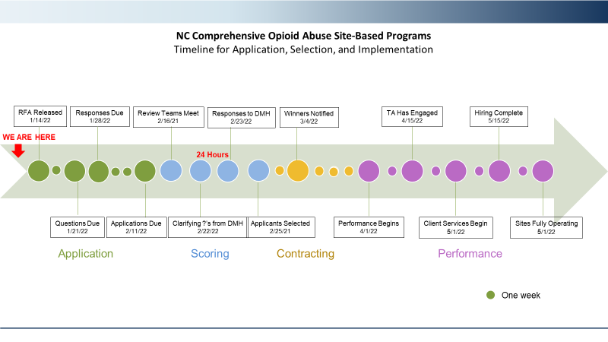
NC Comprehensive Opioid Abuse Site-Based Programs
Timeline for Application, Selection, and Implementation
Applicant Webinar
Questions Due
11/5/21
11/21/21
Applications Due
12/3/21
Review Teams Meet
12/8/21
Successful Applicants Selected
12/17/21
Successful Applicants Notified
12/30/21
All Contracts Executed, Performance Begins
2/1/22
TA Has Engaged with All Sites
2/15/22
Client-Facing Services Begin with Staff In-Place
3/1/22
Hiring Is Completed
3/15/22
All Client-Facing Services Have Begun
4/1/22
RFA Released
10/18/21
RFA Released
1/14/22
Responses Due
1/28/22
Review Teams Meet
2/16/21
Responses to DMH
2/23/22
Winners Notified
3/4/22
TA Has Engaged
4/15/22
Hiring Complete
5/15/22
WE ARE HERE
24 Hours
Questions Due
1/21/22
Applications Due
2/11/22
Clarifying ?’s from DMH
2/22/22
Applicants Selected
2/25/21
Performance Begins
4/1/22
Client Services Begin
5/1/22
Sites Fully Operating
5/1/22
Application
Scoring
Contracting
Performance
One week
Notes:
Summary slide for the Department.
Since our last update the total number of projects and concepts have remained the same at 25 and 26 respectively. The upper left quad gives you an indication of the workload across divisions.
On the Upper Right Quad we have used the data from the application rationalization effort and shown the status of applications based on 4 different buckets. The four buckets are – Applications that are in the process of being replaced, Applications that are in the planning phase for next replacement/retirement., Applications that are targeted to be replaced or retired in the future and the fourth category is for those applications still being analyzed for disposition or those being retained
The colors give you an indication of the number by category.
In Progress (Green) ~ 32, In Planning (Yellow) ~ 95, Future Replace/Retire (Red) ~ 21 and Retain/Analyzing (Blue) ~ 230
Bottom line this really indicates that while we are extremely busy with current efforts, there is still a lot of work to do to ensure our applications modernized across each portfolio
Bottom left quadrant shows the status of the DevOps strategy. We’re continuing to make progress with new DevOps practices which will ultimately improve quality of code and accelerate the release process.
Bottom right quadrant shows the status of the Agile transformation that we have undertaken within the APMO (Medicaid and NC FAST and efforts in DPH)

Slide 16
Resources
North Carolina Opioid Action Plan https://www.ncdhhs.gov/about/department-initiatives/opioid-epidemic/north-carolinas-opioid-action-plan
NC Division of Public Health, Injury and Violence Prevention Branch, Epidemiology and Surveillance Unit (Related data available here) http://www.injuryfreenc.ncdhhs.gov/DataSurveillance/Poisoning.htm
National Sheriffs Association Jail Based MAT guide https://www.sheriffs.org/Jail-Based-MAT
SAMHSA Use of Medication-Assisted Treatment for Opioid Use Disorder in Criminal Justice Settings
https://store.samhsa.gov/product/Use-of-Medication-Assisted-Treatment-for-Opioid-Use-Disorder-in-Criminal-JusticeSettings/PEP19-MATUSECJS
SAMHSA Opioid Overdose Prevention Toolkit https://bjatta.bja.ojp.gov/system/files/naloxone/SMA16-4742.pdf
Naloxone Saves NC
www.naloxonesaves.org
Community Catalyst Promising Practices for Pre-Arrest Diversion Programs https://www.communitycatalyst.org/resources/publications/document/Promising-Practices-for-Pre-Arrest-DiversionPrograms.pdf
Pre-arrest Diversion Program
https://www.nchrc.org/programs/lead/
NC Safer Syringe Initiative
https://www.ncdhhs.gov/divisions/public-health/north-carolina-safer-syringe-initiative
North Carolina Certified Peer Support Specialist Program
https://pss.unc.edu

Slide 17
Questions?
RFA.responses@dhhs.nc.gov
Questions due January 21, 2022 Applications due February 11, 2022

