Slide 1

Verification Services web User Interface - user guide

Slide 2
Topics Covered
How to Login
Ordering Your Verification(s)
  Search By Social Security Number (SSN)
  Search By Name, Address and Date of Birth
Viewing Verification Results
  View Results
  Saving to PDF and Printing
More Order Information Required

Slide 3
How to log in

Slide 4
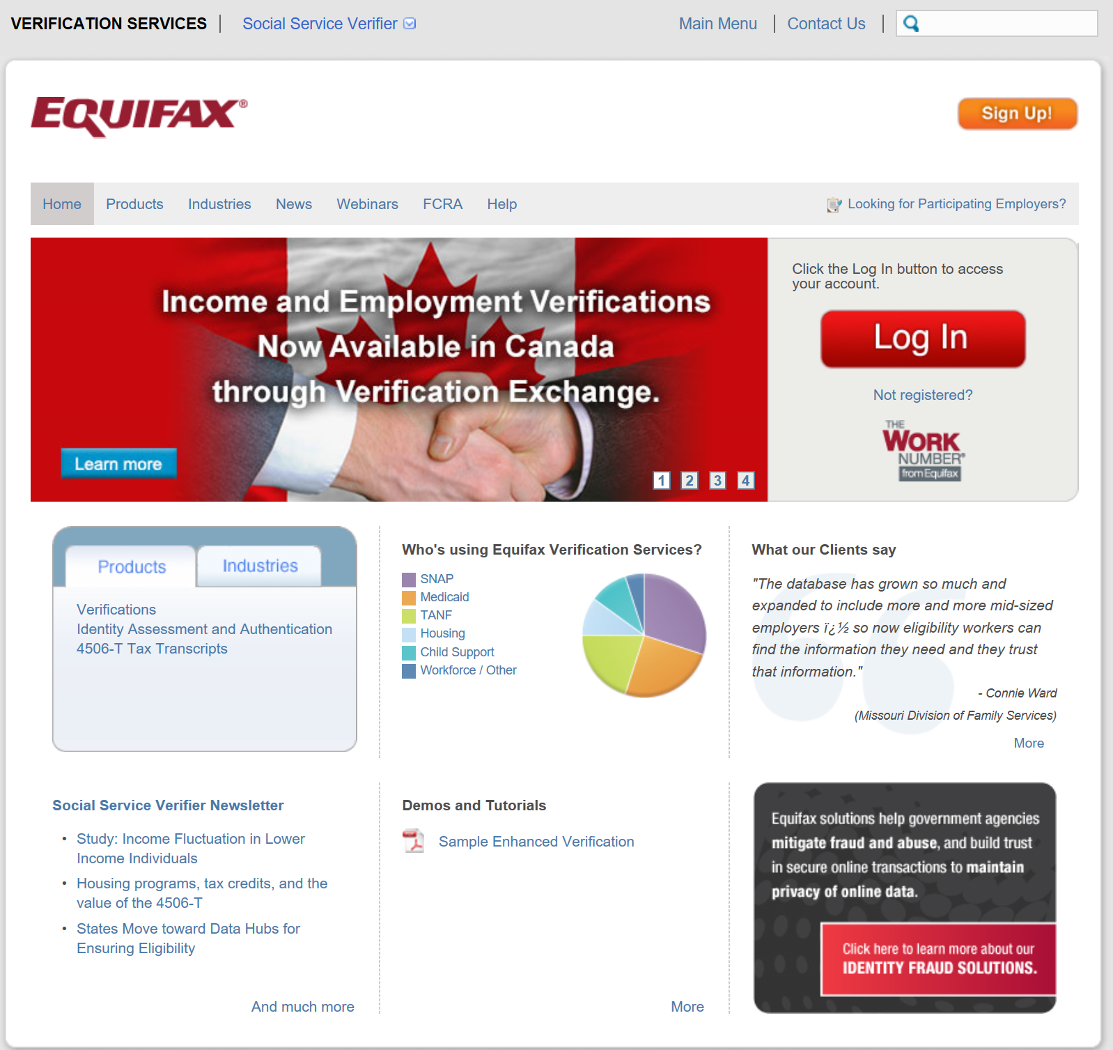
How to login
You can access through the Equifax Social Services Verification webpage http://www.theworknumber.com/SocialServices/

Slide 5
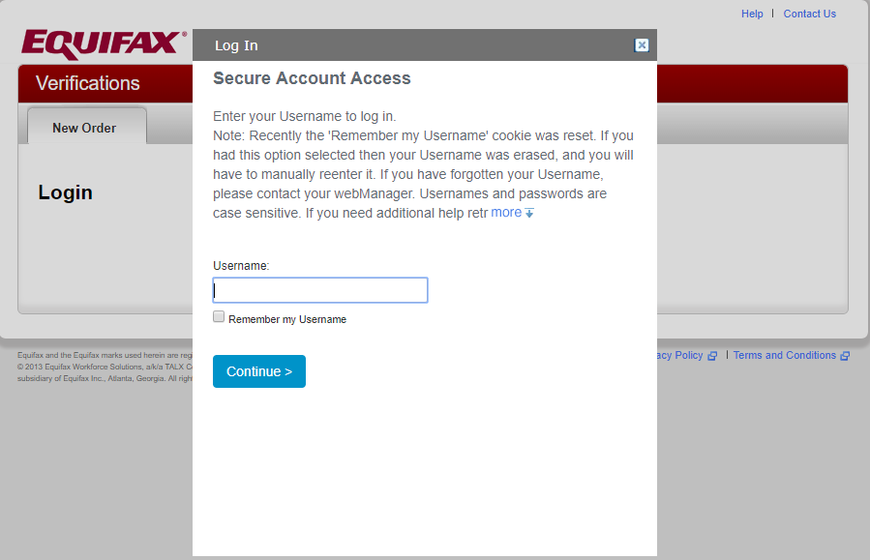
Login – Enter Your Username
When you have been granted access to the service, you will be sent two emails from verifierid@equifax.com.
One will contain your username.
The other will contain a temporary password.
Please note that both username and password are case sensitive.
Enter your username on the screen shown and click Continue.

Slide 6
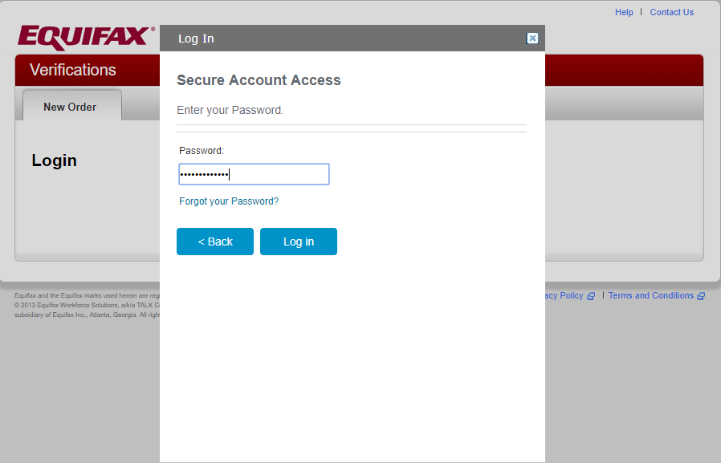
Login – Enter Your Password
Enter your password and click Log in.
The first time you login, you will be prompted to select 6 security questions and provide answers.
You will be required to select a security image and personalize your password.
First-time users will go through an enrollment process to set up security questions and security image for future password resets, etc.

Slide 7
Ordering your verification

Slide 8
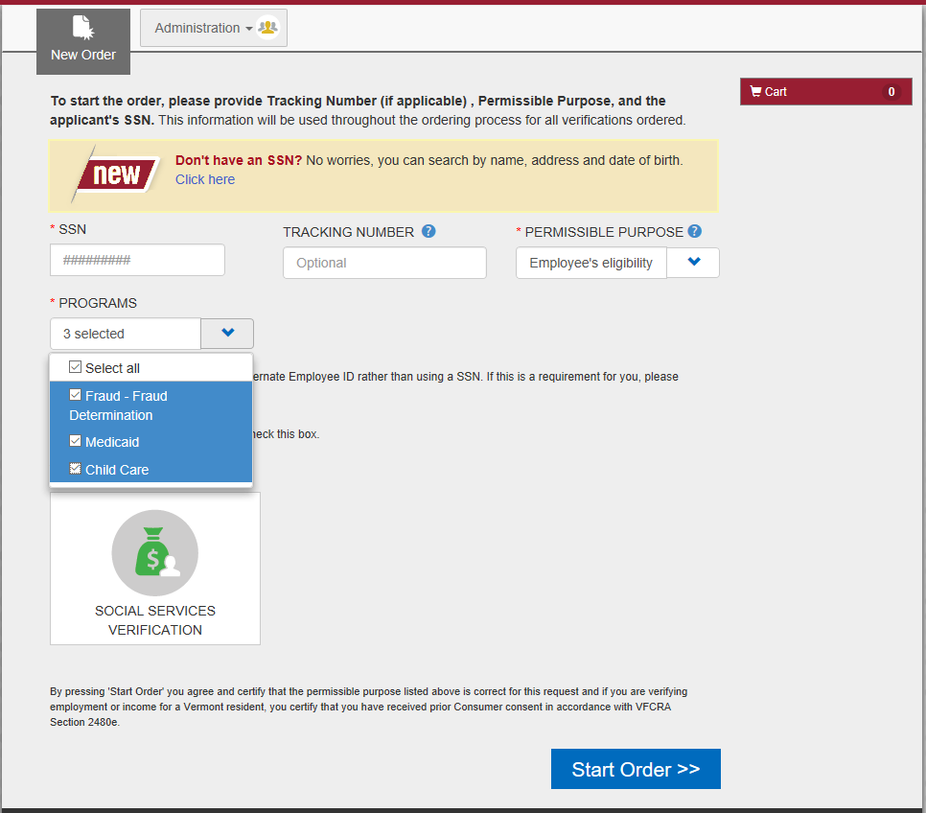
Product Ordering for multiple Programs
Enter the SSN (if available, if not, follow instructions on next slide)
Enter Tracking Number (configurable as optional or required)
Select Permissible Purpose from drop down menu(the reason you are verifying this individual’s employment)
Select Program(s) from the drop down menu (you are using the verification)
5. Choose your order type
Products presented to you are determined by your contract with Equifax
6. Once all selections are made, click “Start Order”

Slide 9
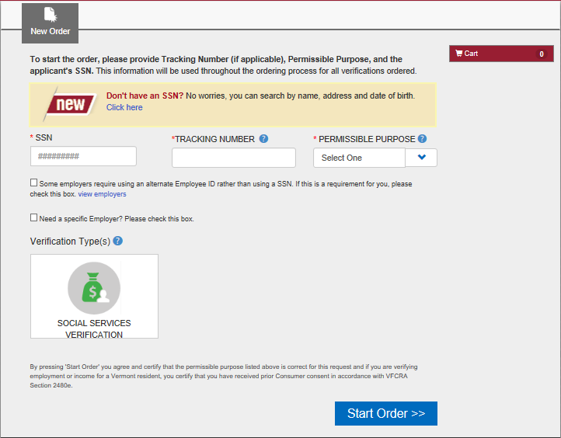
Don’t have an SSN or not sure it’s accurate?
If you do not have the applicant SSN but have other personal data to search with, before selecting the product type, simply choose “Click Here” in the highlighted area.
This may also be used if you have already searched unsuccessfully on SSN and suspect the SSN may be incorrect.

Slide 10
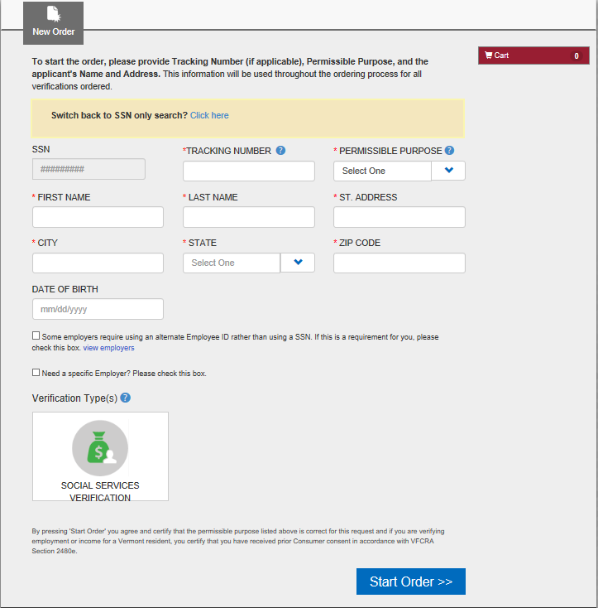
Don’t have an SSN or not sure it’s accurate? (cont.)
Enter Tracking Number (optional field)
Select Permissible Purpose from drop down menu (the reason you are verifying this individual’s employment)
Provide First Name, Last Name, Address required data (indicated with *).
Once all required information has been entered, you may proceed with selecting the product(s) needed and click
“Start Order”

Slide 11
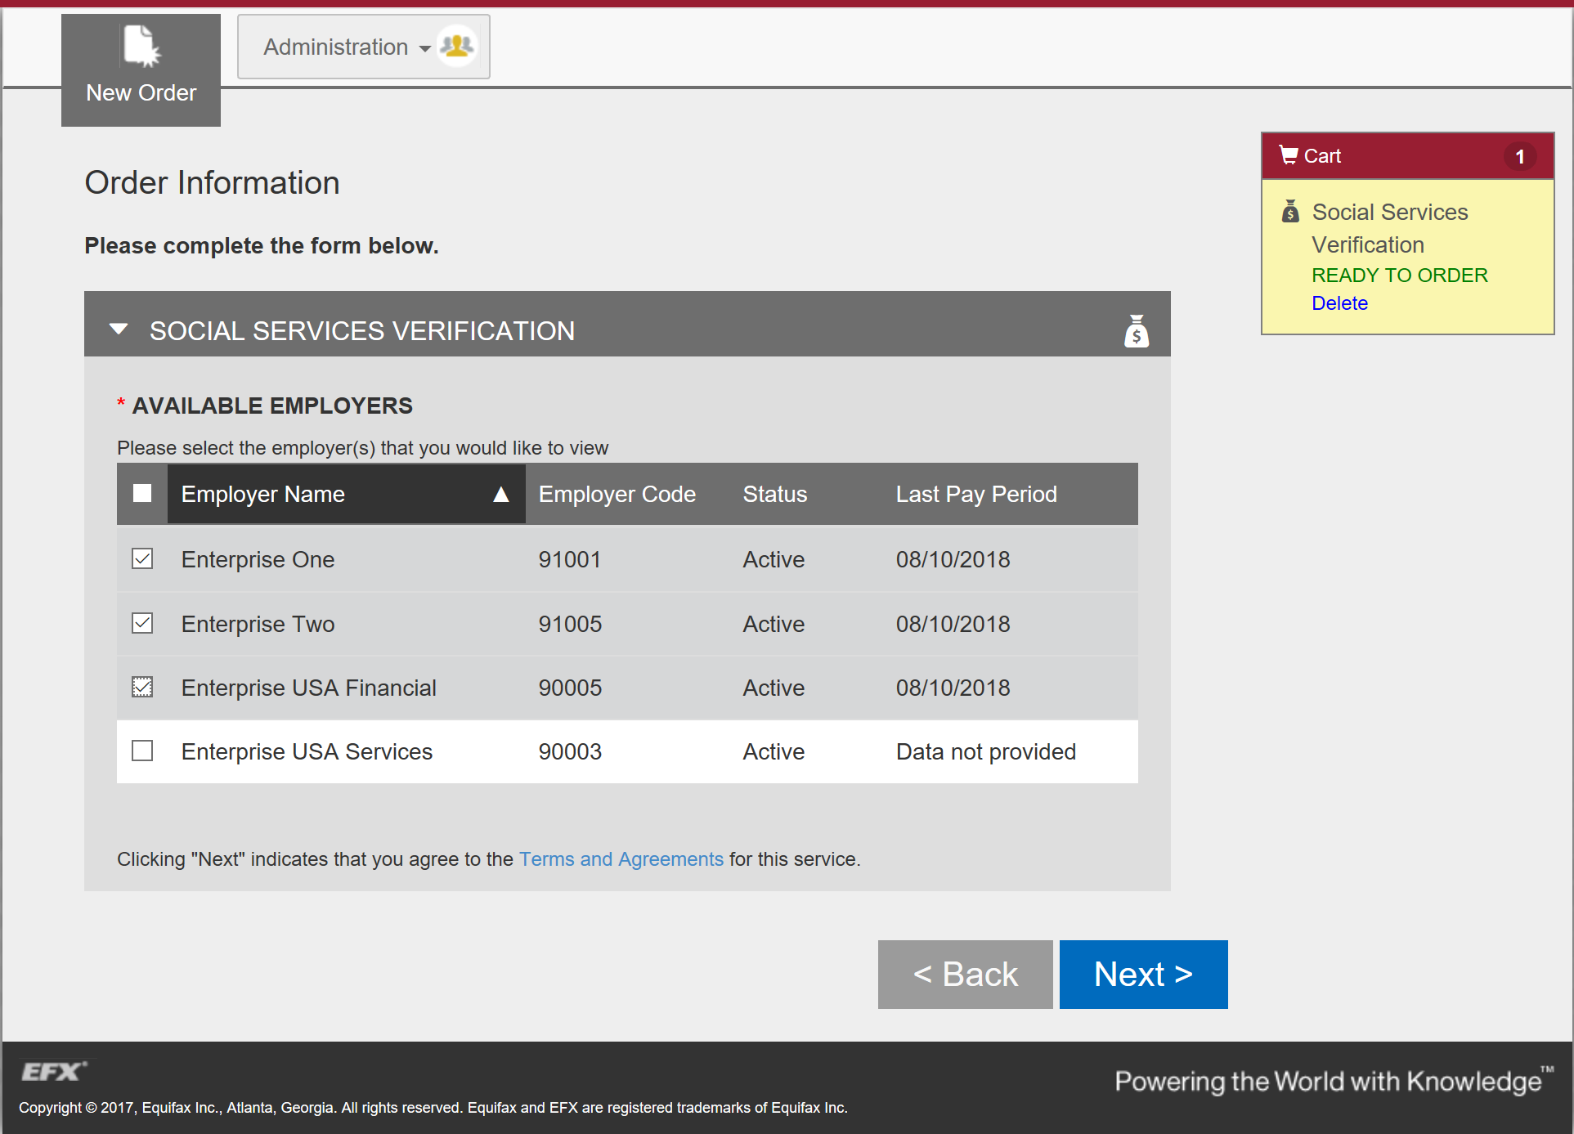
Employer Search upgraded with Last Pay Period
Date of the applicants last pay check.
New Shopping Cart feature tracks order progress throughout
Choose which records are needed – All Employers or pick Specific Employer records
Place the Order

Slide 12
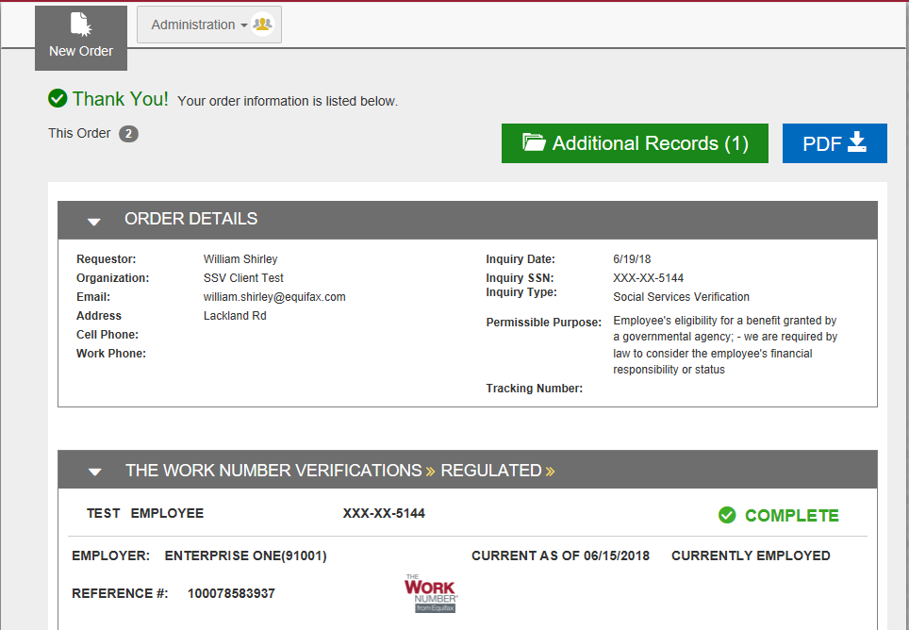
Download Report & Order Additional Records
Opportunity to order additional records available
Report available for download

Slide 13
Viewing Verification Results

Slide 14
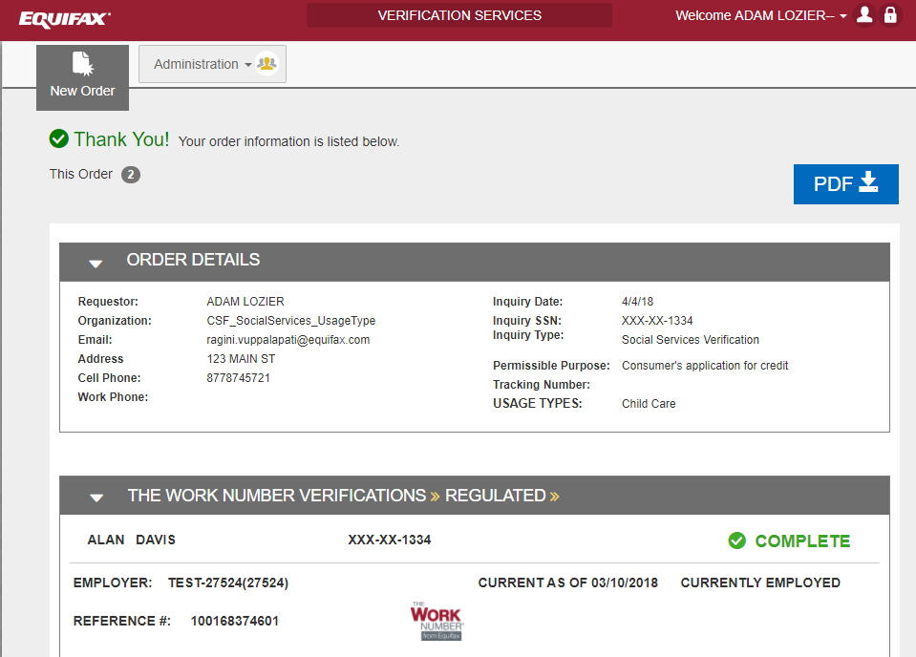
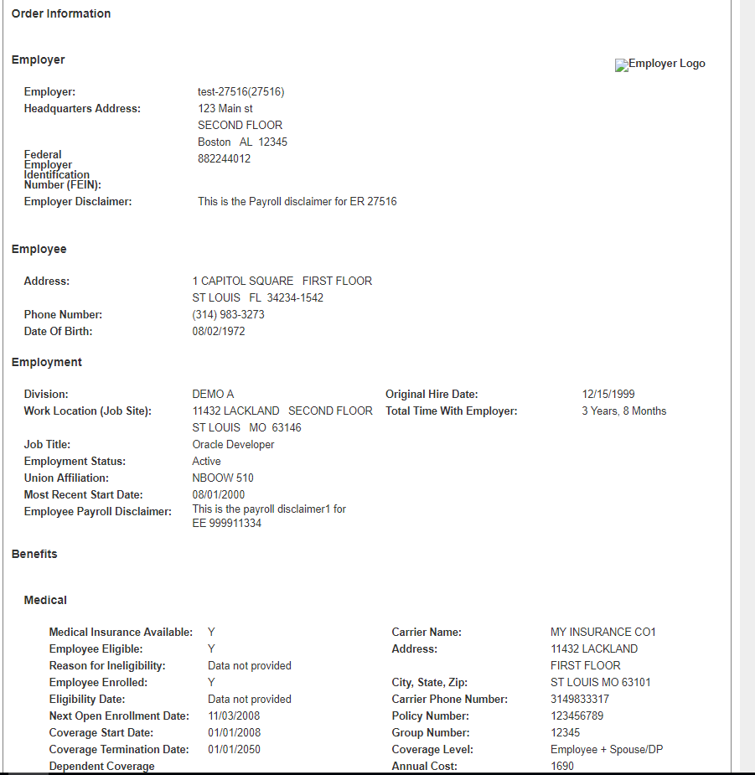
Sample Output of Completed Verification Order
Order information followed by employee, employment, and benefits information

Slide 15
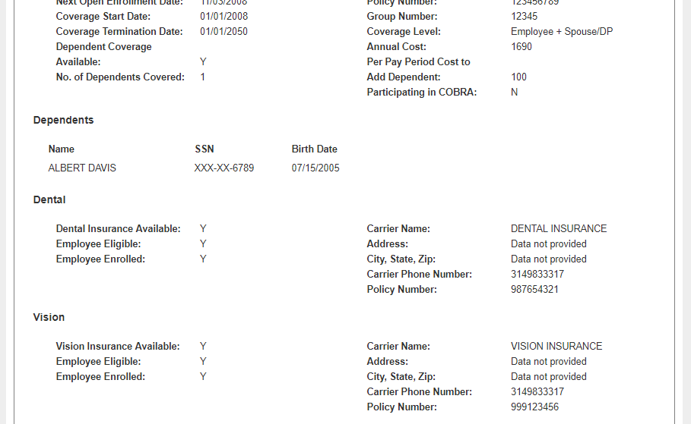
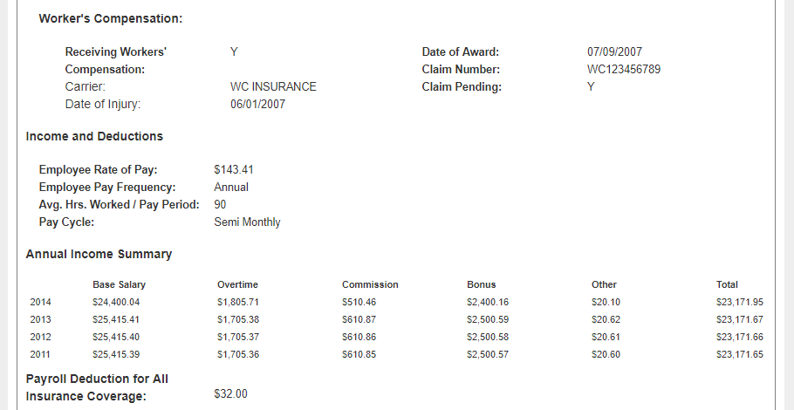
Sample Output (cont.)
As you scroll down, you’ll see additional information available should the employer choose to provide it: Dependents, Dental Insurance, Vision Insurance, Workers’ Compensation, Income and Deductions…
It includes information that was provided by the employer about pay, frequency, and annual wages.

Slide 16
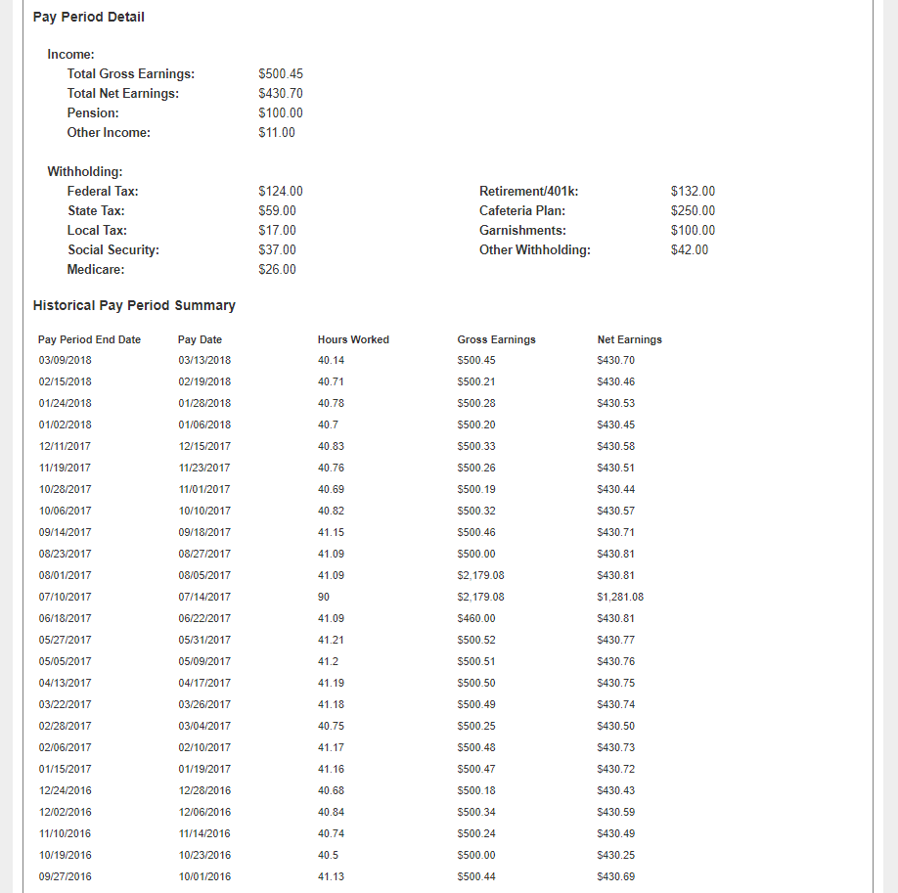
Sample Output (cont.)
You will also see Pay Period Detail and Historical Pay Period Summary Information.

Slide 17
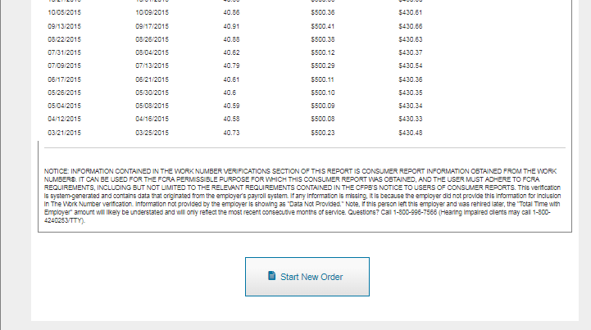
Starting a New Order
You can start a new order from a completed order by clicking on Start New Order

Slide 18
More Order Information required

Slide 19
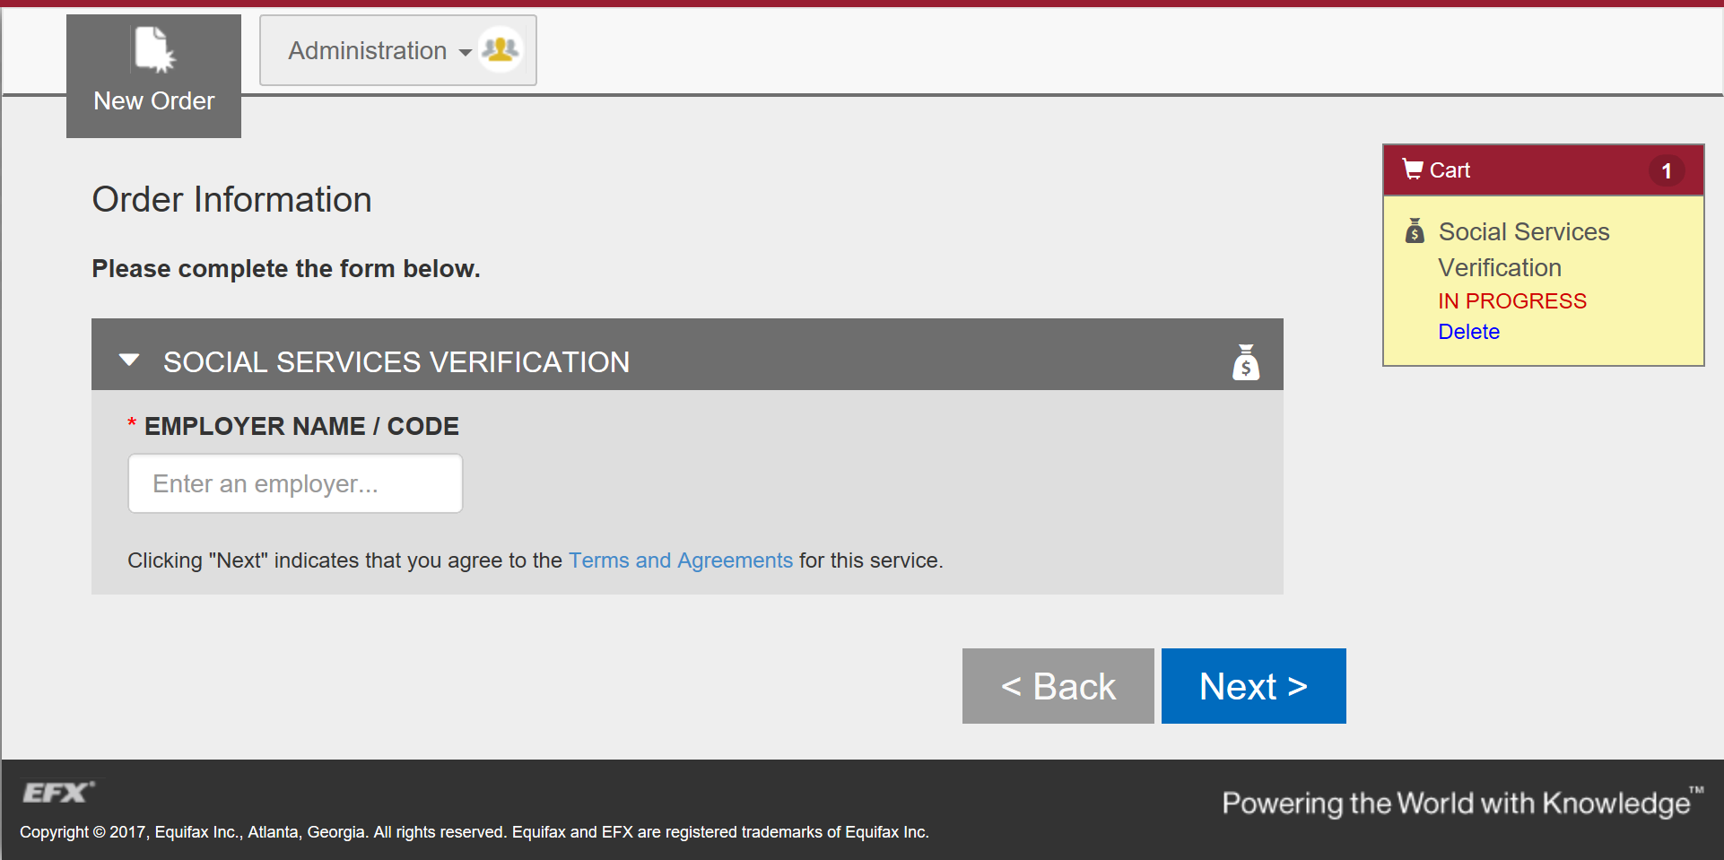
More Information Required – Multiple Identity
Provide the Employer Name or Code
It does not happen often, but when an SSN on The Work Number database has a multiple identity, employer information must be provided.
Place the Order

Slide 20
Equifax Verification Support Services
  For Social Service Verification (SSV)
      socialservices@equifax.com
      1-800-660-3399
  For Other Verification Services
      member@equifax.com
      1-800-367-5690
  Hours of Operation: 7am - 7pm CST
Please Note: Be sure to mention the product you are calling about and that you are using the new web user interface.

