Slide 1
Session 1
LTC Review
DHHS Operational Support Team
August, 2017

Slide 2
Myth Buster
It is incorrect to tell facilities that Medicaid does not cover the first month in LTC

Slide 3
Red Zone Month
Month of entry is called the “Red Zone” month in NC FAST
Private Living Budgeting (PLA) month, but cost of care will be paid if MA eligible
Manual DMA-5016 required
Job Aid: LTC/PACE
  Job Aid: LTC/PACE – Red Zone

Slide 4

Continuous Period of Institutionalization
Continuous period of institutionalization (CPI) - 30 consecutive days in a medical facility or combination of two or more medical facilities.

Slide 5
CPI Begin Date
The begin date is the date the individual enters the medical facility – hospital, nursing home, etc., from private living (home) or an Adult Care Home.
Webinar on NC FAST Learning Gateway: Continuous Period of Institutionalization

Slide 6
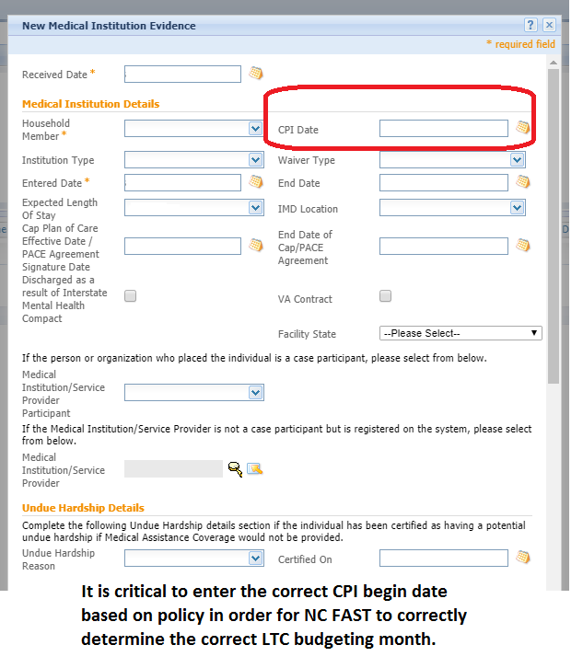
IMPORTANT * IMPORTANT * IMPORTANT

Slide 7
Month of Entry
MA-2270 IV provides policy for determining eligibility for the month(s) prior to LTC budgeting – there has been no change in policy
  Individual is PLA with household of 1
LTC budgeting may not begin until the month after the CPI begins in most cases
As long as individuals are eligible for Medicaid and have an FL-2 on file, the month of entry is still covered.
Forced Eligibility may be required in Red Zone month(s)
  $0 PML must reflect on benefit history
  DMA-5016 sent to facility

Slide 8
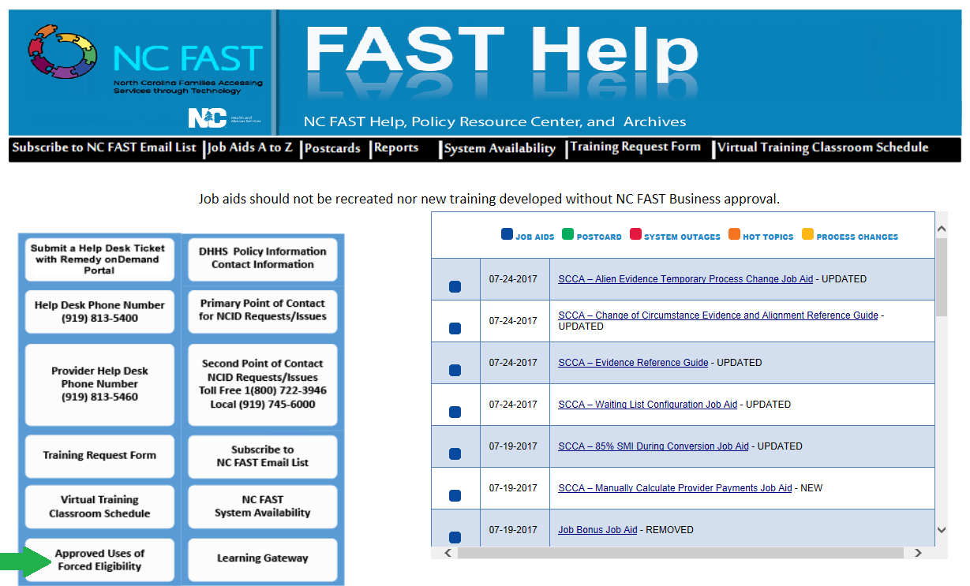
Approved Uses for Forced Eligibility

Slide 9
FL-2 NC Tracks Report in Data Warehouse
Public Folder >> DHHS Main Documents >> HS0003 >> folder labeled DMA state sanctioned
Shows Approvals, Denials, and Suspensions
Report is updated weekly – must be pulled weekly
Critical in processing LTC/CAP apps/changes

Slide 10
Best Practices Alert
Enter Living Arrangement evidence prior to other LTC mandatory evidences.

Slide 11
Level of Care

Slide 12
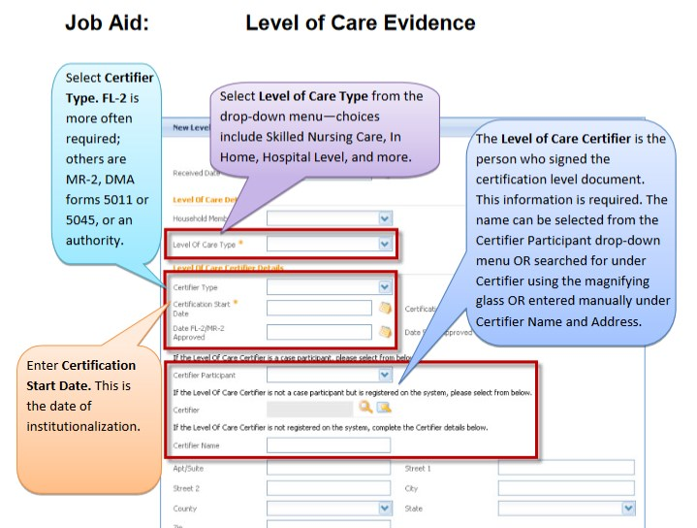
Level of Care Evidence

Slide 13
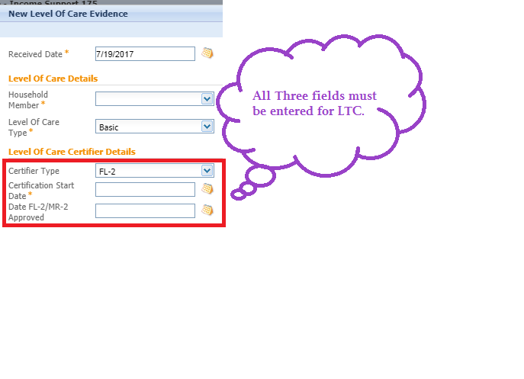
Level of Care Certifier Details

Slide 14
LTC Forced Eligibility
Forced must be entered for Red Zone PLA budgeting month(s) if beneficiary is:
  SDX recipient
  Full Medicaid recipient
Select type: PML and enter dollar amount.
LTC evidence must be on evidence dashboard.
Review the LTC portion of Forced Eligibility Job Aid, updated 6/21/16

Slide 15
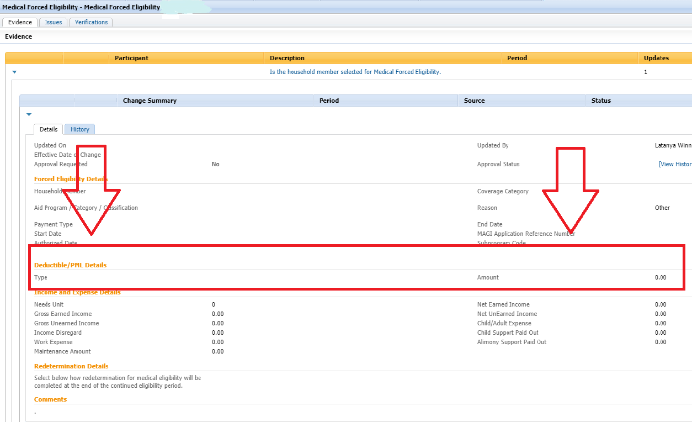

Slide 16
ABD Example 1
Josephine is a Medicaid beneficiary living alone at her home. On July 8, she fell, broke her ankle and was admitted to hospital for surgery to occur on July 9. Since Josephine lives alone, her doctor determined she needs skilled care for a brief time to rehabilitate and was admitted to Angels of Care Nursing Facility on July 10 and discharged home on July 31. FL-2 was approved for skilled care effective July 9.

Slide 17
ABD Example 1: Explanation
No CPI due to not being in facilities for 30+ consecutive days
PLA budgeting applies
$0 PML for July
DMA-5016 completed and sent to nursing facilities
Forced Eligibility required with appropriate evidence entered to ensure $0 PML reflects on benefit history

Slide 18
ABD Example 2
Rhonda is a Medicaid beneficiary living alone at her home. She fell, broke her hip, admitted to hospital, and had to have emergency surgery on July 9. Rhonda’s health quickly declined and the decision was made to place her in a nursing facility permanently. She was admitted to Angels of Care Nursing Facility on July 17. FL-2 was approved for skilled care effective July 17.

Slide 19
ABD Example 2: Explanation
CPI begin date?
SNF entry?
LTC budgeting begins?
  Calculate PML based upon income
Red Zone month of entry?
Forced Eligibility info needed?

Slide 20
F/C Example
Carolyn receives MAF-C as a caretaker for her two children. She was in a severe car accident on July 4th and broke her back. She was admitted to the hospital and was discharged on July 10th to ABC Rehabilitation Center to receive the skilled nursing care during her recovery. The physician states she will be there for three months. The FL-2 was approved effective July 9th.

Slide 21
F/C Example: Explanation
Still eligible to receive MAF-C as caretaker due to being in medical facility for 12 months or less
PLA budgeting applies for this time period
$0 PML for July
DMA-5016 completed and sent to nursing facility
Forced Eligibility keyed in P26 required with appropriate evidence entered to ensure $0 PML reflects on benefit history.
Do not close the MAGI (P7) case in this situation (temporary placement).

Slide 22
Common Issues Impacting LTC cases

Slide 23
County Issues Identified
  No LTC product activated in NC FAST
  Redeterminations not completed
  Converted benefit evidence not end-dated
  Multiple PDCs active at the same time
  No DMA-5016 sent to facility

Slide 24
Incorrect Case Conversion
Follow the EIS Converted Case job aid.
End date Converted EIS Benefit evidence
Close the converted PDC

Slide 25
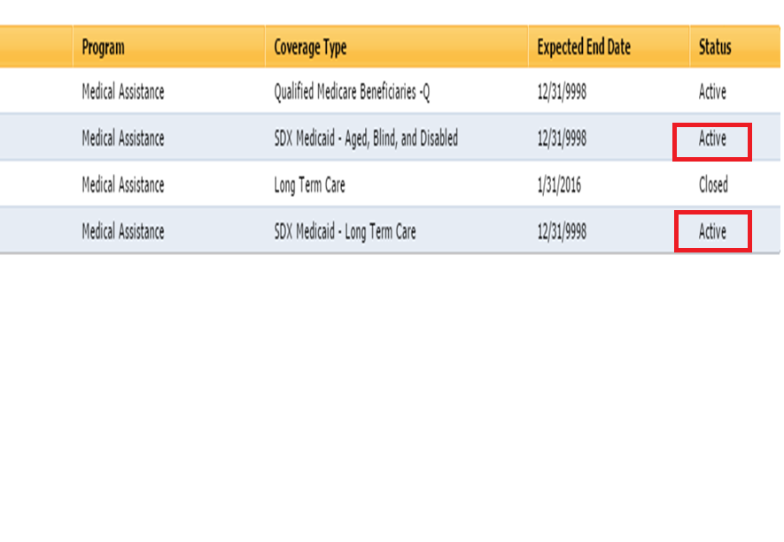
LTC/SDX
LTC/SDX – change in situation from PLA SDX to LTC SDX must be completed on the same Income Support case associated with SDX PDC.

Slide 26
LTC/SDX
Important note:
One key difference with SDX cases in NC FAST is when there is a change in situation to LTC for an SDX case you must close the SDX ABD case once the SDX LTC case is open.

Slide 27
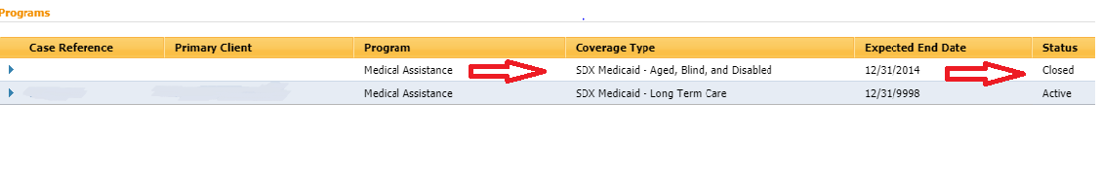
LTC/SDX

Slide 28
5016 Not Sent to Facility
Manual 5016 MUST be sent to facilities at this time
  Initial
  Change in PML
PML amount on 5016 must match PML in Benefit History
Automated 5016 is in development
  It is critical that facility information is entered in MEDICAL INSTITUTION EVIDENCE
  NC FAST will not be able generate automated 5016 without the facility info

Slide 29
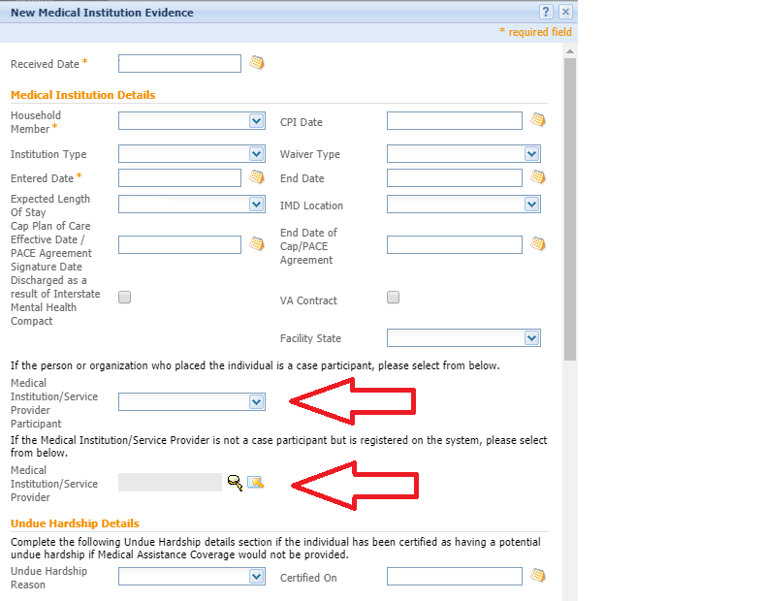

Slide 30
Take Aways and Best Practices
Review LTC Job Aids with staff, including Red Zone, Forced Eligibility
Designate LTC contact for facilities and notify agency staff of contact name
Review cases prior to advising facility there is system issue
Respond to facility inquiries/calls
Key Forced Eligibility for month of entry/Red Zone in identified situations, regardless of month needed

Slide 31
Questions?

