Slide 1
NC FAST Project Updates
100 County Director Call
March 27, 2019

Slide 2
NC FAST Updates
The Learning Gateway underwent maintenance on March 1^{st.}
When users log in for the first time after the maintenance they will will be directed to update their Learning Gateway user profile before the system will allow them to perform any other navigation or functions in the Learning Gateway.
This process will take approximately five minutes.
We are asking that all NC FAST users complete this process by March 31; profiles not updated by March 31 will be considered inactive.
Please reference the communication sent on Friday, February 22nd for additional information regarding the Learning Gateway upgrade and how to receive a report of the user profiles that still need to be updated in your county.

Slide 3
NC FAST Project 4 Updates
Ongoing functionality updates will be deployed for use by the Pilot Counties beginning on May 20th
Pilot Counties will be invited to participate in County testing from April 23rd – May 3rd.
  Eastern Paper-Based Intake and Assessment Go-live date has changed
  The March 25th Go-live has been delayed by one week and is now scheduled for April 1st
  Each County has the option to opt-in or opt-out. Please communicate your county’s intent to Susan Osborne no later than noon today (March 27th)
  An updated list counties going live will be distributed March 29th
  Counties that do go-live will receive county support from NC FAST for 4 weeks. A support agenda will be sent to counties Thursday, March 28th
  All other Go-live dates and plans are currently under review
  Scheduled training and readiness activities have been postponed until further notice

Slide 4
NC FAST Project 12 Updates
During the March release, the All Documents tab was made available on Child Welfare Intake and Assessment case types.
The Datacap application was also updated to reflect the taxonomy changes that were implemented in February. NC FAST is in the process of working with the Datacap Pilot counties to restart the use of the Datacap application.
NC FAST is continuing to work with Richmond and Durham counties on the conversion and federation models.

Slide 5



Managed Care Changes Release + Launches
Soft Launch
Managed Care Status assigned for NC Medicaid clients in NC FAST
PHP and PCP preference selection available for new applicants in NC FAST
Tailored Plan/HIPP information available in NC FAST
Beneficiaries can begin contacting the Enrollment Broker to select their Prepaid Health Plan (PHP) and Primary Care Provider (PCP)
Auto-Assignment
PHP auto-assignment in NC FAST for beneficiaries who
have not selected a PHP
PCP auto-assignment by PHPs
Medicaid/Plan Cards for Medicaid Managed Care members sent by PHPs
Go Live
Medicaid Managed Care coverage begins
Beneficiaries may begin receiving services from their PHPs and associated PCPs

Slide 6
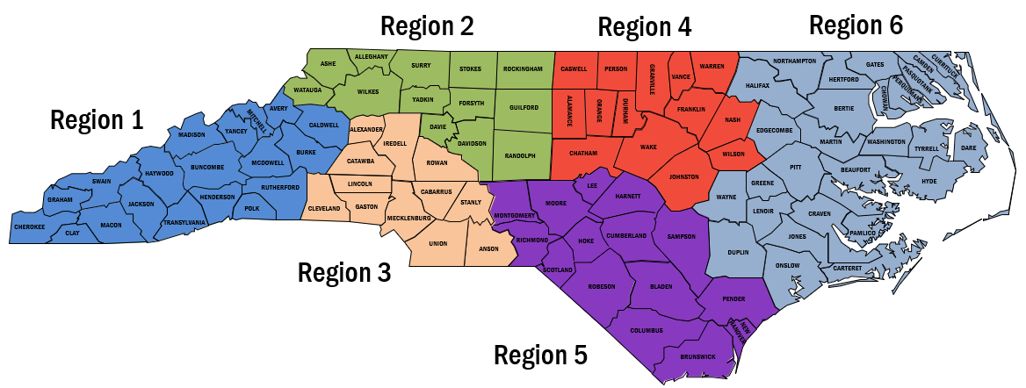
Managed Care Changes Release + Launches
 | NC FAST Soft Launch Release | Medicaid Managed Care Soft Launch | Auto-Assignment | Go-Live
Phase 1 Regions 2,4 | May 20, 2019 | June 3, 2019 | Sept. 16, 2019 | Nov. 1, 2019
Phase 2 Regions 1,3,5,6 | May 20, 2019 | Sept. 2, 2019 | Dec. 16, 2019 | Feb. 1, 2020

Slide 7
NC FAST P14 – 4.0 Soft Launch Release
On May 20, 2019 NC FAST will be updated to include new functionality related to P14 4.0 Managed Care Changes.
Person page
  New tab: Tailored Plan / HIPP
  Benefit History tab: Updated to include Managed Care information
Evidence Dashboard on Income Support and Insurance Affordability Applications and Cases
  Managed Care evidence renamed Primary Care Provider – Fee for Service
  Four new pieces of evidence
    One county entry
    One state-user entry
    Two automatically completed by Enrollment Broker, PHP, or NC FAST

Slide 8
P14 – 4.0 Key Dates and Additional Information
Key Training and Readiness Dates
April 12, 9:30 – 11:00 am: NC FAST County Readiness Call with Medicaid Transformation
April 15 and April 29: Soft Launch Training Available in Learning Gateway
Early-May: P14 4.0 Training Webinars
More Information
County Readiness Materials on FAST Help
  Economic Services → Managed Care Changes (MCC)
NC FAST County Readiness Liaisons
  See March County Readiness Call for County Readiness Liaison assignments

