Slide 1
NC Department of Health and Human Services
Child Support Services
Carla West
Section Chief
June 19, 2019

Slide 2
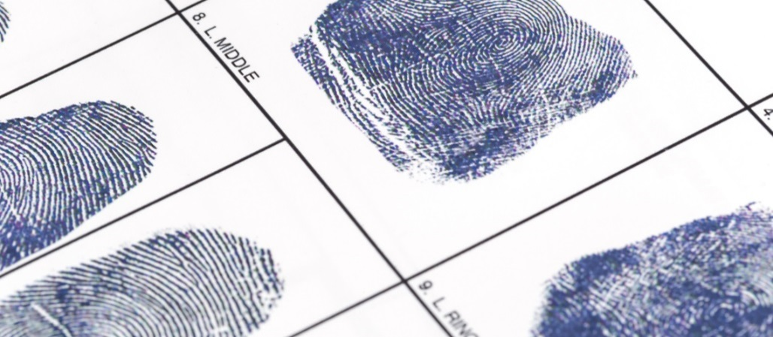
Background Check Policy
Required by IRS Publication 1075
Scheduled to begin August 2019 and end May 2020
Training will be set up for staff who are responsible for submitting up the background checks
Counties will receive a policy template and roll-out schedule

Slide 3
Background Check Policy
Policy must include the following:
Employees with access to FTI must be subject to:
Local and federal background checks
FBI fingerprinting
Citizenship requirement
Checks are completed prior to the employee accessing FTI
Suitability background check is favorable
Applies to current and future employees and must be conducted every 10 years

Slide 4
Payment of Fees
Background Checks Fee
Cost is $38 per person for the FBI check
The state will pay 100% and draw down 66% FFP
The county’s 34% share will be a line item deduction on their monthly EFT reconciliation
Multi-Factor Authentication Fees
$1.50 per month per user
The county’s 34% share will be a line item deduction on their monthly EFT reconciliation

Slide 5
FFY 2017 Incentive Settlement Awards
Incentives are paid by the federal government based on the following:
Performance on the five incentive measures for not just North Carolina but all states and US territories during the federal fiscal year (Oct – Sept)
Results of the federal data reliability audit for not just North Carolina but all states and US territories
SOURCE: 45 C.F.R. § 305

Slide 6
FFY 2017 Incentive Settlement Awards
Federal incentive dollars are typically paid out two years after the end of the fiscal year
North Carolina advances future incentive dollars to the counties October – June each state fiscal year
Settlement occurs after the federal Office of Child Support Enforcement notifies us the actual amount earned
SOURCE: 45 C.F.R. § 305

Slide 7
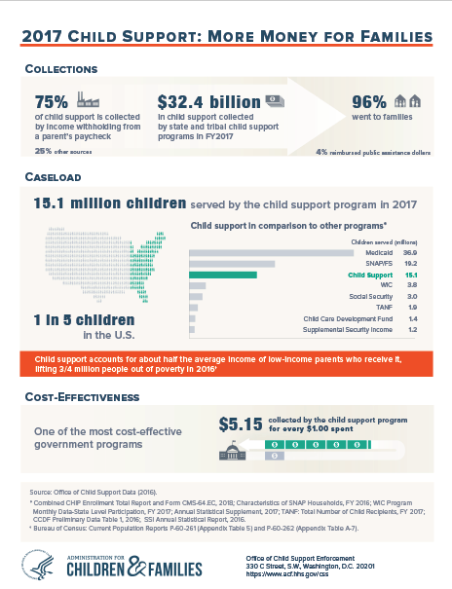
FFY 2017 Incentive Settlement Awards
The Data Reliability Audit (DRA) for FFY 2017 was significantly delayed causing a delay in the final Incentive Payment Reconciliation Award
Settlement payments to counties for FFY 2017 have been delayed

Slide 8
Carla West
carla.west@dhhs.nc.gov
919-855-4405

