Slide 1

Child Support Services
Continuous Quality Improvement Plans
New name… same process
Track your progress on the performance measures and self-assessment categories
Develop a plan for improvement
See a list of available trainings
Identify resources and monitors requests

Slide 2
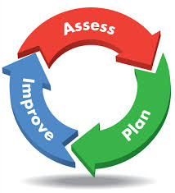
Child Support Services
Continuous Quality Improvement Plans
Child Support Performance Measures are Annual Goals
The CQI is not a punitive action – there are no monetary penalties assessed for being off track
The real goal is to improve our program!

