Slide 1
North Carolina Medicaid Transformation
Medicaid Managed Care Update
Debra C. Farrington
Chief of Staff
Date: 3/27/19

Slide 2
PHPs for NC Medicaid Managed Care
Statewide contracts
AmeriHealth Caritas North Carolina, Inc.
Blue Cross and Blue Shield of North Carolina, Inc.
UnitedHealthcare of North Carolina, Inc.
WellCare of North Carolina, Inc.
Regional contract – Regions 3 & 5
Carolina Complete Health, Inc.
Notes:
Patrick

Slide 3
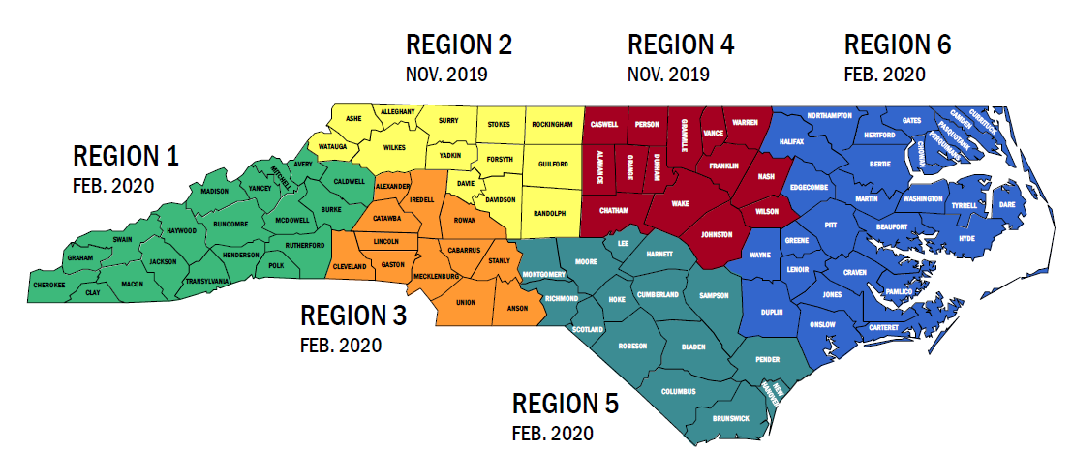
NC Medicaid Managed Care Regions and Rollout Dates
Rollout Phase 1: Nov. 2019 –Regions 2 and 4
Rollout Phase 2: Feb. 2020 –Regions 1, 3, 5 and 6
Learn more: https://www.ncdhhs.gov/news/press-releases/dhhs-announces-prepaid-health-plan-contracts-medicaid-managed-care
Notes:
Patrick

Slide 4
Medicaid Transformation Timeline
Timeline | Milestone
February 2019 | Member Educational Materials mailed
June 2019 | Soft Launch, Call Center open, welcome packages mailed
Summer 2019 | PHPs contract with providers and meet network adequacy
July – Sept. 2019 | Open enrollment period (July 15-Sept. 13)
November 2019 | Managed Care Standard Plans launch in Regions 2 & 4; Phase 2 open enrollment
February 2020 | Managed Care Standard Plans launch in Regions 1,3,5,6
Notes:
Patrick

Slide 5
Current Managed Care Activities
Maximus
  Community based meetings
  Website development
  Welcome packet
PHP onboarding
  Contracting
  Outreach to counties
  Meeting with Associations
  Reporting problems or issues

Slide 6
DSS TRAINING – Managed Care
Regional Trainings Complete
Upcoming Training
  Annual Meeting 5/1/19 Wilmington
  SSI 7/30/19- 8/1/19 Hickory
NEMT webinar
  Date pending

Slide 7
Ombudsman Update
Features
  Independent entity
  Assist individuals in fee for service (FFS) and managed care
  Four core functions
    Referral- FFS, LME-MCO and managed care recipients
    Information and Education - FFS, LME-MCO and managed care recipients
    Issue Resolution – managed care recipients
    Trend Monitoring- system level
RFP released
Responses Due 4/12/19
Award RFP 5/24/19
Notes:
an entity experienced in working with State Medicaid agencies to serve as an Ombudsman to support the goals of North Carolina Medicaid and of Medicaid Managed Care Program through:
Utilizing a “no wrong door” approach for providing information about NC Medicaid and the Medicaid Managed Care Program;
Serving as a central resource to resolve issues within the Medicaid Managed Care delivery system;
Making referrals to and collaborating with other resources including but not limited to State agencies, Department partners, community-based advocacy, and legal services organizations to support access to care;
Identifying trends or systemic issues in delivery system performance; and
Supporting the Department’s vision of creating a healthier North Carolina.

Slide 8
Questions
DISCUSSION
NC MEDICAID TRANSFORMATION WEBSITE www.ncdhhs.gov/medicaid-transformation
Contact
Debra.Farrington@dhhs.nc.gov
Notes:
Debra

