Slide 1
Office of NC FAST
Project Updates
100 County Director Call
August 28, 2019

Slide 2
NC FAST P4 Child Welfare
NC FAST Mobile Assessment App
Four Pilot counties currently utilize the App
Six counties are receiving training in August & September
NC FAST is moving forward with Assessment App for Windows 10 devices this fall
Extended Access
Completing additional testing
Would allow users to complete most actions (i.e. Intakes, case notes) while system is undergoing monthly release updates

Slide 3
NC FAST P14 4.0 Managed Care Changes
Auto-Assignment Training
Released Wednesday August 14
Two self-paced web-based courses: Auto-Assignment Overview and Auto-Assignment Examples
Approximately 30 minutes total
Audience: Medicaid Staff
Complete training prior to initial Auto-Assignment
Phase 1: September 16, Phase 2: December 16
Auto-Assignment Readiness Checklist
Due from County Champions today (8/28)
Assesses each county’s NC FAST preparedness prior to Auto-Assignment
NC FAST Readiness Liaisons will follow-up with counties with missing or incomplete information and may include OST/DHB
Notes:
Auto-Assignment Training
Weekly progress reports are being sent to DSS Directors and County Champions on Mondays. To show a course as completed, users must pass the associated quiz.
Both Auto-Assignment courses have been added to all Learning Paths on the Learning Gateway
Auto-Assignment Checklist
Used to help monitor each county’s progress prior to Auto-Assignment
The County Readiness Team has received a number of checklists so far, thank you!

Slide 4
NC FAST P14 4.0 Managed Care Changes
Reminders
Authorized Representative information must be added to the Person page, Client Contact tab to allow the Enrollment Broker to speak to someone other than the Case Head.
Refer to the Adding an Authorized Representative job aid on FAST Help
The September County Readiness Call, including P14 4.0, P14.2, and Medicaid Transformation will be Thursday Sept. 12. A calendar invitation will be sent to County Champions next week.

Slide 5
Managed Care Virtual Assistant (MIRA)
MIRA is a virtual assistant to help Medicaid workers find answers to common questions about topics related to Medicaid Transformation and NC Medicaid Managed Care.
Coming in September 2019
Accessed via a link in NC FAST
Provides quick answers
Links to websites and documents
Gets smarter over time

Slide 6
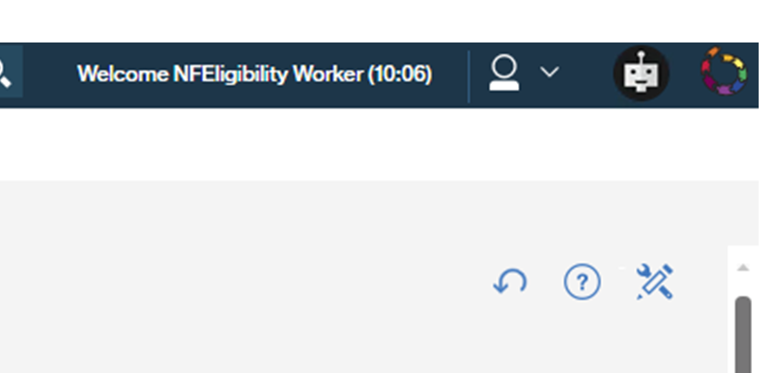
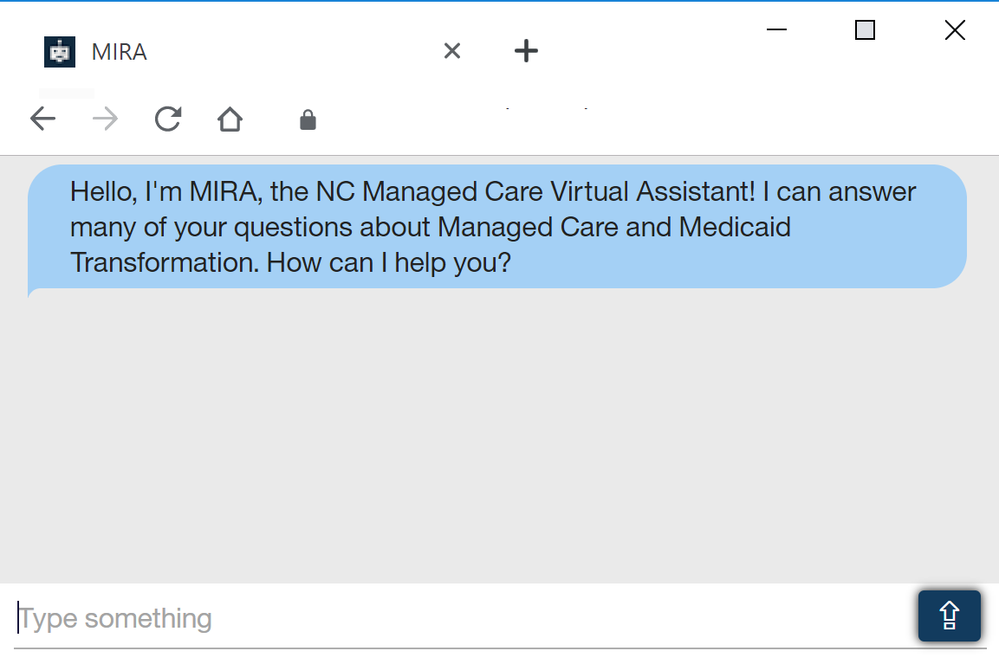
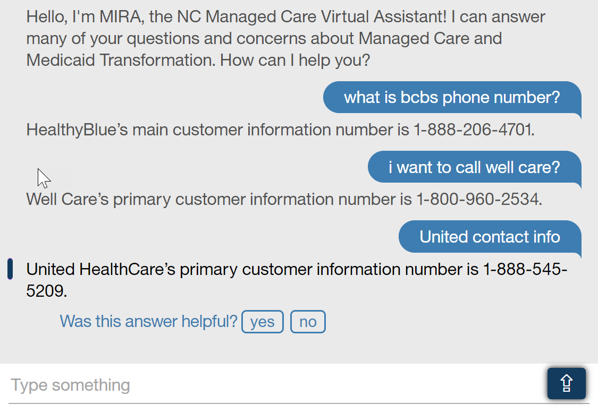
Using MIRA
Click new virtual assistant icon in NC FAST
MIRA appears in a new window
Ask questions about Medicaid Transformation and Managed Care
Get quick responses
Respond to yes/no survey questions and help MIRA improve over time
Available September 2019

Slide 7
NC FAST P14.2 Release 1 Project Overview
In December 2019, NC FAST will be updated to include functionality related to P14.2 Improved Beneficiary Experience Changes.
Straight-through Processing (only for the following conditions)
New applicants without income
Existing clients without income who are not on open Insurance Affordability Case
Simplified Online Verifications
E.g. Citizenship, Residency, Social Security, Birth and Death Details, etc.
Verification of no client income
Automated Notices
DMA-5097 – Request for Information
DMA-5059* – NCHC Enrollment Fee Notice
Post Eligibility Case Review Actions
Case assignment and complete case review
Caseworker continues manual application processing
*Note: DMA-5059 will be automated except for the four enrollment fee waiver counties.
Notes:
Straight-through Processing related to Release 1 will include:
Straight-Through Processing (new applicants with no income OR applicants known to NC FAST without an open MAGI Integrated Case with no income)
Simplified Online Verifications:
Interface calls through OVS are systematically made within NC FAST
OVS sends back information which is used to validate the verifications within an application
In parallel, NC FAST performs parent caretaker and household composition verification checks
Online Verification Sources:
DES/ESCWS: Unemployment Benefit Verification
SOLQis: Social Security Verification/ Income
SOLQic: Citizenship Verification
DMV/DES: Residency Verification
SAVE: Citizenship Verification
NEWHR/DES: Income Verification
Automated Notices:
DMA-5097 notice will be drafted by the system and sent to central print
DMA-5059* is being automated as part of R1 except for the four waiver counties. When the application falls out due to income, and the caseworker manually processes the application, the DMA-5059 will be auto-generated upon authorization and sent through central print, unless it’s one of the four enrollment fee waiver counties
Post Eligibility Case Review Actions
Post enrollment items are specific categories of information that require further review by a caseworker after a MAGI application is authorized. After an application completes Straight-through Processing, NC FAST will check for post enrollment items
If an application does not complete Straight-through Processing, caseworkers must manually check for the following post enrollment items:
Assign Case to a Caseworker
Child Support Enforcement Referral
Veterans’ Benefits
Other Health Insurance
90 day Reasonable Opportunity
Unemployment Benefits
Same applicant/beneficiary on existing Presumptive Eligibility application or case

Slide 8
P14.2 Key Dates and More Information
Readiness and Training Dates
September 12, 2019: NC FAST County Readiness Call with Medicaid Transformation and P14 4.0 Managed Care Changes
October 2019:
User End to End Testing with Partner Counites (Robeson & Alamance)*
Beneficiary Engagement with Partner County (Wake)*
Training Available in Learning Gateway
November 2019: P14.2 IBE State and County Testing*
December 2019: P14.2 IBE Release 1
More Information
County Readiness Materials on FAST Help
Economic Services → Improved Beneficiary Experience (IBE)
NC FAST County Readiness Liaisons
See June County Readiness Call for County Readiness Liaison assignments
*Note: Activity date subject to change.
Notes:
Sept. 12 Readiness Call
Topics include: ROP, case review, residency verification
October Activities
User End Testing with Partner Counites (Robeson & Alamance)*
Beneficiary Engagement with Partner County (Wake)*
Training via WBTs will be available in October. We anticipate that it will take caseworkers approximately 2-hours to complete P14.2 training for Release 1. We will continue to engage partner counties with training material reviews to gather their feedback to better inform updates where possible (e.g. User Checkpoint 1).
*Note: Activity dates are subject to change.
November 2019
More information to come on State and County Testing
December 2019
Release 1 scheduled
Process for Release 2 development restarts

Slide 9
NC FAST P12 Document Management
Due to lack of funding in the biennium budget, Project 12 will be paused until July of 2020; information on a restart will be shared as the budget becomes available
Based upon feedback from the Pilot Counties, the use of the Datacap scanning tool will be discontinued
NC FAST will continue to work with Richmond and Durham Counties on the conversion and federation models in addition to some performance tuning architectural changes
Attaching documents in NC FAST will remain an available function as will the All Documents tabs that were deployed on Person, Application and Case Records
Support for additional counties that expressed interest in converting or federating will be considered based upon available resources

