Slide 1
NC State Board of Elections
NVRA Updates
Kori House
SBE NVRA Elections Specialist
October 2019
Notes:
Good Morning. My name is Kori House and I am the elections specialist tasked with NVRA duties at the NC State Board of Elections. I am here with a few updates regarding the voter registration form, the status of the laminated forms also known as the NVRA Information Sheet and some quick friendly reminders.

Slide 2
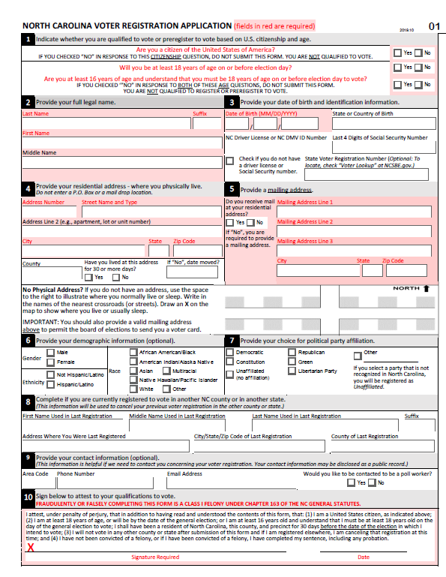
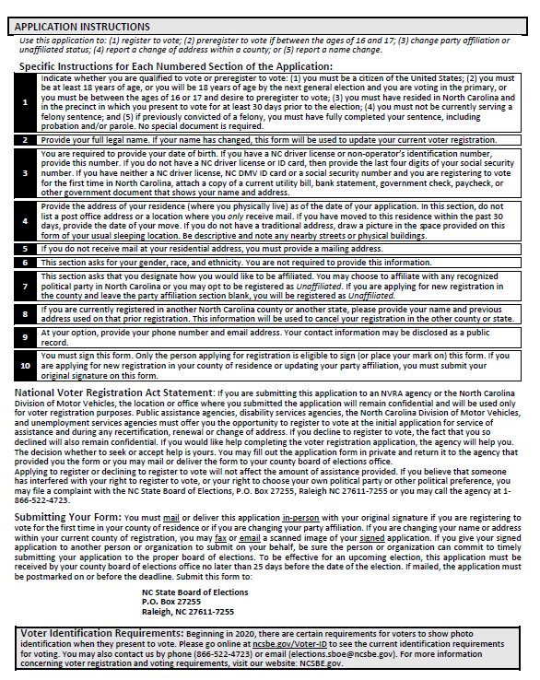
NC Voter Registration Application Updated Form
Voter Registration Applications for Public Assistance agencies are coded as “01”
New design that now includes information regarding Voter ID requirements
Counties may continue to use the current forms in stock until depletion
Notes:
Remember Public Assistance agencies, meaning the programs that fall under the NVRA umbrella at the county DSS offices, must order and use the coded 01 voter registration applications. That is how we track the applications submitted by your agency to the local boards of elections.
There was a new design to the form earlier this year that resembles the first page of the newest version of the application, which is the first picture in this slide. County DSS offices were instructed to order the updated forms earlier this year and discontinue the use of the old forms. However, the newest and most recent design now includes information regarding the Voter ID requirements that will begin in 2020. Caseworkers should not attempt to answer any question regarding Voter ID and should instead refer clients to the County or State Board of Elections.
In addition, county DSS offices may continue to use their current stock of the old ‘new’ design that were ordered earlier this year until depletion. We want to make you aware that any new orders would be sent the most recent rendition of the NC Voter Registration Application.

Slide 3
Voter Registration form Distribution
Notes:
Here is a quick snapshot taken from data retrieved from NC FAST for the months of August and September of this year regarding the amount of Voter Registration Applications that have been either mailed or provided to the client in person, by all 100 counties in the state. Great work with providing voter registration services to your clients.

Slide 4
NVRA supplies Update
Laminated Forms
For use by county DSS office caseworkers; given to each client to review during the voter registration In-Person Transaction process
Request for additional hard copies can be sent to nvra@ncsbe.gov
An electronic version of the laminated form can be found on the DHHS and SBE websites. Copies can be printed and used until additional hard copies are received.
Hard copies should arrive within the next two weeks
DSS Cover Letter
For use by county DSS office caseworkers to be included in mailings along with a coded Voter Registration Application after a Remote Transaction process
A link to print the DSS Cover Letter is on the DHHS and SBE websites
All electronic versions of the NVRA supplies and Training can be found on the DHHS website under the Program Compliance section of the Training webpage for the Social Services Division and on the SBE website under the NVRA Agencies page.
https://www.ncdhhs.gov/divisions/social-services/county-staff-information/training#program-compliance
https://www.ncsbe.gov/Voter-Registration/NVRA

Slide 5
reminders
Offer Voter Registration Services during each Covered Transaction (Application, Recertification and Change of Address for both In-Person and Remote Transactions)
NVRA Question
At every covered transaction ask participants the NVRA Question:
“If you are not registered to vote where you live now, would you like to apply to register to vote here today?’’
Transmit all completed voter registration applications to the County Board of Elections within 5 business days.

Slide 6
NVRA Contacts
NC State Board of Elections SBE NVRA Coordinator: Veronica Degraffenreid & NVRA Elections Specialist: Kori House NVRA@ncsbe.gov
NC Department of Health and Human Services (DHHS) DHHS NVRA Coordinator: Jennifer Braley NVRA@dhhs.nc.gov
DHHS - Division of Social Services NC DSS NVRA/Civil Rights Coordinator: Carlotta Dixon Carlotta.Dixon@dhhs.nc.gov

