Slide 1
NC Department of Health and Human Services
LIEAP Automated Payment
Jasmyne Simmons
Energy Program Consultant
October 7, 2020

Slide 2
Social Distancing Measures
To continue to maintain social distancing measures and to minimize the number of clients physically coming in the agency, the following has been set in place.
CIP and LIEAP applicants can apply by mail, fax, email, drop off or by phone.
Telephonic signatures can be accepted. Telephonic signature guidelines have been updated in policy.
Online Energy applications for CIP and LIEAP will be available on ePASS starting January 2, 2021.

Slide 3
Messaging
When reviewing Energy Plans, counties remember to add language about the automated payment. You do not need to re-submit outreach plans.
The Division is working on crafting media releases to inform the public of the automated payment and the safer alternative ways citizens can apply for Energy programs.
Upcoming Media Releases:
Press Release with updated posters and flyers
Postings on Social Media outlets
Media packets will be sent to counties
All media releases will have information regarding the LIEAP automated payment.
Releases will also have language encouraging citizens to take advantage of the new social distancing measures when applying for CIP and LIEAP

Slide 4
What is the automated payment?
This is a direct payment to an applicant’s energy vendor without the traditional application process
Due to Covid 19, this process is to help eliminate the targeted population of elderly and disabled individuals from coming into the agency to apply for LIEAP.
SOURCE:

Slide 5
Regular LIEAP
Anyone who is not eligible for the automated payment can still apply for LIEAP.
Households containing a person age 60 or older or disabled receiving DAAS services can apply starting December 1, 2020. All households can apply starting January 1, 2021.
LIEAP applications are accepted until March 31, 2021 or until funds are exhausted.

Slide 6
Who will receive the automated payment?
Targeted population must meet the following criteria:
Households with persons aged 60 or older or
Households with disabled individuals receiving DAAS services and
Currently receiving FNS and
Received LIEAP during the 2019-2020 LIEAP season
SOURCE:

Slide 7
Payment Amounts
Automated payment amounts for each household will be based on the heating source type
$300 for Coal or Wood
$400 for LP Gas, Natural Gas, Kerosene, Fuel Oil, Energy-other
$500 for Electric
SOURCE:

Slide 8
The Process Timeline
November 2: Counties will have access to a report that will be posted in FAST Help. This report will list the clients that will be receiving the DSS-8106 LIEAP Automated Payment Notice on November 10th.
November 7-8: NC FAST November release weekend
November 9: All the pre-populated automated payment applications will display on the NFOMD023C - Energy Pending Apps by Worker Detail report
November 10: The DSS-8106 “LIEAP Automated Payment Notice” will be sent via NC FAST to potential eligible households. These households were listed on the FAST Help report on Nov 2nd.
November 24: 10th business day due date for clients to return notice or report any changes
SOURCE:

Slide 9
Timeline Continued…
December 4: Due date for workers to have processed reported changes and deny any ineligible applications
December 9: NC FAST will generate approval notices and create payment request for counties. The LIEAP Automated Payment report will be generated.
December 11: LIEAP Automated Payment report will be added to FAST Help for counties access.
Counties will have 30 days from December 11, 2020 to process provider payments.
SOURCE:

Slide 10
The DSS-8106 Notice
The DSS-8106 “LIEAP Automated Payment Notice” will be sent out on November 10th.
Only households that meet the qualifying criteria will receive a notice
This notice will have 2019-2020 pre-populated application information on it for the household to review.
SOURCE:

Slide 11
Notice Instructions
Notice will instruct applicant to review all household information provided last year on LIEAP 2019-2020 application.
If any information has changed. The household can contact their local DSS office by phone or make edits on notice and return to local DSS office by mail
Applicant has 10 business days to report any changes
If no changes reported, the 2019-2020 information will be used to process this year 2020-2021 LIEAP payment.
This serves as client’s LIEAP payment for this year 2020-2021. Client will be informed.

Slide 12
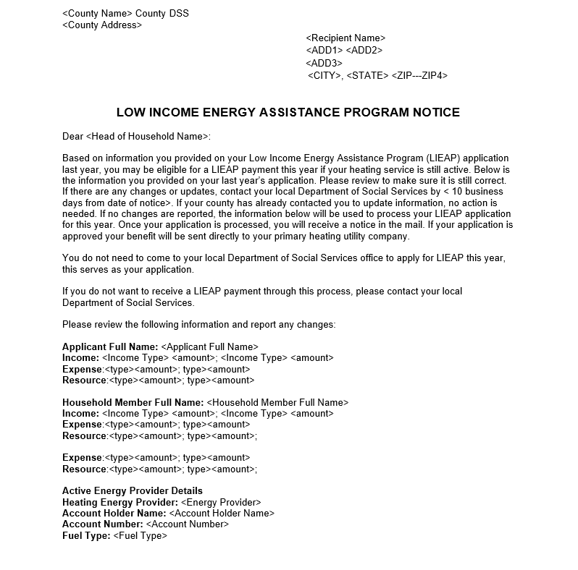

Slide 13
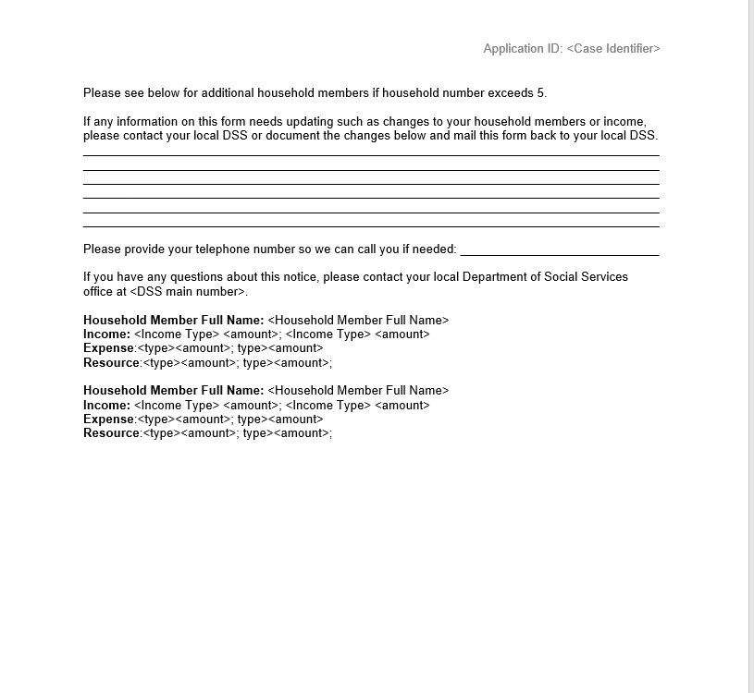

Slide 14
Reminders
Once the report is available November 2nd, workers can proactively start contacting clients to determine if any information from their LIEAP application last year needs to be updated. From November 9th- December 4th all changes to pre-populated applications and denials should be processed in NC FAST
Approval Notices will be sent via NC FAST. Denial Notices are a manual process like for regular LIEAP. Worker will print and mail notices to applicants. Denial Notices must be completed before the payment batch runs December 9, 2020

Slide 15
Reminders
The new fund name for the automated payments is called “Pandemic LIEAP”
Any household approved for Pandemic LIEAP will not be eligible to receive regular LIEAP funds until next LIEAP season. The Pandemic LIEAP funding will serve as their LIEAP funds for this year.

Slide 16
Questions???

