Slide 1
Keeping Medicaid While You Work – Health Coverage for Workers with Disabilities
AnneMarie Wiwatowski
Medicaid County of Origin Specialist
April 25, 2019

Slide 2
BACKGROUND:
The federal Ticket to Work and Work Incentives Improvement Act (TWWIIA) of 1999 offers states an option to protect Medicaid coverage for workers with disabilities.
The State of NC is authorized to provide Medicaid for workers who are blind or who have a disability under Health Coverage for Workers with Disabilities Act (G.S. 108A-54.1).

Slide 3
DID YOU KNOW?
That more than 1.3 million people in the State of NC over the age of 5 have a disability? That is approximately 13% of our state’s population.
That less than 35% of people with disabilities between 18 and 64 years of age are employed?
That North Carolinians with disabilities experience high levels of unemployment, residential segregation, financial dependency, and poverty?
People with disabilities are often discouraged from working for fear their earnings would make them ineligible for Medicaid.

Slide 4
NC Health Coverage for Workers with Disabilities (HCWD)
Provides an incentive for persons with disabilities to go to work, or to increase their hours of work while protecting Medicaid eligibility.
Covers individuals with a disability or blindness, aged 16 to 64 regardless of the total countable income or Community Alternatives Program (CAP/Home and Community Based Waiver) status.
Person’s are limited to an unearned income of 150% of the federal poverty level.
This means the person will have full Medicaid coverage under Aid for the Blind (MAB) or Aid for the Disabled (MAD)

Slide 5
Coverage Groups:
Basic Coverage Group consists of persons aged 16 to 64 who, except for engaging in substantial gainful activity (i.e. work), meet the Social Security/Supplemental Security Income (SSI) disability criteria, or who do not engage in gainful activity but are over income and/or reserve for regular Medicaid for the Disabled (MAD)
Medically Improved Group consists of individuals aged 16 to 64 who previously received HCWD in the Basic Coverage Group but lost eligibility because their medical conditions improved and they no longer meet the Social Security/SSI definition of disability.
The beneficiary must continue to have a severe medically determinable impairment:
a) Still has the underlying condition or conditions that brought on their disability.
b) Is under treatment for the condition or conditions.
c) Has a strong likelihood of again meeting the Social Security/SSI definition if they were to cease treatment.

Slide 6
Eligibility (Please always consult with your local DSS Agency Income Maintenance Case Worker)
1) Be at least 16 years of age, but less than 65.
2) Meet the SS Administration’s disability definition, except for earnings, or be eligible under the Medically Improved Group.
3) Be employed.
4) Have countable resources equal to or less than the minimum community spouse resource allowance (MA 2231).
5) Meet the income requirements for their coverage group.
6) Meet all other eligibility requirements applicable to Adult Medicaid.

Slide 7
Disability:
To be eligible for Basic Coverage the person must meet the Social Security/SSI definition, other than not be engaging in a substantial gainful activity. Evidenced by one of the following:
1) Receipt of Social Security Disability or SSI
2) A determination by Disability Determination Services (DDS)
3) A determination of blindness by Division of Services for the Blind (DSB)

Slide 8
Medically Improved:
For active MAD (Medicaid to the Disabled) Cases
a) If Disability Determination Services determines that the person in the basic group no longer has a disability, and the person is still working the county DSS is to assume that they are Medically Improved until the next redetermination.
b) At redetermination the county will not refer the person to Disability Determination Services. To determine if the person continues to meet the Medically Improved criteria, contact the person’s treating physician by using the DMA-5151 and the DMA-5028. The form addresses (3) questions:
1) Does the person still have the underlying condition or conditions which indicated that they have a disability?
2) Is the person still under treatment?
3) Is there a strong likelihood that the person would once again become disabled if treatment were to cease?
If the answer to all (3) yes, the recipient continues to meet the Medically Improved status.

Slide 9
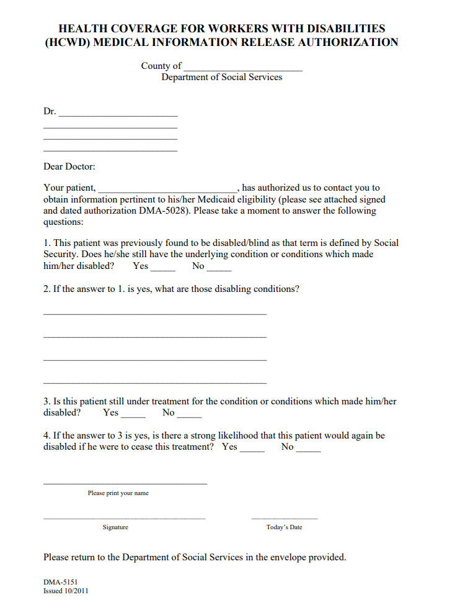

Slide 10
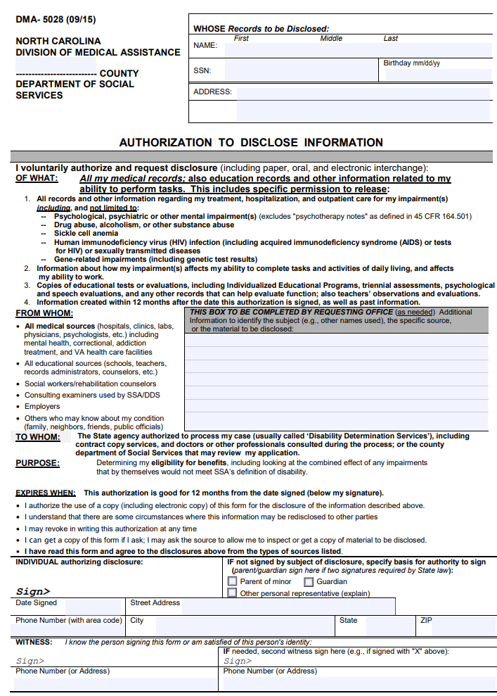

Slide 11
Income:
HCWD has varying income limits that determine eligibility and/or cost sharing:
Those who have unearned income greater than 150% of FPL are not eligible.
Those who have total countable income equal to or less than 150% of FPL have no cost sharing (other than applicable co-pays).
Those who have a total countable income greater than 150% of FPL must pay a $50 annual enrollment fee.
Those who have a total countable monthly income in excess of 200% of the FPL must pay a monthly premium in addition to the annual enrollment fee.
NOTE: These individuals are likely to have work-related expense exclusions for the blind and impairment-related work expense exclusions for people with disabilities. Please be sure to partner with the local DSS agency to determine both countable and unearned income.

Slide 12
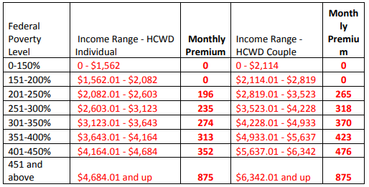
Premiums:

Slide 13
Now that people are working, let’s talk savings:
The NC ABLE Account is a great way for persons with a disability to save money.
Up to $15,000/year can be saved without endangering benefits from federal and state programs.
Able to work? Then you can save an additional $12,140 of earned income.
Any funds in this account can be used for disability-related expenses, such as additional medical costs that are not covered by Medicaid.
Money spent for qualified disability expenses is not considered income.

Slide 14
What is a Qualified Disability Expense?
Education – Tuition for special education services including tutoring and educational materials.
Housing – Expenses for a primary residence, home improvements, and modifications.
Transportation - Expenses for transportation, including mass transportation, and the purchase or modification of vehicles.
Employment Support – Expenses related to obtaining and maintaining employment, including job related training, assistive technology, and personal assistance supports.
Health and Wellness – Expenses for health and wellness including mental health, medical, vision, dental, habilitation and rehabilitation services, durable medical equipment, respite care, long term services and supports, nutritional management, communication services, adaptive equipment, assistive technology, and personal assistance.

Slide 15
Who is eligible?
ABLE accounts are open to people with disabilities. The onset of the person’s disability must have occurred prior to his/her 26th birthday.
No special medical forms are required. A person can self-certify that they qualify to open an ABLE account.
People who receive Supplemental Security Income (SSI) or Social Security Disability Insurance (SSDI) benefits under Title II of the Social Security Act are eligible to open an ABLE Account.
And, people with disabilities who are not otherwise eligible for federal benefits but who meet criteria similar to those required by federal programs like SSI or Medicaid may open an ABLE account.
A qualified person can open an ABLE account - or a parent or guardian can open an ABLE account on his/her behalf.

Slide 16
How does the federal government treat ABLE accounts under SSI and Medicaid?
Supplemental Security Income (SSI):
If the assets in an ABLE account reach $100,000, and the beneficiary is receiving Supplemental Security Income (SSI) benefits, these SSI benefits will be suspended. Once the assets in the ABLE account fall below $100,000, the SSI benefit suspension ceases and monthly SSI benefits resume. The beneficiary will not have to reapply for SSI benefits once the account drops back below the $100,000 threshold.
Medicaid:
A person can save up to $450,000 in an NC ABLE account and continue to qualify for Medicaid.

Slide 17
Is there a Medicaid payback provision?
Yes. When the qualified beneficiary (the person who "owns" the ABLE account) dies with remaining assets in an ABLE account:, the assets in the ABLE Account may be used to “pay back” any state Medicaid plan up to the value of Medicaid services provided to the beneficiary after the account was opened.
The amount is calculated after:
1) Any outstanding qualified disability expenses are paid.
2) After any funeral and burial expenses for the qualified beneficiary are paid.
3) Any Medicaid premiums paid by the beneficiary are subtracted.

Slide 18
How do I enroll in the NC ABLE program?
Enroll online at NC.SaveWithABLE.com
The simple, online process takes just a few minutes. No special medical forms are required. NC ABLE accounts are not opened at banks or with financial planners.
For assistance with the enrollment process, call the NC ABLE Program Customer Service Center toll-free at 888-627-7503, Monday - Friday, 8:00 am - 5:00 pm ET.

Slide 19
Questions/Comments

