Slide 1

Transparency in Provider Monitoring
Developed by the
NC DHHS-LME/MCO-Provider
Collaboration Workgroup
February 2014
Presented by Mary T. Tripp
Policy Unit Leader
DHHS-DMH/DD/SAS Accountability Team
Revised 3-4-14
Notes:
Hello, my name is Mary Tripp. I am the Policy Unit Leader in the Division of Mental Health, Developmental Disabilities and Substance Abuse Services Accountability Team. On behalf of the DHHS-LME/MCO-Provider Collaboration Workgroup, we are pleased to present this webinar on “Transparency in Provider Monitoring.”
This webinar is part of a series of webinars developed as a follow-up to the workshops that were presented in February 2014 to introduce the new process and tools for routine provider monitoring. These webinars supplement the workshops by allowing us to provide more detail and explanations than was possible during the introductory workshops.
The webinars are presented in modules so you can select whichever module you would like to review without having to view the entire series.
1

Slide 2
Focus of this Webinar
Sample Selection and Sample Size
Scoring and Weighting Items on the Tools
Important Process Points
Internal Quality Assurance
Notes:
The purpose of this webinar is to explain some of the behind-the-scenes aspects of routine monitoring to help you better understand how the process works – leading up to the provider’s score or rating on the tools.
We hope that by sharing this information, it will help to dispel any anxiety providers might have about the prospect of being monitored by equipping them with essential information about how the process is structured.
This is all part of our emphasis on transparency. Provider monitoring is an open book test. We have provided the tools and guidelines to equip reviewers and providers with the information they need to successfully use the tools.
First, I will talk about how the sample is selected and the sample size for different components of the tools.
We will also explain how the items on the tools are scored, including some features that are built into the process to facilitate scoring.
We will also discuss key components of the process, highlighting important timelines to be aware of from the time the provider is notified of the date of the on-site review to when the provider can expect to receive the report of findings and the timelines for submitting a plan of correction.
In this webinar, we will introduce the Provider Monitoring Survey. This survey was developed to assist the workgroup in getting feedback from providers on the provider monitoring the on-site visit and the provider’s performance.
And finally, we will discuss the benefits of setting up an internal QA/QI process for conducting periodic self-audits where we encourage providers to be proactive in setting up viable systems to enable them to be audit-ready at any time.

Slide 3


Service Event → Paid Claim
Notes:
I’ll start by talking about how the sample is drawn for the on-site review but first, let me explain some of the terminology.
When I mention “paid claims,” I am talking about service events for which a provider has been reimbursed.
The sample for most of the items on the tools is drawn from paid claims – where the provider has submitted a claim for services provided and the provider has been reimbursed for those services. Claims are based on service codes and dates of service. An appointment, visit or treatment is called a “service event.”
For the purpose of this discussion, “paid claims” can be used interchangeably with “service events.”

Slide 4

Sample Selection
Random Sampling
Notes:
The service events selected for the routine review are drawn by random sampling.
Random sampling is a method of selecting a sample purely by chance where each event has an equal chance of being selected to be included in the sample from the pool of all events that meet the criteria or condition for selection.
For example:
All the claims paid out during the 90-day time period from which the sample is drawn are equally as likely to be included in the sample.
The same applies to the review of incidents, restrictive interventions, complaints, funds management and medication review – no one incident is more likely to be selected than another from the incident log, for example.
Only those events that have the specified characteristic are eligible for possible inclusion in the sample, (for example, a paid claim vs. a claim that is pended and has not been fully adjudicated. The sample for these reviews is based on paid claims – claims that have been fully adjudicated.
Another example of how a certain characteristic or condition must be present before sampling is relevant is in the case of the Funds Management and Medication Review. These services only occur in certain situations, programs and services. When the items pertaining to these services are reviewed, the sample is drawn from individuals for which these services are relevant. Complaints and Restrictive Interventions are also examples of where the sample is restricted to those situations where these events occurred.
With an adequate sample size, the results of a provider’s performance based on a randomly selected sample are considered to be representative of the provider’s level of compliance across the board.

Slide 5

Sample Selection
The sample is randomly selected from:
  Paid claims
  Incidents
  Restrictive Interventions
  Complaints
  Funds Management
  Medication Administration
Notes:
For licensed independent practitioners, the sample selection is straightforward – that is, sample selection on the LIP tools is based strictly on randomly selected paid claims for both the routine review and for the post-payment review with the exception of the Storage of Records question on the Routine Review Tool which involves a review of the LIP’s policy and procedures for storage of records and a physical inspection of the area used to store records.
For provider agencies, the sample selection process is more diversified.
The post-payment review for provider agencies is based entirely on paid claims. However, as we explained earlier, some of the items on the routine review tool are based on paid claims (for example, those items having to do with Rights Notification, Coordination of Care and Service Availability) while other items on the routine review tool are based on whether certain activities occurred, such as Incidents, Restrictive Interventions, Complaints, Funds Management or Medication Administration.
Paid claims are the basis upon which most of the sample is drawn, however, there is not necessarily a direct correlation between the number of paid claims or service events required for the sample and the number of records to be reviewed, especially when multiple service events are selected for the same person.

Slide 6

Sample Size
Licensed Independent Practitioners *
-- Provide basic benefit services only
  Solo Practice: N = 10
  Group Practice Billing Under the Same Provider Number: N = 30
*Applies to the Routine Review and the Post-Payment Review
Notes:
The sample size or N means the number of service events required for the sample.
For LIPs, the sample size is the same for the routine review and the post-payment review.
However, the sample size varies according to whether the LIP is in a solo practice or a group practice.
LIPs that operate a solo practice will have a sample size of 10 service events. This includes a LIP who shares office space with other clinicians but has their own contract and provider number with the LME-MCO.
For LIPs in a group practice where they all bill under the same provider number, the sample size is 30 service events.
For licensed clinicians who are employees of an agency that provides an array of services other than outpatient services, for example, a CABHA, that clinician’s work is included in the sample for the agency.

Slide 7
Sample Size
Provider Agencies
N = 30
Rights Notification
Coordination of Care
Service Availability
Post-Payment Review
N = 10
Incidents
Restrictive Interventions
Complaints
N = 5
Funds Management
Medication Review
Notes:
As alluded to earlier, the sampling methodology for the Routine Review Tool for provider agencies is not as uniform as with the LIP review tools. Various sample sizes are required based on the specific item(s) being reviewed.

Slide 8


Scoring & Weighting
Notes:
Now let’s turn our attention to how the rating system is set up.

Slide 9

Scoring
The three (3) scoring options are:
  Met
  Not Met
  Not Applicable (N/A)
Notes:
The scoring options have remained the same – Met, Not Met and Not Applicable or N/A.
There is also included in the workbook special checklists to assist in scoring those items for which there are multiple elements to which the provider is required to comply (e.g., Medication Review, Staff Qualifications and Authorization to Release Information).

Slide 10
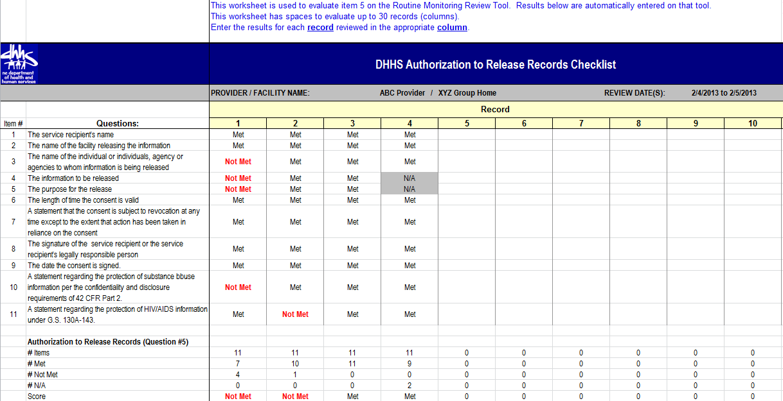
Notes:
For these items, the checklists help the provider to know which of the multiple element(s) was out of compliance.
The Authorization to Release Information is new. It is the latest checklist to be developed.

Slide 11

Scoring
Enhanced Guidelines:
  More specific
  More pertinent to general program operations
Notes:
One of the most significant accomplishments from the collaborations within the workgroup is the contributions made by the LME-MCO and provider representatives in refining the guidelines for the tools.
The criteria for rating and scoring is clearer and more closely reflects general operations within a provider’s practice.

Slide 12
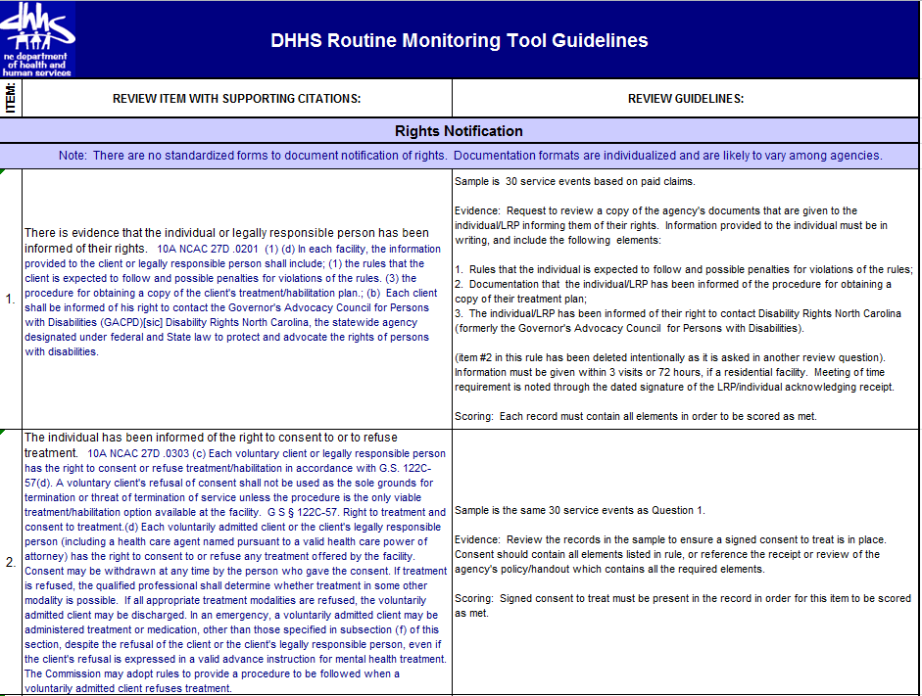
Notes:
The Guidelines include the sample size and the evidence or documentation the reviewer needs to see in order to rate the item as passed.

Slide 13

Scoring
The threshold for passing each section of the routine review tool is 85%. (Exception: On the Agency Tool, if the Restrictive Interventions item is missed, the entire section on Incidents, Restrictive Interventions and Complaints is failed).
The minimum overall score for the routine review tool is also 85%.
Notes:
There is a 85% threshold for passing each section of the tool as well as for passing the review overall.
The exception is with Restrictive Interventions, where if a provider fails that item, the provider fails the entire section on incidents, complaints and restrictive interventions.

Slide 14

Weighting
The weight for any item scored as “N/A” is distributed across the other items in that section.
Notes:
When an item is found to be not applicable, the provider is not penalized for a N/A rating.
These items are not factored into the score for that section of the tool.

Slide 15
Weighting
Non-compliance on certain items results in the individual record being scored as “Not Met:”
  Authorization to Release Records
  All elements required by rule must be included in the record release form in order for this item to be scored as “Met.” [See Record Release Checklist]
  Medication Review Tool
  If any of the following requirements is out-of-compliance, the individual record is “Not Met.” [see Medication Review Checklist]
    Medication Order Properly Signed/Countersigned by Prescribing Physician
    Medication Label Matches the Medication Order
    List of Medications on the MAR match the Medication Order
    Documentation that Medication Education Occurred
Notes:
If a provider misses some items on the checklists, it results in that item being Not Met for that record. The score is automatically populated onto the review tool.

Slide 16
Weighting
Non-compliance on certain items results in the entire section to be scored as “Not Met:”
  Restrictive Interventions
  If the Restrictive Intervention question is “Not Met” for any event reviewed, the entire section on Incidents, Restrictive Interventions and Complaints is failed.
Notes:
The workgroup felt that problems in implementing restrictive interventions were significant enough that because of the risk associated with restrictive interventions, if this item is not Not Met, it provider has to perform extremely well on the other parts of the review in order to pass the review.

Slide 17

Some Monitoring
Process Points
17
Notes:
Now that we have explained how the sample for the review is selected, let’s turn our attention to several important junctures in the review process.

Slide 18

Selection of the Review Period
How is the timeframe from which the sample is drawn determined for the routine review?
Notes:
For the majority of the review, the sample of paid claims will be based on claims paid starting 6 months before the scheduled on-site visit through the next 3 months (~ 90 days).
Example: If the date of the on-site is May 1, the sample will drawn from randomly selected claims that were paid between December 1 – February 28.
The timeframe for incidents, restrictive interventions, complaints, funds management and medication review can go back up to 1 year in order to obtain an adequate sample.
It is important to note here that these parameters apply to routine monitoring only. There are no prescribed timelines for how far an audit may extend in the case of a targeted review or investigation.

Slide 19
Notification of Routine Monitoring
Provider agencies and LIPs will be notified in writing 21 – 28 calendar days prior to the date of review.
Provider agencies and LIPs will be notified of specific service records needed for review no less than 5 business days prior to the date of review.
Notes:
The LME-MCO will notify the provider 3 – 4 weeks (or within 21-28 calendar days) prior to the on-site review when the review has been scheduled. This notification will be in writing with confirmation of receipt.
To ensure that the provider has the records and documentation available for the review, the LME-MCO will notify the provider of the service records that will be needed. To maintain the integrity and fidelity of the review, the LME-MCO will not identify the specific services or dates of service that will be reviewed.

Slide 20

Prior to the On-site Review
Organized Accessible Recordkeeping
Notes:
Having organized and easily accessible records and documentation makes things go smoother and can expedite the review regardless of whether the records management system is electronic or paper.

Slide 21


During Monitoring
How involved should I be?
Notes:
There’s always the question of how involved providers should be involved during the review. It’s important to strike to balance between being intrusive and being helpful. The process is intended to be collegial and congenial. While it’s important to give the review team the privacy and space to conduct an independent review, it is important for providers to have staff available to help navigate the records and documentation if needed. Since providers best know what their records are organized, it is a good idea to explain to the review team how your records are organized before the review starts.
While it is not required that staff be present during the review, have staff available can enhance and facilitate the process to answer questions.
If documentation for a specific item is not immediately available, it can be accepted at any time before the conclusion of the on-site review.

Slide 22

Exit Interview
Preliminary impressions
Trends
No Final Score
Next Steps
Major Issues
Contact Person
Notes:
An Exit Interview will occur following the on-site review to provide the LIP or agency with some immediate feedback:
General impressions on preparedness and results of the review
General information on any major findings, trends, etc.
Expectations, if any, for technical assistance needed, plan of correction and follow-up
A final score cannot be given at the conclusion of the review. The review team may be able to tell the provider if technical assistance can be provided. Requests for plans of correction are usually deferred until the report is finalized.
It is very important during the exit interview that the provider provides the contact information, including the name of the individual to whom the final report should be sent, including the mailing address and e-mail address for that individual.

Slide 23
Monitoring Report
Comprehensive findings will be reported by the LME-MCO within 15 calendar days.
Notes:
The provider can expect to receive the monitoring report within 15 calendar days of the conclusion of the on-site review.

Slide 24
Modifications in the
Overall Summary Worksheet
  The Overall Summary worksheet has been moved to after the Workbook Set-up worksheet to make it easier for providers to see the results when they open their monitoring report.
  The overall results have been moved to the top of the worksheet.
  Performance is displayed for each section of the tool.
Notes:
One of the first things a provider is interested in when the monitoring report is received is their overall performance. Consequently, the Overall Summary Worksheet has been moved closer to the beginning of the workbook (i.e., next to the Workbook Set-up worksheet).

Slide 25
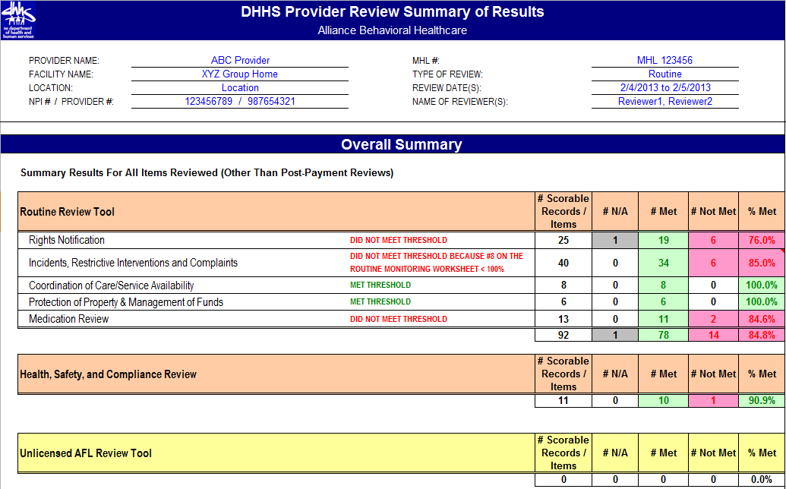
Notes:
In addition, the detail concerning how the provider performed overall has been moved from the bottom of the worksheet to the top of the worksheet along with an itemized listing of how the provider performed on each of the sub-sections of the tool.
These modifications were instituted to make the tool more user-friendly for providers.

Slide 26

Provider Monitoring Survey
LME-MCO Compliance with Notification Guidelines
Professionalism of Review Team
Results of the Review/
Provider Performance
Notes:
When the monitoring report is received, there will be a link to the Provider Monitoring Survey. This survey is the mechanism through which the workgroup will monitor how this new process is unfolding, identify emerging issues that need to be addressed, and gauge the extent to which positive interactions between providers and LME-MCOs are occurring.
It is very important for us to receive this feedback. Therefore, we encourage providers to complete this survey as soon as they receive their monitoring report. A link to the survey will be included with the cover letter or e-mail for the report.
The Provider Monitoring Survey is completed online via SurveyMax and is completely confidential. This survey looks at the LME-MCO’s compliance with the notification guidelines, the professionalism of the review team, and the provider’s performance on the review.
Notification
Received notification of date of on-site review in accordance with guidelines
Information needed for the review was included in the notification letter
Professionalism of the Review Team
Reviewers introduced themselves in a professional manner.
Reviewers were knowledgeable about the services that were reviewed.
Reviewers followed the guidelines for scoring the items on the tools.
Was able to have an open discussion with reviewers.
Had adequate time to provide the requested information.
Results
A clear explanation was given for all non-compliances found.
Specific areas of non-compliance found during the routine review and the post-payment review
Did the review result in a payback?
Did the review result in a plan of correction?
Does the provider plan to appeal any non-compliant findings?

Slide 27
Plans of Correction
Ensure POC is specific, detailed and addresses each of the systemic areas noted in the findings.
Fully implement the POC – seek technical assistance as warranted.
Notes:
Plans of correction will follow the guidelines and timelines in the DMH/DD/SAS Plan of Correction Policy. When a POC is required, it is because non-compliant issue(s) were identified that were determined to be systemic in nature which need special attention in order to be ameliorated.
If technical assistance is needed to address the findings, request assistance from the LME-MCO.

Slide 28
What happens if a provider agency does not pass the monitoring or review?
Notes:
Sometimes a provider may not meet the 85% threshold for passing the review.

Slide 29
LME-MCO Responses to Unsuccessful Monitoring
One or more of the following may occur, specific to individual LME-MCO policy.
  Technical Assistance
  Plan of Correction
  Recoupment (for Post-Payment Reviews only)
  Targeted Investigation
  Referral to internal review committee for determination of provider status
LME-MCOs will inform providers and LIPs of their process for appeal or reconsideration.
Notes:
When this occurs, there are several options the LME-MCO may pursue in taking action in response to the provider’s performance during the review.
In some instances, technical assistance will be offered. Some non-compliances will require a plan of correction. In the case of the post-payment review, some non-compliance will result in a payback.
A targeted review is sometimes instituted based on issues found during the routine review which necessitate the LME-MCO during a further investigation of the issues or concerns raised. The targeted review may occur in conjunction with the routine review or may occur at a different time. It is important to note here that targeted reviews and investigations will typically not have the same sampling methodology as the routine review. The size and scope and parameters instituted to conduct a targeted review are specific to the nature of the concern or issue which needs to be further investigated.
In some instances, an inter-departmental team is convened to discuss the provider’s performance and to make a decision about the provider’s status with the LME-MCO. This team is generally multidisciplinary. The team looks at the provider’s performance across the board, in terms of looking at compliance to other requirements per their contract – not just the provider’s performance on the routine review.

Slide 30

Internal Quality Assurance
…. only involves a review of documents needed to determine the met/not met/NA status for the review tool questions.
….less anxiety-provoking when providers (LIPs and agencies) use the tool as a pre-review self-assessment.
Notes:
As we conclude this webinar, I want to talk about the importance of provider’s having an internal process to be proactive in routinely conducting self-audits.
Here are some tips for becoming audit-ready:
Organize your records and documentation so that the information needed for to present as evidence of compliance is readily accessible.
The guidelines are an important source of reference for what documentation is required for the reviewer to determine if the requirements have been met.
Establishing a system where a self-audit is periodically conducted helps providers identify areas of non-compliance or weak controls so that corrective action can be taken as part of the provider’s internal QA/QI process.

Slide 31

Internal Quality Assurance
The best offense is a good defense.
Notes:
Be proactive – the best offense is always a good defense.

Slide 32

Transparency
Notes:
This is a transparent process. LME-MCOs and providers have all the tools and the same resource information at their disposal. Everything you need to know to enable your success is laid out in the tools and on the Provider Monitoring web page.

Slide 33

Internal Quality Assurance
Notes:
This is an open-book test. Put systems in place to ensure your success.

Slide 34

Internal Quality Assurance
Be Proactive
Notes:
How much easier can it be than this?

Slide 35
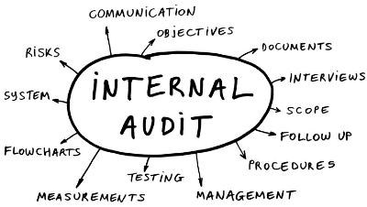
Internal Quality Assurance
Do you have a system in place that ensures audit-readiness at all times?
Notes:
Implement and carry out a system that ensure audit-readiness at all times. Conduct periodic self- audits. Practice makes perfect and is an important component of a good continuous quality improvement program.

Slide 36
Helpful Information
DMH/DD/SS Provider Monitoring link for tools, guidelines and updated information: http://www.ncdhhs.gov/mhddsas/providers/providermonitoring/index.htm
Records Management and Documentation Manual: http://www.ncdhhs.gov/mhddsas/statspublications/Manuals/rmdmanual-final.pdf
DMA Clinical Coverage Policies: http://www.ncdhhs.gov/dma/mp/
DMH/DD/SAS Plan of Correction Policy and forms: http://www.ncdhhs.gov/mhddsas/providers/POC/ index.htm
DHSR Mental Health Licensure Section: http://www.ncdhhs.gov/dhsr/mhlcs/mhpage.html
Notes:
Develop expertise in knowing, interpreting and applying the rules and regulations to which you are held. This also includes your contractual obligations.

Slide 37
Additional Information & Updates
Additional background information about the DHHS Provider Monitoring Process can be found on the Provider Monitoring web page:
http://www.ncdhhs.gov/mhddsas/providers/ providermonitoring/index.htm
Check the Announcements page for new postings.
Notes:
We are constantly updating information on the Provider Monitoring web page. Keep abreast of these updates. Make a habit of checking the Announcements page on the DMH web site at least once a week to see if anything new pertaining to provider monitoring has been posted. You might assign a specific staff person to do this for your agency.

Slide 38
Questions
Please send any questions or comments about the Provider Monitoring Tools or process to the following mailbox:
provider.monitoring@dhhs.nc.gov
Please put either “FEEDBACK” or “QUESTION” in the subject line!
Notes:
This concludes this webinar on Transparency in the Provider Monitoring Process.
If you have questions or other feedback, please send them to the provider monitoring mailbox. The e-mail address is provider.monitoring@dhhs.nc.gov.

