Slide 1

Using the Automated Workbook for the Provider Monitoring Tools
Developed by the
NC DHHS-LME/MCO-Provider
Collaboration Workgroup
February 2014
Presented by PeiChi Wu
Human Services Planner/Evaluator
DHHS-DMH/DD/SAS Accountability Team
Notes:
I am Pei Chi Wu. I will be showing you how to use the automated workbooks for routine provider monitoring. Although the examples that I will be using today are from the Provider Agency workbook, the same principles apply to the workbook for licensed independent practitioners.
I will be moving systematically through the workbook from one worksheet or tab to the next.
Both the agency and LIP tools have two workbooks – one contains dummy or test data and the other one is a clean copy of the tool itself. For purposes of illustration during this webinar, I will be using the workbook with test data so you can see how the workbook looks when data is inputted.
After explaining each of the worksheets, I will show you how to set up the workbook prior to the review and how the results of the review are tabulated.
I will be going back and forth between these PowerPoint slides and the Excel workbook to show you what I am talking about.
1

Slide 2

Instructions
  Give a brief explanation of how to use the workbook.
  Is color-coded to correspond to each section of the workbook.
Notes:
The Instructions worksheet explains how to use the workbook and how each tool is used.
Each section of the instructions is color-coded to correspond to the color of the tabs for that section in the workbook.

Slide 3
Guidelines
  Guidelines are provided for each of the review tools. The guidelines are embedded in a single PDF file.
  Service definitions can be found in the DMA Clinical Coverage Policies. A list of the Behavioral Health Clinical Coverage Policies is included on the Guidelines worksheet. Links are provided for direct access to each policy.
Notes:
The guidelines for all tools are in one pdf document. All guidelines are bookmarked so they are easier to find. You will need to double click the icon to open the pdf file.
[Demonstrate this --- Select a guideline and open it up/let them know which guideline you are opening]
Also included in this guidelines worksheet is the list of the Behavioral Health Clinical Coverage Policies. Among the clinical coverage policies most frequently used by behavioral health providers are:
8A for Providers of Enhanced Services
8C for Licensed Independent Practitioners and Outpatient Service Providers
8P for Providers of Innovations Waiver Services
You can double click on each link to access each policy.
[Click on Clinical Coverage Policy 8A for Providers of Enhanced Services to show them how the link works. An alternative way of accessing the links is to go to the DMA website, click on the Provider portal, under the Quick Links, click on Medicaid Clinical Coverage Policies and Provider Manuals on the left side of the page , then scroll down to Section 8 where you will find the Clinical Coverage Policies]

Slide 4

Overview
  This sheet provides a brief description of the purpose of each tool and how each tool fits into the routine monitoring process.
Notes:
The Overview page provides a description of each tool and lets you know which tools are used to monitor LIPs and which tools are used to monitor agencies and under what circumstances.

Slide 5

Frequency of DHSR Surveys
  This grid provides a list of MH/DD/SA services and frequency of surveys conducted by DHSR Mental Health Licensure and Certification Section.
DHSR
Notes:
The Frequency of DHSR Surveys worksheet shows the services that are licensed under GS 122C are surveyed by DHSR. The services are organized by service category and service name. The frequency with which the Mental Health Licensure section surveys each service after initial licensure is reflected on this grid. This worksheet is a very important reference for planning an on-site review at an agency that provides licensed services.
DHSR’s annual survey of residential and opiod treatment services in done in lieu of routine monitoring of these services by the LME-MCO.
“Annual” is defined as a survey which is conducted every 12 – 15 months.
[Pull up the grid. Note opiod treatment and 2-3 of the residential services that are surveyed on an annual basis. Also note a couple of other services where DHSR only surveys as part of follow-up or a complaint investigation after initial licensure].

Slide 6
Workbook Set-up
Consists of Three Sections
  Provider/LME-MCO/Review Team/Date(s) of On-site Review
  Section of Review Tools Based on the Provider’s Service Array
  DHSR Survey Information
Notes:
The Workbook Set-up worksheet is a very important page in helping to organize your review.
The top section is for you to enter the provider info, the name of reviewers, dates and type of review. You can enter more than 1 reviewer, separated by comas. If the review occurs in 1 day, then enter the same date for Begin Review Date and End Review Date. The LME-MCO and the Type of Review fields are drop-down menu so you do not have to type these in.
The second section is for you to indicate which tools are used in this review. You can select Yes or No from the drop down menu. The purpose of this section is to filter out all the tools that are not used in this review in the Overall Summary worksheet so you can view or print only the results of the applicable tools.
The third and last section is for you to enter the DHSR Survey information such as the date of last survey, service category, type of survey and survey results or findings. This is the only section on this page that is not linked to anything else in this workbook. It is here to help you determine and document which licensed services you will review based on the frequency grid we discussed earlier.

Slide 7
Workbook Set-up
  Contains information about the LME-MCO, the provider, the review, and the tools used for the review.
  Only needs to be entered one time.
  Is automatically entered throughout the workbook where needed (e.g. in the header of each tool and staff qualification worksheet, the Overall Summary, and the Data Extraction worksheet).
  Simply update the workbook set-up sheet, and the information will be automatically updated throughout the workbook when changes need to be made.
Notes:
Once all the basic information is entered on the Workbook Set-up worksheet, this information is automatically populated throughout the tool, thereby necessitating this information only needing to be entered once.
I will return to this page later in this session when I talk bout how to set up the workbook prior to beginning the review.

Slide 8
Overall Summary
  Summarizes the results for all tools in one convenient place.
  Calculates the number and percent met for each item or record reviewed.
  Calculates overall performance for each individual tool as well as for all tools combined.
  Can be printed and attached to the review report to serve as a handy reference to the provider and reviewer of results and items needing corrective action.

Slide 9
Overall Summary
  Uses color coding to indicate which items were Met, Not Met or Not Applicable:
    Green = Met
    Red = Not Met
    Gray = Not Applicable
  Identifies whether the 85% threshold for passing was Met or Not Met.
  Results can be filtered so that only those tools which were used during the review will be printed for the report.
Notes:
The Overall Summary worksheet shows the results of all the tools used in the review. This page will give you the score in percentage for each question of all tools. It will also gives you the overall or summary results for each tool and for all tools. Items that are Met will turn Green, Not Met will turn Red and N/A will turn Gray. At the top of the Overall Summary page where the overall results are, the total percentage will turn RED if the 85% threshold is not met, and will turn green if the threshold is met.
The far right column of this worksheet indicates whether the tool was designated on the Workbook Set-Up worksheet to be applicable to the review. This column may be used to filter the report to hide results for tools that were not used and to print the results only for the tools that were used. [demonstrate this]

Slide 10
Routine Monitoring Tools
  Routine Review
  Health, Safety and Compliance Review
  Unlicensed AFL Review
Notes:
The Routine Monitoring Tools consist of the Routine Review tool, Health, Safety and Compliance Review tool, and the Unlicensed AFL Review tool.
The Health, Safety and Compliance Review Tool and the Unlicensed AFL Review Tool are used in specific situations which are described on the Overview worksheet.

Slide 11
Routine Review Tool
  LIP and Provider Agency Tools
    Rights Notification
    Coordination of Care/Service Availability
  LIP Tool
    Storage of Records
  Provider Agency Tool
    Incidents, Restrictive Interventions, Complaints
    Protection of Property/Funds Management*
    Medication Review*
  * These sections of the tool are used as applicable to the service(s) being reviewed.
Notes:
The Routine Review Tool for LIPs and Provider Agencies both look at Rights Notification, Coordination of Care and Service Availability.
The LIP Tool looks at the additional area of Storage of Records while the routine tool for provider agencies looks at incidents, restrictive interventions, and complaints in addition to rights notification, coordination of care and service availability and depending on the type service provided, the routine review may also include a review of protection of the individual’s property, funds management and medication review.

Slide 12
Routine Review Tool
The following checklists correspond to specific items on the tool. When these checklists are completed, they automatically score the associated item(s) on the routine review tools.
  Record Release Checklist: Rights Notification Section - question #5 – required elements on a record release form.
  Medication Review: Medication Review Section – relates to questions #15, 16, 17, and 18 for each individual in the sample.
Notes:
There are 2 tools that are used along with the Routine Review tool. They are the Record Release Checklist and the Medication Review tool.
The Record Release Checklist is associated with Question #5 in the Rights Notification section of the tool.
The Medication Review worksheets link to Questions #15 through 18 on the Routine Review tool. Up to 20 medications for each individual can be entered on the Medication Review tool.
The results on each of these checklists automatically populate the corresponding items on the tool.

Slide 13
Automated Features
  Each tool is designed with multiple columns to provide a place to document results for multiple records.
  Each column is numbered for easy reference.
  The number of columns provided represents the maximum possible number of records anticipated to be sampled during a review.
Notes:
As you can see in the Routine Review tool, the heading (LME, Provider Name, Facility Name, etc.) came from the Workbook Set-up page. You will not need to enter this over and over again on each tool. The format of each tool in this workbook is the same. Each question has a drop down menu where you can select “Met”, “Not Met” or “N/A”. If you select “Not Met”, the result will turn RED, “N/A” will turn GRAY. For this particular tool, you will not be able to select anything for # 5, 15, 16, 17 and 18 because the results are linked to these other worksheets. All tools and worksheets are protected so no one will accidentally overwrite and delete things they are not supposed to such as the questions or formulas. If you scroll all the way to the right, you will see results for each question on that tool. These results are automatically transferred to the Overall Summary worksheet.

Slide 14
Automated Features
  If all columns are not needed, either hide unneeded columns or limit the number of pages printed (worksheets are formatted to print 10 columns per page).
  Some items (such as policies and procedures) are reviewed once for the individual or agency being reviewed. Enter the results for these items in the first column.
  Columns that do not apply have been shaded gray and are locked to prevent anything being entered.
Notes:
If you scroll all the way down, you will see results for each event for that review. You will also be able to enter comments under the scores. There are also spaces for each column under the tool where you can enter the reviewers’ initials. You can enter up to 30 events in this tool and most of the tools. Each tool is set up to print 10 events to a page. If you only have 10 events for this review, you can hide the rest of the columns when you print. All you need to do is highlight all the columns you don’t need, right mouse click and select hide.

Slide 15
Automated Features
  Cells for entering results contain drop-down menus to indicate whether an item is "Met", "Not Met" or "N/A". Items that are "Not Met" will be displayed in red font to make them stand out. Each tool contains columns at the far right and/or rows at the bottom for automatically counting the number of items on the tool that are marked "Met", "Not Met", and "N/A" (not applicable). Results from each tool are automatically entered on the "Overall Summary" worksheet (explained below).
Notes:
The Health, Safety, and Compliance Review and Unlicensed AFL Review tools have the same format as the Routine Review tool.

Slide 16
Post-Payment Review Tools
Licensed Independent Practitioners
  Post-Payment Review Tool for LIPs
Provider Agencies
  Post-Payment Review Tool for Providers (Generic Tool)
  Post-Payment Review Tool for Innovations Waiver Service Providers
  Post-Payment Review Tool for Opioid Treatment Services
  Post-Payment Review Tool for Diagnostic Assessment
  Post-Payment Review Tool for Residential Services
  Post-Payment Review Tool for Day Treatment
  Post-Payment Review Tool for Psychiatric Residential Treatment Facilities (PRTF)
Notes:
The LIP Tool has its own Post-Payment Review Tool.
There are 7 different PPR tools in the Provider Agency workbook: PPR Generic, Innovations Waiver, Opiod Treatment, Diagnostic Assessment, Residential Services, Day Treatment and PRTF. The specific tool that is used is based on the service that is being reviewed. Each post-payment review tool is tailored to the specific requirements of the service definition.

Slide 17
Post-Payment Review Tools
  The specific post-payment review tool(s) used during a review are determined by the service(s) reviewed.
  In cases where there is not a designated service-specific post-payment review tool, use the generic post-payment review tool.
  These tools work the same way the multiple column review tools work.
  Some items contain a place to enter "from" and "to" dates for items that are not met. At the bottom of the column are two rows that automatically calculate the earliest "from date" and the latest "to date" for all items in the column with date entries.
Notes:
On most of the PPR tools, you will be able to enter From and To dates for items that are “Not Met” over a period of time. At the bottom of the tool, it will automatically calculate the earliest From date and the latest To date in each column for all items with dates that are “Not Met”.
All of the review tools are designed to document results for items reviewed and individual records sampled. They do not contain protected health information (PHI) and may be printed and attached to the review report or given to the provider, as appropriate, as part of the supporting documentation.

Slide 18
Staff Qualifications Worksheets
  Each Post-Payment Review tool has one or more staff qualification worksheets to assist the reviewer document answers to questions related to specific service requirements, staff qualification/training requirements, supervision, health care registry, and criminal record checks.
  The Generic Post-Payment Review tool has multiple staff qualification worksheets. Use the applicable worksheet(s).
Notes:
These worksheets are used to document and answer questions/items regarding staff qualifications and training requirements for the service.
Since the Generic PPR tool can be used for a number of services, there are different staff qualifications worksheets for the Generic PPR tool, depending on the type of services reviewed. There are also staff qualification worksheets that are used for specific PPR tools.
The Staff Qualifications worksheets are placed to the right of the applicable PPR tool. However, these worksheets are not linked to the PPR tools.
Each Staff Qualifications worksheet has multiple columns to provide a place to document results for multiple staff reviewed. Each column is numbered for easy reference. Only use the columns needed. [For example, if throughout the sample, there were only 4 providers for the 7 Day Treatment service events that were pulled, you only need to fill out 4 columns on the Staff Qualifications Checklist for Day Treatment].
Each tool contains columns at the far right and/or rows at the bottom for automatically counting the number of items on the tool that are marked "Met", "Not Met", and "N/A" (not applicable). Again, the results are for information purposes only and are not linked to any other worksheet in this workbook.

Slide 19
Innovations Waiver Services
Special Requirements for Services Provided Under the Innovations Waiver (formerly known as the Community Alternatives Program [CAP-IDD]
Notes:
The CAP Services Special Requirements is an information worksheet that provides criteria for evaluating items on the PPR Tool for the Innovations Waiver.

Slide 20
VIP* Spreadsheets
Individual Records List
Personnel List
Post-Payment Review List
Workbook Set-Up Worksheet
*These spreadsheets are the lifeline of the monitoring process. Each of these sheets needs to be completed before the review.
Notes:
In addition to the Workbook Set-Up Worksheet which I discussed earlier, towards the end of the workbook are 3 very important spreadsheets that provide critical and essential information about the service events included in the sample, the individuals who received the service and the clinician/staff person who provided the service.
These 3 worksheets are the Individual Records List, the Personnel List, and the Post-Payment Review List are used to document the specific records in the sample to be reviewed.
Although these worksheets appear at the end of the workbook, they should be completed first --- before the review begins whether you are conducting a internal quality assurance self-audit or an LME-MCO conducting an on-site review.
The record #s on these sheets correspond to the record # or service event on the review tools. These sheets enable you to match the service events in the sample to the individual who received the service and the person who provided the service for purposes of follow-up after the review.
The Individual Records worksheet pertains to the recipient of the service.
The Personnel List identifies the clinician/staff person who provided and billed service.
The Post-Payment Review List identifies the service events that are a part of the sample drawn for the review.

Slide 21
VIP Spreadsheets
  These worksheets provide a place to list the individual consumer records, staff, and the post-payment records that are part of the sample for the review.
  The worksheets involve consumer records and include identifying information that is considered to be Protected Health Information (PHI) and as such require the file to be stored in a secure location and encrypted/password protected prior to emailing. The record numbers in the first column in these worksheets (e.g. 1 through 30) correspond to the record numbers across the top of the review tools.
Notes:
The Individual Records List, the Personnel List and the Post-Payment Review List worksheets involve consumer records which include identifying information that is considered to be Protected Health Information (PHI) and as such require the file to be stored in a secure location and encrypted/password protected prior to emailing. Again, the record numbers in the first column in these worksheets (e.g. 1 through 30) correspond to the record numbers across the top of the review tools.
Each of these worksheets is separate and not linked to any of the other worksheets in the workbook.

Slide 22
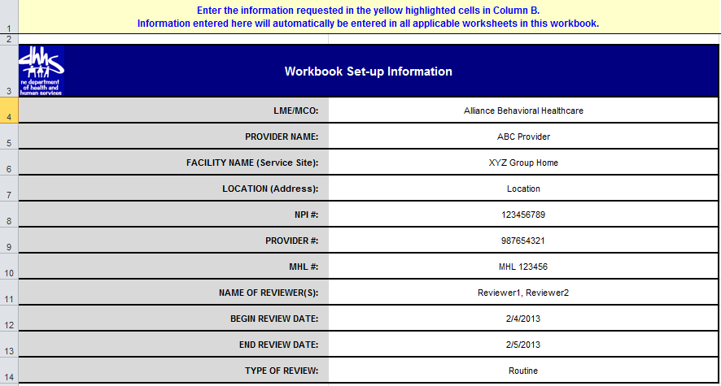
Workbook Set-up Information
Notes:
After you have completed the Individual List, the Personnel List and the Post-Payment Review List, you are now ready to complete the Workbook Set-Up Worksheet, the final step before conducting the actual review.
These are screen shots of the Workbook Set-up Worksheet. This slide shows the first section of the worksheet which identifies the LME-MCO and captures information about the provider. This information is automatically transferred to other parts of the workbook so that this basic identifying information about the LME-MCO and the provider only needs to be entered once.

Slide 23
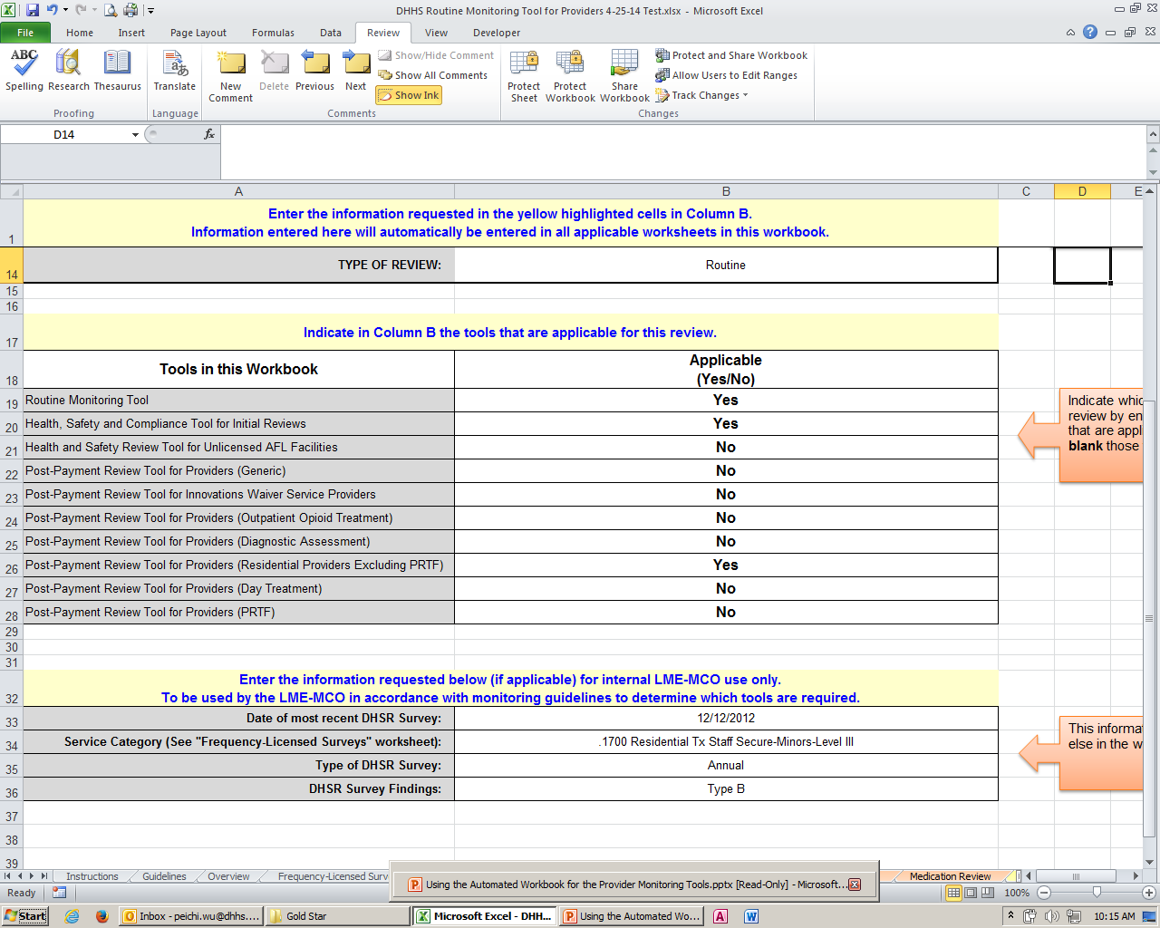
Tools in this Workbook
Notes:
The next section of the Workbook Set-up Worksheet is where you actually select all the tools necessary for the review based on the sample drawn from paid claims and the provider’s complaint, restrictive interventions, and incident logs.
Keep in mind that the LME-MCO is responsible for conducting post-payment reviews on licensed services, including residential services and opiod treatment services which DHSR surveys on an annual basis.

Slide 24
Documentation of DHSR Survey Results
Notes:
The last section of the Workbook Set-up Worksheet helps determine whether a licensed service should be included in the review. This worksheet is used in conjunction with the Frequency – Licensed Survey grid to help planning the monitoring event.
Now that all 4 of the VIP spreadsheets have been completed, you are now ready to begin the actual monitoring process using the appropriate monitoring tools.

Slide 25
Data Extraction Worksheet
  This worksheet is linked to the Workbook Set-up and Overall Summary worksheets and places identifying information and summary results into a single row in a format that will permit the data to be copied and pasted into a separate Excel database.
  The Excel database may be used by the LME-MCO and DHHS to aggregate and analyze review results for all providers over time and across the catchment area and the state.
Notes:
The Data Extraction Worksheet is the last worksheet in both workbooks.
The purpose of the Data Extraction Worksheet is to transfer the review results from this workbook to an external database. You do not enter anything on this page.
Columns A-J are information from the Workbook Set-up page.
Columns K-BH are the summary results for each tool which come from the Overall Summary page.
Columns BI-BW are the overall results for all tools which also come from the Overall Summary page.
The selected row can be copied and pasted to an external database. The database is an Excel database that will help us aggregate and analyze the results for all providers in 1 place.

Slide 26
Questions
If you have any questions about how the use the automated workbook and review tools, please send your questions to the Provider Monitoring mailbox:
provider.monitoring@dhhs.nc.gov
Please include in the Subject line the nature of your question.
Notes:
We are now at the end of this webinar presentation. If you have any questions regarding the automation of the tools and workbook, please send your questions to the Provider Monitoring mailbox. Remember to include the nature of your question in the Subject line to expedite processing of your question.

