Slide 1
Eastern Regional Meeting
Fiscal Officers Session
February 27, 2025
Notes:
Welcome
Introductions
Housekeeping – Restrooms, vending machines

Slide 2
A G E N D A
9:00 am – 12:00 pm
Review of Latest XS411 Report
FY25-26 Budget Estimates/Narrative Overview
Budget Issues – things to think about while planning for FY25-26
Trust Accounts
Negative Check Adjustments
Medicaid Expansion Funding
Odds and Ends:
Path NC Implementation
Indirect Cost Plan – due 4/15/2025; Cost breakout – 310/804
FNS E & T Program rebranding to MTAJ-NC (More Than A Job-NC)
Meeting MOE by the 11th month
NC-CoReLS Report / fund that tracks your MOE
Employee IDs – What does your county use? Ensure no duplicate IDs.
NC-CoReLS Multiple Import Sources Report
Special Assistance In-Home Case Management Program – MAC 386 & 387
Feedback on Disaster Programs
1:30 pm
Budget Template Training

Slide 3
XS411 Report Review

Slide 4
XS411- Report for Review
 |  |  | QTRLY SSBG FEDERAL |  |  | QTRLY STATE IN HOME |  |  | QTRLY ADOPT /FC STATE
PROGRAM CODES |  |  | X |  |  | B, C, I |  |  | Fiscal Officer codes to it
 |  |  |  |  |  |  |  |  | Change - 38/09 to 38/10 or 38/11
 |  |  | AMOUNT | PCT SPEND RATE |  | AMOUNT | PCT SPEND RATE |  | AMOUNT | PCT SPEND RATE
ANNUAL ALLOCATION |  |  | 52,222.00 |  |  | 408.70 |  |  | 28,359.87
Month Submitted - July - June 1571
EXPENDITURE JUNE |  |  | 13,550.33 | 25 |  | 135.16 | 33 |  | 0.00 | 0
 | JULY |  | 16,106.46 | 30 |  | 425.67 | 104 |  | 0.00 | 0
 | AUG |  | -16,600.80 | 31 |  | -329.58 | 80 |  | 0.00 | 0
 | SEPT |  | 9,670.86 | 18 |  | 0.00 | 0 |  | 13,860.00 | 48
 | OCT |  | 3,385.13 | 6 |  | 0.00 | 0 |  | 0.00 | 0
 | NOV |  | 0.02 | 0 |  | 0.00 | 0 |  | 0.00 | 0
 | DEC |  | 13,055.99 | 25 |  | 0.00 | 0 |  | 0.00 | 0
 | JAN |  | -0.02 | 0 |  | 0.00 | 0 |  | 6,930.00 | 24
 | FEB |  | 0.02 | 0 |  | 0.00 | 0 |  | 0.00 | 0
 | MAR |  | 10,783.79 | 20 |  | 0.00 | 0 |  | 0.00 | 0
 | APRIL |  | 2,270.20 | 4 |  | 0.00 | 0 |  | 4,234.74 | 14
 | MAY |  | 0.02 | 0 |  | 177.45 | 43 |  | 3,335.13 | 11
Y-T-D EXPENDITURES |  |  | 52,222.00 | 100 |  | 408.70 | 100 |  | 28,359.87 | 100
UNEXPENDED BALANCE |  |  | 0 |  |  | 0 |  |  | 0

Slide 5
XS411- Report for Review
 |  |  | PERM PLAN ADM |  |  | PERM PLAN SVC |  |  | QTRLY FED ADC
PROGRAM CODES |  |  | P - split at state level |  |  | P |  |  | Part IV
 |  |  | AMOUNT | PCT SPEND RATE |  | AMOUNT | PCT SPEND RATE |  | AMOUNT | PCT SPEND RATE
ANNUAL ALLOCATION |  |  | 454.99 |  |  | 4,133.62 |  |  | 0.00
Month Submitted - July - June 1571
EXPENDITURE JUNE |  |  | 159.41 | 35 |  | 907.08 | 21 |  | 0.00
JULY |  |  | 67.09 | 14 |  | 394.84 | 9 |  | 0.00
AUG |  |  | 133.37 | 29 |  | 867.23 | 20 |  | 0.00
SEPT |  |  | 95.12 | 20 |  | 941.24 | 22 |  | 0.00
OCT |  |  | 0.01 | 0 |  | 695.96 | 16 |  | 0.00
NOV |  |  | -0.01 | 0 |  | 292.65 | 7 |  | 0.00
DEC |  |  | 0.00 | 0 |  | -0.01 | 0 |  | 0.00
JAN |  |  | 0.00 | 0 |  | 0.01 | 0 |  | 0.00
FEB |  |  | 0.01 | 0 |  | 0.00 | 0 |  | 0.00
MAR |  |  | -0.01 | 0 |  | 0.00 | 0 |  | 0.00
APRIL |  |  | 0.00 | 0 |  | 0.00 | 0 |  | 0.00
MAY |  |  | 0.00 | 0 |  | 34.62 | 0 |  | 0.00
Y-T-D EXPENDITURES |  |  | 454.99 | 100 |  | 4,133.62 | 100 |  | 0.00
UNEXPENDED BALANCE |  |  | 0 |  |  | 0

Slide 6
XS411- Report for Review
 |  |  | ENERGY ADMIN |  |  | CRISIS |  |  | SHARE THE LIGHT old energy neighbors
PROGRAM CODES |  |  | E |  |  | Energy portal - FIS |  |  | Energy portal - FIS
 |  |  | AMOUNT | PERCENT SPEND RATE |  | AMOUNT | PERCENT SPEND RATE |  | AMOUNT | PERCENT SPEND RATE
ANNUAL ALLOCATION |  |  | 13,841.00 |  |  | 104,506.00 |  |  | 1,535.00
Month Submitted - July - June 1571
EXPENDITURE JUNE |  |  | 0.00 | 0 |  | 0.00 | 0 |  | 0.00 | 0
JULY |  |  | 0.00 | 0 |  | 600.00 | 0 |  | 0.00 | 0
AUG |  |  | 99.60 | 0 |  | 419.71 | 0 |  | 2.00 | 0
SEPT |  |  | 54.30 | 0 |  | 1,171.13 | 1 |  | 18.00 | 1
OCT |  |  | 8,078.39 | 58 |  | 17,561.55 | 16 |  | 0.00 | 0
NOV |  |  | 199.30 | 1 |  | 73,260.81 | 70 |  | 0.00 | 0
DEC |  |  | 5,409.41 | 39 |  | 1,376.37 | 1 |  | 0.00 | 0
JAN |  |  | 0.00 | 0 |  | 3,134.66 | 2 |  | 8.00 | 0
FEB |  |  | 0.00 | 0 |  | 1,168.14 | 1 |  | 0.00 | 0
MAR |  |  | 0.00 | 0 |  | 2,006.12 | 1 |  | 34.00 | 2
APRIL |  |  | 0.00 | 0 |  | 1,717.13 | 1 |  | 2.00 | 0
MAY |  |  | 0.00 | 0 |  | 0.00 | 0 |  | 0.00 | 0
Y-T-D EXPENDITURES |  |  | 13,841.00 | 100 |  | 102,415.62 | 97 |  | 64.00 | 4
UNEXPENDED BALANCE |  |  | 0 |  |  | 2,090.38 |  |  | 1,471.00

Slide 7
XS411- Report for Review
 |  |  | QTRLY IV -E CPS |  |  | LIHWAP ADM |  |  | SSBG STATE
PROGRAM CODES |  |  | 215, 219 and 228 - Z - (penetration rate - small %) |  |  | Program ended |  |  | no longer funded - rolled into SSBG Federal
 |  |  | AMOUNT | PERCENT SPEND RATE |  | AMOUNT | PERCENT SPEND RATE |  | AMOUNT | PERCENT SPEND RATE
ANNUAL ALLOCATION |  |  | 11,309.69 |  |  | 0 |  |  | 0
Month Submitted - July - June 1571
EXPENDITURE JUNE |  |  | 3,881.01 | 34 |  | 0.00 |  |  | 0.00
JULY |  |  | 4,138.60 | 36 |  | 0.00 |  |  | 0.00
AUG |  |  | -5,222.86 | 46 |  | 0.00 |  |  | 0.00
SEPT |  |  | 2,796.75 | 24 |  | 0.00 |  |  | 0.00
OCT |  |  | 0.00 | 0 |  | 0.00 |  |  | 0.00
NOV |  |  | 0.00 | 0 |  | 0.00 |  |  | 0.00
DEC |  |  | 2,796.75 | 24 |  | 0.00 |  |  | 0.00
JAN |  |  | 0.00 | 0 |  | 0.00 |  |  | 0.00
FEB |  |  | 0.00 | 0 |  | 0.00 |  |  | 0.00
MAR |  |  | 1,931.70 | 17 |  | 0.00 |  |  | 0.00
APRIL |  |  | 865.05 | 7 |  | 0.00 |  |  | 0.00
MAY |  |  | 122.69 | 1 |  | 0.00 |  |  | 0.00
Y-T-D EXPENDITURES |  |  | 11,309.69 | 100 |  | 0.00 |  |  | 0.00
UNEXPENDED BALANCE |  |  | 0 |  |  | 0 |  |  | 0

Slide 8
XS411- Report for Review
 |  |  | QTRLY CWS NH EXP |  |  | APS/CPS COVID |  |  | QTRLY CPS STATE
PROGRAM CODES |  |  | IHE |  |  | Part II payments- money advanced to county Program ended |  |  | CPS
 |  |  | AMOUNT | PERCENT SPEND RATE |  | AMOUNT | PERCENT SPEND RATE |  | AMOUNT | PERCENT SPEND RATE
ANNUAL ALLOCATION |  |  | 11,234.31 |  |  | 19,523.00 |  |  | 7,578.42
Month Submitted - July - June 1571
EXPENDITURE JUNE |  |  | 7,945.44 | 70 |  | 0.00 | 0 |  | 0.00 | 0
JULY |  |  | 0.00 | 0 |  | 0.00 | 0 |  | 8,771.34 | 115
AUG |  |  | -5,238.19 | 46 |  | 0.00 | 0 |  | -6,891.34 | 90
SEPT |  |  | 2,707.25 | 24 |  | 0.00 | 0 |  | 0.00 | 0
OCT |  |  | 0.00 | 0 |  | 15,523.00 | 79 |  | 1,880.00 | 24
NOV |  |  | 0.00 | 0 |  | 0.00 | 0 |  | 0.00 | 0
DEC |  |  | 0.00 | 0 |  | 3849.00 | 19 |  | 1,880.00 | 24
JAN |  |  | 2,707.25 | 24 |  | 0.00 | 0 |  | 0.00 | 0
FEB |  |  | 0.00 | 0 |  | 0.00 | 0 |  | 0.00 | 0
MAR |  |  | 0.00 | 0 |  | 0.00 | 0 |  | 1,880.00 | 24
APRIL |  |  | 2,707.25 | 24 |  | 0.00 | 0 |  | 0.00 | 0
MAY |  |  | 405.31 | 3 |  | 0.00 | 0 |  | 58.42 | 0
Y-T-D EXPENDITURES |  |  | 11,234.31 | 100 |  | 19372.00 | 99 |  | 7,578.42 | 100
UNEXPENDED BALANCE |  |  | 0 |  |  | 151.00 |  |  | 0

Slide 9
XS411- Report for Review
 |  |  |  | LIHWAP CAA |  |  | SMART START REIM |  |  | CPS EXP - TNF TO S
PROGRAM CODES |  |  |  | Program ended |  |  | 4 |  |  | 23
 |  |  |  | AMOUNT | PERCENT SPEND RATE |  | AMOUNT | PERCENT SPEND RATE |  | AMOUNT | PERCENT SPEND RATE
ANNUAL ALLOCATION |  |  |  | 0 |  |  | 0 |  |  | 0
Month Submitted - July - June 1571
EXPENDITURE JUNE |  |  |  | 0.00 |  |  | 0.00 |  |  | 0.00
JULY |  |  |  | 0.00 |  |  | 0.00 |  |  | 0.00
AUG |  |  |  | 0.00 |  |  | 0.00 |  |  | 0.00
SEPT |  |  |  | 0.00 |  |  | 0.00 |  |  | 0.00
OCT |  |  |  | 0.00 |  |  | 0.00 |  |  | 0.00
NOV |  |  |  | 0.00 |  |  | 0.00 |  |  | 0.00
DEC |  |  |  | 0.00 |  |  | 0.00 |  |  | 0.00
JAN |  |  |  | 0.00 |  |  | 0.00 |  |  | 0.00
FEB |  |  |  | 0.00 |  |  | 0.00 |  |  | 0.00
MAR |  |  |  | 0.00 |  |  | 0.00 |  |  | 0.00
APRIL |  |  |  | 0.00 |  |  | 0.00 |  |  | 0.00
MAY |  |  |  | 0.00 |  |  | 0.00 |  |  | 0.00
Y-T-D EXPENDITURES |  |  |  | 0.00 |  |  | 0.00 |  |  | 0.00
UNEXPENDED BALANCE |  |  |  | 0 |  |  | 0 |  |  | 0

Slide 10
XS411- Report for Review
 |  |  |  | CHILD CARE DEV |  |  | LIEAP COVID 19 |  |  | QTRLY WF FEDERAL
PROGRAM CODES |  |  |  | L |  |  | Pandemic LIEAP Energy Portal – FIS Program ended |  |  | R
 |  |  |  | AMOUNT | PERCENT SPEND RATE |  | AMOUNT | PERCENT SPEND RATE |  | AMOUNT | PERCENT SPEND RATE
ANNUAL ALLOCATION |  |  |  | 80,000.00 |  |  | 87,995.15 |  |  | 154,856.00
Month Submitted - July - June 1571
EXPENDITURE JUNE |  |  |  | 5,517.24 | 6 |  | 0.00 | 0 |  | 10,541.04 | 6
JULY |  |  |  | 5,637.09 | 7 |  | 0.00 | 0 |  | 8,152.42 | 5
AUG |  |  |  | 9,812.80 | 12 |  | 0.00 | 0 |  | 20,020.54 | 12
SEPT |  |  |  | 6,452.54 | 8 |  | 0.00 | 0 |  | 31,370.14 | 20
OCT |  |  |  | 4,022.35 | 5 |  | 0.00 | 0 |  | 7,343.86 | 4
NOV |  |  |  | 6,442.74 | 8 |  | 0.00 | 0 |  | 0.00 | 0
DEC |  |  |  | 5,876.93 | 7 |  | 54,995.15 | 62 |  | 38,714.00 | 25
JAN |  |  |  | 5,726.03 | 7 |  | 0.00 | 0 |  | 0.00 | 0
FEB |  |  |  | 4,150.11 | 5 |  | 0.00 | 0 |  | 0.00 | 0
MAR |  |  |  | 2,931.69 | 3 |  | 0.00 | 0 |  | 22,896.03 | 14
APRIL |  |  |  | 1,890.33 | 2 |  | 0.00 | 0 |  | 15,817.97 | 10
MAY |  |  |  | 2,174.18 | 2 |  | 0.00 | 0 |  | 0.00 | 0
Y-T-D EXPENDITURES |  |  |  | 60,634.03 | 75 |  | 54,995.15 | 62 |  | 154,856.00 | 100
UNEXPENDED BALANCE |  |  |  | 19,365.97 |  |  | 33,000.00 |  |  | 0

Slide 11
XS411- Report for Review
 |  |  | QTRLY ST CPS CSLD R |  |  | SHARE THE WARMTH |  |  | QTRLY STATE ADC
PROGRAM CODES |  |  | CRF |  |  | Energy Portal - FIS |  |  | Part IV
 |  |  | AMOUNT | PERCENT SPEND RATE |  | AMOUNT | PERCENT SPEND RATE |  | AMOUNT | PERCENT SPEND RATE
ANNUAL ALLOCATION |  |  | 0 |  |  | 0 |  |  | 0
Month Submitted - July - June 1571
EXPENDITURE JUNE |  |  | 0.00 |  |  | 0.00 |  |  | 0.00
JULY |  |  | 0.00 |  |  | 0.00 |  |  | 0.00
AUG |  |  | 0.00 |  |  | 0.00 |  |  | 0.00
SEPT |  |  | 0.00 |  |  | 0.00 |  |  | 0.00
OCT |  |  | 0.00 |  |  | 0.00 |  |  | 0.00
NOV |  |  | 0.00 |  |  | 0.00 |  |  | 0.00
DEC |  |  | 0.00 |  |  | 0.00 |  |  | 0.00
JAN |  |  | 0.00 |  |  | 0.00 |  |  | 0.00
FEB |  |  | 0.00 |  |  | 0.00 |  |  | 0.00
MAR |  |  | 0.00 |  |  | 0.00 |  |  | 0.00
APRIL |  |  | 0.00 |  |  | 0.00 |  |  | 0.00
MAY |  |  | 0.00 |  |  | 0.00 |  |  | 0.00
Y-T-D EXPENDITURES |  |  | 0.00 |  |  | 0.00 |  |  | 0.00
UNEXPENDED BALANCE |  |  | 0 |  |  | 0 |  |  | 0

Slide 12
XS411- Report for Review
 |  |  | FC CASE WKR VISIT |  |  | QTRLY TANF TO SSBG |  |  | QTRLY APS SSBG
PROGRAM CODES |  |  | Fiscal Officer codes to it - 109,117 or 118 - P,V,X,R,0,9 change to 05/10/A |  |  | V |  |  | J
 |  |  | AMOUNT | PERCENT SPEND RATE |  | AMOUNT | PERCENT SPEND RATE |  | AMOUNT | PERCENT SPEND RATE
ANNUAL ALLOCATION |  |  | 1,850.56 |  |  | 37,816.28 |  |  | 16,701.58
Month Submitted - July - June 1571
EXPENDITURE JUNE |  |  | 0.00 | 0 |  | 9,877.89 | 26 |  | 9,840.50 | 58
JULY |  |  | 0.00 | 0 |  | 9,758.88 | 25 |  | 6,246.47 | 37
AUG |  |  | 0.00 | 0 |  | 14,148.37 | 37 |  | -11,971.98 | 71
SEPT |  |  | 0.00 | 0 |  | -16,055.15 | 42 |  | 4,115.00 | 24
OCT |  |  | 0.00 | 0 |  | 0.01 | 0 |  | 0.01 | 0
NOV |  |  | 0.00 | 0 |  | -0.02 | 0 |  | -0.01 | 0
DEC |  |  | 0.00 | 0 |  | 8,865.00 | 23 |  | 4,115.00 | 24
JAN |  |  | 1,785.00 | 96 |  | 0.00 | 0 |  | 0.00 | 0
FEB |  |  | 0.00 | 0 |  | 0.01 | 0 |  | 0.00 | 0
MAR |  |  | 0.00 | 0 |  | 4,576.92 | 12 |  | 3,510.99 | 21
APRIL |  |  | 0.00 | 0 |  | 4,288.09 | 11 |  | 604.01 | 3
MAY |  |  | 65.56 | 3 |  | 2,356.28 | 6 |  | 241.59 | 1
Y-T-D EXPENDITURES |  |  | 1,850.56 | 100 |  | 37,816.28 | 100 |  | 16,701.58 | 100
UNEXPENDED BALANCE |  |  | 0 |  |  | 0 |  |  | 0

Slide 13
XS411- Report for Review
 |  |  | TANF CPS & FC/ADOPT |  |  | LINKS |  |  | LIEAP COVID 19 ADMIN
PROGRAM CODES |  |  | 0 (zero) |  |  | K |  |  | E (SIS code 889) Program ended
 |  |  | AMOUNT | PERCENT RATE SPEND |  | AMOUNT | PERCENT SPEND RATE |  | AMOUNT | PERCENT SPEND RATE
ANNUAL ALLOCATION |  |  | 20,857.30 |  |  | 10,066.86 |  |  | 5,125.00
Month Submitted - July - June 1571
EXPENDITURE JUNE |  |  | 0.00 | 0 |  | 2,173.33 | 21 |  | 0.00 | 0
JULY |  |  | 28,670.35 | 137 |  | 17.67 | 0 |  | 0.00 | 0
AUG |  |  | -8,180.35 | 39 |  | 1,500.00 | 14 |  | 0.00 | 0
SEPT |  |  | 0.00 | 0 |  | 955.00 | 9 |  | 0.00 | 0
OCT |  |  | 0.00 | 0 |  | 455.92 | 4 |  | 0.00 | 0
NOV |  |  | 0.00 | 0 |  | 98.85 | 0 |  | 1,939.12 | 37
DEC |  |  | 0.00 | 0 |  | 2,297.85 | 22 |  | 194.74 | 3
JAN |  |  | 0.00 | 0 |  | 770.06 | 7 |  | 0.00 | 0
FEB |  |  | 0.00 | 0 |  | 1,235.82 | 12 |  | 0.00 | 0
MAR |  |  | 0.00 | 0 |  | 181.18 | 1 |  | 0.00 | 0
APRIL |  |  | 0.00 | 0 |  | 72.70 | 0 |  | 0.00 | 0
MAY |  |  | 367.30 | 1 |  | 308.48 | 3 |  | 0.00 | 0
Y-T-D EXPENDITURES |  |  | 20,857.30 | 100 |  | 10,066.86 | 100 |  | 2,133.86 | 41
UNEXPENDED BALANCE |  |  | 0 |  |  | 0 |  |  | 0

Slide 14
XS411- Report for Review
 |  |  | QTRLY ADULT HOME S |  |  | LIHEAP |  |  | NC MIC 1 used to be NC Health choice
PROGRAM CODES |  |  | O |  |  | Energy Portal - FIS |  |  | MIC 1
 |  |  | AMOUNT | PERCENT SPEND RATE |  | AMOUNT | PERCENT SPEND RATE |  | AMOUNT | PERCENT SPEND RATE
ANNUAL ALLOCATION |  |  | 1,418.37 |  |  | 126,147.00 |  |  | 3,839.36
Month Submitted - July - June 1571
EXPENDITURE JUNE |  |  | 133.00 | 9 |  | 0.00 | 0 |  | 1,701.67 | 44
JULY |  |  | 313.45 | 22 |  | 0.00 | 0 |  | 796.85 | 20
AUG |  |  | -95.45 | 6 |  | 0.00 | 0 |  | 2,516.20 | 65
SEPT |  |  | 157.79 | 11 |  | 0.00 | 0 |  | 3,984.33 | 103
OCT |  |  | 193.21 | 13 |  | 0.00 | 0 |  | 2,606.44 | 67
NOV |  |  | 0.00 | 0 |  | 0.00 | 0 |  | 2,296.28 | 59
DEC |  |  | 193.74 | 13 |  | 71,400.00 | 56 |  | -10,123.50 | 263
JAN |  |  | 157.26 | 11 |  | 19,900.00 | 15 |  | 0.00 | 0
FEB |  |  | 0.00 | 0 |  | 2,800.00 | 2 |  | 0.00 | 0
MAR |  |  | 73.91 | 5 |  | 25,965.00 | 20 |  | 0.00 | 0
APRIL |  |  | 16.04 | 1 |  | 1,665.00 | 1 |  | 0.00 | 0
MAY |  |  | 275.42 | 19 |  | 4,247.00 | 3 |  | 61.09 | 1
Y-T-D EXPENDITURES |  |  | 1,418.37 | 100 |  | 125,977.00 | 99 |  | 3,839.36 | 100
UNEXPENDED BALANCE |  |  | 0 |  |  | 170 |  |  | 0

Slide 15
XS411- Report for Review
 |  |  | FAM REUNIFICATION |  |  | CCDF FRAUD INVEST |  |  | APS 100% FED
PROGRAM CODES |  |  | 24 |  |  | L |  |  | PSX
 |  |  | AMOUNT | PERCENT SPEND RATE |  | AMOUNT | PERCENT SPEND RATE |  | AMOUNT | PERCENT SPEND RATE
ANNUAL ALLOCATION |  |  | 24,229.91 |  |  | 0 |  |  | 0
Month Submitted - July - June 1571
EXPENDITURE JUNE |  |  | 274.36 | 1 |  | 0.00 |  |  | 0.00
JULY |  |  | 1,297.71 | 5 |  | 0.00 |  |  | 0.00
AUG |  |  | 1,415.53 | 5 |  | 0.00 |  |  | 0.00
SEPT |  |  | 1,581.62 | 6 |  | 0.00 |  |  | 0.00
OCT |  |  | 0.00 | 0 |  | 0.00 |  |  | 0.00
NOV |  |  | 9,689.99 | 39 |  | 0.00 |  |  | 0.00
DEC |  |  | 1,742.80 | 7 |  | 0.00 |  |  | 0.00
JAN |  |  | 523.99 | 2 |  | 0.00 |  |  | 0.00
FEB |  |  | 0.00 | 0 |  | 0.00 |  |  | 0.00
MAR |  |  | 0.00 | 0 |  | 0.00 |  |  | 0.00
APRIL |  |  | 0.00 | 0 |  | 0.00 |  |  | 0.00
MAY |  |  | 7,703.91 | 31 |  | 0.00 |  |  | 0.00
Y-T-D EXPENDITURES |  |  | 24,229.91 | 100 |  | 0.00 |  |  | 0.00
UNEXPENDED BALANCE |  |  | 0 |  |  | 0 |  |  | 0

Slide 16
XS411- Report for Review
 |  |  | LIEAP ARPA ADM |  |  | LIEAP ARPA |  |  | APS ESSENTL SVCS
PROGRAM CODES |  |  | E Program ended |  |  | Part II Program ended |  |  | Part II Payments Program ended
 |  |  | AMOUNT | PERCENT SPEND RATE |  | AMOUNT | PERCENT SPEND RATE |  | AMOUNT | PERCENT SPEND RATE
ANNUAL ALLOCATION |  |  | 0 |  |  | 0 |  |  | 0
Month Submitted - July - June 1571
EXPENDITURE JUNE |  |  | 0.00 |  |  | 0.00 |  |  | 0.00
JULY |  |  | 0.00 |  |  | 0.00 |  |  | 0.00
AUG |  |  | 0.00 |  |  | 0.00 |  |  | 0.00
SEPT |  |  | 0.00 |  |  | 0.00 |  |  | 0.00
OCT |  |  | 0.00 |  |  | 0.00 |  |  | 0.00
NOV |  |  | 0.00 |  |  | 0.00 |  |  | 0.00
DEC |  |  | 0.00 |  |  | 0.00 |  |  | 0.00
JAN |  |  | 0.00 |  |  | 0.00 |  |  | 0.00
FEB |  |  | 0.00 |  |  | 0.00 |  |  | 0.00
MAR |  |  | 0.00 |  |  | 0.00 |  |  | 0.00
APRIL |  |  | 0.00 |  |  | 0.00 |  |  | 0.00
MAY |  |  | 0.00 |  |  | 0.00 |  |  | 0.00
Y-T-D EXPENDITURES |  |  | 0.00 |  |  | 0.00 |  |  | 0.00
UNEXPENDED BALANCE |  |  | 0 |  |  | 0 |  |  | 0

Slide 17
XS411- Report for Review
 |  |  | LIHWAP ARP |  |  | LIHWAP ARP ADM |  |  | APS-ARPA-SSA
PROGRAM CODES |  |  | Part II Program ended |  |  | Program ended |  |  | Part II Payments
 |  |  | AMOUNT | PERCENT SPEND RATE |  | AMOUNT | PERCENT SPEND RATE |  | AMOUNT | PERCENT SPEND RATE
ANNUAL ALLOCATION |  |  | 0 |  |  | 0 |  |  | 0
Month Submitted - July - June 1571
EXPENDITURE JUNE |  |  | 0.00 |  |  | 0.00 |  |  | 0.00
JULY |  |  | 0.00 |  |  | 0.00 |  |  | 0.00
AUG |  |  | 0.00 |  |  | 0.00 |  |  | 0.00
SEPT |  |  | 0.00 |  |  | 0.00 |  |  | 0.00
OCT |  |  | 0.00 |  |  | 0.00 |  |  | 0.00
NOV |  |  | 0.00 |  |  | 0.00 |  |  | 0.00
DEC |  |  | 0.00 |  |  | 0.00 |  |  | 0.00
JAN |  |  | 0.00 |  |  | 0.00 |  |  | 0.00
FEB |  |  | 0.00 |  |  | 0.00 |  |  | 0.00
MAR |  |  | 0.00 |  |  | 0.00 |  |  | 0.00
APRIL |  |  | 0.00 |  |  | 0.00 |  |  | 0.00
MAY |  |  | 0.00 |  |  | 0.00 |  |  | 0.00
Y-T-D EXPENDITURES |  |  | 0.00 |  |  | 0.00 |  |  | 0.00
UNEXPENDED BALANCE |  |  | 0 |  |  | 0 |  |  | 0

Slide 18
XS411- Report for Review
 |  |  | LIEAP SUPPLMENT II |  |  | CCU MEDICAID |  |  | MEDICAID EXP
PROGRAM CODES |  |  | Energy Portal – FIS Program ended |  |  | Money Advanced FY23 for FY24 |  |  | MAE/MIX
 |  |  | AMOUNT | PERCENT SPEND RATE |  | AMOUNT | PERCENT SPEND RATE |  | AMOUNT | PERCENT SPEND RATE
ANNUAL ALLOCATION |  |  | 0 |  |  | 0 |  |  | 0
Month Submitted - July - June 1571
EXPENDITURE JUNE |  |  | 0.00 |  |  | 0.00 |  |  | 0.00
JULY |  |  | 0.00 |  |  | 0.00 |  |  | 0.00
AUG |  |  | 0.00 |  |  | 0.00 |  |  | 0.00
SEPT |  |  | 0.00 |  |  | 0.00 |  |  | 0.00
OCT |  |  | 0.00 |  |  | 0.00 |  |  | 0.00
NOV |  |  | 0.00 |  |  | 0.00 |  |  | 0.00
DEC |  |  | 0.00 |  |  | 0.00 |  |  | 0.00
JAN |  |  | 0.00 |  |  | 0.00 |  |  | 0.00
FEB |  |  | 0.00 |  |  | 0.00 |  |  | 0.00
MAR |  |  | 0.00 |  |  | 0.00 |  |  | 0.00
APRIL |  |  | 0.00 |  |  | 0.00 |  |  | 0.00
MAY |  |  | 0.00 |  |  | 0.00 |  |  | 0.00
Y-T-D EXPENDITURES |  |  | 0.00 |  |  | 0.00 |  |  | 0.00
UNEXPENDED BALANCE |  |  | 0 |  |  | 0 |  |  | 0

Slide 19
XS411- Report for Review
 |  |  | EMERGENCY PLMT-FC
PROGRAM CODES |  |  | Part II Payments
 |  |  | AMOUNT | PERCENT SPEND RATE
ANNUAL ALLOCATION |  |  | 43,436.00
Month Submitted - July - June 1571
EXPENDITURE JUNE |  |  | 0.00
JULY |  |  | 0.00
AUG |  |  | 0.00
SEPT |  |  | 0.00
OCT |  |  | 0.00
NOV |  |  | 0.00
DEC |  |  | 0.00
JAN |  |  | 0.00
FEB |  |  | 0.00
MAR |  |  | 0.00
APRIL |  |  | 0.00
MAY |  |  | 0.00
Y-T-D EXPENDITURES |  |  | 0.00
UNEXPENDED BALANCE |  |  | 0

Slide 20
?
?
QUESTIONS
?
?
?
Notes:
We want counties to spend all funds available to them, so make sure strategies are implemented so that you don’t fall short at the end of the year!

Slide 21
FY2025-2026 Budget Estimate Narrative Overview
Budget Estimates published before February 15th of each year per § 108A-88.
Narrative Overview highlights specific service areas where changes are underway that may impact local budgets.
While the State may not be able to provide cost on some items, it is important to provide information that would be helpful to counties.
Please note that budgets are subject to change, this is an early projection based on the best available information at this point-in-time.
Link to Budget Estimates webpage:
https://www.ncdhhs.gov/divisions/social-services/dss-budget-office/dss-budget-estimates
Budget Estimate Narrative tells you the things you will need to take into consideration when preparing your budget.

Slide 22
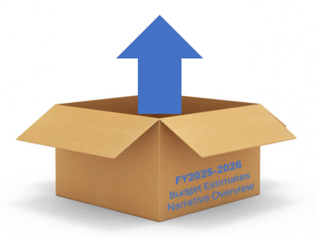
Let’s UNPACK the
FY2025-2026 Budget Estimates Narrative Overview…
I Workstation Security | No change to prior year The IRS Publication 1075, Tax Information Security Guidelines for Federal, State and Local Agencies notes: "The agency must scan for vulnerabilities in the information system and hosted applications at a minimum of monthly for all systems and when new vulnerabilities potentially affecting the system/applications are identified and reported" (Section 9.3.14.3(a)). Please be aware that this requirement applies to all programs, workstations, and systems with access to FTI, not only Child Support.

Slide 23
II Enhanced 75/25 Medicaid Administration Funding
 | Beginning the September 2022 service month (claimed and reimbursed in October 2022), NCDHHS implemented changes to the NC CoReLS system and claiming processes for local DSS agencies. These changes involved standardizing the reporting of job classifications and the monthly reclassification of certain expenditures from 75/25 to 50/50. CMS continues to engage DHHS in review of our process as well as doing local county site visits in the fall of 2024. At this point, we have no additional information to share.

Slide 24
III Economic & Family Services
The Work Number | Management of this contract has been moved from the Division of Social Services to the Division of Health Benefits (DHB). A new, annual contract was executed by DHB, with the current contract expiring November 1, 2025. Medicaid costs are covered at 100% by a combination of federal and state funding. Counties are responsible for the nonfederal share for other economic services programs and will be invoiced by DHB. Note: county share has not been drafted since 10/2022.
Notes:
We are hearing that Work Number charges will be back to July 2024, although we have not received official correspondence in writing.

Slide 25
IV Child Welfare
Family First Prevention Services Act (FFPSA) of 2018 | Changes anticipated in SFY 2024 into SFY 2025 will enable counties to increase IV-E reimbursement for case management costs for candidates for foster care. Changes: Increased IV-E reimbursement rate will become available to candidates for foster care receiving in-home services and who are receiving Homebuilders services. Because all candidates for foster care receiving an EBP service under the state’s approved Title IV-E Prevention Services Plan are IV-E eligible under FFPSA, the IV-E penetration rate will not be applied to administrative claims for these children. New procedures for counties to determine foster care candidacy during a CPS Assessment. More details on new protocols for determining candidacy for foster care will be provided as those protocols are ready for implementation.
Notes:
EBP = Evidence Based Programs

Slide 26
IV Child Welfare (continued)
Congregate Care Bridge Funding | NCDHHS is assessing potential options, but cannot confirm whether there will be any funding available at this time.
Kinship Care Reimbursement | Rate based on half of the standard foster care board rate (effective November 16, 2023). 50% State/50% County Share.
Emergency Placement Fund | Funds allocated to assist county departments of social services in preventing children from staying in the DSS office while awaiting an appropriate Medicaid leveled treatment placement. 1571 Part II Identified practices which can be supported with these funds are in DCDL CWS-08-2024 and CWS-73-2024.
Notes:
Identified practices:
Maintaining experienced foster families on retainer to provide temporary emergency placement until a treatment placement can be located.
Providing short-term rate increases to placement providers who can meet the needs of children who require an exceptional level of supervision.
Implementing individual local solutions (approved on case by case) that prevent a child in DSS custody from spending a night in the DSS offices.

Slide 27
IV Child Welfare (continued)
FMAP | The FMAP rate is used to determine the federal share for Title IV-E funding for foster care maintenance, adoption assistance, and guardianship assistance. Effective October 2024, the regular FMAP is 65.06%, and changes in October 2025 are expected to be minimal.
Child Welfare Information System | The new system is called PATH NC (Partnership and Technology Hub for NC). Module implementation plans anticipated for: SFY 2024-25 – Intake and Assessment Modules SFY 2025-26 – Ongoing Case Management Modules Counties should expect involvement in the Readiness, Training, and Implementation process for about 3.5 months during SFY 2024-2025 and the beginning of SFY 2025-2026.
Notes:
PATH NC = Partnership and Technology Hub for North Carolina
Does your county use a case management system in child welfare other than CWIS/PATH NC? NCDHHS has implemented a statewide child welfare solution, PATH NC, and this system may contain components that could be considered duplicative of some or all functionality that a county purchased system provides. When ADP is duplicative, costs are not approved for reimbursement and become a county expense.

Slide 28
V Child Support
IRS Background Investigation | For those counties who conducted their criminal background checks for all staff in SFY 2020-2021, the five-year requirement for redoing the check will be in SFY 2025-2026. Cost estimate is $24 per employee + fees charged by local sheriff’s department.
Genetic Testing | The State maintains an umbrella contract with a paternity testing vendor and counties benefit from the negotiated state rate. Current contracted rate of sample collection cost if conducted by LabCorp is $42 per person; if by certified child support staff is $21 per person. County offices may choose to have individual contracts to perform paternity testing for child support purposes.
Offset – IV-D Incentive | No change
Notes:
Background – Cost is estimated at $24.00 per employee plus any additional fees charged by the agency’s local sheriff’s department for fingerprinting costs associated with background check testing. Counties are billed (drafted?) 34% for the background fee, so this is not reimbursable. Fees charged to agency by local sheriff’s department for fingerprinting are reimbursable.
Genetic Testing – Counties are billed directly by vendor. Current contract ends April 5, 2028.

Slide 29
VI Adult Services
Guardianship Services | No change – same allocation as received SFY 2024-25
State-County Special Assistance | Special Assistance rates will be adjusted each January 1 using the federally approved Social Security cost-of-living change (if any) effective for the applicable year. Effective January 1, 2025: The monthly Basic Rate shall be $1,359, and the SA Basic Maintenance Amount shall be $1,429. The monthly Enhanced Rate (previously known as the Special Care Unit Rate) shall be $1,743, and the SA Enhanced Maintenance Amount shall be $1,813. Counties should budget for increased county share. Counties receive notification of monthly drafts via EFT Notices.

Slide 30
VI Adult Services (continued)
Adult Protective Services | No change – estimates remain at the 2024-2025 level 1571 Part II – program codes J and PSX
Adult Protective Services Essential Services Fund | Funding ended on June 30, 2024 - no funding available for the APS Essential Services Fund beyond this date
State Adult Day Care Fund | No change – estimates remain at the 2023-2024 level 1571 Part IV expense
State In Home Fund | No change – estimates remain at the 2024-2025 level 1571 Part I, II, or IV – program codes B, C, I
Adult Home Specialist Fund | No change – estimates remain at the 2024-2025 level 1571 Part I – program code O (alpha)

Slide 31
VII Subsidized Child Care Assistance Program
Estimates are based on county allocations as of January 1, 2025, minus any allocated Title IV-E (Foster Care) funding earned by the county. Previous language referencing allowing counties spending at least 92% of their previous year’s allocation to be eligible to receive at least their ending allocation amount plus any additional available funds was removed in NC Session Law 2021-180/Senate Bill 105. All carryforward funds, except for up to 2% of the available funds for preventing termination of services throughout the state fiscal year and repayment of any federal funds per Session Law 2023-134, Section 9D.4.(a)(2), will be available for allocation to all counties based on potential eligible children per the American Community Survey and average cost for services by county in SFY 2023-24 based on their final expenses amounts.

Slide 32
VIII Medicaid
Continuous Coverage Unwinding | SFY 2023-2024 advancement only – No funds will be provided for SFY 2025-2026.
Medicaid Expansion | Funding is expected to be available for each month that expansion is effective. Funds will be allocated to counties on a quarterly basis.
Medicaid Managed Care | The Children and Families Specialty Plan (CFSP), a statewide health plan for foster children, former foster children, and their families, will launch on December 1, 2025. Prior to launch, training will be provided on CFSP to county staff to facilitate the transition and county readiness to implement CFSP will be assessed. County Departments of Social Services may experience an increase in calls and inquiries.

Slide 33
v
IX Food and Nutrition Services (FNS) | Effective June 1, 2024, the FNS administrative waiver that waives eligibility interview of all mandatory verifications are completed will end. Therefore, on June 1, 2024, eligibility staff will be required to conduct interviews for all applications and recertifications. Counties should expect additional time for application and recertification processing. NCDHHS in partnership with NC Department of Public Instruction (DPI), is expanding its food assistance efforts to become one of the first states to administer USDA’s new, permanent summer nutrition program, “SUN Bucks.” NCDHHS will issue three months of benefits at $40 per month ($120 in total) per eligible child, which can be used to purchase nutritious food. There will not be a cost to counties to administer the program; however, counties may experience an increase in calls and inquiries.
Notes:
Counties will see increased costs on their budget estimates for Food and Nutrition services based on increased numbers of FNS recipients enrolled in the program as a result of lingering impact of COVID on the economy, ongoing food insecurities, and Medicaid expansion.

Slide 34
X County Administration Reimbursement System (CARS) – Replacement Project
NC DHHS is actively engaged in the CARS/NC-CoReLS (1571) replacement system project. All state and federal partners were consulted and approved move forward and to release an RFP. Proposals have been received from prospective vendors and the DHHS team is currently reviewing those. Counties will shortly be engaged as critical stakeholders in the project. The new system is projected to go live mid to late 2027.
FY2025-2026
Budget Estimates
Narrative Overview

Slide 35
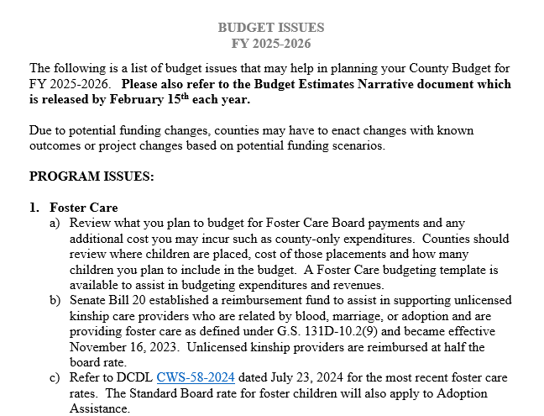
Budget Issues Document
Notes:
We are in the midst of budget season. Some of you may even be completed with our budget as some County Management teams require budgets early. Others will allow time for DSS to receive budget estimates which are released by February 15th annually – which were just released February 13th.
Here are a few key budget issues for to consider for the upcoming year. We included the handout with your materials for today’s meeting.

Slide 36
?
?
QUESTIONS
?
?
?

Slide 37
Trust Accounts
Resources
SSA Payee Website
https://www.ssa.gov/payee/
Phone: 800-772-1213
Guide for Organizational Representative Payees
https://www.ssa.gov/payee/documents/2024OrgGuide.pdf

Slide 38
Suggestions/Helpful Hints
You should have a policy and procedures in place for trust accounts that include a declaration of responsibilities for all agency staff involved with trust accounts.
Finance should be where all SSA correspondence is addressed too. It should never be addressed to social workers.
Trust fund financial information including bank account information for the accounts used for trust accounts should be kept by finance and given to SSA by finance.
Make a contact at your closest local office. Get their phone extension!
Reconcile the bank statements for the accounts monthly.
Keep a spreadsheet of all beneficiaries including names, social security numbers and date of birth. You will need this information any time you have to contact SSA.

Slide 39
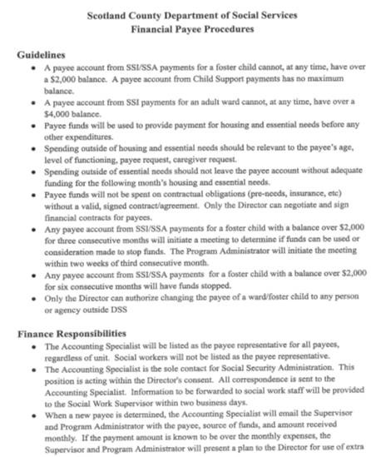
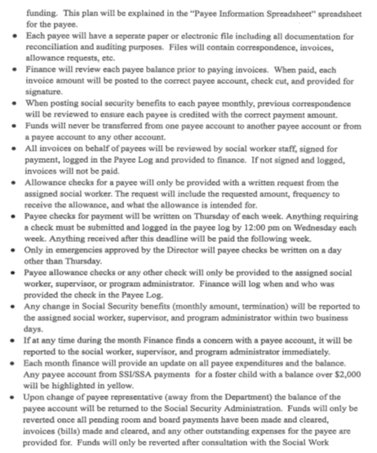
Procedure Example

Slide 40
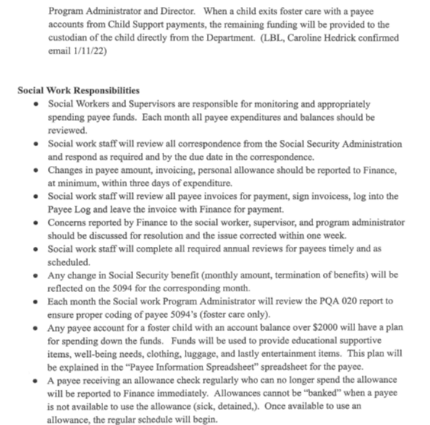
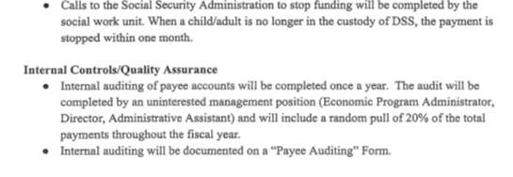
Procedure Example (continued)

Slide 41
MUSTS and MUST NOTS
You MUST have a separate collective savings or checking account for trust account funds. They can NOT be deposited into or operated from the county’s bank account.
You MUST have a separate dedicated account for large back payments. There are restrictions on how funds in a dedicated account can be used.
Dedicated accounts funds can only be used for:
Medical treatment for the beneficiary
Education or job skills training for the beneficiary
Expenses related to the beneficiary’s impairment(s), personal needs assistance, special equipment, housing modification, and therapy or rehabilitation
Other items or services related to the beneficiary’s impairment(s) that SSA determines appropriate.
Dedicated account funds can NOT be used for food, housing, clothing, personal items or to repay any SSI overpayments.

Slide 42
MUSTS and MUST NOTS (continued)
You MUST keep separate records, for each beneficiary for whom you are payee, for at least 2 years. You must keep records of all payments made to you, all bank statements, and receipts or cancelled checks for rent, utilities, and any major purchases made for the beneficiary.
For example, if you withdraw $100 from the beneficiary’s account and buy an $80 item, then there must be a receipt for the $80 and a record reflecting the disposition of the remaining $20
You MUST return any overpayments promptly.
You MUST submit a Representative Payee Report (form SSA-6234) for each beneficiary each year.

Slide 43
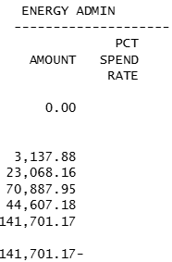
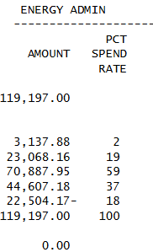
Negative Check Adjustments
This occurs when funding authorizations are not loaded into the XS411 report due to state budget delays.
Counties are reimbursed for expenditures over capped allocations until the funds are allocated.
When funding is entered into the XS411, the state must recoup the amount reimbursed over the allocation.
This county has overspent its Energy Admin funding by $22,504.17

Slide 44
Negative Check Adjustments (continued)
These adjustments are shown on the XS335 report with **, which denotes state office manual adjustments.
The $22,504.17 for prior months plus Energy Admin overspending for the current month will show in this entry.
Depending on the total amount of overspending, the county may receive a reduced or no reimbursement from expenditures claimed on the 1571.

Slide 45
Medicaid Expansion Funding
Ongoing funding for Medicaid Expansion
Extra state revenue for staffing expenses due to for Medicaid Expansion.
Initial ‘supplanting’ of budgeted expenditures removed from guidelines – ALL Medicaid staff may code to these funds.
MIX is for Family & Children’s and MAE is for Adult Medicaid
Used for staff coding, equipment for Medicaid Staff. (Equipment must request to and be approved to direct charge and must be used exclusively by Medicaid staff and tracked.)
E&E allowable expenditures (staff who do not key daysheets, overhead) will cost allocate to these funds.
Reimbursed through the 1571 process.

Slide 46
Medicaid Expansion Funding (continued)
Quarterly Allocation –
XS411 “MED EXP” XS335 – State Portion is capped allocation on XS411

Slide 47
Medicaid Expansion Funding (continued)
MAE/MIX to and from Medicaid Codes are an allowable
administrative coding shift
Please do not wait until
year-end to draw these funds

Slide 48
Reclass Letters / Adjustments

Slide 49
PATH NC Implementation
What is PATH NC? open
NCDHHS will begin implementation of PATH NC for Intake and Assessment modules beginning in Spring 2025 with Ongoing Case Management functionalities to follow.
Related DCDLs:
1/10/2025 CWS-03-2025 PATH NC Pre-Readiness Survey Attachment 1 - PATH NC Champion Overview Attachment 2 - PATH NC County IT Requirements
1/17/2025 CWS-05-2025 Updated PATH NC Implementation Timeline in Response to Hurricane Helene Recovery Efforts - Time Sensitive Attachment - PATH NC Intake and Assessment Rollout Groups

Slide 50
Indirect Cost Plan
Plans are due no later than 4/15/25 (Cost Allocation Plan for Fiscal Year Ended 2023 which contains indirect costs for FY2025)
Original cover letter, Schedule A, and Roll Forward Computation mailed to Controllers’ Office
May also email documents, however, original signed cover letter must be mailed
If not received, counties must back out all indirect costs claimed
Make sure your preparer is breaking down costs to 310 & 804 and review what is in the plan for these costs

Slide 51
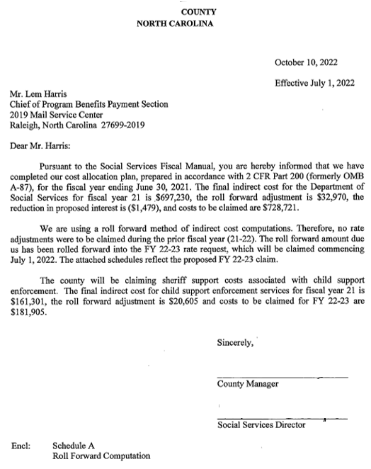
Sample Cover Letter
On County Letterhead
Signed by County Manager & DSS Director
Include Schedule A and Roll Forward Computation

Slide 52
Sample Cover Letter
Date of Letter and Effective Date
Mail Original to:
Make sure this date is correct

Slide 53
FNS E&T Program Rebranding
The E & T (Employment & Training) Program has rebranded and is now the MTAJ-NC (More Than A Job – NC) Program.
Program web page is linked here.

Slide 54
Maintenance of Effort (MOE)
Counties must meet MOE to draw the federal portion of the block grant
MOE amounts have remained the same since the block grant was established in 1996-1997.
General Statute: NCGS 108-A
Each standard county shall maintain funding in Work First, child welfare, and related activities as defined by the Department at one hundred percent (100%) of the county funds budgeted in State Fiscal Year 1996-97 for AFDC Administration, JOBS employment and training, and AFDC Emergency Assistance (cash and services).
Provides funding for several initiatives…Employment Services, Child Welfare, and Childcare.

Slide 55
Where to find amounts…..
County Budget Estimate
TANF
MOE

Slide 56
When to meet your MOE
Have a plan…
Never wait until the 12th month (which is MAY service month reported in June)
Monitor your TANF to make sure you are not overspending each quarter (and if you are – could some of those cases be coded to MOE?)
If you have met your MOE and you still have TANF dollars you may want to have discussions with your LBL regarding other opportunities to pull down these funds, for example, TEA-FC

Slide 57
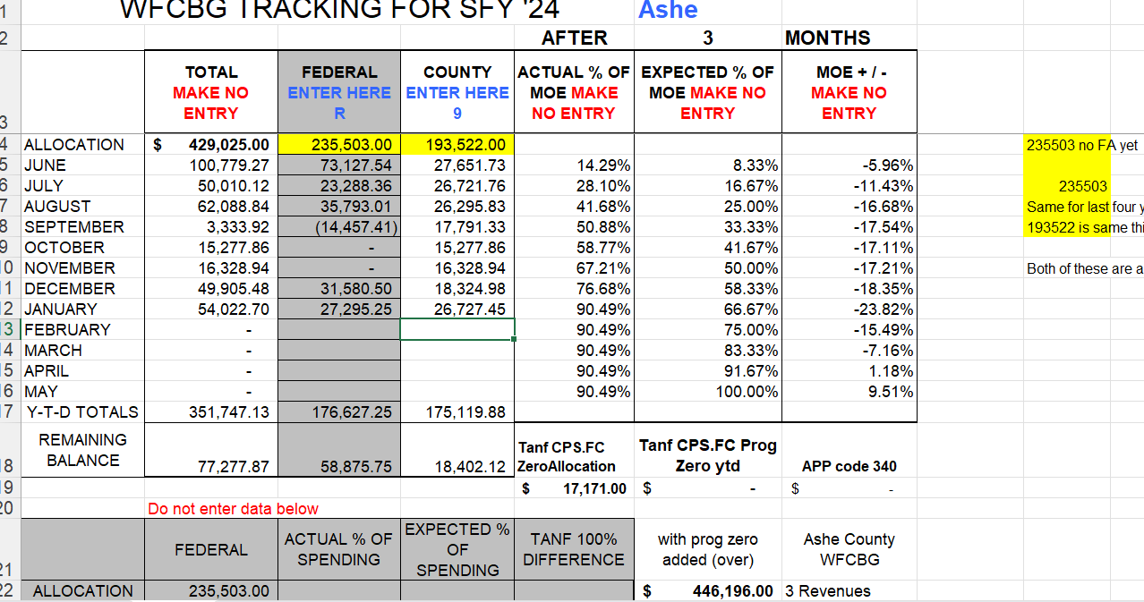
Tracking your MOE

Slide 58
CARS Replacement Project Update
Goals is to replace County Administrative Reimbursement System (CARS) and Day Sheets
Shift from 100% time reporting to Random Moment Time Sampling (RMTS) or RMTS/direct-time reporting hybrid
Statewide solution
Currently the state is evaluating vendor proposals
County engagement will begin in Summer/Fall
Go live date estimated Spring 2027

Slide 60
?
?
QUESTIONS
?
?
?

Slide 61
Budget Template Training

Slide 62
Prepare by Gathering Data
Salary and benefits for employees
Past History of Expenditures from your general ledger
Equipment (new staff or future planning)
Contracts
Projects
Individual Unit Needs
Budget estimates
AVG Percentage of Time Report from NC CoReLs
State XS337
WHATEVER YOU FEEL IS NECESSARY TO COMPLETE YOUR BUDGET

Slide 63
ADVICE FROM REGION 7’S DIRECTOR
BRANDY MANN

Slide 64
A FEW THINGS TO REMEMBER
You can only key data in the BLUE areas.
Part-time employee’s FTE = .5; Full time = 1
If part-time employee DOES NOT use county insurance, change insurance months to 13.
When grouping employees together, change the FTE, add salaries together, add percentage of time together and change insurance months.
Use fully qualified salary for “Work Against” employees.
For split employees, split the benefits to 6 each.
When keying employees, click CLOSE. Avoid hitting enter.
If you unprotect a worksheet, please go back and protect the sheet.
Keep an eye on the Error Indicator on the Total Revenues page
SAVE, SAVE, SAVE!!!

Slide 65
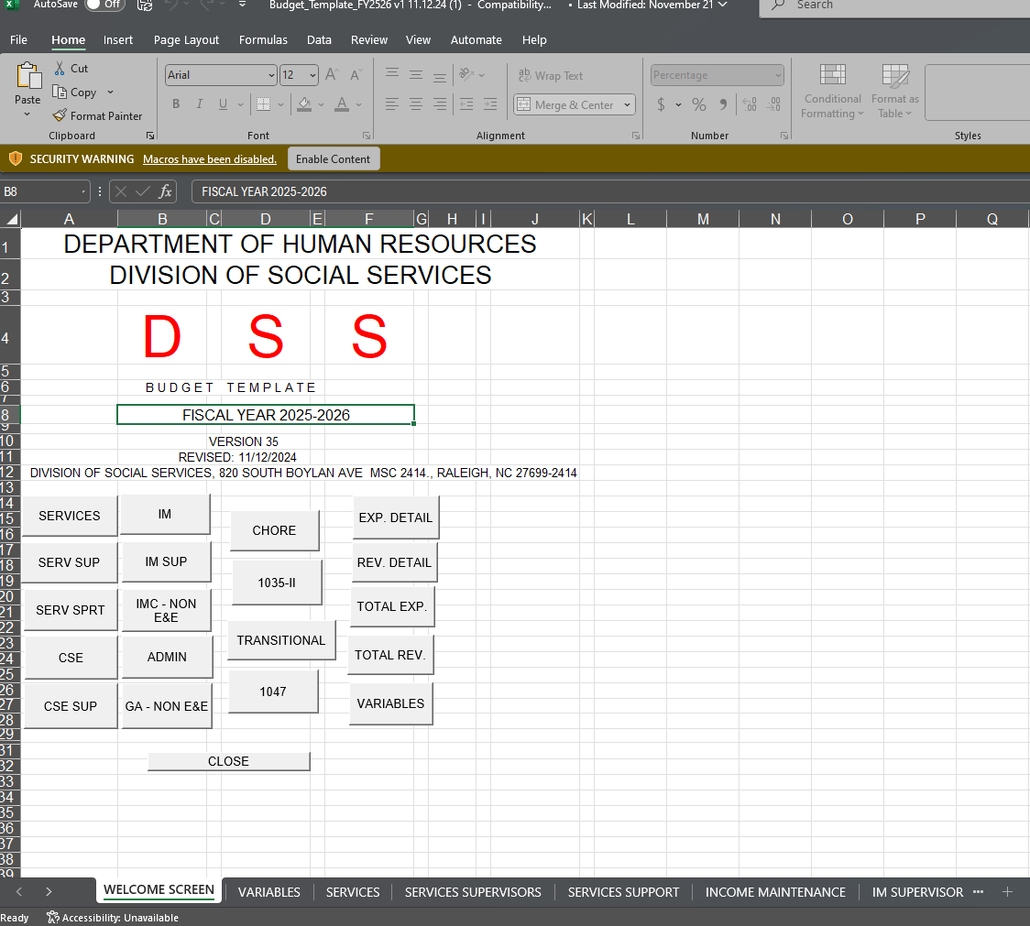

Slide 66
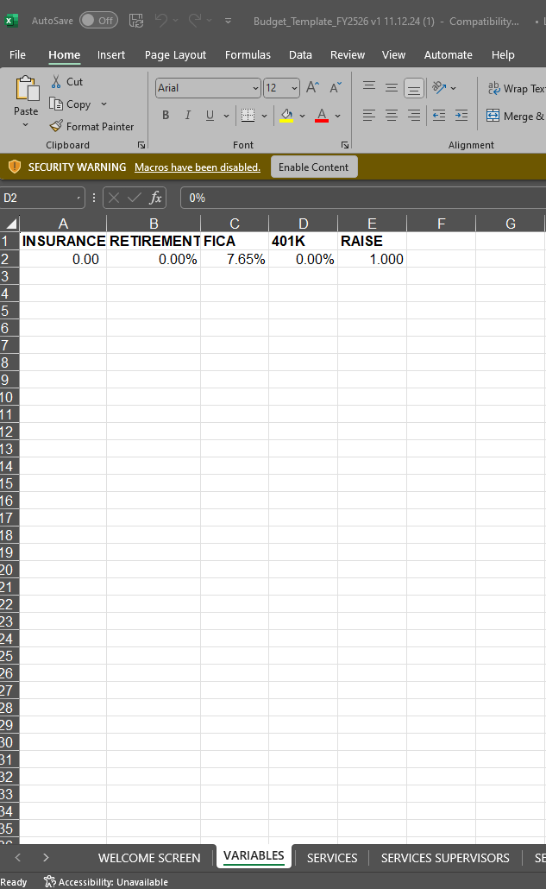
VARIABLES
Must unprotect to key numbers on this page.
In A2 - Key monthly county cost of health insurance.
In B2 – Key your county’s rate of retirement
In C2 – FICA is 7.65%
In D2 – Key your county’s match of 401k
In E2 - 1 = No Raise. If you are budgeting a 5% raise, then key 1.05

Slide 67
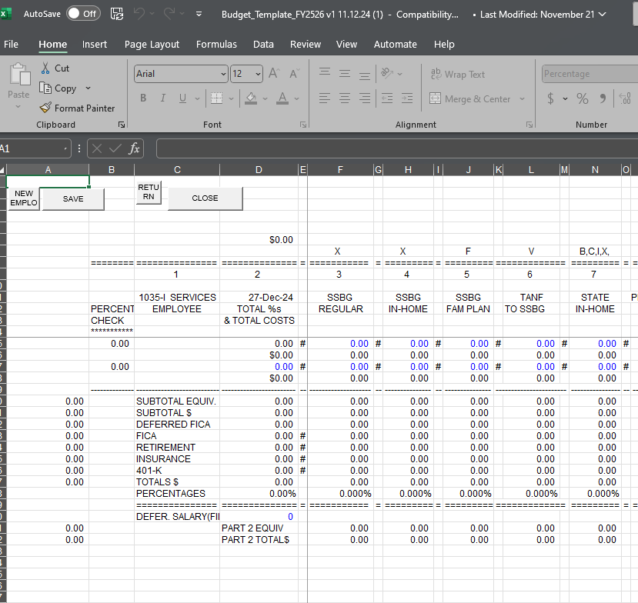
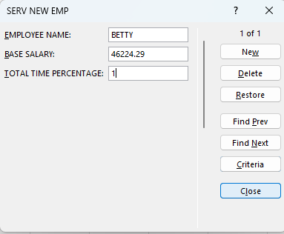
Services
Let’s key in Betty’s info
Employee | Job Title | Salary Total | FTE | Fund
Betty | SW II | $ 46,224.29 | 0.25 | L
 |  |  | 0.25 | O
 |  |  | 0.25 | V
 |  |  | 0.25 | R
Click on New Employee on the left corner
Next, key in Employee’s info and click Close.

Slide 68
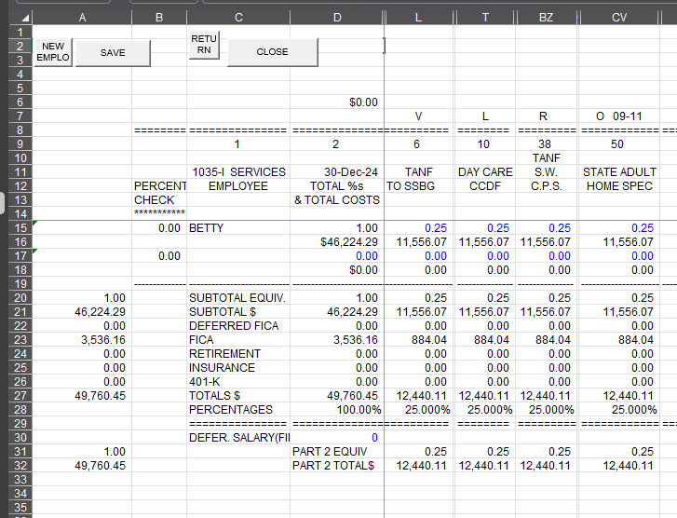
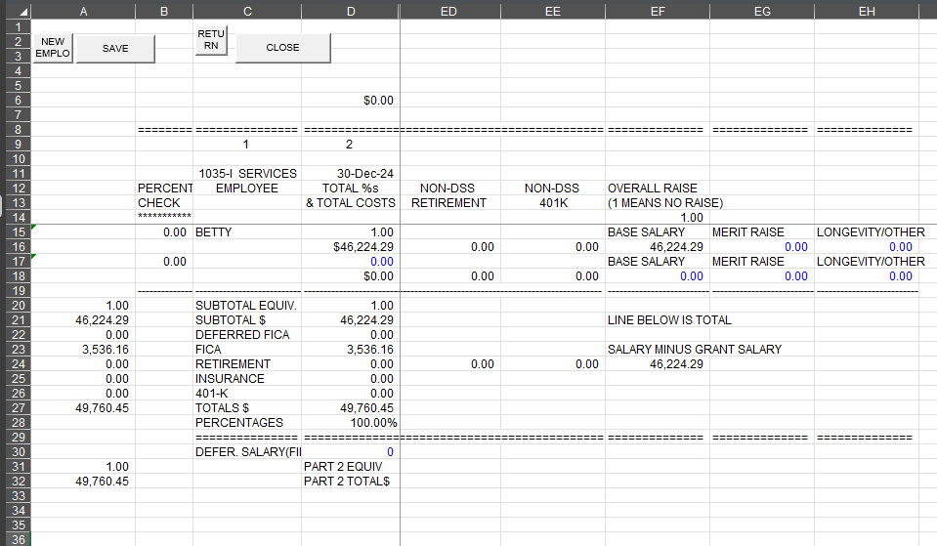
Services cont…..
Employee | Job Title | Salary Total | FTE | Fund
Betty | SW II | $ 46,224.29 | 0.25 | L
 |  |  | 0.25 | O
 |  |  | 0.25 | V
 |  |  | 0.25 | R
Now, enter the percentage of time the worker codes. There should be a ‘0’ under Percent Check beside the workers name to display that you have 100% time reporting.
Scroll over to see salary, longevity, merit raise.

Slide 69
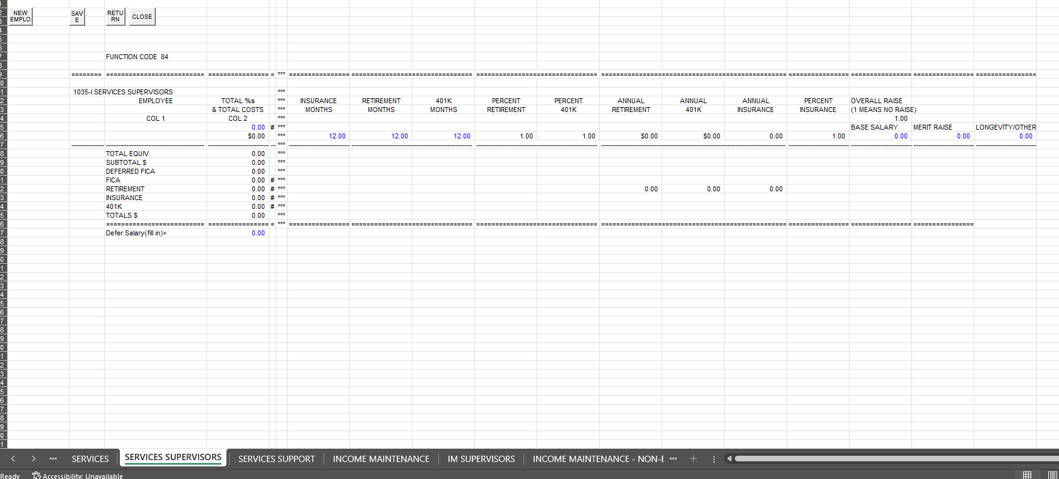
Services Supervisor
All you do is enter the data:
Employee’s Name
Salary
FTE

Slide 70
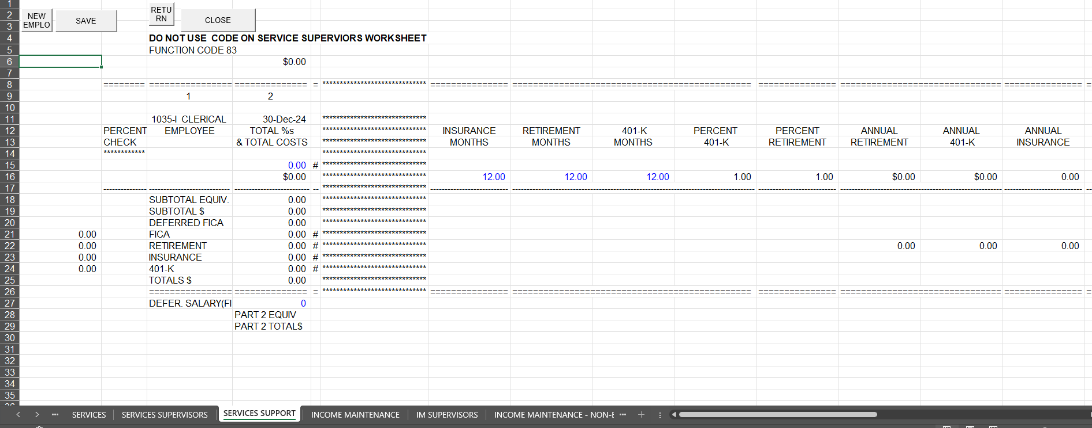
Services Support
Clerical Workers that DOES NOT do a Daysheet or key 5097’s will go on this page.

Slide 71
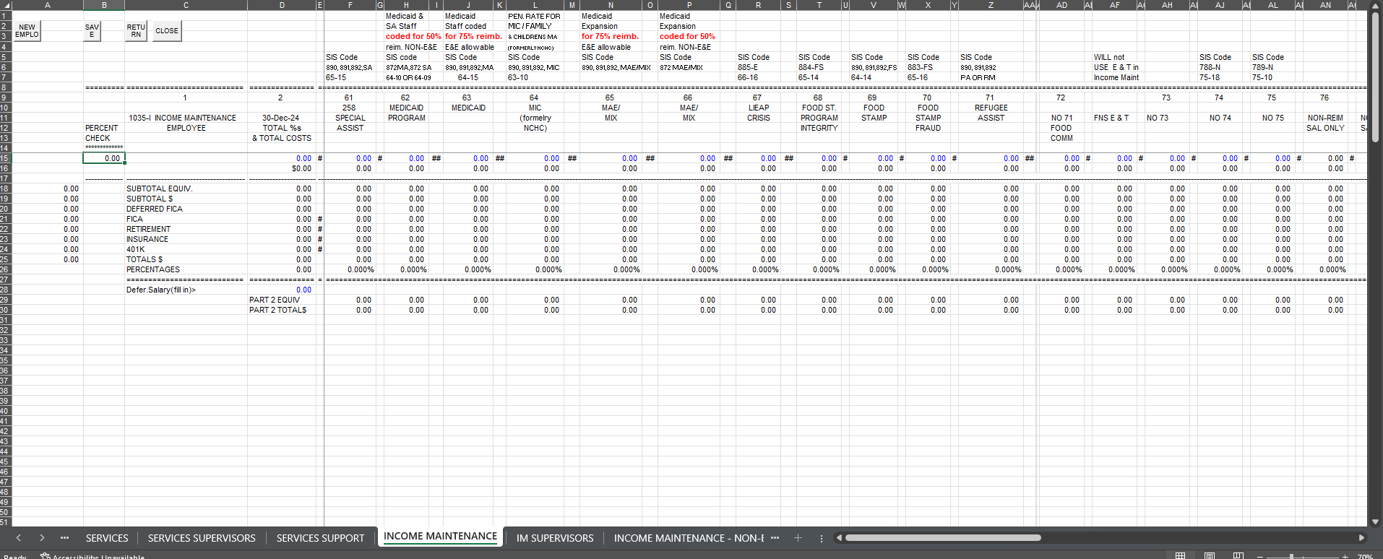
Income Maintenance
There are many different funding sources such as: MIC1, PI, QA, FNS, LIEAP, Fraud, etc.

Slide 72
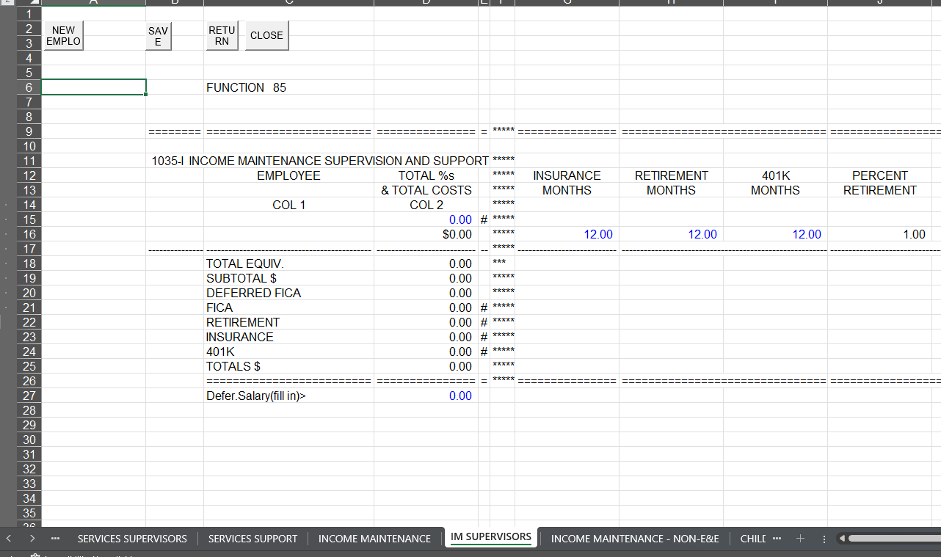
IM Supervisors
E & E Supervisors go on this page.

Slide 73
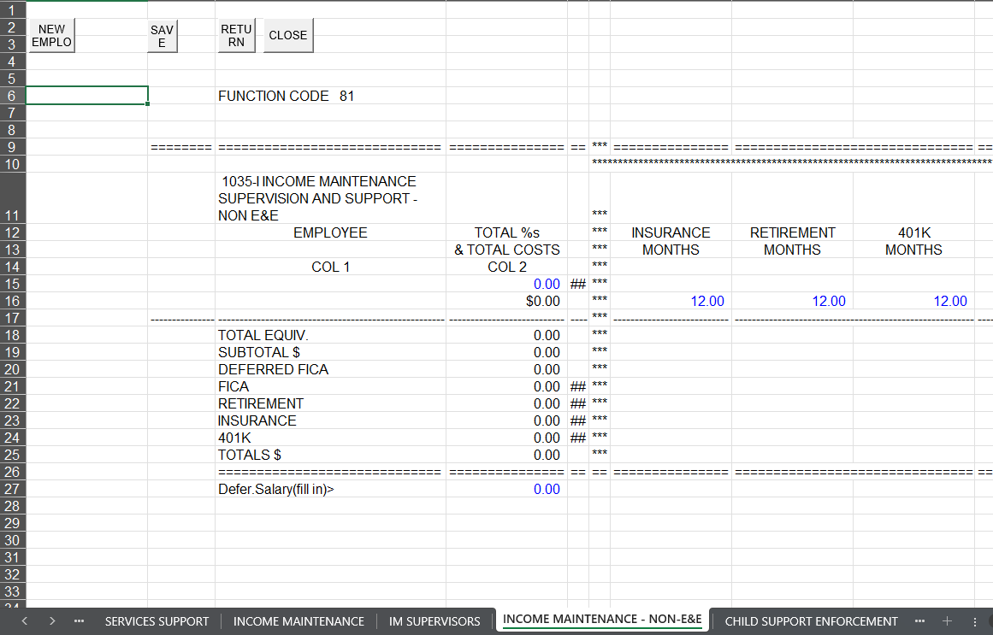
Income Maintenance Non-E&E
ONLY Supervisors are entered on this page.
For example, Energy Supervisor and Program Integrity Supervisors.

Slide 74
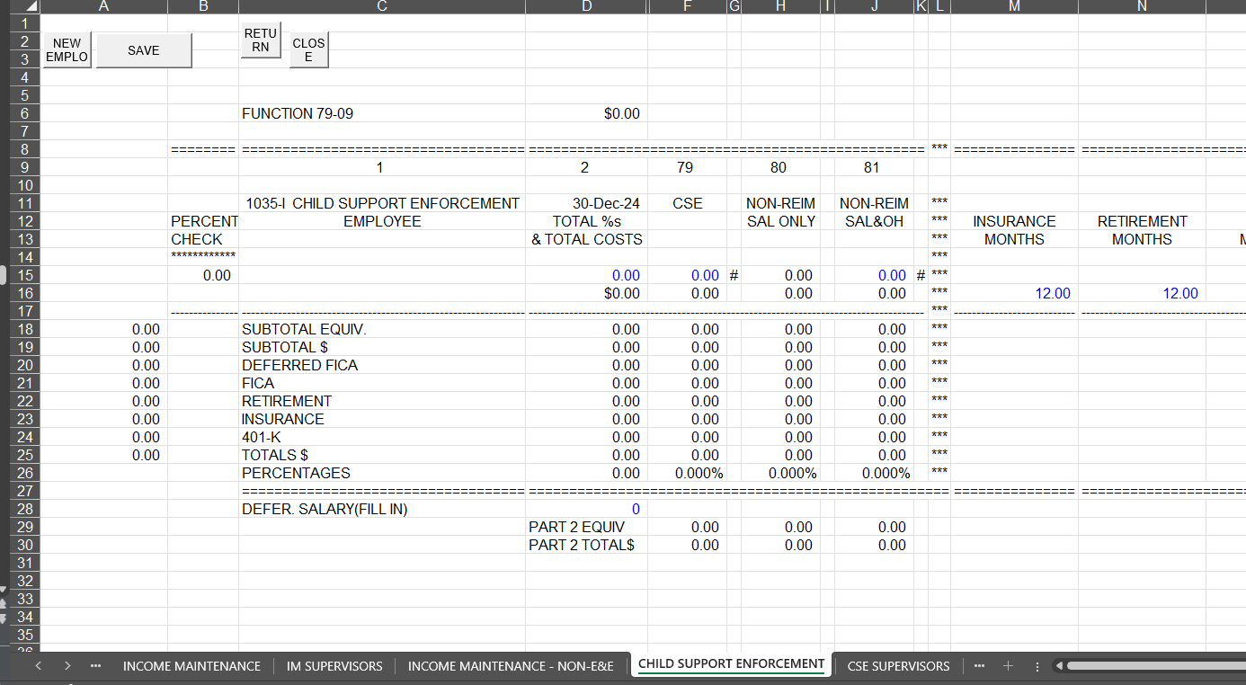
Child Support Enforcement
CSE workers are entered on this page. All you are doing after you enter the employee’s name, salary and FTE is assigning the Effort under CSE.

Slide 75
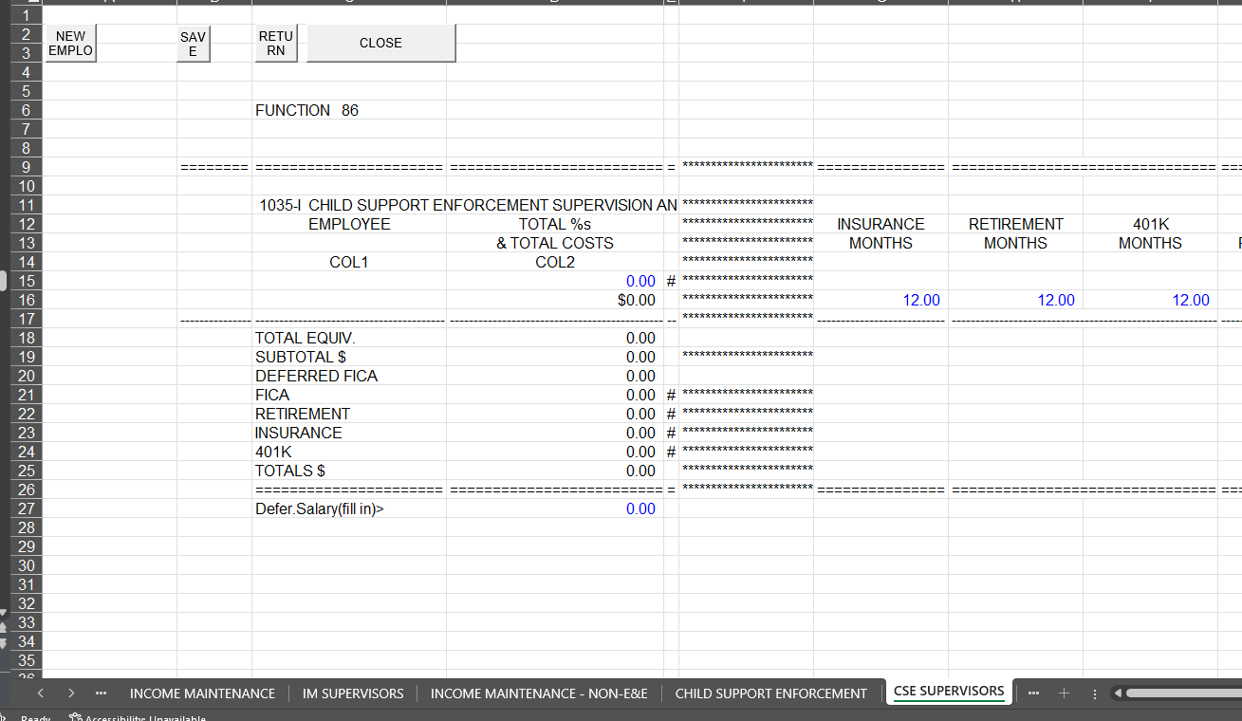
CSE Supervisors

Slide 76
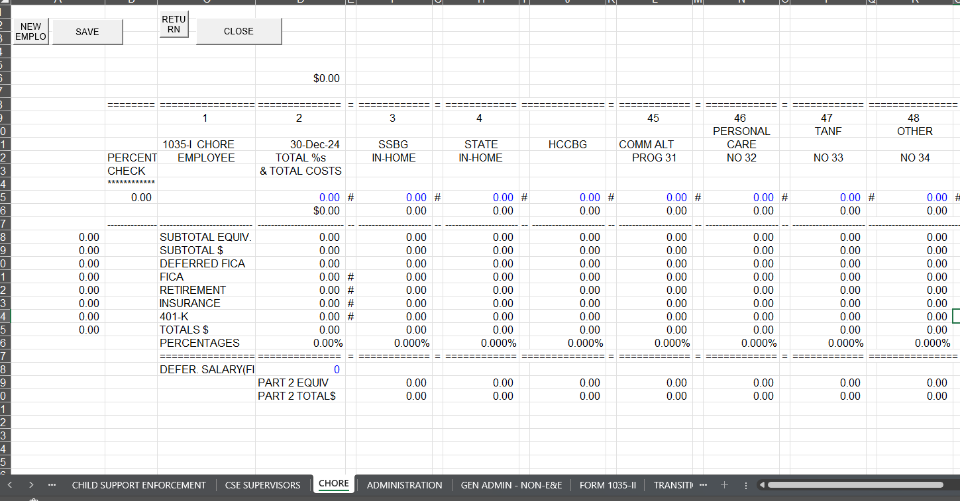
CHORE
In Home Aid workers that are DSS employees go on this page.

Slide 77
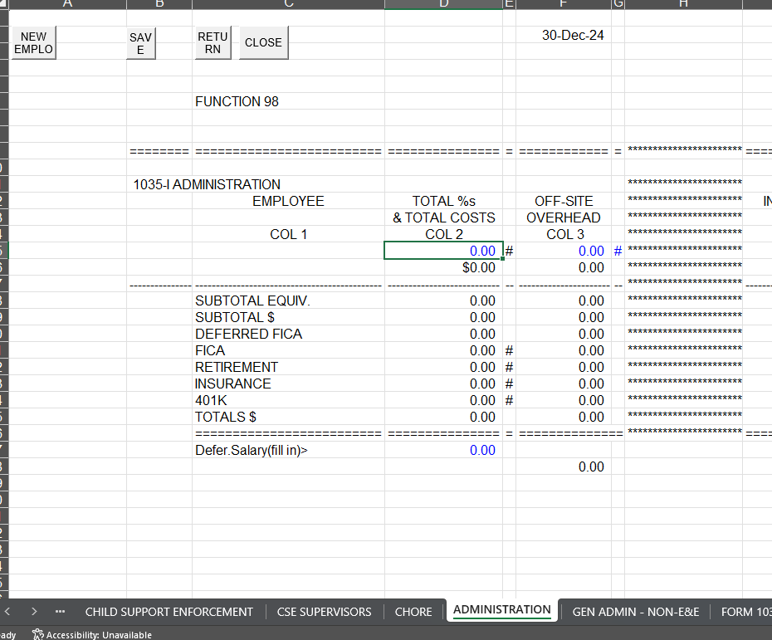
ADMINISTRATION
Directors
Front Desk workers that touches MA (E&E allowable)

Slide 78
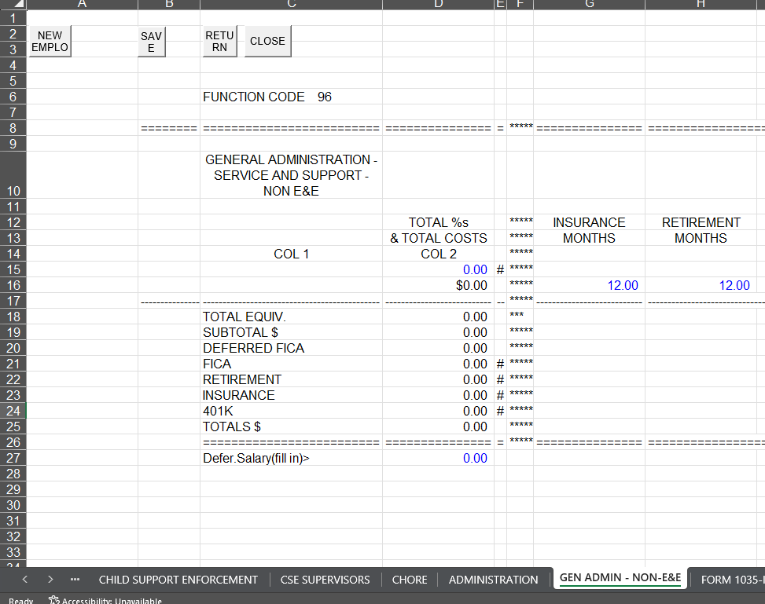
Gen Admin – NON- E&E
Workers with NO NC Fast access are entered on this page. For example,
Trust Account Workers
Payroll Workers
Accounting Workers
Admin Assistant to Director

Slide 79
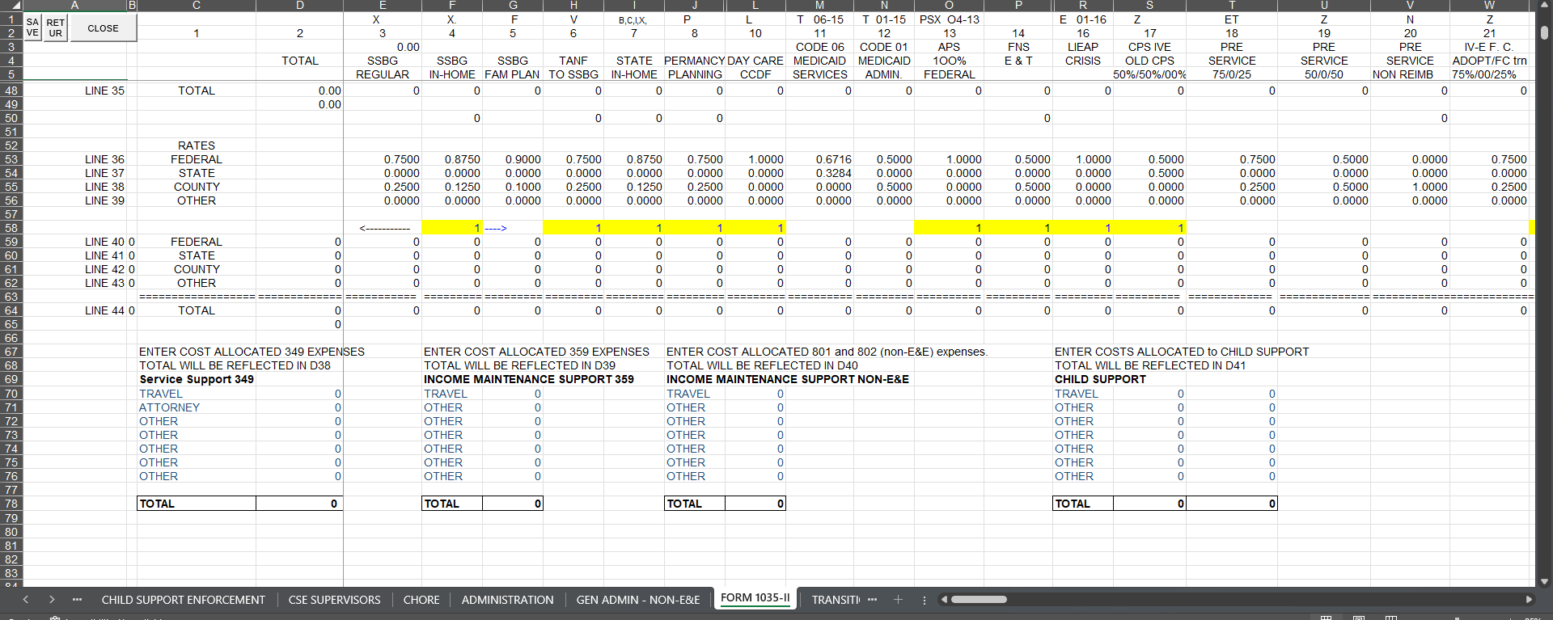
FORM 1035-II
In the yellow highlighted section, use your Budget Estimates to key Federal or State estimates. Leave the 1 if you don’t have an allocation. Overspending is shown in Line 42 (row 61).
At the very bottom of this page, use your general ledger to enter the Part II costs that are allocated to specific expenses to services.

Slide 80
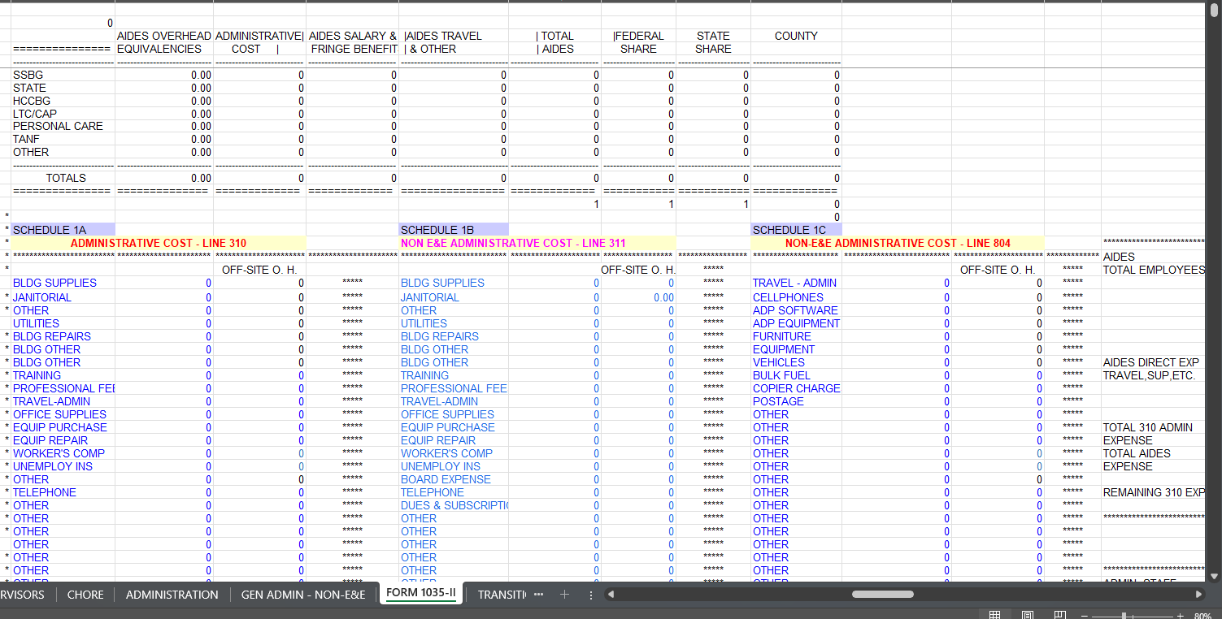
FORM 1035-11 cont…
310 – Costs allocated across the entire agency. Ex: some office equipment, IDC plan
311 – Indirect costs for the agency but doesn’t benefit clients. Ex: board payments, NCACDSS dues
804 – NON-E&E Allowable costs. Ex: postages, registration fees for training, admin travel

Slide 81
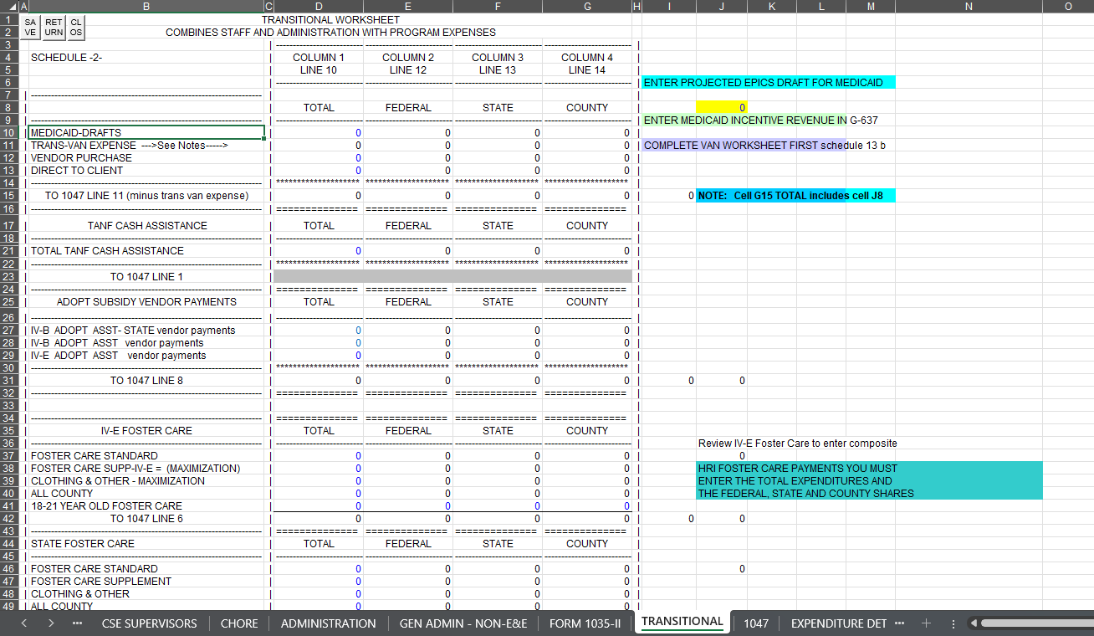
Transitional
Use GL and Budget estimates
Program related costs

Slide 82
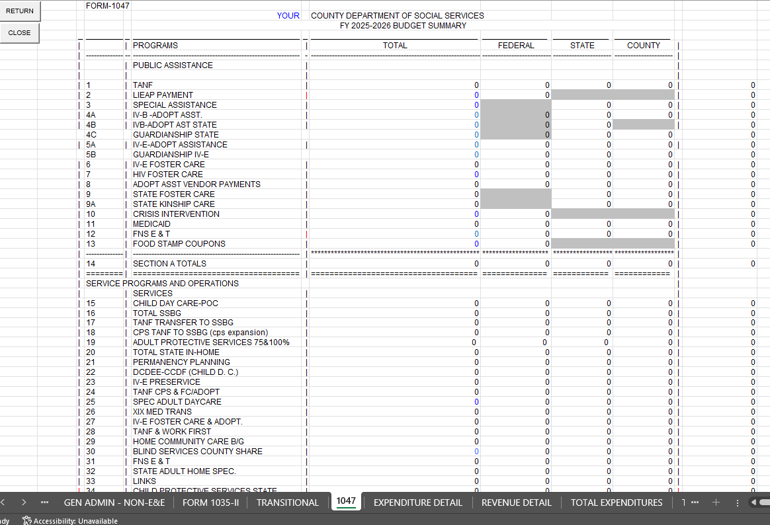
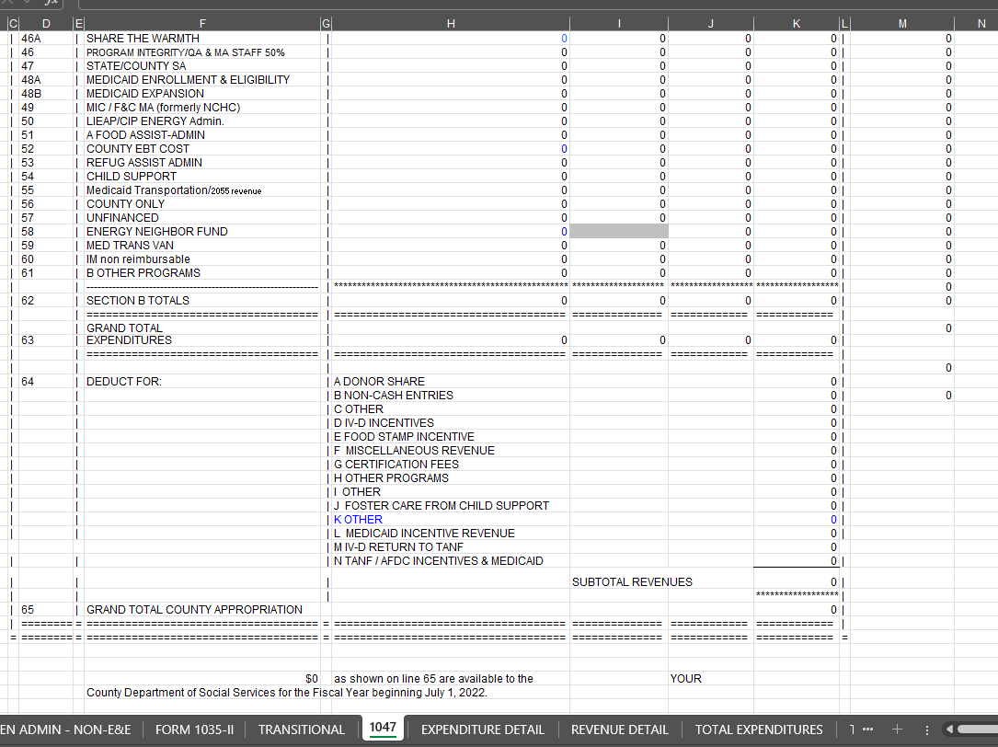
1047 - Everything totaled together to show federal, state, and county budget summary. Provides a breakdown.

Slide 83
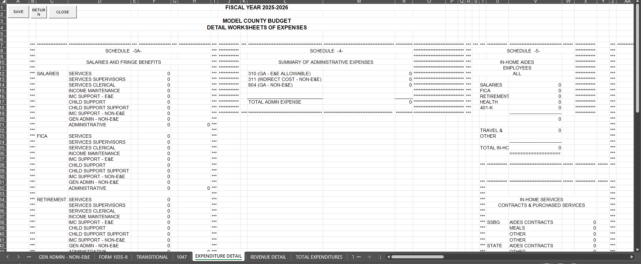
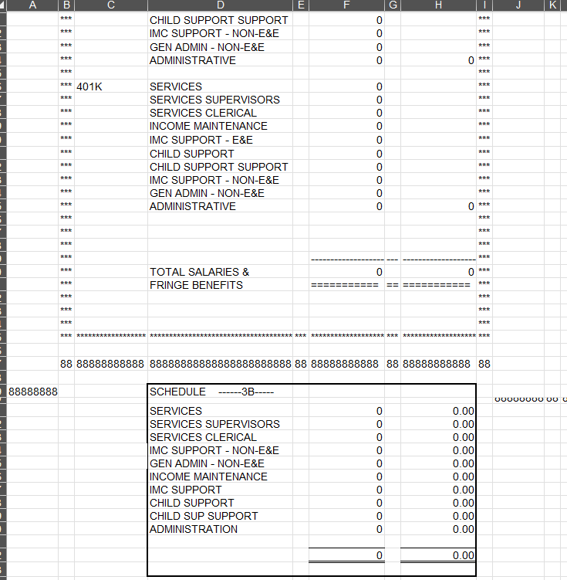
Expenditure Detail - Provides your county amounts you are requesting.
FYI: Check FTE’s on Line 92 to ensure you have all your positions on the template.

Slide 84
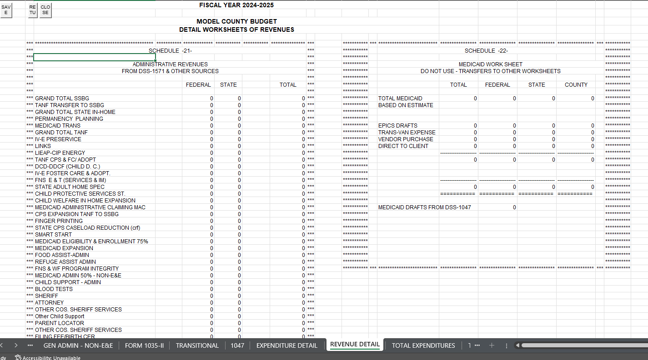
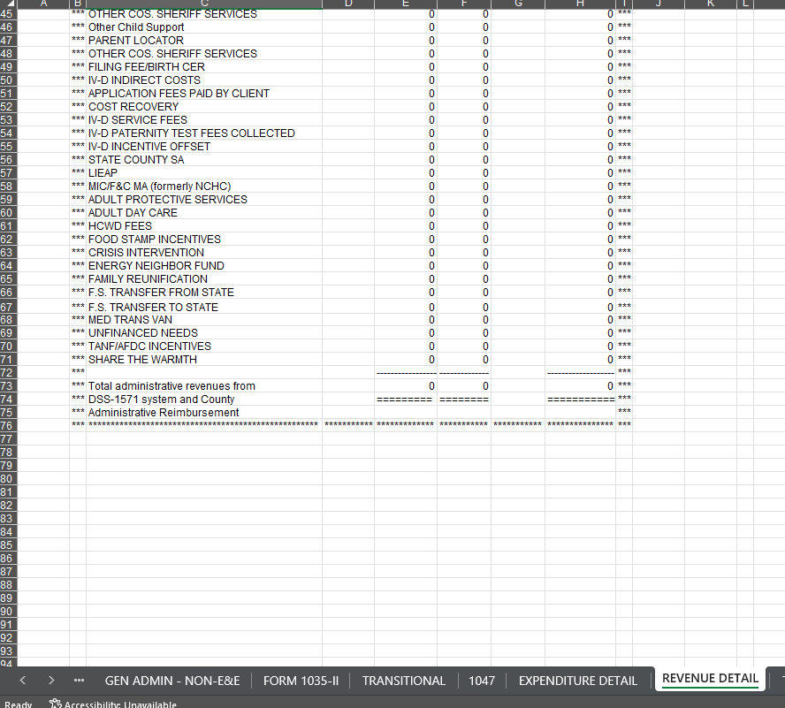
Revenue Detail Page - Shows what parts are federal and state along with all your administrative revenues. Then gives you a bottom line.

Slide 85
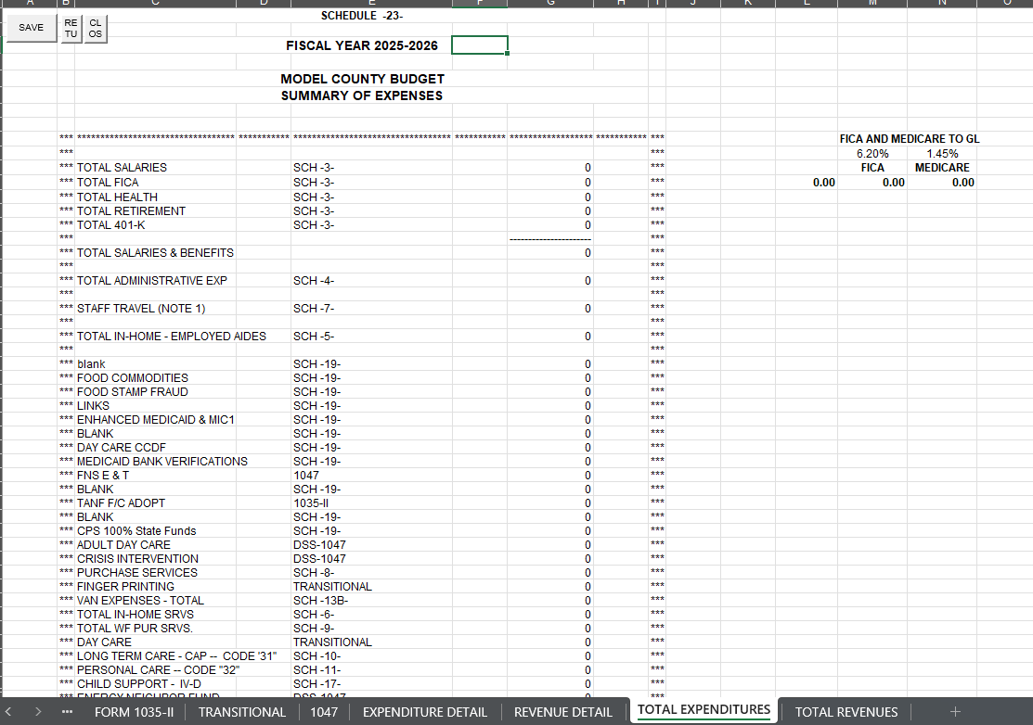
Total Expenditures
What does your county plan to spend?

Slide 86
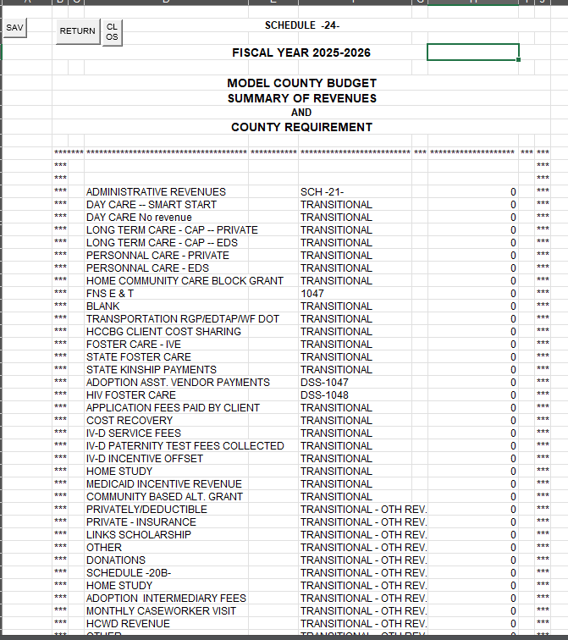
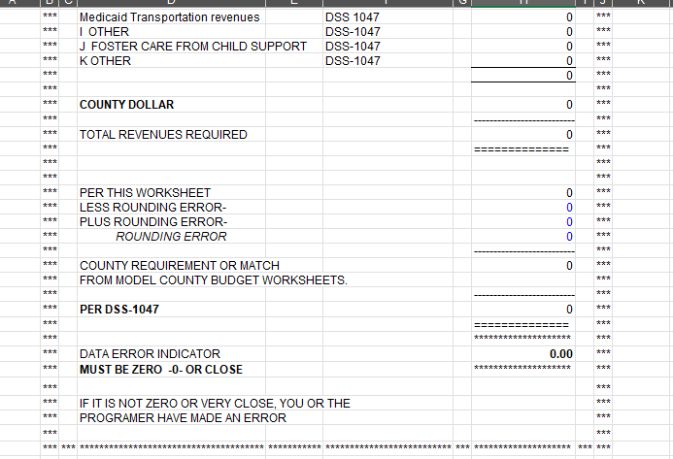
Total Revenues - Gives you a total of revenues required, your county dollar.

Slide 87
?
?
QUESTIONS
?
?
?

Slide 88
- Please reach out to your LBL with questions -
Thank you
for attending!

Slide 89
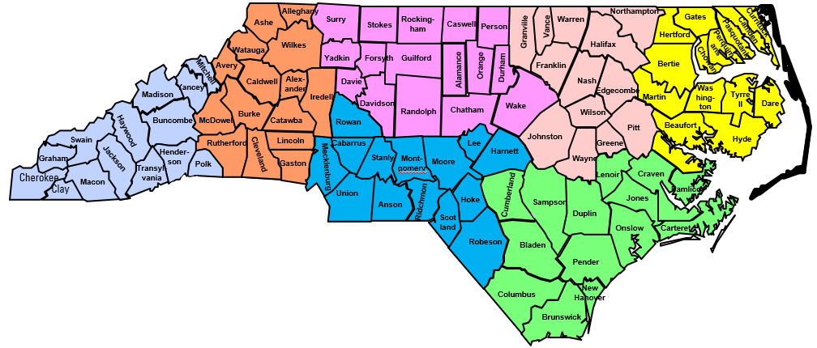
LBL County Assignments – December 2024
Region 1: Pamela Graham
Region 2: April McMasters
Region 3: Caroline Hedrick
Region 4: Caleb Hawkins
Region 5: Elizabeth Winstead
Region 6: Amber Currie
Region 7: Latisha Mills

Slide 90
