Slide 1
North Carolina
FEI WITS
Overview
March 2021
Instructor: Eamonn McAteer

Slide 2
North Carolina SOR Team
DeDe Severino
Section Chief
Ken Schuesselin
Project Director
Ellen Stroud
Assistant Project Director
Young Fiabema
Data Analyst
TBD
Data Coordinator
TBD
Recovery Coordinator

Slide 3
Agenda
How to request a new user account
Demo on submitting a GPRA via FEI
Review of common challenges
Question & Answer

Slide 4
Requesting a new FEI user account
Submit the following information to the SOR Team (sor.gpras@dhhs.nc.gov).
Name of individual needing an account
Email address for this individual
Specific office location/s that this individual requires access to

Slide 5
Once the account is created
The individual will receive two emails from FEI WITS
One email will be a confirmation of the account creation and will contain the individual's username.
The second email will contain a link to set a password and pin, as well as setting an account security question.

Slide 6
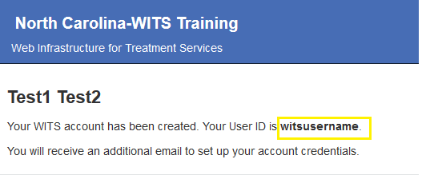
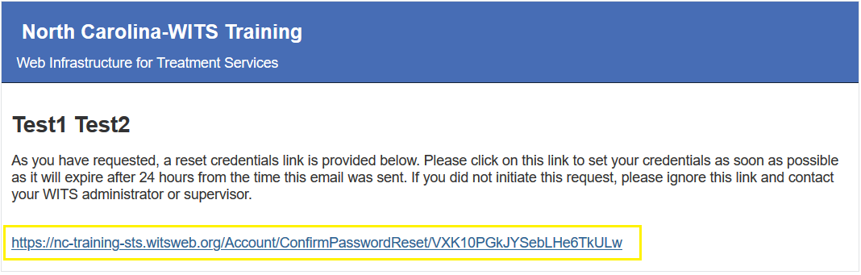

Slide 7
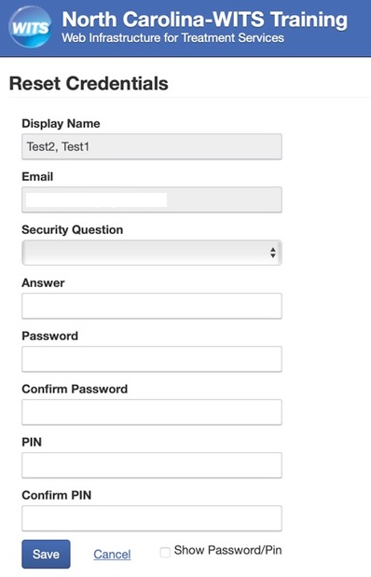
Setting your login information
Click the link in the email and you will be taken to the FEI site so that you can set a password, pin and security question.
* The SOR team does not have access to your password, pin or security question answer. You should save this information in a secure setting.

Slide 8

Setting your login information cont.
Once you have set the password, pin and security question, you will see a confirmation screen with an option to log in to FEI WITS.

Slide 9
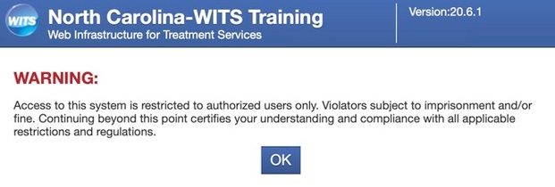
Logging into FEI WITS
FEI WITS website: https://nc.witsweb.org
You will be presented with a ‘Warning’ that you must acknowledge by clicking ‘OK’.

Slide 10
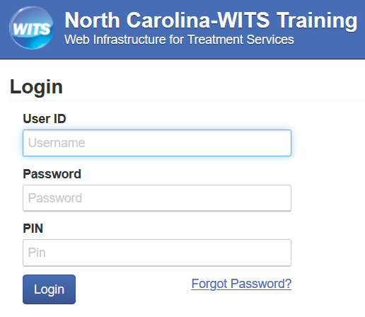
Logging into FEI WITS cont.
At the login screen, you will enter your username, password and pin. These are case sensitive.
If you forget your password and/or pin, you can click ‘Forgot Password?’.
You will need to know your username and the answer to your security question.
If you enter the incorrect login information 3 times, your account will be disabled and the SOR team will have to reset it.

Slide 11
Common login difficulties
Username: Some web browsers will automatically save your email address as the username. If your browser is auto-populating your login information, ensure that the correct username is saved.
The username, password and pin are case sensitive. You must enter these in the same manner they were initially created.

Slide 12
Information to know
When your account is created, the link to set a password, pin and security question is valid for 24hrs.
If your account is disabled due to failed login attempts and you receive a reset password & pin email, the link in this email is also valid for 24hrs.
FEI will automatically lock accounts that have no activity for 4 weeks. This is part of the FEI security protocol and cannot be changed.
If your account is locked, you should contact the SOR team and request an unlock. When the account is unlocked, you must sign into the FEI WITS site by 9pm that day or it will auto lock again.

Slide 13
Additional information
Questions regarding the GPRA, submission of the GPRA and the use of the FEI Systems tool should be directed to the SOR Team, Addictions and Management Operations Section, DMH/DD/SAS.
Email: sor.gpras@dhhs.nc.gov
Resource videos and other materials to assist with completing the GPRA document and how to use the FEI WITS platform are posted on our website for you reference. https://www.ncdhhs.gov/divisions/mhddsas/grants

Slide 14
Demo Time!!

Slide 15
GPRA information
The GPRA should be completed within 3 days of the individual beginning services for inpatient providers and within 4 days for outpatient providers.
The GPRA should be added to FEI WITS within 7 days of the individual beginning services.
A 6-month follow-up GPRA is required for all individuals, regardless of status i.e., an individual could be discharged 1 month after beginning services, but a follow-up should still be completed when due.
There is a 6-month follow-up window: 1 month prior to the due date and up to 2 months after the due date. This means there is a 3-month window to complete the follow-up GPRA.
SAMHSA has set North Carolina an 80% follow-up compliance rate. Only follow-up GPRAs with a complete interview, count towards this compliance rate.

Slide 16
THANKS!
What can we clarify?
What do you need more information on?
What concerns do you have?
What other questions do you have?

