Slide 1
HEARING HEALTH IS BRAIN HEALTH FOR NC RESIDENTS
North Carolina Building Our Largest Dementia (NC BOLD) Infrastructure Project

Slide 2
HEARING HEALTH IS BRAIN HEALTH FOR NC RESIDENTS
North Carolina Building Our Largest Dementia (NC BOLD) Infrastructure Project

Slide 3
North Carolina Building Our Largest Dementia (NC BOLD) Infrastructure Project
Notes:
This is a wonderful video of dementia and reducing the risks by controlling diabetes and treating hearing loss. Since diabetes and other chronic conditions appear to be dementia when in fact they could be hearing loss, it is mandatory to have a hearing evaluation and treatment before any cognitive evaluations. Ask the audiologist to check for auditory processing issues, since you could have normal hearing but the sound is not processing well in the brain: not dementia!

Slide 4
HEARING SCREENING WILL START THE PROCESS
https://www.
Theaudiology
project.com/
hearscreenusa
North Carolina Building Our Largest Dementia (NC BOLD) Infrastructure Project
Notes:
With headphones this online screening delivers a reliable and validated pass fail for hearing screening.
Takes 3 minutes and then the professional or patient can go to links to find an audiologist. Taking a picture of your hearing now ensures knowing if it
Is changing over time, with uncontrolled diabetes or other chronic diseases such as CVD, CRD, hypothyroidism, infections and brain disorders.

Slide 5
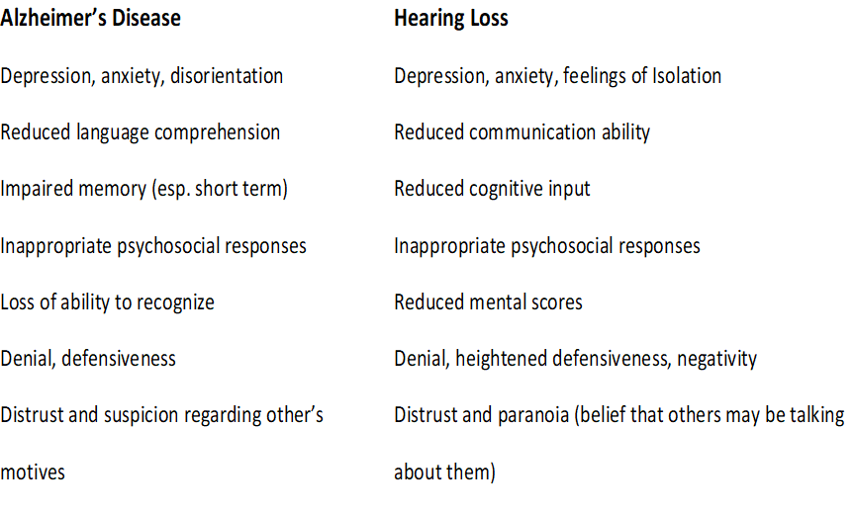
SYMPTOMATIC SIMILARITIES OF COGNITIVE ISSUES AND UNTREATED HEARING LOSS
North Carolina Building Our Largest Dementia (NC BOLD) Infrastructure Project
Notes:
ALZHEIMER'S DISEASE: Risks
Research suggests that a host of factors beyond genetics
1) vascular conditions such as heart disease, stroke, and high blood pressure,
2) metabolic conditions such as diabetes and obesity.
3) Medications
4) Noise and other head trauma
Since hearing loss is invisible, only a hearing test can tell if these symptoms are hearing related or Alzheimers related.
Find an audiologist in your area for an evaluation.

Slide 6
North Carolina Building Our Largest Dementia (NC BOLD) Infrastructure Project
Notes:
How to explain hearing loss: an invisible handicap
This video shows how the person with a hearing loss hears or doesn’t hear based on the severity of hearing loss. Note that this video shows hearing in the low pitches is normal or mild loss, allowing you to hear vowel sounds: oo, ee, ah, uh, etc. The video shows more and more damage in the high pitch areas, which block the consonant sounds in speech: s, f, th, etc. If you watch the person speaking, lipreading will help you ‘see’ the high pitch consonant sounds.

Slide 7
North Carolina Building Our Largest Dementia (NC BOLD) Infrastructure Project
Notes:
The new Lancet report states that hearing loss that is treated can lower your risk of dementia significantly. A ‘modifiable risk’ means that you can modify the outcome of being cognitively impaired just by treating the hearing loss.

Slide 8
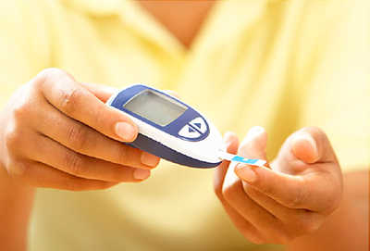
DISEASES AFFECTING HEARING & BALANCE
Diabetes
Chronic renal disease
Cardiovascular disease
Hypothyroidism
Alzheimer’s disease
Paget’s disease
Chron’s disease
North Carolina Building Our Largest Dementia (NC BOLD) Infrastructure Project
Notes:
Chronic and infectious diseases all have the potential to damage hearing. If you have any of these disease, go to an audiologist every year to monitor your hearing levels. Also report any medications your take as some prescriptions for pain management, infection control, cancer chemo and diuretics can permanently damage hearing. You may experience a ringing in your ear when taking these medications, which is an indication of damage. Always have your hearing tested when taking these medications to monitor any change. Report this to your treating medical doctor.
Photo credit: https://img.webmd.com/dtmcms/live/webmd/consumer_assets/site_images/article_thumbnails/quizzes/type2_diabetes_rmq/493x335_type2_diabetes_rmq.jpg?resize=400px:*&output-quality=50

Slide 9
North Carolina Building Our Largest Dementia (NC BOLD) Infrastructure Project
Notes:
These are NC Medicare recipients medical histories reported to Medicare when they are tested. This is not a complete list, but it does highlight the chronic disease impact. Educate your physicians and other medical personnel about the need for ongoing hearing healthcare. You will not ‘see ‘ hearing loss. It must be tested based on these medical issues or any trauma, falls, noise exposure, etc.

Slide 10
HEARING AIDS REDUCE THE SYMPTOMS OF DEMENTIA
North Carolina Building Our Largest Dementia (NC BOLD) Infrastructure Project
Notes:
Hearing aid work! And NC has programs to help pay for hearing aids. If you are still working, Vocational Rehabilitation will cover the cost of hearing aids, If you live in a low income independent living situation, there is coverage, based on the Olmstead Act, which mandated coverage based on the Americans with Disabilities Act. Nursing homes are mandated to cover hearing aids and audiology services for all residents in need. And the state has donated hearing aids that may be used for those who are unable to pay for hearing aids. Take the first step to hear better and appear more ‘with it’!!

Slide 11
HEARING SCREENING WILL START THE PROCESS
https://www.
theaudiology
project.com/
hearscreenusa
North Carolina Building Our Largest Dementia (NC BOLD) Infrastructure Project
Notes:
Only a valid hearing screening will let you know if there is a problem. Go to www.theaudiologyproject.com/hearscreenusa under IMPACT to find this free hearing screening.
This is used by CDC on their website for persons with diabetes.
With headphones this online screening delivers a reliable and validated pass fail for hearing screening.
Takes 3 minutes and then the professional or patient can go to links to find an audiologist. Taking a picture of your hearing now ensures knowing if it
Is changing over time, with uncontrolled diabetes or other chronic diseases such as CVD, CRD, hypothyroidism, infections and brain disorders.

Slide 12
Thoughts and Questions?
North Carolina Building Our Largest Dementia (NC BOLD) Infrastructure Project

