Slide 1
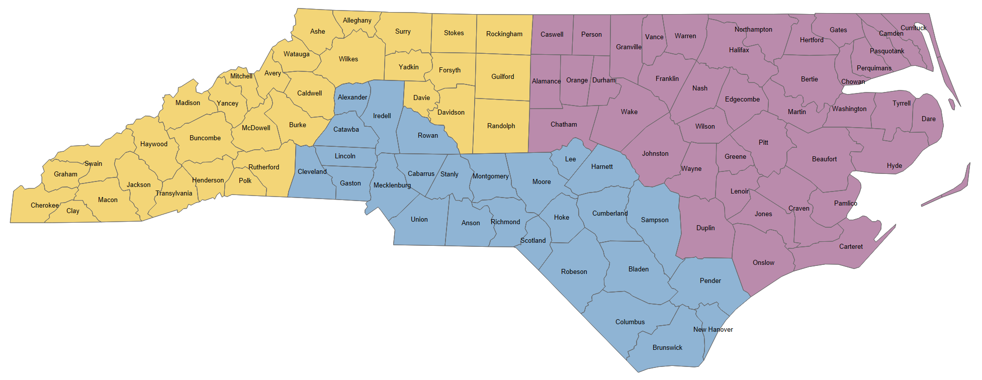
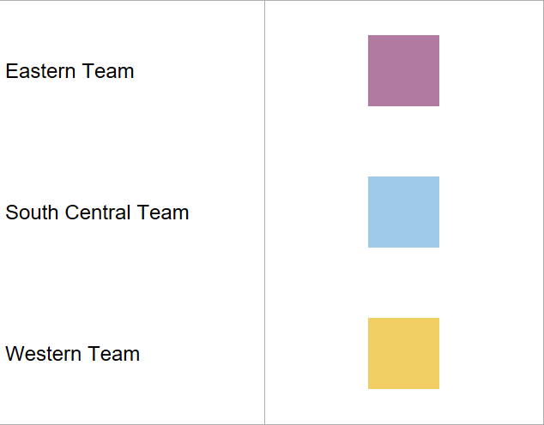
NC Office of Rural Health Service Area Map
ORH Health IT Specialists
Eastern – Sebastian Gimenez Sebastian.Gimenez@dhhs.NC.gov
Central – Adonnica Rowland
Adonnica.Rowland@dhhs.nc.gov
western – ROBYN MCARDLE
ROBYN.MCARDLE@dhhs.nc.gov

