Slide 1
Energy – EPI
Training
HSBIA
(Human Services Business information and Analytics)

Slide 2
AGENDA
Introduction
Creating an Energy Investigation
Creating an Energy Claim
Energy Financials in a claim
Energy Financial Screens in NC FAST
Reports

Slide 3

Energy
Investigations

Slide 4
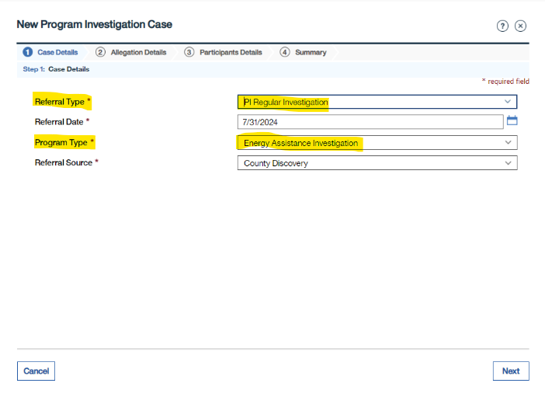
Energy Program Integrity Referrals are created the same as other programs using the Program Type ENERGY ASSISTANCE INVESTIGATION .

Slide 5
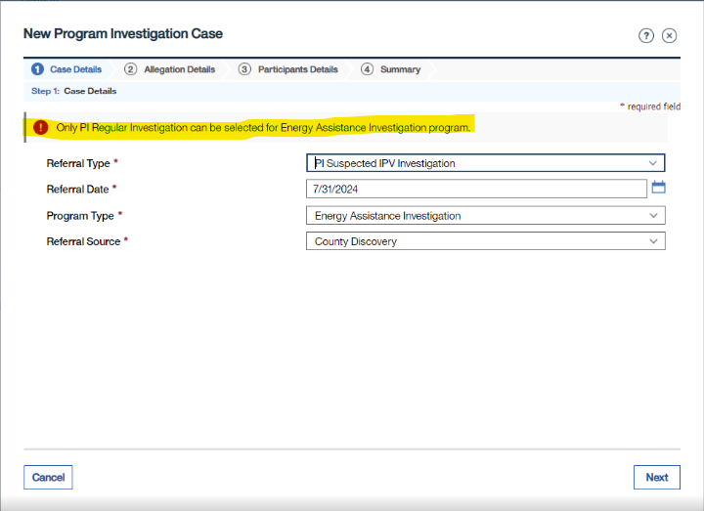
Energy will only allow the Referral Type
PI Regular Investigation
Users will receive an error message if another Referral Type is selected

Slide 6
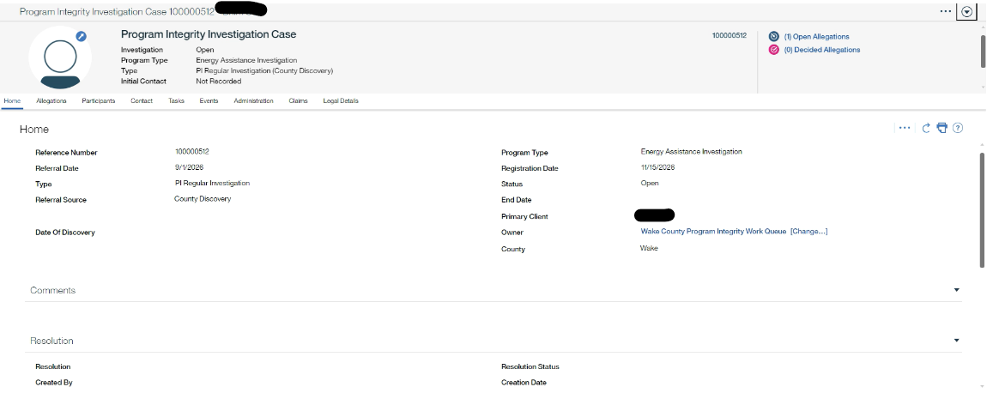
Energy Program Integrity Investigation Case (PIIC) will display similarly to other program PIICs

Slide 7
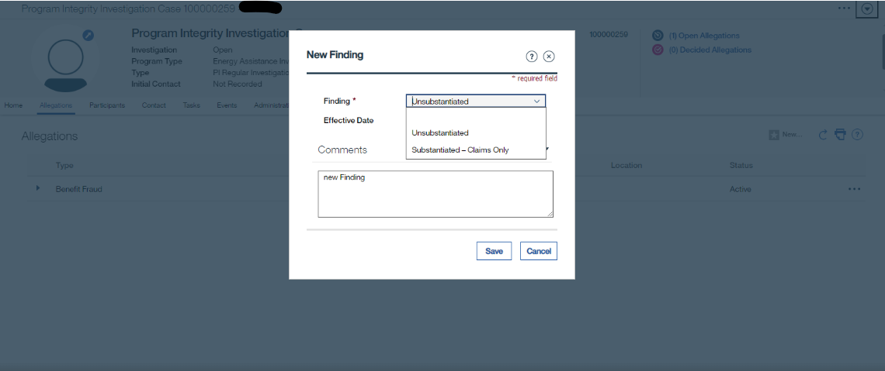
Only Findings of UNSUBSTANTIATED or SUBSTANTIATED- CLAIMS will be available

Slide 8

Energy Claims are created and managed most like the WFFA claims with just a few differences

Slide 9

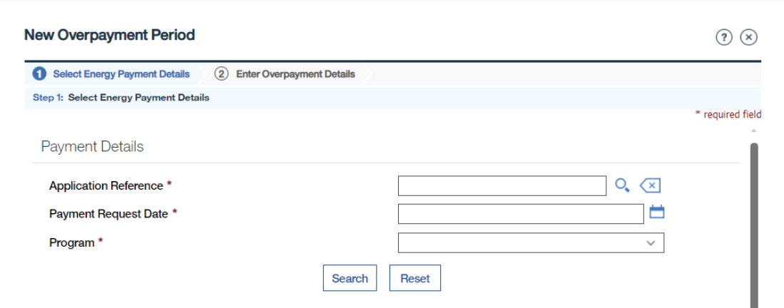
Energy Assistance Investigations NEW OVERPAYMENT PERIOD wizard will require Application Reference, Payment Request Date, and Program to Search

Slide 10
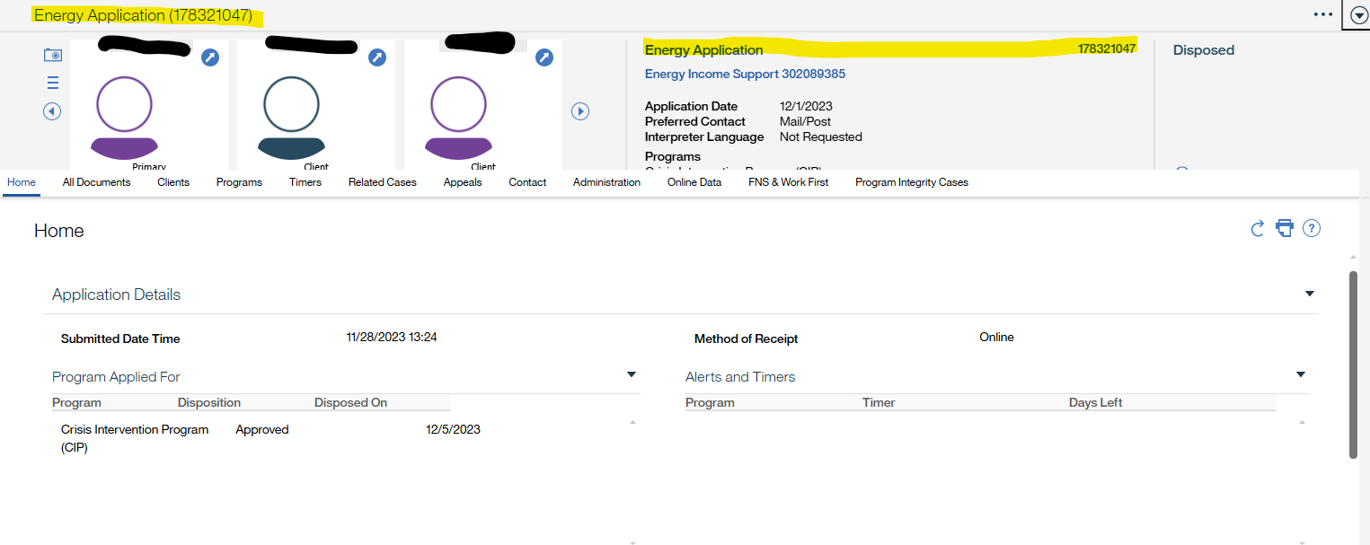
The Application Reference is the Energy Application Number
(NOT THE ENERGY INCOME SUPPORT).

Slide 11
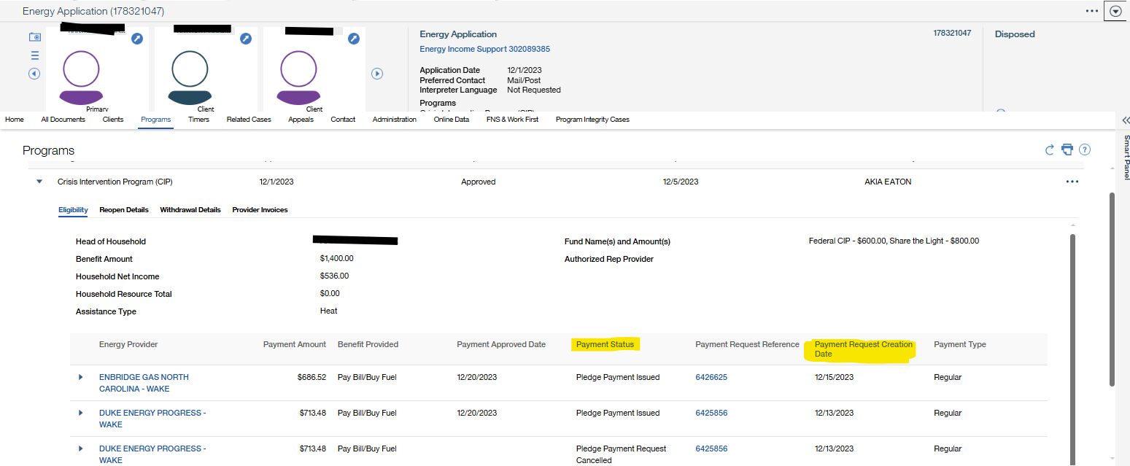
The Payment Request Date is the Payment Request Creation Date which is found on the Energy Application>Programs>Inline Page>Eligibility>Payment Request Creation Date
The Payment Request Date will be automatically populated as the start and end date of the Overpayment Period
(it is the same date)

Slide 12
The Program is a dropdown for CIP or LIEAP
The Application Reference must match an Energy Application and be the Application linked to the Investigation Case
The Payment Request Date cannot be older than 12 months or a future date.
The Payment Status (see previous screenshot) on the linked Application must be Pledge Payment Issued
The Payment has not been included in an Overpayment already
The Payment Amount cannot be $0 (see previous screenshot)
The Payment must be issued from the County that is assigned to the PIIC (see above screenshot-Energy Provider)
The following must be true to prevent an error message upon clicking "Search" to continue to the next step of the wizard:

Slide 13
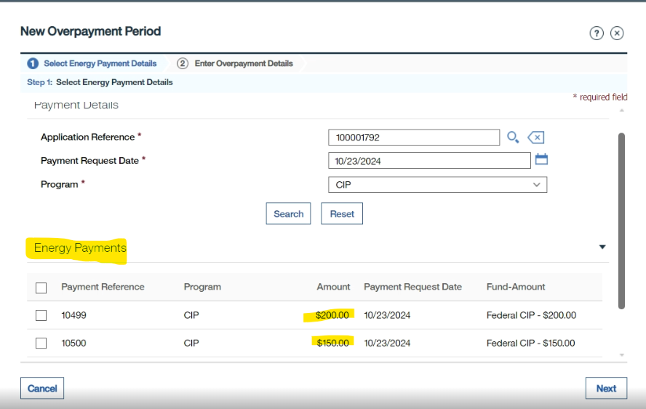
If all are true
(on previous screenshot), upon clicking "Search" any matching payments will display and can be selected for choosing the overpayment
Users can select one or more Payments to add to the Overpayment Details

Slide 14
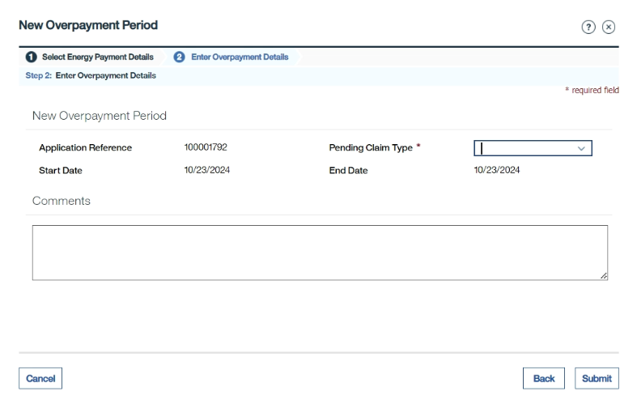
clicking Next, users will be required to enter the Pending Claim Type
Agency Error(AE) or Inadvertent Household Error (IHE)

Slide 15
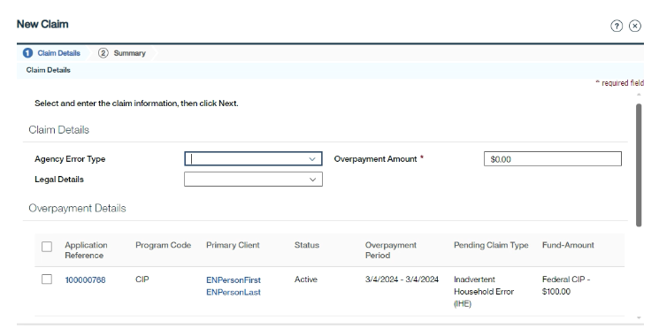
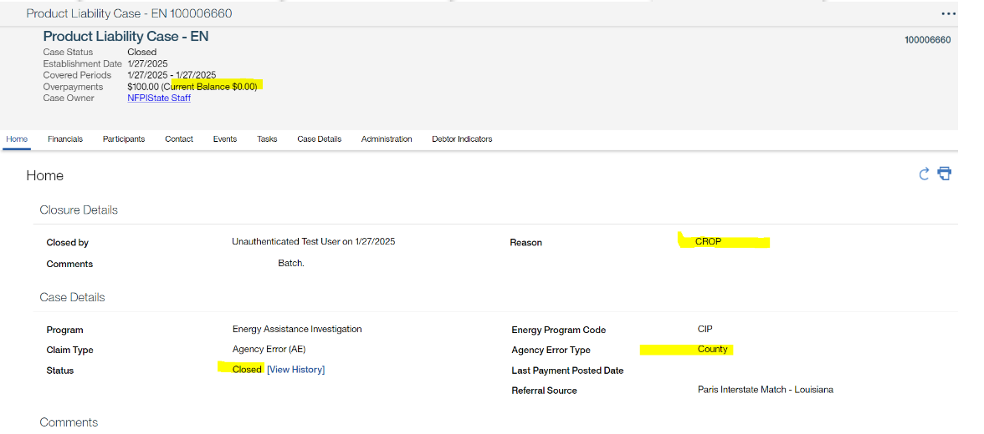
If Agency Error was selected as the Claim Type, the AE type must be selected (State or County)
The Overpayment Amount cannot be more than the total benefit issued.
The Overpayment Period must be within 12 months of the date the claim is being established.
Only one Program (CIP or LIEAP) can be selected. If the Investigation includes both a CIP and LIEAP payment, two claims need to be created.
SROP’s must be created by State Staff.
CROp’s & SROP’S can be created.

Slide 16
PLC and Financials
Energy

Slide 17

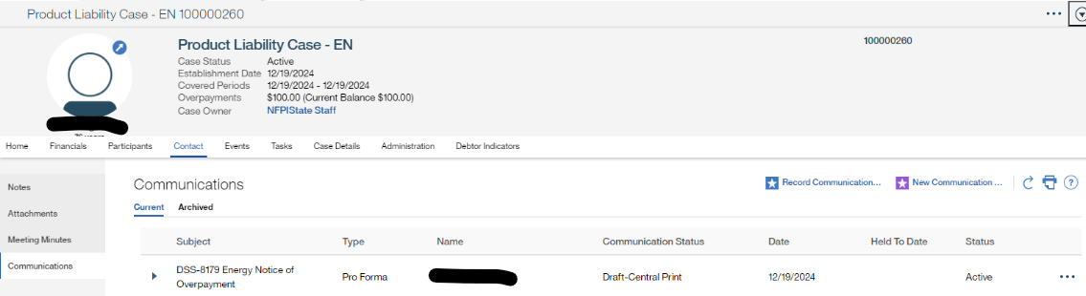
Upon Creation of an IHE PLC
a DSS-8179 Energy
Notice (LOI) of Overpayment
will be system generated
(like other programs)

Slide 18
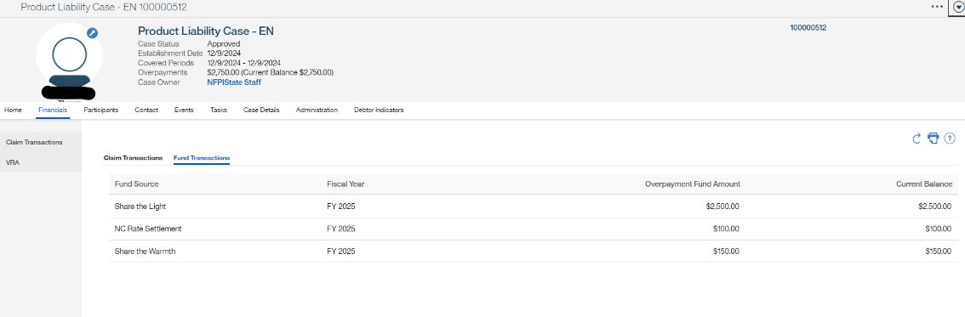
Most screens in the PLC will look and function like other programs.
The Financials screen has an additional tab (PLC>Financials>Fund Transactions)
This tab will list the Fund Source, Fiscal Year, Overpayment Amount (original overpayment amount) and Current Balance (after payments)
This information is system generated and cannot be changed or edited.
Other Payment Functionality (Reversals, Refunds, Overpayment Increase/Decrease) will function the same as other programs, and will similarly impact the Fund Transactions

Slide 19


Energy Claims will have Voluntary Payment Agreements (VRA) with the following requirements:
The minimum payment for an Energy VRA is $25 (An error message will be thrown if a Payment Amount is less than $25).
The first payment due date must be within 30 days (An error message will be thrown if a First Payment Due Date is entered greater than 30 days)

Slide 20

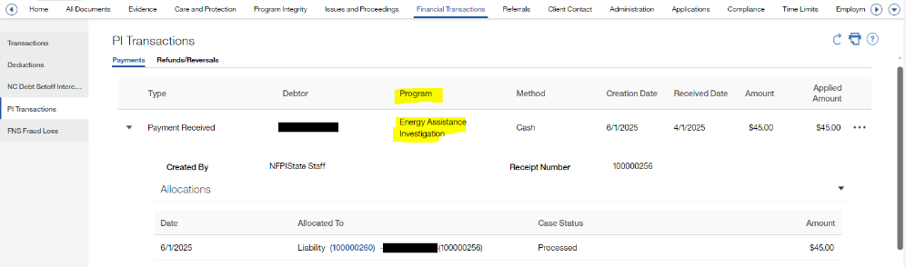
Payments will be posted on the Person Page>Financial Transactions>PI Transactions and PLC>Financials the same as they are for other programs:
PI Users will Receive a Payment the same as all other programs.
AT THIS TIME, only Cash payments will be applied to Energy Claims. The state teams are working with NC Dept of Revenue to eventually add DOR/NCEL offset functionality.

Slide 21
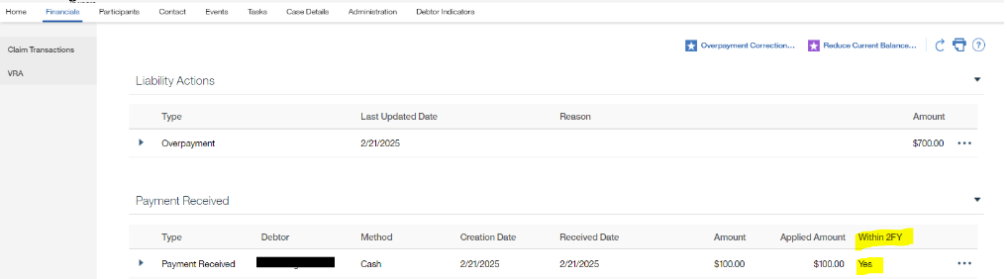
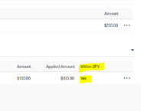
On the PLC, one additional Column will be added "Within 2FY“
This is a new indicator that indicates if the payment was applied to the claim within the 2FY from the date of application
If the payment is applied within the 2FY of the Date of application, then it will go back into the fund source.
If applied outside of the 2FY the county will need to send a
DSS-1571 form

Slide 22
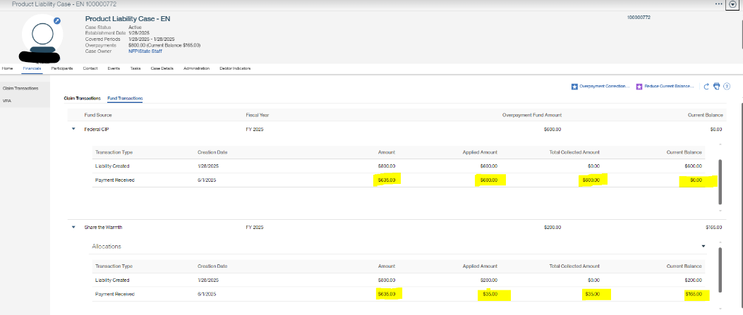
Energy Program Integrity Referrals are created the same as other programs using the Program Type ENERGY ASSISTANCE INVESTIGATION .
Each payment will display how much went to each fund source associated with the claim. There will be a balance for each fund source when the claim is created. Each time there is a payment made to the claim that balance on the claim will be adjusted.
New Fund Transaction Tab

Slide 23
Fund Fiscal Year Screens
Energy

Slide 24
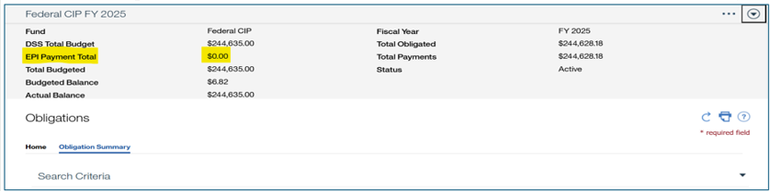
Screen Changes & Lingo
Energy EPI Payments applied to a claim will be listed as
“EPI Payments”
The Total Budgeted field is the sum of
DSS Total Budget + EPI Payment Total

Slide 25
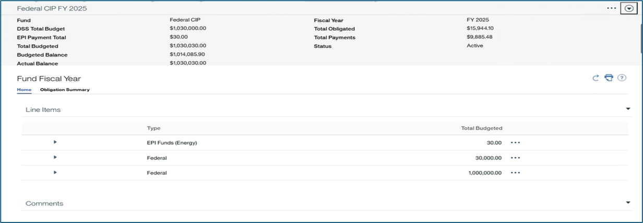
When EPI payments are received; the EPI payment “Total” will display along with the federal funds deposited into the fund source.
Note: All EPI Payments received within the 2 FY will be added to the appropriate fund source and can be used for applications.

Slide 26
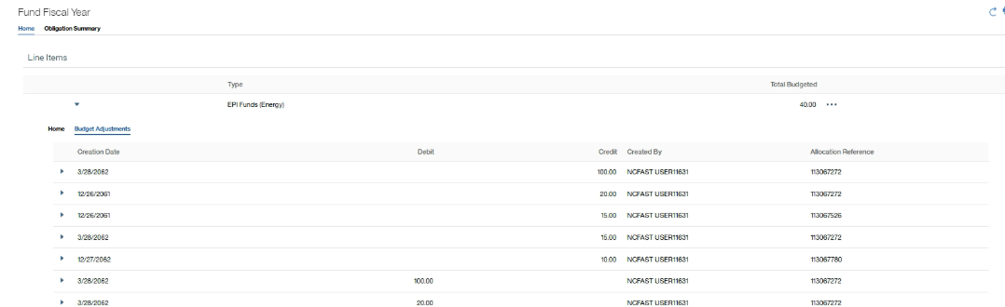
Toggle down into the EPI Funds (Energy) to see actual epi payments

Slide 27
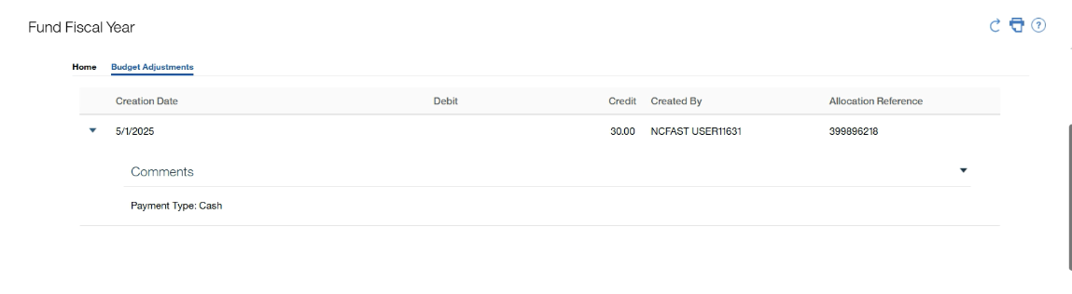
The method of payment for a received payment, such as CASH, DOR, or NCEL, is displayed in the comments field under the claim line item as read-only.

Slide 28
Reports
Energy

Slide 29
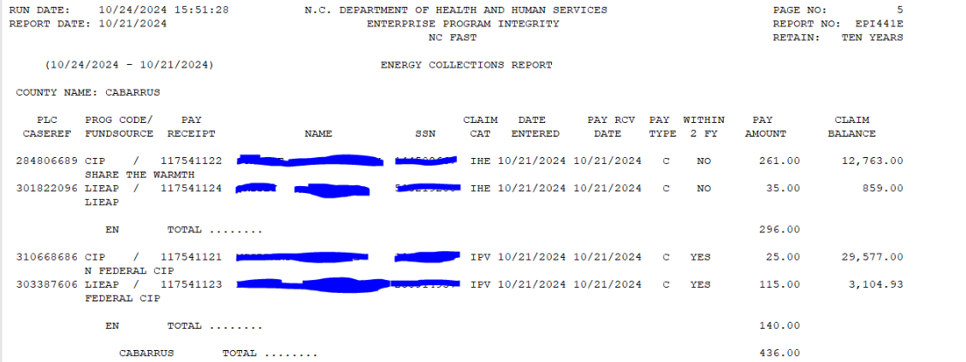
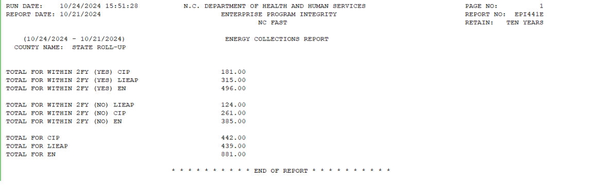
EPI-441E Will display
Energy EPI Payments

Slide 30
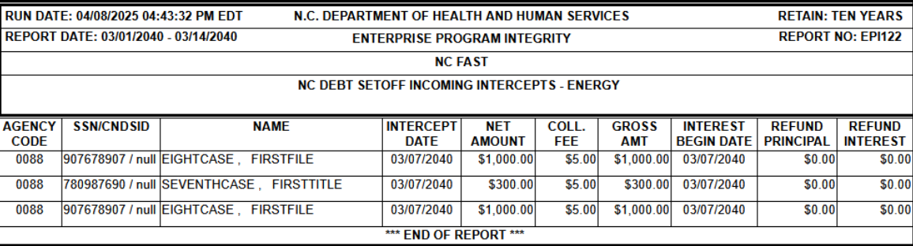
EPI-122EN has been created to capture pending DOR offsets for Energy EPI payments
EN

Slide 31
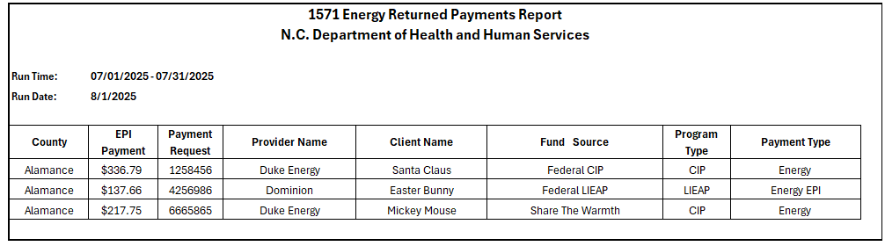
A new monthly BIRT report will be created. It will display EPI Payments and returned checks that were received outside of the 2 FY from the date of application
1571 Energy Returned Payments Report

Slide 32

Questions ?

