Slide 1
NC cross-program continuous quality improvement
Journey to North Carolina’s CQI Cycle

Slide 2
Rylan’s Law
System Reform
Regional Supervision
Memoranda of Agreement
Child Well-Being Transformation Council
Regional Departments of Social Services
Key Points
Notes:
Rylan’s Law, enacted in 2017, governs a legislatively required, statewide reformation of North Carolina’s social services and child welfare programs. North Carolina recognizes that more accountability and oversight are needed for County Departments of Social Services to produce better performance and outcomes. Rylan’s Law provides North Carolina with a blueprint for how we can collectively transform social services to improve outcomes for families and children. There are 5 key components to Rylan’s Law. 1) It requires an independent assessment to evaluate the current system. NC chose Public Knowledge to be their partner in that process, and remains a partner today. 2) The law requires that NC move towards a regional structure to improve collaboration, 3)All counties have a contractual obligation with DHHS to monitor annual performance for all social service programs. 4) To promote a more coordinated approach to services that help improve outcomes for children, the General Assembly created the Child Well-Being and Transformation Council to work collaboratively in providing public services to children. And 5) Rylan’s law give counties the option to create regional departments of social services to provide more flexibility to combine resources and improve the provision of social services among more than one county.
Having a strong CQI process that promotes proactive responses to challenging situations is critical for enacting Rylan’s Law across social service departments.

Slide 3



What is cqi?
Philosophy
Process
System
Notes:
CQI is defined as the complete process of identifying, describing, and analyzing strengths and problems and then testing, implementing, learning from, and revising solutions.¹ It relies on an organizational or system culture that is proactive and supports continuous learning. It is dependent upon the active inclusion and participation of staff at all levels of the agency as well as system partners. Partners may include youth, families, adults, courts, and other stakeholders.
It is a philosophy; it places a high value on improvement.
It is a process; it seeks to identify, describe, analyze strengths and problems, then test, implement, learn from, and revise solutions.
It is a system, a coherent set of components that supports the continuous
The CQI process includes a set of essential tasks that take organizations from problem identification to developing a credible hypothesis about its cause. The process may be iterative as the discovery of new information can lead to new questions and deeper data analysis.

Slide 4
Why Cross-Program CQI?
Child Welfare
Child Support
Economic and Family Services
Adult Services
Notes:
Successes and challenges are a regular part of work in the human services. Successes help validate our decision to work in a field that supports the people of North Carolina. Challenges can be frustrating and leave us feeling at a loss. But how do we improve? How do we know what actions we should take for improvement? And how do we know if our actions are having the intended impact? That is the goal of continuous quality improvement or CQI.
In 2022, NC with support from Public Knowledge, developed a CQI model to use across the following programs: Child Welfare, Child Support, Economic and Family Services including Food and Nutrition Services and Work First, and Adult Services. A goal for the NC Cross-Program CQI model is to establish a common framework facilitated by authentic partnerships and a teaming structure that supports the seamless and quality delivery of services and benefits to those served.
Successful implementation of the model included training, coaching, and support to train staff and apply the model to improve practice and impact for all services involved families across systems.
The NC Cross-Program CQI Cycle allows DSS and DAS programs to effectively use data to systematically make decisions that will lead to desirable change at the state, regional, and county levels.

Slide 5
ESTABLISH GOVERNANCE TEAM
ASSESS READINESS
DEVELOP CQI MODEL
DEVELOP TRAINING
MAJOR TASKS
Notes:
Developing a new model for CQI requires multiple steps. First, a Governance team was established that included representatives from DSS and DAS program areas. This mujlti-disciplinary team set a vision for CQI, set goals and strategic priorities, and promoted a program culture and climate to support CQI efforts at the state, program, regional and local levels. Once a Governance team was established, A readiness process that aimed to assess staff and stakeholder motivation and capacity across all program areas was established. This work included identifying data sources, and developing surveys to assess department readiness. After thorough research and vetting of CQI models, NC chose a model and developed an implementation approach for the cross-program model selected. And finally, a CQI foundational training program was developed to provide problem solving approaches to social service issues across departments.

Slide 6
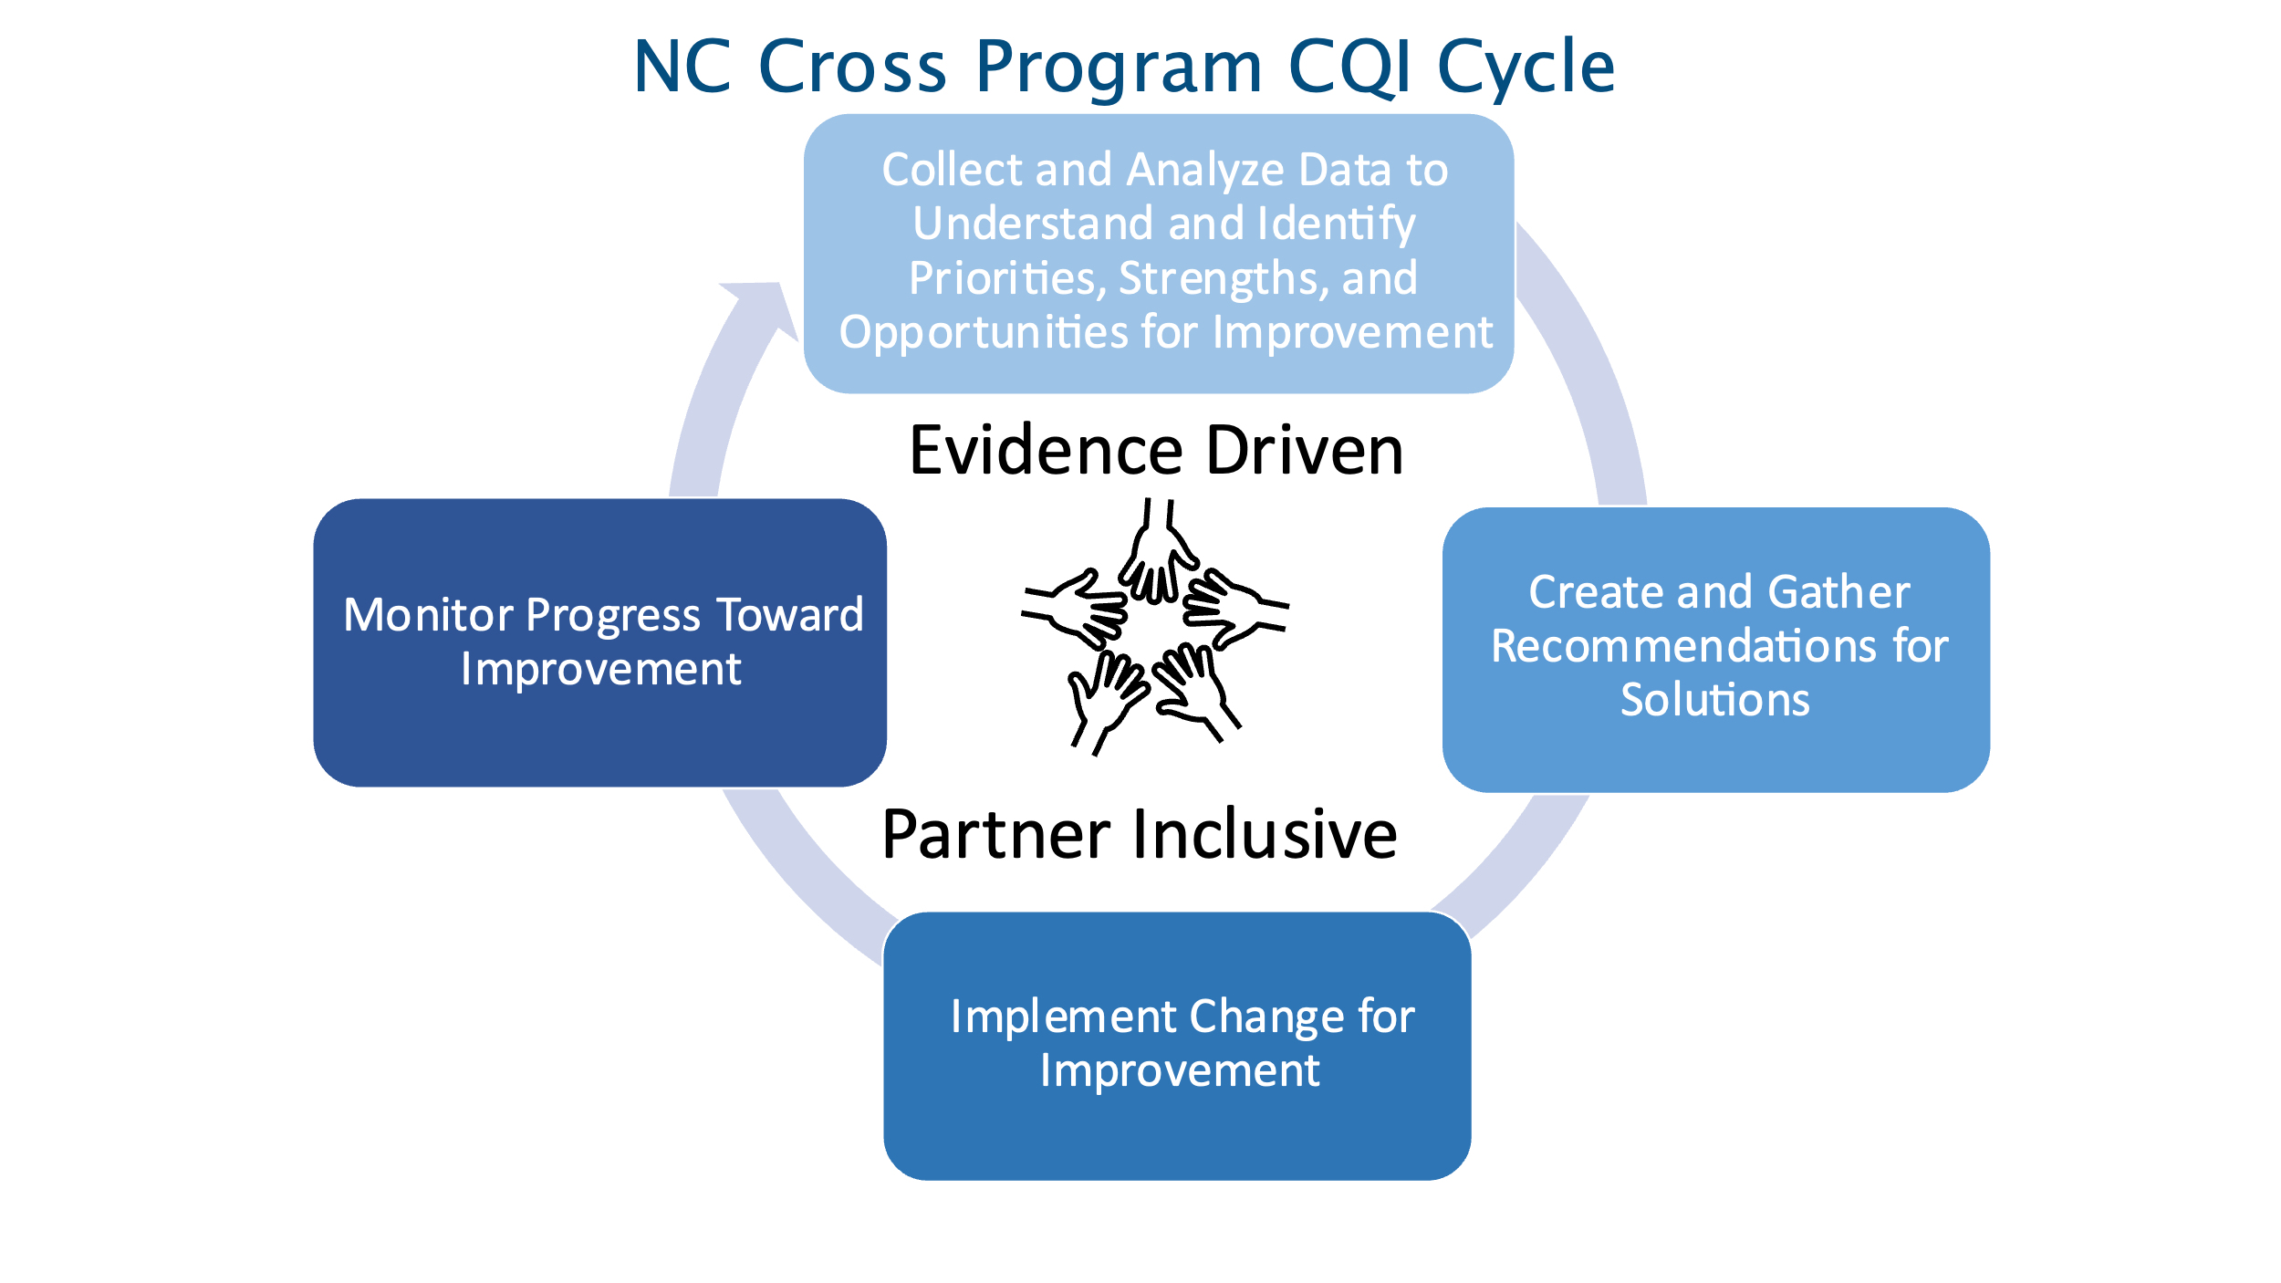
NC Cross-Program CQI Cycle: The 4 C’s
COLLECT
Monitor/Check Progress
CREATE
CHECK
CHANGE
Notes:
Leadership across the divisions spent several months going over CQI models and cycles, as well as each division’s current cycle, crafting the cross-program CQI cycle to be used across all divisions. The primary purpose of this is that while the content may be different, the state wants counties to experience the same way consistently.​
The resulting four step CQI cycle is called the Four C’s:
In the first phase of Collect, DSS and DAS programs examine multiple sources of data to identify programmatic strengths at the state, regional, and county levels and identify a root cause to an issue.
In the second phase of Create, programs research solutions to address the root cause of the problem by assessing its feasibility and effectiveness
In the third phase of Change, the program develops an implementation plan for addressing the solution, which includes defining the activities and goals, developing a communication plan, and
delivering training to program area staff.
In the last phase of Check, programs monitor the progress of the implemented solution to the problem. This evaluation requires actively assessing data, asking the right questions, and identifying strengths and opportunities of the solution and the implementation process.
Now that you have a background about NC’s CQI cycle, please talk to your supervisor about accessing the CQI foundational training, which digs deeper into CQI and each phase of the cycle.

