Slide 1
NC Department of Health and Human Services
Inclusion Connects Report Summary
Summary views of key metrics from the Inclusion Connects Quarterly Report are available in the following sections.
July 15, 2026
Data Collection Period: January 1, 2026, through March 31, 2026

Slide 2
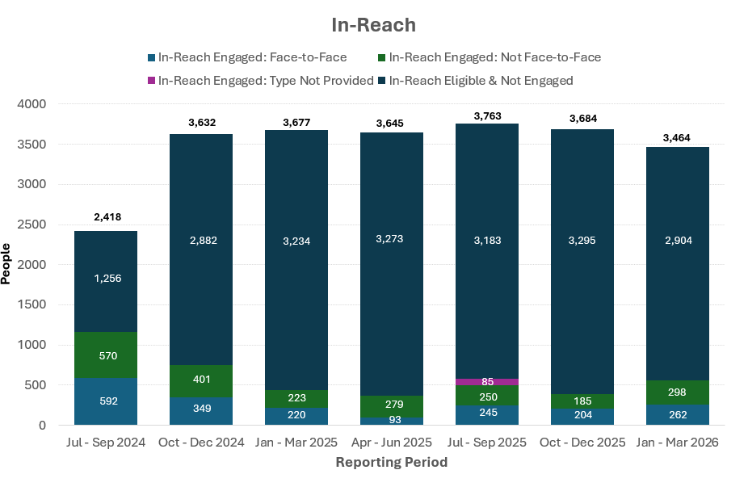
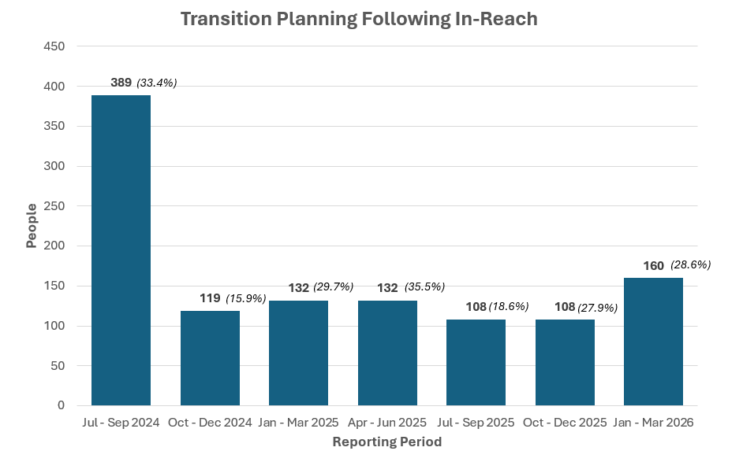
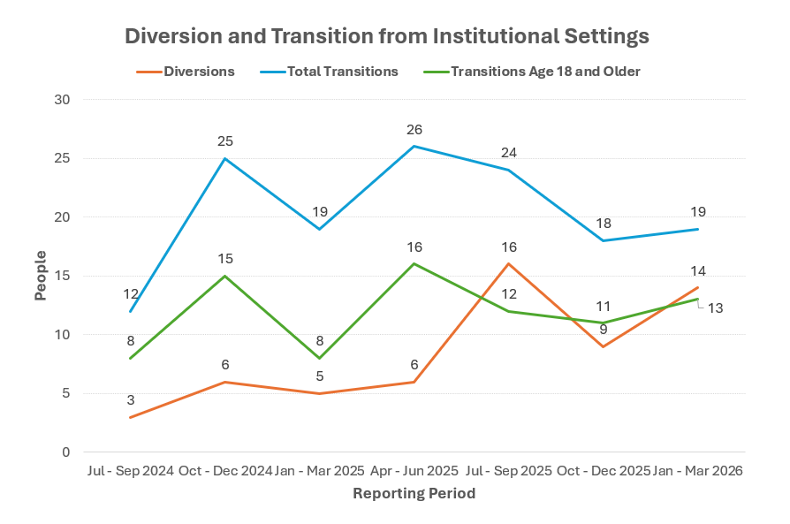
Transition & Housing Overview
Please note metrics may fluctuate as data quality improves, reflecting more accurate populations and cleaner, more reliable data. Current data is sourced from LME/MCO reporting.
-
-
-
-
The total number of members reported living in institutional settings remains stable across LME/MCOs.
In-Reach efforts reflect internal policies of each LME/MCO.
Percentages are calculated using the number of people engaged in In-Reach during the quarter who decide to move into the “transition planning” phase.
NCDHHS continues to work with the LME/MCOs¹ to ensure people eligible for diversion are tracked correctly.
Transition data from the Money Follows the Person program are included. TCL² program data is not included in the above chart.
All 37 people who moved during Jul – Dec 2024 have remained successfully living in the community for at least 1 year.
LME/MCO: Local Management Entity/Managed Care Organization
TCL: Transitions to Community Living

Slide 3
Transition & Housing
In-Reach
In-Reach involves educating people with disabilities in institutional settings and their Legally Responsible Person (LRP) on the benefits and availability of community-based services.
In-Reach staff also offers visits to community-based settings and opportunities to meet other people with disabilities who are living, working and receiving services in inclusive settings.
In-Reach involves face-to-face and virtual discussions with each person, depending on their preference. The goal is to support people in making the best living decision for themselves.
-
-
-
-

Slide 4
Transition & Housing
Transition Planning
In-Reach education allows people with disabilities to make an informed choice about where they want to live and receive services.
The goal of transition planning is to make sure the person has the supports they need to move into the community living option of their choice, if it is a good fit.

Slide 5
Transition & Housing
Transition & Diversion
Transition involves moving from an institutional setting into a community-based setting, if a person chooses to do so.
A “successful” transition is counted as living in the community for one year.
Diversion involves identifying people with I/DD who may be at risk of moving into an institution and providing them with extra supports and services to help them stay in their own homes and neighborhoods.
Diversion means making sure every person can get important services like Medicaid Home and Community-Based Services (HCBS), 1915(i) services, special waivers, or state programs to help them remain living in the community

Slide 6
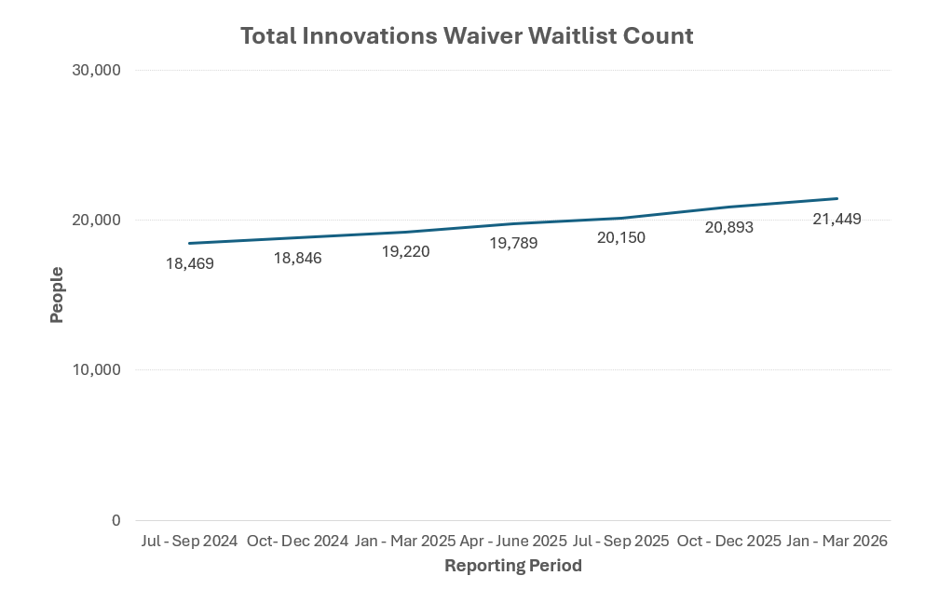
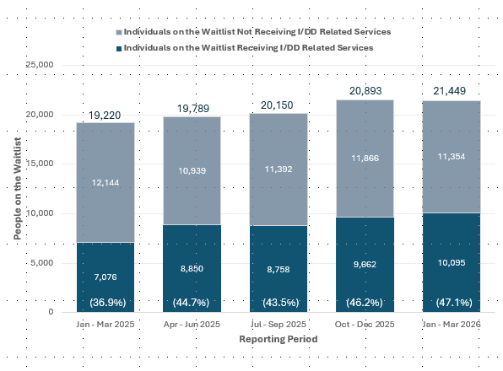
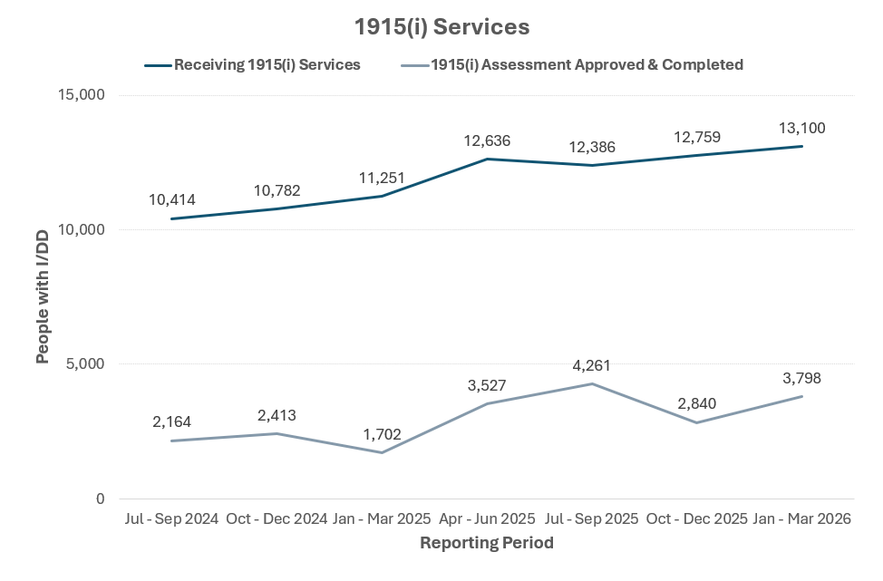
Services Overview
Total Innovations Waiver Waitlist Count
The Innovations Waiver Waitlist continues to grow, reflecting increasing awareness and need for services within the I/DD community.
The number of people receiving I/DD services continues to grow relative to growth of the Innovations Waiver - showing that while the demand for services increases, access is also expanding.
People with approved 1915(i) assessments are new each reporting period, but those receiving 1915(i) services may overlap across periods.

Slide 7
Services
Innovations Waiver
The Innovations Waiver gives people with I/DD the most services and support at home, in the community, and at work. It helps them live and do well in community settings. The waiver offers person-centered plans made to fit each person’s needs.
There are not enough waiver slots to allow for everyone, which leads to a growing waitlist.

Slide 8
Innovations Waiver
Inactive Assigned Slots - Some Reasons Slots May be Assigned to Member but Inactive:
At Beginning of Slot Assignment Process
(Can last up to 90 days)
14,736
Total Waiver Slots
Disability Determination In Progress
Deceased
(Slot Not Yet Reassigned)
Active Slots 14,188
Remaining Reserve Slots 51
Inactive Assigned Slots 497
Total Waiver Slots 14,736
In Institutional Setting
(Assigned Slot Temporarily Held at Member's Request)
Inpatient and Transitioning

Slide 9
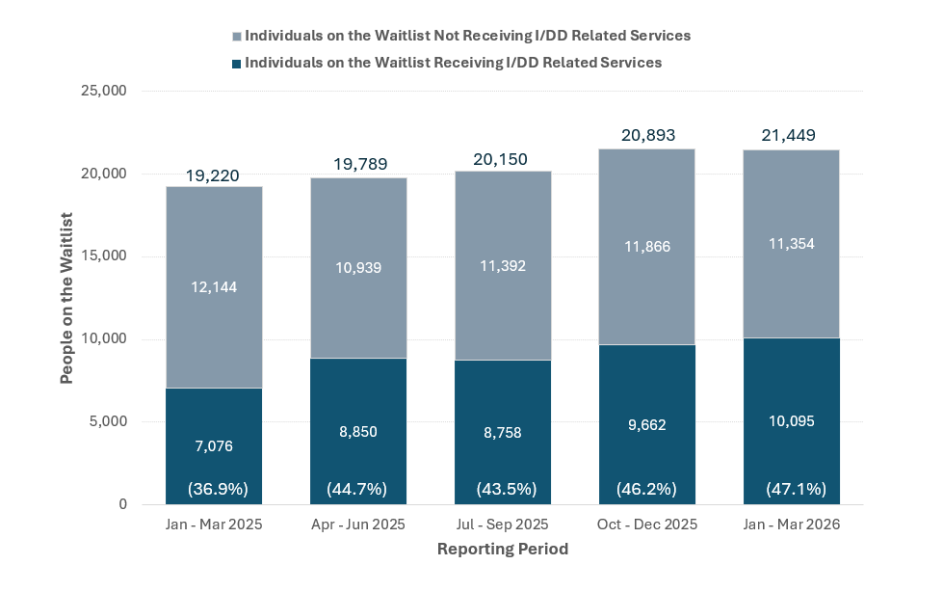
Services
I/DD Services
Like the Innovations Waiver, I/DD services in North Carolina provide for people with I/DD to help them live independently and fully in their communities. This can help improve quality of life and reduce reliance on institutional care.
Over one third of people on the waitlist are currently receiving I/DD services outside of the Innovations Waiver while they wait for a slot.
To reduce confusion and align with the data used in the Innovations Waiver Waitlist Dashboard, this data was updated to use the same set of I/DD service codes as the Dashboard.

Slide 10
Services
1915(i) Services
1915(i) is a Medicaid program in North Carolina that helps people with I/DD, mental health needs, substance use disorders, or traumatic brain injuries get care at home or in their communities.
To get started, a person contacts their LME/MCO to request an assessment, which is completed within 90 days. After this, a personalized support plan is created for each person.
The program gives people important services that can help with all their needs. It also supports people while they are on the Innovations Waiver waitlist. 1915(i) services may even fully meet a person’s needs, making the Innovations Waiver unnecessary.
1915(i) Services Include:*
  Community Living and Supports
  Supported Employment
  Respite
  Community Transition
*1915(i) Services do NOT include Tailored Care Management (TCM).

Slide 11
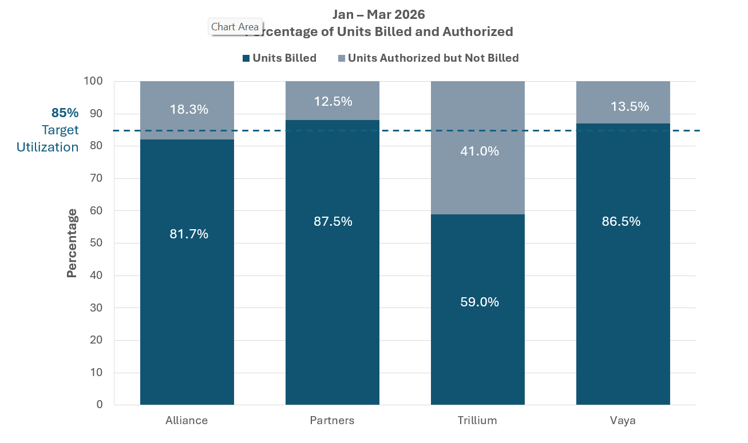
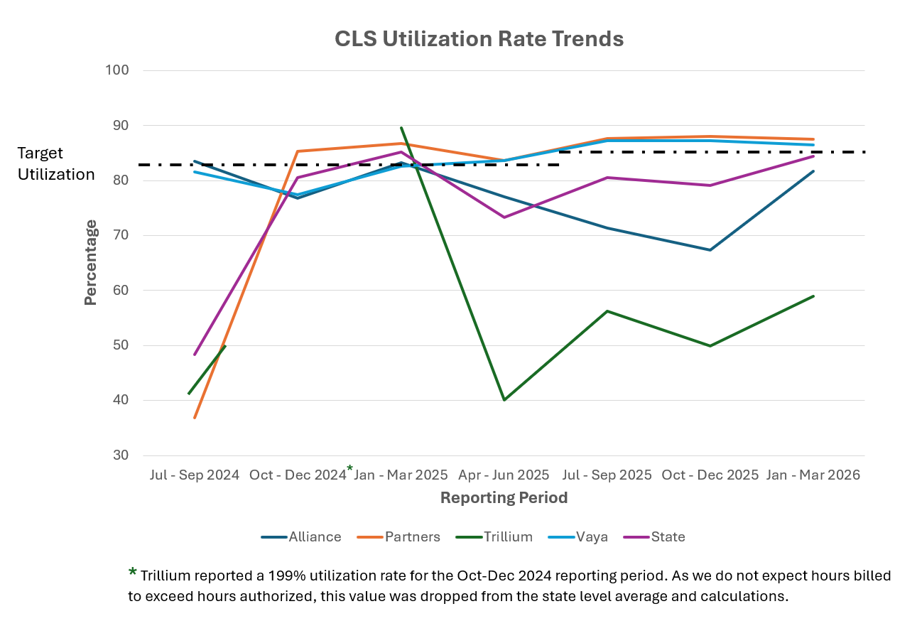
Direct Support Professional (DSP) Workforce Overview
Utilization rates represent authorized Community Living and Support (CLS) services provided to people on the Innovations Waiver.
The Department is looking into utilization rate data quality and taking necessary steps to ensure all LME/MCOs report this information in the same way.
While improvements in data quality have been seen, the Department continues to engage with the LME/MCOs to understand discrepancies in reporting and ensure accurate data.
Starting in the Jan – March 2025 period, the collection group was limited to members whose plans ended during the reporting period, resulting in different populations each quarter. Future year-over-year comparisons may support better trend analysis.

Slide 12
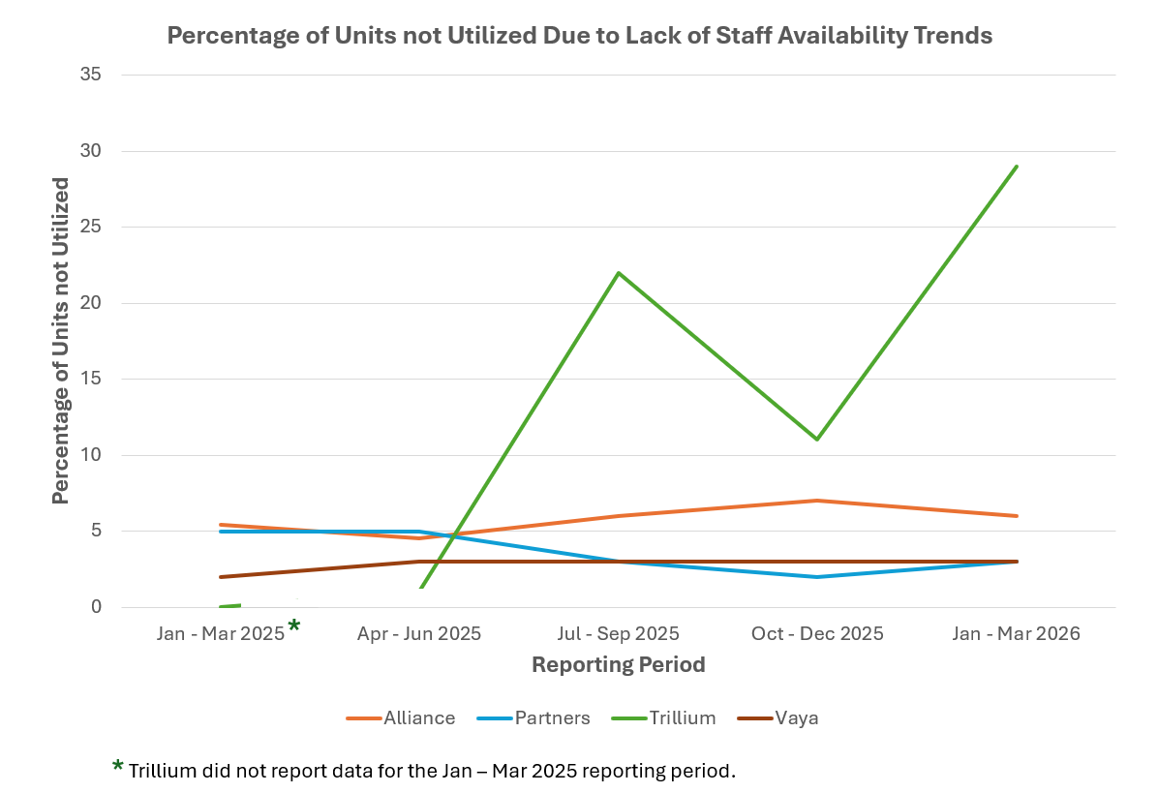
DSP Workforce
CLS Staffing
North Carolina currently does not have enough Direct Support Professionals (DSPs). This makes it harder for people with I/DD to get the help they need at home and in their communities.
To give good care, Community Living and Support (CLS) services need DSPs who are well-trained, supported, and have clear paths to grow in their jobs. This helps make sure people with I/DD get steady and high-quality support.
Utilization rates represent CLS services provided to individuals on the Innovations Waiver.

Slide 13
NC Department of Health and Human Services
Inclusion Connects Report Summary
Contact: DMHIDDContact@dhhs.nc.gov
July 15, 2026

