Slide 1
SCFAC Updates​
Charles Rousseau
Director of Strategy & Planning
NC DHHS Division of Mental Health,
Developmental Disabilities, and Substance Use Services
March 13, 2024

Slide 2
Agenda
MH/SU/IDD/TBI System Announcements & Updates
Brief Overview of Child Behavioral Health Investment
DMHDDSUS’ Role in Strengthening the Child Behavioral Health Residential System
Non-Law-Enforcement Transportation (NLET)

Slide 3
MH/SU/IDD/TBI System Announcements & Updates

Slide 4
March Community Collaboration Topic: Child Behavioral Health
Side by Side
3/4
SCFAC
LME/MCO Clinical
Providers & Associations
NCHA BH Workgroup
3/13
3/19
3/19
3/21
Workforce
(Peers)
3/14
3/6
Crisis System
Child Behavioral
Health
Advisory Committees
Workforce
(DSPs)
Supports for Justice-Involved Individuals
3/18
3/12
3/25
Notes:
Groups will be representative of the SCFAC, LME Clinical, and Provider groups
Design groups will present to
Other stakeholders: other advocates, mobile crisis providers (if not already captured under providers), DPH, etc., 911/988 operator
While design group will present to larger committees, the advisory committee will be opportunity to really dig deep on the targeted recommendations.

Slide 5
April’s Side by Side topic will be​ Tailored Plans!​
Tailored Plans are important to understand if you receive Medicaid and have:
Severe Mental Health issues (SMI)
Substance Use issues (SUD)
Intellectual or Developmental Disability (I/DD)
Traumatic brain injury (TBI)
Tailored Plans have been delayed several times to give more time for health care providers to join.
But the transition is mandated to happen on July 1st.
Learn how to prepare during the Choice Period (April 15 – May 15) to select your Primary Care Provider (PCP).
Why it is important to attend:​

Slide 6
Brain Injury Awareness Month
Brain Injury Awareness Month is an opportunity to raise awareness about this "silent epidemic" while also highlighting the increasing availability of services and supports for individuals living with brain injury in NC.
An estimated 2.8 million Americans sustain a Traumatic Brain Injury (TBI) every year, with over 80,000 of those occurring in NC annually, according to the Center for Disease Control (CDC).
In SFY 2019, 41,398 individuals with a TBI diagnosis received behavioral health services in NC.
With active statewide screening efforts, many more NC residents who are undiagnosed are being identified.
NC DHHS has recently received authority to
expand the TBI Waiver statewide
offer 1915(i) services to adults living with TBI
expand the Justice Re-entry and Reintegration Program
support the TBI state funds program statewide
The Brain Injury Association of NC (BIANC) is the only statewide advocacy organization for the brain injury community. For information regarding awareness and education events this month and ongoing, please visit the BIANC website at www.bianc.net

Slide 7
Intellectual and Developmental Disabilities Awareness Month
Intellectual and Developmental Disabilities (I/DD) Awareness Month brings awareness to our communities about the value, needs, and ongoing contributions of persons with an I/DD diagnosis.
Intellectual and developmental disabilities are
Chronic
begin at birth or before the age of 22
adversely affect a person’s functioning and daily living
Common developmental disabilities include Cerebral Palsy (CP), Autism Spectrum Disorder (ASD), & Down Syndrome
There are nearly 200,000 persons diagnosed with I/DD in NC
7% of children ages 0-17 are diagnosed with an I/DD
NC DHHS is currently working on initiatives to:
Improve access to Home & Community Based Services
Improve transition outcomes after incarceration for persons with I/DD
Strengthen the DSP workforce
Promote Competitive Integrated Employment (CIE) opportunities for persons with I/DD
Want to know more?
Join these Lunch & Learns!
In the IDD Awareness Month Lunch and Learn on March 13th, we will partner with the Office of Diversity, Equity, and Inclusion and the NC Council on Developmental Disabilities to present "Unmet: North Carolina's Disability Crisis" with further discussion following.
In the Inclusion Works Lunch & Learn on March 25th, we will discuss best practices to support individuals with intellectual and developmental disabilities (I/DD) and Traumatic Brain Injury (TBI) on their path to achieving Competitive Integrated Employment (CIE).

Slide 8
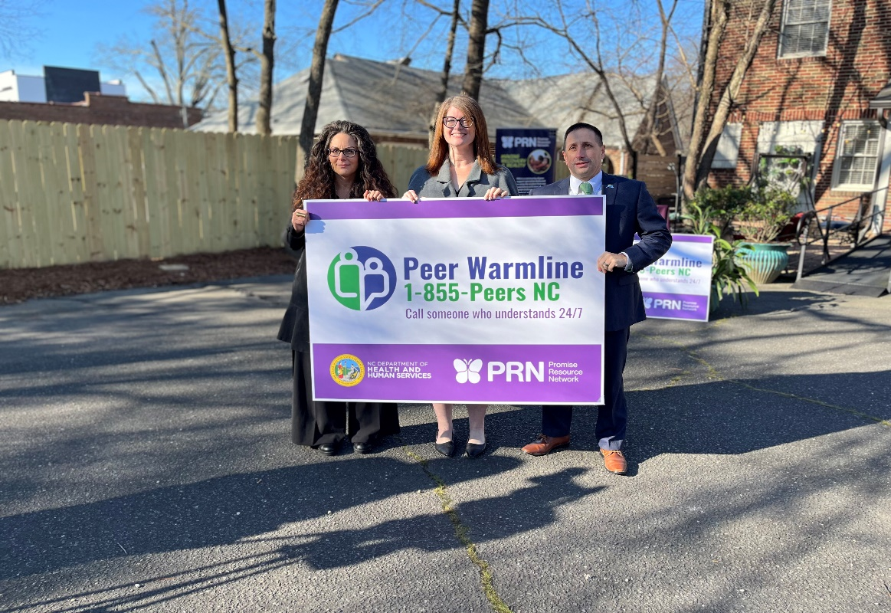
The Statewide Peer Warmline Launched on 2/20!
People are calling 988 looking for support and resources.
40% of people are repeat callers
The Peer Line is open 24/7/365
People can call the Peer Warmline Directly OR 988 can do a warm transfer
Peer Support Specialists are people living in recovery with a mental illness and/or substance use disorder
offer non-clinical support and resources to those who reach out
offer a unique perspective of shared experiences
Read the press release here!

Slide 9
Brief Overview of Child Behavioral Health Investments

Slide 10
Funded Budget Provisions By Topic
PROVISION | FY24 | FY25
Reimbursement Rates for Behavioral Health | $165M | $220M
Crisis System | $54M | $77M
Justice System | $29M | $70M
Behavioral Health Workforce | $44M | $71M
Child and Family Well-Being | $20M | $60M

Slide 11
$80M Investment in Behavioral Health for Children
Within our current state, there are critical system needs that our investments must address. We also have identified our desired outcomes that our interventions set out to achieve.
Prevent children from entering a behavioral health crisis and/or unnecessarily using the emergency department for behavioral health
Ensure behavioral health needs of children are quickly and accurately identified
Keep children in the home whenever possible
Increase access to residential options for children who need an out of home placement

Slide 12
Child and Family Investments
Area of Focus | Strategies (examples of possible modalities)
Community Based Services | Increase access to behavioral health services in schools
 | Expand access to family-focused community-based support & care coordination (e.g. Family Peer Support, High Fidelity Wraparound)
 | Establish emergency respite pilots for caregivers
 | Expand Access to Evidence-Based (EBP) Community-Based Treatment Services (e.g. Family Centered Treatment, Child Assertive Community Treatment Teams)
Foster Care BH Continuum | Build capacity for DSS-managed crisis stabilization and assessment placements (e.g. Flexible DSS Emergency Placement Fund, Placement First Plus)
 | Invest in and expand professional foster parenting
Family-Type Placements | Build capacity for emergency placements in family-type settings for children at risk of boarding or inappropriate placement, regardless of custody status
 | Increase availability and quality of family-type therapeutic placements (e.g. Intensive Alternative Family Treatment, Therapeutic Foster Care)
Residential/Facility Based Services | Increase quality and management of residential levels of care
 | Build specialty residential care capacity (e.g. PRTF, levels II-IV).
Notes:
The $80 million investments seek to increase treatment options for children, especially those in or at risk for boarding in DSS offices and EDs.
Priority investment areas are noted on the slide.
And in particular significant investments seek to create and expand access to family type placements, including IAFT and TFC.
Recruitment of new homes committed to serving children with complex needs.
Support of existing homes to get to a yes for more children with complex or co-occurring needs
Creating family setting options for short term crisis/emergency placements to avoid or reduce boarding in DSS and EDs.

Slide 13
Payment to Support Relatives & Family Members Who Step in to Care for Children in Need
Click here to read the press release
Payments will Provide:
financial support and promote placement with appropriate kinship care providers for children in foster care
positive impact on permanency outcomes for children – leading to children exiting from foster care to adoption, guardianship or reunification sooner

Slide 14
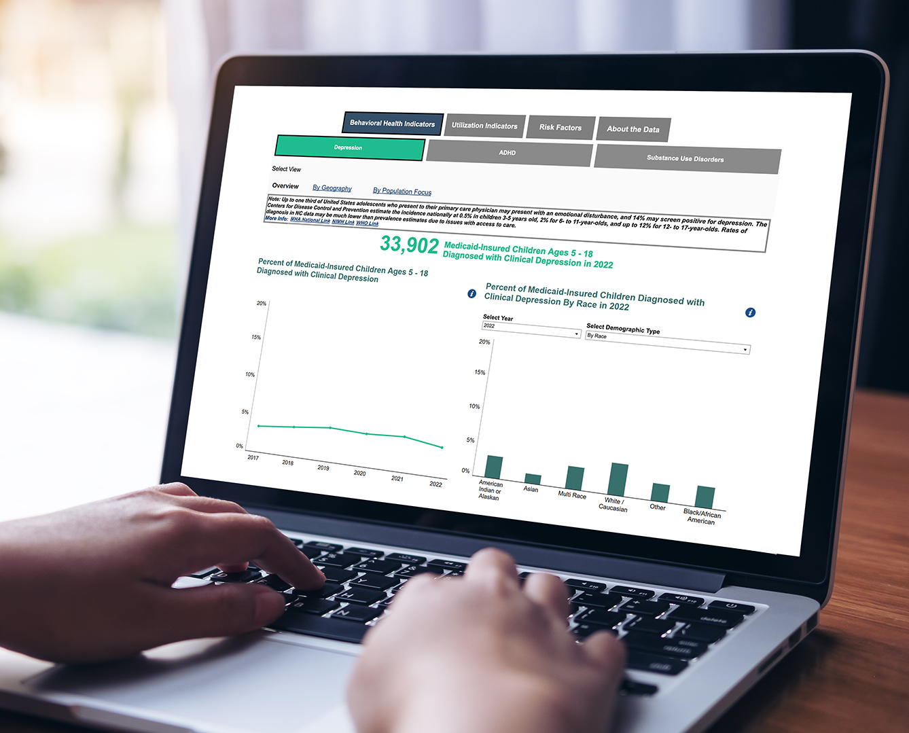
The Child Behavioral Health Dashboard Launched on 2/1!
Click here to read the press release
Key Features:
Identifies and addresses gaps and disparities in behavioral health services for children
Enhances visibility into child behavioral health needs
Allows for shared stakeholder accountability to identify and address opportunities for improvement
Provides additional visibility into child behavioral health in underserved populations

Slide 15
Child Behavioral Health Dashboard
Metric (Data Source) | Child Population ^{M} = Medicaid Pop
# of children with ADHD dx (Medicaid) | ✓^{M}
# of children with depression dx (Medicaid) | ✓^{M}
# of children with Substance Use Disorder diagnosis (Medicaid MD) | ✓^{M}
ED utilization for behavioral health (Medicaid MD) | ✓^{M}
Suicide attempts resulting in ED visit (NC DETECT) | ✓
Mobile Crisis Utilization (counts, later cost) (Medicaid) | ✓^{M}
PRTF utilization (counts, later costs) (Medicaid) | ✓^{M}
School Behavioral Health
% high schoolers and % of middle schoolers feeling sad or hopeless in last 12 months (YRBS) % high schoolers and % of middle schoolers feeling good about themselves (YRBS)
Early Childhood
% babies born with low and very low birth weight (Vital Statistics)

Slide 16
Medicaid-Insured Children in Psychiatric Residential Treatment Facilities (PRTFs): August 2023-October 2023
We reviewed the dashboard in the October 2023 Side by Side webinar.
The most recent report was published in January 2024 on DMH/DD/SUS’ website at: Reports | NCDHHS

Slide 17
DMHDDSUS’ Role in Strengthening the Child Behavioral Health Residential System

Slide 18
NC Child Behavioral Health Residential Service Array: Current State
Service Area | Service | Service Definition
Residential Services | Residential Treatment: Level I/Family Type | Service targeted to children under age 21, which offers a low to moderate structured and supervised environment in a family setting, excluding room and board.
Residential Services | Residential Treatment: Level II/Family/Program Type | Service targeted to children under age 21, which offers a moderate to high structured and supervised environment in a family OR program type setting, excluding room and board. Service is responsive to the need for intensive, interactive, therapeutic interventions below the level of staff secure/24-hour supervision or secure treatment settings.
Residential Services | Residential Treatment: Level III (Residential Treatment High) | Service targeted to children under age 21 which offers a highly structured and supervised environment in a program setting only, excluding room and board. This setting has a higher level of consultative and direct service from psychologists, psychiatrists, medical professionals, etc. Treatment is provided in a structured program setting and staff is present and available at all times of the day, including overnight awake
Residential Services | Residential Treatment: Level IV/Secure (Residential Treatment Secure) | Provides a physically secure, locked environment in a program setting only. This level of service includes all Residential Treatment—High Level III elements plus medically supervised secure treatment, continual and intensive interventions designed to assist the beneficiary in acquiring control over acute behaviors and support for youth in gaining skills necessary to step down to a lower level of care.
PRTF | Psychiatric Residential Treatment Facilities (PRTFs) for Children under the Age of 21 | Non-acute inpatient facility care for children and adolescents who have a MH condition or a SUD Dx and who require 24-hour supervision and specialized care.
Inpatient Hospitalization | Inpatient Behavioral Health | Provide continuous treatment for beneficiaries with acute psychiatric or substance use problems in a hospital setting.

Slide 19
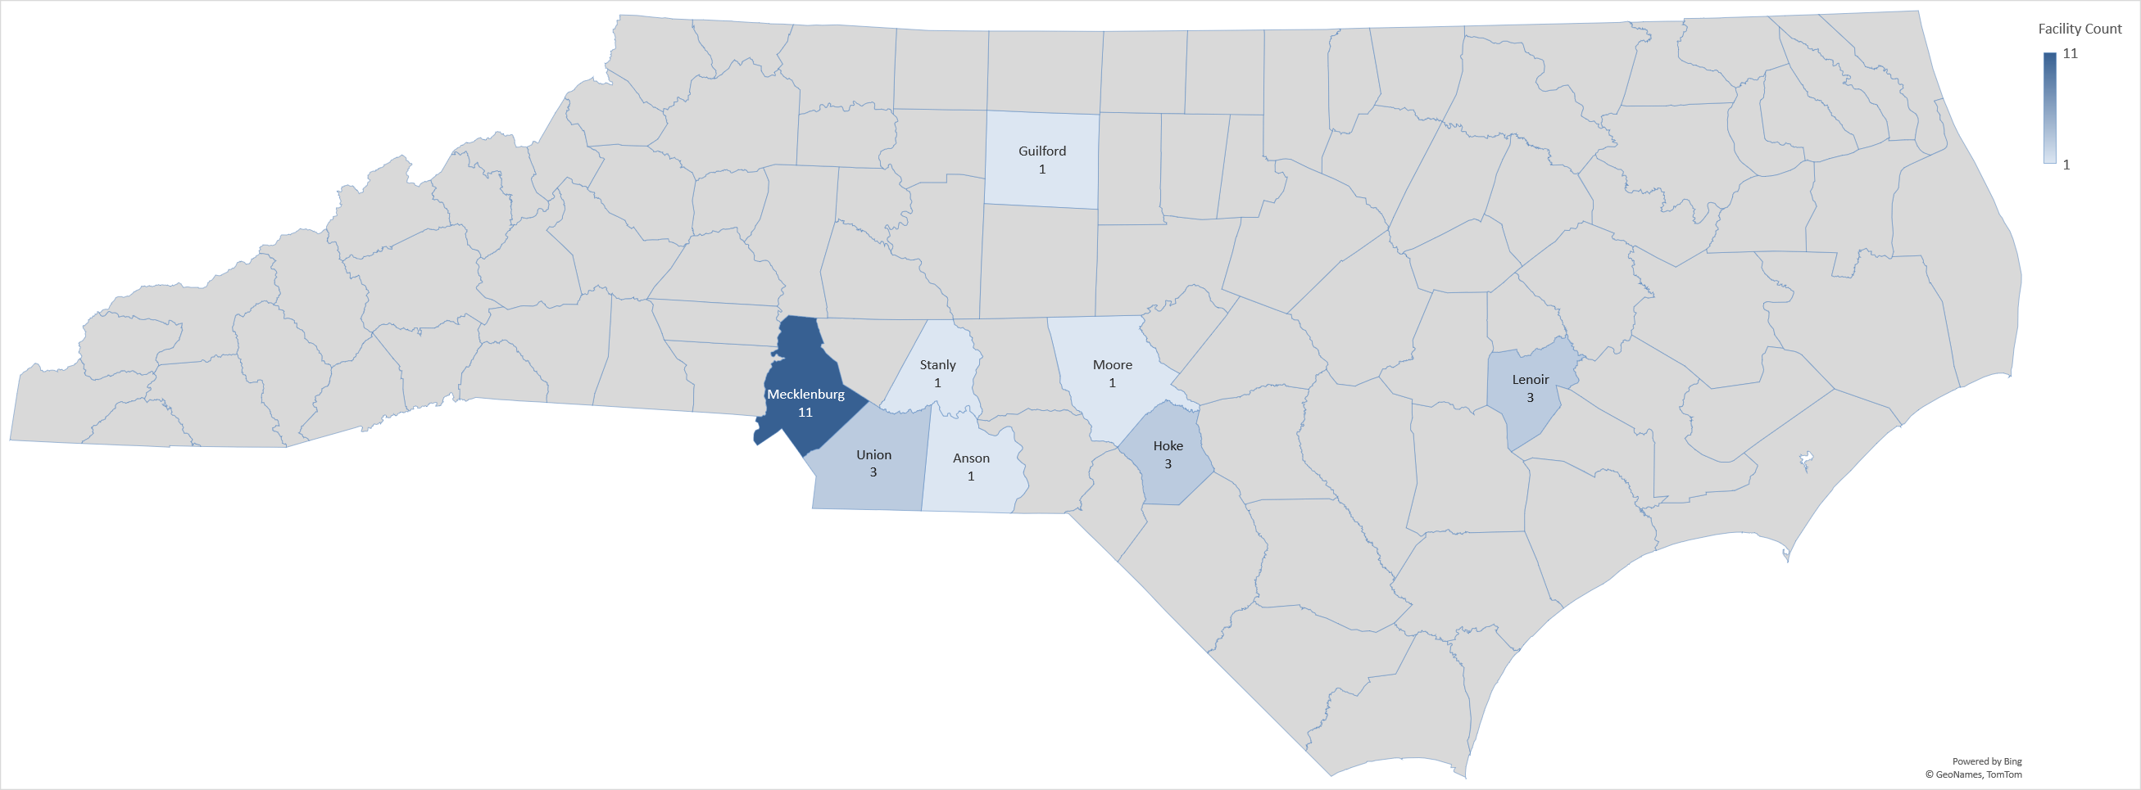
Residential Treatment Availability Creates Challenges
Residential Treatment
High quality residential treatment is not always available to youth who need it, when and where they need it.
Every week, over 50 children sleep in EDs and DSS offices due to lack of available residential treatment options.¹
A majority of youth discharged from PRTFs move to lower levels of care, but 25% go to another PRTF or home to no services at all.²
Non-hospital based PRTFs and Level IV facilities are concentrated in one area of the state, with wider availability of Level II and Level III facilities, therapeutic foster care homes, and facility-based crisis centers.³
Roughly 35% of children and adolescents in PRTF placements are in out-of-state PRTFs, and children/adolescents in foster care are more likely to be sent out of state than those not in foster care.⁴
DHSR-Licensed PRTFs (Non-Hospital Affiliated), March 2023
Sources: 1. Investing in Behavioral Health and Resilience (ncdhhs.gov); 2. PRTF Dashboard, includes data from a subset of in-state PRTFs; 3. NC Division of Health Service Regulation, Mental Health Licensure and Certification Section; 4. NC DHHS Data Analysis

Slide 20
Residential Level of Care: Goals for Children
Prevent the utilization of Emergency Departments as temporary residential settings for children
Increase crisis and respite options to support the child, their families, and their systems
Increase access to specialty in-state residential care for children in need (brief, therapeutic, home-like)
Ensure transitions to community-based settings occur during/after PRTF stay with the needed wrap-around supports in place for success

Slide 21
Reminder: NEW Child Behavioral Health Advisory Committee
Committee members with local knowledge and lived experience will be able to share ideas, provide feedback, and help leadership develop strategic priorities to improve our child behavioral health system.
Want to join?​
REGISTER HERE​
The first meeting is on Monday, March 25th from 3:00-4:00pm
After the first meeting, virtual meetings will be held on the third Friday of every month​ from 2:30-3:30pm

Slide 22
Non-Law-Enforcement Transportation (NLET)

Slide 23
North Carolina’s Crisis Continuum
Someone to Call
Someone to Respond
Somewhere to Go
988
Peer Warm Line
Mobile Crisis Team Response
MORES
Behavioral Health Urgent Care (BHUC)
Facility-Based Crisis (FBC)
Peer and Community Respite
NC START

Slide 24
Behavioral Health Budget Provisions
$131M is going towards crisis across SFY23-25.
Provision | FY24 | FY25
Crisis System (e.g., mobile, FBCs) | $30M | $50M
Crisis Stabilization (short-term shelter) | ~$3M | ~$7M
Non-Law Enforcement Transportation Pilot Program | $10M | $10M
BH SCAN | $10M | $10M
Justice-Involved Programs (re-entry, diversion, and capacity restoration) | $29M | $70M
Behavioral Health Workforce Training | ~$8M | $10M
NC Psychiatry Access Line (NC PAL) | ~$4M | ~$4M
Behavioral Health Rate Increases | $165M | $220M
State Facility Workforce Investment | $20M | $20M
Electronic Health Records for State Facilities |  | $25M
Child Welfare and Family Well-Being | $20M | $60M
Crisis

Slide 25
NLET Pilot Program
Background
Many people who experience a mental health and/or substance use crisis are placed under involuntary commitment (IVC) – even if they are willing to receive treatment voluntarily – to secure transport from law enforcement.
Law enforcement provides transport when someone is under an IVC order in most counties.
Law enforcement involvement in transportation, especially the use of handcuffs, can be traumatic and stigmatizing for people, especially children.
North Carolina seeks to implement a recovery-oriented model for transportation as an alternative to law enforcement for these services.

Slide 26
NLET Pilot Program: Summary
Overview
The pilot program will offer NLET to people who need hospitalization or crisis services due to a behavioral health condition.
The state will use a Request for Proposal (RFP) process that is open to health systems and transportation providers.
The program will be piloted in two regions of the state. The regions will be determined through the RFP process.
Goals
Provide trauma-informed, person-centered treatment that de-stigmatizes behavioral health care.
Eliminate the use of IVC as a means of securing transportation between behavioral health facilities.
Help inform and align with other work the state is doing to make sure voluntary behavioral health treatment is prioritized whenever possible.

Slide 27
NLET Pilot Program: Draft Design
Population Served
Children, adolescents and adults who require additional behavioral health treatment who are:
Seeking treatment voluntarily; or
Have been placed under IVC and have completed their first exam at a facility in the pilot region.
People will be clinically assessed to make sure they can be transported safely.
Pilot Transportation Settings
The pilot will provide transportation from facilities in the pilot region where people go when they have a crisis (e.g., acute care hospitals, behavioral health urgent care centers) to treatment facilities (e.g., state psychiatric hospitals, facility-based crisis centers) anywhere in the state.
The pilot will also provide discharge transportation back home or to another community-based setting (e.g., group home, shelter) anywhere in the state after people finish treatment.
Reactions from the Committee on the Proposed Design?

Slide 28
NLET Pilot Program: Draft Design
Pilot Provider Requirements
Service requirements: Pilot transportation provider(s) will be available 24/7/365 to pick people up from facilities in the pilot region and transport them anywhere in the state.
Staffing: Most trips will include two staff members who meet specific training requirements (e.g., supporting people with physical or cognitive disabilities and language accessibility) outlined by the state. Shorter trips or transports where a parent or caretaker accompanies a child or adult, as appropriate, will have one staff member.
Person-centered and trauma-informed treatment: No use of restraints, parents can ride with children, transportation staff will wear plain clothes, at least one staff member will be the preferred gender of the person being transported whenever possible.
Language assistance: Interpretation and translation services will be available to make sure people and their families can communicate with transportation staff members.
Reactions from the Committee on the Proposed Design?

Slide 29
NLET Pilot Program: Draft Design
Vehicles and Safety Features
Vehicles can include unmarked vans, sedans, SUVs, passenger cans and non-emergency ambulance transportation. Vehicles must be able to:
Accommodate wheelchairs and other medical equipment.
Have sensory equipment (e.g., stress balls, weighted blankets) to support people experiencing anxiety and stress during transports.
People will be transported in unmarked vehicles with safety features like partitions, safety locks, cameras, audio-recoding capabilities, and GPS tracking.
Reactions from the Committee on the Proposed Design?

Slide 30
NLET Pilot Program: Feedback Requested
Discussion Questions
How can the state make sure children, adolescents, and adults feel comfortable using the pilot services?
Are there specific concerns people might have about using pilot services?
What unique needs must be addressed to make sure people can use pilot services?
What’s the best way for the state to spread awareness about the pilot?

