Slide 1


Side by Side with DMH/DD/SUS
Improving our system together.
NCDHHS Division of Mental Health,
Developmental Disabilities, and Substance Use Services
March 9, 2026

Slide 2
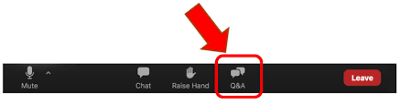
Housekeeping
Reminders about the webinar technology:
  Please make sure you are using a computer or smart phone connected to the internet, and the audio function is on, and the volume is turned up.
  Please make sure your microphone is muted for the duration of the call.
  Questions can be submitted any time during the presentation using the “Q&A” box located on your control panel.

Slide 3
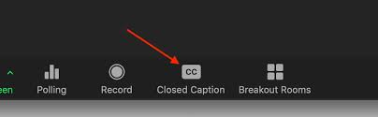
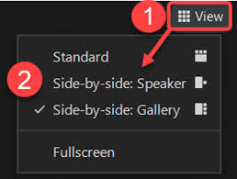
Housekeeping
American Sign Language (ASL) Interpreters and Closed-Captioning
  ASL Interpreters and Closed-Captioning options will be available for today’s event.
  For closed-captioning options select the "Closed Caption" feature located on your control panel.
Adjusting Video Layout and Screen View
  Select the "View" feature located in the top-right hand corner of your screen.
Intérpretes en lengua de signos americana (ASL) y subtítulos:
Habrá intérpretes de ASL y opciones de subtítulos disponibles para el evento de hoy. Para opciones de subtítulos, seleccione la función "Subtítulos" ubicada en su panel de control.

Slide 4
Agenda
Introductions
Overview of Inclusion Connects Work Plan
Overview of TBI
Fireside Chat: I/DD and Brain Injury Awareness Month

Slide 5
Ginger Yarbrough, MPA, CPHQ, NADD-DDS
Chief Clinical Officer, IDD, TBI & Olmstead, DMH/DD/SUS
25 years in IDD/TBI & cooccurring diagnoses field
Experience as a Direct Support Professional, Care Manager, and Quality Management
DMH/DD/SUS since March 2023

Slide 6

Brain Injury Awareness Month
Governor Josh Stein has proclaimed March 2026 as Brain Injury Awareness Month, recognizing the impact brain injuries have on individuals, families, and communities.
Each year, 2.8 million Americans experience a traumatic brain injury (TBI). In North Carolina, more than 80,000 people will sustain a TBI this year. Brain injuries can affect movement, communication, emotions, and cognition.
New resource
The NC TBI Dashboard is now available, showing data on individuals with a TBI diagnosis who have accessed Medicaid and state-funded services
Data is refreshed every 6–12 months to support planning and data-informed decision-making
Upcoming webinar
TBI Dashboard Overview
March 16, 2026 | 3–4 p.m. Register Today!
Get involved
The Brain Injury Advisory Council (BIAC) is seeking applicants to help improve brain injury services across North Carolina. Contact Shannon Kuper at Shannon.Kuper@dhhs.nc.gov for more information.

Slide 7
Brain Injury Awareness Month Activity
Many activities and learning opportunities are occurring throughout the month such as informative webinars, summits, collaborative events with partner organizations, mask making/mask displays and more!
DMH/DD/SUS activity is being shared through Hot Topics while other activity sponsored by the Brain Injury Association of NC (BIANC) which can be found on the BIANC website at:
https://www.bianc.net/biam2026/
Some of these activities overlap with the I/DD community such as the Intimate Partner Violence (IPV) Initiatives.
Join us as we raise awareness, build understanding, and support individuals and families affected by brain injury across the state.

Slide 8
Developmental Disabilities Awareness Month
March is Developmental Disabilities Awareness Month, a time to celebrate people with Intellectual and Developmental Disabilities (I/DD) and strengthen efforts to build more inclusive communities.
Gov Josh Stein has proclaimed March as Developmental Disabilities Awareness Month, recognizing the more than 200,000 North Carolinians living with I/DD and the importance of expanding access to employment, education, housing, health care, and community participation.
New data
The Innovations Waiver Waitlist Dashboard now includes enhanced metrics, including the average time individuals have been on the waitlist
Data is available by county and Tailored Plan, offering new insight into service gaps and helping inform planning and advocacy
Supporting inclusion
Inclusion Connects helps individuals and families navigate services and resources across the lifespan
Inclusion Works promotes Competitive Integrated Employment (CIE) and supports inclusive workplaces
Together, these efforts help strengthen opportunities for people with developmental disabilities to live, work, and participate fully in their communities.

Slide 9

Celebrate Developmental Disabilities and Brain Injury Awareness Month with Us!
March
5th
Olmstead and North Carolina’s Olmstead Plan
Register for the webinar
March
16th
From Numbers to Knowledge: Introducing the TBI Dashboard
Register for the webinar
March
9th
Fireside Chat: I/DD and Brain Injury Awareness Month
Register for the webinar
March
18th
Inclusion Works Lunch and Learn
Register for the lunch & learn
March
11th
Intersection of Interpersonal Violence: Supporting People with I/DD and TBI
Register for the webinar
March
26th
Welcome to TULA: Trillium Ultimate Living Assistant
Register for the webinar

Slide 10

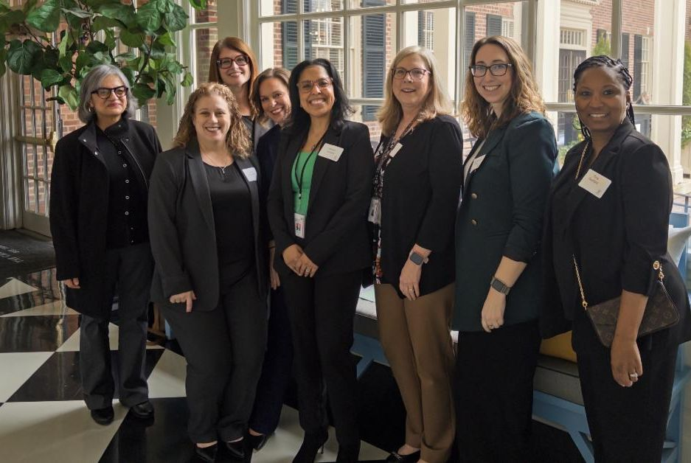
Celebrating 2026 Social Work Month
Governor Josh Stein has recognized the 2026 theme: “Social Workers: Uplift. Defend. Transform.”
Social workers support North Carolinians in many roles—from mental health care and crisis response to child welfare, aging services, and community programs. Their work strengthens families, improves access to care, and supports healthier communities statewide.
Why it matters
97 of North Carolina’s 100 counties are designated Mental Health Professional Shortage Areas
Workforce shortages limit access to care and delay treatment
Workforce investments
Public Service Leadership Program (PSLP) launched with the UNC System and Social Work Coalition to build the next generation of leaders
Licensed Workforce Loan Repayment Program offers up to $50,000 for providers serving in high-need rural areas
Qualified Professional eligibility expansion for community college graduates with AAS degrees in Social and Human Services
This month, we recognize and thank social workers for their dedication to supporting individuals, families, and communities across North Carolina.

Slide 11
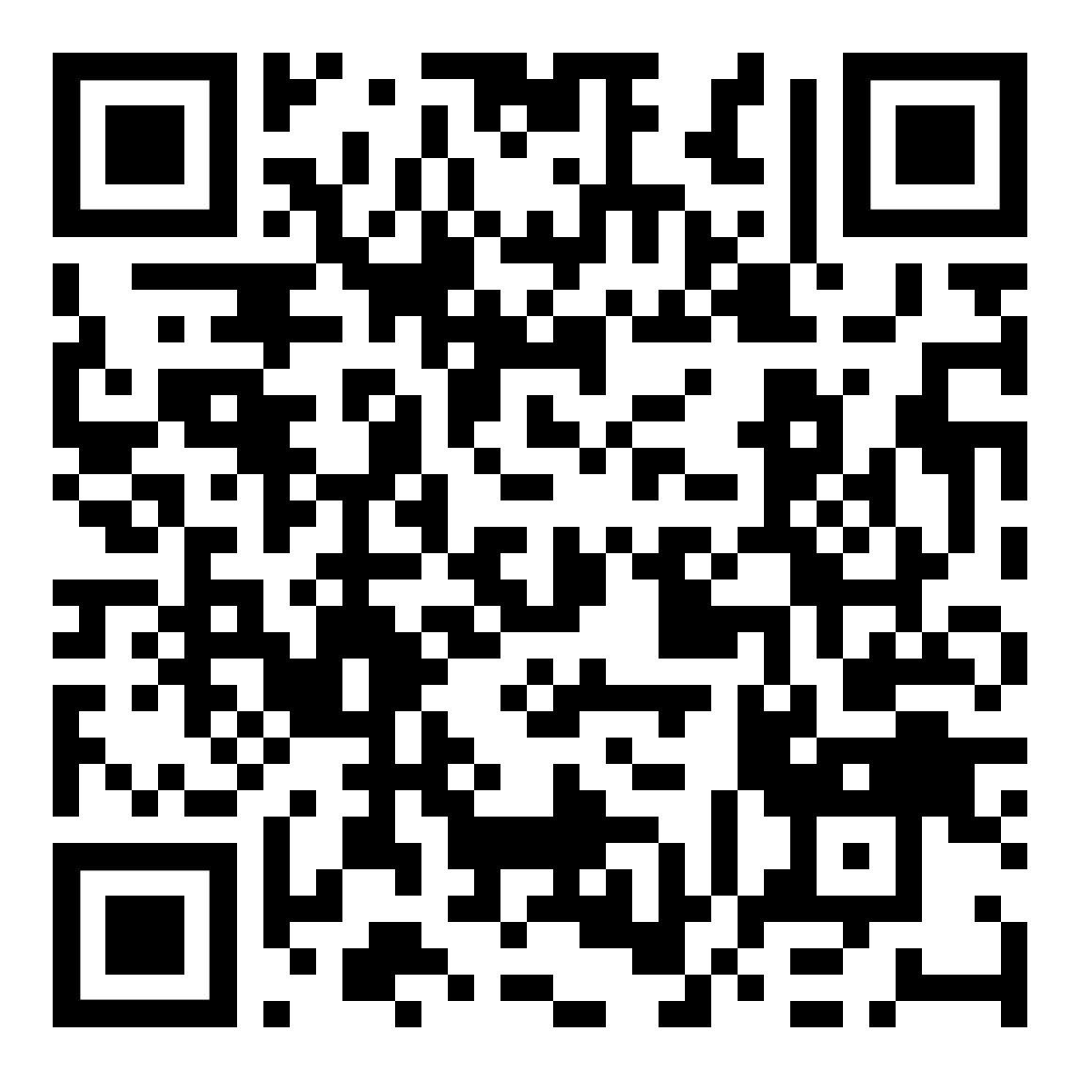

Inclusion Connects Background
Inclusion Connects is an NCDHHS program to connect people with I/DD to more choices and more access to services and supports. It is designed to help people with I/DD, regardless of age or ability level, and their families navigate the complex system of services from birth to the end of life.
Link to Inclusion Connects Website
Inclusion Connects Activities
Supporting the Direct Support Professional (DSP) Workforce: Addresses workforce shortages and connects DSPs with providers and people with I/DD.
Promoting Access to Services: Focuses on providing access to necessary services, including those on the Innovations Waiver Waitlist.
Improving Housing Access: Enhances the housing options available for people with I/DD.
Strengthening Interpersonal Violence (IPV) Supports: Prevent IPV for people with I/DD and provide trauma-informed information and tools.
Inclusion Works:
Expand support employment services and increase access to Competitive Integrated Employment
Notes:
Again, Inclusion Connects is the cross-divisional system that supports people with IDD. This means all people with IDD – regardless of level of skill, age, or where they choose to live.
The goal of Inclusion Connects is to support individuals with IDD across the life span to live their lives where they want with the services and supports they need. We want to provide choice – choice of housing options and services. And finally, we can talk about services and access, but for true access, we must address the Direct Support Professional Workforce Shortage.
And throughout all of this work, we are committed to providing data and transparency to the community. As part of the consent order, there are reporting requirements, but beyond that, we are doing this because we have to have good data to know where we are and if our efforts are doing what we think they will do.

Slide 12
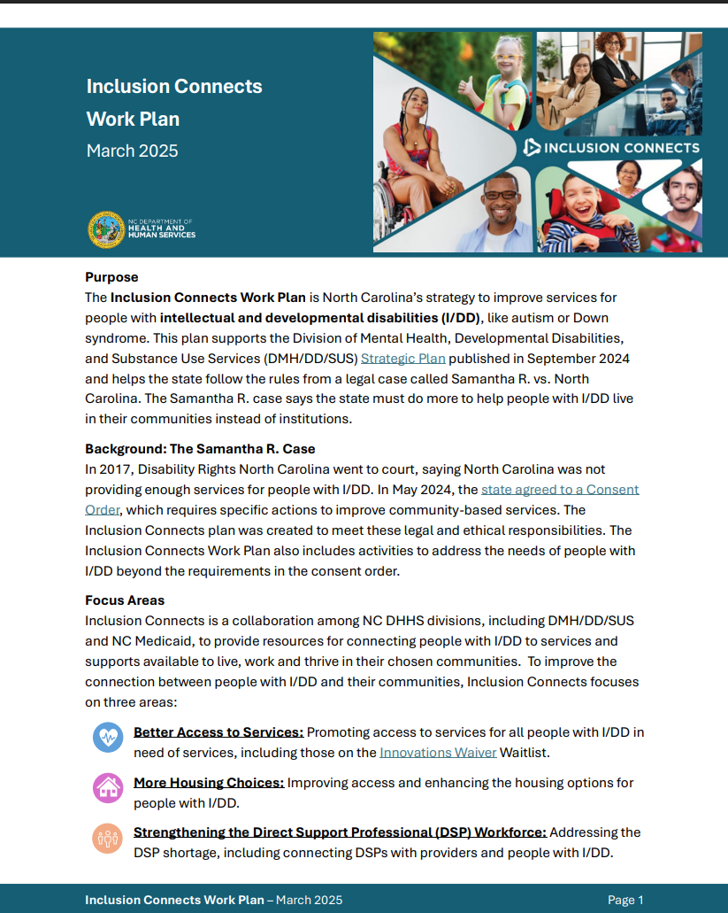
Inclusion Connects Work Plan
The Inclusion Connects Work Plan is North Carolina’s strategy to improve services for people with intellectual and developmental disabilities (I/DD)
Detailed descriptions of activities to improve access to services, more housing choices, and strengthening the workforce.
Includes metrics and targets
The original workplan was posted in
March 2025.
Next update will occur in March 2026.
Visit Inclusion Connects | NCDHHS to read the full workplan.

Slide 13
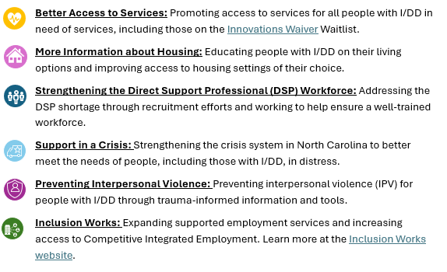
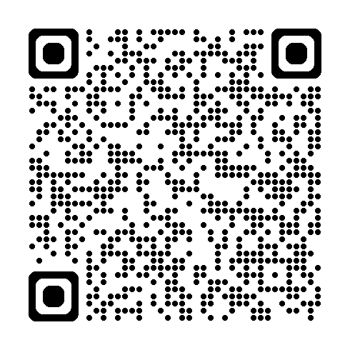
Inclusion Connects Workplan
The Inclusion Connects team has updated our public-facing Workplan for 2026 to reflect work over the past year and share priorities for the coming year with our community.
The workplan focuses on the following focus areas:
The workplan will soon be added to the Inclusion Connects website.

Slide 14
Better Access to Services
Promoting access to services for all people with I/DD in need of services, including those on the Innovations Waiver Waitlist.
✅ Completed and Ongoing Tasks
Update the Innovations Waiver Waitlist Dashboard quarterly, adding new data elements
Partner with people with lived experience, caregivers, Tailored Plans, and providers to improve waitlist management
Educate families on accessing 1915(i) services through webinars, presentations, and print materials
🟨 Upcoming Tasks
Contact people on the Innovations Waitlist who are likely eligible for other services while they wait
Begin assessing the needs of people on the Innovations Waiver Waitlist.
Create a tool to help people navigate I/DD services in NC.
Update the waitlist dashboard to show the average time until a person on the waitlist is assigned an Innovations Waiver slot.

Slide 15
More Information about Housing
Educating people with I/DD on their living options and improving access to housing settings of their choice.
✅ Completed and Ongoing Tasks
Track and report the number of people moving into the community every 3 months
Create a list of statewide housing, funding, and support resources. Visit the Community Living Guide to explore resources
Update the definition of diversion used in reporting to better understand and support those at risk of moving into institutions
Work with state partners to request a remedial preference letter
🟨 Upcoming Tasks
Create a Housing Term Glossary and add to the Community Living Guide
Develop a housing preference and support assessment tool to support informed living choices
Partner with LME/MCOs and community organizations to create an In‑Reach toolkit on community living options for people in institutional settings

Slide 16
Strengthening the Direct Support Professional Workforce
Addressing the Direct Support Professional (DSP) workforce shortage through recruitment efforts and working to help ensure a well-trained workforce.
✅ Completed and Ongoing Tasks
Release a statewide DSP Workforce Plan and update it annually.
Conduct focus groups and surveys with DSPs to understand their needs
Award the first round of recruitment and retention grants for DSPs
Launch a second round of grants to attract more DSPs
Start an advanced training course to help increase skills and knowledge of DSPs
🟨 Upcoming Tasks
Award the second round of recruitment and retention grants
Start a basic training course for participants to learn skills to work as a DSP
Introduce a pilot program to provide a training bonus for DSPs that have the basic and advanced training
Design state-wide networking opportunities for DSPs

Slide 17

Support in a Crisis
Strengthening the crisis system in North Carolina to better meet the needs of people, including those with I/DD, in distress.
✅ Completed and Ongoing Tasks
Add information on 988, North Carolina Crisis Services, and NC Peer Warmline to the Inclusion Connects website
Share crisis resources through presentations, the Inclusion Connects website, and community partnerships
🟨 Upcoming Tasks
Provide I/DD specific training to staff working in crisis care spaces
*More information to come once training is finalized.

Slide 18
Preventing Interpersonal Violence
Preventing interpersonal violence (IPV) for people with I/DD through trauma-informed information and tools.
✅ Completed and Ongoing Tasks
Launch Interpersonal Violence Resource Hub on the Inclusion Connects webpage to provide training resources and ways for people with IDD/TBI
Hold monthly IPV advisory committee workgroup meetings
🟨 Upcoming Tasks
Provide training on Interpersonal violence to be included in DSP Core Competency Curriculum
Update the IPV resource hub every 3 months to make sure people know what’s available and can access helpful resources
Provide information for the community to access future training opportunities on IPV

Slide 19
Inclusion Works
Expanding supported employment services and increasing access to Competitive Integrated Employment (CIE). Learn more at the Inclusion Works website, including the Inclusion Works Strategic Plan.
✅ Completed and Ongoing Tasks
Create a clear process to help people make an informed choice about their work options
Work with people to complete Employment Assessments and create Career Development Plans
Offer opportunities for provider trainings and certifications
Hold various monthly stakeholder meetings to share information and collaborate on tasks
🟨 Upcoming Tasks
Launch the second round of Provider Innovation grants to 8 providers
Launch a social media campaign to share information and increase awareness
Work to address transportation barriers to increase access to employment opportunities

Slide 21
TBI Defined
A TBI is generally defined as:
  injury to the brain caused by an external force, such as a blow, bump, jolt to the head, or a penetrating injury
  disrupts normal brain function.
There are two definitions for TBI in NC statute.
  One provides a detailed description of TBI for all age groups.
  The second focuses on individuals who sustained their TBI prior to the age of 22 during which time the brain is still developing and therefore qualifies as a developmental disability.
Slips and Falls
Car accidents
Hits or strikes to the head

Slide 22
Common Challenges
Physical
Cognitive
Personality
Coordination
Hearing/Vision
Sensory changes
Mobility
Headaches
Memory
Attention
Planning
Judgement
Other changes
Emotions
Depression
Understanding social cues
Relating to others
Forming relationships
Anxiety
Communication
Social Skills/Isolation
Emotional
Lifestyle
Organization
Decision-making
Reduced Independence
Employment challenges
Processing Speed
Mental Health
Seizures
Fatigue

Slide 23
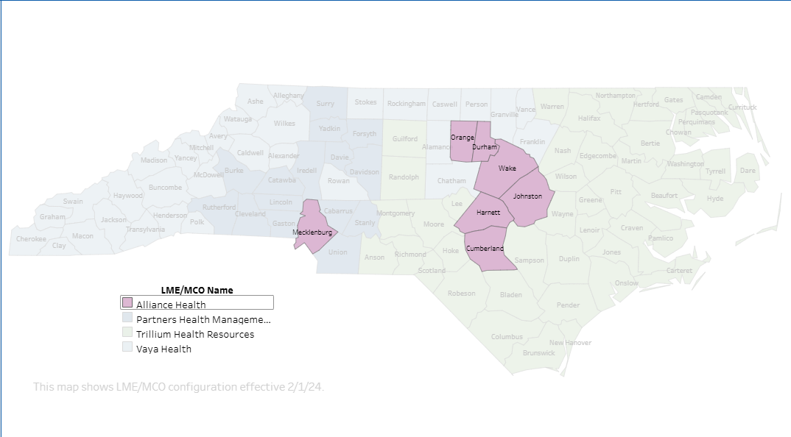
NC TBI Waiver Highlights
NC TBI Waiver Pilot – currently operates as a pilot through Alliance Health Tailored Plan
  Cumberland, Durham, Harnett, Johnston, Mecklenburg, Orange, & Wake counties.
  107 Waiver Slots
NC General Assembly has provided the authority to expand statewide but no funding or slots.
Without a recurring appropriation, the TBI Waiver cannot be expanded.
NCDHHS continues working with stakeholders and the Tailored Plans in preparation for both a Waiver amendment and expansion
Counties With NC TBI Waiver Pilot

Slide 24
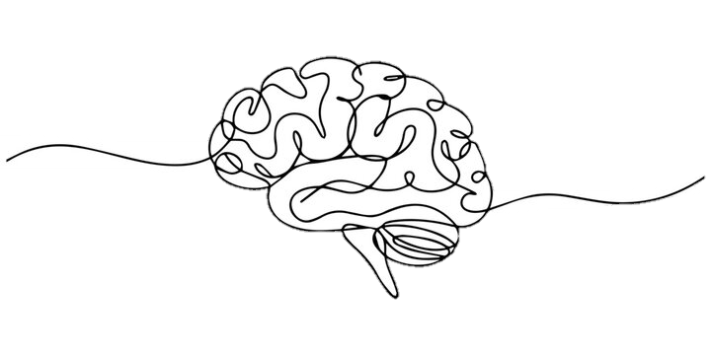
Underdiagnosed, Stigma Reduction and Visibility Efforts
Many individuals are misdiagnosed or undiagnosed
- Mild TBI / Concussion Often Overlooked
- Overlapping Symptoms with Other Conditions
- Lack of Proper Screening
- Delayed or Secondary Symptoms may not show up for days weeks or even months
- Patient Factors
Stigma Reduction and Visibility Efforts
- Education and Awareness
- Public education campaigns, health care and community-based provider training and media representation
        - Unmasking brain injury project
- Language Matters
- Use person first language
- Strength-based narratives
Policy and Advocacy - Your voice matters!

Slide 25
Opportunities For Growth and Service Expansion
Individuals with TBI have historically faced significant barriers and limited access to North Carolina’s public service system or have accessed services under other diagnoses.
Service access based on TBI diagnosis has been increasing over the more recent past largely due to sustained education, advocacy, and screening efforts.
Growing number of service opportunities:
These opportunities – and others still in development – will be guided by our TBI State Action Plan – everyone is encouraged to review and provide feedback on the draft plan when posted later this month.
TBI State Appropriated Funds Program
1915(i) Services
TBI Waiver (pilot and future expansion)
Innovations, CAP/DA and CAP/C Waivers (for those who qualify)
Medicaid State Plan Benefits
Mental Health (MH) and Substance Use Disorder (SUD) Services
Clinically Managed Population-Specific High-Intensity Residential Treatment Program (ASAM 3.3) – coming soon
Peer Support Program – coming soon
Screening efforts across multiple settings, including Transition Programs (TPs), Intimate Partner Violence (IPV) pilot sites, and Certified Community Behavioral Health Clinics (CCBHCs)

Slide 26
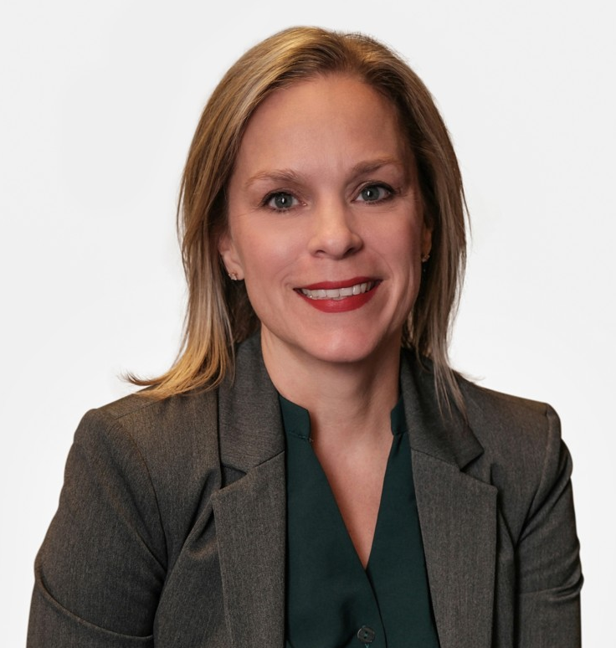
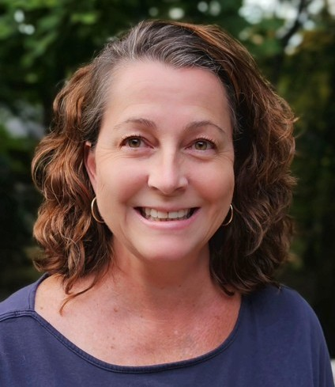

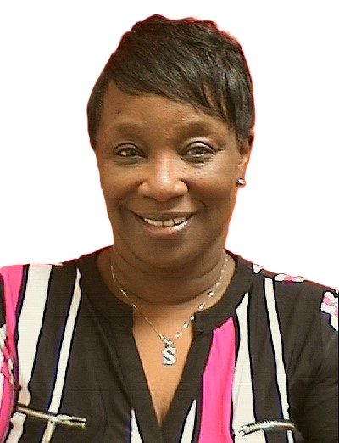
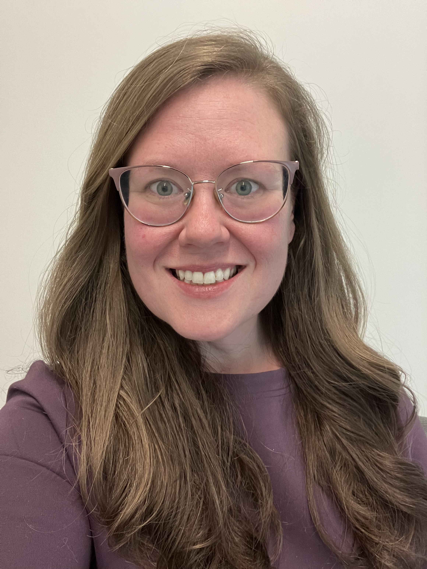
Fireside Chat Panel
Ginger Yarbrough
Tina Barrett
Scott Pokorny
Lauren Spencer
Stephanie Jones
Chief Clinical Officer
IDD, TBI & Olmstead
Assistant Director
IDD Services
Brain Injury
Team Lead
IDD Consultant
DMH/DD/SUS
TBI Policy Consultant
DMH/DD/SUS

Slide 27

Questions and feedback are welcome at BHIDD.HelpCenter@dhhs.nc.gov.
The recording and presentation slides for this webinar will be posted to the DMH/DD/SUS Webinars webpage.

Slide 28
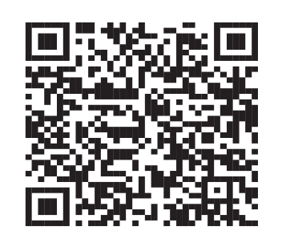
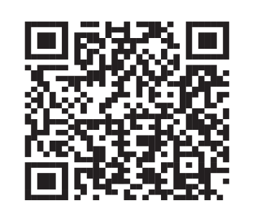


Stay Connected with DMH/DD/SUS
Join our monthly Side by Side Webinars
Join our Mailing List

